Slide 1
From quantification to implementation
Is There a Role for Consumption-Based Policy Instruments in Climate Policy?
Glen Peters
Center for International Climate and Environmental Research – Oslo (CICERO)
glen.peters@cicero.uio.no
twitter.com/Peters_Glen
Notes:
Perhaps appropriate for the last presentation, what next for the IO community?

Slide 2
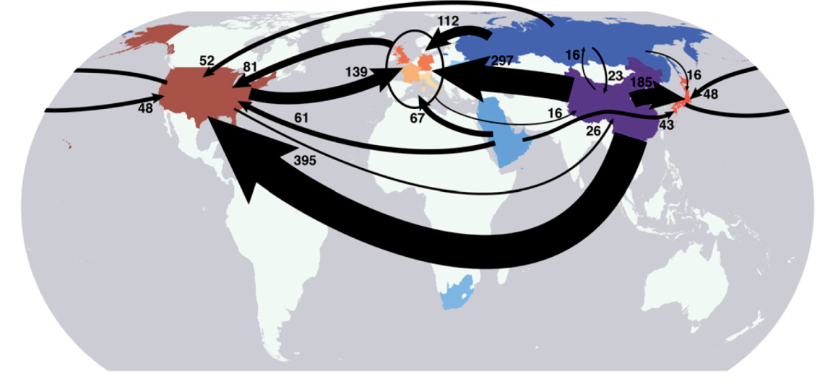
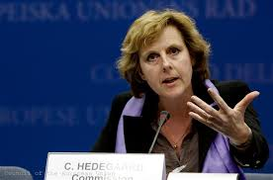
We are experts at accounting, ...
...but are weak at designing,
assessing, and implementing policies?
Notes:
General motivation of this presentation is to challenge the IO community to perform more policy relevant research
IOA has made several lasting contributions, particularly showing convincingly that consumption and trade are important. This is not just for co2, but many environmental factors: energy, materials, biomass, land, water, biodiversity, etc
This has particular policy relevance when some countries have strong policies and others have weak policies, e.g., climate policy
There exists a variety of consumption inspired policies, such as, LCA, labelling, etc
But, there is no broad uptake of consumption policies
How can the IO community go from the quantification phase to the implementation phase?
I have been working on IOA for about 10 years now. When I started it was a quiet field and then had a resurgence due to environmental applications. I suspect this is the same as in the past where Leontief led a IO inspired research agenda, but then it fizzled out and never continued forward. Taken over by equilibrium type analysis.
Are we are in an analogous period now? In the last five or ten year we have mastered the quantification of consumption and trade, but have failed to implement it? Will our CGE colleagues now move in and work on the policy side. Is our run now complete?
What do we work on in the next 5-10 years? Many of the interesting questions I think of, seem to require more than another IOA. Do we work with political scientists, mainstream economists, etc?
What policies have we suggested, have we assessed there effectiveness and efficiency, have they been implemented on a broad scale. Have we had a policy impact?

Slide 3

What are the big research questions in the next 5-10 years?

Slide 4
The Policy Problem

Slide 5
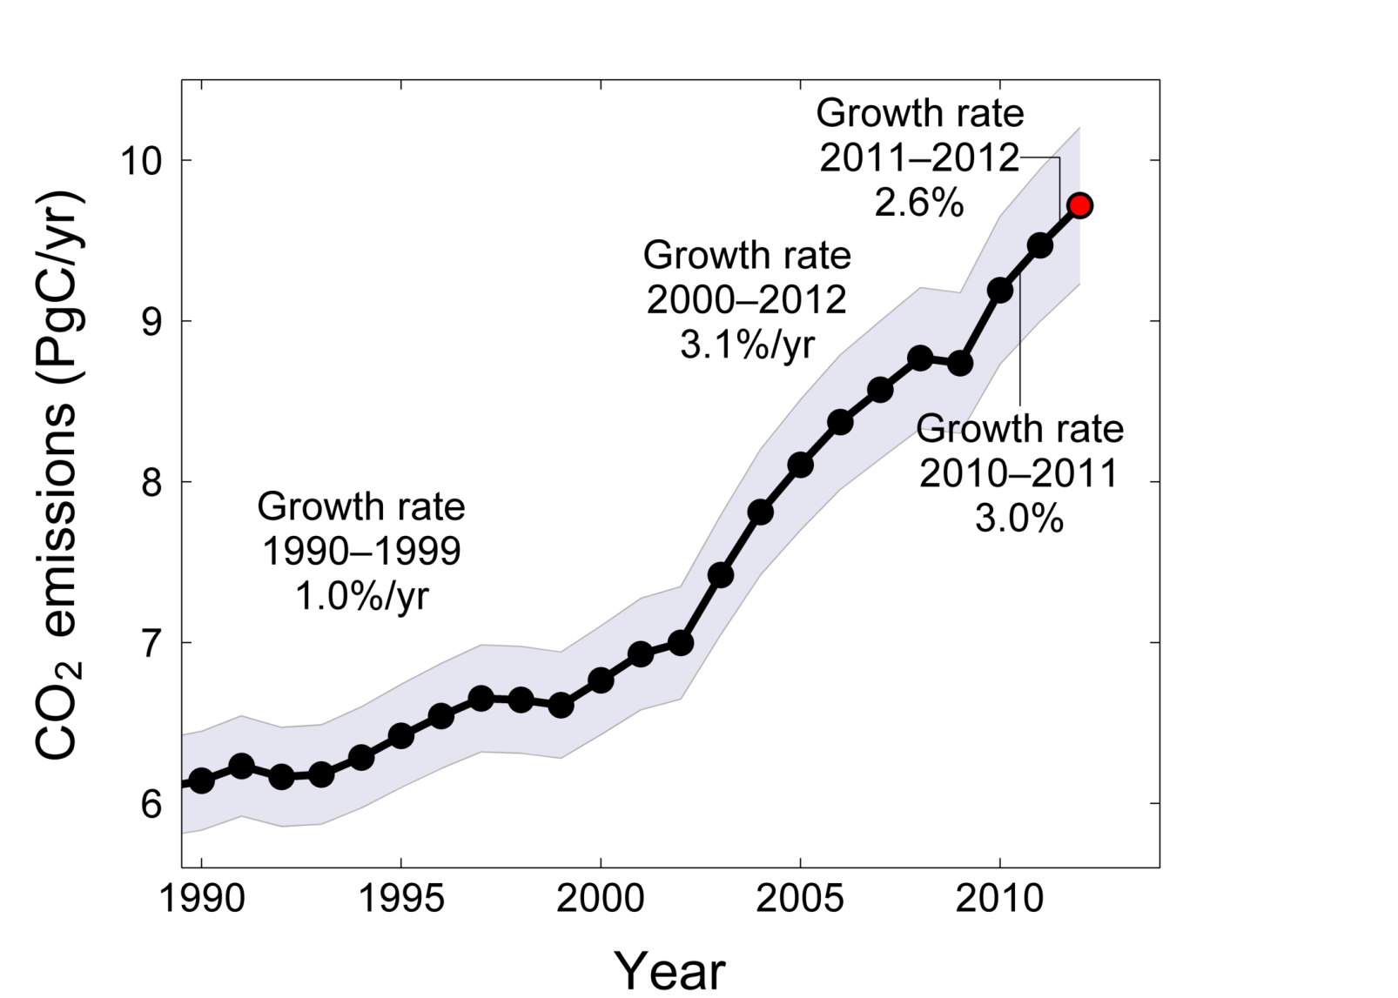
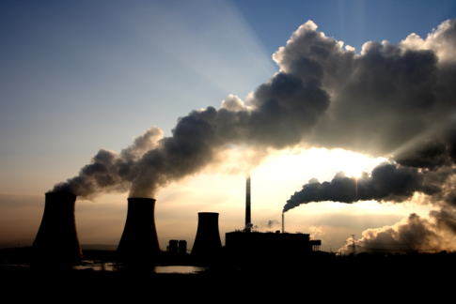
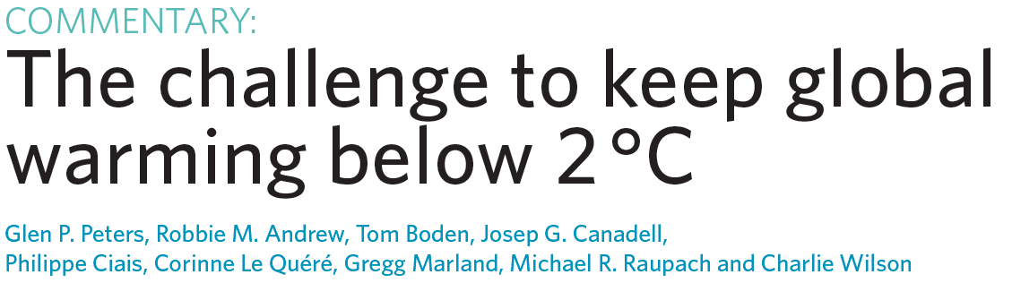
Carbon Dioxide: Fossil and Cement Emissions
Global fossil and cement emissions: 9.5±0.5PgC in 2011, 54% over 1990
Projection for 2012: 9.7±0.5PgC, 58% over 1990
Uncertainty is ±5% for one standard deviation (IPCC “likely” range)
Notes:
Emissions are about 60% higher in 2012 compared to 1990
1%/yr growth rate in the 1990s, 3%/yr in the 2000’s
Despite increase in climate policies, emissions continue to go up
How to deal with growth in global emissions?
Optimal policy solution = “first-best” solution based on economic theory
Economic theory does not include political realities and often has a poor representation of technical limitations, particularly in under developed countries
Thus, the optimal solution is often not politically or technically feasible

Slide 6
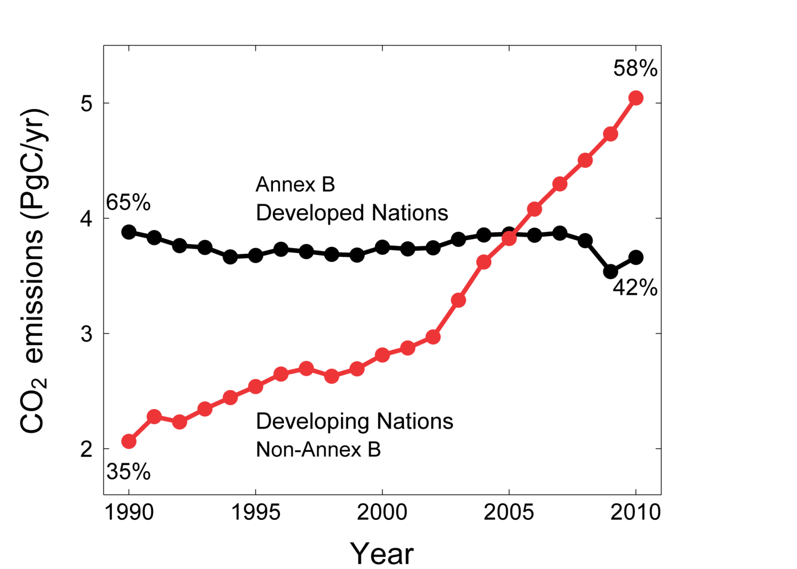
Territorial emissions as per the Kyoto Protocol
The Kyoto Protocol is based on the global distribution of emissions in 1990
The global distribution of emissions is now starkly different
Share of global emissions in 2010
In 2011:
Annex B 60%
Non-Annex B 40%
Source: CDIAC Data; Le Quéré et al. 2012; Global Carbon Project 2012
Notes:
The reality is that we have a “two-tier” fragmented climate policy
Developed countries (whether Annex B, Annex I, OECD, etc) have stabalised there emissions, despite some countries going up and some down. A little help from the global financial crisis
Developing countries emissions are about 2.5 times higher in 2010 compared to 1990, largely driven by the large emerging economies
Developing countries were 35% of emissions in 1990, and almost 60% in 2010. The world is very different
Rich countries generally have some sort of climate policy, poor countries do not. Though, there is no black and white differentiation.

Slide 7
The policy problem
Differential carbon pricing
  → Countries unwilling to deepen and broaden climate policies unilaterally
Two main issues
  Competitiveness concerns (economic)
  Carbon leakage (environmental)
International trade is a key factor
Notes:
Sub-optimal policy solution = “Second best” economic theory, but better than no policy.
Not as efficient as the “first best”, but it is possible to implement
Likely we have a “second best” policy post-2015
Countries unwilling to go further. Eg, EU has reached its 2020, 20% reduction, target already, but it is unwilling to go further.
Competitiveness and carbon leakage are two sides of the one coin.
International trade links these two tightly

Slide 8
The Evidence

Slide 9
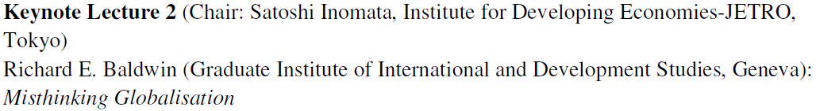
Carbon leakage
Policy-induced carbon leakage
  Caused by climate policy
  Small at today’s carbon prices
Consumption-induced carbon leakage
  Caused by a changing division of labour
  Increased consumption, met by imports
  Large, but not related to carbon prices
Notes:
Policy induced (strong) carbon leakage: E.g., EU-ETS causes industries to expand in China
Consumption induced (weak) carbon leakage: E.g., Expansion of Chinese producation facilitates increased consumption in the EU

Slide 10
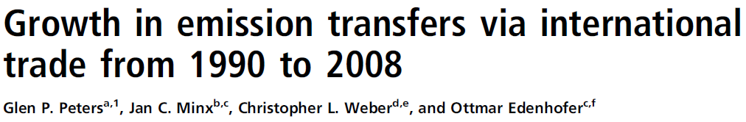
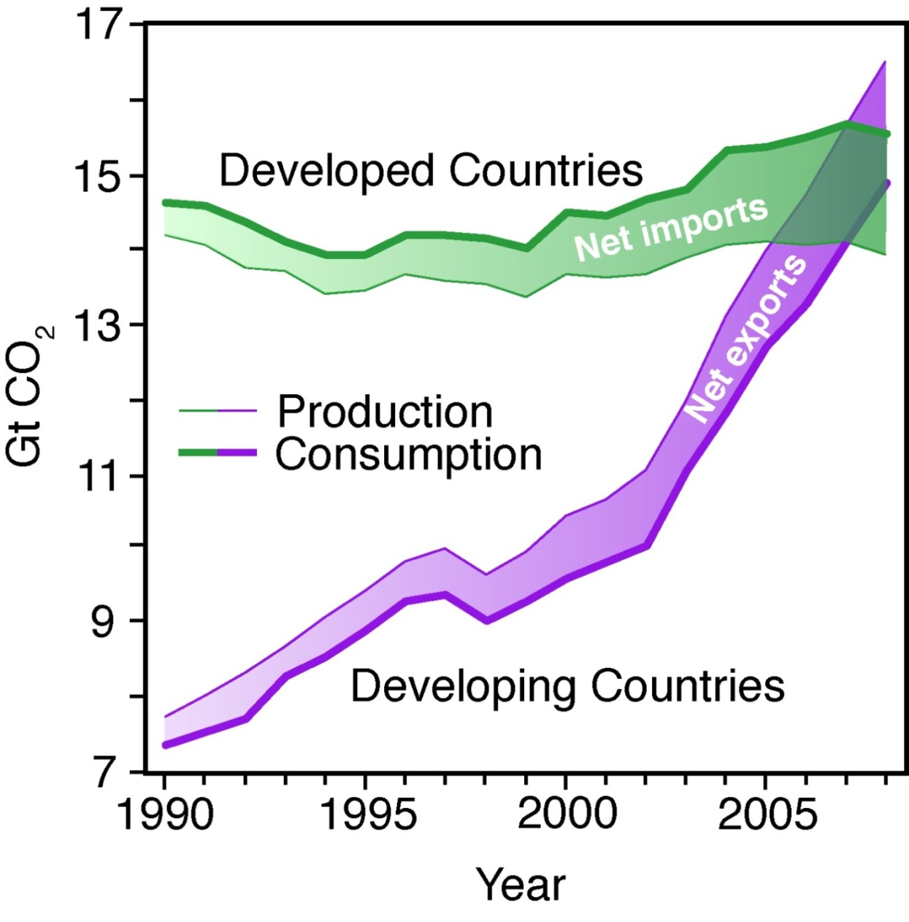
Consumption-induced: The increase in net import into Annex B countries 1990-2008 was five times greater than the achieved emission reduction
Policy-induced: Negligible effect
0.3% of territorial
Notes:
Consumption = Production/Territorial – Exports + Imports
Developed countries are net imports of emissions, and this net import is increasing over time
The change in net importers can more than offset territorial emission reductions, decreasing global effectiveness.

Slide 11
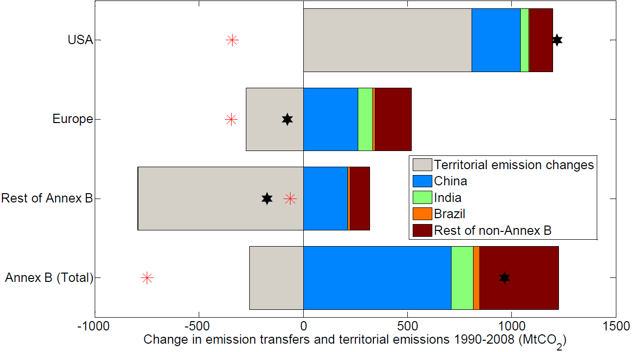
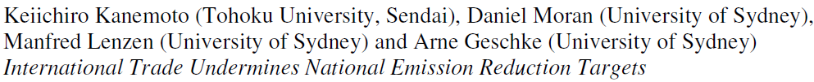
Change 1990-2008
ΔTerritorial
ΔConsumption
ΔPolicy
Notes:
Consumption = Production/Territorial – Exports + Imports
Developed countries are net imports of emissions, and this net import is increasing over time
The change in net importers can more than offset territorial emission reductions, decreasing global effectiveness.

Slide 12
The dilemma
Consumption-induced leakage
Changing global division of labour
Facilitates increased consumption
Consequence is
Increased emissions offset any reductions
Competitiveness concerns
→ No progress in climate policy

Slide 13
The Solution

Slide 14
The solution
Introduce complementary measures
  Keep the territorial/production system
  Broaden with additional measures
More inclusive treatment of
  International trade
  Consumption

Slide 15


Consumption-based approaches are complementary
to production-based approaches
Implementation timeline
Quantify consumption-based emissions
Track Progress
Identify problem areas
1
2
Design and implement politically feasible policy instruments
Track Progress
Did the policies work?

Slide 16
Quantification

Slide 17
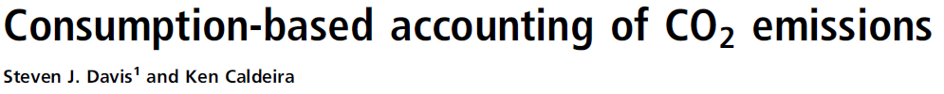

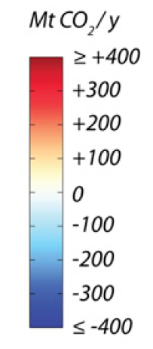
Key Findings (2004):
6.2 GtCO₂ (23%) embodied in trade
Annex B Consumption 1.6 GtCO₂ higher than Production (12%)
OECD Consumption 2.1 GtCO₂ higher than Production (16%)

Slide 18
Production still important!
To reduce consumption-based emissions requires helping developing countries mitigate
Notes:
Large flows of embodied carbon from developing to developed countries. China plays a key role
Thus, consumption emissions in the developed nations are partly dependent on developing nation emissions
To reduce consumption based emissions requires helping developing countries mitigate.

Slide 19


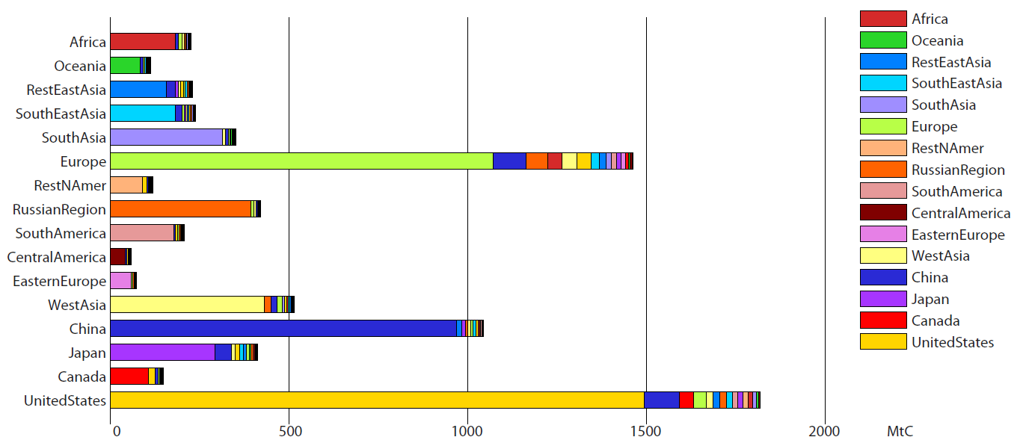
Large share of consumer emissions are territorial
“Imported” emissions

Slide 20
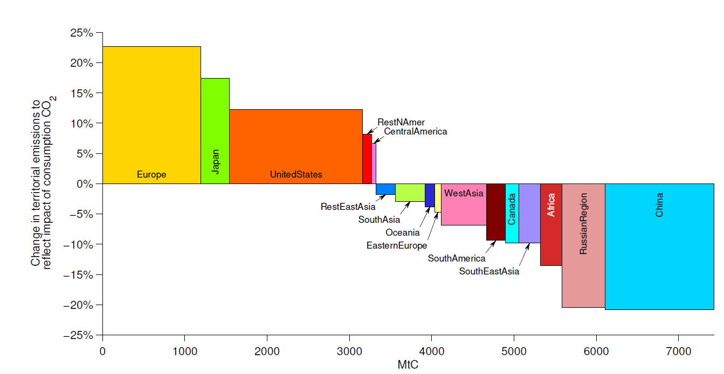
“Rich” countries are generally net imports

Slide 21
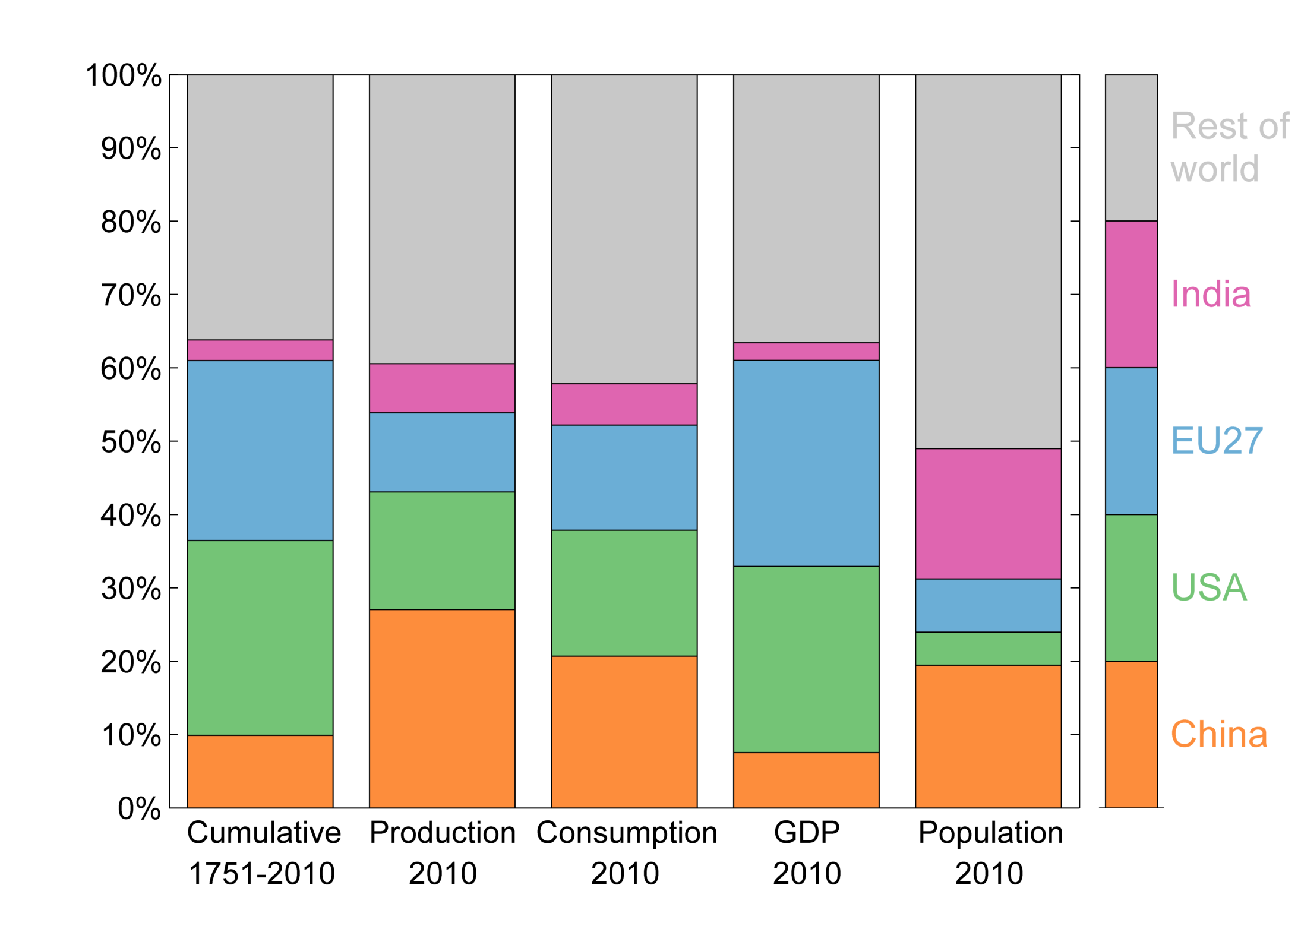
Equity: Allocating emissions
Alternative views of Burden Sharing

Slide 22
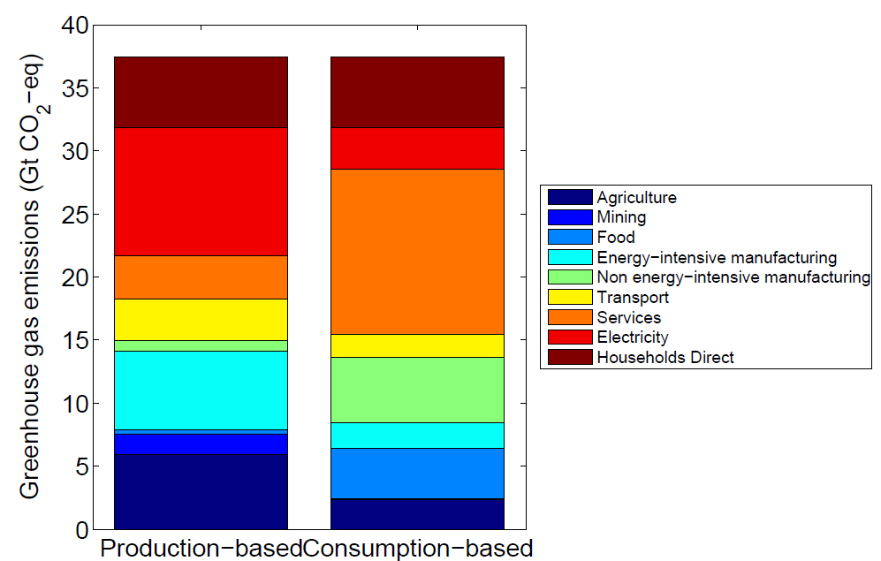
Consumption by sectors
Electricity
Services
En Intensive
Manufacture
A consumption view
shows
different
mitigation options
Food
Agriculture
Notes:
Policy makers don’t know or understand this.
E.g., is electricity important, or is services important?

Slide 23
“Regulating consumption”
Supply chain of clothing consumed in the UK
Consumer
Producers (supply chain)
For clothing consumed in the UK,
most emissions occur in electricity production in China
Andrew et al (in prep)

Slide 24
Who gets the emissions? Who gets the income?
Wearing Apparel
GHG emissions
CHN
GBR
IND
Value added
GBR
MAR
FRA
USA
RUS
FRA
DEU
TUR
ITA
NOR
BGD
DNK
NOR
SWE
RoEU27
ROW
0
10
20
30
40
50
60
70
80
90
100
For clothing consumed in the UK:
Most emissions in China, most value added in the UK
Andrew et al (in prep)

Slide 25
Who gets the emissions? Who gets the income?
Wearing Apparel
GHG emissions
Agriculture
Mining
GBR
Food
Value added
EI Mfg
NonEI Mfg
Transport
Services
Electricity
FRA
NOR
0
10
20
30
40
50
60
70
80
90
100
For clothing consumed in the UK:
Most emissions in electricity, most value added in clothing
Andrew et al (in prep)

Slide 26
Quantification summary
IO community has had a dominant role
Plays a role in motivating further analysis
Quantification is insufficient to design and implement policies

Slide 27
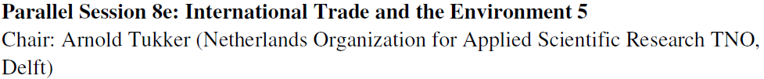
Sessions: Global Environment

Slide 28

Sessions: Global Value Chains

Slide 29
Uncertainty

Slide 30
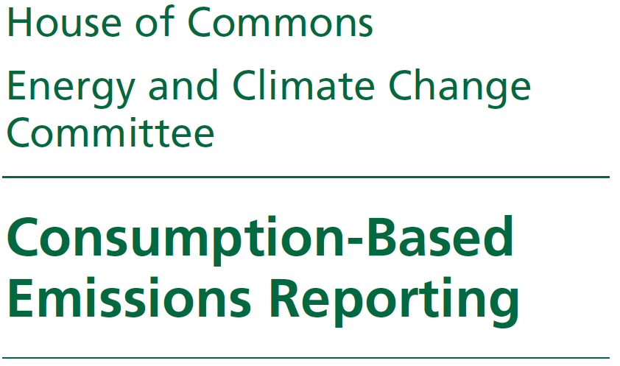

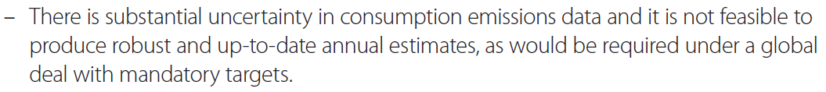
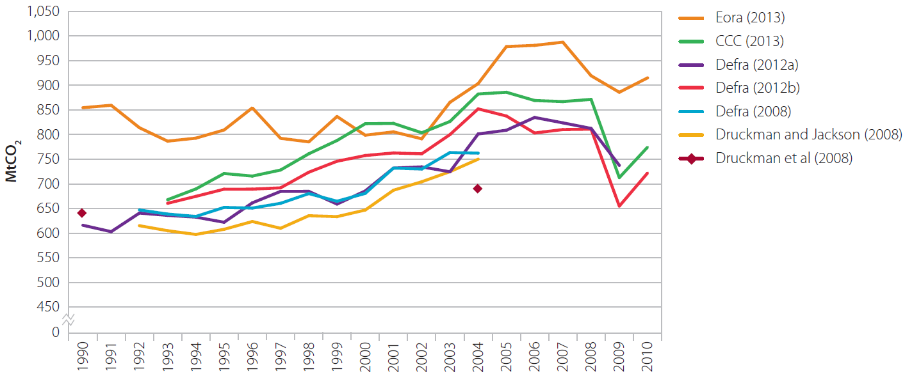

Slide 31
Drivers of uncertainty
Variations in territorial emissions
  Controllable
Variations in definitions
  Controllable
Variations in MRIO datasets
  How important is this?

Slide 32






“Naïve” comparisons
  Peters et al 2011, PNAS
  Peters et al 2012, Nature Climate Change
  Peters et al 2013, Earth Systems Science Data
  Lenzen et al 2012, ES&T
  Wiebe et al 2012, ESR
  Boitier 2012, Final WIOD Conference

Slide 33
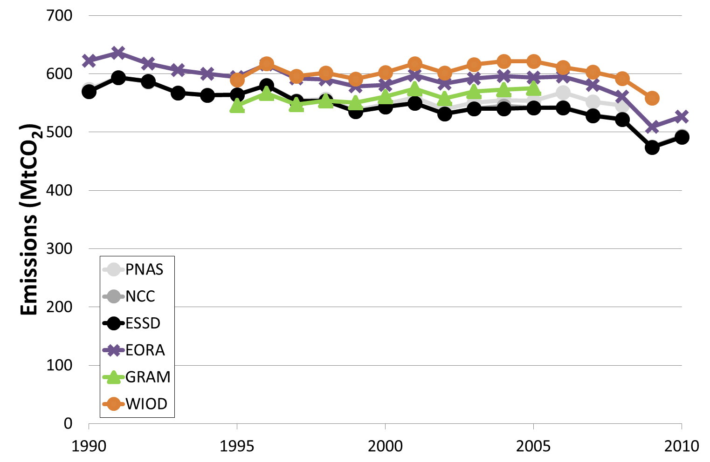
United Kingdom Territorial

Slide 34
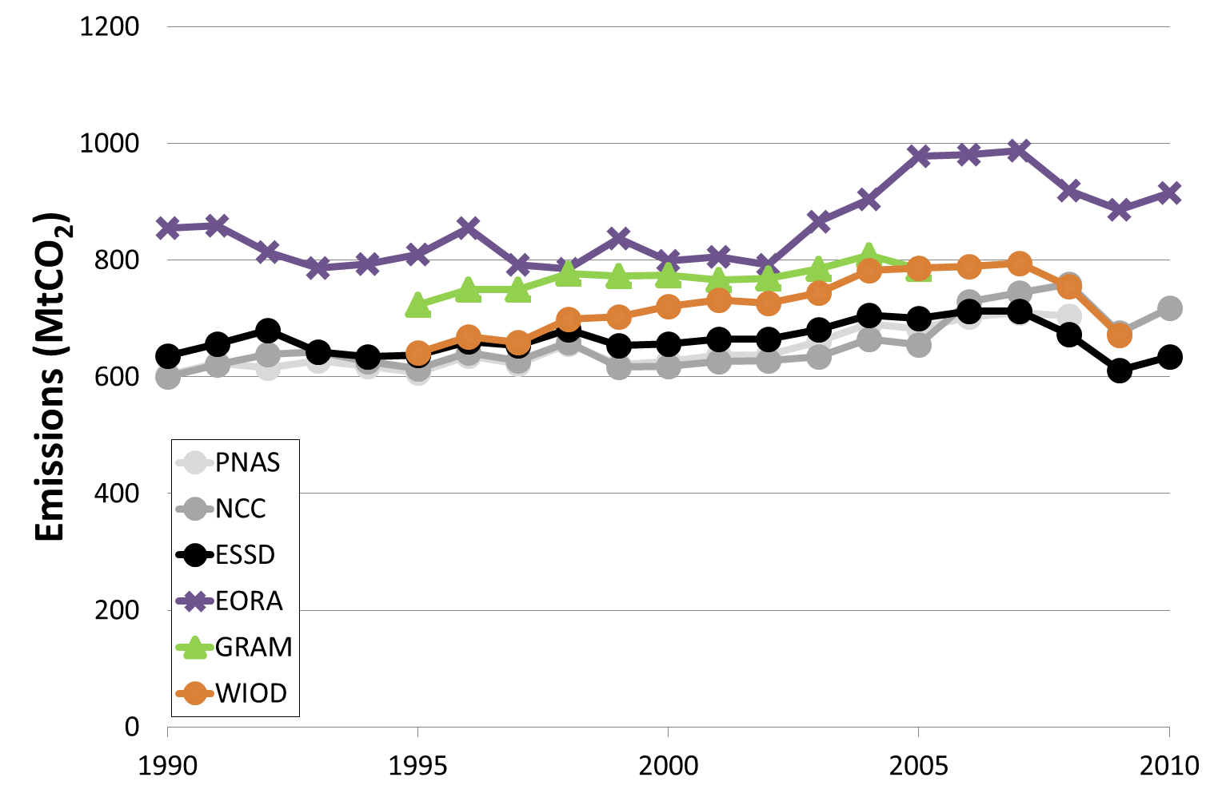
United Kingdom Consumption

Slide 35
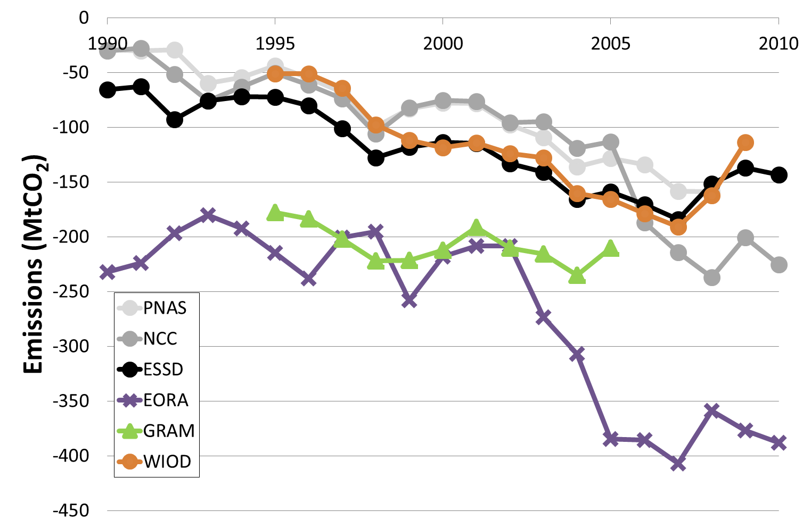
United Kingdom Net Transfer

Slide 36


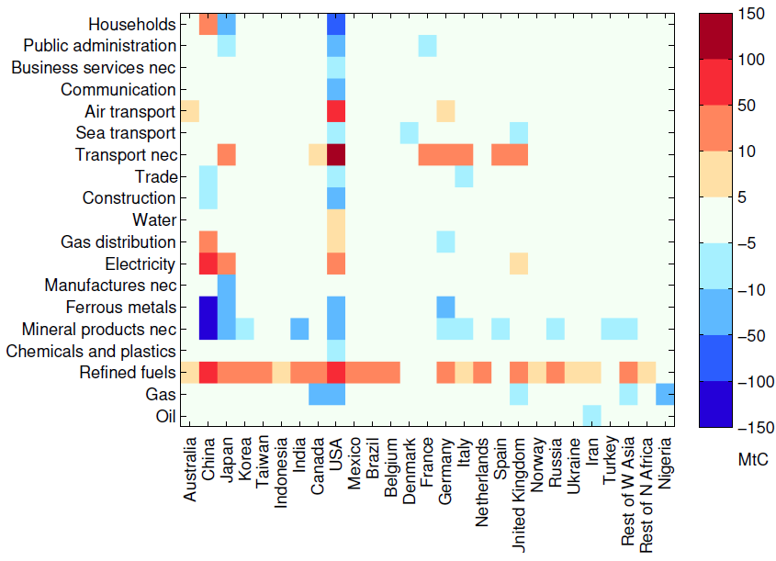
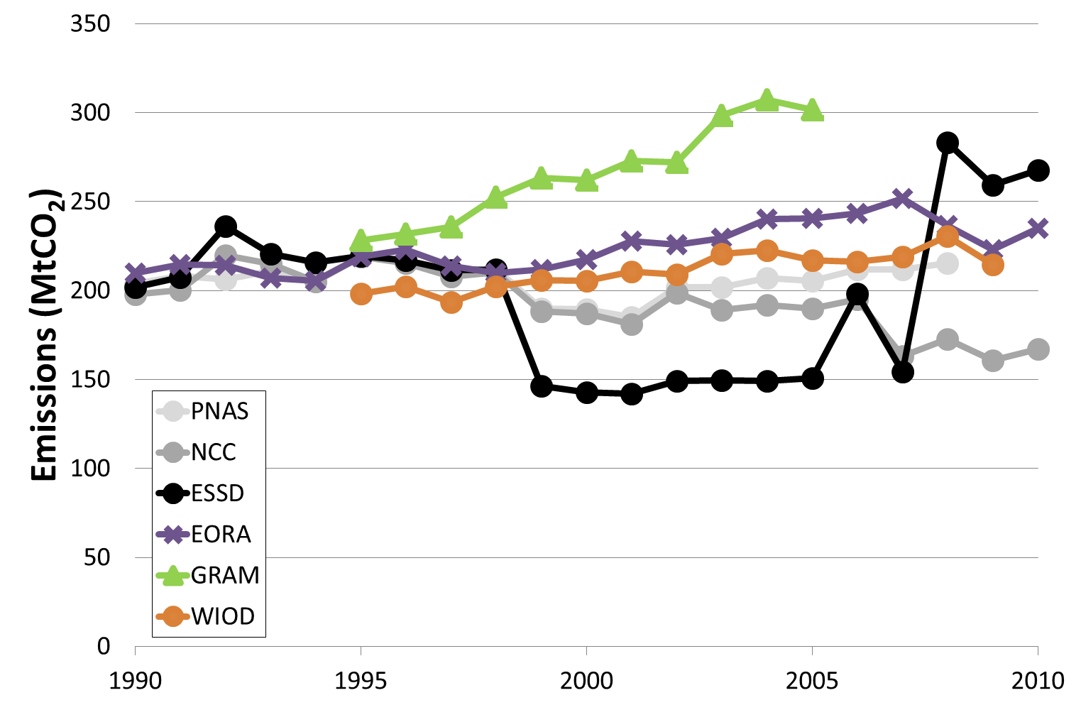
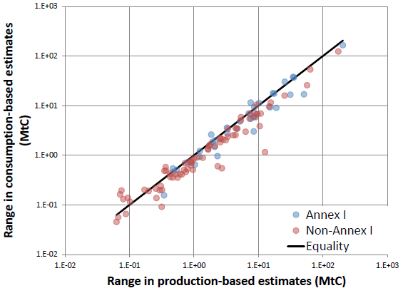
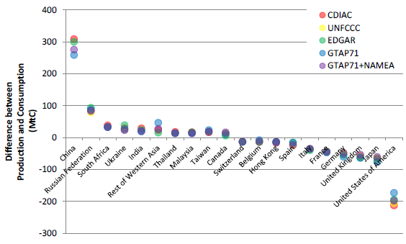

Slide 37
Uncertainty
Current uncertainty limits policy applications
Uncertainty must go down...
  ...if we want to stay relevant
Notes:
Regular Monitoring, Reporting and Verification (MRV) to track progress and identify problem areas
Too uncertain? Depends on the policy application, and policy applications will drive reductions in uncertainty
Uncertainty must go down for hard applications

Slide 38
What NExt

Slide 39
Reduce uncertainties
IO community driven
Diversity in MRIO is important
However, must ensure consistency
  C.f., climate model intercomparisons
  Harmonise definitions, standard sectoral emission data sets, etc.

Slide 40

Analyse policy instruments
The IO community generally gives naïve policy suggestions, but no policy analysis
  Economically efficiency?
  Environmentally effective?
  Politically feasible?
Combine our ideas, tools, and knowledge with others (e.g., CGE)
Notes:
Emissions are changing, so what, what do we do about it?

Slide 41
Alternative Carbon Pricing (1)
Can implement consumption with a Border Carbon Adjustment (BCA)
  Subsidise Exporters
  Include Importers
Cross cutting issues
  Consumption- or policy-induced leakage
  Strategic or environmental implementation
  Legal and technical issues
Production
Exp
Domestic
Imp
Consumption

Slide 42
Alternative Carbon Pricing (2)
Carbon Added Taxation
  Carbon price at the consumer (not producer)
  Value Added Tax (VAT)
    Includes imports, removes exports
  Base carbon pricing on VAT systems
Opportunity for the IO community?
Notes:
We need to be innovative

Slide 43
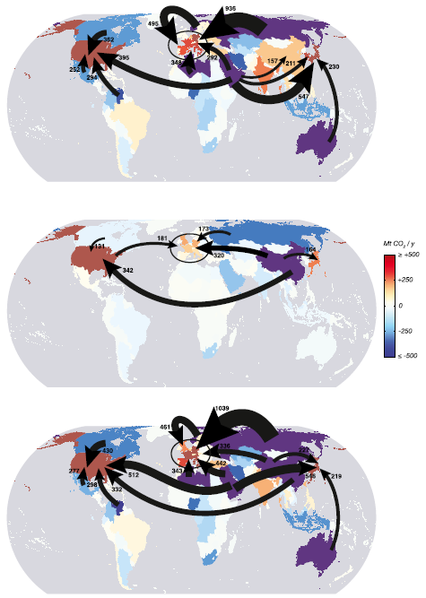

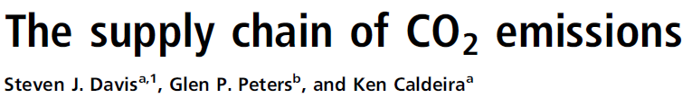
Supply Side Policies
Extraction to Production
Production to Consumption
Extraction
to Consumption

Slide 44
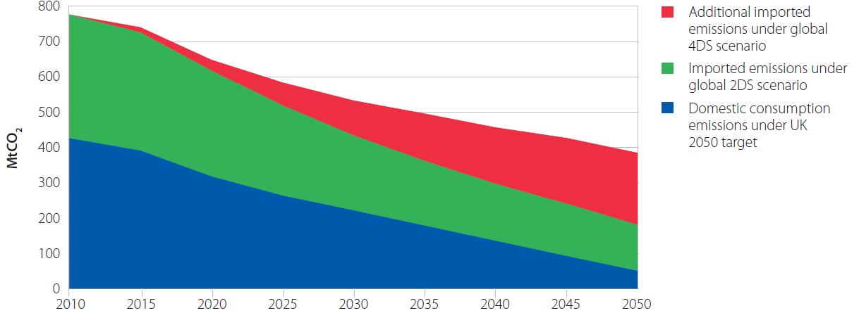

Scenarios
“Imported” emissions may dominate
We are good at the past, the future?
Alternative approaches to scenarios?
Import
Domestic

Slide 45
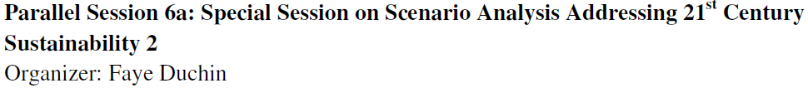
Sessions: Scenarios

Slide 46
International trade
Modelling consumption-based emissions
  Consumption
  Production systems (technologies)
  International trade
We really struggle with historical trade
Can “the rock stars” contribute to modelling future trade?

Slide 47
Other policy applications
Understanding economics
  Reconciling different world views
Sustainable consumption
  What is the macro-effect
Political sciences
  Consumption could lead to a global regime
Equity and fairness
  Consumption could equalise disparities
...

Slide 48
Conclusion

Slide 49
I believe the IO community can make many great contributions
...but can it have a policy impact?
Need to focus on
Critical policy questions
Partner with alternative disciplines

Slide 50
Thank you
glen.peters@cicero.uio.no
twitter.com/Peters_Glen

