Slide 1
Identifying Trade-offs & Synergies of Circularity interventions
A MR EEIO-based framework
Glenn A. Aguilar-Hernandez
Marie Curie Research Fellow
IIOA Conference
July 2nd, 2024

Slide 2
In this presentation
Circularity interventions and Synergies/Trade-offs analysis
MR EEIO-based framework
Example: LATAM vs EU interventions in construction
Lessons learned

Slide 3
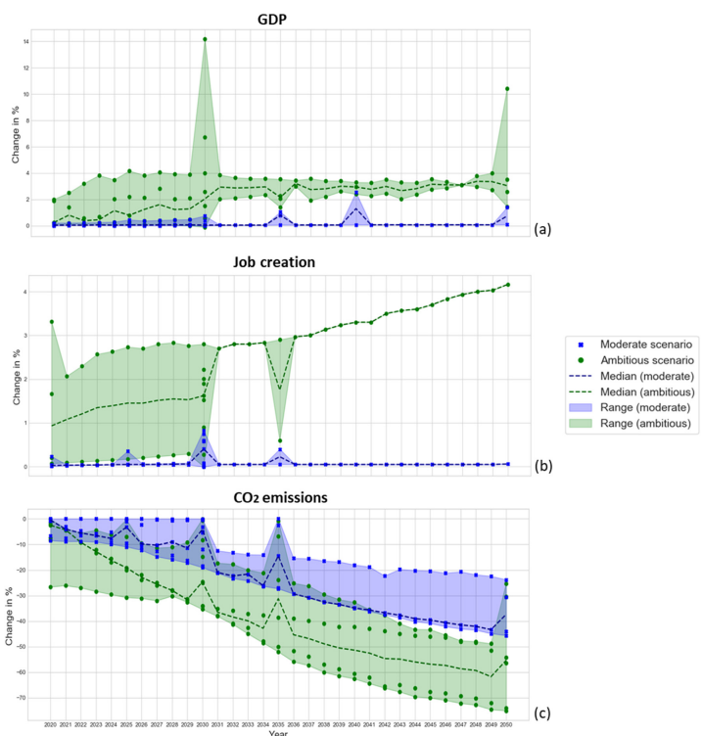
Macroeconomic, social and environmental impacts of Circular Economy
Circularity could generate ‘win-win-win’ situations
BUT, there is lack of understanding of potential trade-offs in multiple dimensions
Fig 1. Changes in GDP, employment, and GHG emissions between 2020 and 2050 from over 300 CE scenarios
Aguilar-Hernandez et al. (2021)
OECD (2022)

Slide 4
Research Question & Methods
How can trade-offs and synergies of circularity interventions be systematically identified to facilitate the interpretation of CE scenarios?
Literature review (TBL, MCDA, DEA)
Develop mathematical expressions

Slide 5
A multi-dimensional framework

Slide 6
MR EEIO-based framework
Step | Mathematical expression | References
1- Scenario analysis | $${CES}_{i}={\hat{b}}_{i}^{∗}x^{∗}={\hat{b}}_{i}^{∗}{(I−A^{∗})}^{−1}y^{∗}$$ | Wiebe et al. (2019) Donati et al. (2020)
2- Data & Sign harmonization | $$N_{i}=\frac{({CES}_{i}−{BAU}_{i})}{\sum_{k=1}^{n}{{BAU}_{k,i}}}×100$$ | Mardani et al. (2017) Aguilar-Hernandez et al. (2021)
 | e.g., $N_{GHG}^{SH}{=−(N}_{GHG})$ | New!
3- Concatenating dimensions | $$TS=[N_{1}^{SH}|N_{2}^{SH}|⋯|N_{m}^{SH}]$$ | New!
4- Trade-offs and Synergies analysis | $$v=\sqrt{{({ts}_{dim−1})}^{2}+{({ts}_{dim−2})}^{2}+⋯+{({ts}_{dim−n})}^{2}}$$ $$v_{sum}= \sum_{k=1}^{w}{v_{k}}$$ | New!

Slide 7
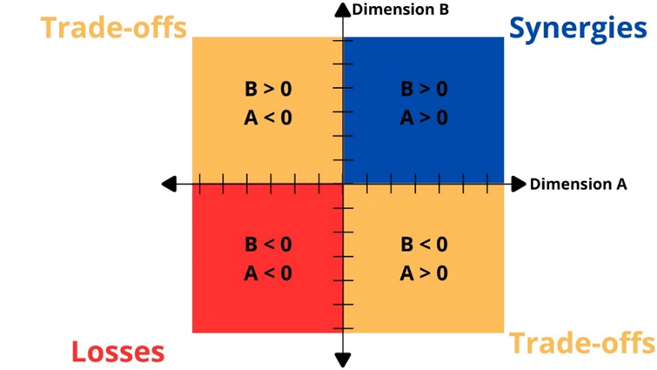
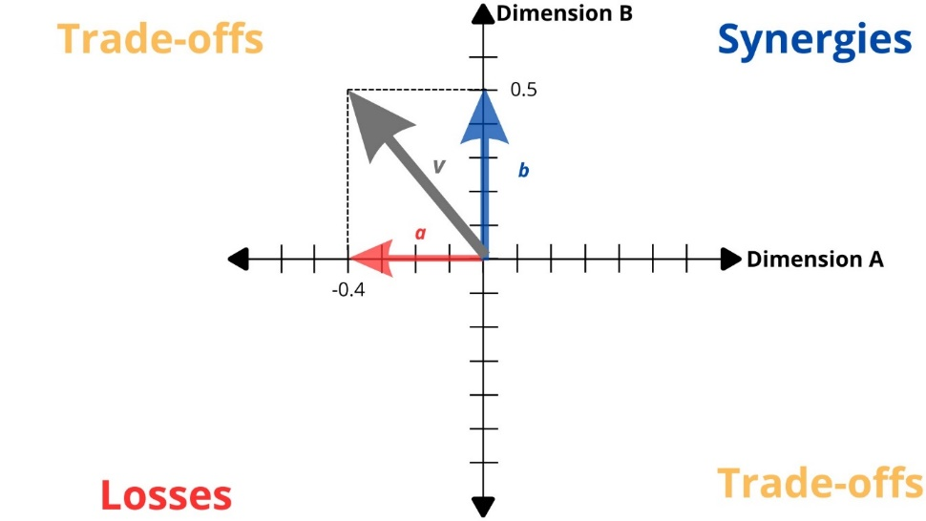
Steps 3 & 4: Concatenating and Eucledian Sum

Slide 8
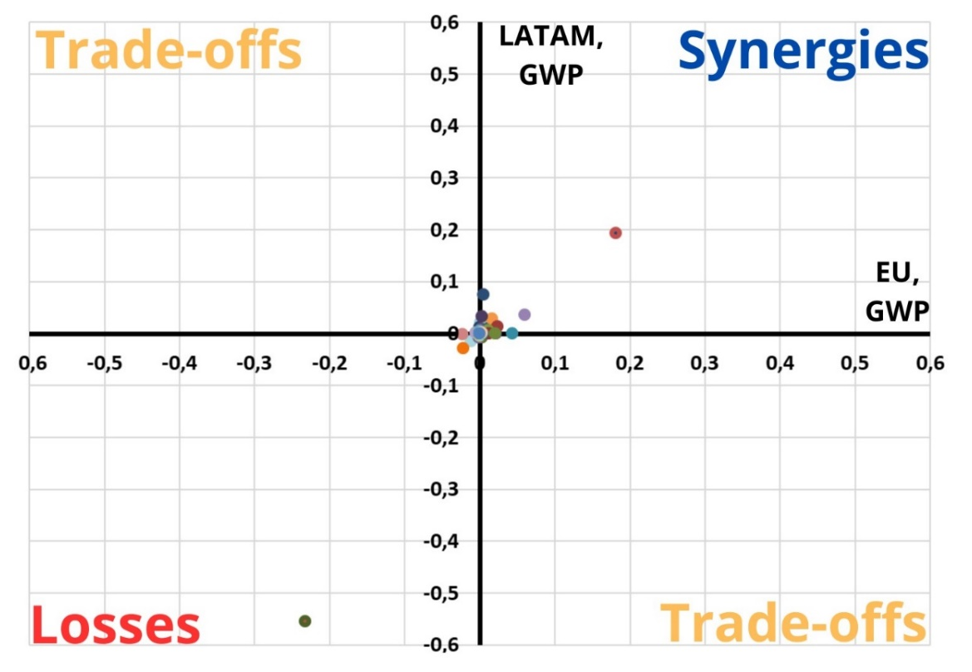
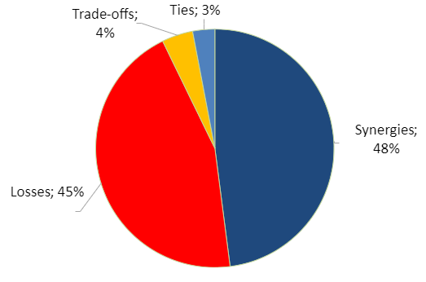
Examples: LATAM - EU circularity interventions impacts on GWP
Fig 2. Circularity trade-offs, synergies, and losses of the EU and LATAM circularity interventions in the construction sector across all 163 sectors for global warming potential (GWP) impacts.
Fig 3. Share of trade-offs, synergies, losses, and ties between the EU and LATAM circularity interventions in the construction sector for global warming potential (GWP).

Slide 9
Lessons learned
MR EEIO-based framework facilitates multi-dimensional analysis, but there’s more to do…
Stakeholders’ collaboration is key for dealing with potential trade-offs and losses
Complexity does not mean improvement

