Slide 1
Drivers of mutual content (production and ownership) in Chinese, EU, and US production
IIOA 2024 Conference
Santiago
Oscar Lemmers, o.lemmers@cbs.nl

Slide 2
Disclaimer
The author is employed at Statistics Netherlands. The opinions expressed in this presentation are those of the author and are not necessarily in accordance with the policies of Statistics.

Slide 3
USA, China and EU strive for strategic autonomy
EU strategic autonomy, a.o. related to economic resilience, foreign and security policies. Strategic dependencies, Critical Raw Materials Act, European Chips Act
CHIPS and Science Act making the US less dependent on foreign manufacturers of chips by stimulating manufacturing in the US. Infrastructure Investment and Jobs Act includes US content requirements for highways, mass transit, and rail.
“Made in China 2025” strategy for manufacturing, increase Chinese content of important materials, emphasis on the semiconductor industry since developments there may lead to spinoffs.

Slide 4
Standard analysis of GVC dependencies
Production in several countries –> dependencies. See, e.g., Kuzmenko & Čechura (2023). If something happens in an industry in a country that produces in your supply chain, you can be affected. Adaptation takes time.
Could be a natural disaster (2011 Tōhoku earthquake and tsunami), a strike, geopolitics (Russian gas), and so on.

Slide 5
Location, location, location?
Location of production in supply chain - only this matters for dependencies?
Everyone who ever rented, knows dependency on the owner of the property!
Country of ownership of production in your supply chains matters: if country A owns production somewhere in the world that ultimately ends up in your supply chain, there is a dependence of country A
Not only a theoretical concept: Li et al. (2024) consider developing countries and trade in sanctioned goods with Russia. Firms with MNEs headquartered in sanctioning countries applied sanctions more often than domestic firms.

Slide 6
Already attention for ownership in own country
UNCTAD (2022): “national security concerns about foreign ownership of critical infrastructure, core technologies or other sensitive domestic assets”
Firms might move production at home to foreign affiliates to circumvent issues with country of production (Alfaro and Chor, 2023)
European Commission proposed improved screening of foreign investment into the EU to protect against risk (24 January 2024)
(and so on)
But ownership in the supply chain?

Slide 7
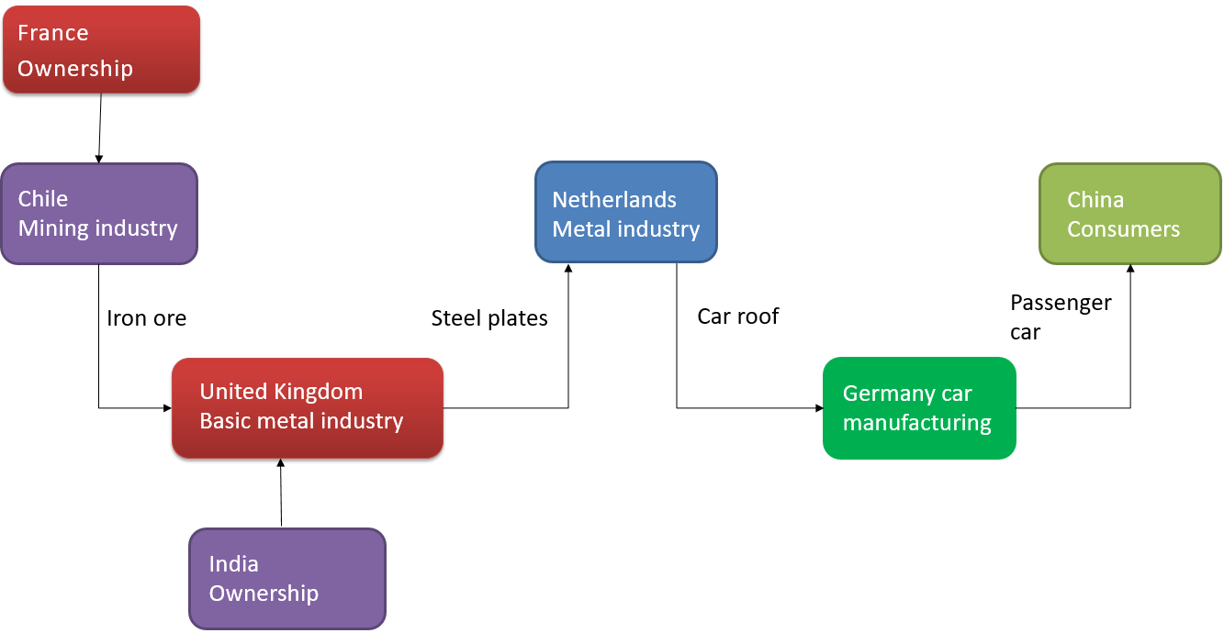
Our new approach
Adding the ownership dimension brings another type of dependency to light

Slide 8
Data to map global value chains and ownership
Inter-country input-output table, over 60 countries and 35 industries, from Asian Development Bank
OECD AMNE (Cai et al. 2023): for each industry in each country, what is domestically owned, what is foreign owned by which country. Based on Eurostat Inward FATS, Eurostat Outward FATS, data BEA for US, some more sources and FDI with estimates for the confidential part -> complete

Slide 9
Drivers of mutual content (production and ownership) in Chinese, EU, and US production

Slide 10
Three large economic partners: China, USA and EU
USA related content in EU production: the share of value added embodied in EU production that is produced in USA and/or was under US ownership outside the USA
Similar: China related content in US production and so on
Questions:
How large is China/USA/EU related content in mutual production?
How did this change over time?
What are factors behind this change?
Are there opportunities for policy involvement?

Slide 11
China/USA/EU related content in mutual production
 | 2000 |  |  | 2019 |  |  | Difference 2019-2000
 | Total | Production | Ownership | Total | Production | Ownership | Total | Production | Ownership
 | % |  |  |  |  |  | %pt
Chinese content in EU production | 0.4 | 0.3 | 0.0 | 1.8 | 1.2 | 0.5 | 1.4 | 1.0 | 0.5
US content in EU production | 4.1 | 1.4 | 2.7 | 6.4 | 2.1 | 4.5 | 1.8 | 0.7 | 1.1
Chinese content in US production | 0.4 | 0.3 | 0.1 | 1.4 | 0.9 | 0.4 | 1.0 | 0.4 | 0.4
EU content in US production | 4.5 | 2.0 | 2.3 | 5.4 | 1.8 | 3.8 | 1.6 | 0.1 | 1.3
US content in Chinese production | 1.8 | 0.6 | 1.2 | 2.6 | 1.2 | 1.2 | 0.8 | 0.7 | 0.1
EU content in Chinese production | 2.0 | 1.4 | 0.7 | 3.2 | 1.7 | 1.2 | 1.2 | 0.5 | 0.6
Using medians over tradeable industries: in 2000, production of an EU industry contained 1.4% value added produced in US. 2.7% was produced outside USA under USA ownership. Total 4.1 %. In 2019 the total was 6.4%.

Slide 12
Decomposing changes over time, 2000-2019
A structural decomposition analysis of the change, building on Oosterhaven & Van Der Linden (1997), with
Factors that can be influenced by policies
Investments by others in the own territory
Exports by others to the own territory
Factors that cannot be, or difficult to be, influenced by policies (the rest)
General trade fragmentation
Changing technology
Trade with both countries involved outside the own territory
Investments with both countries involved outside the own territory

Slide 13
Decomposing change 2000-2019, median for tradeable industries
Sizeable impact of direct factors that policies may influence: partner A imported more from partner B or partner B owned more in territory of partner A. Technology played a large part for EU content in US production.

Slide 14
Decomposing changes, 2000-2019, electrical & optical industry
Smaller impact of direct factors that policies may influence: partner A imported more from partner B or partner B owned more in territory of partner A. Technology and fragmentation sometimes play a large part.

Slide 15
Which value added can be influenced?
Currently, look at value added created in country A or owned by country A. That is related to production country A has influence on.
Is there more?
E.g., value added created in country X, embodied in a product that is exported to country A, used to create exports to country Y.
Country A can prevent this flow from X to Y. Should one add value added that flows through country A to the part that can be influenced, using a hypothetical extraction (e.g., Los et al. 2016)? Or is it too much?

Slide 16
Conclusion & way forward
One can map ownership in the supply chain of individual industries
This ownership can be sizeable
In spite of strive for autonomy, USA/China/EU related content in USA/China/EU production increased – both production and ownership
Sizeable part of changes of content in production is explained by changes in direct trade and ownership; can be influenced by policy
Is the trend reversing in recent years, can it be reversed in practice?
Policy makers ask for more detail in industry, country of production (Africa – AfCIOT project!) and country of ownership.

Slide 17
Questions, remarks, comments?
Now (if time permits), or later via
o.lemmers@cbs.nl

