Slide 1

30th IIOA Conference
Unveiling the Panama Canal's Economic Influence: An Input Output measuring
Carlos Adrián Romero
IIEP-UBA/CONICET
María Priscila Ramos
IIEP-UBA/CONICET
Juan Ignacio Mercatante
IIEP-UBA/CONICET
María Laura Ojeda
IIEP-UBA/CONICET
Juan Carlos Hallak
IIEP-UBA/CONICET

Slide 2
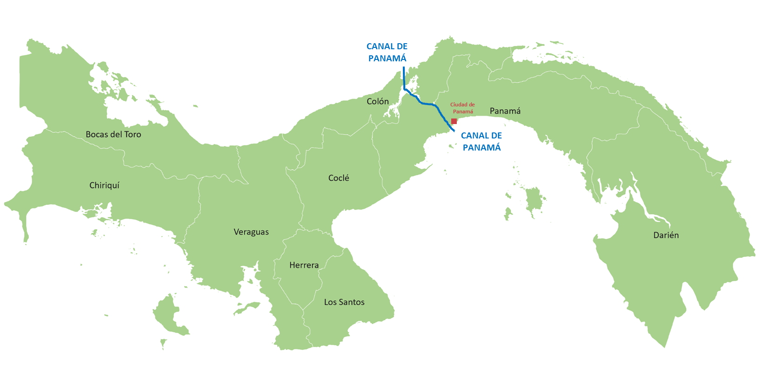
Motivation
Panama has shown notable economic growth in the early 21st century, standing out among Latin American nations.
The Panama Canal has been key to the country's economic surge and government revenue.
It is necessary to estimate the Panama Canal's direct and secondary economic impacts, including interindustry linkages, labor compensations, and government transfers.
The principal objective of this study is to furnish a rigorous quantitative measure that encompasses the total impact of the Panama Canal on the national economy using and IO methodology.

Slide 3
Previous studies on the Importance of the Panama Canal
Early studies:
  Gibbs (1978) valued the Panama Canal's global net present economic value at $6 billion, with $1.6 billion attributed to the United States.
Econometric studies:
  Bhadury (2016) and Park et al. (2020) conducted data-driven studies evaluating the impact of the Panama Canal expansion on the United States port industry.
  Rodrigue & Ashar (2016) and Miller & Hyodo (2021) found that the Panama Canal benefits U.S. trade and boosts trade within the Caribbean and South America.
  Lanzalot et al. (2018) applied Synthetic Control Methods to assess how the expansion impacted private investment.
IO and CGE studies:
  Hoyos et al. (2011) utilized a dynamic recursive CGE model calibrated for 2003 to assess macroeconomic and distributional impacts of the expansion of the Panamá Canal.
  Pagano et al. (2012) further investigated this matter using CGE and IO models calibrated to 2006, consistently aligning with Hoyos et al.'s (2011) findings.
  ACP (2015) also employed CGE and IO approaches with 2010 as base year for calibration to analyze the impacts of the post-expansion period over the country’s economy.
  Pagano et al. (2021) used a model with 2012 data to assess post-pandemic investments in Panama's trade and logistics development.

Slide 4
DATA
MODEL
SCENARIO
RESULTS
SAM Panamá 2022 – with detail of the Canal’s activity
IP model
Effect decomposition
Production multipliers (BL and FL)
Employment multipliers
Hypothetical Extraction of the Panama Canal
GDP
Employment
Exports
Government Revenue
Satellite account of employment for Panama 2022

Slide 5
Construction of a SAM for Panamá 2022
Data from different official and Canal sources have been treated in a consistent manner.
Some sources consulted were:
  INEC (SNA, Balance of payments, Income generation accounts and Supply and use tables for 2021)
  Ministry of Economy and Finance (Detailed Government Budget for 2022)
  General Directorate of Revenue (Fiscal information for 2022)
  Household income and expenditure survey 2017-2018
  Panama Canal Balance Sheets (fiscal year 2022)
  Specific data provided by the ACP
The result was a SAM for the year 2022 with 28 key productive sectors including the Canal.

Slide 6
Panama’s SAM 2022: Value Added composition

Slide 7
Construction of a SAE for Panama 2022
A Satellite Account of Employment for Panama 2022 was built with the following characteristics:
Occupational Category | Public Sector worker
 | Private Sector worker
 | Independent worker
 | Manager
 | Family worker
Sex | Male
 | Female
Age | Up to 24 years of age
 | Older than 24 years of age
Educational Background | No Education
 | Only Primary Education
 | Only Secondary Education
 | Tertiary
 | University Education
 | Vocational
Data sources consulted were:
  Survey of Multiple puposes (INEC).
  National Economic Census (INEC).
  Authority of the Panama Canal

Slide 8
Input Output model
To assess the Canal's contribution to the economy, an IO model was calibrated using the SAM for Panama in 2022
This model, grounded in the theoretical framework of Miller & Blair (2009) captures direct effects originating from a specific shock, indirect effects stemming from sector interactions via input transactions, and induced effects resulting from household and government consumption.
In the context of Panama, the induced effect also incorporates government expenditure, as revenues from the Canal (excluding reserves).

Slide 9




EFFECTS
Immediate effect due to the initial shock on the Panama Canal
Spillover effect due to trade relations between productive sectors (Panama Canal and others).
Spillover effects due to changes in household consumption generated by changes in disposable income.
Spillover effects due to changes in government revenues and transfers
Households
Panama Canal
Direct
Indirect
Induced through households remunerations
Firms
Induced through government transfers
Government

Slide 10
Multiplier Analysis
Production Multipliers
Sector | Direct and Indirect Effects |  | Direct, Indirect and Induced Effects
 | BL | FL | BL | FL
Panama Canal | 1.06 | 1.35 | 1.60 | 1.50
Economy’s Average | 1.38 | 1.38 | 1.62 | 1.62
Employment Multipliers
Sector | Direct and Indirect Effects | Direct, Indirect and Induced Effects
Panama Canal | 1.40 | 6.80
Economy’s Average | 1.73 | 2.27

Slide 11

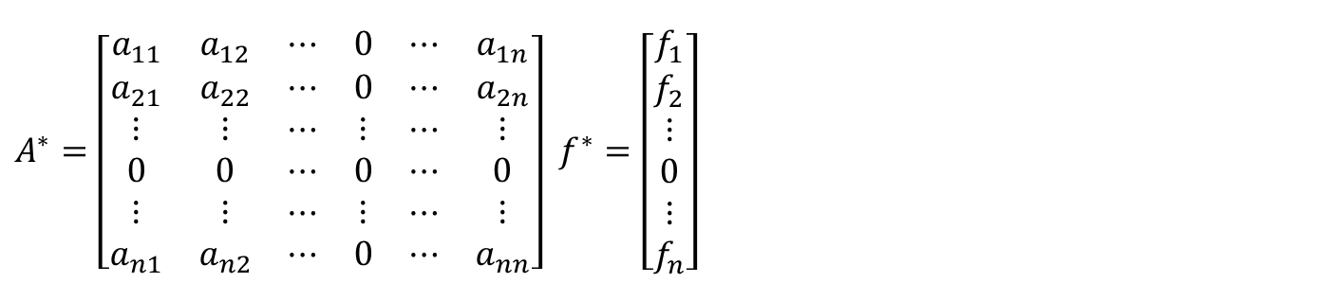
Hypothetical Extraction Method
A Hypothetical Extraction method within the IO framework is designed to quantify the relevance of a specific sector in the economy.
In order to do so, the sector is “extracted” from the economy to study the consequences in terms of production and value added.
From a technical standpoint:
$A^{∗}=\left[\begin{matrix}a_{11} & a_{12} & ⋯ & 0 & ⋯ & a_{1n} \\ a_{21} & a_{22} & ⋯ & 0 & ⋯ & a_{2n} \\ ⋮ & ⋮ & ⋯ & ⋮ & ⋯ & ⋮ \\ 0 & 0 & ⋯ & 0 & ⋯ & 0 \\ ⋮ & ⋮ & ⋯ & ⋮ & ⋯ & ⋮ \\ a_{n1} & a_{n2} & ⋯ & 0 & ⋯ & a_{nn}\end{matrix}\right]$ $f^{∗}=\left[\begin{matrix}f_{1} \\ f_{2} \\ ⋮ \\ 0 \\ ⋮ \\ f_{n}\end{matrix}\right]$
$$X^{∗}{=(I−A^{∗})}^{−1}f^{∗}$$
with
This approach was initially developed by Miller & Lahr (2001) and later expanded upon by Dietzenbacher & Lahr (2013).

Slide 12
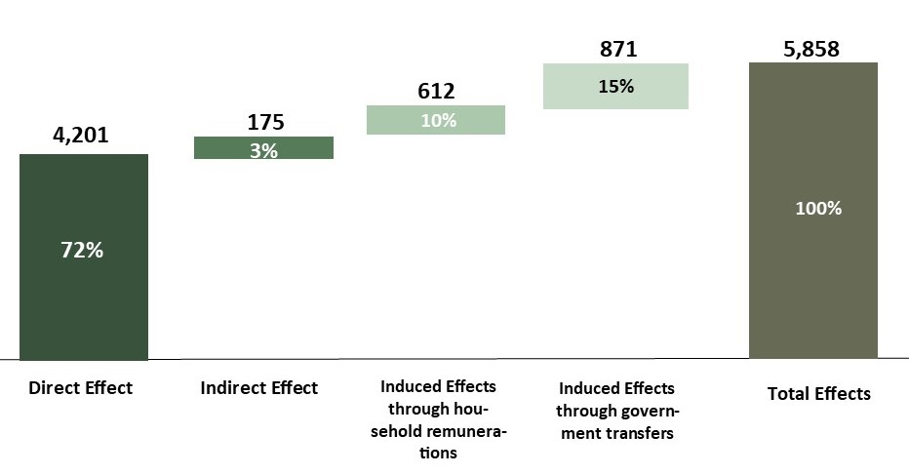
Aggregate Results:GDP
5,858
7.7% of Panama’s GDP

Slide 13
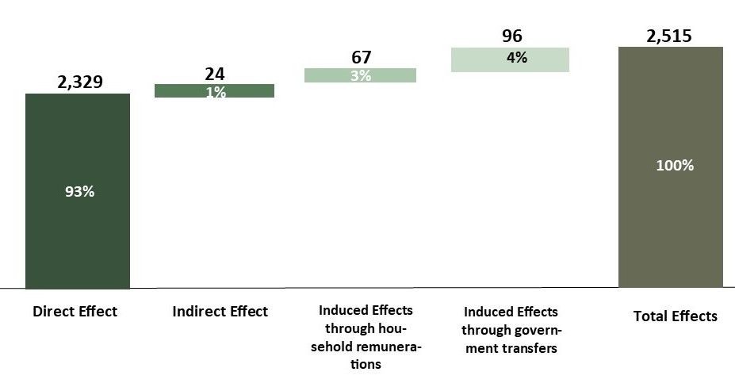
Aggregate Results: Government Revenue
2,515
23.6% of total Government Transfers

Slide 14
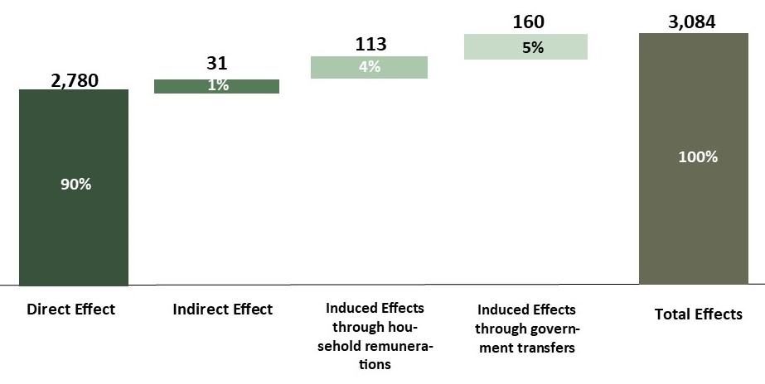
Aggregate Results: Exports
3,084
15.9% of total exports

Slide 15
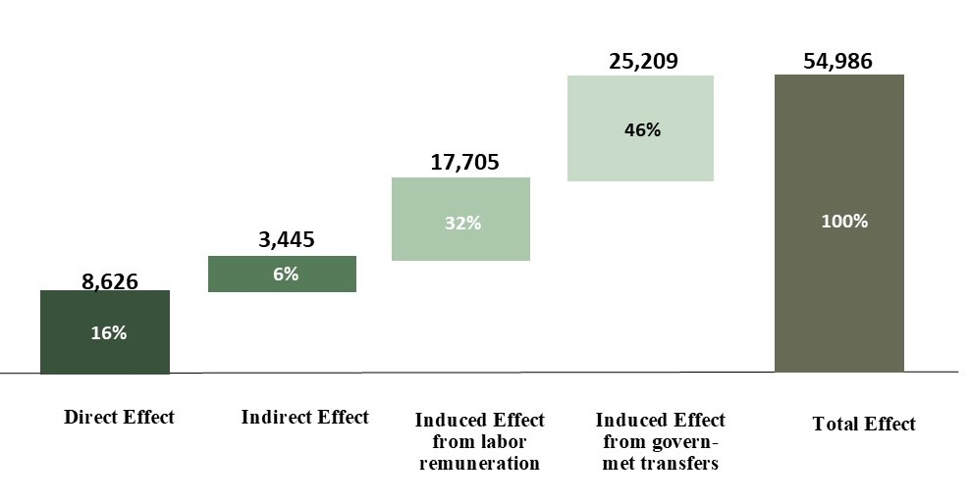
Aggregate Results: Employment
54,986
2.9% of total employment

Slide 16
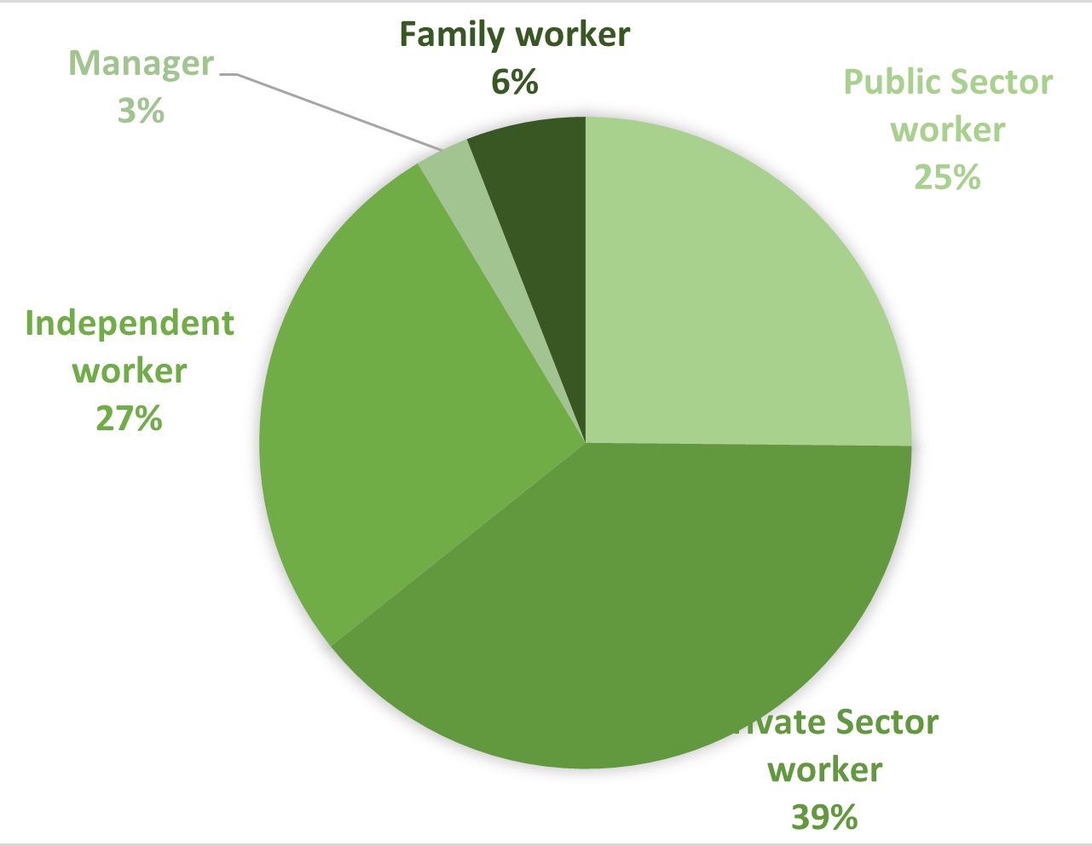
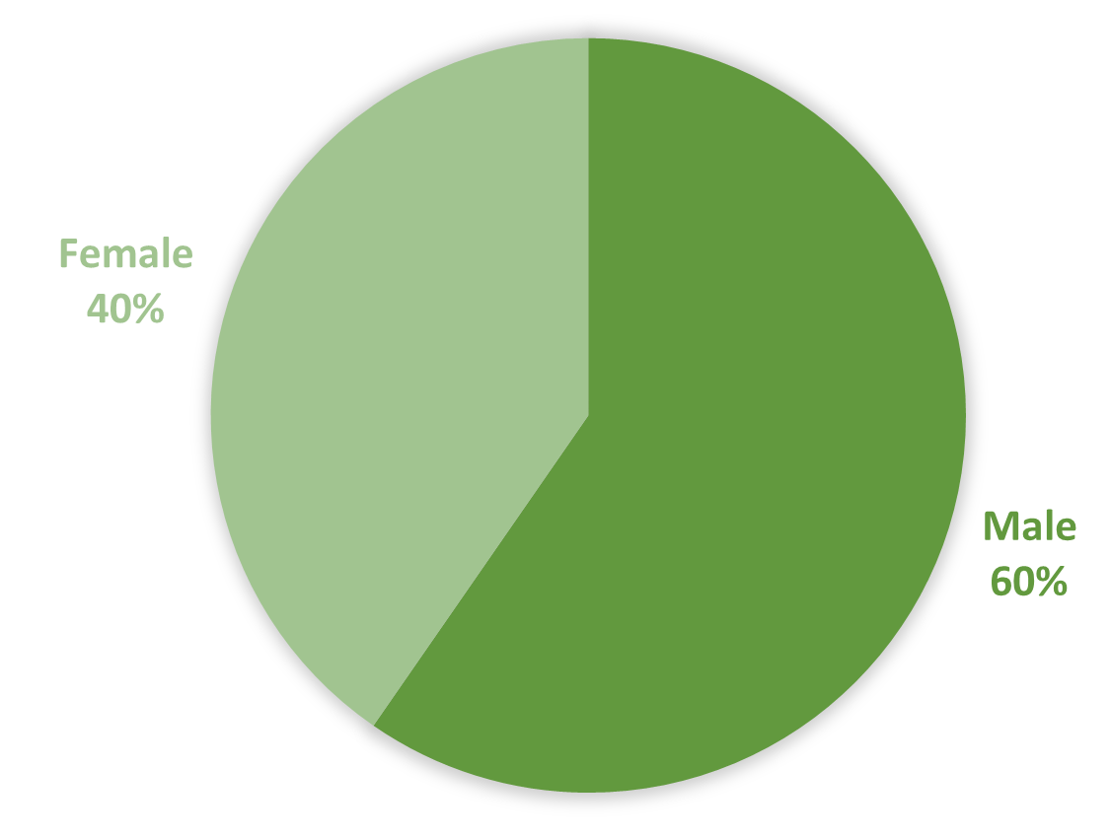
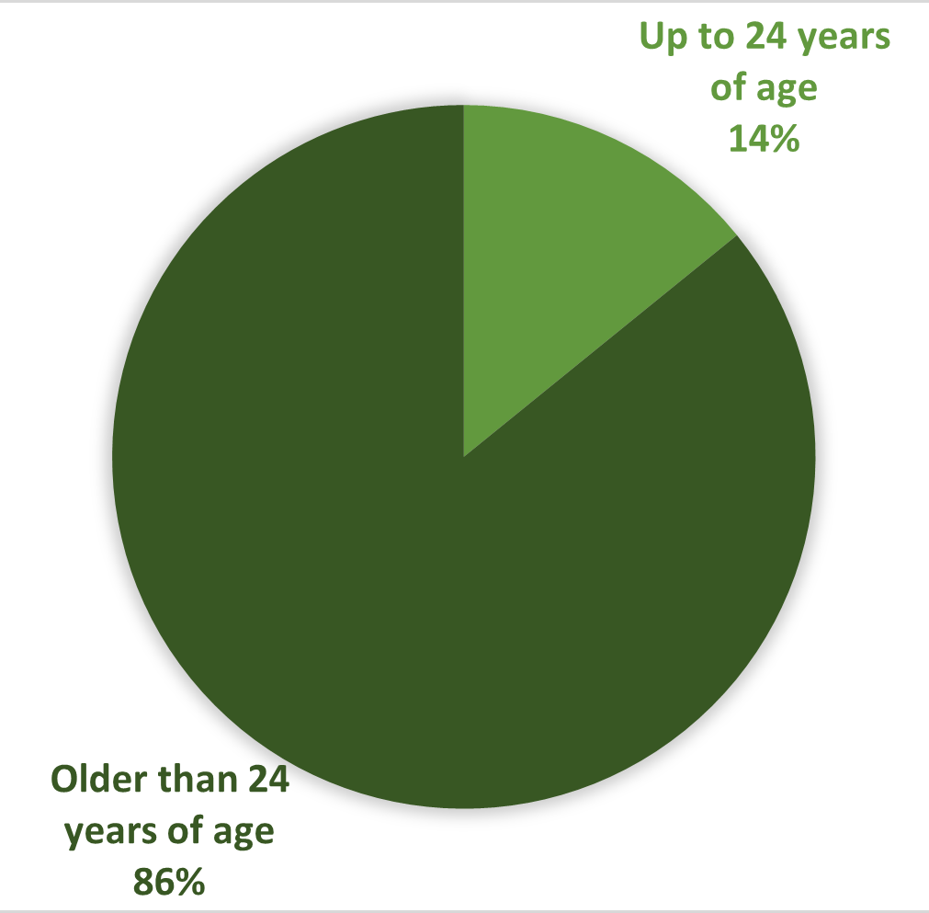
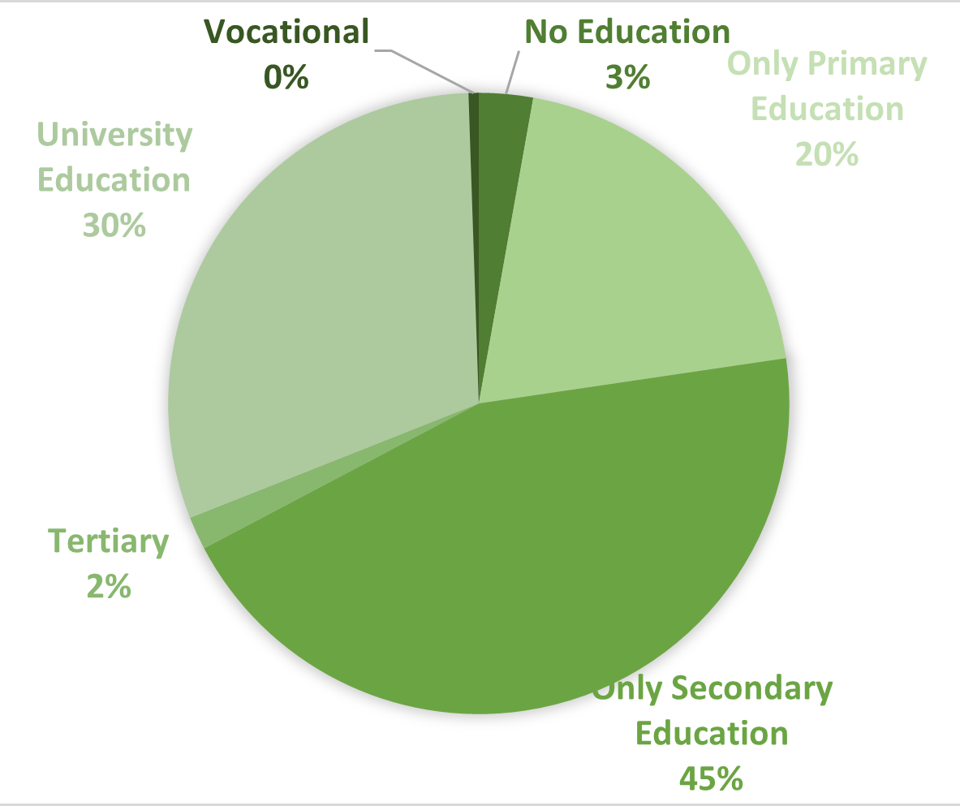
Occupational Category
Gender
Age
Educational Background

Slide 17
Sectoral Results
GDP
Government Revenue

Slide 18
Sectoral Results
Exports
Employment

Slide 19
Final Comments
To assess the Canal's direct, indirect, and induced effects on Panama's economy, we developed an IO model.
The model was calibrated with a new Social Accounting Matrix and Employment Satellite Account, detailing the Panama Canal's operations and 27 key economic sectors.
Using the Hypothetical Extraction method, we quantified the Canal's broader economic impact through various channels, including intersectoral links and household and government income-expenses.
The Canal contributes 7.7% to Panama's GDP, 15.9% to exports, over 23% to government revenue (mainly dividends), and creates 2.9% of total jobs directly, indirectly, and induced.

