Slide 1

Implications of basic income policies for long-term climate goals
Iñaki Arto, Simone D’Alessandro, Kurt Kratena,
Guilherme Spinato Morlin, María Victoria Román,
Manuel Tomás, Paola López-Muñoz and Ignacio Cazcarro

Slide 2

Low-carbon society:
An enhanced modelling tool for the transition to sustainability

Slide 3
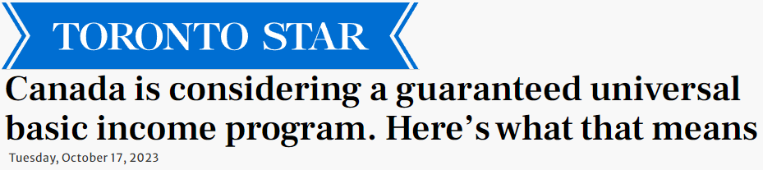
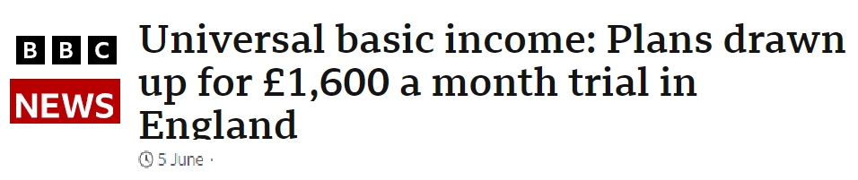
01
Introduction
Universal Basic Income policy
European countries
Inequality x Climate
Notes:
First I will make a brief introduction.
The motivation of this exercise was to try to model within an Integrated Assessment Model a policy that is included in the degrowth policy agenda: the Universal Basic Income
This policy is interesting for different reasons, one of them is that it might help to control de increase in inequality.

Slide 4
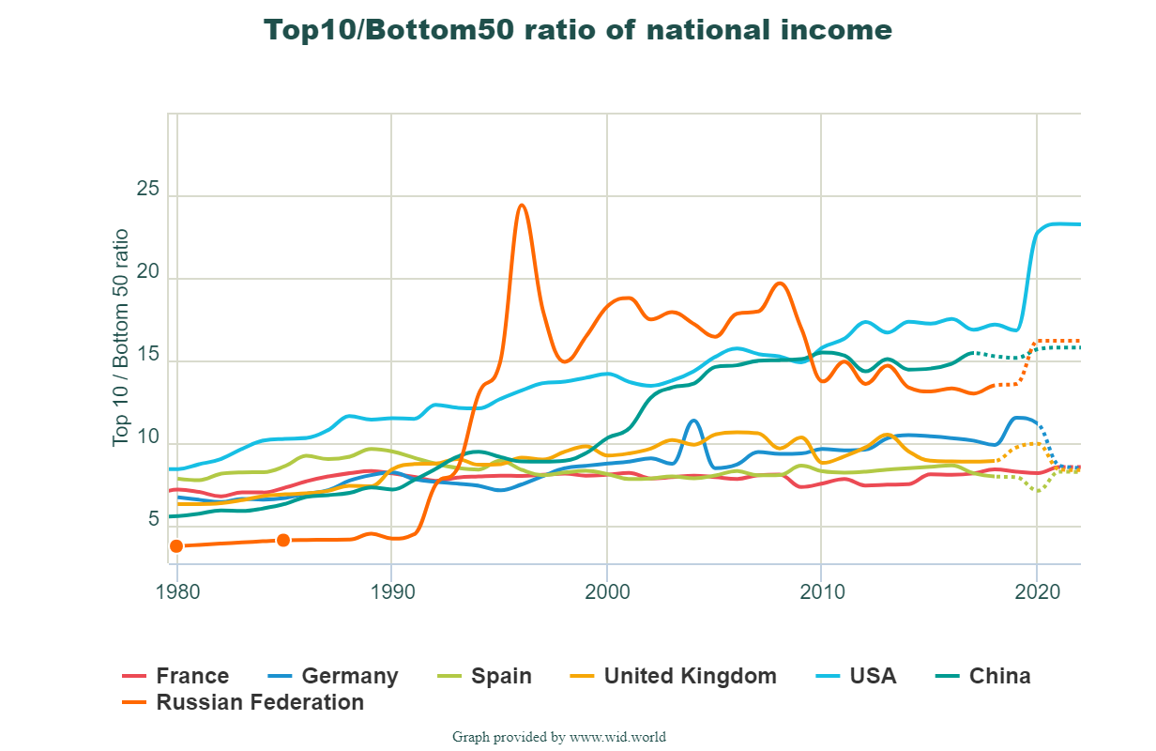
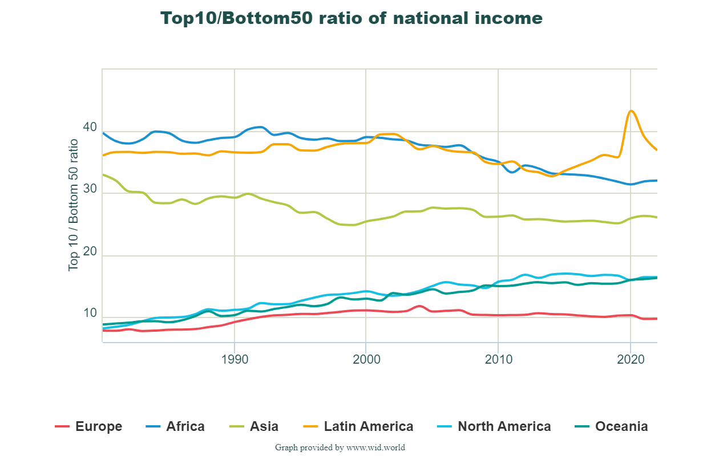
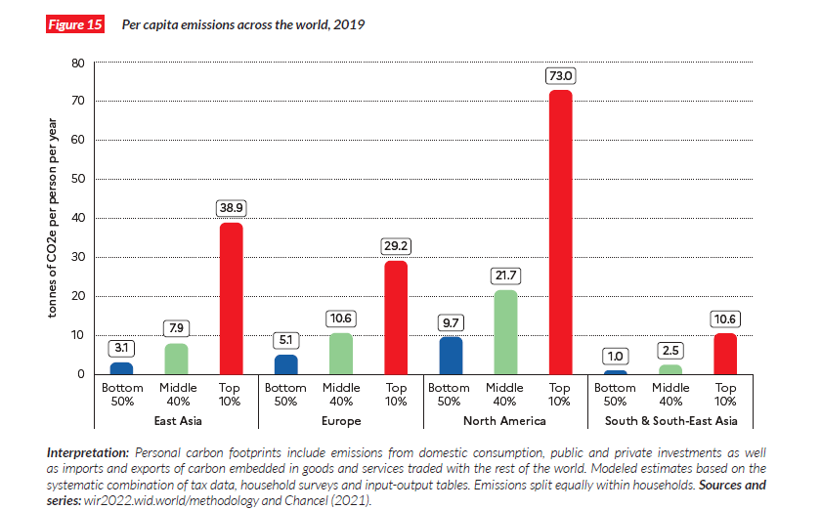
Increasing
Inequalities

Slide 5
Universal Basic Income
Regular payment from the government
For every citizen, irrespective of their income, wealth, or working condition.
Equal to the minimum amount of money required to live in a certain society
Theory
Reduction of inequality, prevent poverty traps due to poor education, increases bargaining power of labor force, redistribution of paid work, support for care work, increased participation in political and communitarian life, enabling frugal lifestyles, breaks the link between growth and economic security, increases acceptability of climate policies
Practice
Poverty alleviation, redistribution of income, emancipatory effect for minorities, disabled and women, enables longer education and trying new jobs, health benefits, life satisfaction, decreased child and elderly labour
Not enough to increase employability, nor to reduce carbon footprint

Slide 6
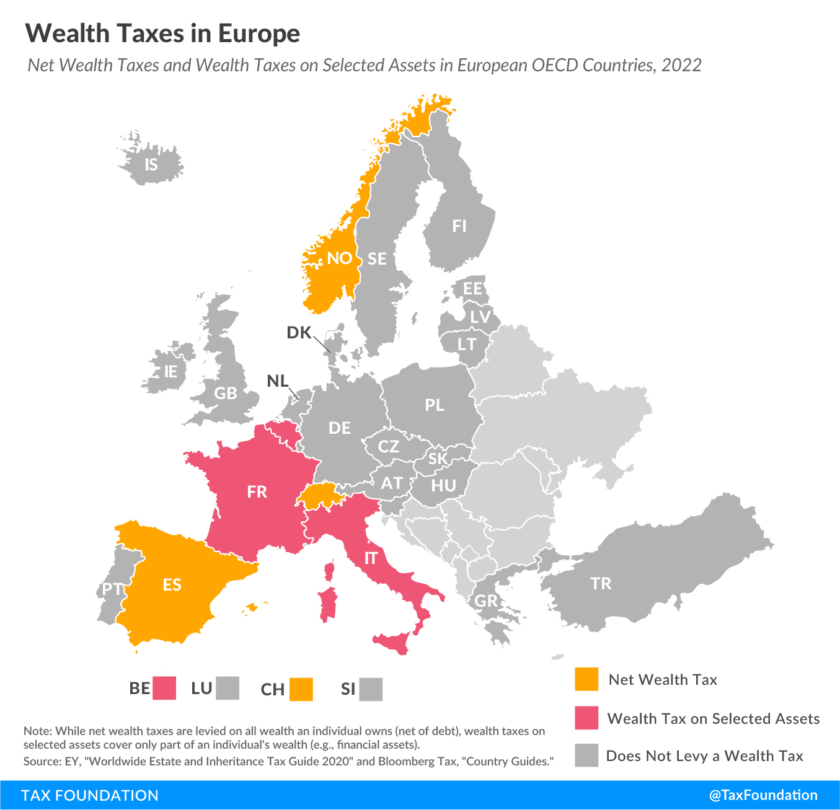

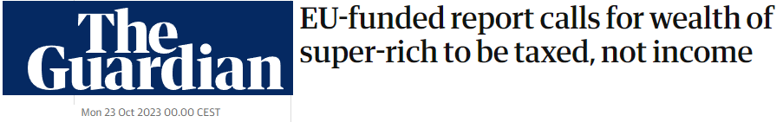
Wealth Tax
Reduction of inequality
Limited effect on carbon footprint

Slide 7
Carbon Tax
Notes:
Another option to pay for the UBI is a tax on carbon. Previous studies show that countries with higher carbon taxes tend to be less carbon intensive, as we see in these two graphs from the OECD.
In the X axis is the carbon price, and in the Y is the emissions intensity (per dollar), each point is a country.
So, we see that both for road emissions (in the right) and for non-road emissions (in the left), the larger the price on carbon emissions, the lower the carbon intensity of the economy

Slide 8
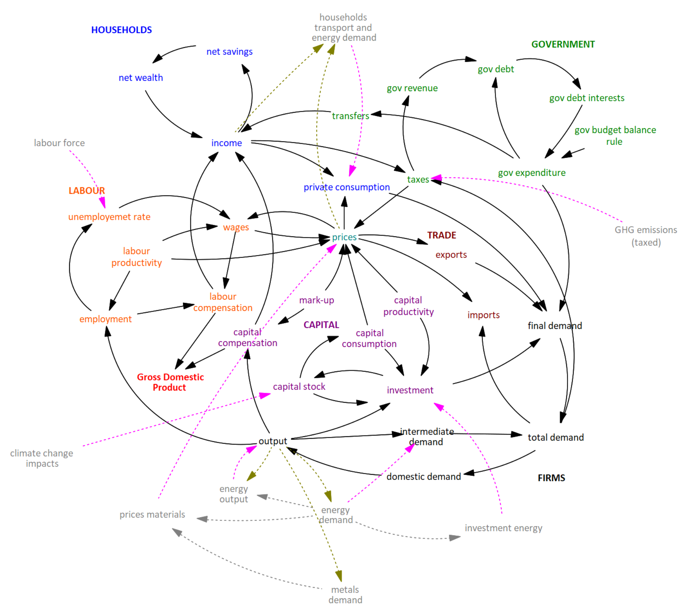
02
Methodology
WILIAM Within Limits Integrated Assessment Model
Simulate a UBI in 21 European countries from 2025 – 2050
Different sources of funding: wealth tax and carbon tax
Notes:
So, with these ideas in mind, what we did was to use the Within Limits Integrated Assessment Model (WILIAM for friends) to simulate a UBI in Europe from 2025 – 2050 with different sources of funding: a wealth tax and a carbon tax

Slide 9
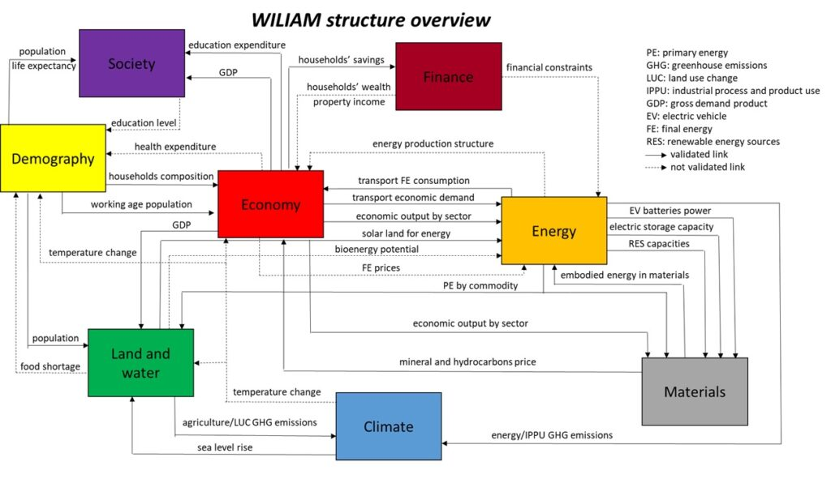
Within limits Integrated Assessment Model
  Understanding the relations between economic activity and climate change, resources use, inequality, and supporting the design of alternative futures to cope with challenges
  Analysing the economy-wide implications of sustainable policies and scenarios at country, sector and household level
  Representing alternative storylines (green-growth, post/beyond/de-growth,…) and policies
  Captures energy ↔ economy ↔ materials/climate interactions
Notes:
The WILIAM model is based on the MEDEAS model, and was developed thanks to an EU-funded project called LOCOMOTION.
It is a Systems Dynamics model with different modules, as you see in the right (economy, climate, materials, energy, etc…), with a global scope, and a disaggregation of big regions, as you see from the colours in the map.
Certain parts of the model are disaggregated for the country level, like it is the case of the Economy for the European countries, that we use in this particular exercise
Capturing the feedbacks between economy and nature
Demand/supply of resources (materials, energy, land and water)
Impacts of climate change

Slide 10
WILIAM Economic Module
Dynamic econometric Multi-regional Input-Output model extended by endogenous final demand and by mutual feedbacks between quantities and prices
Simulation model: agents do not optimize, results are not necessary optimal micro/macro level
Economic growth is driven by demand
  exogenous capital and labor productivity, and liquidity constraints
  endogenous energy intensity, labor force and resources availability
Markets are not generally cleared by the price mechanism
Effective demand under supply constraints (labor, resources) determines the output for the different industries and countries
Usually be spare production capacity available (involuntary unemployment)
Notes:
There is no guarantee that all available capital and labor resources will be used and there will usually be spare production capacity available (involuntary unemployment)
The features that are special from WILIAM are the following:
First, it has more detail in the economic module than similar IAM: with different types of households for the EU countries (distinguishing by income level, rural and urban, gender, etc.), with 62 different economic sectors, etc…
The economic growth is not exogenous, but depends on different factors, like exogenous factor productivities and liquidity constraints, and endogenous energy intensities, labour force and resource availability
This means that economic growth is somehow restricted by the availability of the different production factors, and it is also impacted by climate change
Also, renewables are more realistically represented than in other models, with restrictions of land, efficiency, etc…
To sum up, following the philosophy of MEDEAS, WILIAM tries to incorporate certain limiting biophysical, technological and economic factors, that are not normally introduced in this type of models. And that is why it is called “Within Limits IAM”

Slide 11
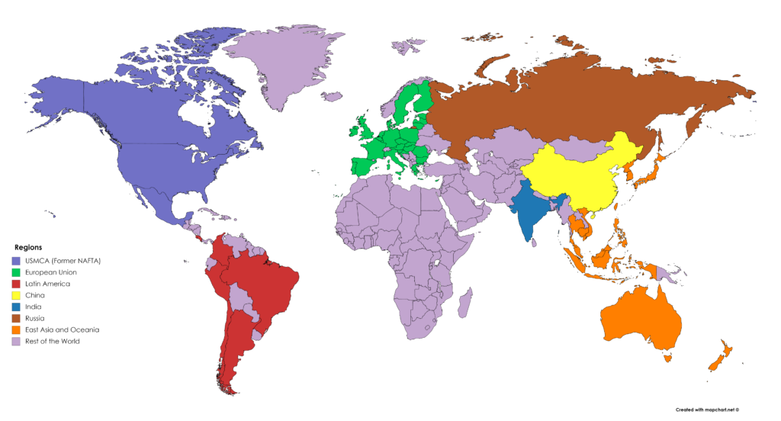
WILIAM Economic Module
Interregional Input Output
62 Industries
Multi-household modelling
approach for EU
Economy ↔ Demographic Modules
60 household typologies in most EU regions
type: single, couple, single + children, couple + children, other, other + children
urban x rural
income quintile
WILIAM is one of the existing IAMs with the highest level of household heterogeneity
Fundamental to study inequality and its interrelationships with climate change.
Notes:
There is no guarantee that all available capital and labor resources will be used and there will usually be spare production capacity available (involuntary unemployment)
The features that are special from WILIAM are the following:
First, it has more detail in the economic module than similar IAM: with different types of households for the EU countries (distinguishing by income level, rural and urban, gender, etc.), with 62 different economic sectors, etc…
The economic growth is not exogenous, but depends on different factors, like exogenous factor productivities and liquidity constraints, and endogenous energy intensities, labour force and resource availability
This means that economic growth is somehow restricted by the availability of the different production factors, and it is also impacted by climate change
Also, renewables are more realistically represented than in other models, with restrictions of land, efficiency, etc…
To sum up, following the philosophy of MEDEAS, WILIAM tries to incorporate certain limiting biophysical, technological and economic factors, that are not normally introduced in this type of models. And that is why it is called “Within Limits IAM”

Slide 12
Regions with Disaggregated Households
Notes:
We run different scenarios.
The Baseline, that serves to make comparisons with the policy scenarios represents the BAU following historical trends.
Then we run policy scenarios for the 21 European countries for which we have detailed information of households, so we can see the impacts on income inequality
The first policy scenario combines the UBI with the Wealth tax
The UBI consists on 10% of the annual per capita disposable income distributed to households proportional to the number of people in each household
This program would cost between 4% and 7% of the GDP of countries (similar to health or education expenditures)
So, then we collect the money from the financial assets of the 2 richest quintiles of the population at a rate so that we can pay for the UBI: this is between 1-5% (lower than those recommended to reduce wealth concentration)
In the second scenario, we introduce a carbon tax growing from 50 to 250 dollars per tonne, and applied to the carbon footprint of households
previous work recomends tax rates around 6-8% to reduce top-end wealth concentration

Slide 13
Main data sources
Merging of different databases and connections between micro and macro variables, resulting in a Multi-Household National Accounts.
Household Budget Survey (HBS). | Data on household consumption expenditure on goods and services in monetary units (for all items) and in physical units (only for food categories in some countries) the COICOP classification and includes different socio-demographic variables of households and individuals
Statistics on Income and Living Conditions (SILC). | Multidimensional cross-sectional data on household income, transfers, taxes, poverty, social exclusion and living conditions. Also, it includes detailed information on the socio-demographic situation of all household members.
Household Finance and Consumption Survey (HFCS). | Provides information on households’ economic behaviour and financial situation through detailed data on assets and liabilities, some variables related to income and consumption, and other household socio-demographic variables
European System of Accounts (National Accounts of the EU countries) | Macro-data on income, consumption and wealth from the National Accounts of the EU countries,
Notes:
We run different scenarios.
The Baseline, that serves to make comparisons with the policy scenarios represents the BAU following historical trends.
Then we run policy scenarios for the 21 European countries for which we have detailed information of households, so we can see the impacts on income inequality
The first policy scenario combines the UBI with the Wealth tax
The UBI consists on 10% of the annual per capita disposable income distributed to households proportional to the number of people in each household
This program would cost between 4% and 7% of the GDP of countries (similar to health or education expenditures)
So, then we collect the money from the financial assets of the 2 richest quintiles of the population at a rate so that we can pay for the UBI: this is between 1-5% (lower than those recommended to reduce wealth concentration)
In the second scenario, we introduce a carbon tax growing from 50 to 250 dollars per tonne, and applied to the carbon footprint of households
previous work recomends tax rates around 6-8% to reduce top-end wealth concentration

Slide 14
Scenarios 2025 – 2050
Represents an interpretation of the continuation of current trends. It is modelled along the lines of the SSP 2 storyline
10% of the annual per capita disposable income of 21 that have detailed data for households.
Transfered to households proportionally to the amount of people
The nominal value updated according to the consumer price index of each country. Represents between 4% and 7% of the GDP of the studied countries
Collected from the financial assets of households in quintiles 4 and 5 of the income distribution.
Rate calculated for the revenue to equal the spending on the UBI deducting the revenue from the carbon tax.
It remains between 1% and 5%.
In line with previous work
Payment proportional to the quantity of CO₂ embedded in household consumption of energy and transport.
Exogenous value linearly increasing in time, from 50 USD per tonne in 2025 to 250 USD per tonne in 2050
Baseline
Universal Basic Income
Wealth tax
Carbon tax
Notes:
We run different scenarios.
The Baseline, that serves to make comparisons with the policy scenarios represents the BAU following historical trends.
Then we run policy scenarios for the 21 European countries for which we have detailed information of households, so we can see the impacts on income inequality
The first policy scenario combines the UBI with the Wealth tax
The UBI consists on 10% of the annual per capita disposable income distributed to households proportional to the number of people in each household
This program would cost between 4% and 7% of the GDP of countries (similar to health or education expenditures)
So, then we collect the money from the financial assets of the 2 richest quintiles of the population at a rate so that we can pay for the UBI: this is between 1-5% (lower than those recommended to reduce wealth concentration)
In the second scenario, we introduce a carbon tax growing from 50 to 250 dollars per tonne, and applied to the carbon footprint of households
previous work recomends tax rates around 6-8% to reduce top-end wealth concentration

Slide 15
03
Results
As expected the UBI reduces income inequality.
However, it also increases consumption.
Without the carbon tax, the UBI produces an increase in emissions
Notes:
We obtain that, as expected the UBI reduces income inequality, but without the carbon tax, it increases emissions because it boosts consumption and economic growth

Slide 16
Inequality
Change w.r.t. the baseline in the Gini Index (average 2025-50)
As expected, the UBI decreases inequality between 2.5 and 5.1 percentage points.
A decrease similar to that experienced recently by various European countries (Czechia, Hungary, France, Cyprus...)
Notes:
Here we have plotted the average across years of the reduction in inequality reached with the UBI in the two policy scenarios compared with the reference.
Also as expected, this decrease is larger when the UBI is completely financed through the wealth tax, because in that case the wealth tax is also larger
The decrease in inequality is between 2 and 5 percentage points, what is in the order of magnitude of observed yearly reductions of income inequality

Slide 17
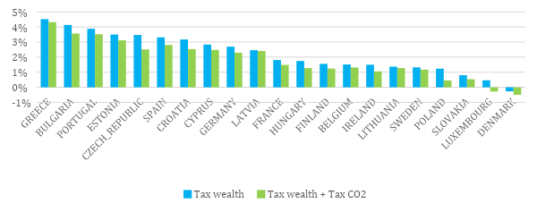
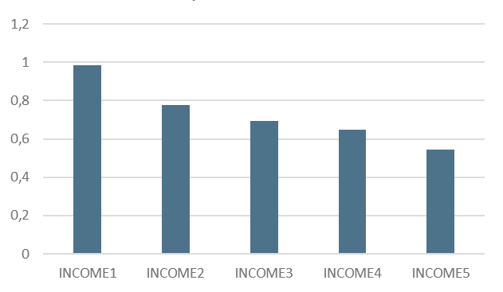
Income and Consumption
Average real households consumption (2025- 2050)
But the UBI also increases disposable income and real households consumption inducing more economic
Average propensity to consume of EU (across households types) by income quintile (year)
Note: Relative change w.r.t. baseline

Slide 18
Carbon Emissions
Cumulative CO₂ emissions (2025-2050)
Without carbon tax, the UBI increases emissions due to its positive effect on consumption. The carbon tax enables to reduce emissions. However, the reduction is not enough for the attainment of climate objectives.
Notes:
All this implies more emissions if the carbon tax is not introduced. Note that when this climate policy is introduced, emissions are reduced despite the faster economic growth, meaning certain degree of decoupling. Nevertheless the reduction in emissions is not in live with the reductions that are necessary to meet the climate objectives.

Slide 19
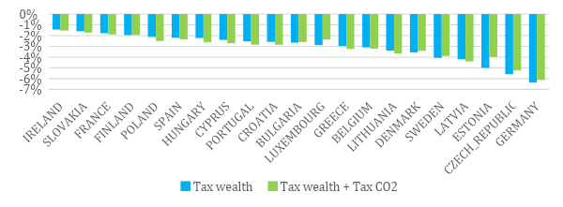
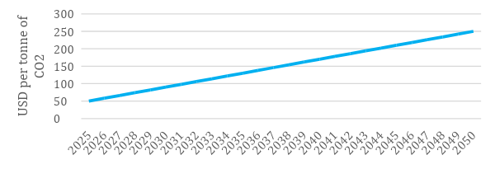
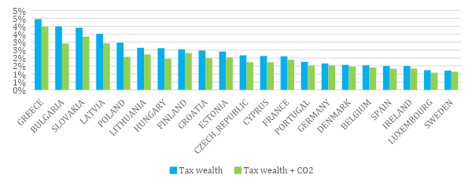
Public Finance
Public debt to GDP ratio (2025 - 2050)
Evolution of the CO2 tax
Average wealth tax rate necessary to finance the BI (2025-2050).

Slide 20



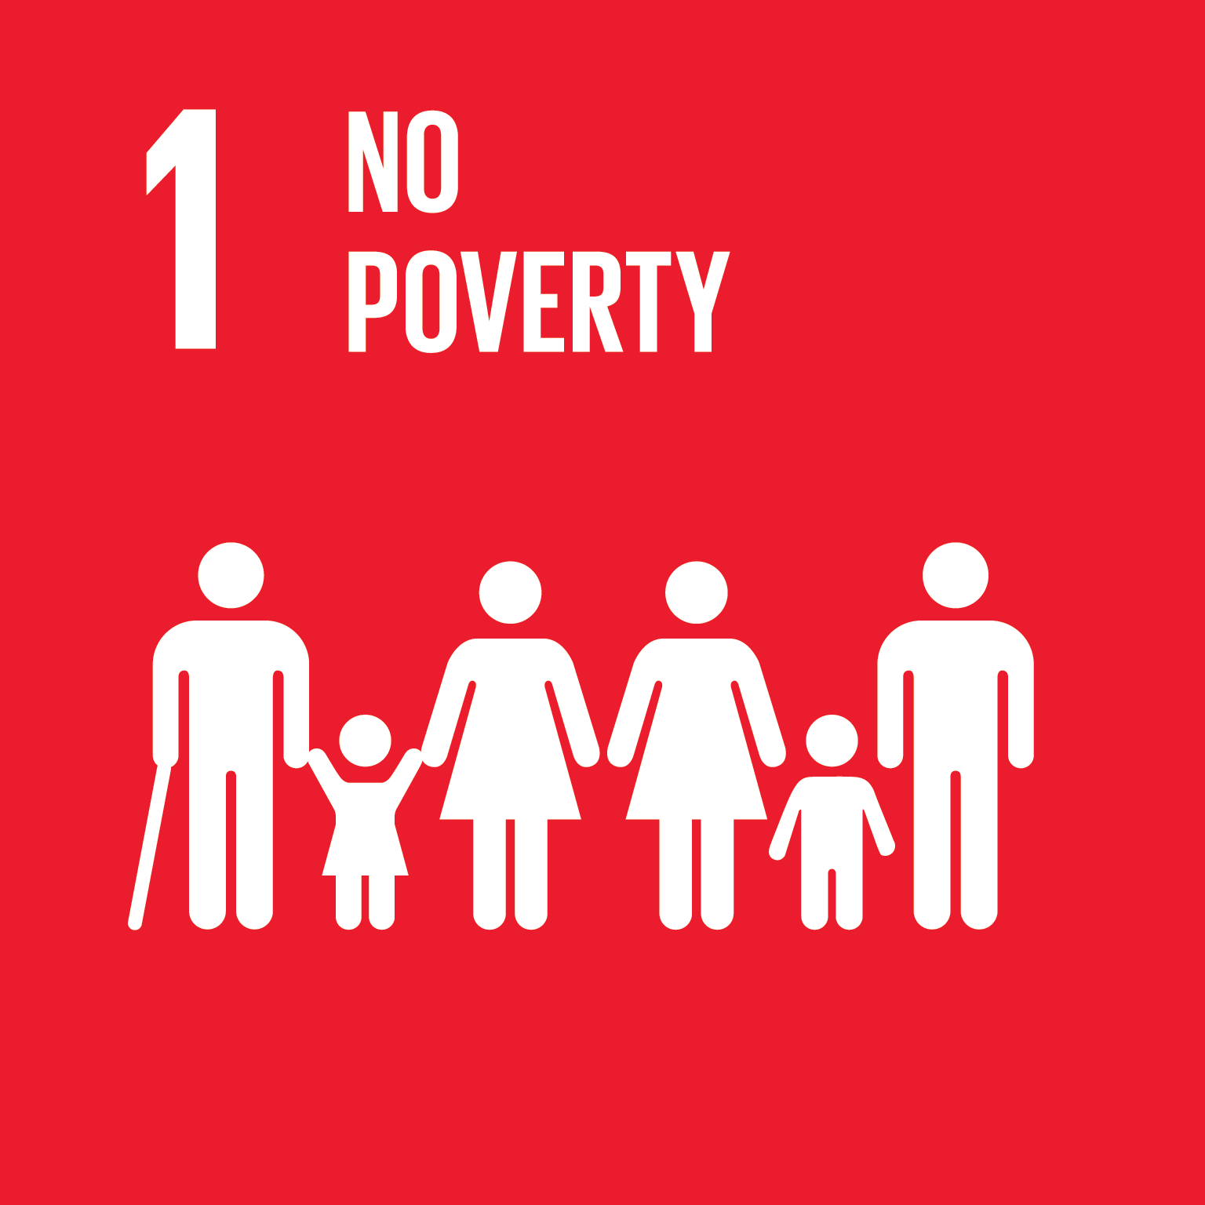

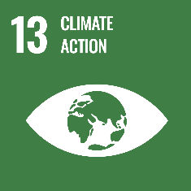
04
Final Remarks
Notes:
We obtain that, as expected the UBI reduces income inequality, but without the carbon tax, it increases emissions because it boosts consumption and economic growth

Slide 21

Main Findings
The policy mix including a carbon tax has better outcomes than the baseline but does not substantially reduce emissions
UBI is feasible.
Public debt-to-GDP ratio falls in the policy scenarios
A redistributed carbon tax reduces emissions but does not lead to absolute decoupling.
UBI reduces inequality.
Income redistribution boosts consumption.
Avoiding the increase in emissions depends on additional green policies.
Notes:
In terms of policy implications, maybe the most relevant ones is that the implementation of the UBI has to consider how to avoid the rebound effect in emissions due to economic growth.
I have chosen three possibilities, but there might be others.
Earmark the money transfer to sufficiency consumption, or substitute by Universal Basic Services (including housing and food)
Combine the UBI with policies to reduce total production: like reducing productivity or working hours
Combine the UBI with a maximum income
For future research it would be interesting to run scenarios that are compatible with current climate goals, like net zero for 2050 in the EU
In this exercise emission continue to grow in all scenarios.. The carbon tax reduces emissions compared to the baseline but emissions continue growing. So absolute decoupling is not achieved

Slide 22
Future research
New results on the impact of carbon tax coming soon.
Explore scenarios with a decrease in final demand through, working time reduction policy.
Universal Basic Services
How to make income distribution compatible with climate targets?
Notes:
In terms of policy implications, maybe the most relevant ones is that the implementation of the UBI has to consider how to avoid the rebound effect in emissions due to economic growth.
I have chosen three possibilities, but there might be others.
Earmark the money transfer to sufficiency consumption, or substitute by Universal Basic Services (including housing and food)
Combine the UBI with policies to reduce total production: like reducing productivity or working hours
Combine the UBI with a maximum income

Slide 23


Thank you!
guilherme.morlin@unipi.it
Further information: Locomotion

