Slide 1

The impact of global productivity on national welfare through global value chains
Wenyin CHENG
Kyoji FUKAO
Bo MENG
(IDE-JETRO, Japan)
July. 2, 2024

Slide 2






Motivation: Welfare benefits from global TFP growth (foreign & domestic)
PC
circuit board
Chips
Trade policy
Technology policy
Notes:
The impact of domestic TFP growth on national welfare has been well-documented.
Yet, the impact of global TFP growth on welfare through the lens of global value chains (GVCs) remains poorly understood.
Here we illustrate how the US. benefits from the TFP growth in China and US.
There are at least three ways in which global TFP affects national welfare
Incorporating all the effects into the welfare analysis is crucial for formulating rational trade and technology policies.

Slide 3
Model based on growth accounting framework
National welfare growth
GDP growth
Terms of trade
GVC TFP
Global TFP
Global factor prices
Country origins: Domestic & foreign
Global TFP
Notes:
we developed a model to explore the TFP-welfare nexus based on growth accounting framework.
As widely noted in the literature, national welfare growth can be decomposed into GDP growth and Terms of trade effect. But how the terms of trade is affected by global TFP remains poorly understood.
To fill the gap, we introduce the new concept of GVC TFP to investigate the components of terms of trade.

Slide 4
Research Objective
Develop a simple yet potent model to explore the TFP-welfare nexus
Simple: growth accounting framework, streamlining the assumptions and parameters needed
Potent: full integration of production networks, slicing up the GVCs in various dimensions.

Slide 5
Contributions
(1) TFP-welfare: we delve into the effects of global TFP growth on national welfare, a topic that has traditionally been explored through the lens of domestic TFP growth (Basu & Fernald, 2002; Petrin & Levinsohn, 2012; Basu et al., 2009, 2022).
(2) unlike quantitative trade models, our model streamlines the assumptions and parameters needed, facilitating the comprehensive integration of production networks.
“Although these (four primitive) assumptions are admittedly restrictive, they are satisfied in many well-known trade models”. (Arkolakis et al., 2012, AER)
“assuming a constant trade elasticity when the true elasticity is variable can lead to substantial quantitative discrepancies between the predicted and true welfare effects.” (Melitz & Redding, 2015, AER)

Slide 6
Contributions
(3) our research advances the understanding of the TOT effect by elucidating its multi-dimensional origins.
v.s. (Diewert & Morrison 1986; Ossa, 2014; Feenstra et al., 2015; Harchaoui & Willemsen, 2017).
(4) our framework enables us to directly assess the global impact of both supply-side policies, such as technology and labor policies, and demand-side policies, especially monetary policies.
v.s. (Lingens, 2007; Lee, 2023)

Slide 7
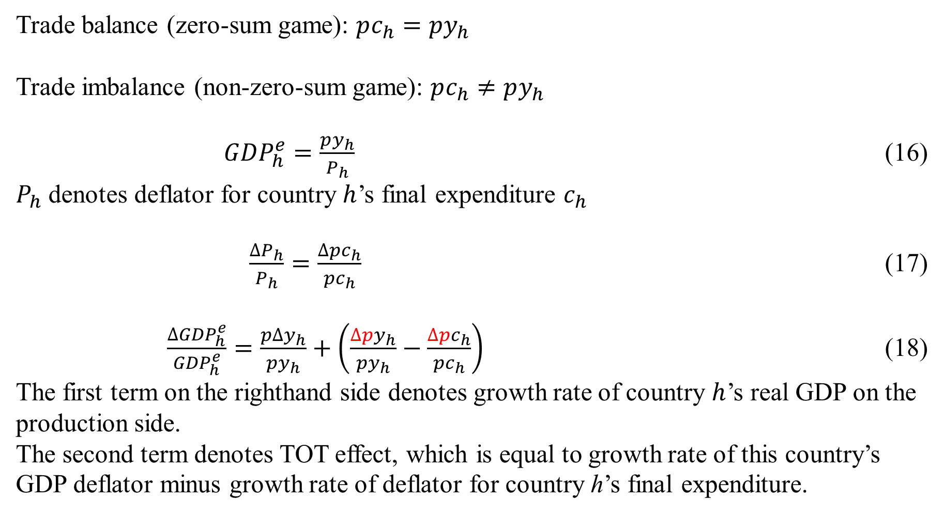
Model
Trade balance (zero-sum game): $pc_{h}=py_{h}$
Trade imbalance (non-zero-sum game): $pc_{h}≠py_{h}$
${GDP}_{h}^{e}=\frac{py_{h}}{P_{h}}$ (16)
$P_{h}$ denotes deflator for country $h$’s final expenditure $c_{h}$
$\frac{∆P_{h}}{P_{h}}=\frac{∆pc_{h}}{pc_{h}}$ (17)
$\frac{∆{GDP}_{h}^{e}}{{GDP}_{h}^{e}}=\frac{p∆y_{h}}{py_{h}}+\left(\frac{∆py_{h}}{py_{h}}−\frac{∆pc_{h}}{pc_{h}}\right)$ (18)
The first term on the righthand side denotes growth rate of country $h$’s real GDP on the production side.
The second term denotes TOT effect, which is equal to growth rate of this country’s GDP deflator minus growth rate of deflator for country h’s final expenditure.

Slide 8
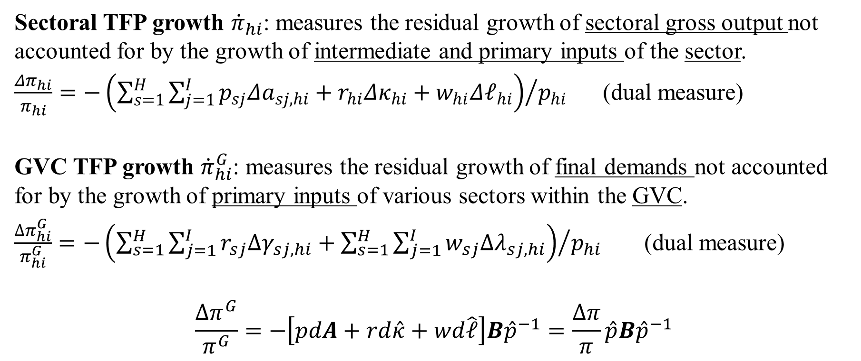
Model
Sectoral TFP growth ${\dot{π}}_{hi}$: measures the residual growth of sectoral gross output not accounted for by the growth of intermediate and primary inputs of the sector.
$\frac{Δπ_{hi}}{π_{hi}}=−{\left(\sum_{s=1}^{H}{\sum_{j=1}^{I}{p_{sj}Δa_{sj,hi}}}+r_{hi}Δκ_{hi}+w_{hi}Δ𝓁_{hi}\right)}/{p_{hi}}$ (dual measure)
GVC TFP growth ${\dot{π}}_{hi}^{G}$: measures the residual growth of final demands not accounted for by the growth of primary inputs of various sectors within the GVC.
$\frac{∆π_{hi}^{G}}{π_{hi}^{G}}=−{\left(\sum_{s=1}^{H}{\sum_{j=1}^{I}{r_{sj}∆γ_{sj,hi}}}+\sum_{s=1}^{H}{\sum_{j=1}^{I}{w_{sj}∆λ_{sj,hi}}}\right)}/{p_{hi}}$ (dual measure)
$$\frac{∆π^{G}}{π^{G}}=−\left[pdA+rd\hat{κ}+wd\hat{𝓁}\right]B{\hat{p}}^{−1}=\frac{Δπ}{π}\hat{p}B{\hat{p}}^{−1}$$

Slide 9
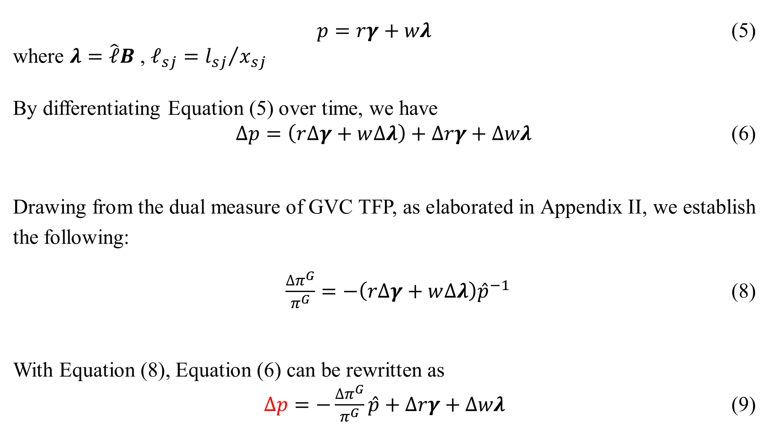
Model
$p=rγ+wλ$ (5)
where $λ=\hat{𝓁}B$ , $𝓁_{sj}={l_{sj}}/{x_{sj}}$
By differentiating Equation (5) over time, we have
$∆p=\left(r∆γ+w∆λ\right)+∆rγ+∆wλ$ (6)
Drawing from the dual measure of GVC TFP, as elaborated in Appendix II, we establish the following:
$\frac{∆π^{G}}{π^{G}}=−\left(r∆γ+w∆λ\right){\hat{p}}^{−1}$ (8)
With Equation (8), Equation (6) can be rewritten as
$∆p=−\frac{∆π^{G}}{π^{G}}\hat{p}+∆rγ+∆wλ$ (9)

Slide 10
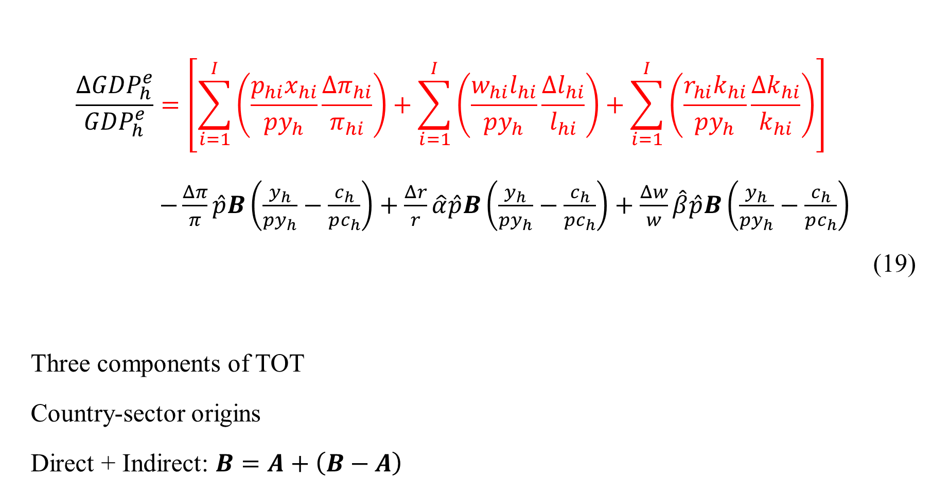
Model
$$\frac{∆{GDP}_{h}^{e}}{{GDP}_{h}^{e}}=\left[\sum_{i=1}^{I}{\left(\frac{p_{hi}x_{hi}}{py_{h}}\frac{Δπ_{hi}}{π_{hi}}\right)}+\sum_{i=1}^{I}{\left(\frac{w_{hi}l_{hi}}{py_{h}}\frac{Δl_{hi}}{l_{hi}}\right)}+\sum_{i=1}^{I}{\left(\frac{r_{hi}k_{hi}}{py_{h}}\frac{Δk_{hi}}{k_{hi}}\right)}\right]$$
$−\frac{Δπ}{π}\hat{p}B\left(\frac{y_{h}}{py_{h}}−\frac{c_{h}}{pc_{h}}\right)+\frac{Δr}{r}\hat{α}\hat{p}B\left(\frac{y_{h}}{py_{h}}−\frac{c_{h}}{pc_{h}}\right)+\frac{Δw}{w}\hat{β}\hat{p}B\left(\frac{y_{h}}{py_{h}}−\frac{c_{h}}{pc_{h}}\right)$
(19)
Three components of TOT
Country-sector origins
Direct + Indirect: $B=A+\left(B−A\right)$

Slide 11
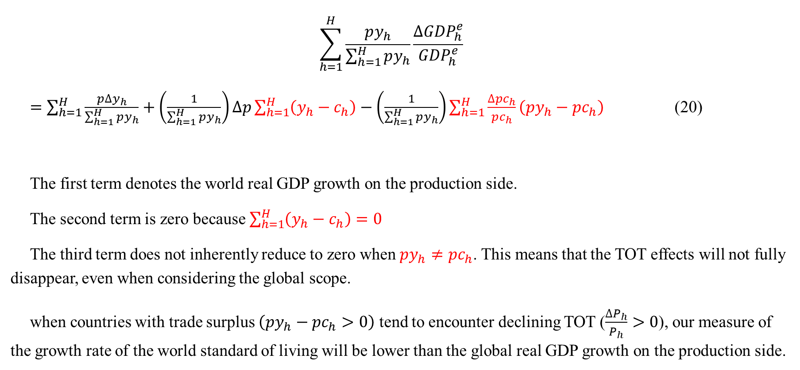
Non-zero-sum game
$$\sum_{h=1}^{H}{\frac{py_{h}}{\sum_{h=1}^{H}{py_{h}}}\frac{∆{GDP}_{h}^{e}}{{GDP}_{h}^{e}}}$$
$=\sum_{h=1}^{H}{\frac{p∆y_{h}}{\sum_{h=1}^{H}{py_{h}}}}+\left(\frac{1}{\sum_{h=1}^{H}{py_{h}}}\right)∆p\sum_{h=1}^{H}{\left(y_{h}−c_{h}\right)}−\left(\frac{1}{\sum_{h=1}^{H}{py_{h}}}\right)\sum_{h=1}^{H}{\frac{∆pc_{h}}{pc_{h}}\left(py_{h}−pc_{h}\right) }$ (20)
The first term denotes the world real GDP growth on the production side.
The second term is zero because $\sum_{h=1}^{H}{\left(y_{h}−c_{h}\right)}=0$
The third term does not inherently reduce to zero when $py_{h}≠pc_{h}$. This means that the TOT effects will not fully disappear, even when considering the global scope.
when countries with trade surplus $\left(py_{h}−pc_{h}>0\right)$ tend to encounter declining TOT ($\frac{∆P_{h}}{P_{h}}>0$), our measure of the growth rate of the world standard of living will be lower than the global real GDP growth on the production side.

Slide 12
Data
We used the WIOD, which covers 56 sectors in 44 countries ranging from 2000 to 2014. It includes the world input–output tables (WIOTs) and social economic accounts (SEAs) , and thus allows the calculation of GVC and TFP.
Limitation of data:
We are uncertain about the extent to which the price data within the WIOD accurately captures quality change of output.

Slide 13
Our estimates v.s. PWT v.s. WDI: GDP effect

Slide 14
Our estimates v.s. PWT: TOT effect
Notes:
Our estimates of the GDP effect and the TOT effect, derived from the WIOD, closely correspond with the results obtained from the PWT.
The TOT effect in China significantly surpasses that in the U.S during the period from 2001 to 2014. However, the trend in China exhibits an inverted U shape, while the U.S. trend demonstrates a U shape, with both patterns pivoting around the 2008 financial crisis as a turning point.

Slide 15
Empirical Evidence
Notes:
From 2001 to 2014, China and India experienced remarkable welfare growth, surpassing that of three developed countries (the U.S., Japan, Germany). However, post-financial crisis, welfare growth in developing countries saw a decline, in contrast to the resilience shown by developed countries, except Japan. The primary drivers of welfare changes were found to be GDP growth, as opposed to the TOT effect.

Slide 16
Empirical Evidence
Notes:
The TOT effect resulting from global TFP changes is positive for the U.S., but negative for China.
In contrast, the TOT effect resulting from global wage growth is positive for China, but negative for the U.S..

Slide 17
Welfare benefits from foreign TFP growth
TOT effect (-)
Trade curse?
Wage effect (-)
TFP effect (+)
Global wage effect (+)
Global wage effect (-)
Why differ?
Reason: China’s wage growth is much faster than that in the U.S.
Global TFP effect (-)
Global TFP effect (+)
Reason: China’s TFP growth is much faster than from imported goods.

Slide 18
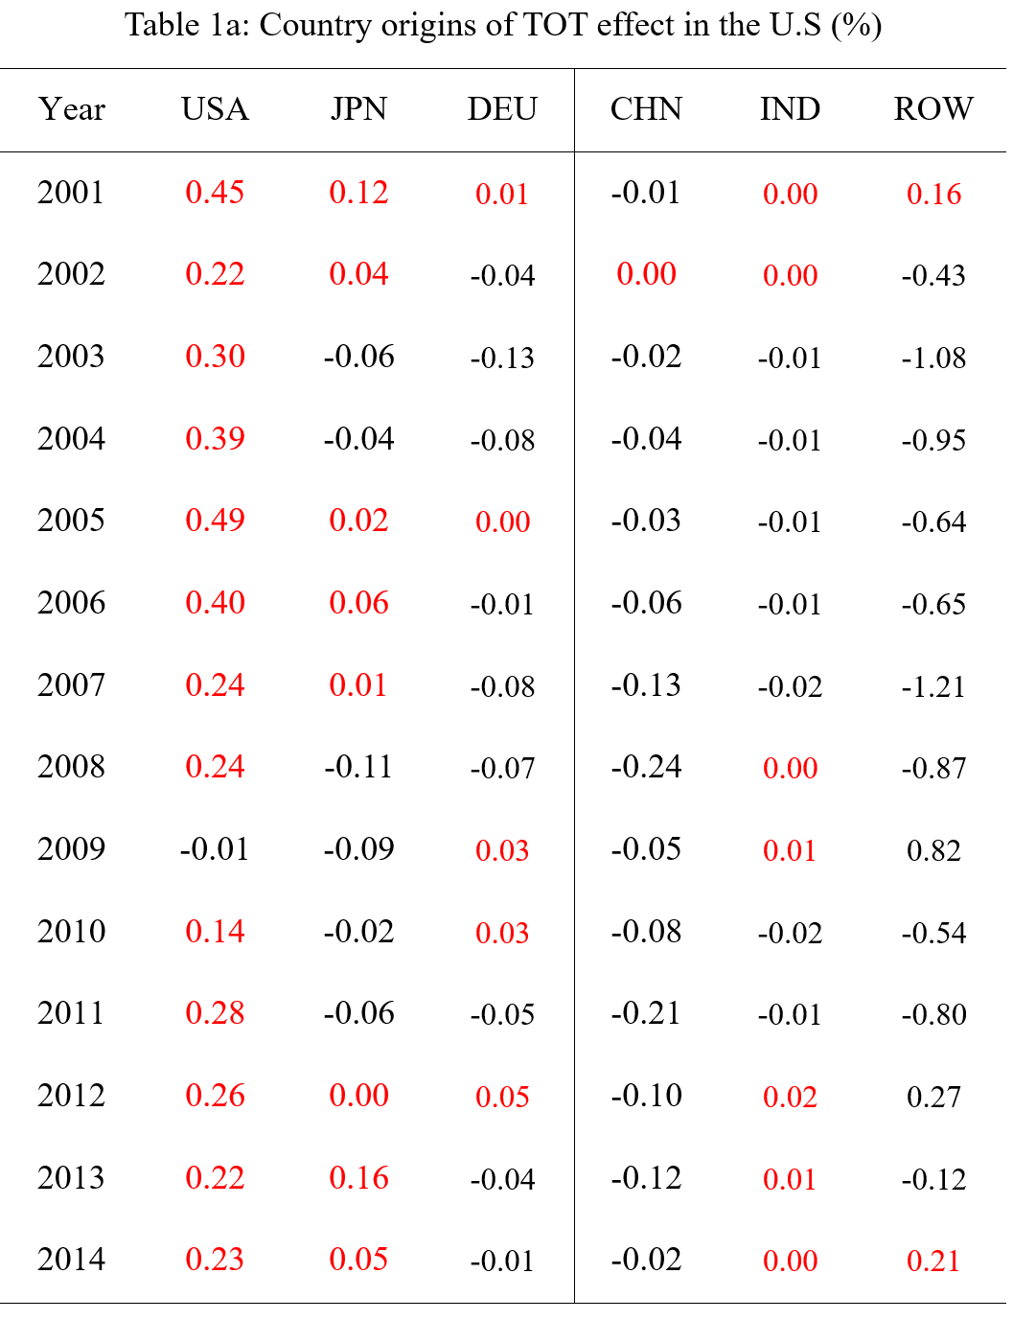
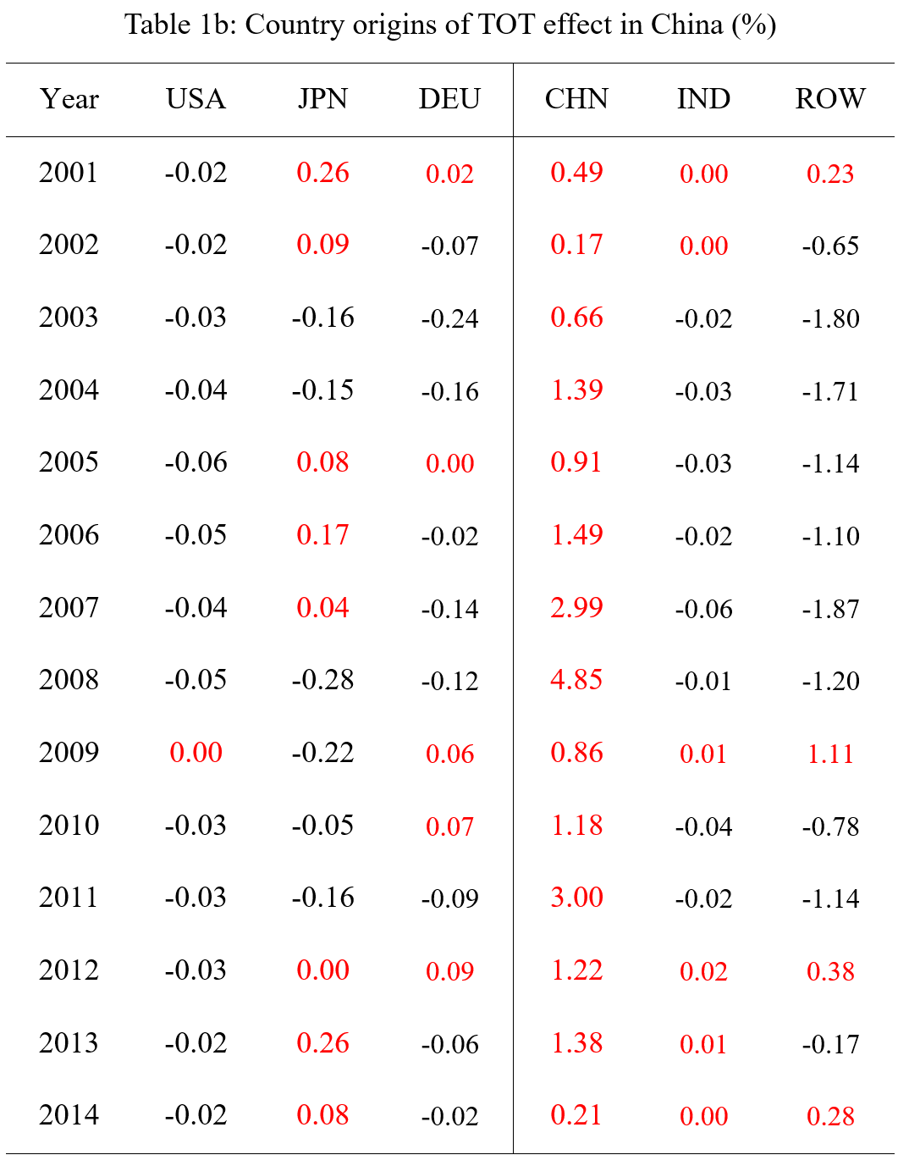
Country origins of TOT
Notes:
Both China and the U.S. experience negative TOT effects towards each other.

Slide 19
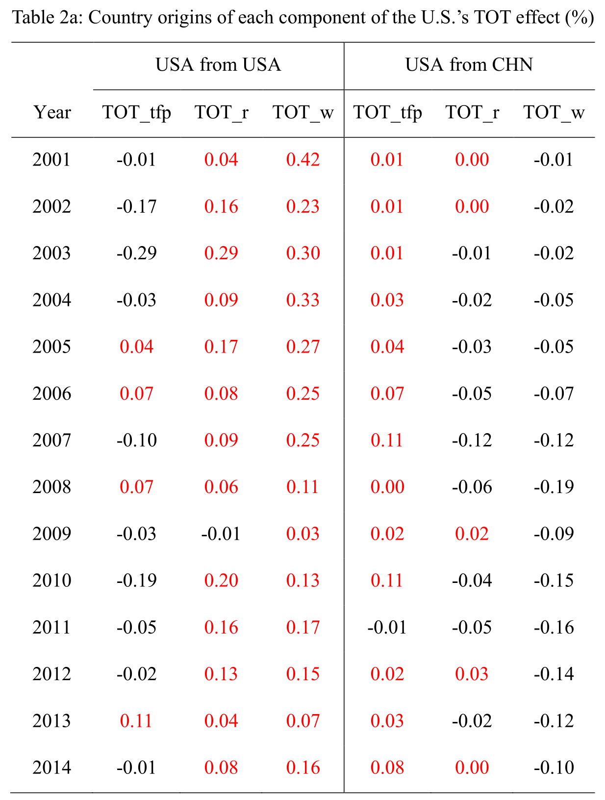
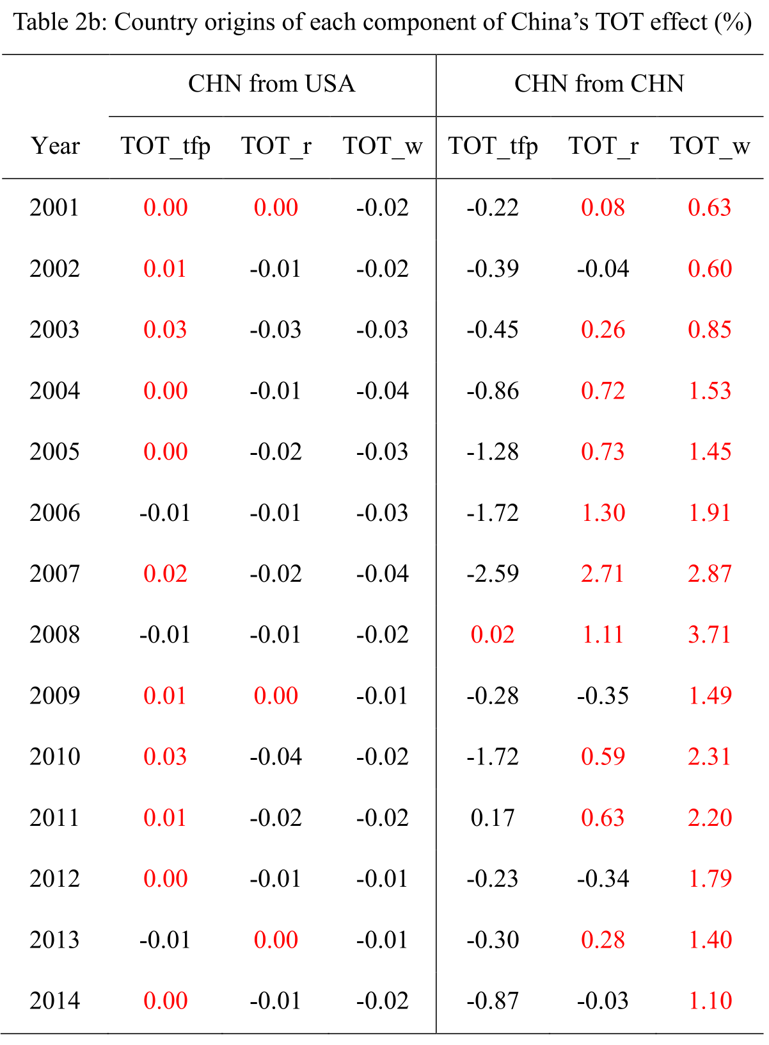
Country origins of TOT components
Notes:
The negative TOT effects towards each other primarily results from increasing factor prices, notably wages, in the other economy. However, both nations benefit from positive TOT effects stemming from TFP growth within each other's economies. This underscores the importance of foreign TFP growth in enhancing welfare.
The adverse TOT effect observed in China due to global TFP changes is primarily attributed to China's own TFP growth during the sample period. This TFP growth in China results in reduced costs for U.S. imports from China, thereby contributing to an increase in welfare growth in the U.S. In addition, the positive TOT effect in China resulting from global wage change primarily stems from China's wage growth during the sample period. This wage growth in China leads to increased costs for U.S. imports from China, consequently diminishing the welfare growth in the U.S.

Slide 20
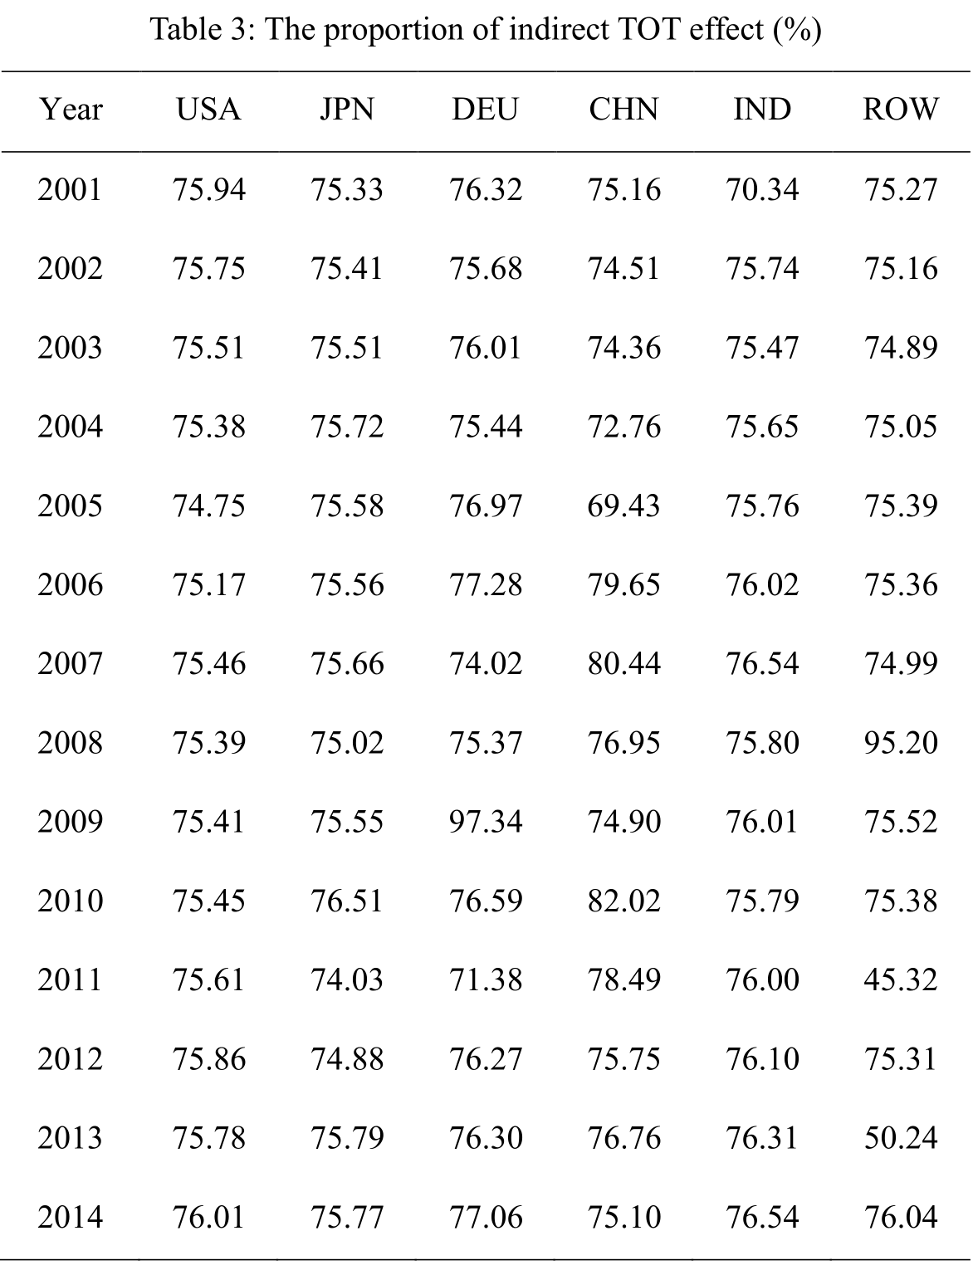
Findings
Notes:
The distinction between direct and indirect input-output relationships plays a significant role in shaping trade policies and, therefore, must be taken into account when analyzing the TOT effect. The signs of both direct and indirect TOT effects align, with the indirect TOT effect contributing to approximately 75% of the total TOT impact. The substantial contribution, along with the possible stronger resilience, of indirect input-output relationships underscores the necessity of assessing potential welfare gains and losses, with a particular focus on the indirect TOT effect, before proceeding with the implementation of trade restrictions, such as the introduction of higher tariffs.

Slide 21
Conclusions
Leveraging the concept of GVC TFP, we gain the ability to fully integrate the input-output relationships into the productivity-welfare nexus. Furthermore,
to break down the TOT effect into three primary components: global TFP growth, global wage growth, and global capital price growth. Through delving deep into the components of the TOT effect, we can reveal some novel insights.
to further pinpoint the specific country origins of the three TOT effect components; By investigating the country-specific origins of the TOT effect, we can thoroughly comprehend findings that are initially challenging to understand.
to differentiate between the direct and indirect TOT effects. The distinction between direct and indirect input-output relationships plays a significant role in shaping trade policies and, therefore, must be taken into account when analyzing the TOT effect.

Slide 22
Future Research
Addressing the endogeneity of factor prices by introducing general equilibrium model.
Considering the quality of factors and products, such as working hours and education levels;
Transitioning from a static framework to a dynamic analysis by including the capital accumulation.

Slide 23

Thanks for your kind attention!
Comments are very welcome!

Slide 24
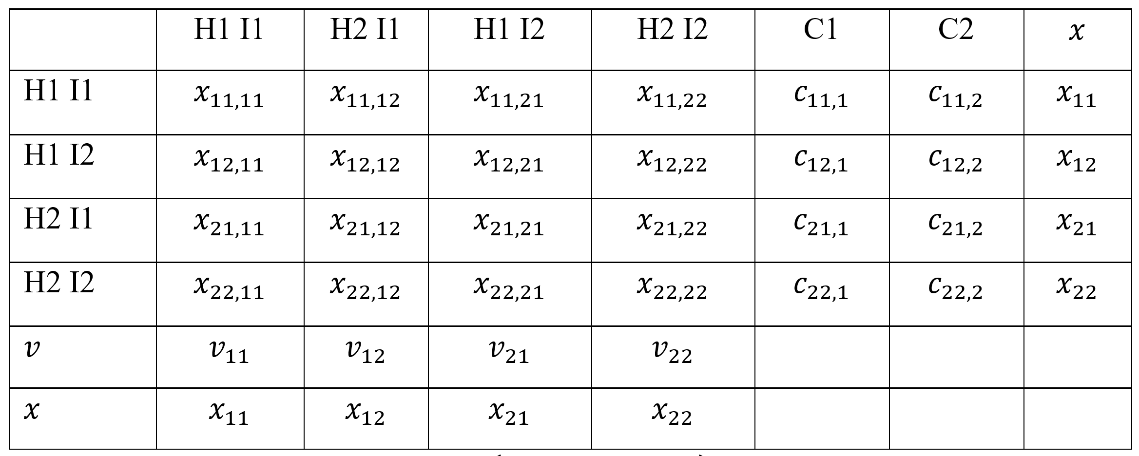
Notes

Slide 25
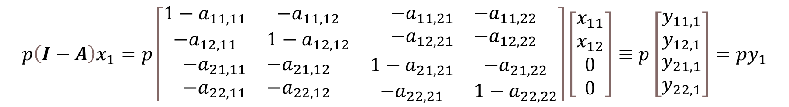
Notes
$$p\left(I−A\right)x_{1}=p\left[\begin{matrix}\begin{matrix}1−a_{11,11} & −a_{11,12} \\ −a_{12,11} & 1−a_{12,12}\end{matrix} & \begin{matrix}−a_{11,21} & −a_{11,22} \\ −a_{12,21} & −a_{12,22}\end{matrix} \\ \begin{matrix}−a_{21,11} & −a_{21,12} \\ −a_{22,11} & −a_{22,12}\end{matrix} & \begin{matrix}1−a_{21,21} & −a_{21,22} \\ −a_{22,21} & 1−a_{22,22}\end{matrix}\end{matrix}\right]\left[\begin{matrix}x_{11} \\ x_{12} \\ \begin{matrix}0 \\ 0\end{matrix}\end{matrix}\right]≡p\left[\begin{matrix}y_{11,1} \\ y_{12,1} \\ \begin{matrix}y_{21,1} \\ y_{22,1}\end{matrix}\end{matrix}\right]=py_{1}$$

