Slide 1
Agenda
1. Motivation
2. Description of the Model
3. Model Evaluation
4. Application of the Model (If time)

Slide 2
Aim: Development of an empirical Ecological Stock-Flow-Consistent Input-Output model for Denmark
GreenREFORM- Energy/Environmental CGE model for the Danish economy.
Used by the Danish ministry (Svarer et al. 2024).
Calibrated on data from 2014-2016 and forecasts in 2030.
EESFC-IO- Empirical Ecological Stock-Flow-Consistent Input-Output model for the Danish economy.
Estimated on data from 1995-2019 (soon 2020/2023)
Demand-driven.
Introduces the financial sector.

Slide 3
Overview of the model
6 Sectors: Households, Non-Financial Corporations, Financial Corporations, Government, Rest Of the World, and an Environmental sector.
9 Industries: Agricultural/Forestry/Fishery, Mining, Manufacturing of meat products, Manufacturing of dairy products, Manufacturing of bread products, Manufacturing of other food products, Energy supply industry, High Co2E intensive industries, and Other industries. (Dynamic)
7 final consumption goods: Bread, Meat, Fish, Dairy, Fruit and vegetables, other food, and other consumption products.
21 types of Energy: See Appendix.
6 types of emission: Carbon dioxide (Co2), Nitrous oxide (N2O), Methane (CH4), Sulphur hexafluoride (SF6), Perfluorocarbons (PFC), Hydrofluorocarbons (HFC).
Used to calculate Co2E emissions.
8 types of financial assets: Gold, Deposits, Securities, Loans, Equities, Insurance, Financial derivatives, and Trade credits.

Slide 4
Overview of the model

Slide 5
The IO set up: Price deflators
Producer prices: $px_{t}^{n}=\left(1+Mark up\right)∗\frac{COSTS_{t}^{n}}{sales_{t}^{n}}$
Consumer prices: $pc_{t}^{p}=Weighted average of producer prices ∗(1+tax rate)$

Slide 6
The model set-up: Final demand
Endogenous:
- Consumption in real values: $c_{t}^{tot}=f(Disposable income, Financial net wealth)$ - Investments in real values: ${inv}_{t}^{tot}=f(Capacity utilization rate, Profit share)$ - Exports in real values: ${ex}_{t}^{n}=f(Real exchange rate, World imports)$

Slide 7
The model set-up: Supply & total sales
Total sales (Real value): ${sales}_{t}^{n}=Domestically produced inputs+Final demand for domestic products$
Technical coefficients: $a_{t}^{in}=\frac{z_{t}^{in}}{Sales_{t}^{n}}$

Slide 8
The IO setup: Value added
Total sales (Nominal): ${SALES}_{t}^{n}=\left(Domestically produced inputs+Final demand for domestic products\right)∗px_{t}^{n}$
Gross operating surplus: $B2_{t}^{n}={SALES}_{t}^{n}−{COSTS}_{t}^{n}$

Slide 9
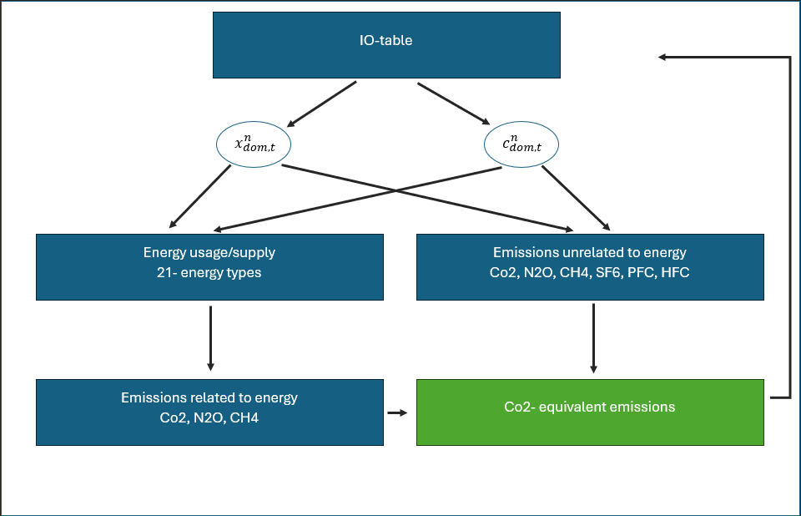
The environmental block
Energy coefficients
$D_{n,t}^{ENERGY^{use}}=\frac{ENERGY_{n,t}^{use}}{{sales}_{t}^{n}}$ $D_{n,t}^{ENERGY^{sup}}=\frac{ENERGY_{n,t}^{sup}}{{sales}_{t}^{n}}$
Emissions coefficients
$$EMISSION_{coef_{n}}^{ENERGY}=\frac{EMISSION_{n}^{ENERGY}}{ENERGY_{n}^{use}}$$
$$EMISSION_{coef_{n}}^{UnENERGY}=\frac{EMISSION_{n}^{UnENERGY}}{x_{dom,t}^{n}}$$
Environmental taxes
$$ENV_{tax,t}^{n}=θ_{t}^{n}∗Co2E_{t}^{n}$$

Slide 10
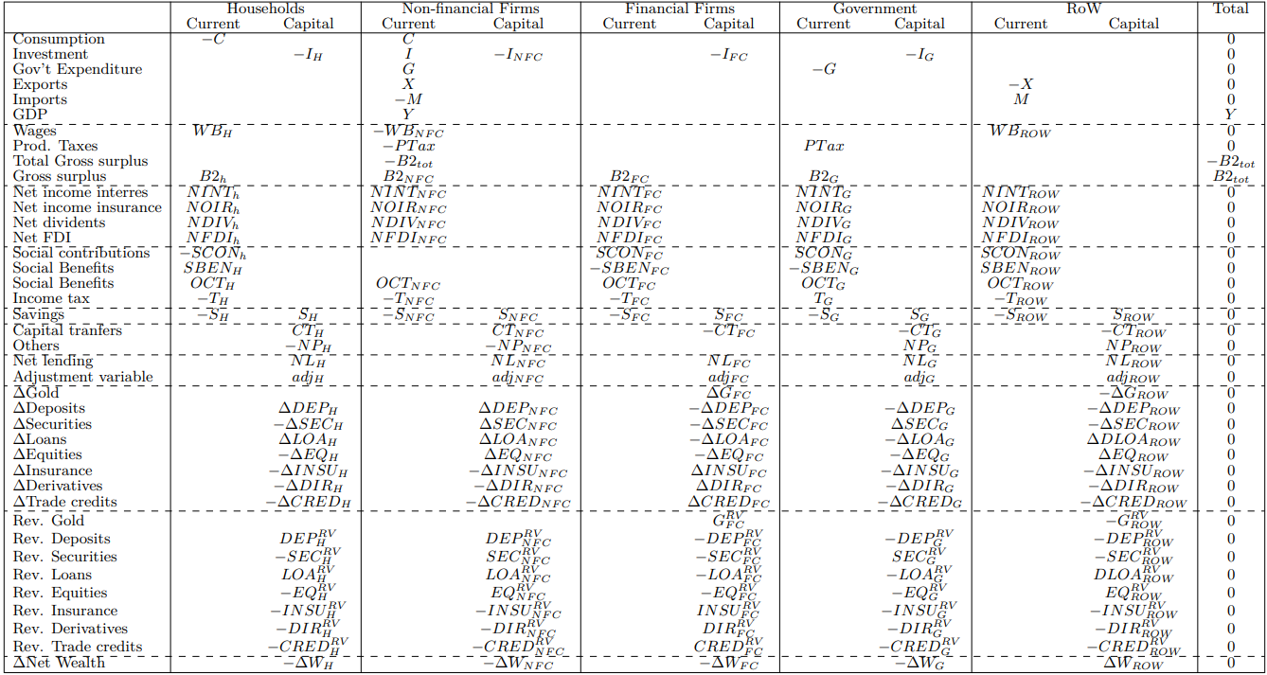
The Stock-Flow-Consistent block

Slide 11
Model evaluation: Aggregate variables

Slide 12
Application

Slide 13
Application: Motivation
The Svarer-report 2024
Expert-group founded by the Danish parliament.
How do Denmark most efficiently reach the 2030 climate goals.
Conclusion: Co2E-tax on agricultural production (Unrelated to energy usage)
Evaluation of a Co2E-tax on final consumption. (requested by the Danish parliament)
Not included in the simulations presented by the Expert-group.
Production tax (pros): 1.) Effect on exports. 2.) Incentivize climate-friendly technologies
Consumption tax (pros): 1.) Negative carbon leakage. 2.) Financial stability.

Slide 14
Application: Tax on consumption vs. Production.
Scenario 1: Consumption tax on household consumption.
Consumption tax on Meat and Dairy products.
Consumers pay 750 DKK (107 USD) pr ton Co2E emitted.
Co2E-intensities from Svarer et al. (2024).
Scenario 2: Production tax in the Agricultural industry.
Agriculture pays 370 DKK (53 USD) pr ton Co2E emitted (non-energy related).
All environmental taxes on energy are removed.
In both Scenarios the additional tax-revenue is 2.3 billion DKK (0.33 billion USD)

Slide 15
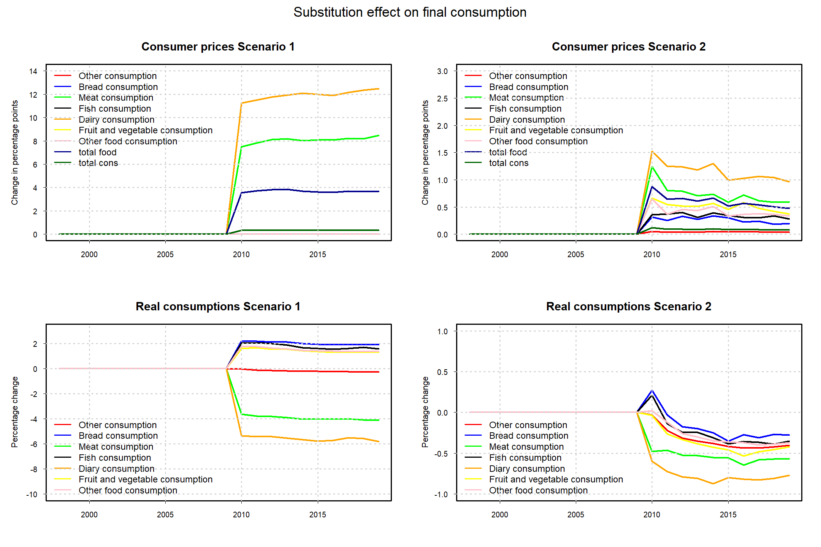
Application: Tax on consumption vs. Production.
Three main effects on consumption:
1.) Wealth/income effect.
2.) Substitution between products.
3.) Substitution between Domestic and imported products.

Slide 16
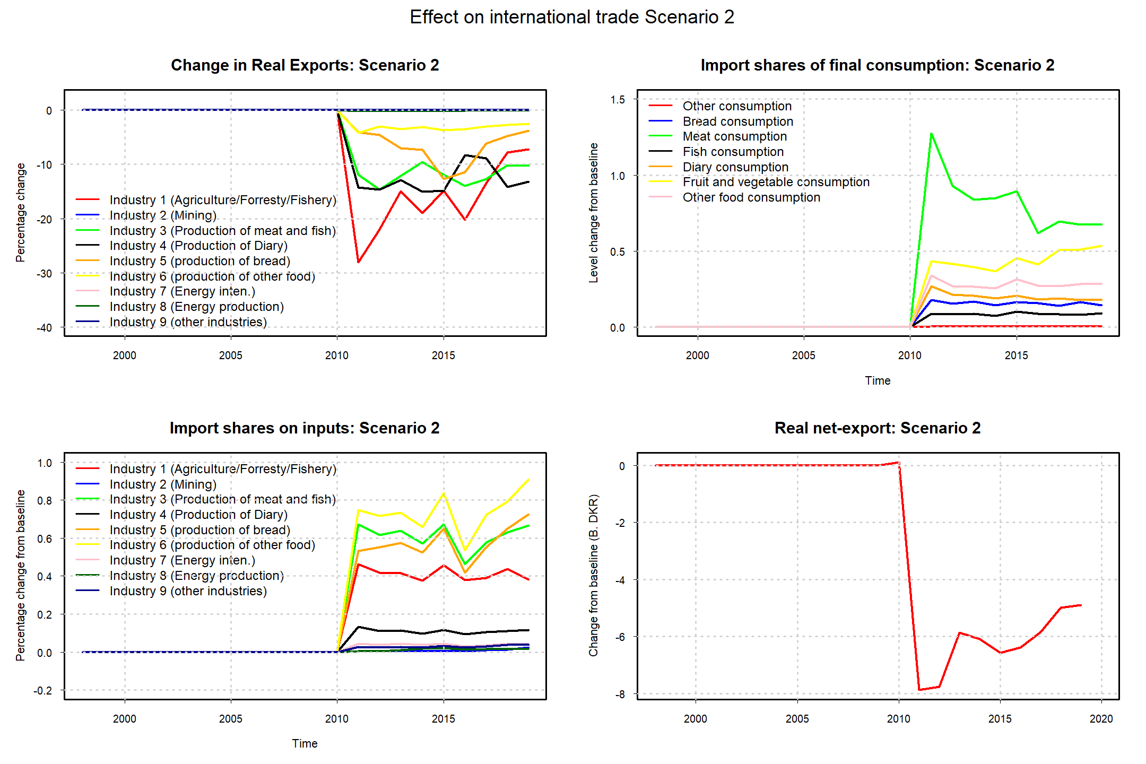
Application: International trade
Production tax: Net-exports falls with 5% in the final period of simulation.
Consumption tax: No direct effect as tax is implemented on both Domestic and imported goods.

Slide 17
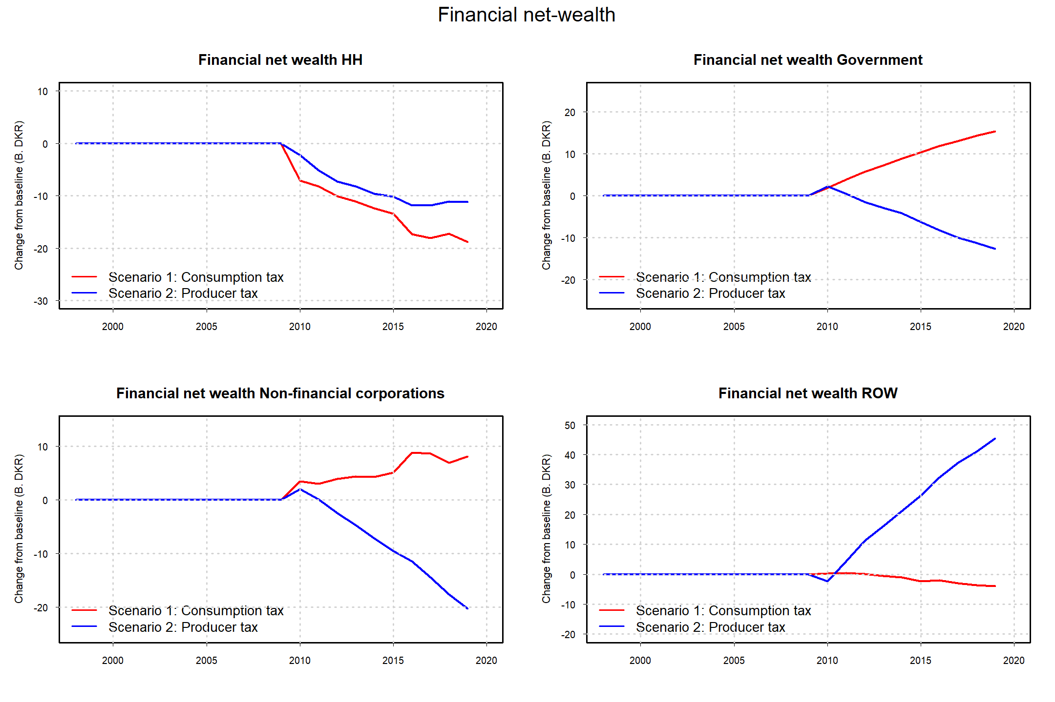
Application: Financial net wealth
Production tax:
Wealth is redistributed away from the regulated country as net exports fall.
Lower economic activity leads to a drop in all domestic sectors.
Consumption tax:
Wealth is distributed from HH to the government sector through the tax-revenue.

Slide 18
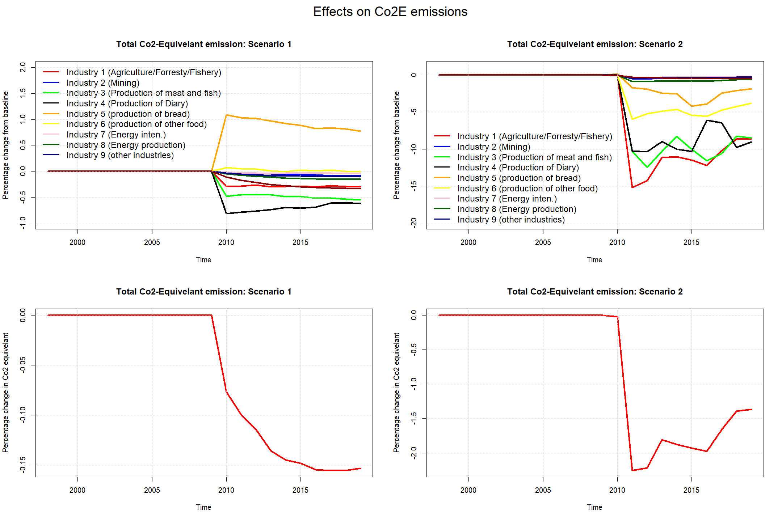
Application: Co2E- Emissions
Production tax:
Emission falls in all industries – Agricultural, Meat production, and Dairy production reduce Co2E –emissions by 8%.
Lower economic activity creates a re-bound effect on net exports.
Consumption tax:
Emissions reduced by the Meat and Dairy production. Still, main driver is HH.
Small effect relative to production tax.

Slide 19
Concluding remarks
EESFCIO-model for Denmark
Alternative to the GreenREFORM model (CGE)
Disaggregation of the non-financial corporation sector
Inclusion of a Financial sector
Demand-driven
Application:
A consumption tax results in government surplus – Recycling of tax revenues
Scenario 1b: Subsidies on low Co2E intensive food products
Scenario 1c: Mix of Consumption and production tax

Slide 20
Appendix

Slide 21
21 Energy types

Slide 22
The model set-up – Input-Output block
We deflate the IO-table using: $ΔR=\frac{{V_{t}P}_{t}}{V_{t}P_{t−1}}=\frac{P_{t}}{P_{t−1}}$

Slide 23
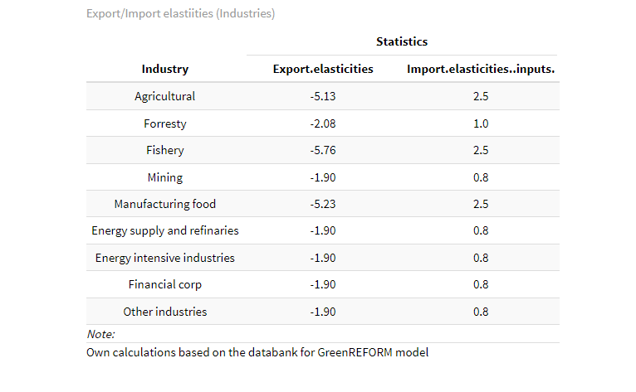
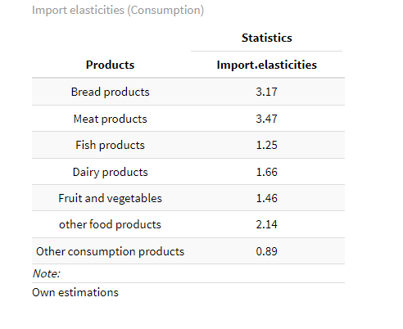
International Trade
Exports (Industry):
$mex_{t}^{n}=\exp\left(μ_{0}^{n}+μ_{1}^{n}∗rer_{t−1}^{n}\right)+adj_{mex,t}^{n}$
$mex_{t}^{n}$- Market share of exports in industry ”n”.
$μ_{1}^{n}$ - Export elasticity. (Kronborg, Poulsen, & Kastrup (2020))
$adj_{mex,t}^{n}$- Adjustment term (Exogenous)
Imports (Industry/consumer products):
$φ_{c,t}^{p}=\exp\left(β_{0}^{c^{p}}+β_{1}^{c^{p}}∗\log\left(rer_{t}^{p}\right)\right)+adj_{φ_{c},t}^{p}$ (Products ”p”) $φ_{z,t}^{ij}=\exp\left(β_{0}^{z^{ij}}+β_{1}^{z^{n}}∗\log\left(rer_{t}^{n}\right)\right)+adj_{φ_{Z},t}^{p}$ (Industry ”n”)
$φ_{c,t}^{p}, φ_{z,t}^{ij}$ - Import shares.
$β_{1}^{c^{p}}, β_{1}^{z^{n}}$ - Import elasticities. (The rule of two)
$adj_{φ_{c},t}^{p},adj_{φ_{Z},t}^{p}$ - Adjustment term (Exogenous)

Slide 24
Model evaluation: Industry output

