Slide 1
30th IIOA Conference in Santiago de Chile – 5th July 2024
Net jobs generation and net GHG emissions reduction from biogas partially replacing fossil fuels in Southern Brazil
Gustavo A. Ferro
UCEMA & CONICET
M. Priscila Ramos
MESi-IIEP(UBA-CONICET)
Carlos A. Romero
MESi-IIEP(UBA-CONICET)

Slide 2
OUTLINE
01
02
03
04
INTRODUCTION
DATA & MODEL
SCENARIO &RESULTS
CONCLUSION

Slide 3
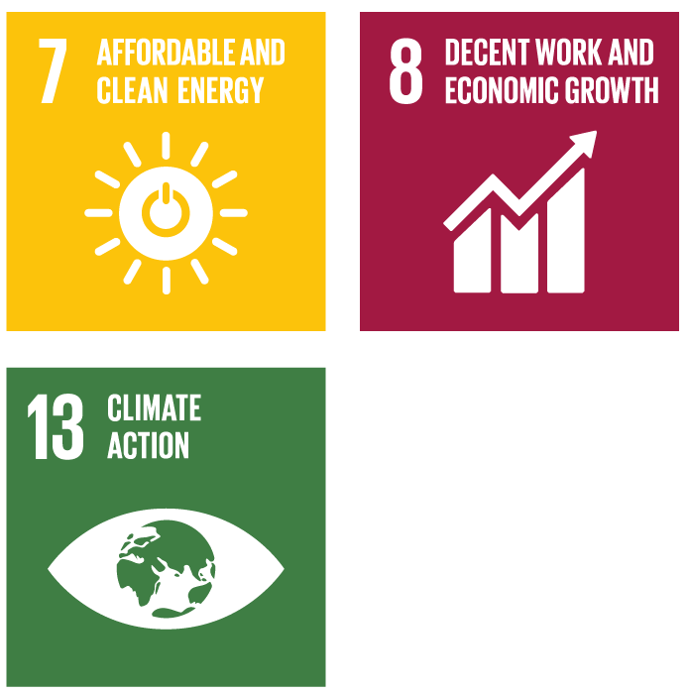
01
INTRODUCTION
Context & motivation
70 % of GHG emissions due to the use of fossil fuels
Solution: progressive replacement with renewable energies.
Brazil
middle-class industrial-based country (10th in GDP in the world).
energy matrix relatively clean
- hydroelectricity: 65% of the electricity matrix
- great potential for biogas production (today 3.4 % of the potential)
- great diversity of substrates (agricultural, agro-industry, waste &sewage)
- in an extended geography.
NDC goals:
- 45 % share of renewable energies in its energy matrix by 2030.
- to reduce dependence of hydroelectricity (because of climate variability)
- to incentivize self-production & distributed generation.

Slide 4
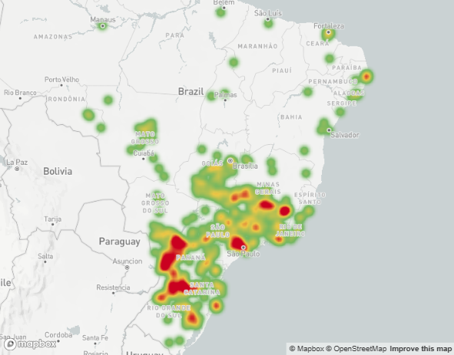
01
INTRODUCTION
Context & motivation
18% of biogás produced in médium-small plant in the Sourthern región (62% in Southeast región with médium-large plants)
71% of biogás produce by urban solid wastes & sewage treatment
70% of biogás to generate electricity
Source: https://cibiogas.org/ BiogásMAP

Slide 5
01
INTRODUCTION
Objectives & Hypothesis
OBJ: To explore the reach of net job creation and net GHG emissions reduction from the partial substitution of conventional energy sources by renewables (biogas) in Southern Brazil.
HYP: Regional economic growth in the Southern Brazil with
Net job creation: because biogas industries are more labor intensive than fossil fuel energy generation.
Net GHG emissions reduction: since biogas industries generate lower GHG emission levels than conventional energy sources.

Slide 6
02
DATA & MODEL
Methodological Approach
BIOGAS
(6 new sectors)
DATA
MODEL & SHOCKS
BIOAGR: Agriculture and Cattle
BIOSLA: Slaughterhouses
BIOMIL: Flour Mills
BIOSUG: Sugar and Alcohol
BIOFOO: Beer breweries, dairy and other food processors
BIOWAS: Solid waste and sewage treatment
3 Input-Output Matrices RG, SC, PR 2018 – with 6 BIOGAS sectors.
3 Input-Output Models for the Sourthern Brazil
Investment
In Biogas capacity
3 IOM Southern Brazil 2018 with BIOGAS
FLQ and RAS/CE
Production of Biogas
IOM
(3 states)
Satellite accounts of Employment
& GHG emissions
RG: Rio Grande do Sul
SC: Santa Catarina
PR: Paraná

Slide 7
02
DATA & MODEL
Characterization of Biogas sectors in the Southern Brazil
Sector | Biogas Production |  | Employment in Biogas |  | Electricity Equivalent
 | MM Nm3 | MM Nm3 / ton of substrate | Jobs (#) | Jobs (#) per MM Nm3 | MWh (1,510*MM Nm3)
BIOAGR | 60 | 40.88 (*) | 771 | 13 | 89,996
BIOSLA | 29 | 98.62 | 222 | 8 | 43,579
BIOMIL | 22 | 5.90 | 88 | 4 | 33,447
BIOSUG | 65 | 13.43 | 413 | 6 | 98,890
BIOFOO | 6 | 82.92 | 77 | 13 | 8,773
BIOWAS | 121 | NA | 1,923 | 16 | 182,770
Total | 303 |  | 3,494 | 12 | 457,455

Slide 8
02
DATA & MODEL
Southern Brazil 2018 baseline
 | Biogás Production |  | Employment in Biogas |  |  | GHG emissions | Electricity Equivalent
States | MM Nm3 | MM 2018 USD | Jobs (#) | Jobs (#) per MMNm3 of Biogas | Jobs (#) per MM 2018 USD of Value Added | MtCO2e | MWh (1,510*MM Nm3)
PR | 196 | 48 | 1,669 | 9 | 208 | 102.8 | 295,990
SC | 28 | 9 | 481 | 17 | 373 | 40.8 | 42,250
RS | 79 | 27 | 1,344 | 17 | 295 | 89.6 | 119,215
Total | 303 | 85 | 3,494 | 12 | 252 | 233.2 | 457,455

Slide 9
02
DATA & MODEL
Southern Brazil 2018 baseline
Sector | Paraná | Rio Grande do Sul | Santa Catarina | Total
BIOAGR | 17.9% | 6.5% | 69.0% | 19.7%
BIOSLA+BIOMIL+BIOSUG+BIOFOO | 58.2% | 8.6% | 5.4% | 40.4%
BIOWAS | 23.9% | 84.9% | 25.6% | 40.0%
Biogas production (MM Nm3) | 196.0 | 78.9 | 28.0 | 302.9
% of used installed capacity | 47% | 66% | 31% | 48%
% used of potential (substrates) | 9% | 6% | 3% | 7%
Employment in biogas | 571 | 460 | 165 | 1,197
% of total employment of the state | 0.011% | 0.008% | 0.005% | 0.008%
GHG emissions (MtCO2e) | 102.8 | 89.6 | 40.8 | 233.2
% of total GHG emissions of the country | 10.4% | 9.0% | 4.1% | 23.6%

Slide 10
03
SCENARIOS & RESULTS
Scenarios’ design
General assumptions:
50 percent of potentially recoverable biomass used to produce biogas in each sector/region
Investment required in biogás plants (time to build = 10 years)
All biogas used to produce electricity that substitutes thermal power generation.
Power generation plants located in the rest of Brazil (outside the Southern región)
Costs of biogás production includes transport costs of biomass
3 scenarios that combine the following parameters of energy efficiency, technology of the power plants, direct labor productivity in biogas
Scenarios | Energy Efficiency (kWh/m3 biogas) | Power plant technology (investment costs) in million USD per MW | Labor productivity direct (000 USD/job)
Low | 1.51 | 1.5 | 100.3
Base | 2.81 | 3.1 | 149.4
High | 5.93 | 4.5 | 292.8

Slide 11
03
SCENARIOS & RESULTS
Results comparison for biogas in the Southern Brazil
Average annual results (direct and total, including indirect) during the 10 years of biogas sector investments and production horizon.
Scenarios | Biogas Production (MM USD) |  | GHG Emissions (Mtco2e) |  | Employment (jobs)
 | Direct | TOTAL | Direct | TOTAL | Direct | TOTAL
Low | 650 | 1,416 | 0.01 | -0.07 | 9,441 | 16,097
Base | 824 | 1,729 | 0.06 | -0.46 | 10,090 | 19,130
High | 1,301 | 2,585 | 0.18 | -1.37 | 16,380 | 31,942
Non linearity in job creation:
(-) with greater L productivity
(+) with greater energy efficiency
Scale of Investment
Substitution of termal by biogás power generation

Slide 12
04
SCENARIOS & RESULTS
Base Scenario results by biogas origin (sector/state)
.
 | Production (MM USD) |  | GHG Emissions (Mtco2e) |  | Employment (jobs)
 | Direct | TOTAL | Direct | TOTAL | Direct | TOTAL
BIOAGR | 257 | 546 | 0.02 | 0.05 | 3,073 | 5,607
BIOSLA | 119 | 263 | 0.01 | -0.10 | 1,220 | 2,302
BIOMIL | 38 | 80 | 0.00 | -0.03 | 391 | 1,043
BIOSUG | 87 | 186 | 0.01 | -0.06 | 1,163 | 2,424
BIOFOO | 26 | 52 | 0.00 | -0.02 | 293 | 508
BIOWAS | 296 | 602 | 0.02 | -0.30 | 3,950 | 7,245
TOTAL | 824 | 1,729 | 0.06 | -0.46 | 10,090 | 19,130
State | Production (MM USD) |  | Emissions (Mtco2e) |  | Employment (jobs)
 | Direct | TOTAL | Direct | TOTAL | Direct | TOTAL
Paraná | 308 | 623 | 0.02 | -0.24 | 5,547 | 10,814
Rio Grande do Sul | 279 | 582 | 0.02 | -0.12 | 2,468 | 4,330
Sana Catarina | 237 | 524 | 0.02 | -0.09 | 2,075 | 3,986
TOTAL | 824 | 1,729 | 0.06 | -0.46 | 10,090 | 19,130

Slide 13
04
CONCLUSION
Conclusions
Regional IO models for three states of Brazil 2018 with detailed representation of sectors that produce substrates for biogas
Scenarios based on the Southern Brazil biogas potential to produce clean electricity
Substantial employment creation in biogas production that could be extended in the whole Brazilian territory because of different sectors related to the biogás substracte (waste & sewage; agricultura & cattle; food industries)
Cleaning the electricity matrix with biogas production for self-generation (or distributed power generation) to be aligned with the Paris Agreement to reduce GHG emissions and to support sectoral-environmental policies

Slide 14
04
CONCLUSION
Caveats & Extensions
Caution is needed in advancing straightforward conclusions based on the scenarios’ assumptions, particularly on:
50 % of substrates used in biogas production,
(partial) substitution of fossil fuels in power generation,
several adjustments required in the infrastructure of electricity generation, and
public policies to help the market develop.
Given the relevance of private investments in the biogas sector, it would be important to complement these results with a private cost-benefit analysis to provide an additional dimension of feasibility in the analysis of the biogas scenarios.

Slide 15
THANK YOU VERY MUCH
Instituto Interdisciplinario de Economía Política
Av. Córdoba 2122 - 1º y 2º piso (C1120 AAQ)
Ciudad Autónoma de Buenos Aires, Argentina
+54 11 5285-6578 | www.iiep.economicas.uba.ar
@iiep_oficial

