Slide 1


30th International Input-Output Association Conference
1-5 July 2024, Santiago, Chile
Implementing the AfCFTA Agreement
and Implications for Africa’s Regional Value Chains
Stephen Karingi (UN-ECA), Simon Mevel (UN-ECA)
Cristina Mitaritonna (CEPII), and Yu Zheng (CEPII)

Slide 2
1. The AfCFTA in Brief

Slide 3
1. The AfCFTA in brief: negotiations vs. implementation
Negotiations on Agreement establishing the AfCFTA started in June 2015, and conducted in 2 Phases:
  Phase I - 3 Protocols:
    Trade in goods (completed; 48 tariff offers submitted to AfCFTA Secretariat; about 93% of RoO finalized);
    Trade in services (completed : 48 schedules of commitments in 5 priority sectors submitted to AfCFTA Secretariat; regulatory frameworks for the 5 priority sectors still under development and to be annexed to the Protocol, with negotiations on the 7 other services sectors to follow);
    Dispute settlement body (completed and Appellate body established; selection of members completed).
  Phase II - 5 Protocols:
    Investment (completed and to be operationalized);
    Intellectual property rights (completed and to be operationalized);
    Competition policy (completed and to be operationalized);
    Digital trade (recently adopted) ;
    Women and youth in trade (recently adopted).
AfCFTA Agreement entered into force on 30 May 2019.
Although trading under AfCFTA Agreement officially started on 1 January 2021…
…first trade recorded only after launch of the AfCFTA Guided Trade Initiated (GTI) in October 2022.

Slide 4
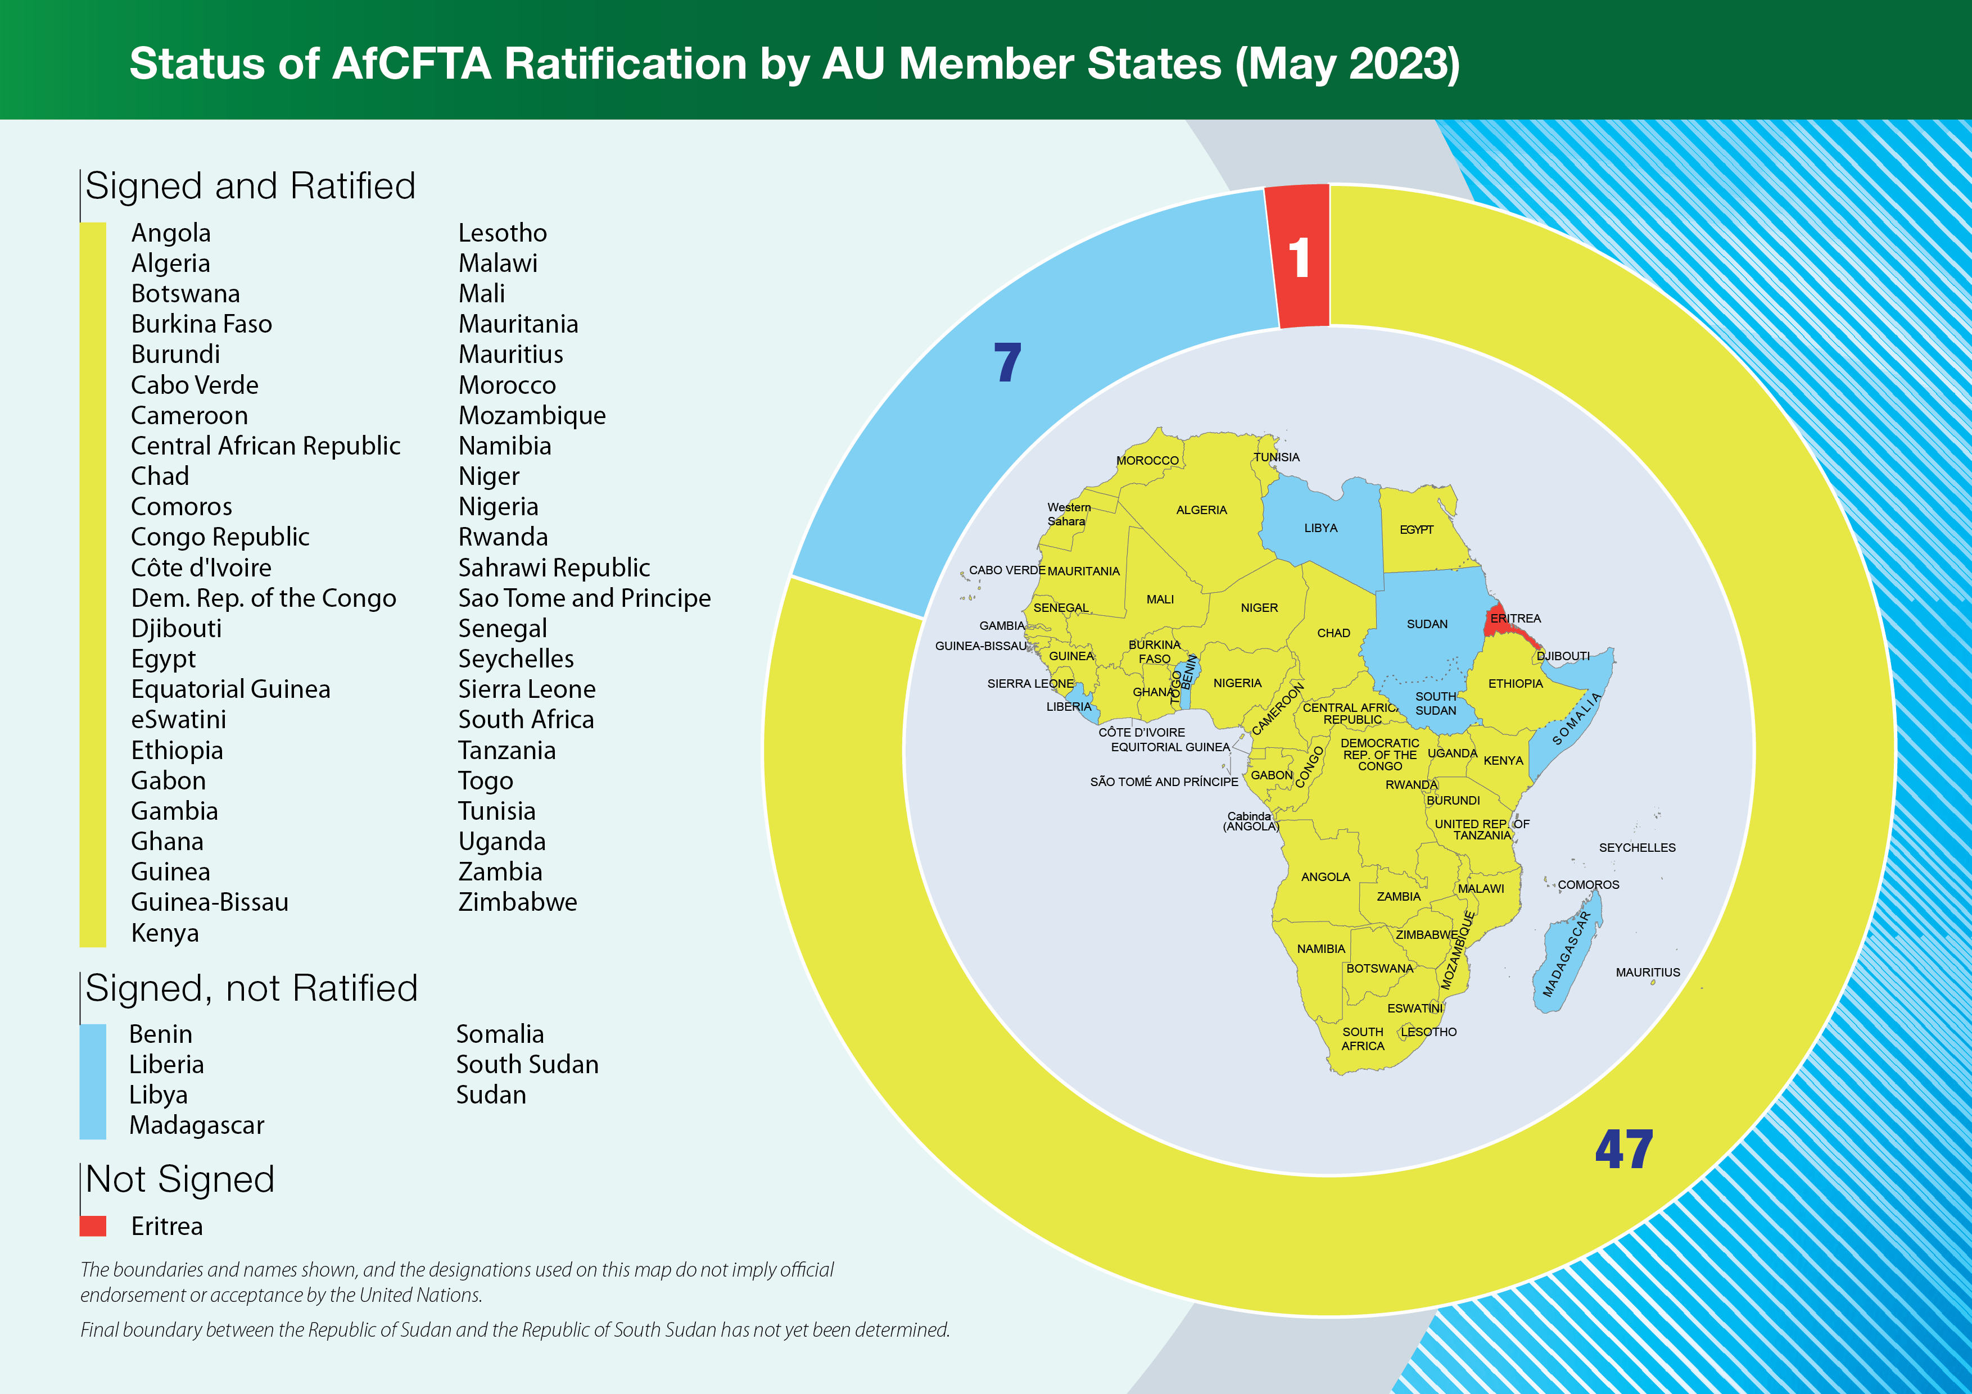
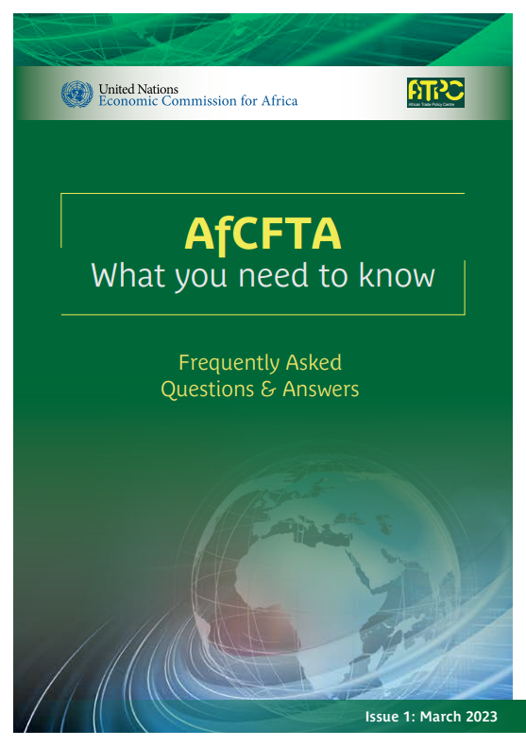
1. The AfCFTA in Brief: Status of AfCFTA Agreement’s signing/ratification by AU member States (as of 1 July 2024)
https://repository.uneca.org/handle/10855/49411

Slide 5
2. Key messages from the study on
“Implementing the AfCFTA Agreement and Implications for Africa’s Regional Value Chains”
Africa mostly performs at the lower end of GVCs, largely explained by modest backward participation in GVCs and undermined development of RVCs.
Through addressing tariffs & NTMs on intra-African trade, particularly for intermediate consumption, the AfCFTA does have a clear potential to promote the development of RVCs in specific sub-sectors.

Slide 6
3. Methodology & Analyzed reform

Slide 7
3. Methodology & Analyzed reform
Dynamic CGE model used for the assessment: MIRAGE-VA building on MIRAGE-e:
      Global & multi-sector – Main database used for calibration: GTAP-MRIO 10.1 (GTAP Data Bases: GTAP 10 Data Base (purdue.edu)).
Double Armington structure: trade in both final consumption and intermediate consumption.
Complete representation of GHG emissions:
  CO2 emissions (proportional to fossil energy consumption;
  Other GHGs (methane-CH4, nitrous oxide-N2O, fluorinated gases-FGAS) in the production function – Database GTAP 10.1 satellite non-CO2 GHG.
Macro baseline: Macro trajectory with 2045 horizon
  Macroeconometrics of the Global Economy (MaGE) to project major economic changes (CEPII - MaGE).

Slide 8
3. Methodology & Analyzed reform
Business as Usual, BaU (baseline or reference scenario) determined in 2 steps:
      1st step: 2045 horizon projected by MaGE in MIRAGE (GDP, population, active population, current account, energy efficiency) + projections of energy prices from EIA.
      2nd step: reflect relevant Trade policies since 2014 + Baseline Paris Agreement (NDCs).
Central AfCFTA scenario (applied to all African Union member States):
      AfCFTA modalities on trade in goods (following official schedules and implemented between 2021 and 2033).
      50% cuts (within Africa only) on actionable NTMs on trade in goods and actionable restrictions to trade in 5 priority services (i.e. communication, tourism, transport, financial, and business services) + health + education (linear reduction between 2021 and 2035).

Slide 9
4. Key findings

Slide 10
4. Key findings: Africa mostly operates at the lower end of GVCs,
with particularly low backward participation in GVCs
Evolution of selected regions’ participation in GVCs, % points of GDP (1990-2018)
Evolution of Africa’s forward & backward participations in GVCs, % points of GDP (1990-2018)
Source: ECA & CEPII (forthcoming), authors’ calculations based on UNCTAD-Eora database

Slide 11
4. Key findings: Africa mostly operates at the lower end of GVCs,
with particularly low backward participation in GVCs
Forward & backward participations in GVCs in selected regions (% of GDP), with ratio of backward participation in total GVC participation (%), 2018
Africa’s backward participation in GVCs in 1990 and 2018, by income level, % of GDP
 | Forward participation (% of GDP) | Backward participation (% of GDP) | Ratio of Backward participation in total GVC participation (%)
Africa | 6.0 | 2.0 | 25
Developing Asia | 5.6 | 3.1 | 36
Latin America & Caribbean | 4.0 | 4.0 | 50
High income | 7.7 | 9.2 | 54
 | Forward participation |  | Backward participation
 | 1990 | 2018 | 1990 | 2018
Africa | 2.9 | 6.0 | 1.1 | 2.0
Africa HIC (0; 1) | 2.8 | 6.9 | 4.2 | 7.1
Africa U-MIC (5;7) | 4.3 | 11.2 | 1.3 | 3.8
Africa L-MIC (15; 23) | 1.9 | 4.4 | 1.0 | 1.3
Africa LIC (31;20) | 1.3 | 1.3 | 0.5 | 0.6
Source: ECA & CEPII (forthcoming), authors’ calculations based on UNCTAD-Eora database
Source: ECA & CEPII (forthcoming), authors’ calculations based on UNCTAD-Eora database and WDI World Bank Database for income level (calculated on 2018 income classification)

Slide 12
4. Key findings: High tariffs & NTMs imposed by Africa on its imports, especially within Africa: AfCFTA to make a difference!
Average tariffs (on goods only) imposed by Africa on its imports - %
Average NTMs on goods imposed by Africa on its imports - %
NTMs on services imposed by Africa on its imports - %
Source: ECA & CEPII (forthcoming)

Slide 13
4. Key findings: AfCFTA to boost intra-African trade in goods & services for both final and intermediate consumptions
Changes in intra-African trade Intra-African trade following implementation of the AfCFTA Agreement,
as compared to baseline (i.e. without AfCFTA), %, 2045
Sector | Consumption type | Variation
 |  | USD billion | %
Agrifood (non-processed) | Final | 7.1 | 81.6
 | Intermediate | 3.9 | 30.6
Agrifood (processed) | Final | 35.2 | 62.8
 | Intermediate | 12.4 | 59.7
Industrial goods | Final | 63.7 | 43.6
 | Intermediate | 101.9 | 51.7
Energy goods | Final | 2.0 | 30.0
 | Intermediate | 44.6 | 28.4
Services | Final | 1.6 | 25.0
 | Intermediate | 3.4 | 40.4
Total goods and services | Final | 109.6 | 49.0
 | Intermediate | 166.1 | 42.0
 | All consumption types combined | 275.7 | 44.5
Source: ECA & CEPII (forthcoming)

Slide 14
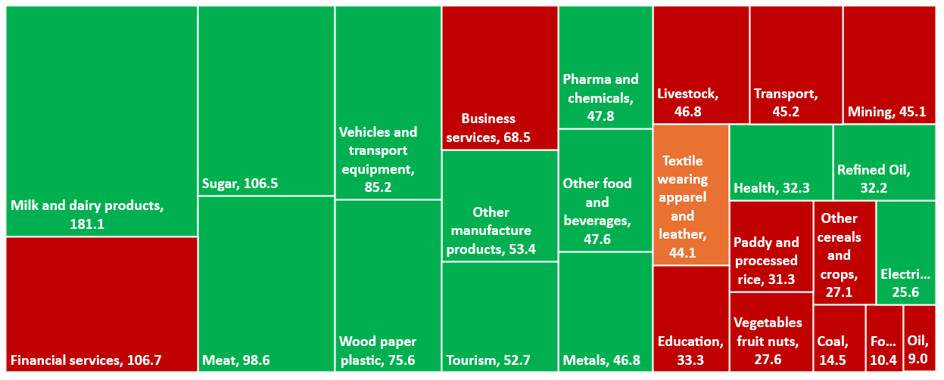
4. Key findings: Sub-sectors with greatest potential for development of RVCs in AfCFTA context
Changes in intra-African trade for intermediate consumption with positive (green) or negative (red) variations in value-added, by sub-sectors, following implementation of AfCFTA Agreement, as compared to baseline (i.e. without AfCFTA), %, 2045
Source: ECA & CEPII (forthcoming)
Note: Highlighted in orange, sub-sector for which value-added would decrease for Africa as a whole but increases in a large number of African countries.

Slide 15

Thank you!
mevel@un.org
www.uneca.org/atpc
Twitter: @atpc2
Facebook: @africantradepolicycentre
Email: eca-atpc@un.org

