Slide 1
Testing heterogeneity in ESUTs
José M. Rueda-Cantuche (European Commission’s JRC)
3 July 2024
30th IIOA Conference – Santiago (Chile)

Slide 2
Testing heterogeneity before compiling ESUTs (with econometric analysis)
For every product, firms surveyed data can be used to test whether MNEs, for instance, use a statistically significant different technology structure (than the average of the industry) to produce it.
This will help countries to identify those industries that would need an additional breakdown by size, ownership, etc.
Therefore, there is no need to break down all industries and/or products to construct a ESUT.

Slide 3
Background and context
(of the econometric analysis)
Firms data can be theoretically linked directly to multipliers without the need to compile IOTs (ten Raa and Rueda-Cantuche, 2007). This approach was extended to SUTs in the absence of firms data (Rueda-Cantuche, 2011).
This framework is appropriate for rectangular SUT-type of firms data with more firms/industries (broken down by size, ownership, etc.) than products, as possibly the case for ESUTs.
Therefore, by using firms data and the appropriate regressions, input-output multipliers can be derived econometrically, also testing whether those multipliers are significantly different across firms in terms of size, ownership, exporter status, etc. vs. the product technology assumption.
Notes:
Form a working level steering committee with one or two representatives per institution that would have at least two (either virtual, hybrid or physical) meetings per year in order to increase their involvement and commitment towards the convergence on a global benchmark of the required input data entering the various TiVA initiatives. The committee will have annual rotating chairs.

Slide 4
Stochastic analysis of input-output multipliers based on SUTs (ten Raa and Rueda-Cantuche, 2007)
Methods for constructing the A-matrix from U and V
Stochastic Input-Output Analysis: From A to (I-A)⁻¹
Bodies of literature
( U,V ) A
A (I – A)⁻¹
(I-A)⁻¹
A
U & V

Slide 5
Employment and output input-output multipliers
EMPLOYMENT MULTIPLIERS
λ = l (I- A)⁻¹
where l and λ are the row vectors of labour coefficients and employment multipliers, respectively. A is the technical coefficients matrix and I the identity matrix.
OUTPUT MULTIPLIERS
μ = e^{T} (I- A)⁻¹
where e^{T} and μ are the row vectors of unities and output multipliers, respectively. A is the technical coefficients matrix and I the identity matrix.
Bearing in mind that the product technology assumption implies that A = UV^{-T} and l = LV^{-T}, that is:
λ = LV^{-T} (I- UV ^{-T} )⁻¹
μ = e^{T} (I- UV ^{-T} )⁻¹

Slide 6
Estimation procedure (I)
For employment multipliers,
= LV^{-T} (I- UV ^{-T} )⁻¹ =
L ((I- UV ^{-T} ) V ^{T} )⁻¹ =
L (V ^{T} - UV ^{-T}V ^{T} )⁻¹ = L (V ^{T} - U)⁻¹
And, therefore, the model would be: L = λ (V ^{T} - U)
For output multipliers,
μ = e^{T} (I- UV ^{-T} )⁻¹ =
e^{T} V ^{T}((I- UV ^{-T} ) V ^{T} )⁻¹ =
e^{T}V ^{T}(V ^{T} - U)⁻¹
And, therefore, the model would be: e^{T} V ^{T}= μ (V ^{T} - U)

Slide 7
Estimation procedure (II)
Then, by using as independent variables the rows of the net output matrix for each establishment (V ^{T}-U), the following multiple linear econometric models can be formulated:
L_{i} = λ₁x_{1i}+ λ₂x_{2i} + λ₃x_{3i}+...+ λ_{k}x_{ki}+ε_{i} i =1,...,m (for employment multipliers)
(e^{T}V^{T})_{i} = μ₁x_{1i}+ μ ₂x_{2i} + μ ₃x_{3i}+...+ μ _{k}x_{ki}+ε_{i} i =1,...,m (for output multipliers)
where the respective regression coefficients are input-output multipliers, k the number of products, m the number of surveyed establishments and ε_{i} an independently normally random disturbance error with zero mean and constant variance.

Slide 8
Twofold uses of this analysis:
Estimation of consistent and unbiased IO (backward) multipliers (incl. employment, output, value added and/or emissions), with confidence intervals. Furthermore, Rueda-Cantuche (2011) showed that the same applied using SUTs instead of firms data (possibly more accessible for academia).
Test econometrically whether those multipliers are significantly different across firms/industries vs. the product technology assumption (all firms/industries produce the same product with the same technology).

Slide 9
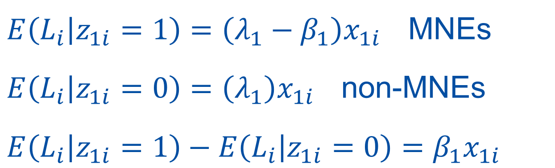
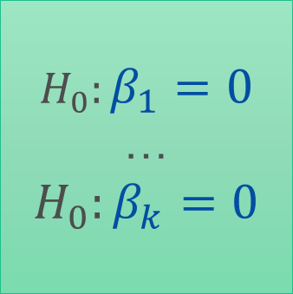
What do firms data tell about heterogeneity?
L_{i} = λ₁x_{1i}+ λ₂x_{2i} + λ₃x_{3i}+...+ λ_{k}x_{ki}+
+ β₁x_{1i}z_{1i}+ β ₂x_{2i} z_{2i}+ β ₃x_{3i}z_{3i}+...+ β _{k}x_{ki} z_{ki} +ε_{i}
i =1,...,m (for employment multipliers)
For product 1… and MNEs…
$$H_{0}:β_{1}=0$$
…
$$H_{0}:β_{k}=0$$
$E\left(L_{i} | z_{1i}=1\right)=\left(λ_{1}−β_{1}\right)x_{1i}$ MNEs
$E\left(L_{i} | z_{1i}=0\right)=\left(λ_{1}\right)x_{1i}$ non-MNEs
$E\left(L_{i} | z_{1i}=1\right)$ $− E\left(L_{i} | z_{1i}=0\right)=β_{1}x_{1i}$
Notes:
Form a working level steering committee with one or two representatives per institution that would have at least two (either virtual, hybrid or physical) meetings per year in order to increase their involvement and commitment towards the convergence on a global benchmark of the required input data entering the various TiVA initiatives. The committee will have annual rotating chairs.

Slide 10
Conclusions
The construction of ESUTs needs to break down industries according to several dimensions (size, ownership, exporter status, etc.)
Firms surveyed data and econometric analysis based on a SUT framework can help selecting the industries requiring a break down due to their statistically significant differences in product technologies.
(Candidate volunteers: Belgium?)

Slide 11
Thank you very much!
José M. Rueda-Cantuche (European Commission’s JRC)
3 July 2024

