Slide 1

Carbon Price App
Statistical Simulation Tool
30th IIOA Conference - July 1-5, 2024
Gregory Legoff, Joaquim Guilhoto,
Yamil Vargas, Alberto Sanchez-Rodelgo
IMF – Statistics Department

Slide 2
Disclaimer
  The views expressed in this paper are those of the authors and do not necessarily represent the views of the IMF’s Executive Directors, its management, or any of its members. The boundaries, colors, denominations, and any other information shown on the maps do not imply, on the part of the International Monetary Fund, any judgment on the legal status of any territory or any endorsement or acceptance of such boundaries.

Slide 3
Outline
    Background
  Conceptual framework
    Case Study
  Impact on Competitiveness
    Way Forward
  Live Demo

Slide 4
Background
Carbon pricing aims at internalizing external costs of climate change not reflected in market prices of fossil fuels
Imposing carbon pricing on polluters increases cost of producing goods and services:
  Which industries are most affected?
  What is the impact on inflation?
  What are the revenues raised?
  How price changes propagate in the economy and in the global value chain?
  What is the impact on competitiveness?

Slide 5
Background
Carbon Price App available for IMF users
  Based on multi-country input-output tables
  77 countries
  45 industries
  1995 to 2020 annual data
  Industry price changes
  Price changes for households, government consumption, capital formation, imports and exports
  Propagation of price changes in the global supply chain

Slide 6
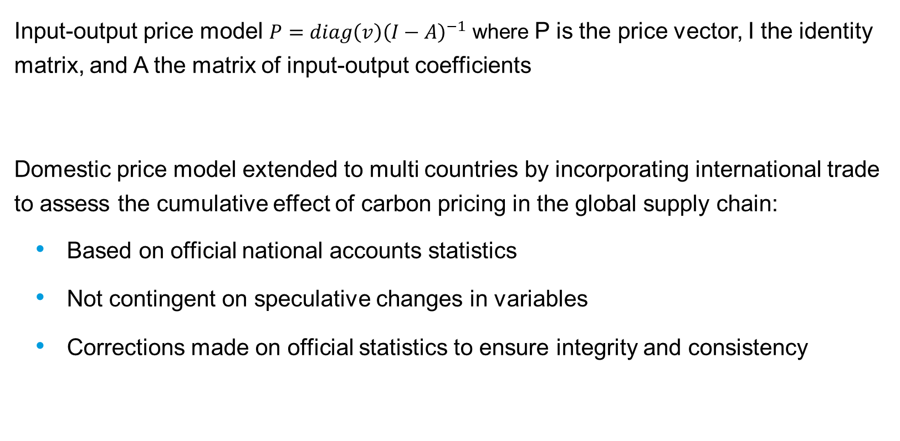
Conceptual framework
Input-output price model $P=diag\left(v\right){\left(I−A\right)}^{−1}$ where P is the price vector, I the identity matrix, and A the matrix of input-output coefficients
Domestic price model extended to multi countries by incorporating international trade to assess the cumulative effect of carbon pricing in the global supply chain:
  Based on official national accounts statistics
  Not contingent on speculative changes in variables
  Corrections made on official statistics to ensure integrity and consistency

Slide 7
Case Study: USA and Canada
USA and Canada are closely integrated economies with significant cross-border transactions
Scenario:
  2020 data
  $ 75 USD carbon pricing applied to all industries
  Carbon pricing applied in individual countries

Slide 8
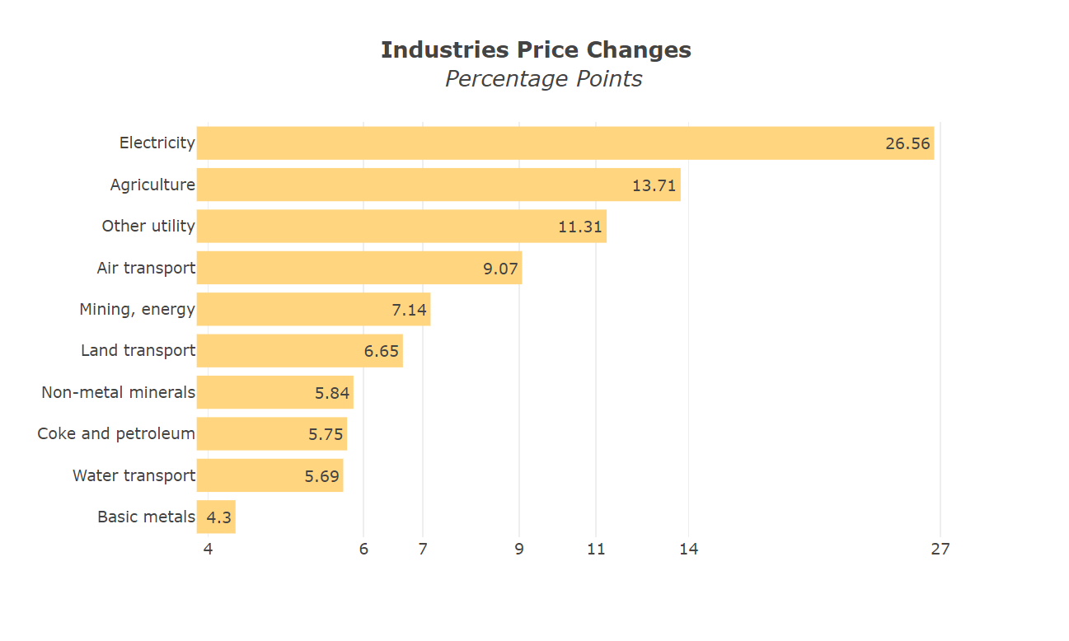
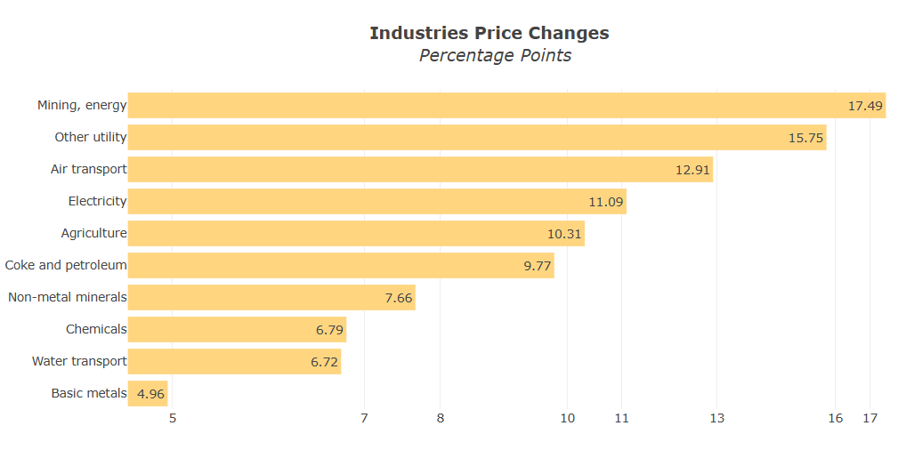
Case Study: USA and Canada
Industrial price changes resulting from $75 carbon pricing applied to all industries, 2020
USA
Canada

Slide 9
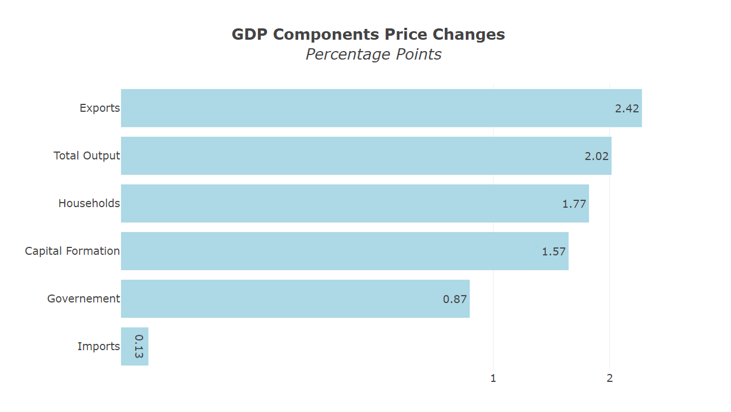
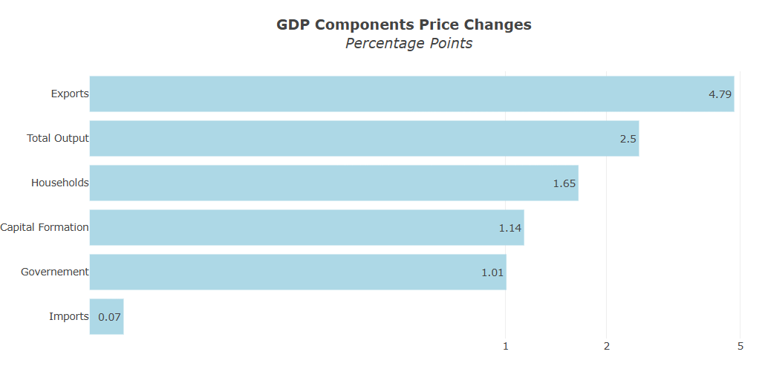
Case Study: USA and Canada
Price changes on GDP by expenditure components resulting from $75 carbon pricing applied to all industries, 2020
USA
Canada

Slide 10
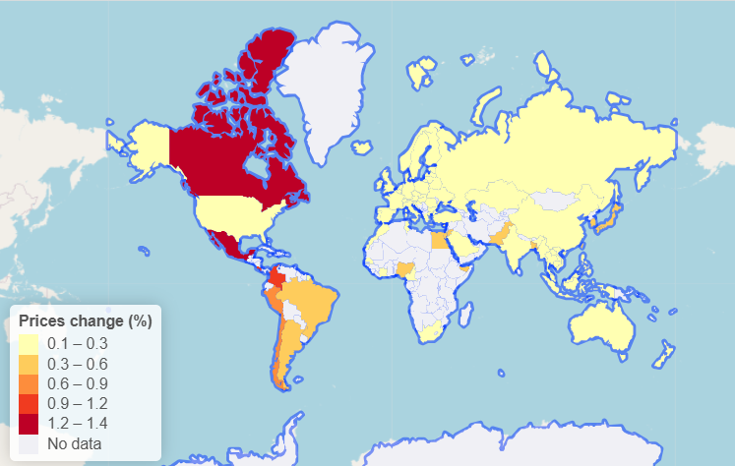
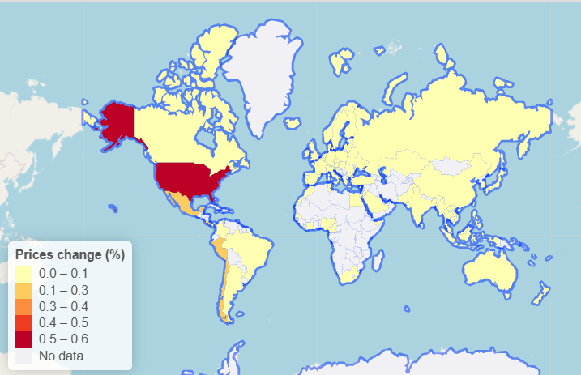
Case Study: USA and Canada
Global import price changes resulting from carbon pricing of $75 USD applied to all industries, 2020
USA
Canada

Slide 11
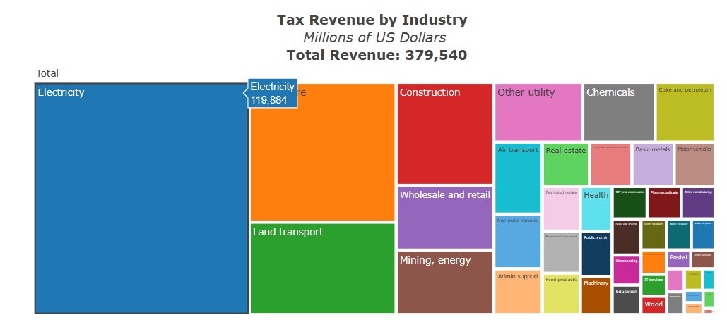
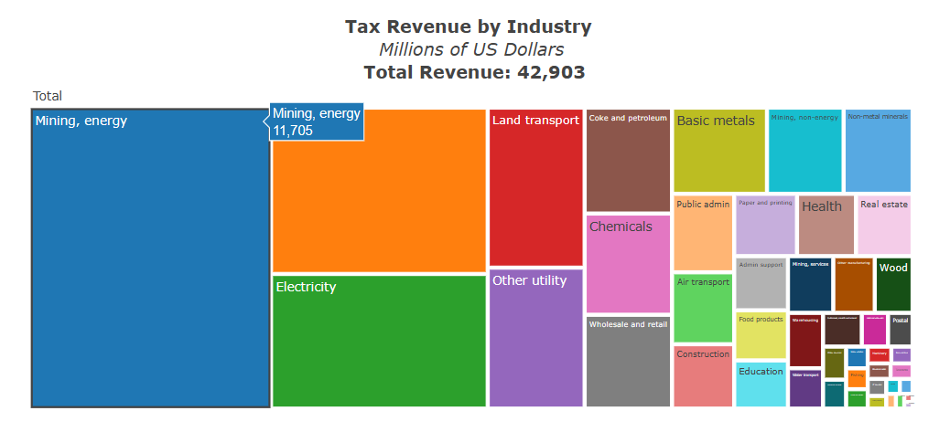
Case Study: USA and Canada
Revenue by industry resulting from $75 USD carbon pricing applied to all industries, 2020
USA
Canada
Agriculture
Agriculture

Slide 12
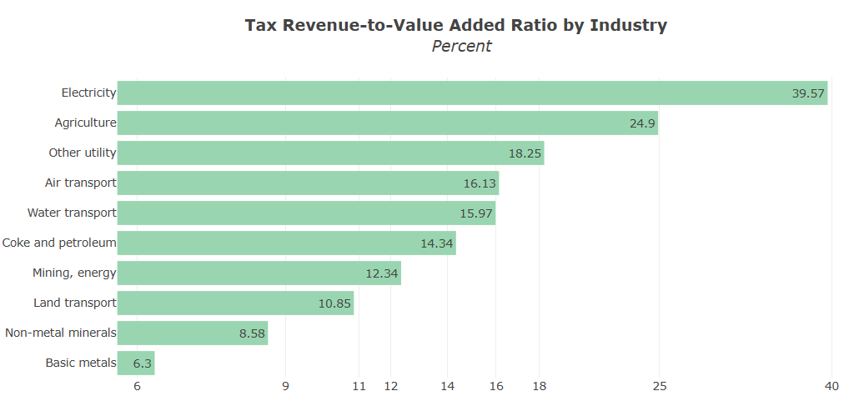
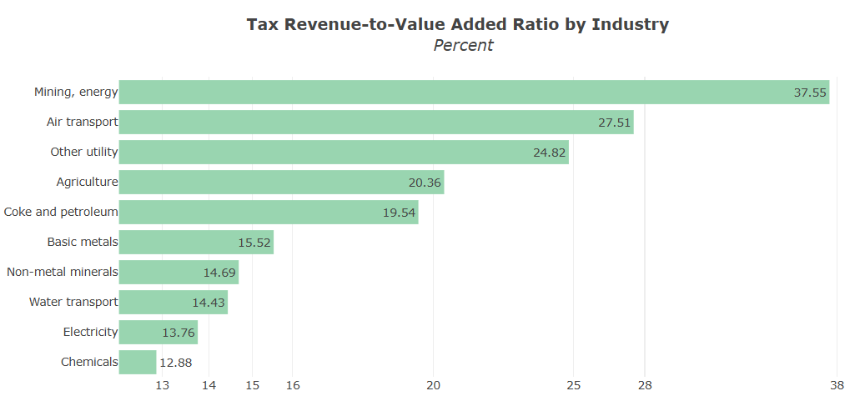
Case Study: USA and Canada
Tax revenue to value added ratio by industry, resulting from $75 USD carbon pricing applied to all industries, 2020
USA
Canada

Slide 13
Impact on competitiveness
Border Carbon Adjustment: level the playing field between domestic industries subject to carbon pricing and foreign producers from countries with no or lower carbon pricing:
  Tax equivalent to the domestic products
  GHG content of internationally traded products assessed in the input-output analytical framework
  Emissions intensities denote the direct emissions per unit of output: crucial metric for assessing environmental impact

Slide 14
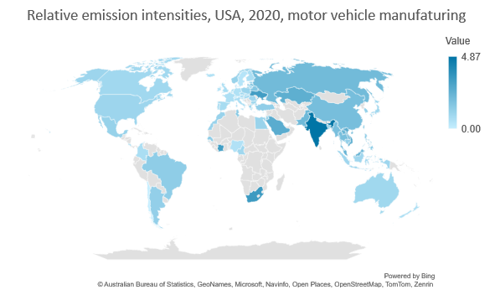
Impact on competitiveness
Example of relative intensities (USA = 1) for motor vehicles

Slide 15
Way forward
  Time series analysis: difficulties to derive price-adjusted economic data
  Pass-through: producers do not fully transfer the cost increase
  Price elasticities: current model based on unchanging input structure and predetermined production ratios
  Extension of the model: IMF MARIO with 212 economies, 178 products, 144 industries, for 1990 to 2022

Slide 16
Price effects on households' consumption of a carbon price equivalent to $ 75 USD in 2020

Slide 17
Way forward
  Further disaggregation of carbon price effects:
    Differentiation of carbon price effects on prices and revenue associated with:
      Imported, exported and domestic products
      Domestic and foreign demand.
    Impact on households by income group

Slide 18
Carbon price revenue incorporated in Exports
Share in each industry (%)
Tax revenue resulting from $75 USD carbon pricing applied to all industries, 2020
USA
Canada

Slide 19
Carbon price revenue incorporated in Domestic Demand
Industries of final demand shares (%)
Tax revenue resulting from $75 USD carbon pricing applied to all industries, 2020
USA
Canada

Slide 20
Price indices by households’ income groups for a carbon price of $75 USD, USA, 2018
USA
Note: This example was generated by the authors using an older version of the dataset than other numerical examples presented in this paper and considering only CO₂ emissions from fuel combustion

Slide 21
Live Demo
CPA

Slide 22
Thank You!

