Slide 1
Global Value Chains indicators fully consistent with EU official statistics
30th International Input-Output Association Conference, 1st - 5th July 2024, Santiago, Chile
Pablo Piñero, Santacruz Banacloche, José Manuel Rueda-Cantuche
Joint Research Centre, European Commission
Notes:
Joint effort with EUROSTAT, the European Union official statistical office, for publishing a GVC (Global Value Added) indicators database

Slide 2
Contents
Background
The 12 GVC indicators selected
Features of the EU GVC indicators database
Conclusions

Slide 3
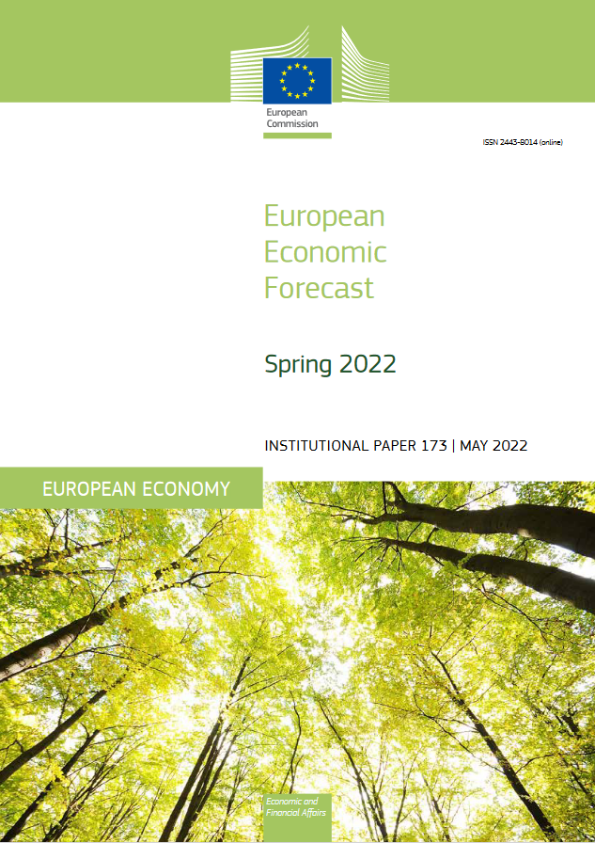
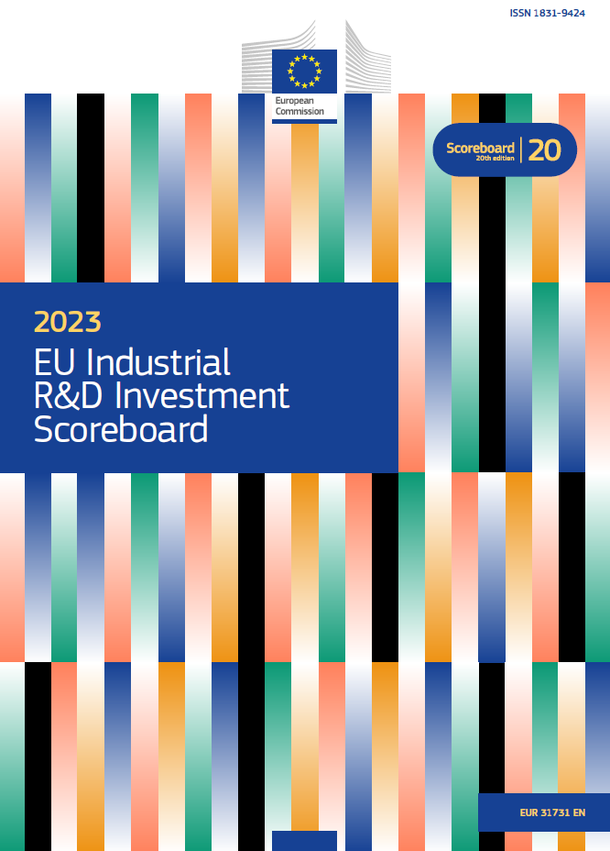
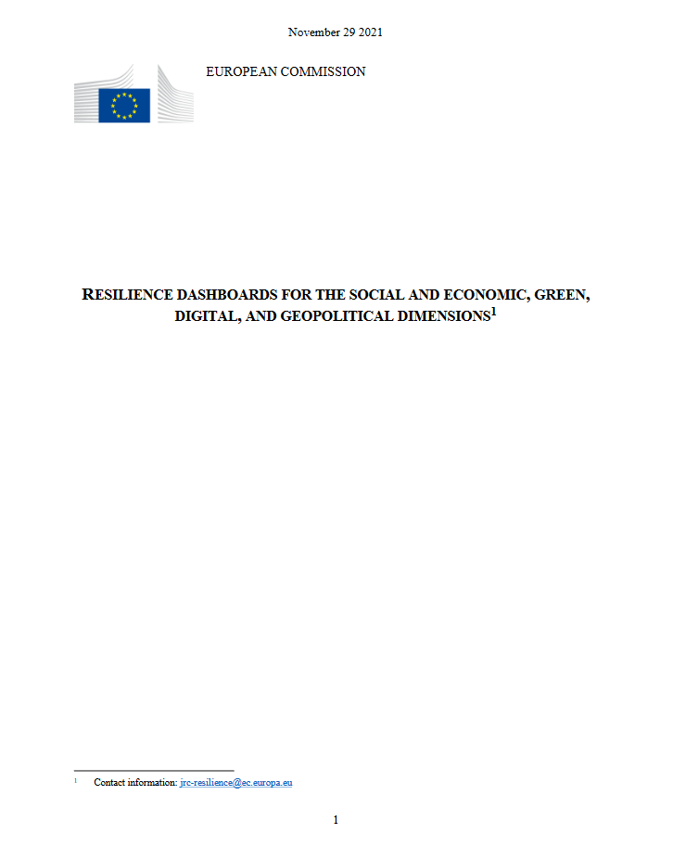
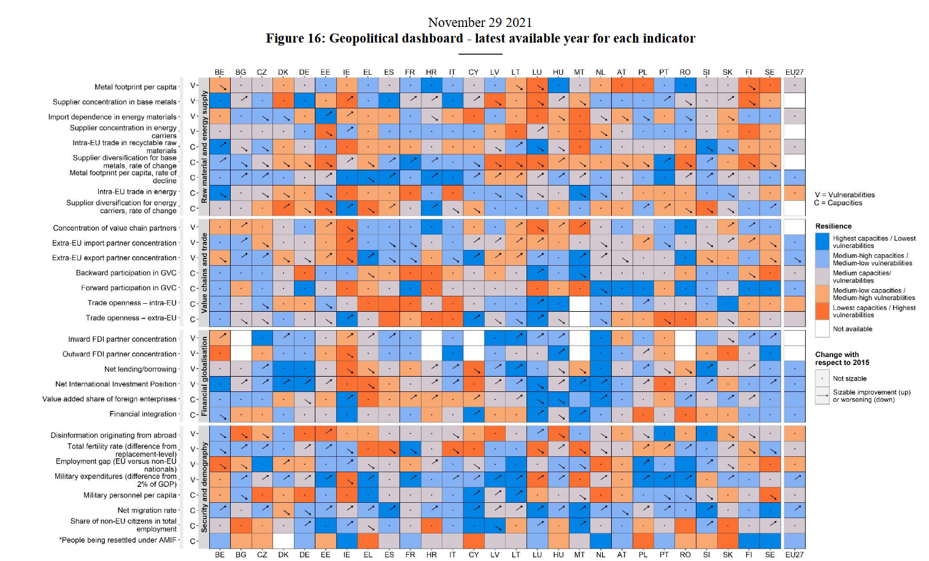
Background
Relevance of GVC indicators for EU policy makers
A list of 12 indicators was selected (those more relevant for policy/widely accepted)
GVC indicators are calculated with the IO components already available in the FIGARO ICIO ind x ind tables

Slide 4
The 12 GVC indicators database
FIGARO stands for ‘Full International and Global Accounts for Research in input-Output analysis’.
The EU inter-country Supply, Use and Input-Output tables, also known as the FIGARO tables, are the results of a co-operation between Eurostat and the European Commission’s Joint Research Centre.
Since 2021 it has become EU Official Statistics: benchmarked to the latest available official macroeconomic aggregates.

Slide 5
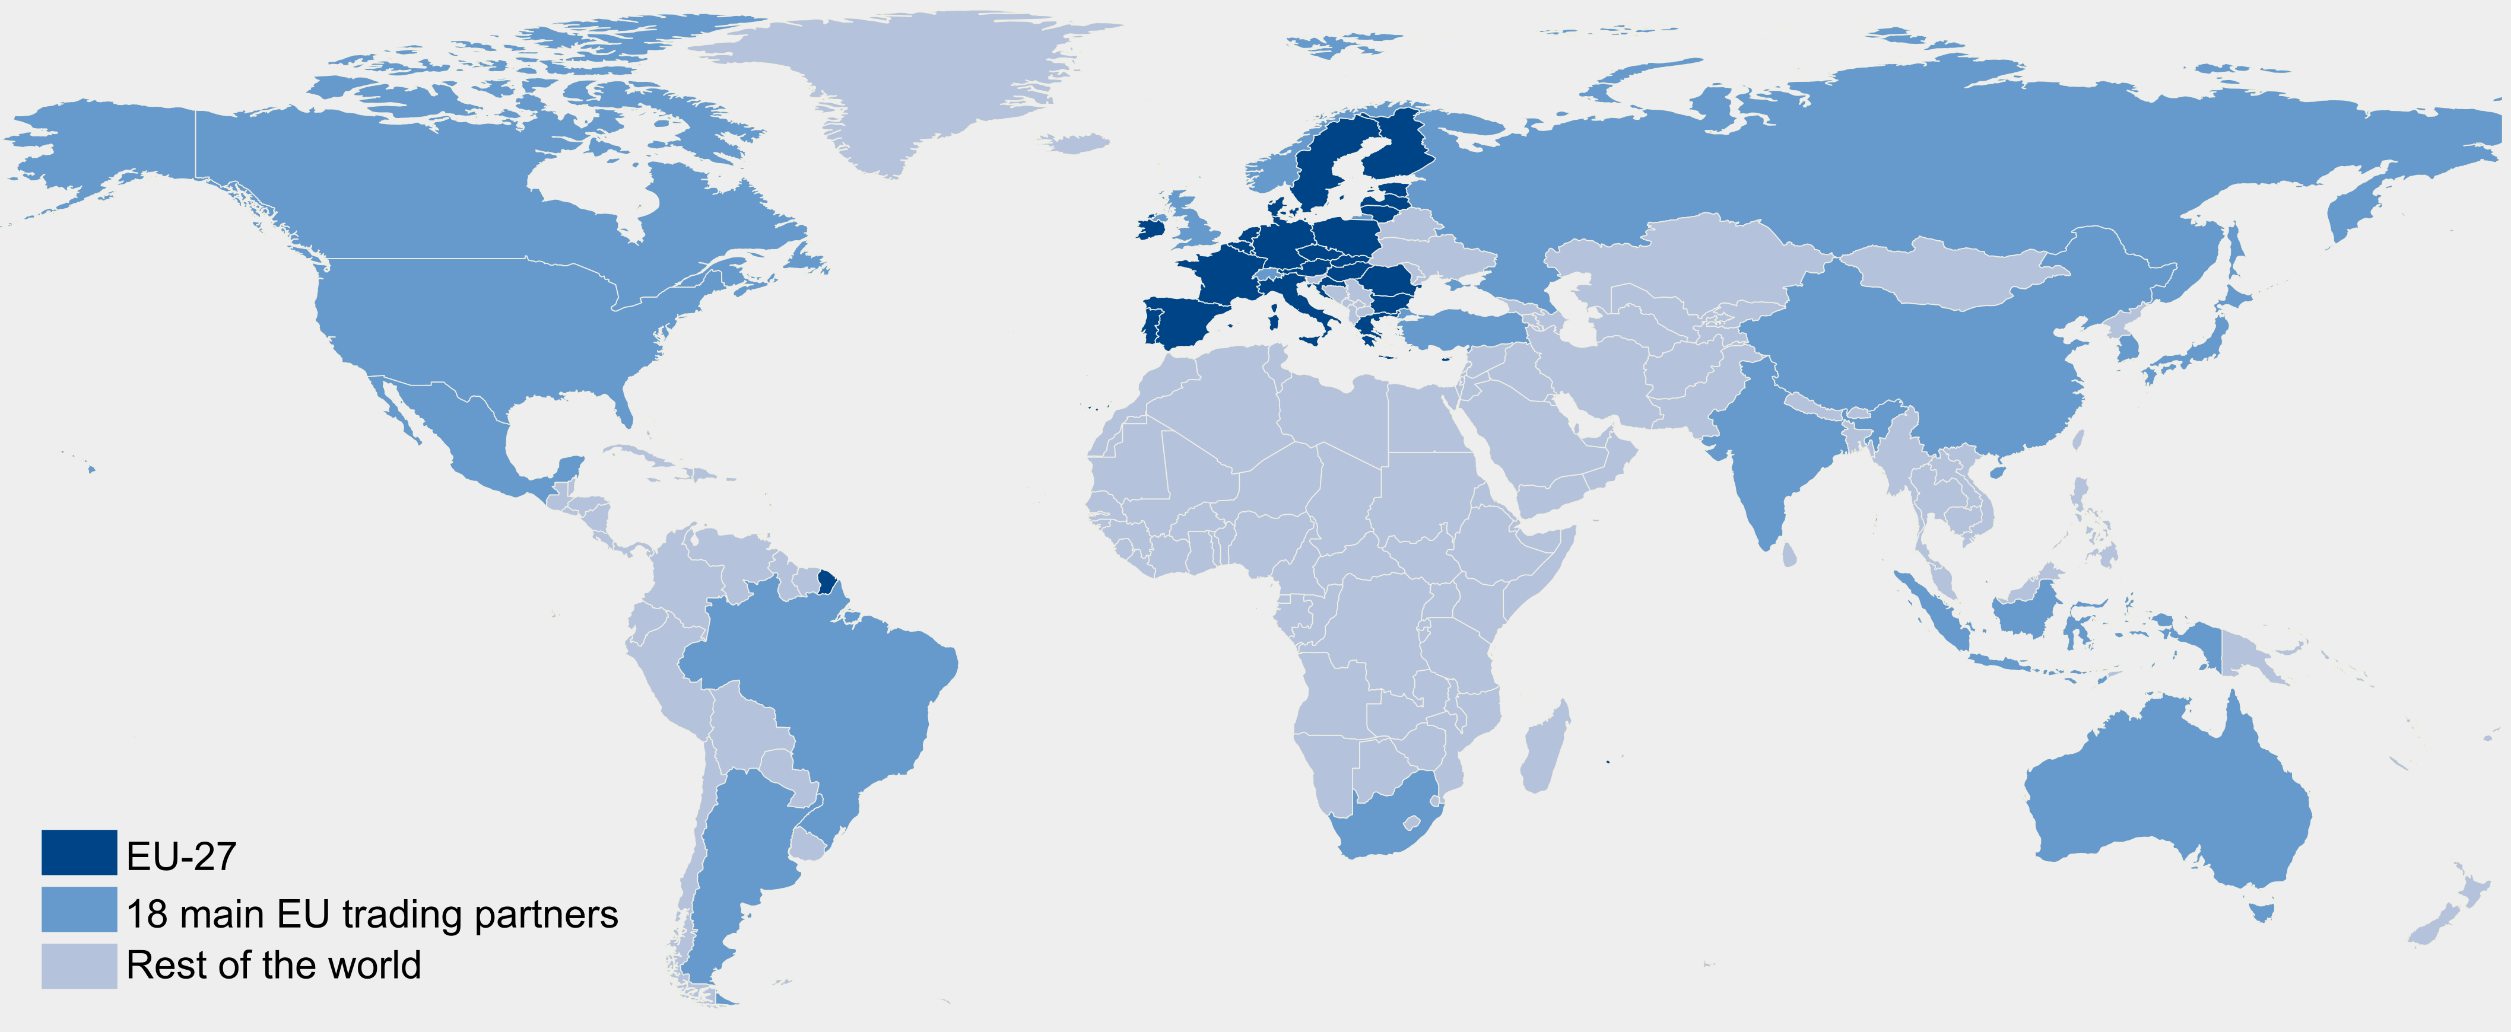
The 12 GVC indicators database
FIGARO tables are expressed in million euros (current prices and valued at basic prices).
The FIGARO tables present the relationship between the EU 27 + 18 non EU + RoW for 64 industries NACE rev.2 (‘ESA 2010 National accounts transmission program)
The FIGARO tables are available from 2010 to 2021 (T-2)
In this presentation → preliminary results for 2021 (from the 2023 edition)
https://ec.europa.eu/eurostat/web/esa-supply-use-input-tables/figaro

Slide 6




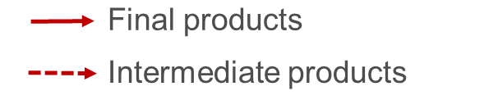
The 12 GVC indicators database
n. | Indicator
1 | Gross exports – the sum of intermediate and final exports.
2 | Gross imports – the sum of intermediate and final imports
3 | Domestic value added in exports – the exported value added produced anywhere in the economy
4 | Foreign value added in exports – the value added of intermediate imports embodied in domestic exports
5 | Domestic value added in foreign final use – the value added exported directly as final products, or indirectly via exports of intermediates that reach foreign final consumption through other countries
6 | Foreign value added in domestic final use – the value added imported directly as final products, or indirectly via imports of intermediates that reach domestic final consumption through other countries.
7 | Forward participation – domestic value added in exports which is exported again by trade partners as percentage of total exports
8 | Backward participation – foreign value added in exports as percentage of total exports
9 | GVC participation index – the sum of forward and backward participation
10 | Single exposure indicator - a combination of trade in value added and value added in trade to cover all exported value added
11 | Domestic employment in exports – the employment supported by exporting industries and by those supplying inputs to them (spillover effects)
12 | Domestic employment in foreign final demand – direct and indirect (spillover effects) employment supported by foreign final demand
III
III
II
I
IV
IV
EU
IV
Basic statistics
VA in Trade
VA in FU
Resilience/Semester
Other developments
Employment

Slide 7
Features of the EU GVC indicators database
Member State vs. EU perspective
Double counted components (DC)
Taxes less subsidies on products (TLS)
Direct purchases abroad by residents, and non-residents direct purchases on domestic territory

Slide 8
Member State vs. EU perspective
The EU is a unique political project, characterized by shared competences and responsibilities with its Member States
          Member State vs. EU perspective
The key difference lies in how intra-EU trade is accounted for, either as international (foreign) trade (MS perspective) or domestic trade (EU perspective)
The two perspectives answer different policy needs, e.g. from EU DGs:
  Member State perspective ➔ DG Grow (single market)
  EU perspective ➔DG Trade (international trade)

Slide 9


Member State vs. EU perspective
EU perspective
MS perspective

Slide 10
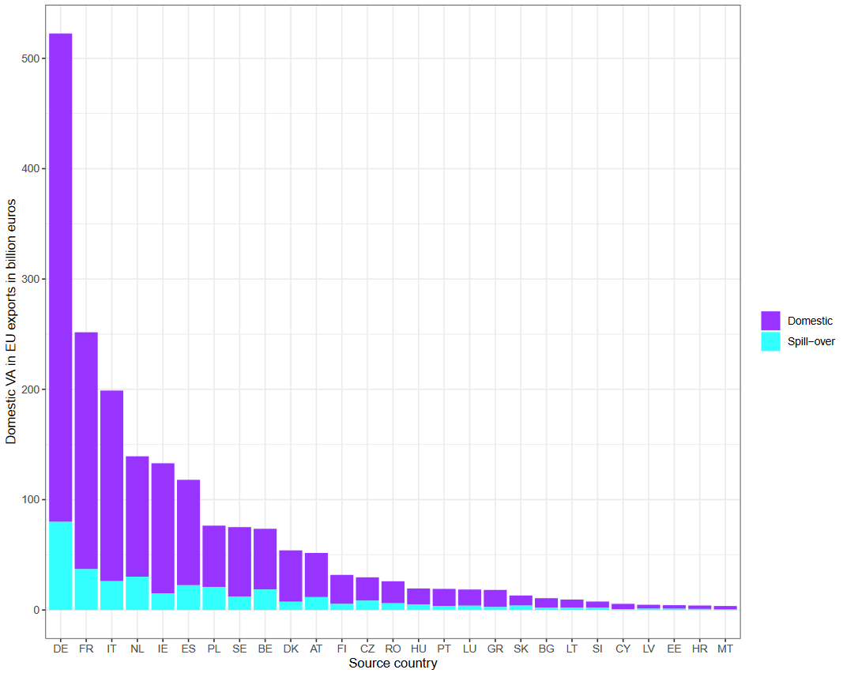
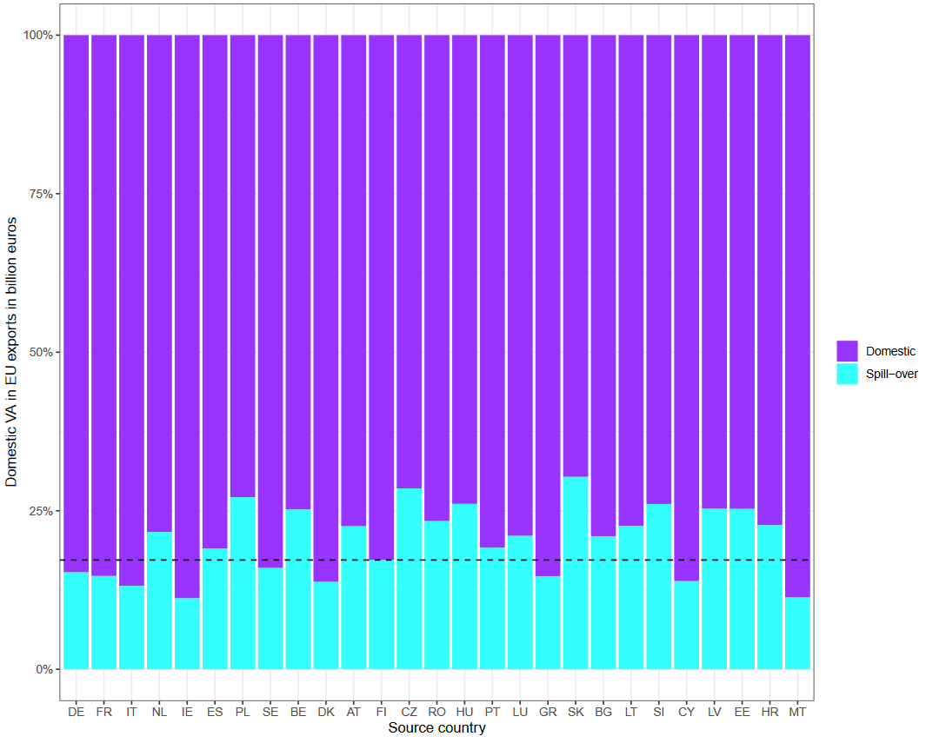

Member State vs. EU perspective
Intra-EU trade due to exports to the world supports employment and generates income → on average 18% of the domestic value added in exports
$$d^{tr}= 〈v^{t}〉L^{tr}〈e^{r}〉$$

Slide 11
DC and TLS decomposition
Typically, trade flows can be decomposed into: i) domestic and foreign fractions, ii) DC and iii) TLS
There are two options regarding ii) and iii)
  To include them → existing approaches
    Explicitly reports full decomposition, easier user interpretation
    …But causes overestimation (DC+TLS) in some industries
  To exclude them → EU GVC (this proposal)
    More accurate estimation of domestic value added in exports (basic prices)
    …But does not explicitly report full decomposition – DC and TLS needs to be added

Slide 12
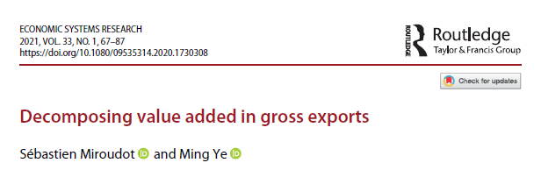
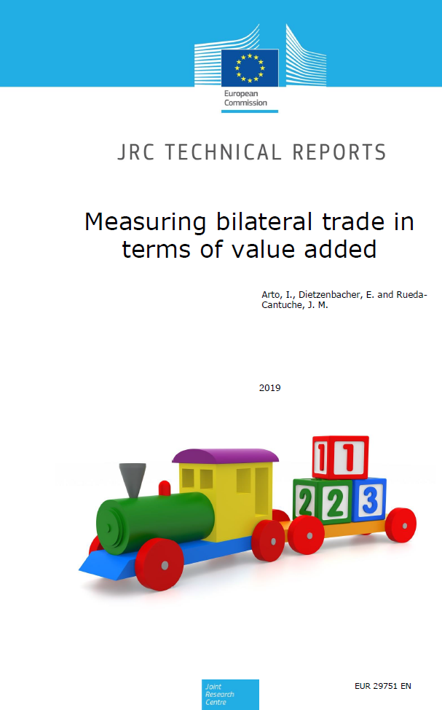
Double counted components
In general, there is a consensus on how to decompose foreign and domestic components for intermediate and final products
But there are still ongoing discussions about how to further decompose the double counted components due to trade in intermediate products
In the EU GVC database → ADR method

Slide 13
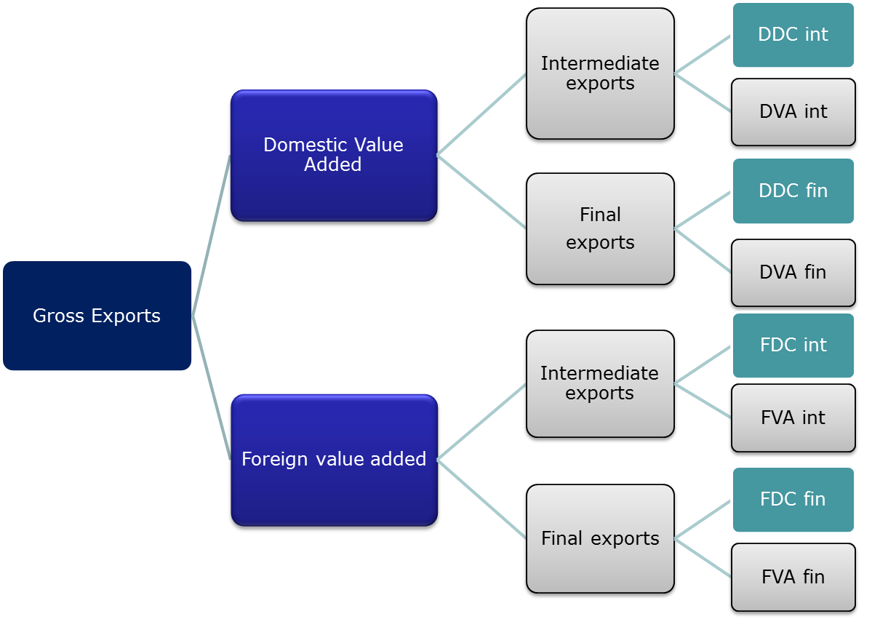
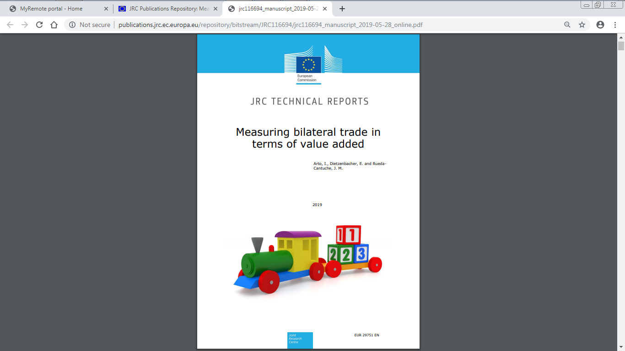
Double counted components

Slide 14
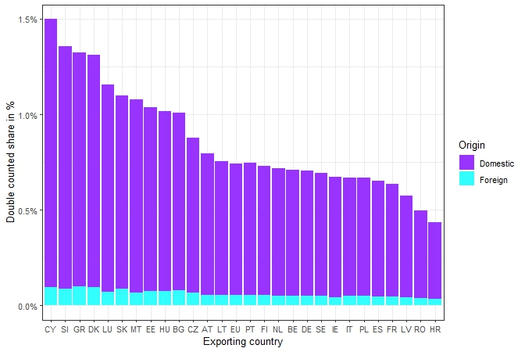
Double counted components
Range oscillates between 1.5% (Cyprus), and 0.5% (Croatia)
In 2021, on average for the EU DC represented around 0.75% of the value of exports (most of it is domestic)

Slide 15
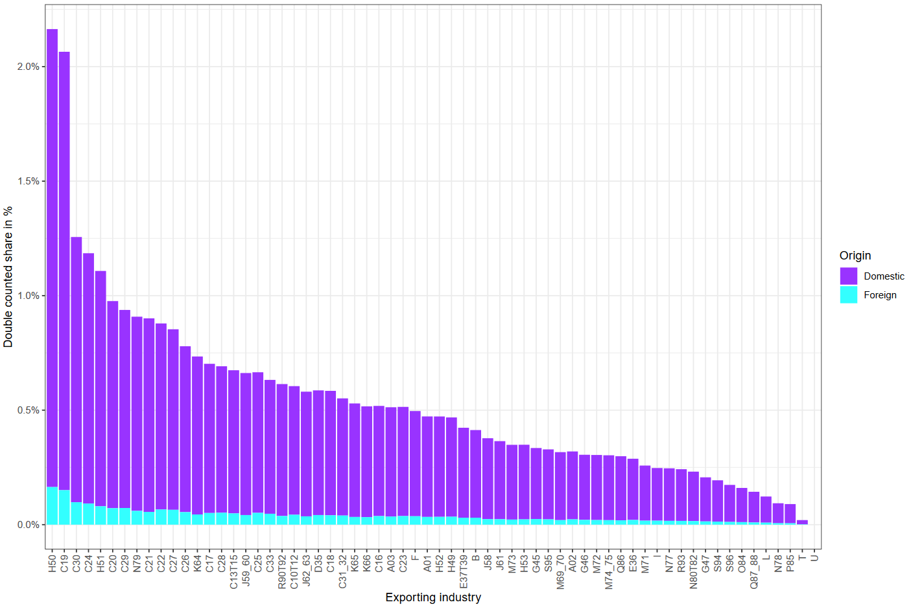
Double counted components
At industry level, highest shares observed for H50, C19 (above 2%), and also C30, C24, and H51 (above 1%)

Slide 16

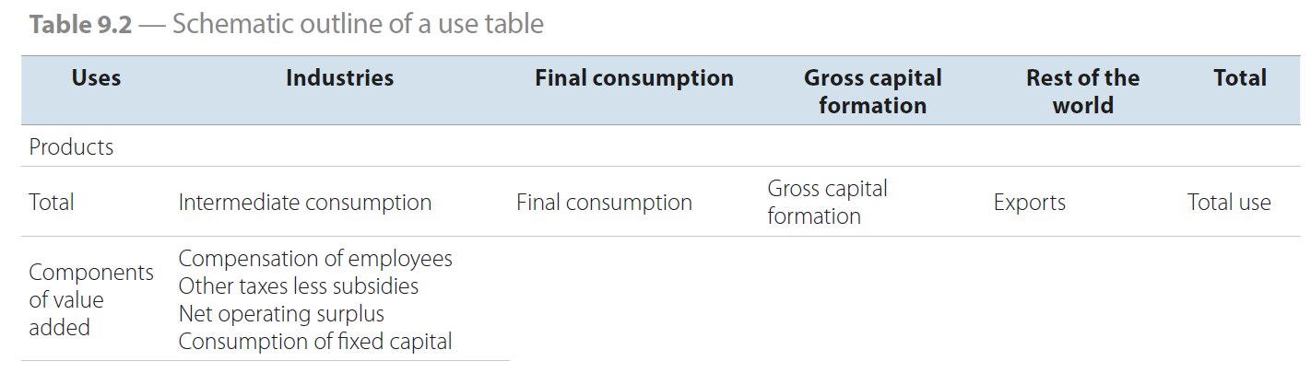
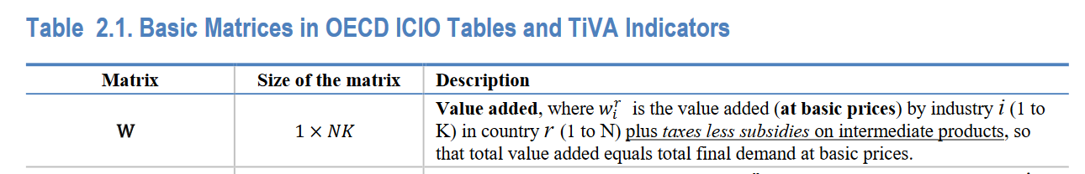
Taxes less subsides on products

Slide 17
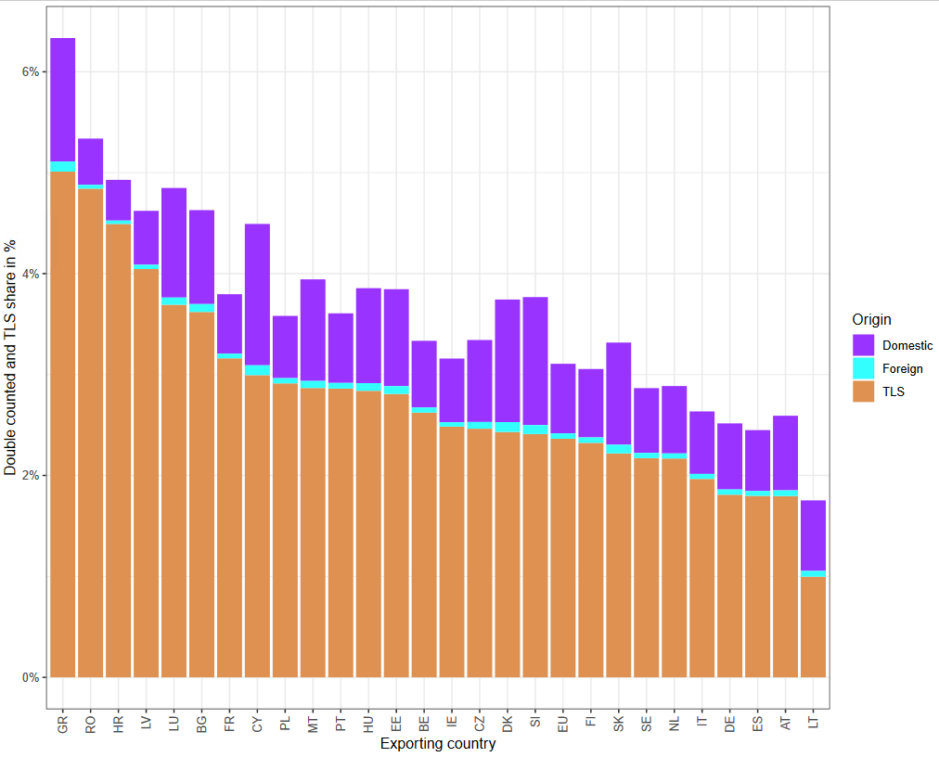
Taxes less subsides on products
At country level shares range oscillates between 5% (Greece), and 1% (Latvia)

Slide 18
Direct purchases abroad by residents and non-residents
Direct purchases abroad by residents, and non-residents direct purchases on domestic territory → two approaches:
  National concept
    Purchases abroad by residents → Imports
    Domestic purchases by non-residents → Exports
  Domestic concept
    Purchases recorded in the final use of the domestic country

Slide 19
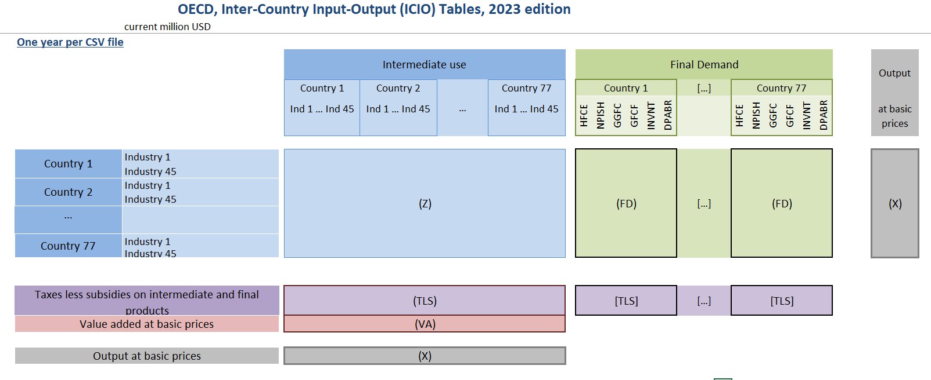
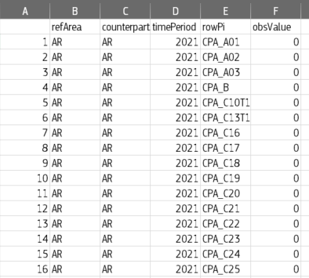
Direct purchases abroad by residents and non-residents
Differences concepts followed in GVC indicators databases:
  As an extra column in the Final Use table (DPABR) in OECD
  As a single figure in the Final Use table and disaggregated by product in an auxiliary table (FIGARO)

Slide 20
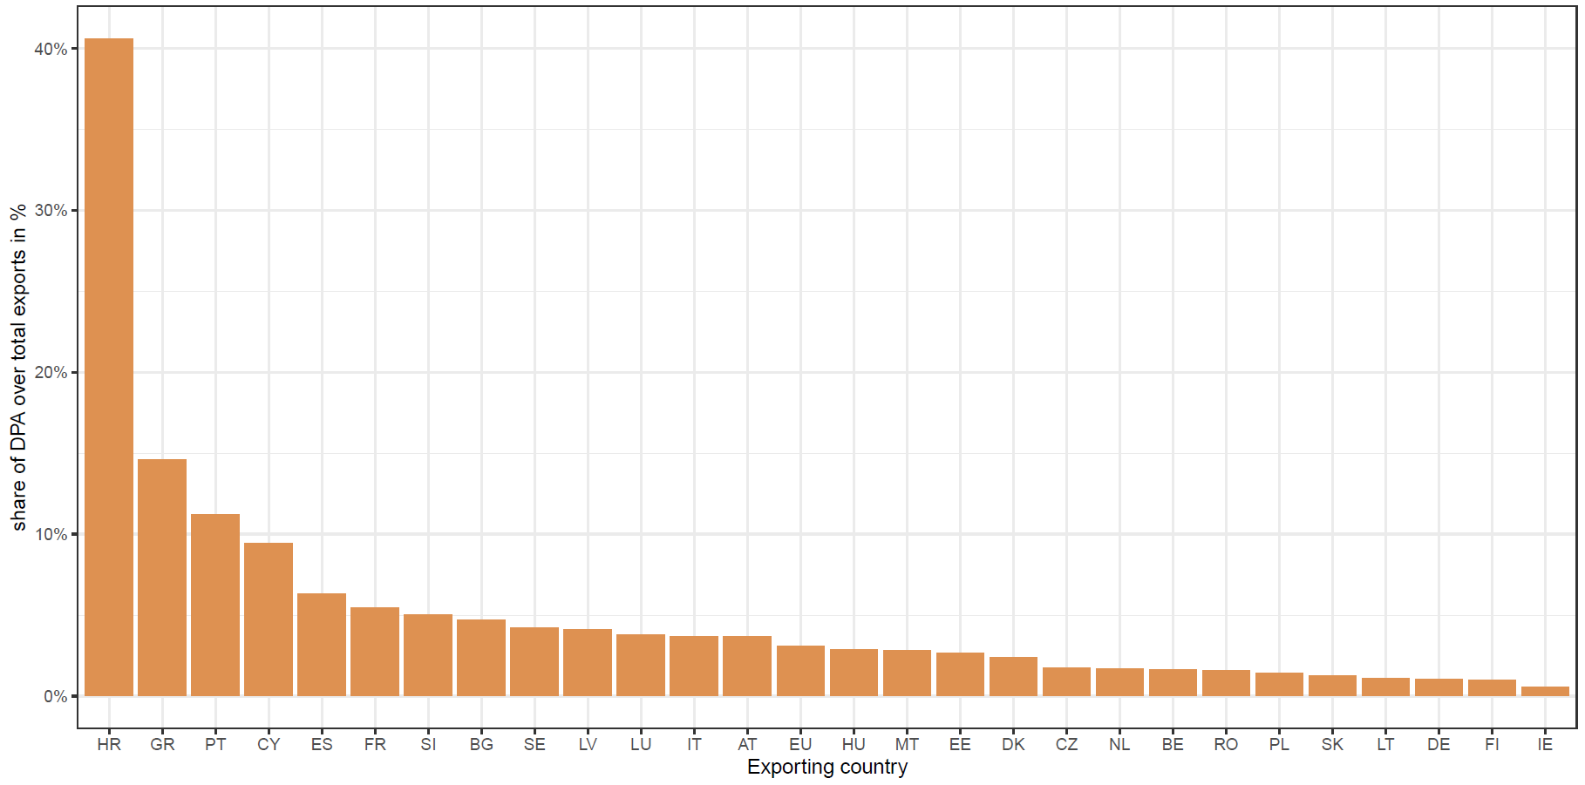
Non-residents purchases on domestic territory
On average purchases by non residents represent a small share,
Circa 3.5%
Share of purchases by non-residents over exports in %
However, for some countries represents more than 10%: Croatia (40%), Greece (15%), Portugal (11%)

Slide 21
Conclusions
A database of already calculated GVC indicators facilitates their use at different stages of the policy making cycle
Beyond data and assumptions, there are conceptual differences between existing GVC databases that need to be well understood by data compilers and users
Decisions regarding in(ex)cluding TLS and direct purchases abroad by residents, and non-residents direct purchases on domestic territory are more important than the double counted fraction
Both Member State and EU perspectives provides relevant information for EU policy making → results dissemination should take this into consideration
Publication of EU GVC database planned to beginning December 2024 → Stay tune!

Slide 22


Thank you
© European Union, 2024
Unless otherwise noted the reuse of this presentation is authorised under the CC BY 4.0 license. For any use or reproduction of elements that are not owned by the EU, permission may need to be sought directly from the respective right holders.

Slide 23
The 12 GVC indicators database
n. | Indicator
1 | Gross exports – the sum of intermediate and final exports.
2 | Gross imports – the sum of intermediate and final imports
3 | Domestic value added in exports – the exported value added produced anywhere in the economy
4 | Foreign value added in exports – the value added of intermediate imports embodied in domestic exports
5 | Domestic value added in foreign final use – the value added exported directly as final products, or indirectly via exports of intermediates that reach foreign final consumption through other countries
6 | Foreign value added in domestic final use – the value added imported directly as final products, or indirectly via imports of intermediates that reach domestic final consumption through other countries.
7 | Forward participation – domestic value added in exports which is exported again by trade partners as percentage of total exports
8 | Backward participation – foreign value added in exports as percentage of total exports
9 | GVC participation index – the sum of forward and backward participation
10 | Single exposure indicator - a combination of trade in value added and value added in trade to cover all exported value added
11 | Domestic employment in gross exports – the employment supported by exporting industries and by those supplying inputs to them (spillover effects)
12 | Domestic employment in foreign final demand – direct and indirect (spillover effects) employment supported by foreign final demand
Measures how much VA is exported to a direct trade partner (final and intermediate uses)
EU
Basic statistics
VA in Trade
VA in FU
Resilience/Semester
Other developments
Employment
Notes:
To be discussed

Slide 24
The 12 GVC indicators database
n. | Indicator
1 | Gross exports – the sum of intermediate and final exports.
2 | Gross imports – the sum of intermediate and final imports
3 | Domestic value added in exports – the exported value added produced anywhere in the economy
4 | Foreign value added in exports – the value added of intermediate imports embodied in domestic exports
5 | Domestic value added in foreign final use – the value added exported directly as final products, or indirectly via exports of intermediates that reach foreign final consumption through other countries
6 | Foreign value added in domestic final use – the value added imported directly as final products, or indirectly via imports of intermediates that reach domestic final consumption through other countries.
7 | Forward participation – domestic value added in exports which is exported again by trade partners as percentage of total exports
8 | Backward participation – foreign value added in exports as percentage of total exports
9 | GVC participation index – the sum of forward and backward participation
10 | Single exposure indicator - a combination of trade in value added and value added in trade to cover all exported value added
11 | Domestic employment in gross exports – the employment supported by exporting industries and by those supplying inputs to them (spillover effects)
12 | Domestic employment in foreign final demand – direct and indirect (spillover effects) employment supported by foreign final demand
Captures value added contributions to the final use of products:
  Directly (final goods or services)
  Indirectly via other countries’ intermediate uses or domestic intermediates uses.
EU
Basic statistics
VA in Trade
VA in FU
Resilience/Semester
Other developments
Employment
Notes:
To be discussed

Slide 25
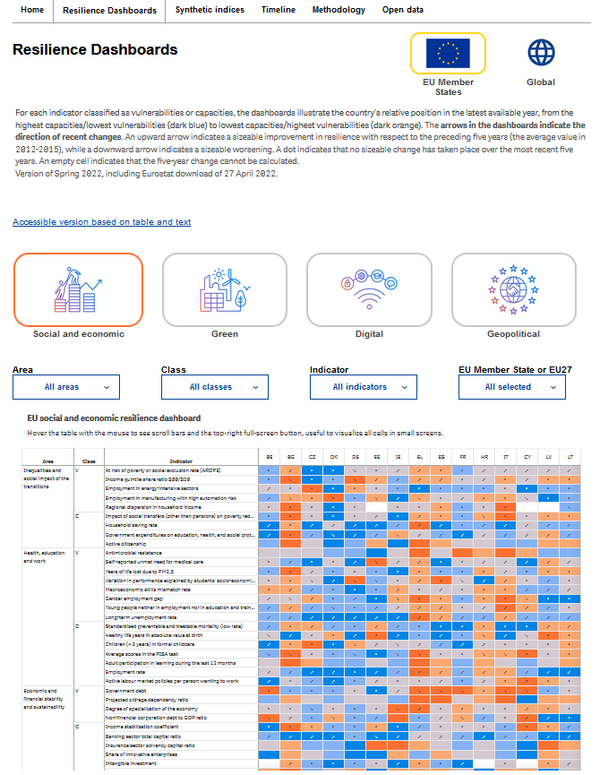

The 12 GVC indicators database
n. | Indicator
1 | Gross exports – the sum of intermediate and final exports.
2 | Gross imports – the sum of intermediate and final imports
3 | Domestic value added in exports – the exported value added produced anywhere in the economy
4 | Foreign value added in exports – the value added of intermediate imports embodied in domestic exports
5 | Domestic value added in foreign final use – the value added exported directly as final products, or indirectly via exports of intermediates that reach foreign final consumption through other countries
6 | Foreign value added in domestic final use – the value added imported directly as final products, or indirectly via imports of intermediates that reach domestic final consumption through other countries.
7 | Forward participation – domestic value added in exports which is exported again by trade partners as percentage of total exports
8 | Backward participation – foreign value added in exports as percentage of total exports
9 | GVC participation index – the sum of forward and backward participation
10 | Single exposure indicator - a combination of trade in value added and value added in trade to cover all exported value added
11 | Domestic employment in gross exports – the employment supported by exporting industries and by those supplying inputs to them (spillover effects)
12 | Domestic employment in foreign final demand – direct and indirect (spillover effects) employment supported by foreign final demand
Forward participation
Backward participation
Included in the Resilience Dashboard and European Semester country reports (Annex)
Basic statistics
VA in Trade
VA in FU
Resilience/Semester
Other developments
Employment
Notes:
To be discussed

Slide 26
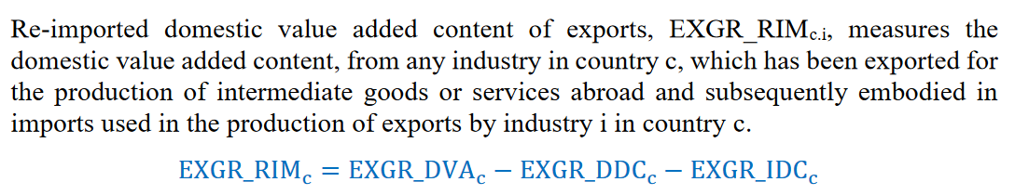




Double counted components
In the OECD TiVA → indicator EXGR_RIM which measures double counted value added from a domestic perspective
…But in the indicators decomposing the domestic and foreign fractions is included, e.g. EXGR_DVA
$$d^{ts}= 〈v^{t}〉B^{tr}〈e^{rs}〉$$
$$d^{ts}= 〈v^{t}〉L^{tr}〈e^{rs}〉$$
OECD
EU GVC
$$B$$
Global Leontief matrix
$$L$$
Local Leontief matrix

Slide 27
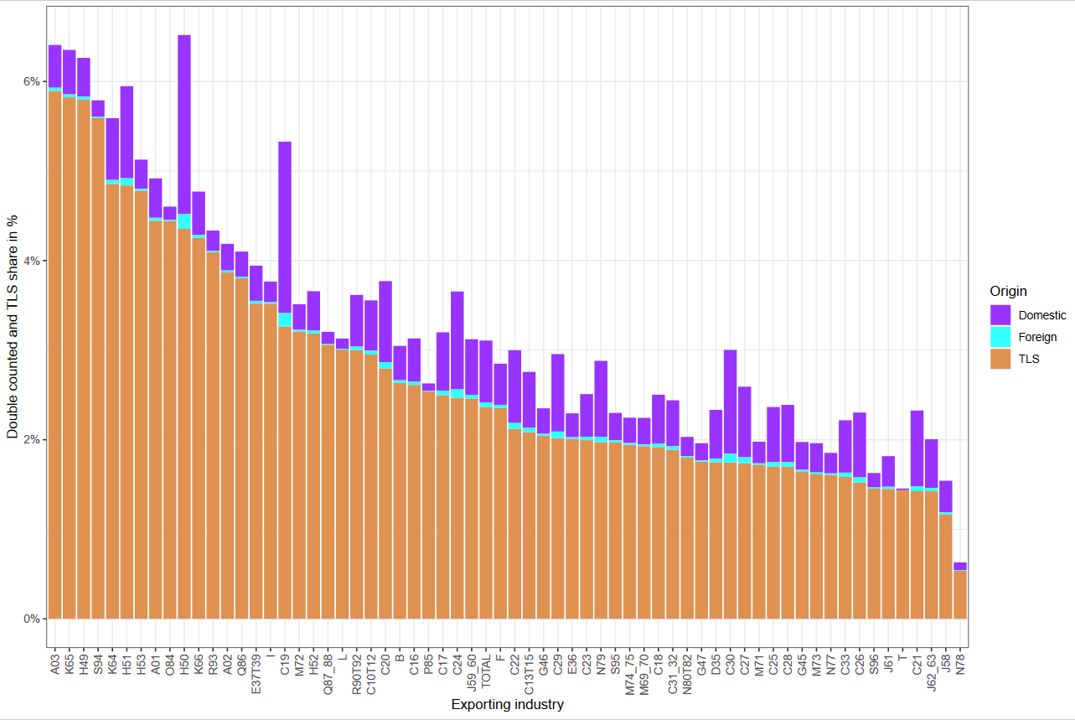
Taxes less subsides on products
TLS more important than DC, with shares up to nearly 6%, and 10 industries above 4%
There seems not to be direct relation between both variables

