Slide 1
DEPLOYERS An agent-based modeling tool for multi-country real-world data
Martin Jaraiz and Ruth Pinacho
Dept. de Electronica, ETSI Telecomunicacion Universidad de Valladolid, Spain

Slide 2
Global economy, one of the current major challenges
Policymakers complain about the lack of useful macroeconomic models and tools that help at least to understand, if not to predict, economic crises.
Macroeconomic studies can be carried out through:
Econometric analysis of data series.
Input-Output matrix analysis.
Simulation:
Equation-based modeling, like Dynamic Stochastic General Equilibrium (DSGE).
Simulation of the activity of agents (individuals, firms, banks,...) followed by data analysis, as if it were a Statistics Office survey (Agent-Based Modeling, ABM).
Currently, macroeconomic simulation is dominated by DSGE.
But DSGE can only reach a low level of disaggregation because the number of equations for current highly interconnected global economy becomes intractable.

Slide 3
Agent-Based Modeling (1/2)
Several agent-based macroeconomic modeling environments have already been developed.
Agent-based simulators have been used to conduct research in specific areas of economic policy, but not as a general simulator of a real economy like, for example, the European Union. Examples of studies:
“Securitization and business cycle: an agent-based perspective”
“Macroprudential policies in an agent-based artificial economy”
“Macroeconomic implications of mortgage loans requirements: An agent-based approach”.
But none of the four main valid models for the euro area, recently listed by Blanchard, is agent-based (Macroeconomics, a European perspective, 2021).
Why?

Slide 4
Agent-Based Modeling (2/2)
The main hindrance to the use of ABM is the difficulty to set up an initial economic system (labor, number and size of firms, a central bank, the government, external sectors...) that reproduces the structure and activity of a real system like a country.
Despite efforts, that include Artificial Intelligence techniques, the estimation or calibration of model parameters remains a challenge and a roadblock to bring ABM to real economic systems.

Slide 5
The DEPLOYERS program: a Darwinian approach to deploy real-world agent-based economic systems
The ABM approach presented here can read a SAM, IOT or SUT and deploy from scratch an economic system (labor, sectors of activity operating as firms, a central bank, the government, external sectors...) whose structure and activity yield a SAM with values in close agreement with those of the actual SAM snapshot.
What is important here is not the specific agent-based model used in this example (which can be any other) but the ability to deploy an economic structure that generates a SAM with the desired values.

Slide 6
A real economic system can be described by a Social Accounting Matrix
like this simple one (six sectors) for Spain in 2008
Firms are created following the pattern of each sector: when a firm from the AgroPesc sector sells 48021 product units pays 4259 m.u. as wages.
includes
Wages
Intermediate consumption
Value added
Dividends
We obtain the included GFCF component
Gross output

Slide 7
Firms act in response to the demand of the Final Consumers and of other firms (for their Intermediate consumption).
Final consumers

Slide 8
Agent-based modeling of real-world economic systems
Approach followed for the optimization task of finding a suitable economic structure:
The difficulty lays on finding a stable, self-sustaining economic system: number and size of each type of firm, household wealth and demand distribution, ...
Problem to be solved: calibration of parameters
Proposed solution: “let the agents do the job” (as they do in real life), no maths
Approach: survival of the firms best fitted to their supply-demand environment

Slide 9
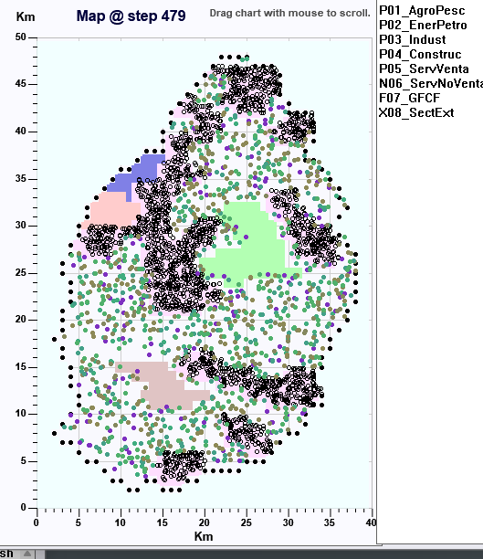
The deployment approach: An overview (1/2)
To build the economic system, the approach simulates the activity of a population of households (active population) in a geographic region, initially with a government, a central bank (CB) and an external sector.
The simulation starts without any firm.
Households begin to try to buy goods and open firms, of types chosen based on local demand.
Survival of the fittest: Firms that become unprofitable are closed.

Slide 10
The deployment approach: An overview (2/2)
A financial market will start as some firms reach a sufficiently large net worth (or meet any other requirement).
Prices evolve from interaction with neighbors following simple supply-demand rules: if the buyer's price is greater than or equal to the seller's price, the transaction takes place, and the buyer's price decreases and the seller's price increases by a small factor. Otherwise, there is no transaction and prices change in the opposite direction.
For the simple model and data (a six sectors SAM) used in the example, 2000 (active) individuals are sufficient to obtain statistically acceptable results and it takes about 2 minutes on standard CPUs. Since agents can have a limited number of interactions per month, the CPU time increases almost linearly with the simulated population.

Slide 11
Description of the model chosen for the deployment example (1/6)
(see Dawid et al. 2019)
Households initially have a few monthly cash wages. They go out once every time step (month) on a random day to buy goods from the neighborhood, initially in the relative proportion given by the SAM (households consumption) but modulated with a logit probability as a function of prices.
The consumption budget at step t, C_{h,t}, depends on the average income (I_{h,t}) and wealth (W_{h,t}) of each household (h), given by the following "buffer stock" rule:
C_{h,t} = I_{h,t} + K · (W_{h,t} – φ · I_{h,t})
H. Dawid, P. Harting, S. van der Hoog, M. Neugart, Journal of Evolutionary Economics 29, 467–538 (2019).

Slide 12
Description of the model chosen for the deployment example (2/6)
Initially there are no firms, but households without a firm have a certain probability of opening a new one of the most frequently demanded types in the neighborhood.
Unlike households, firms can borrow from banks. They sell to households and to other firms for their intermediate consumption (IC). Each firm attempts to produce enough to replenish a level of inventories that is estimated based on average recent demand.
If the firm has liquidity needs to finance production, it can apply for a bank loan. Subsequent volume production is conditioned to the outcome of the application. In addition, if a company meets the requirements to enter the stock market, it can issue new shares.

Slide 13
Description of the model chosen for the deployment example (3/6)
After taxes are paid, a fraction of the profits is distributed as dividends to the owner or shareholders, and the remainder is deposited in a payment account.
A simplified financial market takes place in a clearing house that collects at the end of the month all sell and buy orders (ordered from high to low price) and allocates them starting from their high price end. Prices are adjusted following the supply - demand rule mentioned above.

Slide 14
Description of the model chosen for the deployment example (4/6)
Banks can be founded by households that meet the criteria defined by the Central Bank. We have followed the model described by Dawid et al. [4], in which the bank's ability to extend credit is constrained by a capital adequacy requirement (CAR) and reserve requirement ratio (RRR). The interest rate offered to a firm is an increasing function of credit risk, following the internal risk-based (IRB) approach of the Basel Accords, based on the firm's probability of default on the loan, which is estimated from its debt-to-equity ratio.
The Government, according to the data provided by the SAM, collects taxes and redistributes them in the form of subsidies (unemployment) to households and public spending. In our simple model, the government uses the Central Bank to deposit or withdraw its surplus or deficit, respectively.

Slide 15
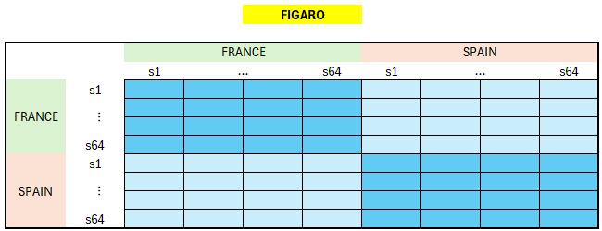
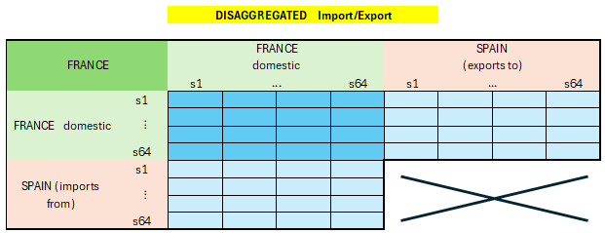
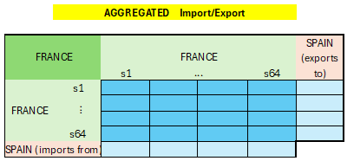
Description of the model chosen for the deployment example (5/6)
Building a SAM from FIGARO
The Import/Export interaction between two countries can chosen to be:
Disaggregated (more CPU time)
one sector per domestic sector in each country
(64 columns, 64 rows per external country)
Aggregated
one sector in each country
(1 column, 1 row per external country)

Slide 16
Description of the model chosen for the deployment example (6/6)
“External sectors” are implemented as special Import/Export domestic firms.
These interface firms can interact (buy/sell) not only with domestic firms but also with external-sector interface firms from other countries.
In the current implementation, they can interact with domestic companies and households daily and with other countries on a monthly basis.

Slide 17
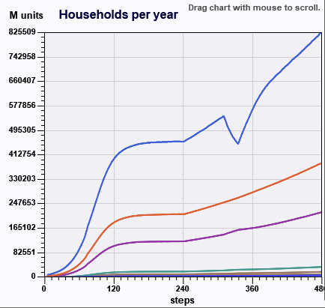
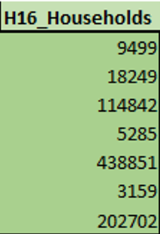
The Self-deployment approach (1/3)
During an initial “deployment stage”, individuals open new firms of the SAM activity sectors, and close unprofitable ones, until the activity output level reaches the experimental final consumers values.
Household consumption by sector
deployment

Slide 18
The Self-deployment approach (2/3)
Upon deployment, the system undergoes a “calibration stage” until it reaches a steady state (like constant average stock of firms, not shown).
During this stage, the program adjusts parameters like K in the household consumption budget.
We refer to this deployment + calibration range the “assisted production” stage.
Household consumption by sector
assisted production
calibration
deployment

Slide 19
The Self-deployment approach (3/3)
At the end of this “assisted production” stage (deployment + calibration) we have the initial state of an economic system that reproduces the values of the real system SAM.
This state can be saved and used to see the response of the system to a series of what-if tests.
Household consumption by sector
assisted production
simulation run
Tax increase

Slide 20
deployment EXAMPLES (1/4)
6-sectors SAM, 2000 indivs
100 * simulation / real values

Slide 21
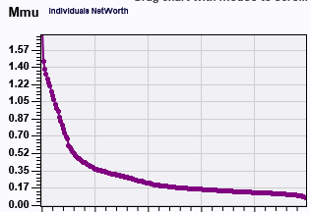
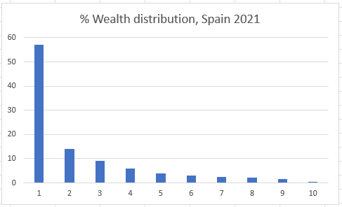
deployment EXAMPLES (1/4)
Individuals Wealth distribution
Simulation
For the simple model and data used in the example (a six sectors SAM):
2000 (active) individuals are sufficient to obtain statistically acceptable results.
It takes about 2 minutes on standard CPUs. Since agents can have a limited number of interactions per month, the CPU time increases almost linearly with the simulated population.

Slide 22
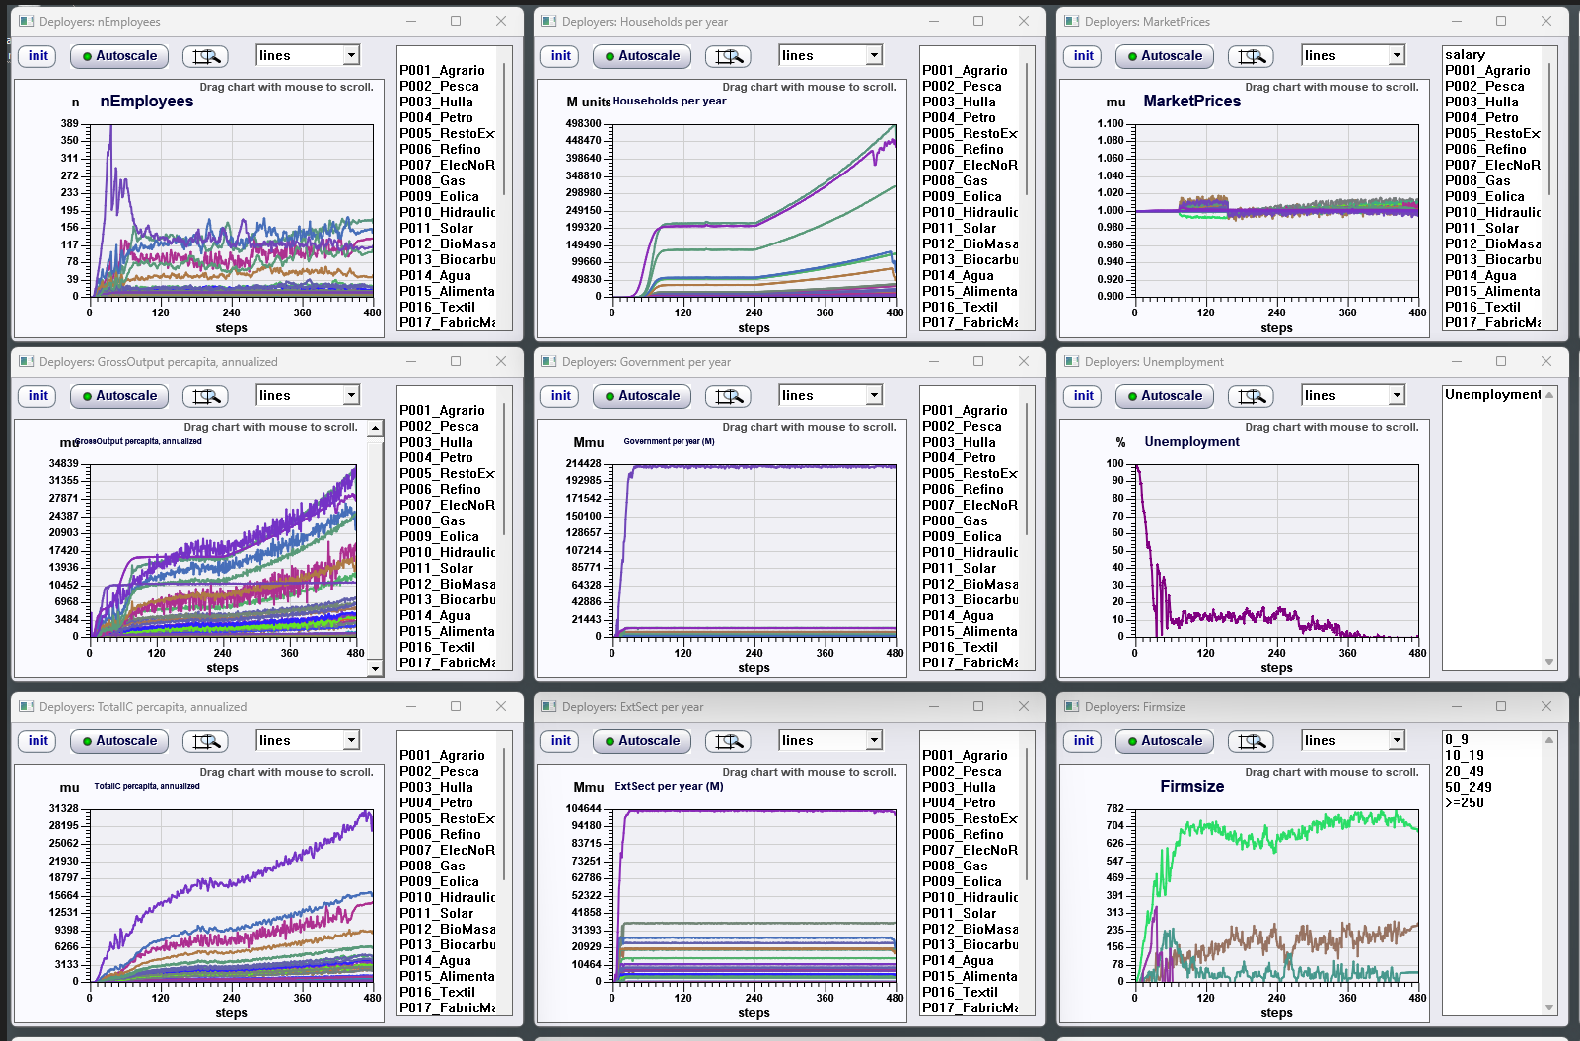
deployment EXAMPLES (2/4)
31 sectors SAM, Spain

Slide 23
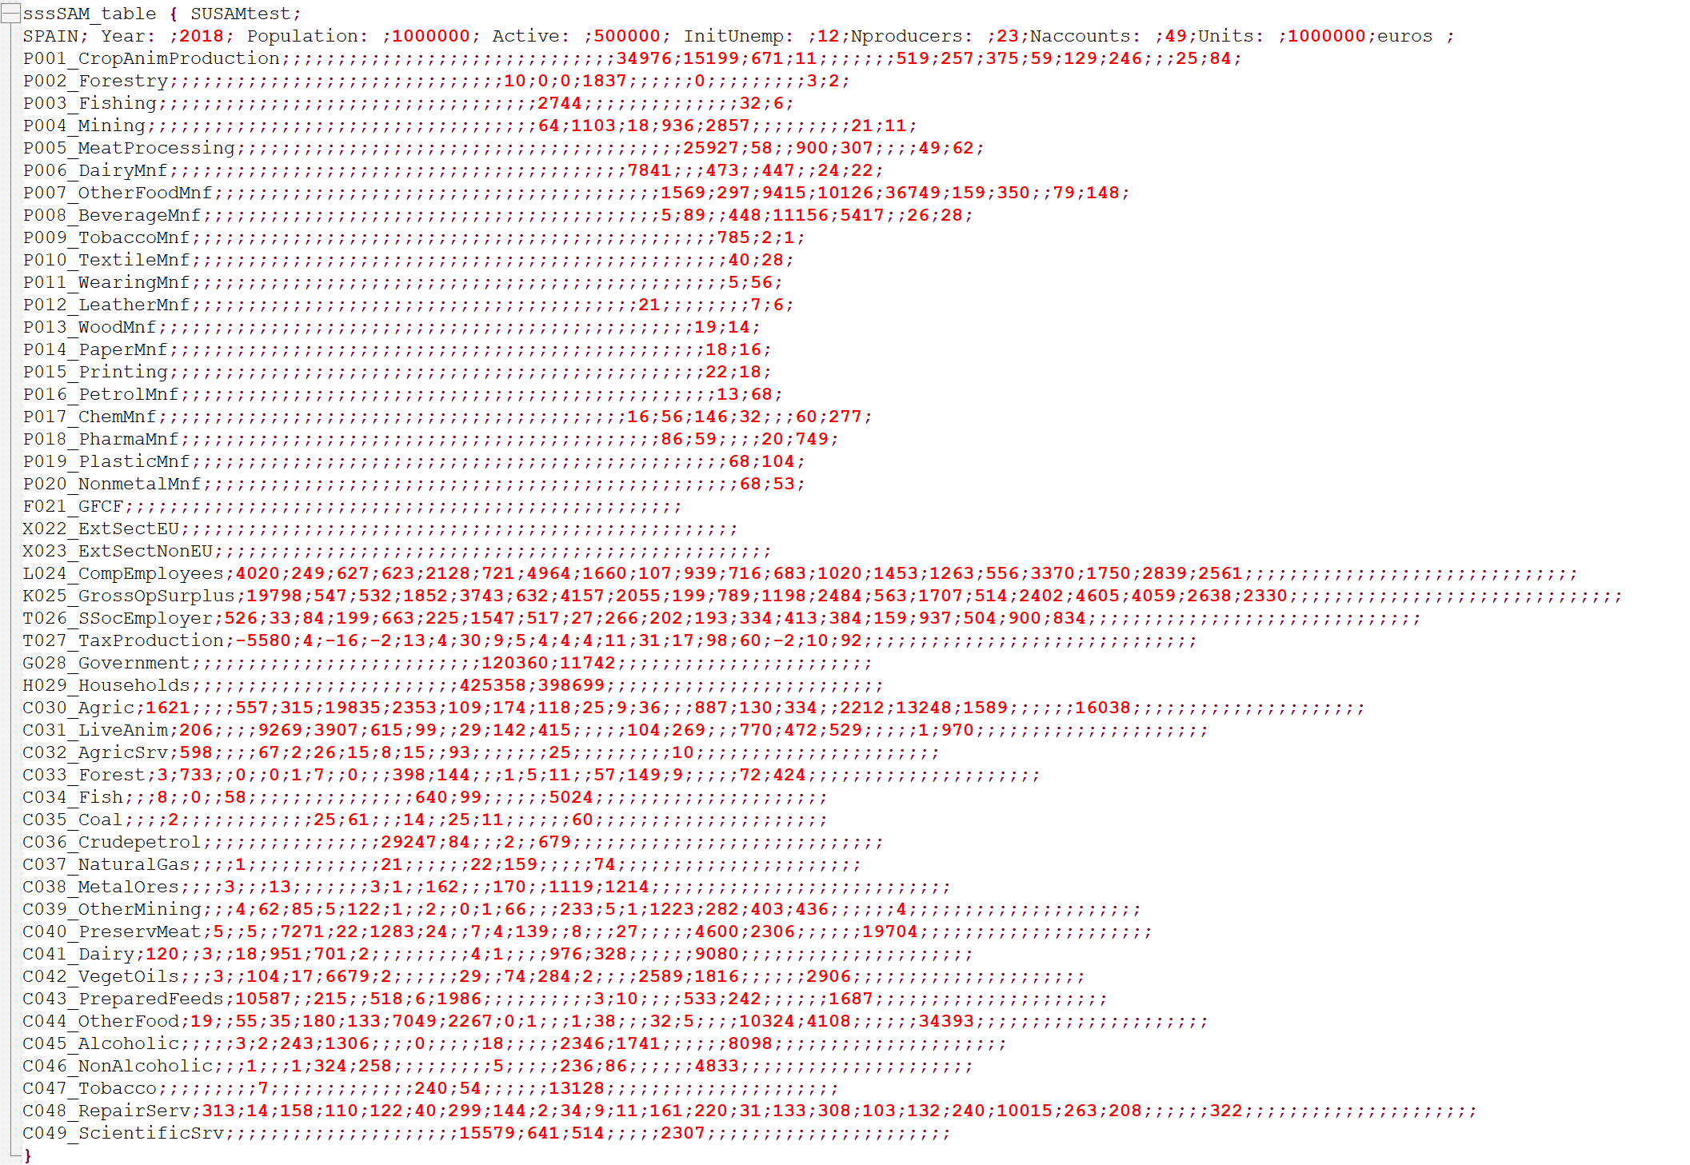
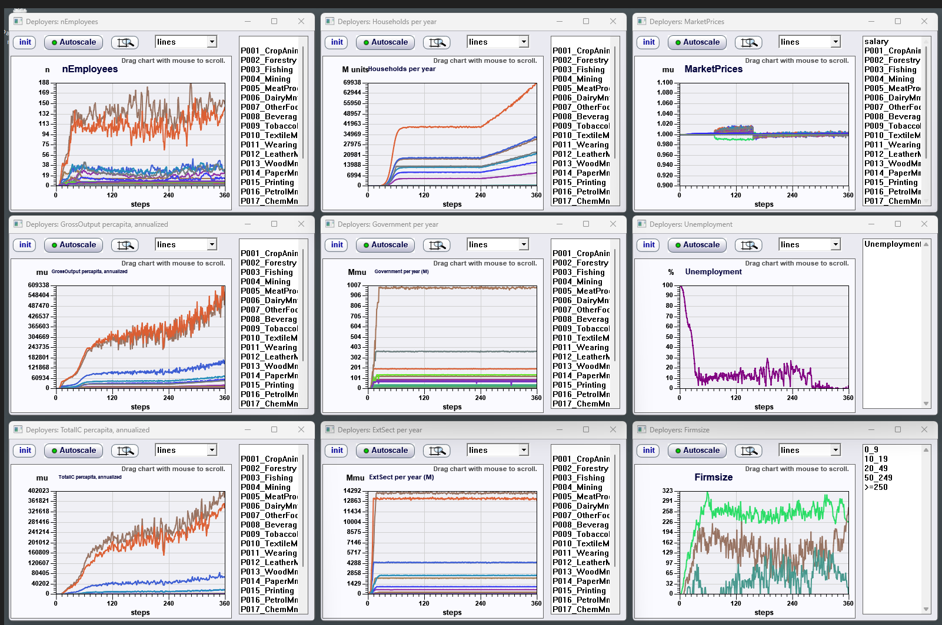
deployment EXAMPLES (3/4)
Calibration with a Supply-Use Table (SUT )

Slide 24
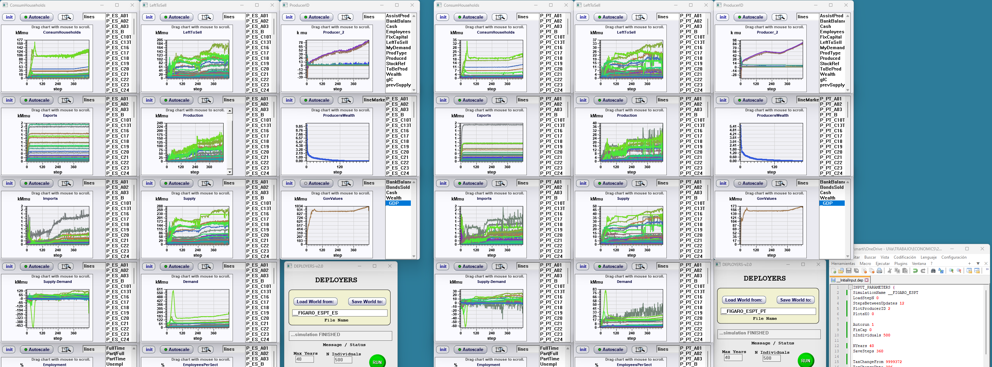
deployment EXAMPLES (4/4)
Using FIGARO intercountry tables
Calibration to the FIGARO intercountry input-output, industry by industry, 2018 table (64 sectors, 46 countries)
Example of deployment and calibration, up to month 360, of Spain and Portugal (aggregated External Sectors in this simulation)
The simulated active population is only 500 individuals per country: enough to achieve a stable economic system and accurate final consumptions and GDP.
15 minutes CPU time.

Slide 25
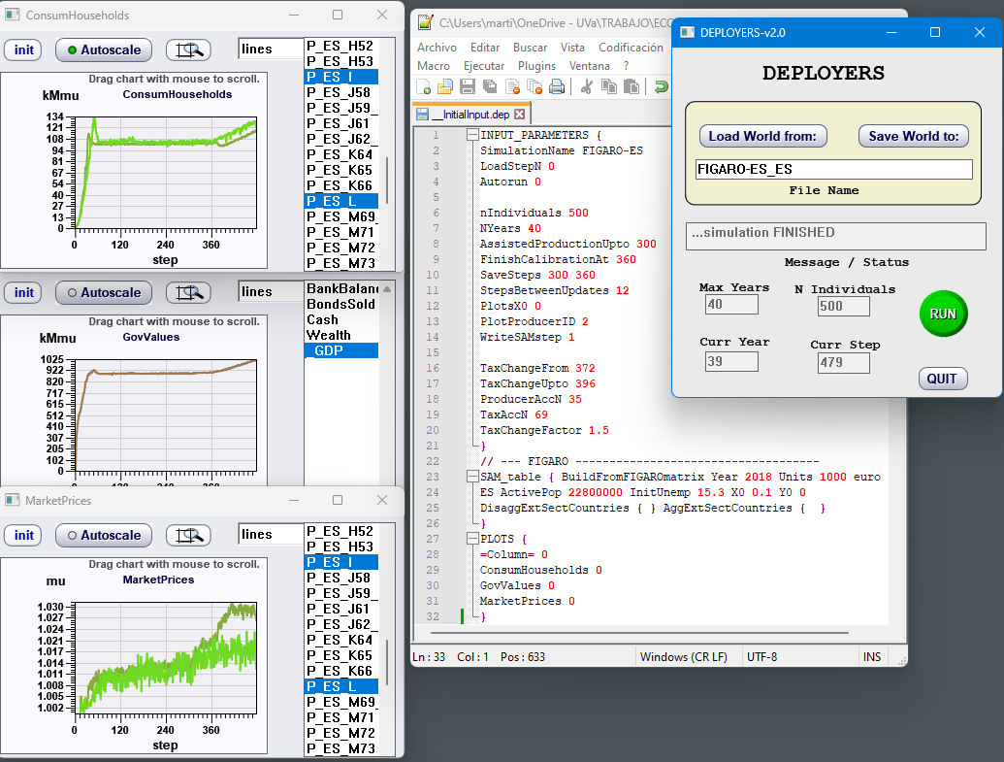
deployment EXAMPLES (4/4)
Using FIGARO intercountry tables
Calibration to the FIGARO intercountry input-output, industry by industry, 2018 table (64 sectors, 46 countries)
Example of a Tax increase, at step 372, of Spain + RoW.
10 years simulated : 2.5 minutes CPU time.

Slide 26
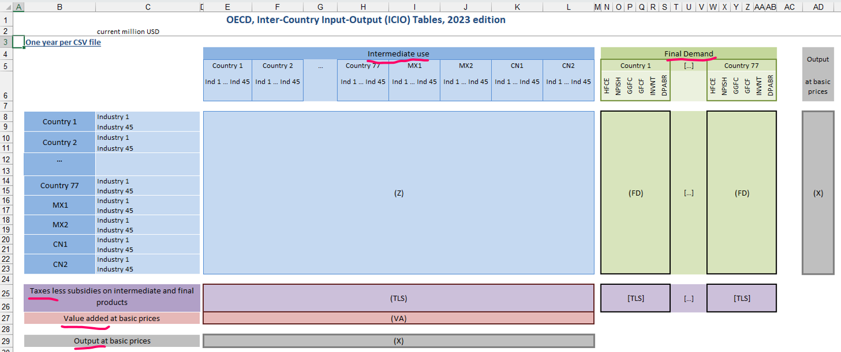
WHAT’S NEXT? (1/4)
Besides FIGARO, other databases could, in principle, be used to calibrate any ABM model using this approach, without user assistance.
For example, the OECD, Inter-Country Input-Output (ICIO), industry by industry, tables (45 industries, 77 countries).[VA needs to be split as VA = L + K]

Slide 27
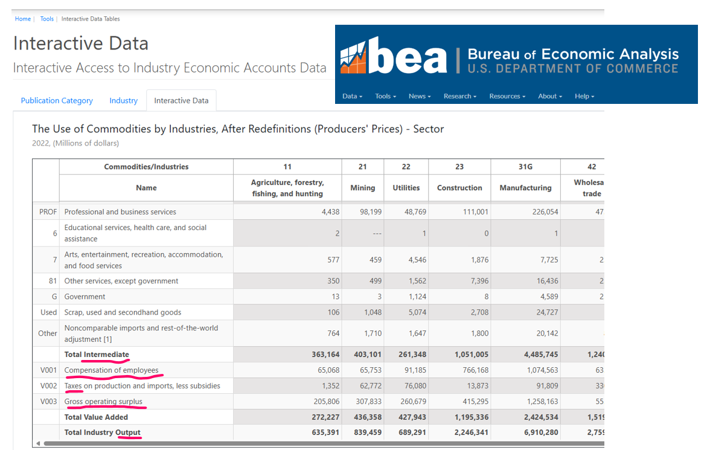
WHAT’S NEXT? (2/4)
Another example of readily usable database is the Supply-Use Tables
from the U.S. Bureau of Economic Analysis:

Slide 28
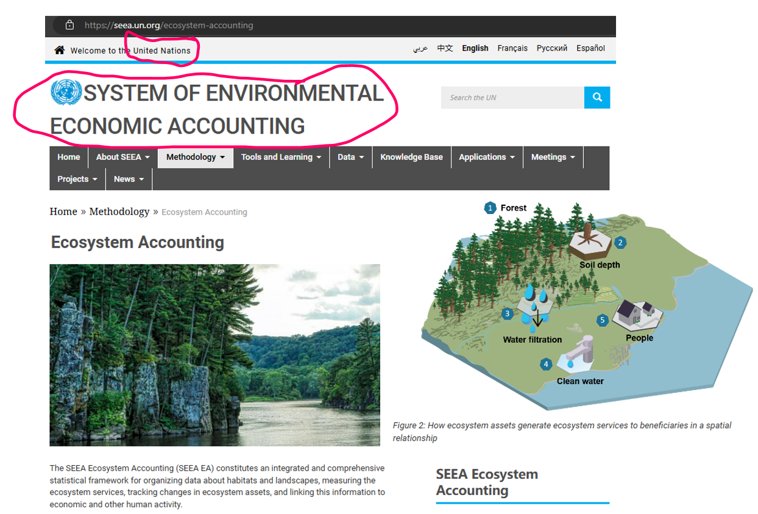
WHAT’S NEXT? (3/4)
Because of its Agent-based foundations, other layers from extended databases, like ecology, social networks or epidemiology, that can interact with economics, could be added in the future.

Slide 29
WHAT’S NEXT? (4/4)
The underlying assumptions driving this work are:
The level of detail (disaggregation) of the structure plays a crucial role in macroeconomic modeling and simulation.
Agent-based modeling can cope efficiently with
Highly disaggregated structures
driven by heterogeneous behavioral rules (no equations, just if-then rules).
There is an awesome amount of static data available. This approach paves the way to ABM dynamic simulation of complex, interacting systems (economics or other) through calibration with static data.

Slide 30
Conclusion
The methodology presented enables the use of agent-based models for real-world economies, as demonstrated by calibrating an ABM model to replicate a SAM, an SUT or an intercountry IOT.
This Darwinian deployment approach opens the way for the use of ABM as a tool for policymakers dealing with complex data from real macroeconomic systems.
In the long term, it provides a testbed for a possible joint effort to develop a unified and holistic ABM model for a country, a multiregional or a global system, including other layers (ecology, climate, social networks...) that can interact with economics.

