Slide 1
Compiling bi-regional input-output tables for the Netherlands capitalising on existing data
IIOA 2024, Santiago
Oscar Lemmers, Ineke Bijlsma, Veronique Verhees, Statistics Netherlands
July 2024

Slide 2
Outline
Why regional information, why a pilot?
Methods and data
Results
Experiences and conclusions

Slide 3
Why regional information?
Dutch policy makers ask for regional information, e.g.,:
Dependencies on foreign countries, direct/indirect
Effect of investment policies on the region and the rest of the country (a.o., circular and energy transition)
Linkages in the own region (a.o., inclusiveness)
Linkages obscure the picture. E.g., a regional car manufacturer hardly imports, but it buys much from a metal manufacturer in another region that imports many raw materials. Hence the car manufacturer is still (indirectly) dependent on foreign countries.

Slide 4
Everything is connected!
The statistical way to map this: bi-regional input-output tables, showing how much industry A in region X sells its output which is input of industry B in region X or Y, consumers in X or Y, government in X or Y and so on

Slide 5
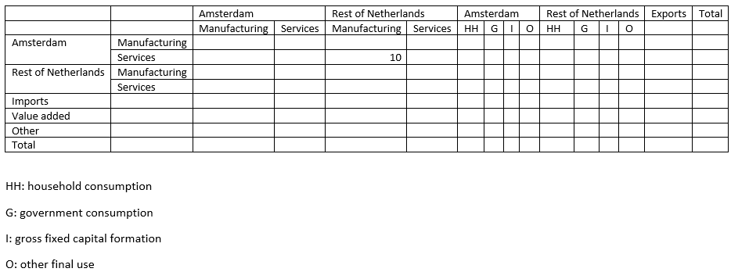
A simplified bi-regional input-output table
Example: services in Amsterdam sells 10 to manufacturing in Rest of Netherlands

Slide 6
Why a pilot?
Data of Statistics Netherlands is old: before 2000
Thissen et al. (2018) compile data for EU regions, 2000-2010, 63 industries and 12 Dutch regions
Huang & Koutroumpis (2023) compile data for EU regions, 2018, but only 10 industries
Statistics Netherlands thought it could provide more regional detail, more recent data, by using existing (micro)data
Pilot: cost-effective way to see where one runs into problems.

Slide 7
Methods and data

Slide 8
General approach
Compile regional supply and use tables: in each region, show by product who is supplying it (industries, imports) and who is using it (industries, consumers, government, gross fixed capital formation, exports)
Connect supply and use to see which supplier in which region sells which product to which user in which region, using trade and transport data
(similar to compiling a regular input-output table)

Slide 9
Derive regional supply & use tables
Assume that regional supply and use of products by industry is the same as national supply and use of products by industry (given an industry, each region has the same production structure)
Result: regional supply & use tables, for 53 regions we have this region and Rest of Netherlands, 64 industries, 25 types of goods and 116 types of services

Slide 10
Data: detailed national and regional macrodata
National Accounts:
about 400 products (goods and services), who supplies them (135 industries, imports), who uses them (industries, households, government, gross fixed capital formation, exports)
Regional Accounts:
For 135 industries in 53 regions: value of production; there is no product level

Slide 11
Origin and destination of use and supply
Trade data: by product by region, what is origin and destination (own region, rest of Netherlands, overseas)
Patch supply, use and trade.
Result: by product, by region, how much is incoming/outgoing, from/to own region, Rest of Netherland, abroad. In other words: all linkages, at product level.

Slide 12
Data: bi-regional trade & transport data (goods)
Combine data from international trade, regional transport, supply and use, regional accounts, cf. Lankhuizen et al. (2020)
Existing dataset: for 53 regions, for 25 products, trade and transport flows within own region, with Rest of Netherlands, with abroad

Slide 13
Data: detailed international trade data (services)
Combining trade in services by enterprise, regional distribution of enterprises, assumption that an enterprise in an industry trades in its “typical services”
Result: for 53 regions, for 116 services, trade with abroad
Missing: trade within own region, trade with Rest of Netherlands. We distinguished between “local services” and “national services” and used proportionality assumptions

Slide 14
Aggregate product detail away
Result: given a region X, how much does industry A supply to
Each industry in region X
Each industry in Rest of Netherlands
Households in region X of Rest of Netherlands
Government in Region X or Rest of Netherlands
…
Foreign countries (exports)
In other words: a bi-regional input-output table

Slide 15
Data we would like to have

Slide 16
Regional microdata/final use macrodata
Which products (goods and services) produces each enterprise where (difficult with multiple branches)
Which products is each enterprise using where
Consumption by household & government, gross fixed capital formation, at product level, by region
We used crude estimates that can be improved

Slide 17
Results

Slide 18
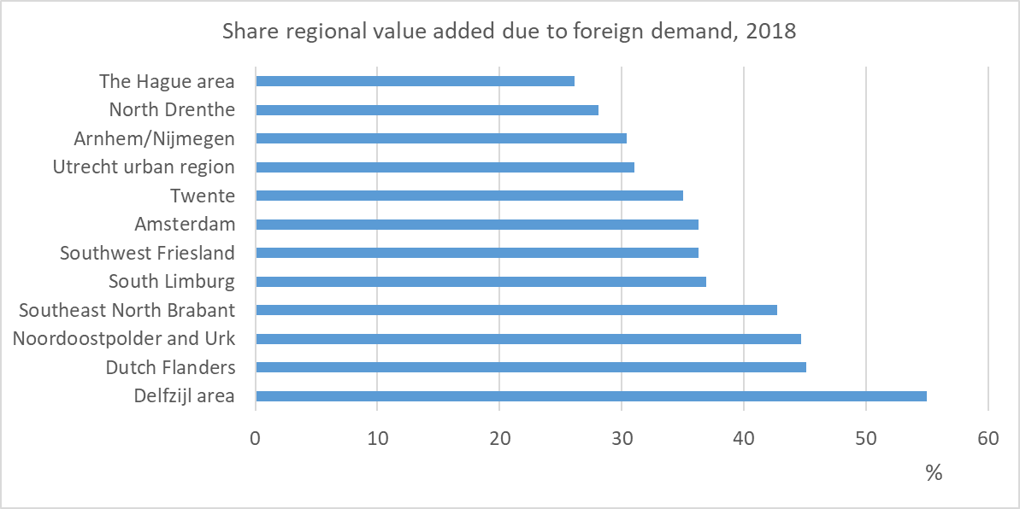
Results (I): regional-global linkages - output
How dependent is a region on foreign demand, via its exports (direct dependence) and its supplies to domestic exporters (indirect)?

Slide 19
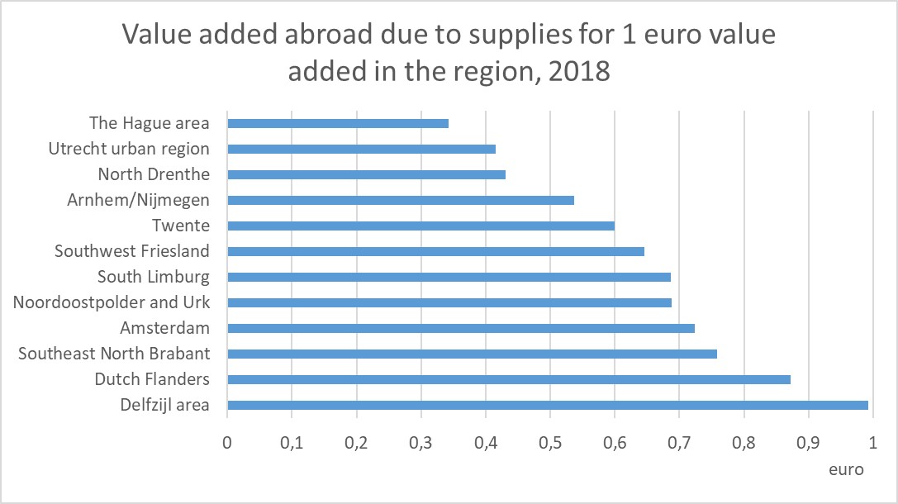
Results (II): regional-global linkages - input
Multiplier effects, relevant for, e.g., subsidies: how much will leak abroad?

Slide 20
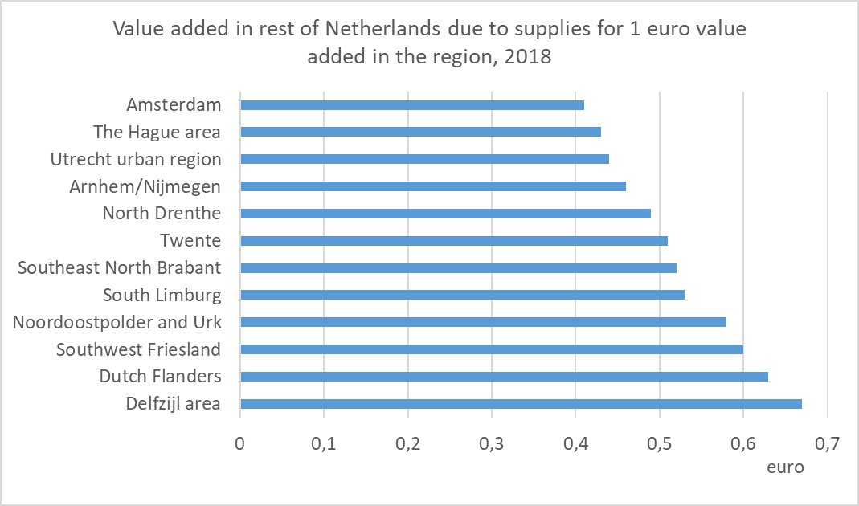
Results (III): inter-regional linkages
Multiplier effects, relevant for, e.g., Dutch Growth Fund: what does a regional investment yield for the rest of the country?

Slide 21
Experiences and conclusion

Slide 22
Experiences
The regional import, export and transit data is very useful
Still some balancing necessary
Not easy: link trade & transport margins of re-export to region
Big problem: intra- and inter-regional trade in services
Stepwise approach (first version regional tables used only trade in services, second version also trade in goods) showed: for some regions adding goods detail does not change the table too much (Vlieger, 2023)

Slide 23
Conclusion
High demand for regional linkages related to, e.g., dependence on foreign countries, investment policies, circular & energy transition
Much possible already with existing national information
Common problem: get access to information at other institutes (Dutch solution: very strong Statistical Law)
Intra- and interregional trade in goods: doable with data
Big problem: intra- and inter-regional trade in services

Slide 24
Thank you for your attention!
Questions – if time & agenda permit
Or later via o.lemmers@cbs.nl, i.bijlsma@cbs.nl, vce.verhees@cbs.nl

