Slide 1

The GIANT initiative
30th International Input-Output Conference
José E. Durán – UN-ECLAC
José M. Rueda-Cantuche – EC’s Joint Research Centre
Santiago de Chile, 4 July 2024

Slide 2





RG-TiVA meeting – 16/11/22
There was broad agreement …!
… to increase the involvement and commitment of the OECD RG-TiVA group members towards the convergence on a global benchmark of the required input data entering the various TiVA initiatives
Notes:
Form a working level steering committee with one or two representatives per institution that would have at least two (either virtual, hybrid or physical) meetings per year in order to increase their involvement and commitment towards the convergence on a global benchmark of the required input data entering the various TiVA initiatives. The committee will have annual rotating chairs.

Slide 3
Setting up a Steering Committee (9/3/23)
  Formed a working level steering committee with OECD, EC, ADB, IMF and UN-ECLAC, chaired by the EC-JRC and UN-ECLAC. The following work programme were agreed, and organised in the following tasks:
    Definition of the ICIO components on which the convergence will be monitored (EC, OECD, UN-ECLAC)
    Definition of the terms of reference of a common repository for the global benchmark input data: structure and feasibility. (EC, UN-ECLAC)
    Workshops, webinars and other events, including technical assistance (ADB, IMF, OECD)
    Common identity signs (logo/acronym) for dissemination, long-term initiatives, releases and acknowledgements (e.g. formal agreements)
Notes:
Form a working level steering committee with one or two representatives per institution that would have at least two (either virtual, hybrid or physical) meetings per year in order to increase their involvement and commitment towards the convergence on a global benchmark of the required input data entering the various TiVA initiatives. The committee will have annual rotating chairs.

Slide 4

The GIANT initiative
(Global Input-output AccouNTs)
12/05/23

Slide 5
What is GIANT?
The GIANT initiative is an inter-agency network consisting of the Asian Development Bank (ADB), the European Commission (Eurostat and JRC), the Organisation for Economic Co-operation and Development (OECD), the International Monetary Fund (IMF) and the United Nations Economic Commission for Latin America and the Caribbean (UN-ECLAC)
World Trade Organisation (WTO) and United Nations Economic Commission for Africa (UN-ECA) joined later on

Slide 6
What is GIANT for?
The goal of GIANT is to converge on a common global benchmark for the input data used by the partner organisations to produce global IC-SUIOTs
The common benchmark will ensure comparability and consistency in the compilation of Global Input‑Output Accounts across different institutions and regions
It will also provide users with consistent messages, irrespective of the specificities of any given ICIO

Slide 7
What will GIANT do?
To achieve convergence, the GIANT initiative will explore the feasibility of a common repository of globally benchmarked data and work on a long-term strategy to exchange processed data and associated metadata
Participating organisations will also work together to strengthen the technical capacity of countries in the compilation of national SUTs and IOTs as well as TiVA analysis through workshops, webinars, trainings, and other capacity-building activities

Slide 8
A chronology of the GIANT meetings
(former Steering Committee)
09/03/23 – Seville (Spain) – EC-JRC premises – Steering C
12/05/23 – Online – Steering Committee
27/06/23 – GIANT1: Sardinia (Italy) – IIOA / UNECA joins
26/09/23 – GIANT2: Online / WTO joins
29/11/23 – GIANT3: Paris (France) – OECD premises
18/03/24 – GIANT4: Online
01/07/24 – GIANT5: Santiago (Chile) – UN-ECLAC premises

Slide 9
Task 1 – Monitoring NAMAs
Agreed to share official / estimated data for the main GDP components used by the partner organisations to produce global IC-SUIOTs
Monitoring (Excel) file filled in by each organisation with as many countries and years as available
Template and automated filtering of differences across initiatives
Agreed to work on the differences among the initiatives data

Slide 11
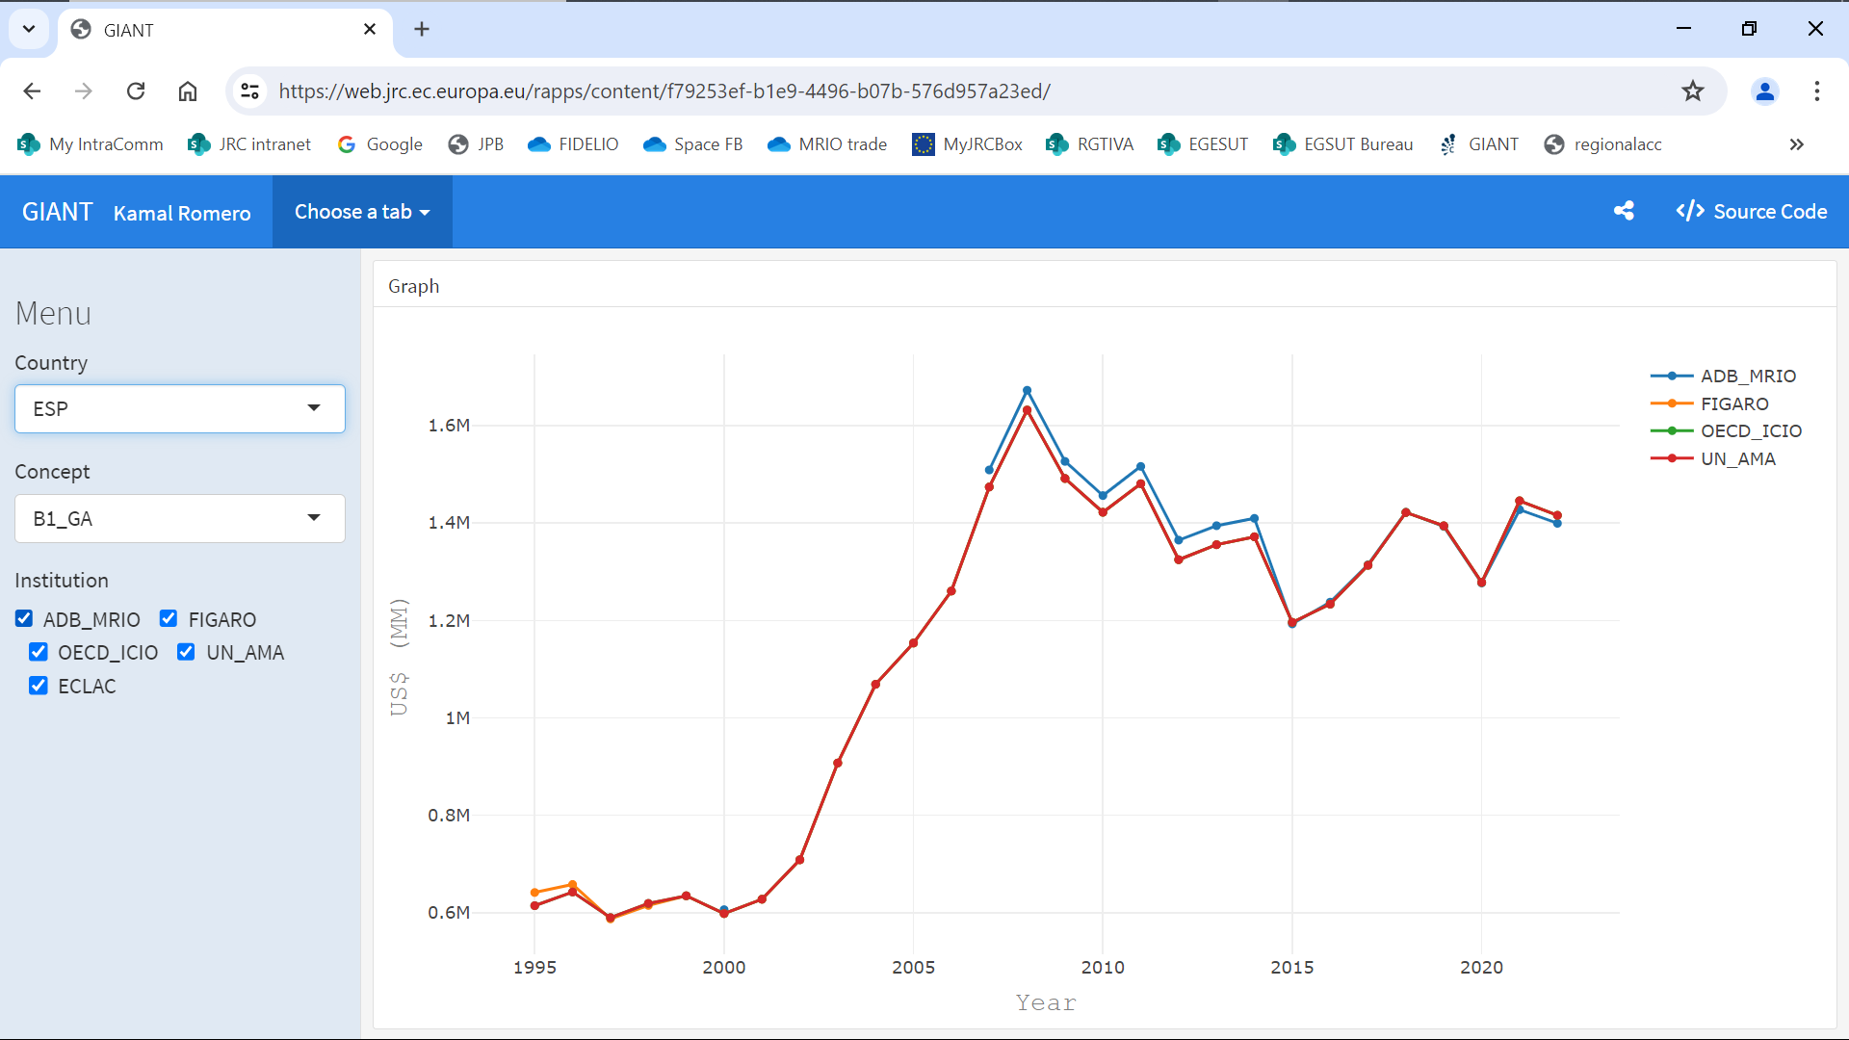

Slide 12

Task 2 – Repository
As a temporary solution while preparing the terms of reference for a longer-term repository, Eurostat presented the Eurostat’s CIRCABC platform as a tool to share information between the GIANT members
The CIRCABC platform is well known by some initiatives and provides important features that meet the goals set by the Committee; namely the platform is secure, and closed space/folders with restricted access can be easily created and managed
Access will be granted only to designated members of the GIANT initiatives; those who upload any file will be the only ones with right to delete or edit it; others will be able to view and download it
Gather the monitoring files (Task 1) but also materials for workshops and technical assistance, national SUTs, etc.

Slide 13
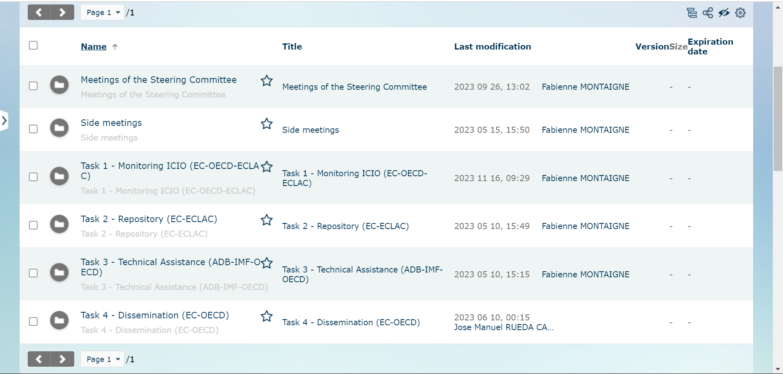
Task 2 – Repository

Slide 14
Task 3 – Technical assistance
Agreed to upload in the GIANT repository the current and future training and workshop programmes, manuals and other methodological documents of each initiative
Already existing support from OECD to trainings organised by ADB and IMF, among others
Agreed to promote and explain the purpose of the GIANT initiative at workshops/meetings organised by other initiatives

Slide 15
Task 4 – Dissemination
Agreed to start acknowledging the GIANT initiative as a source data in upcoming releases, for all initiatives that will have used the data uploaded in the repository, for each respective regional-global ICIO
UN-ECLAC and Eurostat/JRC agreed to have a joint release of LAC-ICIO and FIGARO in summer 2025
Agreed to pursue a multilateral agreement in order to have a common understanding of the commitment among members, with a set of data to be shared
Design of a new logo including the seven institutions
Conferences (IIOA, SHAIO); webinars.

Slide 16


GIANT initiative (2024)
Comparative analysis of GDP main components used by GIANT members, for common countries
➔ distribution of roles and timeline towards a common global benchmark for ICIOs
Populate the repository with more info & data
More cooperation among institutions to align ICIO data and methods (bilateral visits and agreements) and strengthen the support for technical assistance
Design of a new logo including the seven institutions
Multilateral agreement & conferences

Slide 17
Thank you very much!
¡Muchas gracias!
José E. Durán – UN-ECLAC
José M. Rueda-Cantuche – EC’s Joint Research Centre

