Slide 1
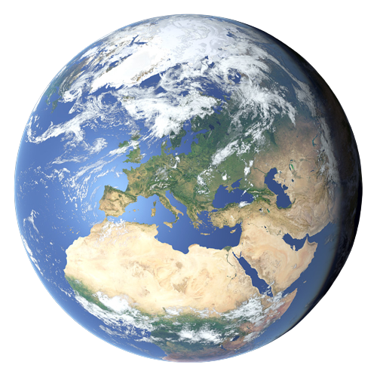
The 2024 release of the FIGARO tables
José M. Rueda-Cantuche
EC Joint Research Centre
Fabienne Montaigne
Eurostat
30th International Input-Output Association Conference, Santiago de Chile, 01/07/2024

Slide 2
What is FIGARO?
‘Full International and Global Accounts for Research in input-Output analysis
EU inter-country Supply, Use and Input-Output tables and applications (environment, economic globalisation)
EU perspective + countries perspective
Long-term co-operation between Eurostat and
the European Commission’s Joint Research Centre
Since 2021, FIGARO published annually as official statistics
Allow deep analyses of the socio-economic and environmental effects of globalisation
https://ec.europa.eu/eurostat/web/esa-supply-use-input-tables/figaro

Slide 3





























Who are the main actors?
National statistical institutes collect and verify data
Use common definitions and methods
Send data to Eurostat
ESS
EU Regulations for data transmission
Consolidate data
Produces European aggregates
Publish official statistics for Europe as open data
Eurostat
Methodology
Economic modelling
GVC indicators
Other FIGARO applications
JRC
Figaro

Slide 4

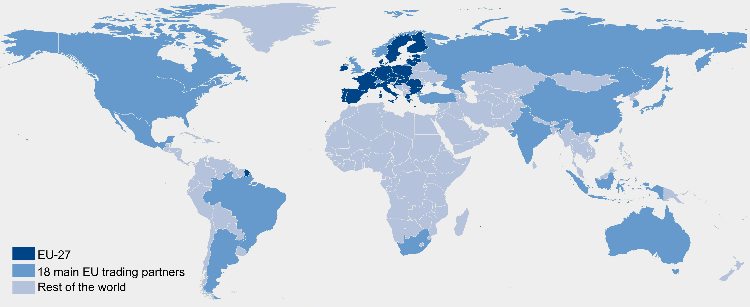
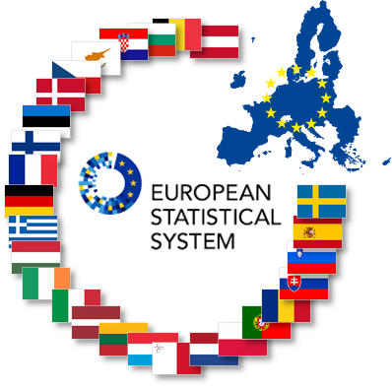
How is it produced?
FIGARO next release 2024 on line on 16 July !!!
18 main
trading
partners
+ RoW
+
=
Figaro
45 + RoW
Globally balanced view of National Accounts Main Aggregates, adjusted to latest national GDP main aggregates (99.1% population and 99.8% GDP)
Build upon available data from National Accounts (national SUTs) and balanced international trade statistics
  Supply-use by 64 product/industry categories (CPA/NACE Rev.2)
  Since 2022, fully aligned with countries’ National Accounts official statistics

Slide 5
FIGARO
Methodological overview

Slide 6
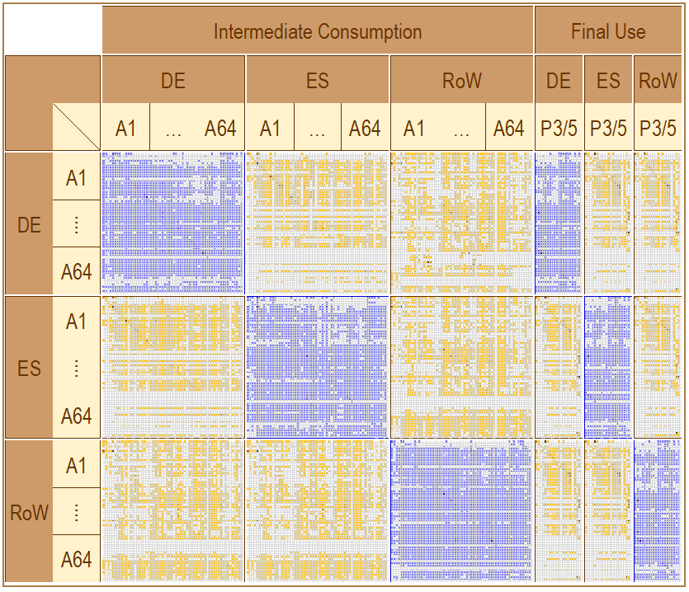
Methodological overview
Uses
Figaro
Resources

Slide 7
Methodological overview
From DE
to ES
(balanced)
Figaro
From ES
to DE
(balanced)

Slide 8

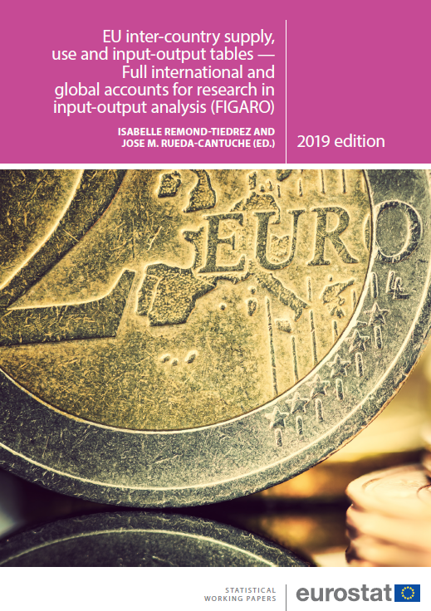
Methodological overview
Mirror
trade
approach
Figaro
Full International and Global Accounts
for Research in input-Output analysis

Slide 9

Methodological overview
Tables
Process
Global National Accounts Main Aggregates (benchmark)
RAS methods
National Supply and Use tables (purchaser’s prices, CIF)
Figaro
Trade and transport margin, TLS
National Supply and Use tables (basic prices, FOB)
Balanced view of trade in goods (QDR methodology)
Balanced view of trade in services (fully consistent)
Goods sent abroad for processing
Estimation of merchanting
Direct purchases abroad
Balanced View of trade (geographical distribution)
Inter-Country SUT (Benchmarked to National Accounts)
Technology/Sales Assumptions
Inter-Country
Input-Output tables

Slide 10
Methodological overview
Tables
Process
Global National Accounts Main Aggregates (benchmark)
RAS methods
National Supply and Use tables (purchaser’s prices, CIF)
Figaro
Trade and transport margin, TLS
National Supply and Use tables (basic prices, FOB)
Balanced View of trade (geographical distribution)
Inter-Country SUT (Benchmarked to National Accounts)
Technology/Sales Assumptions
Inter-Country
Input-Output tables

Slide 11
Methodological overview
Tables
Process
Global National Accounts Main Aggregates (benchmark)
RAS methods
National Supply and Use tables (purchaser’s prices, CIF)
Figaro
Trade and transport margin, TLS
National Supply and Use tables (basic prices, FOB)
Balanced View of trade (geographical distribution)
Inter-Country SUT (Benchmarked to National Accounts)
Technology/Sales Assumptions
Inter-Country
Input-Output tables

Slide 12
Previous editions highlights
2018 edition
2010
A*64 for EU28 + US
Aggregated non-EU imports and exports
Experimental statistics
Working Paper Series (2019)
2021 edition
Time series 2010 - 2019
A*64 for EU27 + US, UK A*21 non-EU (18) + RoW
Misclassification of products
GSA, MCH and DPA
Improved quality checks of national SUIOTs
Regular production in Eurostat (IT infrastructure)
2022/23 editions
Time series 2010 – 2021
A*21 to A*64 for 46 regions
Global balanced NAMA
DPA as additional tables
Extended validation checks (dashboards)
IT “engine” revised to better suit regular statistical production

Slide 13

The 2024 FIGARO edition
  Stable methods and sources but still incorporate some improvements
  Updated CIF/FOB margins & BaTiS data
  Extended use of Balance of Payments data
  Benefit from the cooperation with other international organisations (UN-ECLAC, UNECA, ADB, OECD, IMF, WTO) under the GIANT initiative
  Interpolation in 2 steps of SUTs at basic prices and valuation matrices, when not available
  Better tracing of the different adjustments from source data to final estimates

Slide 14
Value added generated by exports

Slide 15
Employment supported by exports
Notes:
Input-output modelling based on FIGARO tables + complementary employment and CO₂ emissions data
Consistent with national accounts

Slide 16
GHG footprints based on FIGARO
Global CO₂ emissions: EU vis-à-vis the Rest of the world, 2020
 | Serving EU final demand | Serving final demand in Rest of the world | Total emitted
Emitted in EU | 2.3 Gt 7% | 0.5 Gt 2% | 2.8 Gt 8%
Emitted in Rest of the world | 0.9 Gt 3% | 30.7 Gt 89% | 31.7 Gt 92%
Total consumed | 3.2 Gt 9% | 31.2 Gt 91% | 34.4 Gt 100%
Carbon dioxide emission footprints 2010-2021 published on Eurostat website
Coming soon: footprints for other greenhouse gases + year 2022
  Methane emission footprints (CH4 in CO2 equivalent)
  Nitrous oxide emission footprints (N2O in CO2 equivalent)
  Hydrofluorocarbon emission footprints (HFC in CO2 equivalent)
  Perfluorocarbon emission footprints (PFC in CO2 equivalent)
  Nitrogen trifluoride and sulphur hexafluoride emission footprints (SF6_NF3 in CO2 equiv.)

Slide 17
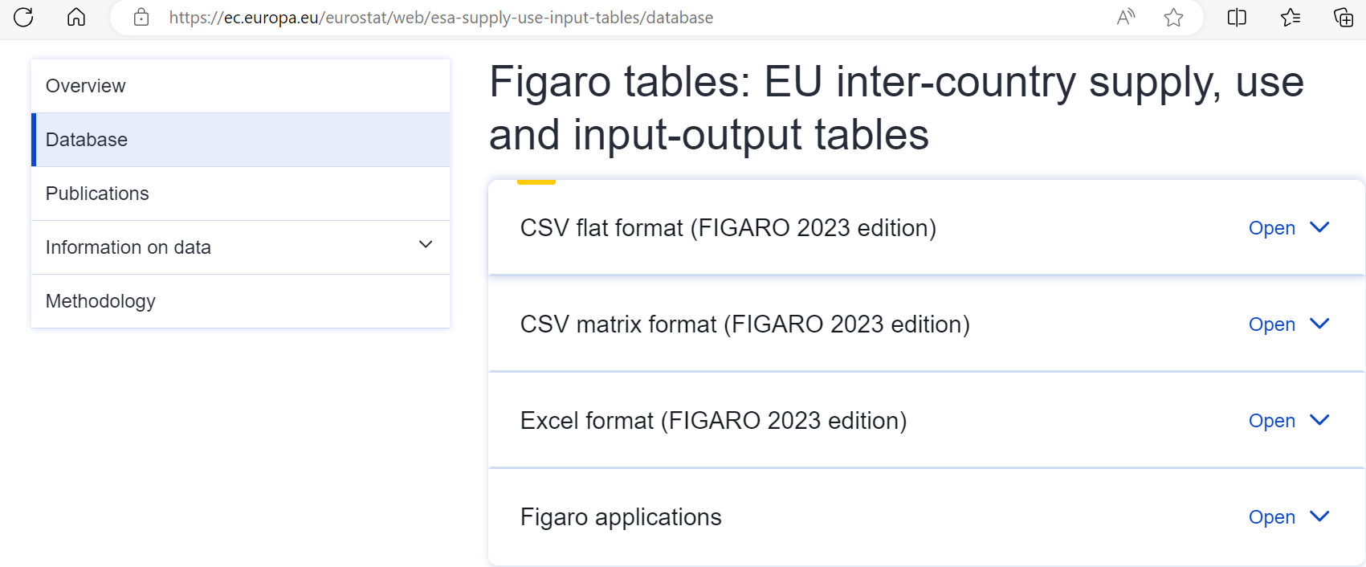
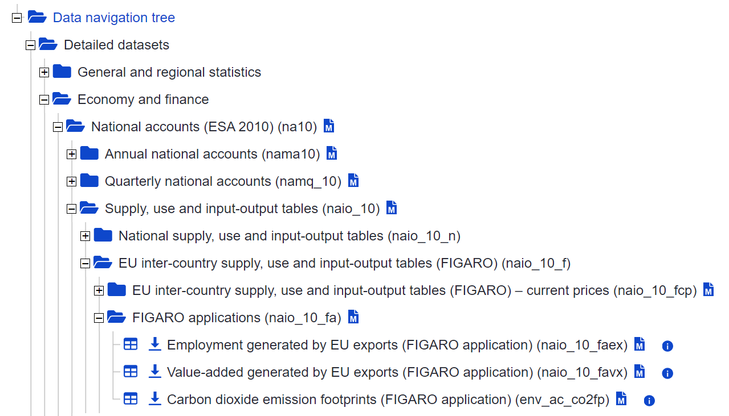


Where to find the results?
  Eurostat’s dissemination database
  Thematic section on the Eurostat website

Slide 18

Thank you
© European Union 2020
Unless otherwise noted the reuse of this presentation is authorised under the CC BY 4.0 license. For any use or reproduction of elements that are not owned by the EU, permission may need to be sought directly from the respective right holders.
Notes:
Update/add/delete parts of the copy right notice where appropriate.
More information: https://myintracomm.ec.europa.eu/corp/intellectual-property/Documents/2019_Reuse-guidelines%28CC-BY%29.pdf

