Slide 1
Advancing the representation of critical minerals supply chains in the global economic models
Maksym Chepeliev,¹ Krzysztof Wojtowicz², Ayse Nihal Yilmaz,² Eddy Bekkers,² Thiago Simonato,¹ Dominique van der Mensbrugghe¹
¹Center for Global Trade Analysis, Purdue University
²World Trade Organization
31st International Input-Output Association Conference, Malé, Maldives
July 6-11, 2025

Slide 2
Outline
Starting point: GTAP Circular Economy (GTAP-CE) Data Base
GTAP critical minerals (GTAP-CM) Data Base
Further disaggregation of the GTAP Data Base (e.g. future technologies)

Slide 3
Public release of the GTAP-CE v11 Data Base
No. | GTAP | New sector | Description
1 | oxt | nmn | Non-metallic minerals mining
2 |  | mio | Mining of iron ores
3 |  | mao | Mining of aluminum ores
4 |  | mco | Mining of copper ores
5 |  | moo | Mining of other ores
6 | rpp | rbr | Rubber products
7 |  | plp | Plastic products – primary
8 |  | pls | Plastic products – secondary
9 |  | plr | Recycling - plastics
10 | nmm | cem | Cement
11 |  | nmx | Other mineral products
12 | i_s | isp | Iron and steel – primary
13 |  | iss | Iron and steel – secondary
14 |  | ris | Recycling - iron and steel
15 |  | isc | Iron and steel casting
16 | nfm | app | Aluminum – primary
17 |  | aps | Aluminum – secondary
18 |  | ral | Recycling - aluminum
19 |  | cpp | Copper – primary
20 |  | cps | Copper – secondary
21 |  | rcp | Recycling - copper
22 |  | mpp | Other metals – primary
23 |  | mps | Other metals – secondary
24 |  | rom | Recycling - other metals
25 |  | nfc | Non-ferrous metals casting
26 | chm | nfr | Nitrogen fertilizer
27 |  | pfr | Phosphorus fertilizer
28 |  | kfr | Potassium fertilizer
29 |  | xch | Other chemicals
First publication release of the GTAP-CE Data Base (January 2025): 76 GTAP-Power 11 Data Base sectors are disaggregated into 99 sectors covering 160 regions.
These sectoral splits provide complete coverage of the CBAM commodities (except hydrogen).
Going forward – taking into account feedback from JRC colleagues – further revisions are anticipated in the part of the representation of non-ferrous metals production
  USGS reports only mine production, while in some countries, e.g. Switzerland and gold, other forms of production are present.

Slide 4
Cost structures and energy inputs
Cost structures for the disaggregated sectors are based on the inputs from EXIOBASE and selected country IOTs (e.g. USA, Canada, Korea, etc.).
Additional adjustment are implemented for the energy inputs across commodities, primarily based on the literature review (techno-economic analyses). The latter provide estimates of energy inputs per unit of output.

Slide 5
GTAP-CE: Sectoral composition (global average)

Slide 6
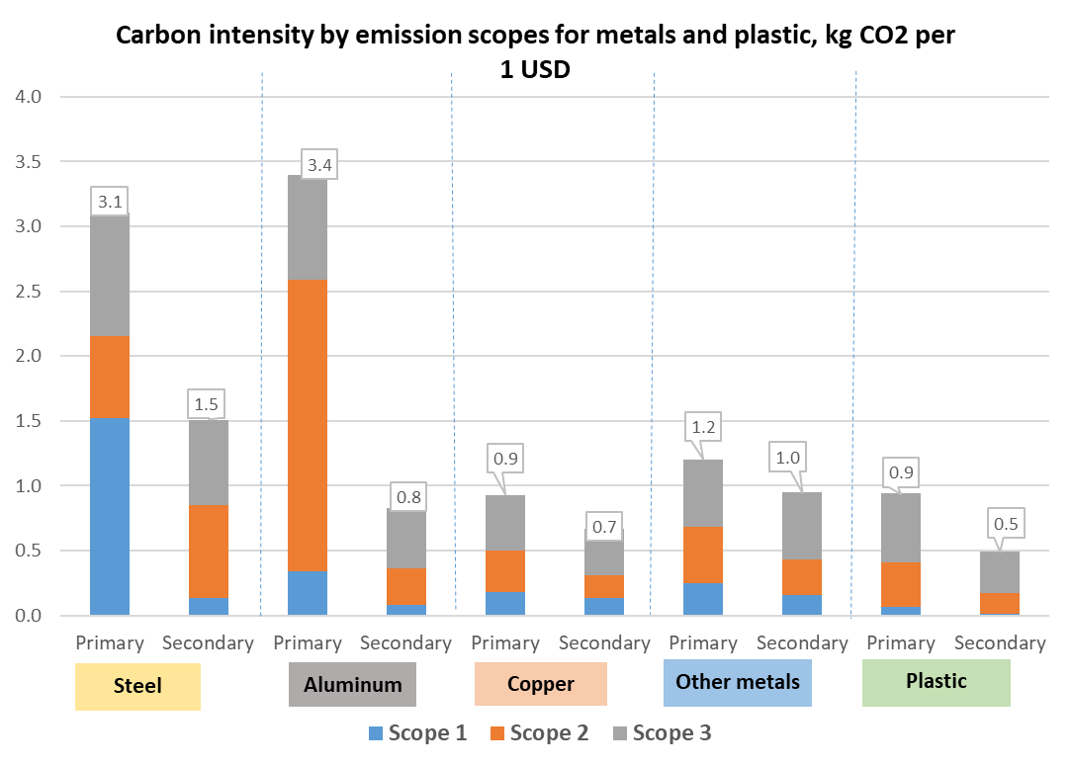
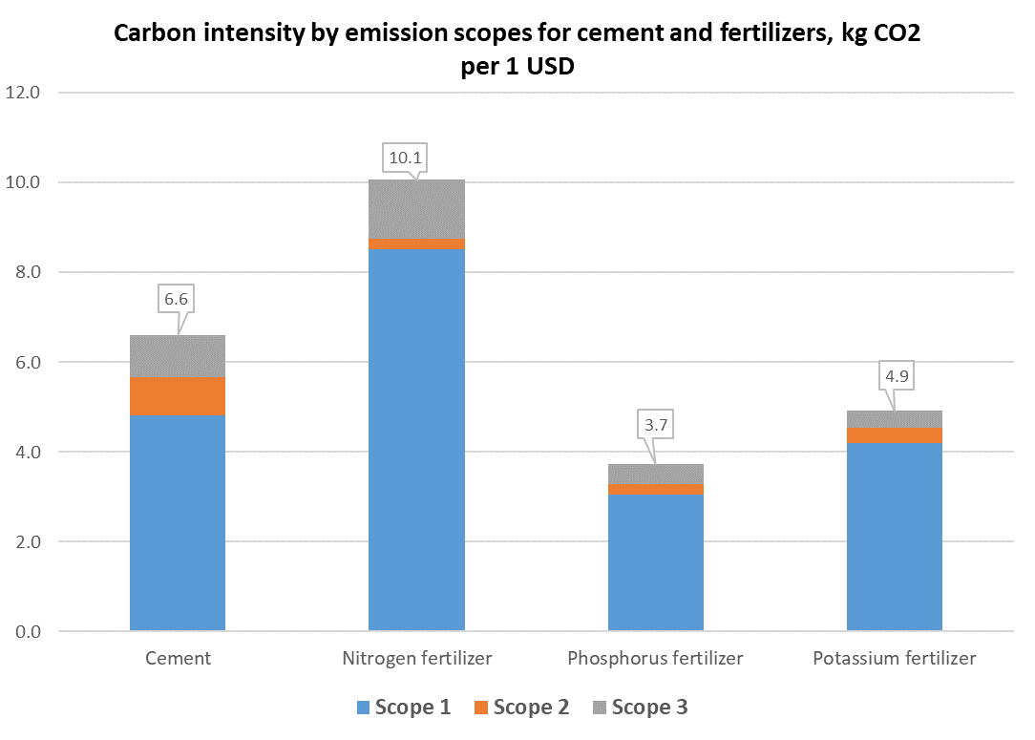
GTAP-CE: differentiated emission intensities across sectors (global average)

Slide 7
Incorporating Critical Minerals into the GTAP Data Base

Slide 8
Ongoing developments: critical minerals supply chains
Ongoing work focuses on further extensions of the GTAP-CE Data Base, in particular, in the part of the representation of critical minerals supply chains
Detailed supply and cost structures
Assumptions on substitutability of inputs
Extraction curves
Ore mining
Ore supply
(for further refining)
Ore refining/processing (across multiple activities)
Use of processed ore in selected products (e.g. magnets, batteries, etc.)
Supply of selected products
Use of products for producing final/intermediate goods (EV, solar panels, etc.)
Bilateral trade in raw ore
Bilateral trade in processed ore
Supply of processed ore
Bilateral trade in selected products
Bilateral trade in final/intermediate goods
Further downstream uses
Supply of final/intermediate goods
Investment matrix (sources and destinations of investment goods)
An overall framework for representing critical minerals supply chains

Slide 9
List of considered minerals is defined using IRENA criticality index
Minerals under explicit disaggregation sorted by IRENA criticality index
IRENA criticality index is used to identify targeted minerals under disaggregation.
The size (value) of the mineral flows is also taken into account.
Selected minerals are combined into groups, e.g. platinum group metals (PGMs) or rare earth elements (REEs).
Color legend

Slide 10
Disaggregation of mining activities is combined with additional details for refining and downstream uses
Disaggregated mining and refining activities
Disaggregated downstream uses
No. | GTAP-CE sector | GTAP-CM sector
 |  | Code | Description
1 | Mining of other ores ("moo") | man | Manganese
2 |  | nik | Nickel
3 |  | cob | Cobalt
4 |  | zin | Zink
5 |  | chr | Chromium
6 |  | tit | Titanium
7 |  | nio | Niobium
8 |  | sil | Silver
9 |  | gal | Gallium
10 |  | pgm | Platinum group metals
11 |  | mooR | Rest of other ores mining
12 | Non-metallic minerals mining ("nmn") | lit | Lithium
13 |  | gra | Graphite
14 |  | rre | Rare earth elements
15 |  | pho | Phosphorus
16 |  | mgm | Magnesium
17 |  | nmnR | Rest of non-metallic minerals mining
18 | Other chemicals ("xch") | coR | Refined cobalt
19 |  | mnR | Refined manganese
20 |  | liR | Refined lithium
21 |  | reR | Refined rare earths
22 |  | niR | Refined nickel
23 |  | agp | Artificial graphite
24 |  | xchR | Rest of other chemicals
25 | Other metals ("mpp") | siR | Refined silver
26 |  | mppR | Rest of other metals
No. | GTAP-CE sector | GTAP-CM sector
 |  | Code | Description
27 | Electrical equipment ("eeq") | mag | Permanent magnets
28 |  | LCO | Lithium Cobalt Oxide batteries
29 |  | LFP | Lithium Iron Phosphate batteries
30 |  | NCM | Nickel Manganese Cobalt Oxide batteries
31 |  | NCA | Lithium Nickel Cobalt Aluminum Oxide batteries
32 |  | LMO | Lithium Manganese Oxide batteries
33 |  | egs | Nacelle
34 |  | egs | Nacelle
 |  | eeqR | Rest of electrical equipment
35 | Electronics ("ele") | sop | Solar panels
36 |  | eleR | Other electronics
37 | Motor vehicles and parts ("mvh") | evl | Light-duty electric vehicles
38 |  | pvl | Light-duty plug-in hybrids
39 |  | evb | Electric buses
40 |  | mvhR | Rest of motor vehicles and parts
In addition to mining activities, refining and selected downstream uses are disaggregated in the GTAP-CM Data Base.
As a result, 7 original GTAP-CE sectors are further disaggregated into 40 activities.
Selected downstream uses include magnets, nacelles, solar panels, various types of batteries and electric vehicles.

Slide 11
The database construction process utilizes a variety of data sources
(4) Database split
Data: Split targets from Step 3.
(5) Construction of the final database
Data: Disaggregated database from Step 4.
(1) Data preparation (output splits)
Data: Volumes and values of output, , bilateral trade data for sectors or interest.
Construction of the production and trade targets using volume and price data.
GTAP Data Base split using SPLITCOM.
(3) Targets’ reconciliation
Reconciliation of the production targets, supply/use structures and trade data for disaggregated SAMs extracted from the GTAP.
Data: GTAP-CE Data Base, data inputs from Steps 1 and 2.
Incorporation of the energy and emission flows for disaggregated sectors. Compilation of the final database.
(2) Data preparation (supply/use splits)
Data: Disaggregated individual country input-output tables, specific cost structure assumptions.
Data sources: USGS, CEPII BACI, IRENA, BNEF, IEA, JRC.
Construction of the cost structure targets.

Slide 12
Data reconciliation routines apply a number of basic assumptions/sanity checks
For every product in the extended database, the flows are constructed using the following criteria:
Production is used domestically or exported.
Output is not lower than exports.
For the country-commodity cases with no output, trade flows are discarded (priority given to the USGS data).
Costs (inputs) are equal to the output value (production) (supply = demand).
Flows are tracked both in quantities (we convert gross weight to material content based on available studies) and in values.

Slide 13
Identifying trade linkages along supply chains
Mineral | Category | Extraction | Processing |  | End use
Rare earths | HS code | 253090 | 2846, 280530 | 850511, 850519 | 850231, 870240
 | description | Mineral substances; n.e.c. in chapter 25 | Compounds, inorganic or organic, of rare-earth metals; Earth-metals, rare; scandium and yttrium, whether or not intermixed or interalloyed | Magnets; permanent magnets and articles intended to become permanent magnets after magnetisation, of metal. Magnets; permanent magnets and articles intended to become permanent magnets after magnetisation, other than of metal | Electric generating sets; wind-powered, (excluding those with spark-ignition or compression-ignition internal combustion piston engines). Vehicles; public transport type (carries 10 or more persons, including driver), with only electric motor for propulsion, new or used
Cobalt | HS code | 260500 | 282200 | 850760 | 870240
 | description | Cobalt ores and concentrates | Cobalt oxides and hydroxides; commercial cobalt oxide | Electric accumulators; lithium-ion, including separators, whether or not rectangular (including square) | Vehicles; public transport type (carries 10 or more persons, including driver), with only electric motor for propulsion, new or used
Lithium | HS code | 261790 | 283691, 282520 | 850760 | 870240
 | description | Ores and concentrates n.e.c. in chapter 26 | Carbonates; lithium carbonate. Lithium oxide and hydroxide | Electric accumulators; lithium-ion, including separators, whether or not rectangular (including square) | Vehicles; public transport type (carries 10 or more persons, including driver), with only electric motor for propulsion, new or used
Graphite | HS code | 2504 |  | 850760 | 870240
 | description | Graphite, natural |  | Electric accumulators; lithium-ion, including separators, whether or not rectangular (including square) | Vehicles; public transport type (carries 10 or more persons, including driver), with only electric motor for propulsion, new or used
Manganese | HS code | 2602 | 282010 | 850760 | 870240
 | description | Manganese ores and concentrates… | Manganese dioxide | Electric accumulators; lithium-ion, including separators, whether or not rectangular (including square) | Vehicles; public transport type (carries 10 or more persons, including driver), with only electric motor for propulsion, new or used

Slide 14
Key inter-sectoral linkages in the GTAP-CM Data Base

Slide 15
Selected data challenges
Inconsistencies between USGS and CEPII BACI trade data:
  Issue: HS code for trade could contain more commodities that explicit mineral in USGS.
  Solution: use more refined trade codes (e.g. HS8, HS10).
  Issue: USGS reports extraction in the ‘mineral content' and trade data is reported is 'gross quantities’.
  Solution: apply adjustment factor to convert from gross quantities into metal content.
  Issue: There are countries where there is export but no production or exports exceeds production, thus implying negative use.
  Solution: assume higher credibility of production data and adjust trade data accordingly.
Implied trade prices for selected country-commodity cases are unrealistically high/low.
  Solution: use regional-average prices or cap price variations.
Lacking data on supply and cost structures (currently utilizing US IOT + selected data sources).
Lacking data on values of output for downstream sectors (exploring proprietary data sources, e.g. BLOOMBERG).

Slide 16
Top 20 countries in the world account for at least 82% of mining of each of the considered mineral

Slide 17
Concentration of mining substantially varies across minerals
The Herfindahl-Hirschman Index (HHI) measures market concentration and is used to determine market competitiveness.
Index value equal to “1” means that there is a single supplier/agent on the market.
Index value close to “0” means that there are many suppliers/agents on the market with (close to) equally distributed shares.

Slide 18
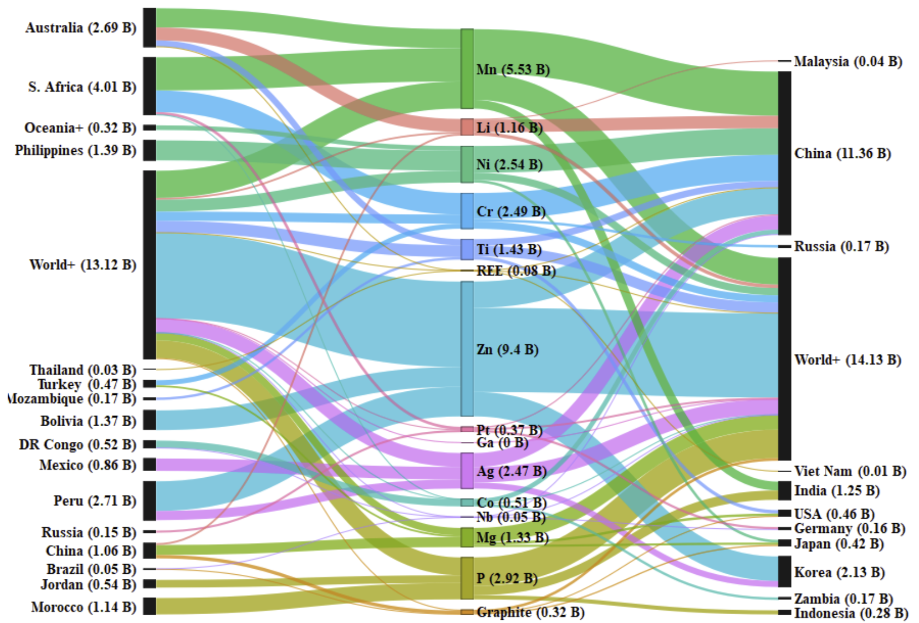
China is a major importer of minerals, but it also is a major extracting country
Minerals trade along supply chains in 2017 ($bn)
Exports of minerals in concentrated in low- and middle-income countries.
While imports are driven by China and a number of high-income countries.
Similar to production, there is a high heterogeneity in the trade supply diversity across minerals.
While DR Congo dominates the exports of cobalt, geography of silver, zink or manganese exports is much more diverse.

Slide 19
Trade in minerals moderately impacts the diversity of supply

Slide 20
Downstream sectors are concentrated in China and high-income countries
Top 12 countries account for 90% of the global downstream sectors’ output.
Over 50% of all output is concentrated in China.

Slide 21
Concentration of downstream activities is even higher than that of mining
Looking at the downstream sectors, concentration of their supply is even higher than that of minerals mining.
Looking at the Herfindahl-Hirschman Index (HHI) 6 out of 11 considered commodities have index value over 0.6.
Production of selected battery types is particularly geographically concentrated.

Slide 22
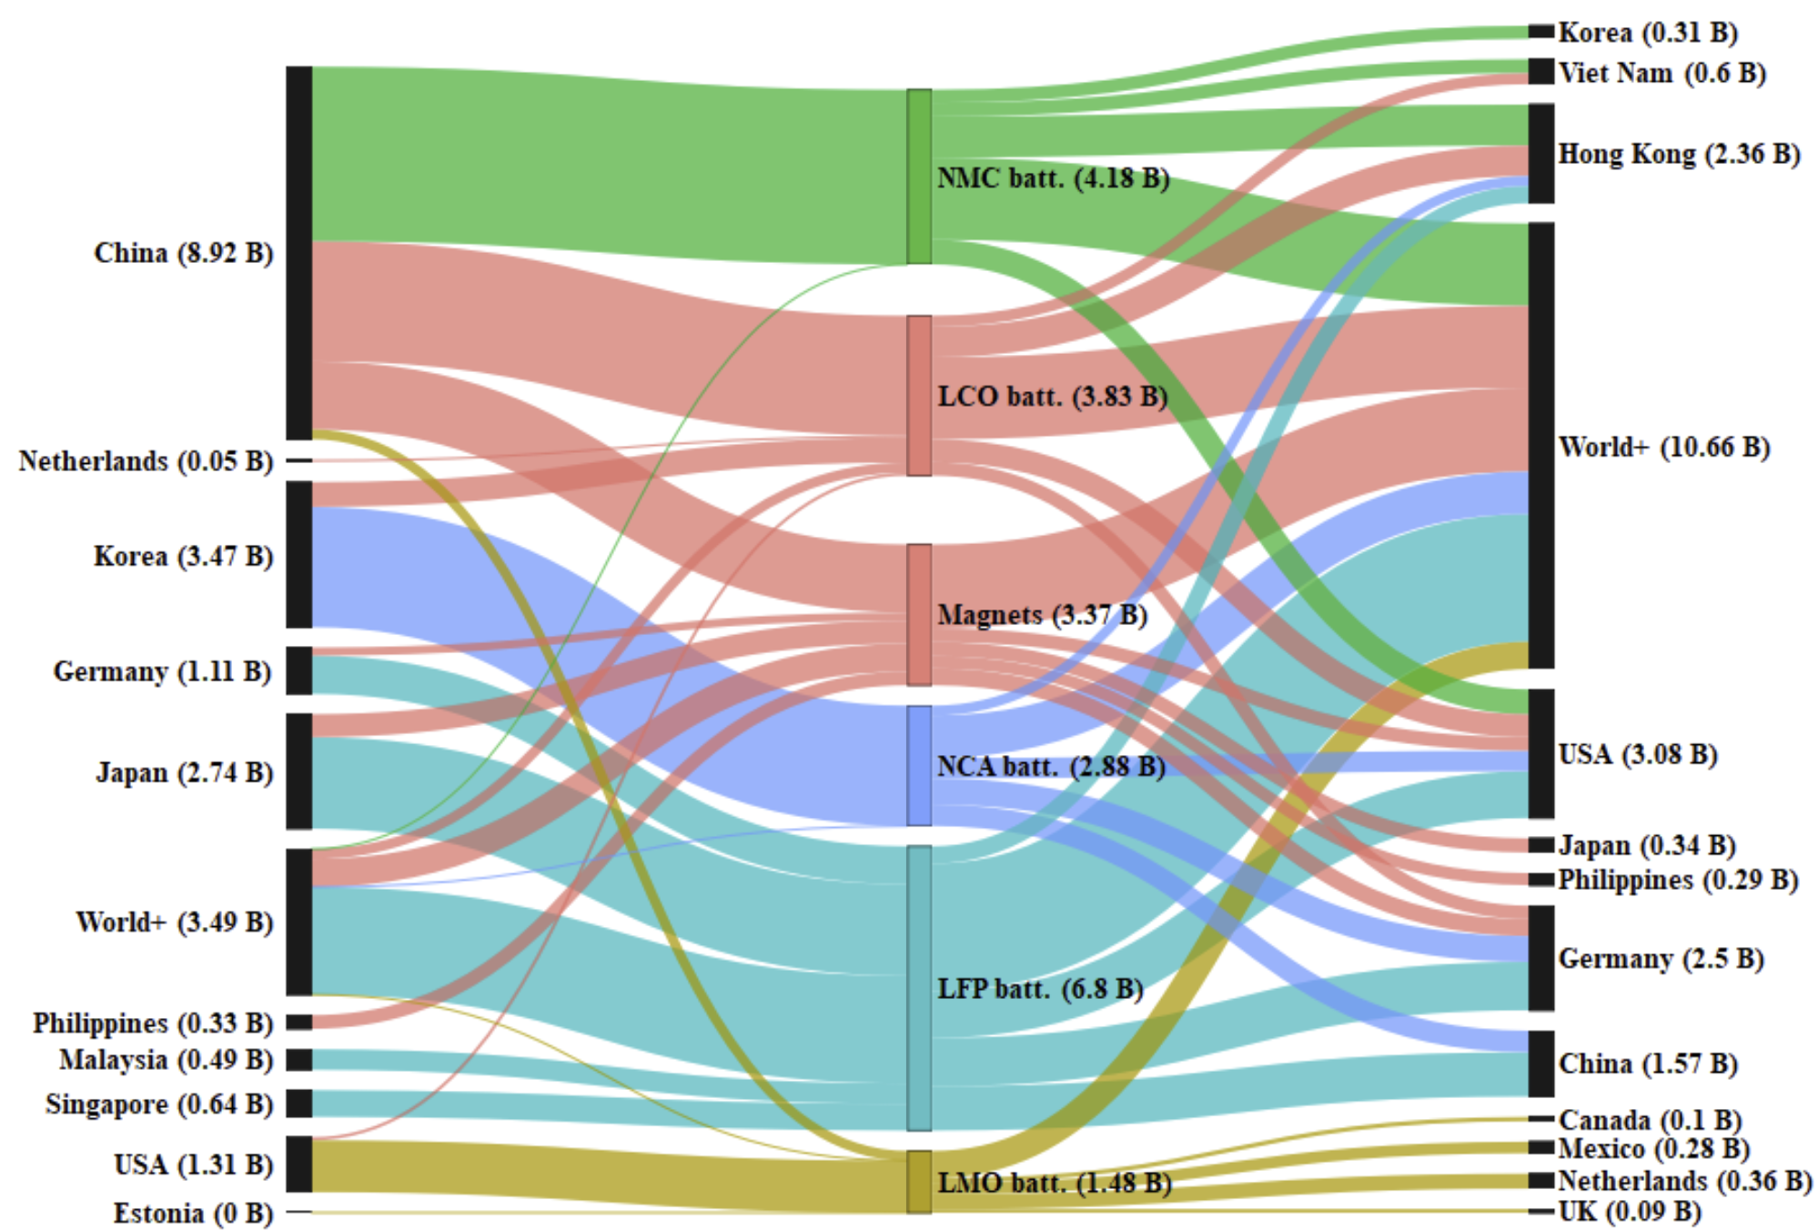
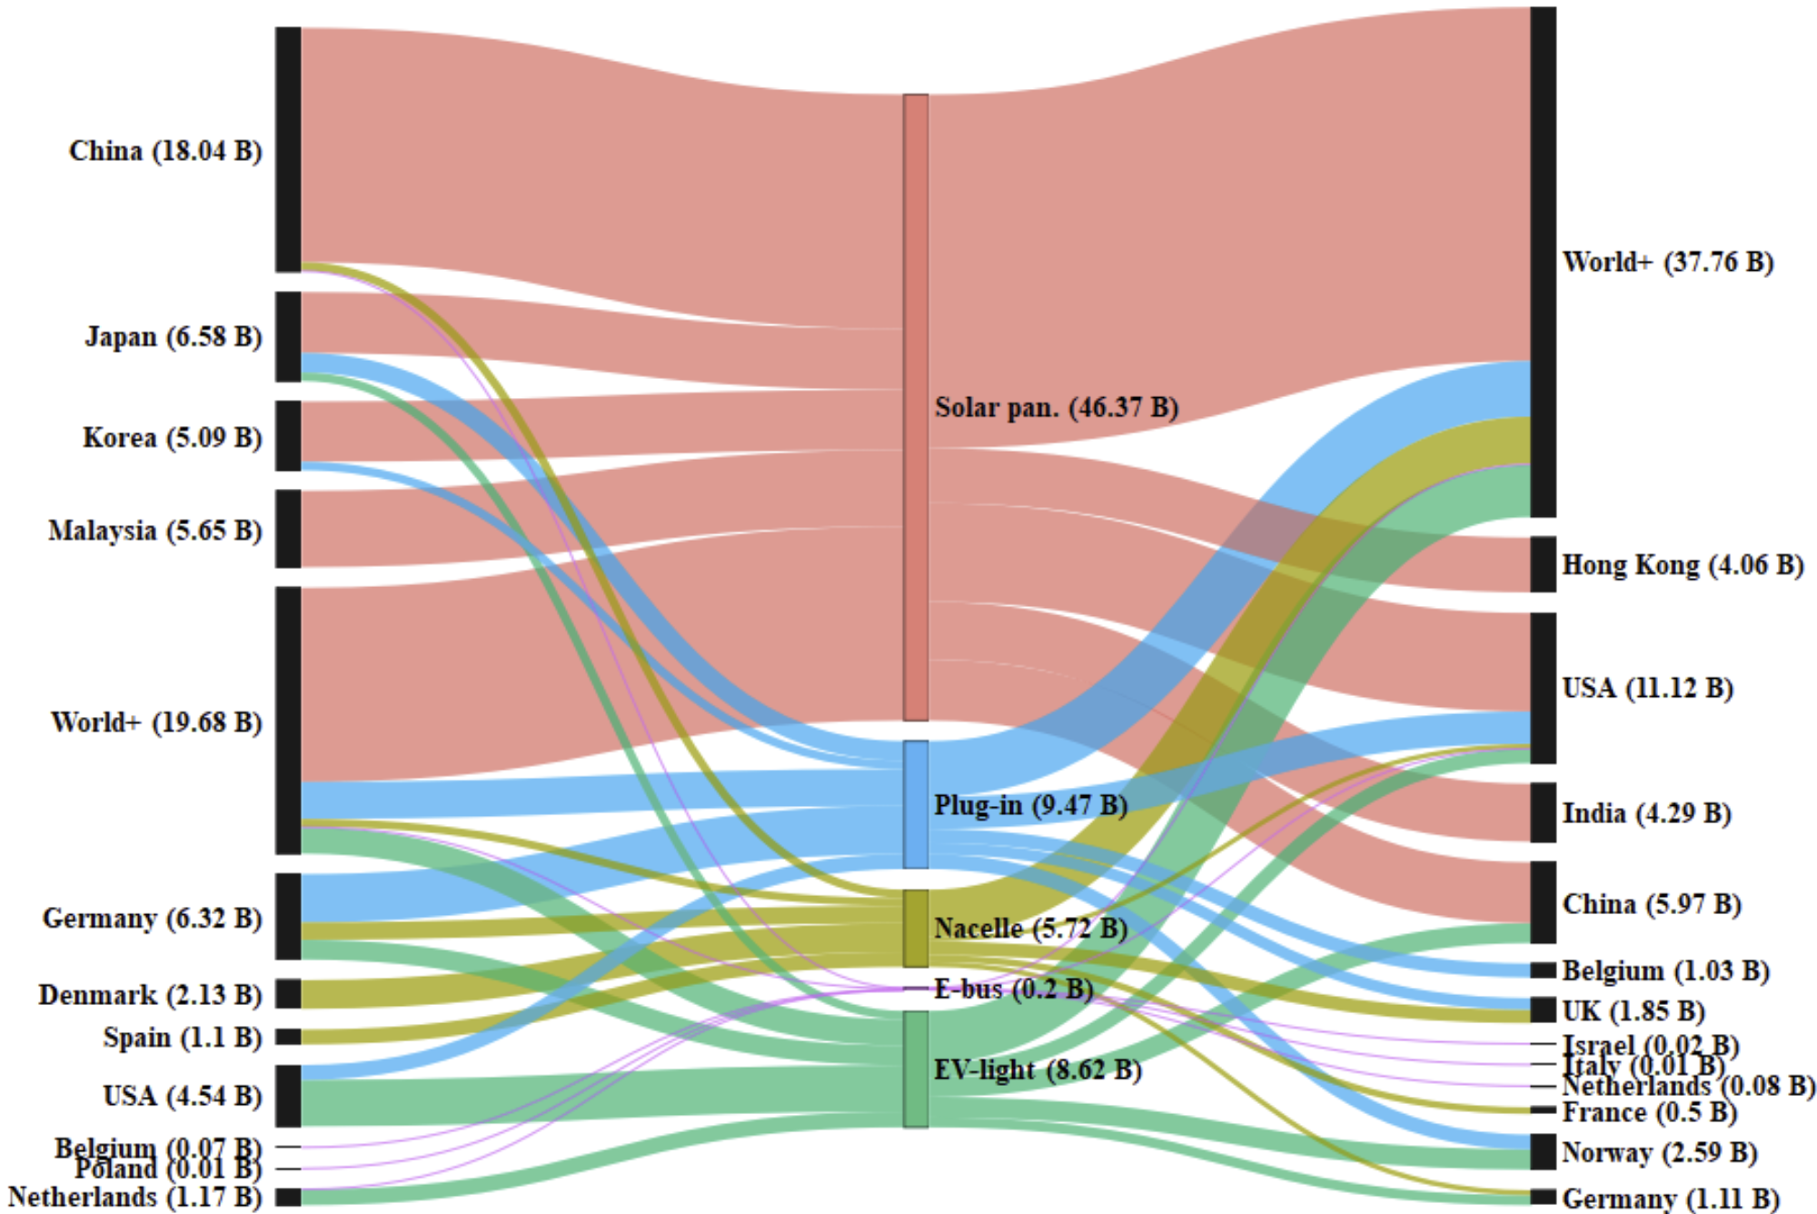
Exports of downstream commodities are dominated by China and high-income countries

Slide 23
Ongoing work on further disaggregation of the GTAP Data Base

Slide 24
More extended set of new sectors/technologies is also being considered
Within the EU HORIZON ENTICE project set of efforts we are developing a list of technologies that will be disaggregated in GTAP, including future and currently non-existent technologies.
A stocktaking of available data inputs is conducted -> community input is appreciated!
Together with colleagues from Politecnico di Milano we are developing new data disaggregation routine based on the MARIO package.
The latter extends MARIO package by introducing data re-balancing algorithms and make the package compatible with GTAP Data Base format (which in many cases is more detailed than other MRIOs).

Slide 25

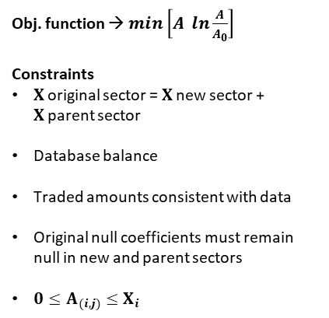

Comprehensive data disaggregation process map
MARIO package is coded in Phyton and is freely available to MRIO users.
In the future it could serve as a more flexible alternative to the SPLITCOM utility.
Inputs
Core processing
Results
MARIO
Region 1
Region 2
MARIO-compatible MRIO database
Intermediate transactions matrix
Z (or z in coefficients)
Final
demand
matrix
Y
Total
prod.
vector
X
Region 1
Cost structure and environmental coefficients
Total output
Trade values
First-guess coefficients breakdown
Any other sector-specific constraint
Minimum entropy + RAS algorithm
Region 2
Obj. function → $\min\left[A \ln{\frac{A}{A_{0}}}\right]$
Constraints
$X$original sector = $X$new sector + $X$parent sector
Database balance
Traded amounts consistent with data
Original null coefficients must remain null in new and parent sectors
$0≤A_{(i,j)}≤X_{i}$
Value added
V
Environmental transactions, E
matrix
Source: developed by the Polimi team.

Slide 26
Conclusions and next steps
GTAP-CE Data Base (was publicly released earlier this year):
  Extends the number of sectors to 99 (mining, metals, plastic, cement, fertilizers), providing a complete coverage of CBAM commodities (except hydrogen).
Is distributed in the format of the core GTAP Data Base packages and can be readily linked to the GTAP-based CGE models -> Users’ feedback is Welcomed!
GTAP-CM Data Base:
  Introduces further disaggregation to the minerals’ mining, refining and downstream activities (7 GTAP-CE sectors are further split into 40 activities).
  Data development is still work in progress; planning to have a refined version for internal testing later this year.
  Selected data challenges require exploring additional data sources (for cost and supply structures, output values, etc.) to complement database construction process, including some proprietary data.
  A number of related activities are underway, including the development of the user-friendly GTAP Data Base disaggregation routine and additional sectoral splits.

Slide 27
Thank you!
mchepeli@purdue.edu

