Slide 1

Implications of the Net Zero Transition Scenarios on SDG Indicators: Linking Global Energy System, CGE and Atmospheric Source-receptor Models
Maksym Chepeliev¹, George Giannakidis², Amit Kanudia³,
and Dominique van der Mensbrugghe¹
¹Center for Global Trade Analysis, Purdue University, USA
²MRC Greece, Greece
³KanORS, India
31st International Input-Output Association Conference, Malé, Maldives
July 6-11, 2025

Slide 2
A vital need to account for interactions and tradeoffs across various developmental aspects
In recent years many countries have increased the stringency of their mitigation pledges, targeting to achieve net zero emissions in the next 30-40 years (Höhne et al. 2021).
United Nations (UN) members also adopted the 2030 Agenda for Sustainable Development (UN 2015).
  Widely recognizing that various transformation pathways are inevitably associated with tradeoffs across various developmental aspects.
  Examples of complex interactions: studies suggest that while climate policies could improve air quality and reduce related mortality, stringent mitigation could have adverse implications on food security (SDG 2) (Fujimori et al. 2020; Fuso Nerini et al. 2019).
  The Sustainable Development Goals (SDGs) framework sets the lower/upper boundaries (depending on the type of indicator) for a variety of socio-economic and environmental dimensions

Slide 3
Remaining gaps in the climate policy-SDGs interaction
Earlier studies have explored the implications of climate mitigation policies across various sustainable development goals (SDG) dimensions, attempting to identify the potential tradeoffs that might arise in this regard (e.g., Cohen et al. 2021; Jakob and Steckel 2016; Fujimori et al. 2020).
Several important aspects remain under-explored and are the focus of this study:
Specific policy solutions for addressing some of the identified tradeoffs (e.g. impacts of alternative carbon revenue recycling options).
Interactions across various SDG indicators (e.g. impacts of improved air quality on economic welfare).
Accounting for country-specific mitigation policies, such as Nationally Determined Contributions (NDCs) and Carbon Border Adjustment Mechanism (CBAM).
Chepeliev, M., Giannakidis, G., Kanudia, A. and van der Mensbrugghe, D. 2024. Implications of the Net Zero Transition Scenarios on SDG Indicators: Linking Global Energy System, CGE and Atmospheric Source-Receptor Models. Lecture Notes in Energy, vol 101. Springer, Cham. https://doi.org/10.1007/978-3-031-58897-6_3

Slide 4
Methodological framework: Multi-model framework
Global computable general equilibrium (CGE) model ENVISAGE
  Recursive-dynamic (2014-2050).
  Linked to the GTAP MRIO Data Base.
Global energy system model KYNESIS
TIMES-family multi-region inter-temporal partial equilibrium model of the global energy system.
Determines least-cost investment pathways and energy system operations to meet exogenously projected energy service demands.
Simulation horizon: 2100.
Flexible regional aggregation.
TM5-FASST source-receptor model
  Global atmospheric source-receptor model.
  Estimates pollutant-related premature mortality rates across regions, covering PM2.5-related diseases and respiratory ozone (O3) exposure mortality.
  Model aggregation: 19 regions and 36 activities.

Slide 5
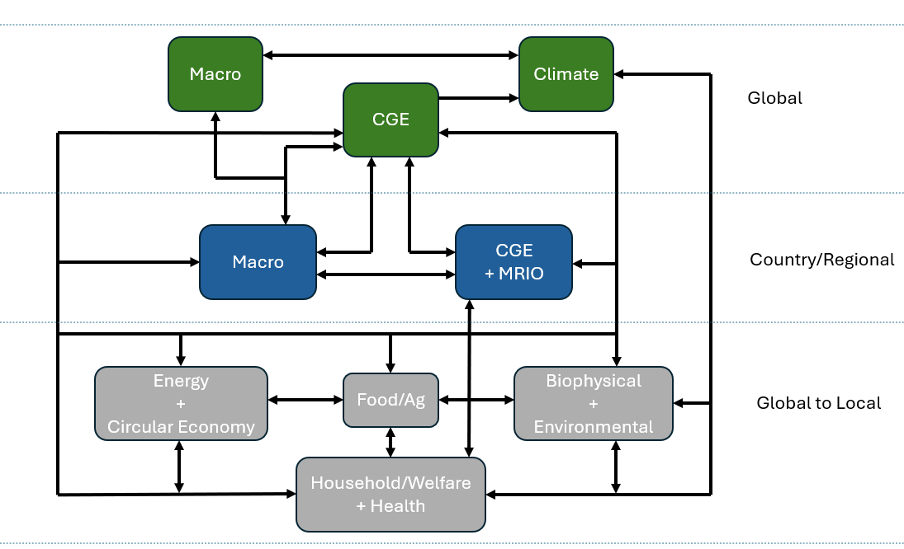
Soft-linking approach is used to couple models
The KINESYS model is run to calibrate the baseline path and assess the range of mitigation scenarios.
The ENVISAGE model is run to provide an assessment of the socio-economic impacts of various mitigation policies targeting carbon budgets estimates in the KINESYS model.
Air pollutant trajectories estimated by the ENVISAGE model across scenarios are transferred to the TM5-FASST model to estimate changes in mortality.
The KINESYS and ENVISAGE models use the same set of macroeconomic and demographic drivers for the baseline scenario calibration.
The KINESYS model provides ENVISAGE with the carbon budget for the baseline scenario and the upper and lower bounds of the carbon budget across mitigation scenarios.
The power generation mix within the baseline scenario is aligned between ENVISAGE and KINESYS models.
Global CGE model
ENVISAGE
Global energy system model KYNESIS
TM5-FASST atmospheric source-receptor model

Slide 6
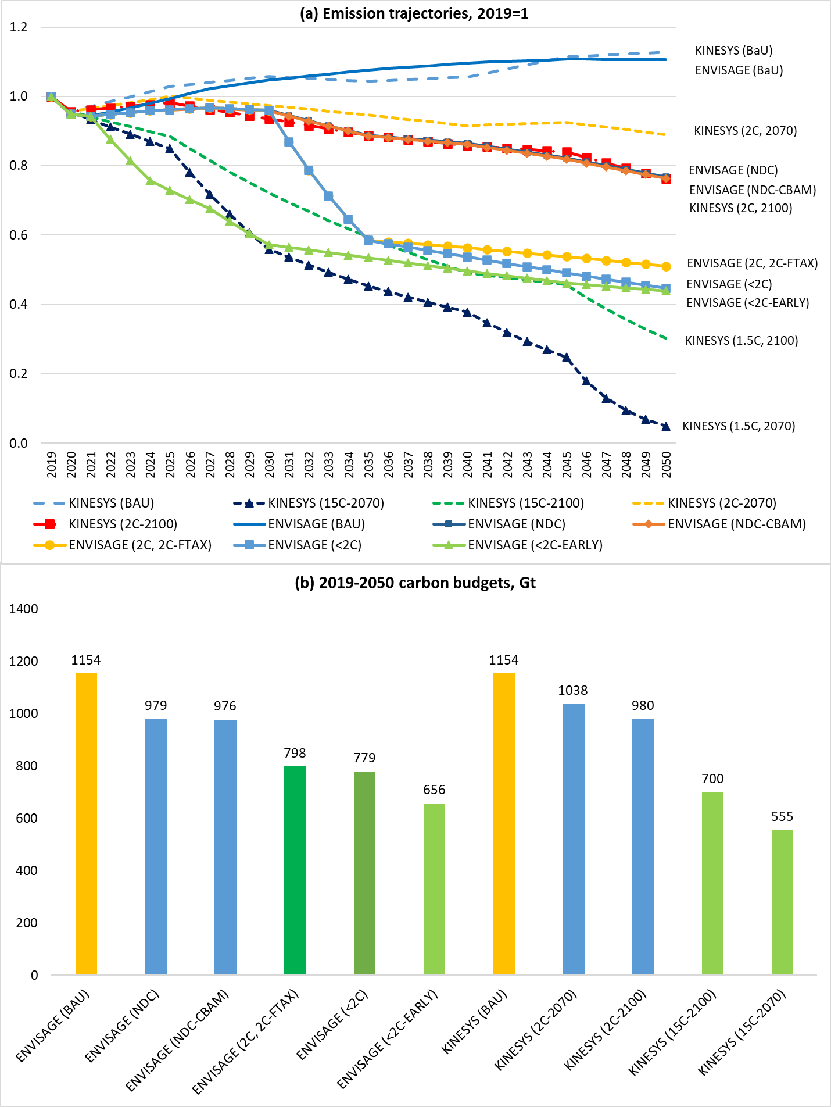
Scenarios cover a broad range of mitigation pathways and policy options
Scenario framework:
Macroeconomic and demographic assumptions for the baseline are based on the Shared Socioeconomic Pathways (SSP) 2 variant.
ENVISAGE models six scenarios, covering different levels of climate mitigation ambition across regions, alternative carbon revenue recycling options (lump-sum payments to households or reduction in factor taxes), as well as potential CBAM configurations (figure on the right).
The KINESYS model represents four policy scenarios, varying in terms of mitigation ambition and the timeframe (2070 and 2100) over which the specified carbon budget is reached (figure on the right).
Cover mitigation of fossil fuel combustion CO₂ emissions.

Slide 7
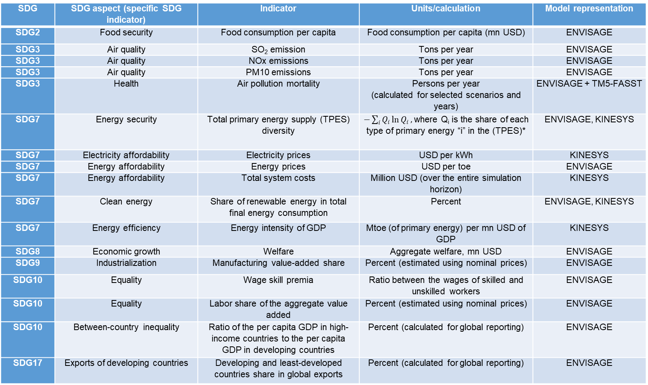
Seventeen SDG indicators are analyzed across a broad scope of sustainability dimensions
SDG | SDG aspect (specific SDG indicator) | Indicator | Units/calculation | Model representation
SDG2 | Food security | Food consumption per capita | Food consumption per capita (mn USD) | ENVISAGE
SDG3 | Air quality | SO₂ emission | Tons per year | ENVISAGE
SDG3 | Air quality | NOx emissions | Tons per year | ENVISAGE
SDG3 | Air quality | PM10 emissions | Tons per year | ENVISAGE
SDG3 | Health | Air pollution mortality | Persons per year (calculated for selected scenarios and years) | ENVISAGE + TM5-FASST
SDG7 | Energy security | Total primary energy supply (TPES) diversity | $−\sum_{i}{Q_{i}\ln{Q_{i}}},$where Q_{i} is the share of each type of primary energy “i” in the (TPES)* | ENVISAGE, KINESYS
SDG7 | Electricity affordability | Electricity prices | USD per kWh | KINESYS
SDG7 | Energy affordability | Energy prices | USD per toe | ENVISAGE
SDG7 | Energy affordability | Total system costs | Million USD (over the entire simulation horizon) | KINESYS
SDG7 | Clean energy | Share of renewable energy in total final energy consumption | Percent | ENVISAGE, KINESYS
SDG7 | Energy efficiency | Energy intensity of GDP | Mtoe (of primary energy) per mn USD of GDP | KINESYS
SDG8 | Economic growth | Welfare | Aggregate welfare, mn USD | ENVISAGE
SDG9 | Industrialization | Manufacturing value-added share | Percent (estimated using nominal prices) | ENVISAGE
SDG10 | Equality | Wage skill premia | Ratio between the wages of skilled and unskilled workers | ENVISAGE
SDG10 | Equality | Labor share of the aggregate value added | Percent (estimated using nominal prices) | ENVISAGE
SDG10 | Between-country inequality | Ratio of the per capita GDP in high-income countries to the per capita GDP in developing countries | Percent (calculated for global reporting) | ENVISAGE
SDG17 | Exports of developing countries | Developing and least-developed countries share in global exports | Percent (calculated for global reporting) | ENVISAGE

Slide 8
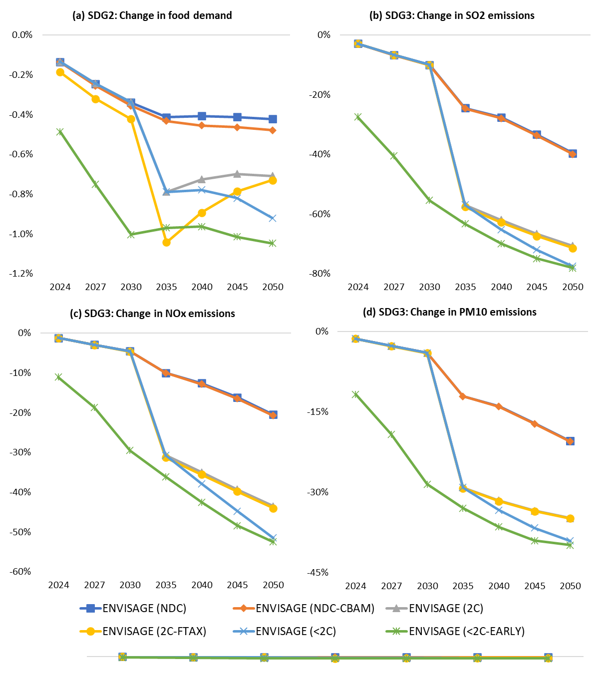
Adverse impacts on food demand but improved air quality
For SDG2 (“End hunger, achieve food security and improved nutrition and promote sustainable agriculture”):
  Moderate impact on reducing overall food demand (and affordability) by 0.4%-1% across scenarios in 2050.
  Primarily happening through the channel of increasing prices of energy-intensive commodities resulting in overall lower consumers’ purchasing power.
  Inclusion of a broader range of mitigation options, such as land-based mitigation and reduction of non-CO₂ GHGs within the food systems might have more substantial implications on food demand.
Global impacts on SDG 2 and SDG 3 indicators relative to the baseline levels
For SDG3 (“Ensure healthy lives and promote well-being for all at all ages”):
Major co-benefits by reducing air pollutant emissions, including SO₂, NO_{x} and PM10.
Emission reductions are around 40% for the case of PM10 under the most ambitious mitigation scenario in 2050 and reach over 75% in the case of SO₂

Slide 9
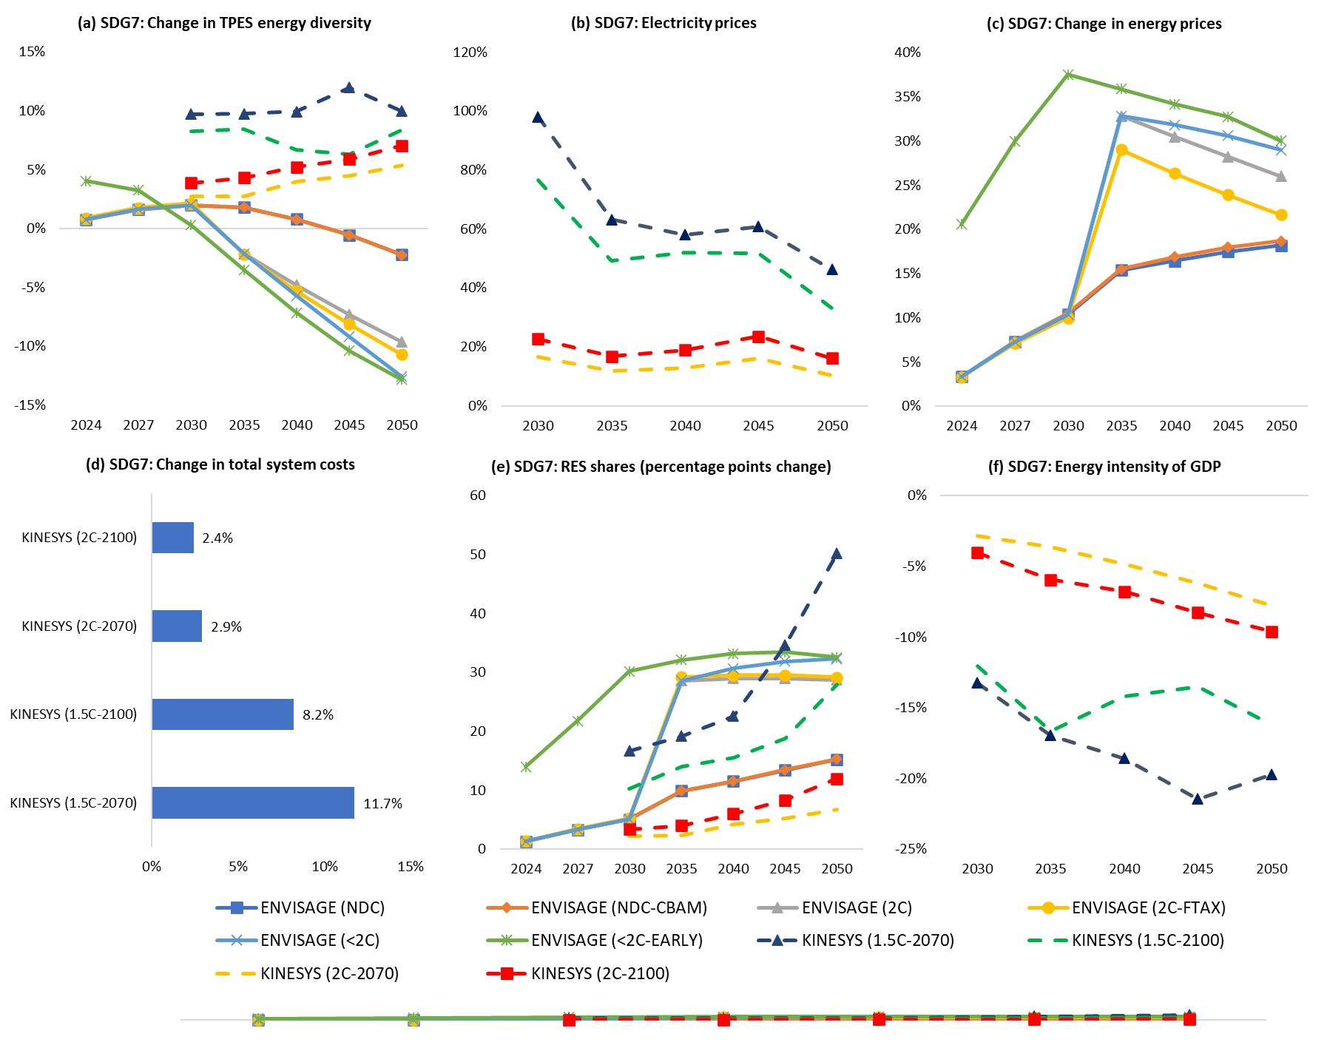
While providing cleaner energy, electricity affordability might be at stake
For SDG7 (“Ensure access to affordable, reliable, sustainable and modern energy for all”), we analyze six different indicators, finding:
A substantial increase in the share of renewables (5-50 pp by 2050 across scenarios)—as well as a reduction in the energy intensity of GDP.
Transformations might put pressure on energy affordability: electricity prices could increase by over 80% under the most ambitious mitigation scenarios in 2030, highlighting medium-term challenges (potential need for support policies).
Overall energy system costs increase between 2%-3% for the lower-ambition mitigation to 8%-12% for the more stringent cases.
Therefore, if costs are properly distributed over time even the most ambitious mitigation efforts represent the economically-affordable policy solutions.
Global impacts on SDG 7 indicators relative to the baseline levels

Slide 10
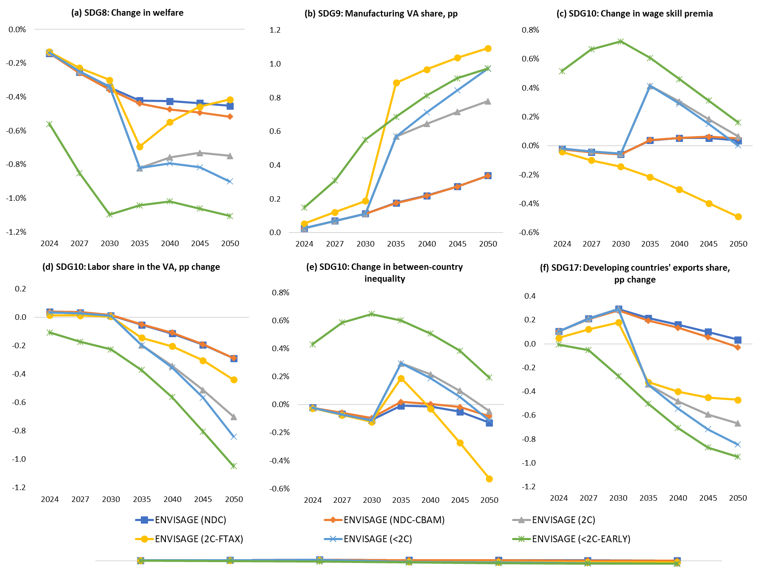
Overall transition costs are low but moderate adverse inequality impacts could be observed
Even the most ambitious climate mitigation scenario global welfare declines by only 1.1% relative to the baseline in 2050 (SDG8).
  Ambitious climate mitigation efforts could increase the share of manufacturing in value-added, reflecting one of the dimensions of SDG9.
  Unless specific policy measures are implemented within the decarbonization pathways, there is a risk of increasing the wage gap between skilled and unskilled workers, which might potentially result in regressive distributional impacts.
  In terms of the implications for between-country inequality, we find that in the long run moderately negative impacts are observed only under the most-ambitious mitigation case, though even then the inequality increases by only 0.2% in 2050.
Global impacts on SDG 8, 9, 10 and 17 indicators relative to the baseline levels

Slide 11
Alternative carbon revenue recycling options might strengthen positive spillovers
Impact of the alternative carbon revenue recycling scheme on the SDG indicators in 2050 (“2C-FTAX” vs “2C” scenarios)
We explore how a change in the carbon revenue recycling approach—from lump-sum payments to households to recycling revenue via reductions in factor taxes for low-carbon activities – impacts the results.
Only indicators covered by the ENVISAGE model are analyzed focusing on 2ºC scenario.
For 11 out of 13 considered SDG dimensions an improvement is observed under the alternative carbon revenue recycling option.
A reduction in factor taxes in low-carbon sectors leads to an expansion in economic activity of these sectors, and a reduction in the economy-wide carbon prices needed to achieve the targeted emission targets, thus overall lower mitigation costs.

Slide 12
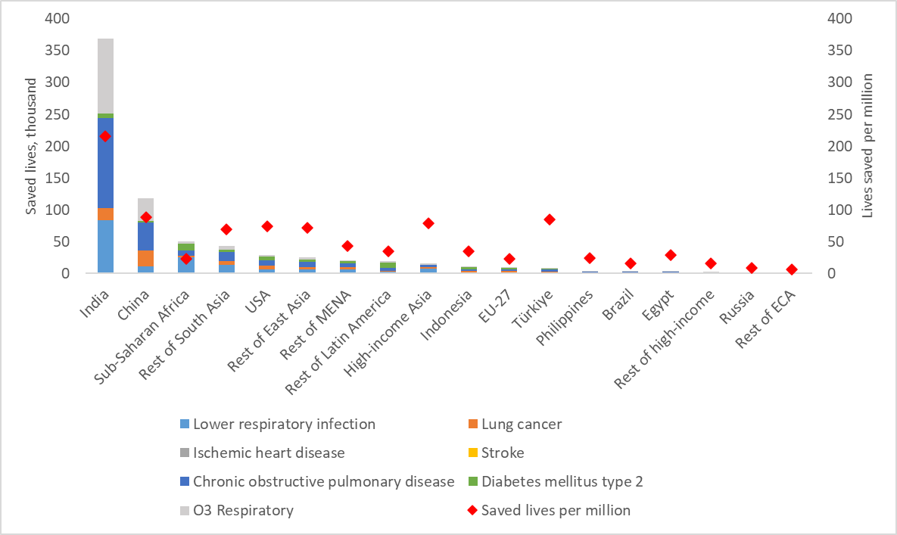
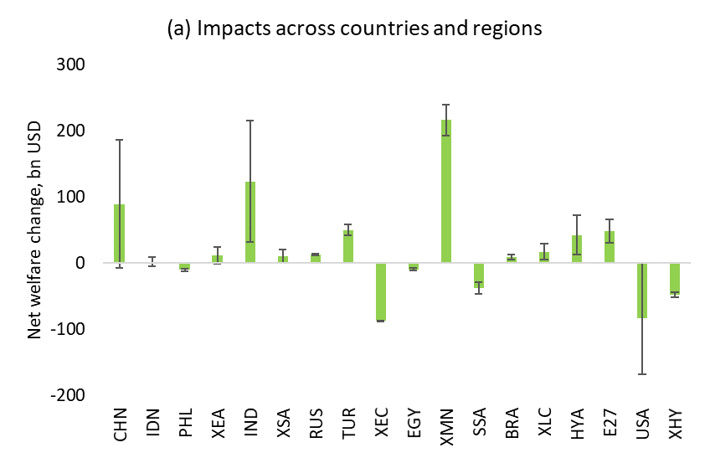
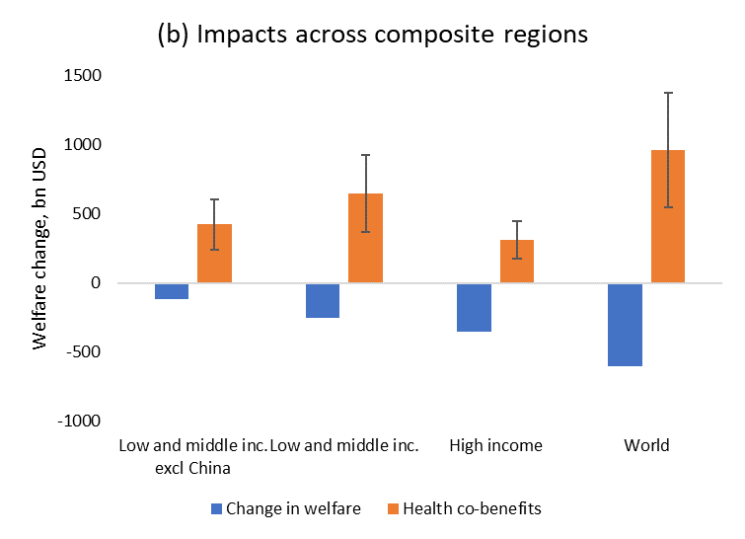
Importance of properly capturing interactions across various SDG dimensions: a case of air pollution-related mortality
Changes in the emission of greenhouse gases and air pollutants are transferred to TM5-FASST.
Health co-benefits from reduced mortality rates are estimated and monetized using the value of social life (VSL) approach.
Under the “2ºC” scenario, a reduction in air pollution due to low carbon development can save almost 740,000 lives in 2050 when compared to the reference scenario.
In absolute terms and per million of population, India benefits the most from the reductions in air pollution, as around half of all saved lives worldwide occur in this country.
When health co-benefits of improved air quality are monetized, the aggregate air pollution reduction health co-benefits outweigh mitigation costs by over a factor of two.
A larger ratio of co-benefits relative to mitigation costs is observed for developing countries compared to high-income economies since on average the latter have lower emission intensities and higher costs of emission reduction.

Slide 13
Conclusions and policy implications
Linking global energy system, economic and air pollution models allows identifying important synergies and trade-offs across various SDG dimensions and across climate mitigation scenarios.
Out of 17 analyzed SDG indicators, 7 experience co-benefits (improved environmental footprints, energy efficiency and clean energy), 6 are subject to trade-offs (energy and food affordability, economic growth and labor participation), while the remaining 4 indicators show mixed trends (distributional aspects and energy diversity).
The identified trade-offs could be substantially reduced through specific policy solutions.
  Recycling carbon revenue via reduced factor taxes, as opposed to lump-sum payments to households, could improve 11 out of 13 SDG dimensions analyzed in this regard.
The need for properly capturing interactions across various SDG dimensions:
  Monetized co-benefits from improved air quality outweigh mitigation costs by more than a factor of two, with higher co-benefits gains in developing countries.

Slide 14
Thank you!
Maksym Chepeliev
mchepeli@purdue.edu
Additional details are available in:
Chepeliev, M., Giannakidis, G., Kanudia, A. and van der Mensbrugghe, D. 2024. Implications of the Net Zero Transition Scenarios on SDG Indicators: Linking Global Energy System, CGE and Atmospheric Source-Receptor Models. Lecture Notes in Energy, vol 101. Springer, Cham. https://doi.org/10.1007/978-3-031-58897-6_3

