Slide 1
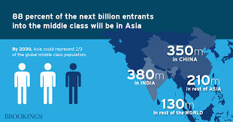
Disproportionate Water Depletion from Middle-Class Consumption in Emerging Economies
Siyu Hou§ Jingwen Huo§ Xu Zhao* Jing Meng* Klaus Hubacek*
WATER
DEPLETION
CONSUMPTION
PRODUCTION
How does middle class consumption contribute to global water depletion?
2025.7.8
Notes:
Around 140 million people join the global middle class each year, with 80% of new entrants in emerging Asian economies.
Middle-class consumption is projected to grow by 4% annually over the long term.
This rapid expansion of middle-class population and consumption is expected to place growing pressure on global water resources.
In a globalized economy, consumption in one region can drive production elsewhere along global supply chains, involving substantial volumes of water.
This can lead to significant water depletion, especially in vulnerable regions along global supply chains.
Yet, the water impact of emerging middle-class consumption remains poorly understood.

Slide 2
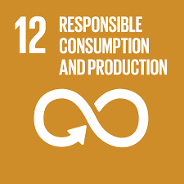
LITERATURE
Production-based approach measures the environmental impacts that occur within a region.
——Ignoring the impact of consumers from other regions on local water resources through trade and make it difficult to promote cooperation among regions for pollution control.
Sustainable development goals (SDG) 12 - UN
Consumption-based approach measures the environmental impacts that occur throughout the entire life cycle of a product or service. It emphasizes the impact of consumers both at home and abroad on the environment.
How to measure consumption impact on global water depletion?

Slide 3
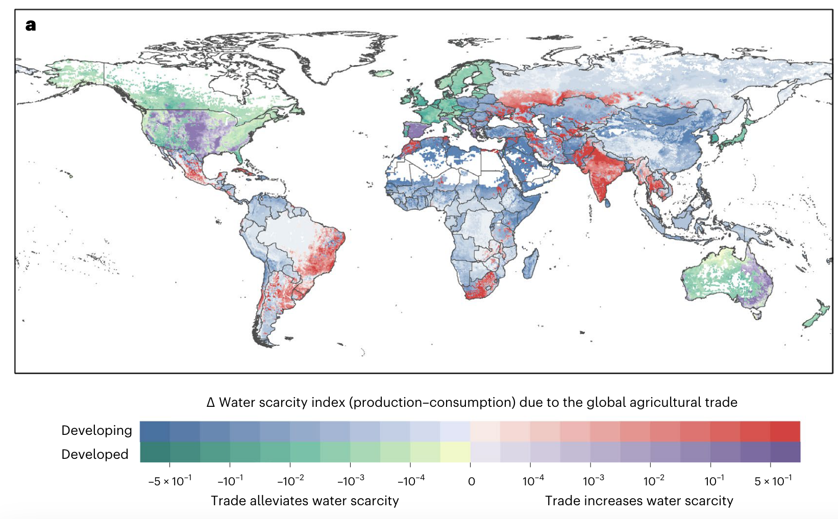
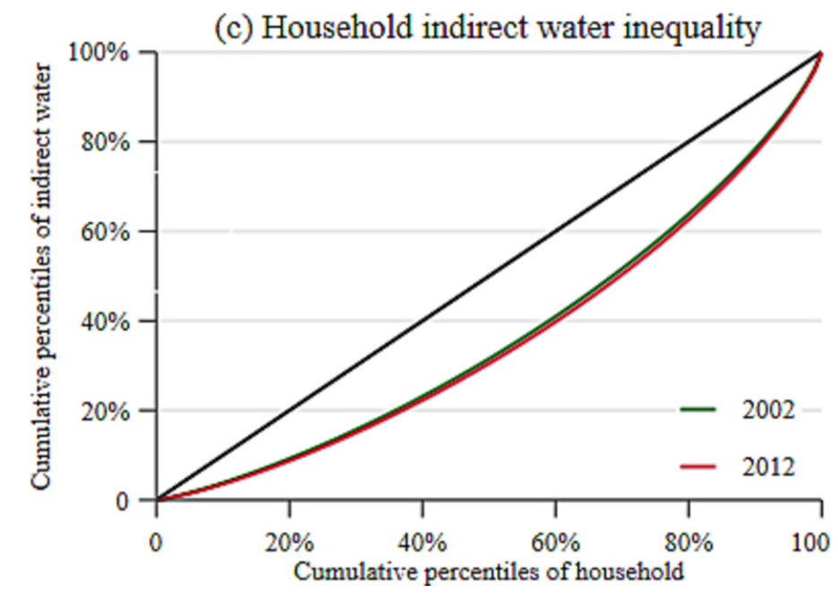
CONSUMPTION PERSPECTIVE
Linking household consumption to water depletion
Process analysis
Focus on crop consumption
Water scarcity embeded in global agricultural trade across developed/dzzeveloping populations. Gu et al. (2024)
Multi-regional input-output (MRIO) analysis
Cover all economic sectors and
full supply chains
Household water footprint inequality in China. Wang et al. (2023)
No research linking the MRIO model with global water depletion
Gu, W. et al. The asymmetric impacts of international agricultural trade on water use scarcity, inequality and inequity. Nat Water (2024) .
Wang, F. et al. Components and drivers of household water footprint inequality in China. Sustainable Production and Consumption 43, 1–14 (2023).
Notes:
conduct in China, Egypt only

Slide 4
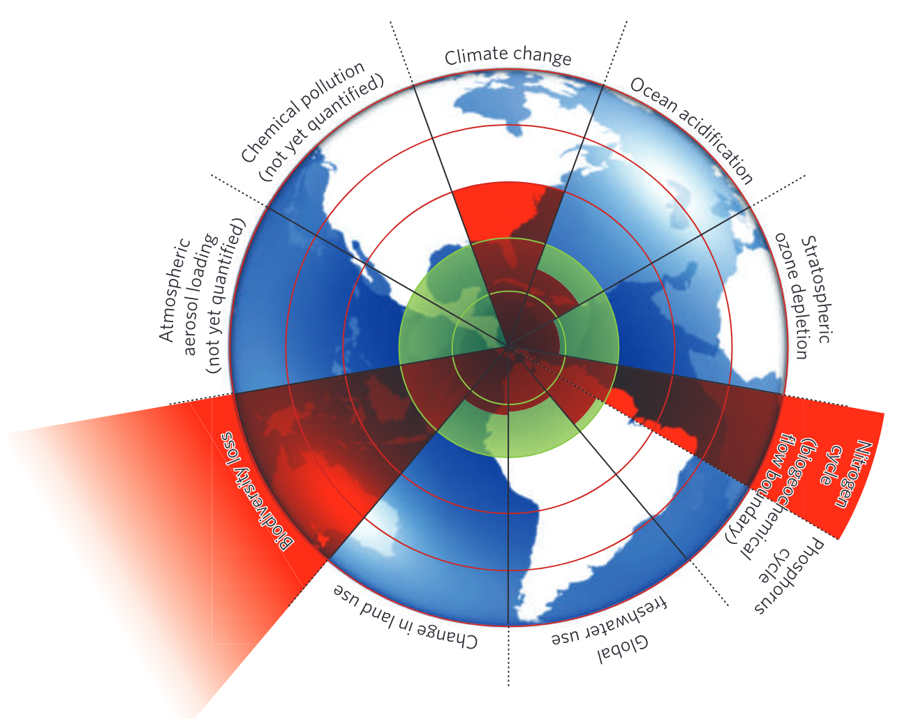
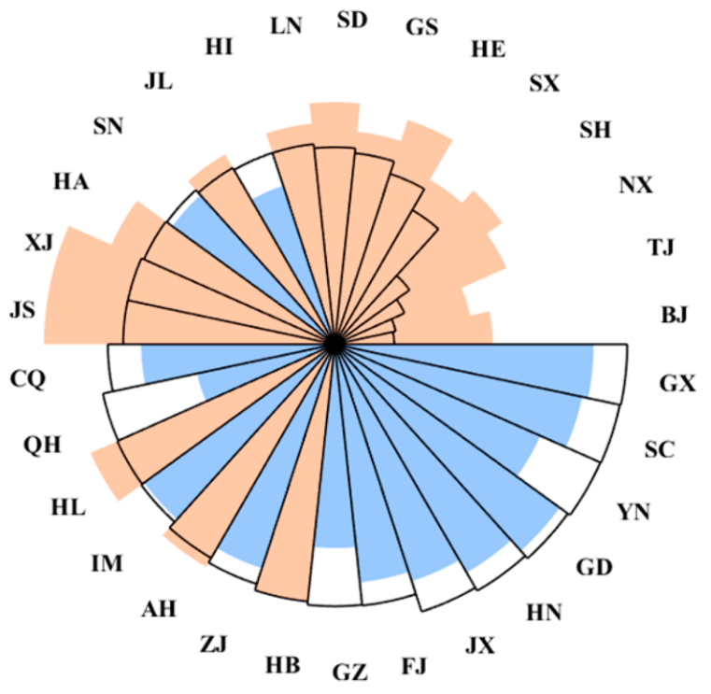
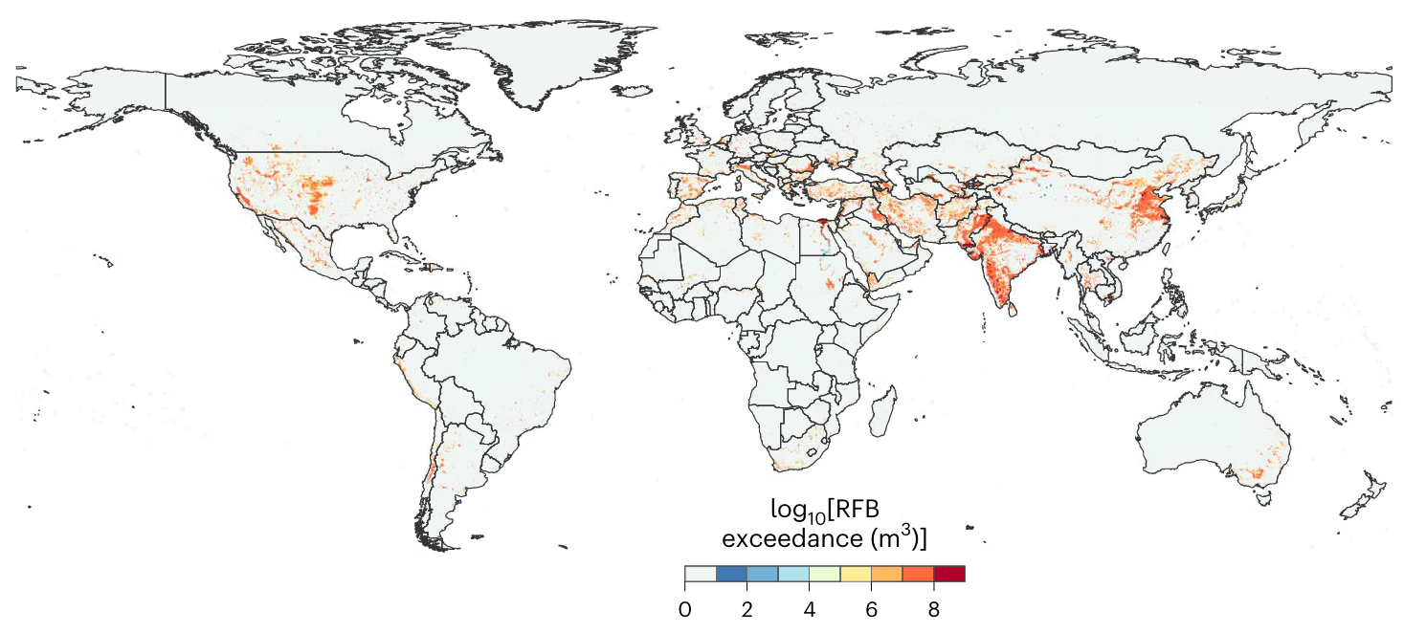
PRODUCTION PERSPECTIVE
Assessing water depletion with high spatial resolution
Criticality ratio = water withdrawal/availability
Building regional freshwater boundary (RFB) for comparison
Enabling the aggregation of grid-level water depletion to larger spatial scales
Global grid-scale water depletion in 2015. Hou et al. (2025)
The water depletion in China’s provinces. Hou et al. (2023)
Safe operating space for nine planetary systems. Rockstrom et al. (2019)
Rockström, J. et al. A safe operating space for humanity. Nature 461, 472–475 (2009).
Hou, S. et al. Tracking grid-level freshwater boundary exceedance along global supply chains from consumption to impact. Nat Water 1–10 (2025).
Hou, S. et al. Revealing Trade Potential for Reversing Regional Freshwater Boundary Exceedance. Environ. Sci. Technol. 57, 11520–11530 (2023).
Notes:
This aggregation may facilitate identifying hotspots across different spatial scales such as urban, river basin, national, and continental levels.

Slide 5
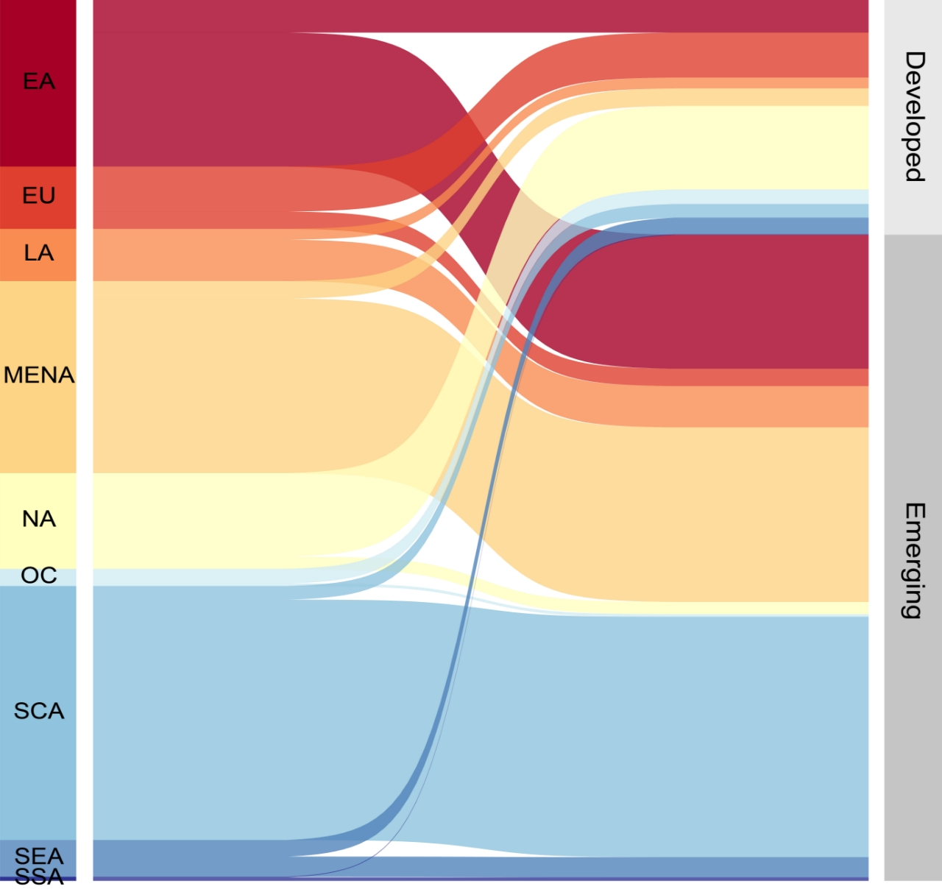
RESEARCH GAP
EXISTING STUDIES
Unequally allocate water resources
Ignore the impact on freshwater depletion
Consumer
groups
National water footprint
?
Expenditure discrepancies worsen the inequality
Coarse spatial
scales…
THIS STUDY
Grid-scale water depletion
Supply-chain effects
Consumption responsibility
Unequal distribution
 |  | R |  | S
 |  | i | j | i | j
R | i
 | j
S | i
 | j
Grid cell
(54 x 54 km)
Country
EMERGING Model
By consumer groups
Among economies and population
Grid-scale water depletion
Aggregate
Producing country
Attribute
Consuming country
Allocate
Consumer
groups
Notes:
Numerous studies have examined the impact of a country's consumption on water scarcity in other countries/basins but this spatial scale is too coarse to capture significant spatial differences in water availability. No studies have yet connected national consumption with RFB exceedance at a very fine resolution globally.

Slide 6
ANALYTIC FRAMEWORK
The proposed framework
estimates grid-level RFB with 75 model mixes to offset uncertainties;
constructs the inventory of water depletion to match the EMERGING MRIO model;
bridges household expenditure to EMERGING model;
links grid-level water depletion to household consumption by income groups.
Notes:
Match consumption categories to sectors in emerging

Slide 7
METHODOLOGY
Matching household expenditure data to EMERGING model
Use sectoral consumption shares by expenditure bins from the WBGCD (2011) as the baseline, covering 33 sectors, 201 expenditure groups, and 168 economies;
Aggregate household expenditure data into 10 groups per economy;
Develop a bridge matrix to map the 33 sectors to the 134 sectors in the EMERGING MRIO table;
Update population to 2019;
Linking water depletion to the household consumption
The water depletion footprint for each expenditure (income) groups in all economies can be calculated by:
$E_{c}=k(I−A)^{−1}H$
where $E_{c}$ is a row vector of the water depletion associated with final household consumption ($H$) for each expenditure (income) group in 245 economies; $k$ is a row vector of water depletion per unit of output for all sectors in all economies

Slide 8
MATERIALS
Data sources
Runoff from ISIMIP2a: Based on the ensemble mean of 15 global hydrological models, driven by ISIMIP2a simulation protocols. These simulations focus on historical data from 1970–2010, at a monthly time scale.
Water withdrawal from WaterGAP2: including 5 sectors at 30 arcmin grid scale in 2019.
Sectoral water intensity: Agriculture sectors from FAOSTAT; Manufacturing, Electricity and Services from EXIOBASE 3.
EMERGING MRIO Table (2019): from CEADs, covering 134 sectors across 245 economies (https://www.ceads.net/data/input_output_tables/).
Household expenditure data: from the World Bank Global Consumption Database (WBGCD)15,18, Eurostat’s Household Budget Survey (HBS), Japan’s Family Income and Expenditure Survey (FIES), Canada’s Survey of Household Spending (SHS), and Australia’s Household Expenditure Survey (HES). The main dataset, WBGCD provides an in-depth profile of household and consumption characteristics, covering 33 consumption categories across 201 expenditure levels for 116 economies in 2011.

Slide 9
Who contributes most to water depletion?
a
b
52%
36%
12%
In 2019, the global middle class was the main driver of household consumption, accounting for 52% of global household consumption.
Across all income levels, households in developed economies consumed more than those in emerging and developing economies (IMF, 2022) but drove less water depletion through consumption.
Emerging economies consumed less, yet caused greater water depletion—especially middle-class households, who contributed 33% of the global depletion footprint, nearly double that of their developed counterparts.
The concentrated trade patterns of emerging economies can partly explain this phenomenon.
Notes:
2019年，中产阶级是全球家庭消费的主力军，贡献了全球 52% 的家庭消费；其次是高收入家庭，占 36%，低收入家庭仅占 12%。
从国家类型来看（依据 IMF 2022 年的分类），无论在哪一收入层级，发达经济体的家庭消费水平始终高于新兴和发展中经济体。尤其是中产和低收入群体，发达经济体对应群体的消费量几乎是新兴经济体的 两倍。
然而，在由家庭消费所引发的全球资源超载方面，新兴和发展中经济体的影响反而更大。其中，新兴经济体的中产家庭对全球超载的贡献最大，占比达 33%，几乎是发达经济体中产家庭的 两倍。
新兴经济体相对集中的贸易模式可以部分解释这一现象。新兴经济体中产消费的供应商主要为水资源短缺的SCA，MENA和EA 国家；而发达经济体中产消费的供应国分散在NA,EU,EA,LA等水资源相对充沛的地区。

Slide 10
Why middle class consumes less but drives
most water depletion?
Middle-class households in emerging economies consume less overall, but their spending is heavily concentrated in water-intensive necessities—like agriculture, food, and electricity.
These sectors account for just 34% of their consumption but cause 83% of their water depletion footprint.
In contrast, middle-class households in developed economies spend mostly on low-water sectors like services and machinery, which make up 82% of their consumption but only 29% of their footprint.
Notes:
Thus, it’s not the quantity, but the pattern of consumption that drives the larger water impact in emerging economies.

Slide 11
Economies pose high risk to global water depletion
a
b
9 x
To reveal the risk level of economy i ’s middle-class consumption on global water depletion:
$Water depletion intensity=\frac{{Water depletion footprint}_{i}}{{Middle−class consumption}_{i}}$ (m³/USD)
Despite developed economies having the largest consumption volume, emerging economies in Central Asia and the Middle East expose a higher level of risk to global water depletion.
Countries like Kyrgyz Republic, Afghanistan, Turkmenistan, and Sudan exceed 1 m³ /USD—the global maximum.
Notes:
These high-intensity emerging economies are hotspots where even modest annual consumption growth can amplify water depletion disproportionately. For example, Kyrgyzstan has sustained real GDP growth around 9% annually from 2022 to 2024, Tajikistan rebounded to 9.4% in 2021, and Turkmenistan averaged above 6% in stable years. Growth in Uzbekistan and Kazakhstan has also averaged ≈5–6%, reflecting rising household consumption. In such high‑intensity economies, even small increases in consumption can exert outsized pressure on water resources. Prioritizing sustainable transitions here is thus critical to global water security.

Slide 12
Economies pose high risk to global water depletion
Table 1. Top 20 economies with the largest depletion intensity related to their middle-class consumption
Country | Depletion intensity of middle class (m3/USD) | Depletion footprint per capita of middle class (m3) | Countries most affected by water depletion driven by middle-class consumption
Kyrgyz Republic | 2.30 | 1649 | Kyrgyz 95%; Uzbekistan 3%
Afghanistan | 1.61 | 543 | Afghanistan 80%; Pakistan 13%
Tajikistan | 1.36 | 700 | Tajikistan 94%; Kazakhstan 2%
Turkmenistan | 1.15 | 4015 | Turkmenistan 99%
Sudan | 1.13 | 446 | Sudan 73%; India 20%; Egypt 5%
Syrian Arab Republic | 0.91 | 677 | Syrian 87%; Egypt 8%
Yemen | 0.74 | 246 | Yemen 58%; Egypt 30%; India 5%
Uzbekistan | 0.70 | 730 | Uzbekistan 93%; Kazakhstan 3%
Egypt | 0.59 | 1114 | Egypt 96%; Syrian 1%
Pakistan | 0.58 | 538 | Pakistan 96%; China 1%
Azerbaijan | 0.54 | 1204 | Azerbaijan 94%;Iran, 2%
Bahrain | 0.53 | 5519 | Bahrain 92%; India 2%
Somalia | 0.52 | 109 | India 81%; Egypt 6%
Iran, Islamic Rep. | 0.48 | 539 | Iran 92%; India 5%
Iraq | 0.34 | 979 | Iraq 93%; China 1%
Libya | 0.29 | 796 | Libya 63%; Egypt 22%
Mauritania | 0.23 | 123 | Mauritania 61%; China 23%
Kazakhstan | 0.18 | 913 | Kazakhstan 83%; Pakistan 4%
Peru | 0.17 | 562 | Peru 95%; China 1%
Qatar | 0.16 | 2638 | Qatar 86%; Pakistan 3%
Outsource to
China, India, Pakistan, Egypt
Domestic
Notes:
These emerging economies not only expose the highest risk level to water depletion through household consumption but also bear the majority of the impact locally. This "consume and deplete domestically" pattern implies that Water stress cannot be alleviated through global trade or outsourcing.
These economies sit at the intersection of rapid population growth, rising consumption, and severe water scarcity.
Without interventions to realign consumption patterns with water sustainability, local crises could spill over into global water insecurity, migration, and geopolitical friction.

Slide 13
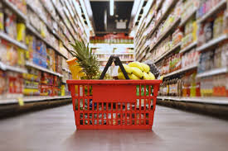
POLICY IMPLICATIONS
Differentiate policy by income tier and expenditure group
Target middle-class consumption in emerging economies
Support structural transitions in household expenditure by incentivizing spending in low-water sectors (e.g., services, digital products, clean energy).
The unprecedented expansion of the global middle class (Brooking institute, 2017)
Food basket. https://www.citizen.co.za/
Notes:
Differentiate policy by income tier and expenditure type, rather than applying universal water-use targets. → Recognize that the same income group behaves very differently in emerging vs. developed economies due to structural consumption differences.
Target middle-class consumption in emerging economies, where rising income leads to disproportionate water depletion due to demand for water-intensive necessities (e.g., food, agriculture, electricity). → Prioritize policies that guide consumption toward low-water alternatives as income rises.
Support structural transitions in household expenditure by incentivizing spending in low-water sectors (e.g., services, digital products, clean energy). → Fiscal tools such as VAT differentiation or targeted subsidies can help reorient demand.

Slide 14
Questions are welcome
Thank you!
siyu.hou@rug.nl
LinkedIn

