Slide 1
Are quantitative models for disaster impact analysis accurate?
A measurement framework and a validation case
Ran Xu ¹, Xiang Gao ^{2*}, Qin Bao ², Cuihong Yang ²
1. School of Management Engineering, Qingdao University of Technology, Qingdao 266520, China;
2. Academy of Mathematics and System Sciences, Chinese Academy of Sciences, Beijing 100190, China

Slide 2
Contents
01
Background and Objective
02
Model and Methods
03
Data and Parameters
04
Empirical Analysis
05
Conclusion

Slide 3
Contents
01
Background and Objective
02
Model and Methods
03
Data and Parameters
04
Empirical Analysis
05
Conclusion

Slide 4
Background
Critical Need: Economic impact assessment of destructive events increasingly important
Fundamental Challenge: Lack of verifiable validation cases to test quantitative model accuracy, undermines trust in impact assessments when needed
Problem: Most disasters involve multiple confounding factors, making it difficult to isolate pure economic effects and validate predictions
Unique validation opportunity: Shanghai COVID-19 Lockdown (2022)
Specificity: City-wide sealing policy with clear boundaries
Short-lived: Well-defined period (March-June 2022)
Minimal confounding factors: Almost laboratory-like conditions
Reliable benchmark: Official economic statistics available for comparison

Slide 5
Literature Review
Impact mechanisms of destructive events
Impact on production:
Destructive events disrupt production, led to negative labor supply shocks and reduced working hours
Breakdown of supply chains generates cascading effects transmitted through the global supply chain
Impact on consumption:
Destructive events restrict residents' daily lives, affecting behavior and consumption patterns
Decrease in overall spending and consumption levels
Vicious cycle where income decreases, poverty rates rise, and consumption is further affected
Comprehensive analysis helps assess event losses and formulate effective loss management policies

Slide 6
Literature Review
Quantitative models for disaster analysis
Computable General Equilibrium (CGE) model
Integration of relationships among economic entities
More suited for long-term equilibrium analysis
Potentially lower impact estimates compared to IO models
Input-Output (IO) model
Flexible and captures impact of sudden shocks
Hypothetical Extraction Method (HEM) in IO model:
Applicable for assessing impact of events and disasters
Dependent on proper "hypothetical extraction" part for accurate impact assessment
Integrates the comprehensive advantages of CGE models and the timely advantages of IO models

Slide 7
Research Questions
Main Contributions
Build and validate a comprehensive disaster impact measurement framework
Incorporation of both production and consumption perspectives
Bridge the credibility gap in disaster impact modeling through empirical validation
Retrospective and prospective analysis using the framework
Empirical validation using Shanghai
Simulations of similar events in other provinces of China
What-if analyses for policies
Empirical confidence in methodology and proves accurate disaster impact modeling achievable
Integration of downstream production loss and short- and long-term demand contraction
Accuracy: Framework estimates 153.8 billion yuan GDP loss, only 3.6% deviation vs. official statistics
Provides insights for policy-making
Comprehensive and accurate economic impact assessment of destructive events
Differentiated characteristics and roles of different regions in the national economic system
Effectiveness of different types of disaster-mitigation policies

Slide 8
Contents
01
Background and Objective
02
Model and Methods
03
Data and Parameters
04
Empirical Analysis
05
Conclusion

Slide 9
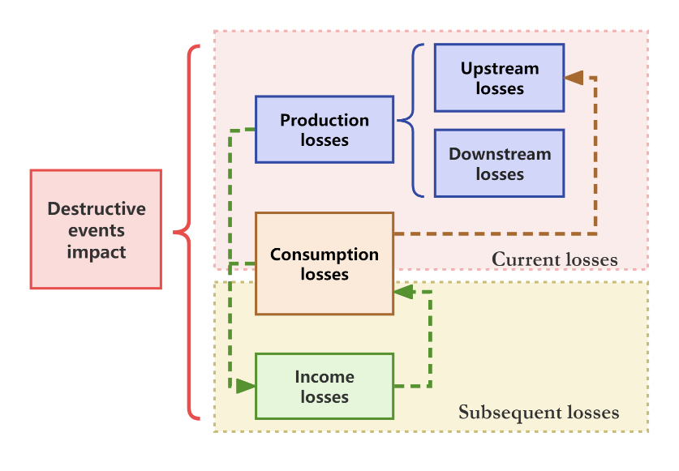
Current impact
Production loss: shutdowns lead to reduced capacity and spread through production network
Upstream loss: due to the disruptions of manufacturing production in the affected areas, the impact on the sector itself and its upstream sectors
Downstream loss: impact caused by disruptions of intermediate product supply in the affected sectors, leading to production shutdowns in downstream sectors dependent on these intermediate products
Consumption loss: the loss caused by restricted household consumption
Subsequent impact
Falling household incomes, leading to consumption contraction
Quantitative framework for assessing the economic losses of destructive events

Slide 10
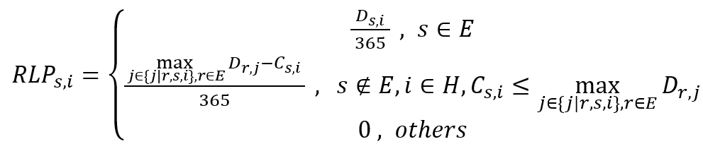
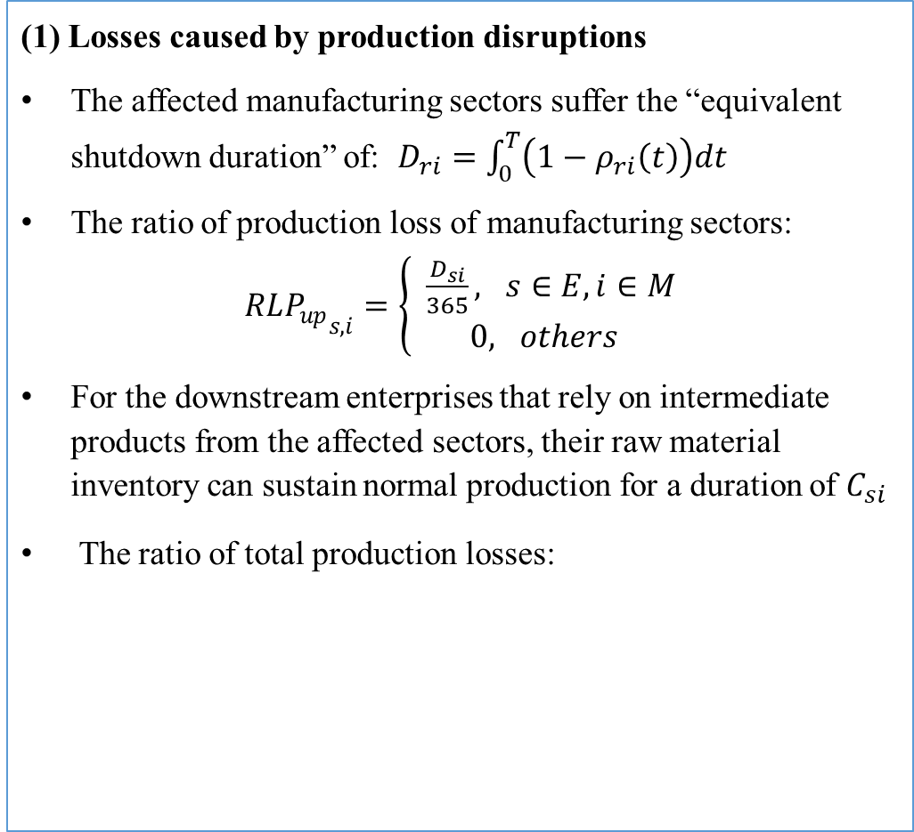
(1) Losses caused by production disruptions
The affected manufacturing sectors suffer the “equivalent shutdown duration” of: $D_{ri}=\int_{0}^{T}{\left(1−ρ_{ri}\left(t\right)\right)dt }$
The ratio of production loss of manufacturing sectors:
$\begin{aligned}{RLP_{up}}_{s,i}=\left\{\begin{aligned} \frac{D_{si}}{365}, s∈E,i∈M \\ 0, &others\end{aligned}\right.\end{aligned}$
For the downstream enterprises that rely on intermediate products from the affected sectors, their raw material inventory can sustain normal production for a duration of $C_{si}$
The ratio of total production losses:
Current losses of destructive events

Slide 11
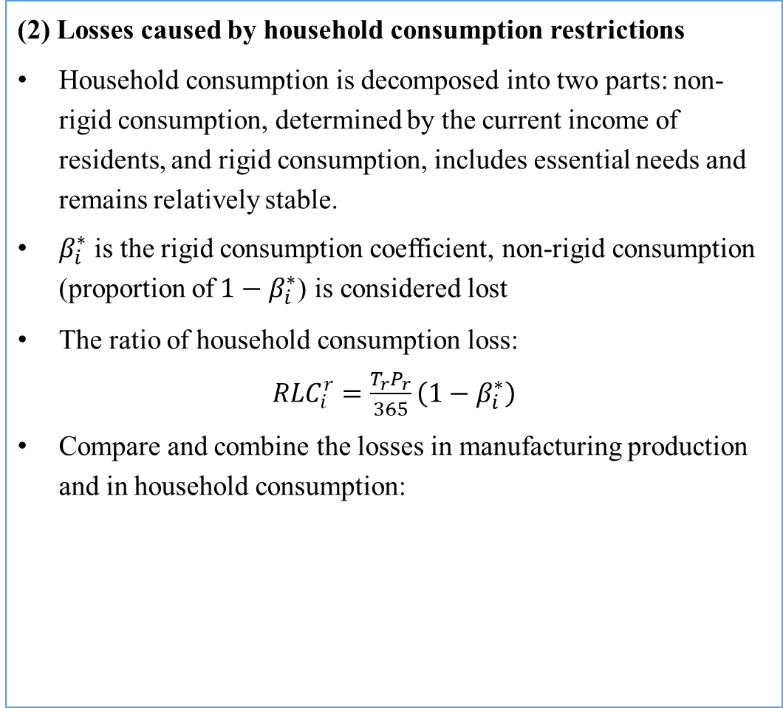
(2) Losses caused by household consumption restrictions
Household consumption is decomposed into two parts: non-rigid consumption, determined by the current income of residents, and rigid consumption, includes essential needs and remains relatively stable.
$β_{i}^{∗}$ is the rigid consumption coefficient, non-rigid consumption (proportion of$1−β_{i}^{∗}$) is considered lost
The ratio of household consumption loss:
${RLC}_{i}^{r}=\frac{T_{r}P_{r}}{365}\left(1−β_{i}^{∗}\right)$
Compare and combine the losses in manufacturing production and in household consumption:
Current losses of destructive events

Slide 12
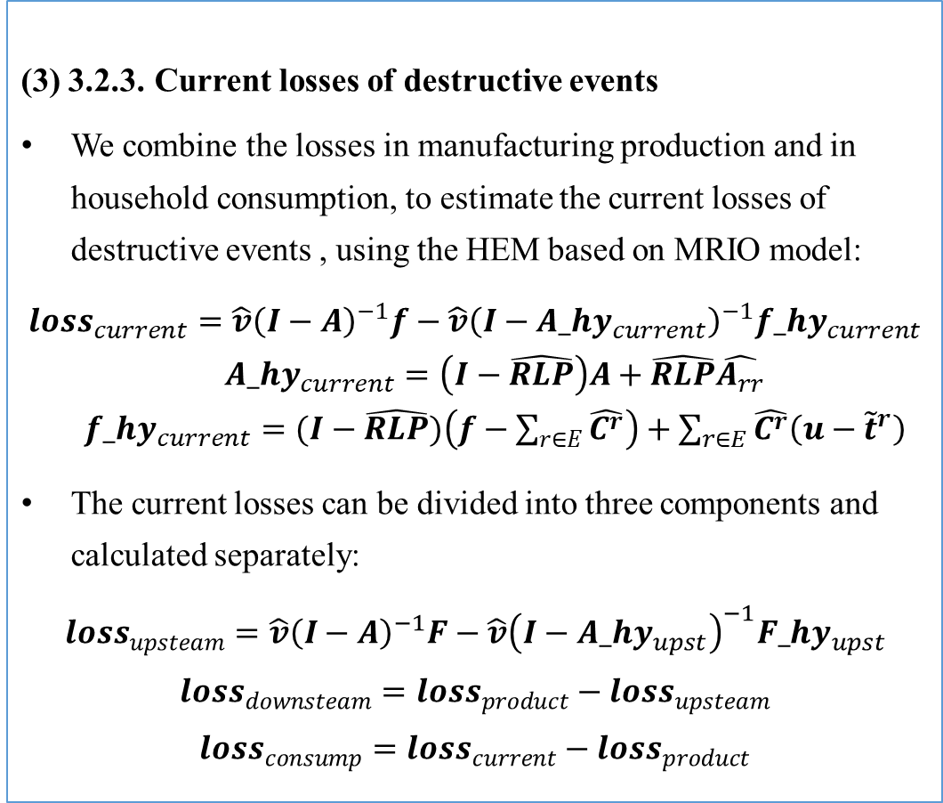
(3) 3.2.3. Current losses of destructive events
We combine the losses in manufacturing production and in household consumption, to estimate the current losses of destructive events , using the HEM based on MRIO model:
$${loss}_{current}=\hat{v}{\left(I−A\right)}^{−1}f−\hat{v}{\left(I−{A_hy}_{current}\right)}^{−1}{f_hy}_{current}$$
${A_hy}_{current}=\left(I−\hat{RLP}\right)A+\hat{RLP}\hat{A_{rr}}$
${f_hy}_{current}=(I−\hat{RLP})\left(f−\sum_{r∈E}{\hat{C^{r}}}\right)+\sum_{r∈E}{\hat{C^{r}}\left(u−{\tilde{t}}^{r}\right)}$
The current losses can be divided into three components and calculated separately:
$${loss}_{upsteam}=\hat{v}{\left(I−A\right)}^{−1}F−\hat{v}{\left(I−{A_hy}_{upst}\right)}^{−1}{F_hy}_{upst}$$
$${loss}_{downsteam}={loss}_{product}−{loss}_{upsteam}$$
$${loss}_{consump}={loss}_{current}−{loss}_{product}$$
Current losses of destructive events

Slide 13
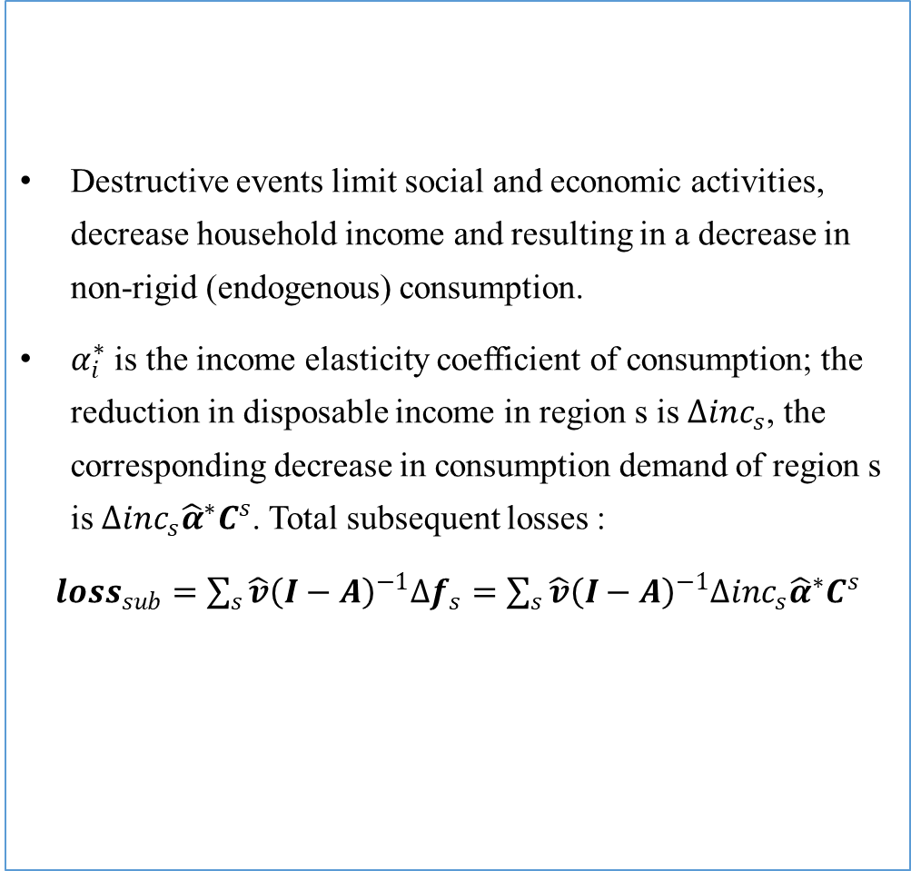
Destructive events limit social and economic activities, decrease household income and resulting in a decrease in non-rigid (endogenous) consumption.
$α_{i}^{∗}$ is the income elasticity coefficient of consumption; the reduction in disposable income in region s is ${∆inc}_{s}$, the corresponding decrease in consumption demand of region s is ${∆inc}_{s}{\hat{α}}^{∗}C^{s}$. Total subsequent losses :
${loss}_{sub}=\sum_{s}{\hat{v}{\left(I−A\right)}^{−1}{∆f}_{s}}=\sum_{s}{\hat{v}{\left(I−A\right)}^{−1}{∆inc}_{s}{\hat{α}}^{∗}C^{s}}$
Subsequent losses of destructive events

Slide 14
Contents
01
Background and Objective
02
Model and Methods
03
Data and Parameters
04
Empirical Analysis
05
Conclusion

Slide 15
Data requirements
Chinese multi-regional input-output table
Income elasticity coefficient and rigid consumption coefficient
Estimation of household income decline
Identification of affected downstream manufacturers
Assessment of raw material “days on hand”

Slide 16
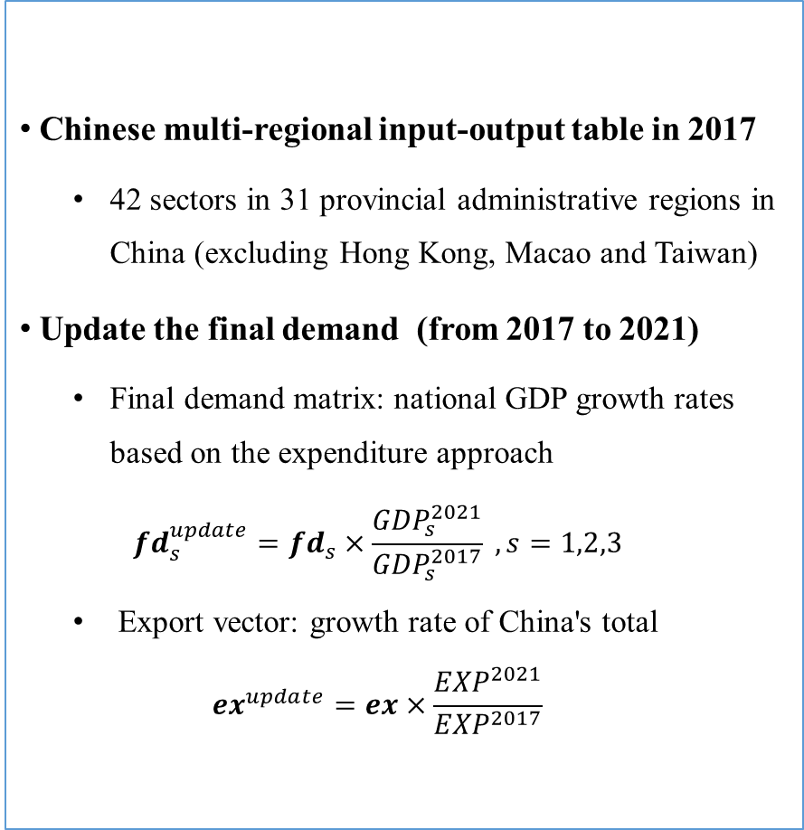
Data requirements
Chinese multi-regional input-output table
Income elasticity coefficient and rigid consumption coefficient
Estimation of household income decline
Identification of affected downstream manufacturers
Assessment of raw material “days on hand”
Chinese multi-regional input-output table in 2017
  42 sectors in 31 provincial administrative regions in China (excluding Hong Kong, Macao and Taiwan)
Update the final demand (from 2017 to 2021)
  Final demand matrix: national GDP growth rates based on the expenditure approach
  $${fd}_{s}^{update}={fd}_{s}×\frac{{GDP}_{s}^{2021}}{{GDP}_{s}^{2017}} , s=1,2,3$$
  Export vector: growth rate of China's total
  $${ex}^{update}=ex×\frac{{EXP}^{2021}}{{EXP}^{2017}}$$

Slide 17
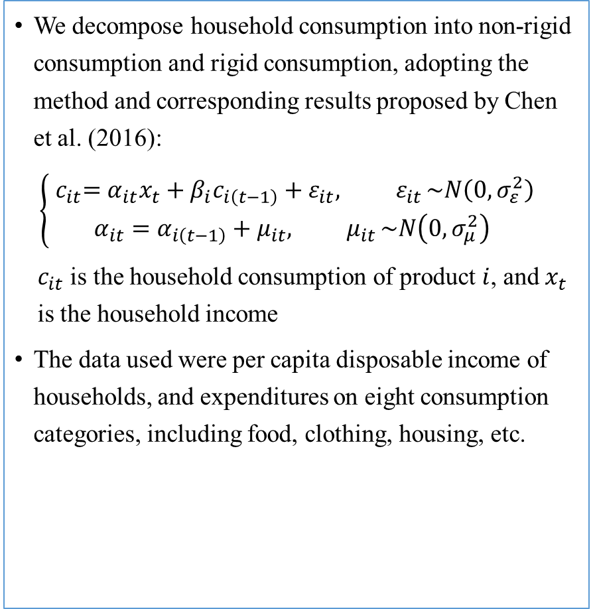
Data requirements
Chinese multi-regional input-output table
Income elasticity coefficient and rigid consumption coefficient
Estimation of household income decline
Identification of affected downstream manufacturers
Assessment of raw material “days on hand”
  We decompose household consumption into non-rigid consumption and rigid consumption, adopting the method and corresponding results proposed by Chen et al. (2016):
  $$\left\{\begin{matrix}{ c}_{it}=α_{it}x_{t}+β_{i}c_{i\left(t−1\right)}+ε_{it}{, ε}_{it}\sim N\left(0,σ_{ε}^{2}\right) \\ α_{it}=α_{i\left(t−1\right)}+μ_{it}{, μ}_{it}\sim N\left(0,σ_{μ}^{2}\right)\end{matrix}\right.$$
  $c_{it}$ is the household consumption of product$i$, and $x_{t}$ is the household income
  The data used were per capita disposable income of households, and expenditures on eight consumption categories, including food, clothing, housing, etc.
Household consumption category | Rigid consumption coefficient
Food | 0.500
Clothing | 0.395
Housing | 0.708

Slide 18
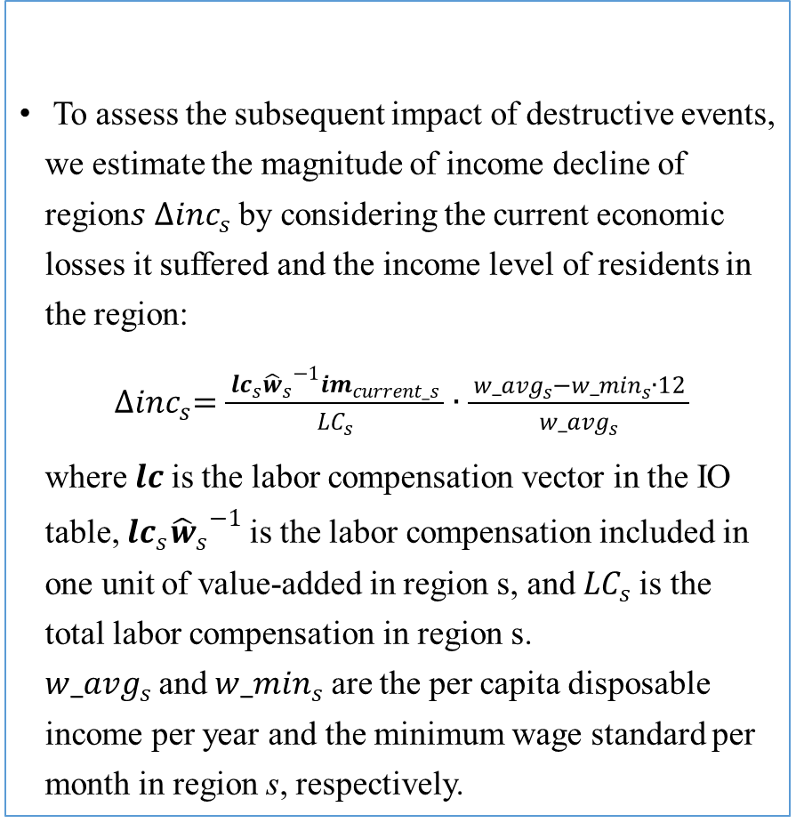
Data requirements
Chinese multi-regional input-output table
Income elasticity coefficient and rigid consumption coefficient
Estimation of household income decline
Identification of affected downstream manufacturers
Assessment of raw material “days on hand”
  To assess the subsequent impact of destructive events, we estimate the magnitude of income decline of region$s {∆inc}_{s}$by considering the current economic losses it suffered and the income level of residents in the region:
  ${∆inc}_{s}=\frac{ {lc}_{s}{{\hat{w}}_{s}}^{−1}{im}_{current_s} }{{LC}_{s}}∙\frac{ {w_avg}_{s}−{w_min}_{s}∙12 }{{w_avg}_{s}}$
  where $lc$is the labor compensation vector in the IO table, ${lc}_{s}{{\hat{w}}_{s}}^{−1}$is the labor compensation included in one unit of value-added in region s, and ${LC}_{s}$is the total labor compensation in region s. ${w_avg}_{s}$and${w_min}_{s}$are the per capita disposable income per year and the minimum wage standard per month in region s, respectively.

Slide 19
Data requirements
Chinese multi-regional input-output table
Income elasticity coefficient and rigid consumption coefficient
Estimation of household income decline
Identification of affected downstream manufacturers
Assessment of raw material “days on hand”
  Downstream manufacturers with high dependence on intermediate products from affected regions may not be able to find reliable alternative sources in the short term. If the supply of intermediate products is not restored when their inventory of raw materials is exhausted, the production of these downstream sectors will be affected.
  Identify the dependent downstream sectors:
  Calculate the proportion of intermediate products used by each that come from other provinces. If the proportion of the affected region ranks in the top three among all sources, we consider the downstream sector to have a high dependence on intermediate products from the affected area.

Slide 20
Data requirements
Chinese multi-regional input-output table
Income elasticity coefficient and rigid consumption coefficient
Estimation of household income decline
Identification of affected downstream manufacturers
Assessment of raw material “days on hand”
Raw material "days on hand" (DOH): the number of manufacturing days before all raw materials on hand are used.
Estimation method:
Obtain annual ending raw material inventory and operating cost data of listed companies and summarize the data by manufacturing sector.
  Extract raw material costs from the operating cost data using the proportion calculated from the MRIO table .
  Raw material inventory turnover rate = the full-year raw material costs / the ending raw material inventory.
  Raw material DOH = the time period of 365 days / turnover rate.
  Averaging the raw material DOH for each manufacturing sector over the three years.

Slide 21
Contents
01
Background and Objective
02
Model and Methods
03
Data and Parameters
04
Empirical Analysis
05
Conclusion

Slide 22
Retrospective Analysis Using the Framework:
Empirical Case Study of Shanghai Lockdown in 2022
Notes:
In mid-March 2022, Shanghai, one of the largest and most dynamic megacities in Asia, experienced a surge of the COVID-19 outbreak. To control the spread of the virus, the local government implemented a provincial-level lockdown policy that covered almost the entire city of Shanghai for the majority of the second quarter of 2022. This event eliminated the interference of other factors and created comparable real-world economic statistical data (such as GDP growth) to confirm the reliability and accuracy of our framework, making it a suitable case study.

Slide 23
the equivalent shutdown duration of manufacturing sectors: 32.8 days (the rate of decline in Shanghai's electricity generating capacity)
the duration of residents‘ living restrictions and the proportion affected: all residents during the 65-day lockdown from March 28th to May 31st, and 52.3% of residents in June (Shanghai urban transportation passengers data)
Economic losses caused by the destructive event in Shanghai
Economic impact category | Losses in VA (billion yuan) | Percentage (%)
Current impact | 533.5
- Within Shanghai | 153.8 | 28.8%
Production loss - upstream | 303.1 | 56.8%
Production loss - downstream | 142.0 | 26.6%
Consumption loss | 88.4 | 16.6%
Subsequent impact | 51.3
- Within Shanghai | 16.2 | 31.6%
only 3.6% error compared to real data
Notes:
According to the quantitative framework, the current losses can be divided into three components. Due to the production shutdown in the affected region, the impact on itself and the upstream regions and sectors providing intermediate products, referred to as “production losses - upstream”, is 303.1 billion yuan in value-added, accounting for more than half of the total current losses. The losses caused by downstream sectors' shutdown due to the interruption of intermediate product supply, referred to as “production losses - downstream”, is 142.0 billion yuan. The “consumption losses” caused by reduced household consumption is 88.4 billion yuan. Additionally, there is a potential loss of 51.3 billion yuan, which is the subsequent losses of the decline in household income and consumer demand

Slide 24
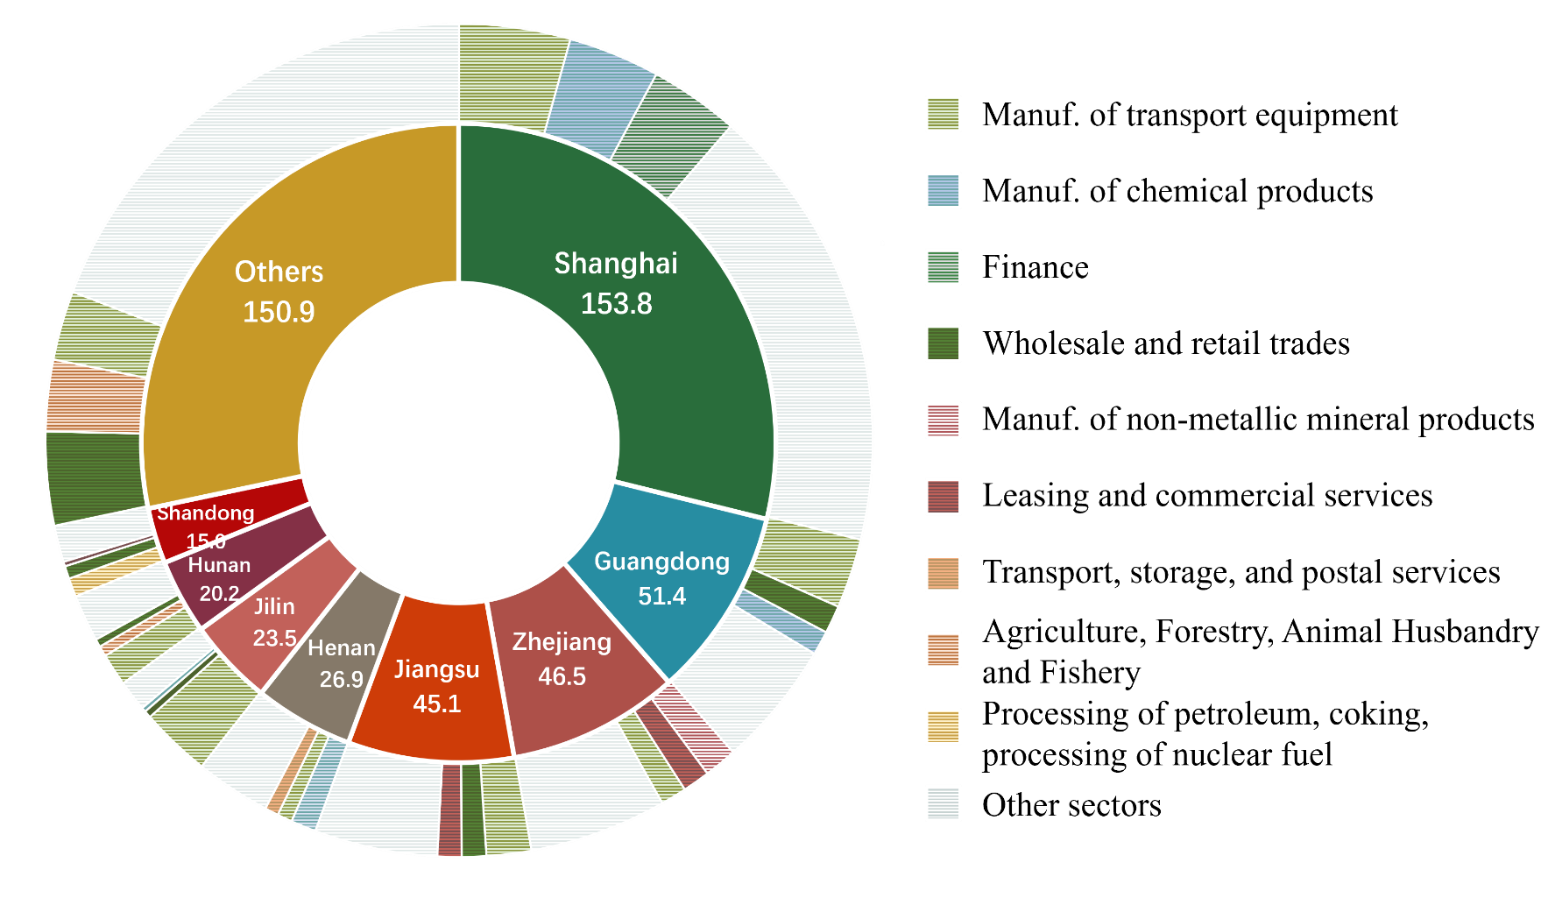
Regions that suffer the highest current losses of the destructive event in Shanghai and their corresponding sectors
Economically developed provinces; geographically close to Shanghai
Closely linked to Shanghai through the supply chain: supply and demand
Key manufacturing industry in Shanghai
Shanghai as the major financial center in China
Essential to the residents’ lives

Slide 25
Prospective Analysis Using The Framework:
Simulations of Similar Events in Other Provinces of China
Notes:
As an empirical example of prospective analysis, we simulated the impact of the same level destructive events (with the same input variables for the analysis framework) occurring in other provinces of China. The results shed light on the differentiated characteristics and roles of different provinces in the national economic system.

Slide 26
Ranking of current impact caused by destructive events in various regions
High total loss: Large and developed provinces
High downstream loss: Crucial suppliers in the production supply chain
High consumption loss: Western regions, where manufacturing industry is less developed
Notes:
If a similar destructive event were to occur in large provinces like Guangdong, Jiangsu, and Zhejiang, the resulting losses would obviously be higher.
From the perspective of the three components, losses caused by production disruption account for a high proportion, and are mainly upstream losses.

Slide 27
Ranking of current impact caused by destructive events in various regions
High total loss: Large and developed provinces
High downstream loss: Crucial suppliers in the production supply chain
High consumption loss: Western regions, where manufacturing industry is less developed
Notes:
Meanwhile, in some provinces, such as Henan, Chongqing, and Jilin, the downstream losses caused by disruptions in intermediate product supply are relatively higher compared to other provinces, indicating that these provinces perform as crucial suppliers in the production supply chain, and many downstream regions and sectors depend on them. For example, in Henan Province, the main production sectors that downstream sectors depend on are food, textile and clothing, and non-metallic mineral products. Chongqing is mainly relied on by the surrounding provinces of Yunnan, Guizhou, and Sichuan, while Jilin primarily affects the surrounding northeastern provinces of Heilongjiang and Liaoning.

Slide 28
Ranking of current impact caused by destructive events in various regions
High total loss: Large and developed provinces
High downstream loss: Crucial suppliers in the production supply chain
High consumption loss: Mid-west regions, where manufacturing industry is less developed
Notes:
In addition, the proportion of losses caused by consumption decline is relatively low, and the provinces with higher proportions in consumption loss are mainly located in the western regions of China, where the manufacturing industry is less developed, resulting in a relatively smaller magnitude in total impact.

Slide 29
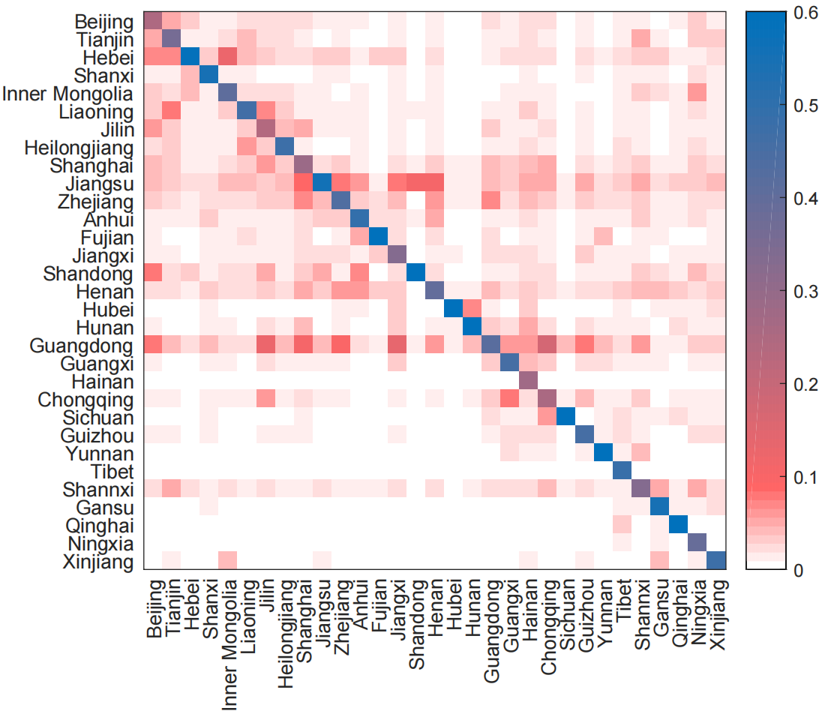
Distribution of current impact caused by destructive events in various regions
Diagonal line - losses incurred in the affected region itself
Concentrated within: relatively self-sufficient in the production network
Widely distributed:
not self-sufficient and rely on other regions to import goods
With a lot of external connections in the supply chain
Determine the level of economic connectivity between regions
Notes:
Figure presents the distribution of current impact caused by destructive events in each region among all regions. The horizontal axis represents the regions where the event occurred, and the vertical axis represents the distribution of the losses in all regions.
On the diagonal line, the economic loss of the provinces where the destructive event occurs is undoubtedly the highest, that is, the losses incurred in the affected region itself.
In some provinces, such as Shandong, Hubei and Hunan, this proportion of their own losses is higher, indicating that these regions are relatively self-sufficient in the production network.
For some provinces, the losses they cause will be widely distributed among different regions. This includes two situations: one is the provinces that cannot be self-sufficient and need to rely on other regions to import goods, such as Hainan and Shaanxi; the other is the provinces that have a lot of external connections in the supply chain, such as Jilin and Henan.
Therefore, we can utilize the simulation of the distribution of losses caused by destructive events in each region to determine the level of economic connectivity between the regions.

Slide 30
Ranking of subsequent impact caused by destructive events in various regions
High subsequent impact: large population or high per capita income
High within-province loss: purchase local consumer goods
Low within-province loss : purchase consumer goods from all over the country
Notes:
The ranking of the subsequent losses caused by the destructive event in each region and the corresponding losses incurred within each region are shown in Figure 5. In regions with larger economic volumes, losses are still higher.

Slide 31
Ranking of subsequent impact caused by destructive events in various regions
High subsequent impact: large population or high per capita income
High intra-province loss: purchase local consumer goods
Low intra-province loss : purchase consumer goods from all over the country
Notes:
Shandong Province has a notably high concentration of losses within the region, suggesting that its residents primarily buy locally produced consumer goods and services. By contrast, Henan, Shanghai, and Chongqing have relatively low percentages of losses within their respective regions, indicating that their residents buy more consumer goods and services from all over the country.

Slide 32
What-if Analysis Using the Framework :
Simulation of Disaster Mitigation Policies
Notes:
In this section, we present a series of what-if analyses, to explore the effectiveness of various coping policies on mitigating the losses caused by destructive events. By adjusting the parameters and input variables in the quantitative framework, we have the flexibility to assess the economic losses under different scenarios.

Slide 33
Effective production management measures: reduce the duration of production shutdowns
Ensuring the household livelihoods
Ensuring transportation and core supply chain resilience
Implementing post-disaster recovery measures
Policy mitigation effects of reducing production shutdown duration in various regions
Notes:
The implementation of measures such as safe passage and closed-loop management (minimizing factories’ exposure to the outside to maintain smooth operation) can effectively reduce the duration of production shutdowns. Figure 6(a) presents the mitigated economic loss values and percentages for each region, achieved through a 10% reduction in production downtime from destructive events.

Slide 34
Effective production management measures
Ensuring the household livelihoods: offer residents access to products and services other than necessities
Ensuring transportation and core supply chain resilience
Implementing post-disaster recovery measures
Policy mitigation effects of reducing consumption in various regions
Notes:
To minimize consumption losses, measures such as community group purchasing can be adopted to offer residents access to products and services other than necessities during destructive events. This ensures that household consumption is maintained at a certain level, thereby minimizing the impact on the overall economy. Figure 6(b) presents the percentage of economic losses that could be mitigated by a 10% reduction in consumption losses for each region.

Slide 35
Effective production management measures
Ensuring the household livelihoods
Ensuring transportation and core supply chain resilience: improves resilience of production and supply networks and reduces losses in downstream sectors
Implementing post-disaster recovery measures
Policy mitigation effects of protecting critical supply in various regions
Notes:
By implementing security measures to protect transportation and critical supply chains in core industrial sectors, downstream disruptions can be minimized. This approach improves the overall resilience of production and supply networks and reduces losses in related sectors. Supply chain resilience is mainly reflected in manufacturers reducing their reliance on their prime suppliers. In this framework, the policy simulation is conducted by considering the downstream sector to be affected by the intermediate supply cutoff only if the affected area is the top one or top two sources of supply (instead of the top three, as originally set), referred to as Policy I and Policy II, respectively. This means that the downstream sectors are less vulnerable to the supply cutoffs. Figure 6(c) illustrates the economic losses that can be mitigated by these two types of policies, both in value and percentage.

Slide 36
Effective production management measures
Ensuring the household livelihoods
Ensuring transportation and core supply chain resilience
Implementing post-disaster recovery measures: stimulate consumption and mitigate the long-term economic impact
Policy mitigation effects of reducing subsequent consumption losses in various regions
Notes:
Post-disaster measures, such as issuing shopping vouchers and subsistence subsidies, can be employed to stimulate consumption and mitigate the long-term economic impact of destructive events. Figure 6(d) presents the values and percentages of subsequent economic losses that can be mitigated through a 50% reduction in consumption losses resulting from income loss. The proactive measures that encourage consumption help expedite post-disaster recovery and prevent the vicious cycle where declining incomes lead to further reductions in consumption.

Slide 37
Contents
01
Background and Objective
02
Model and Methods
03
Data and Parameters
04
Empirical Analysis
05
Conclusion

Slide 38
Main Contributions
Analytical Framework Contribution:
Combines production and household consumption perspectives
Considers both upstream and downstream economic losses caused by production disruptions
Incorporates non-rigid consumption and captures both short- and long-term effects
Empirical Results:
Empirical study in Shanghai demonstrated the accuracy of the framework
Prospective analysis provided estimates of economic losses, as well as insights into regional characteristics and policy effectiveness.

Slide 39
Thank you for listening!
Ran Xu
School of Management Engineering, Qingdao University of Technology
Academy of Mathematics and System Sciences, Chinese Academy of Sciences
+86-18811444106
xuran_94@163.com

