Slide 1
Pathways for Reducing CO₂ Emissions Through Decoupling Processes:
A Global Multi-Regional Structural Decomposition Analysis
Waka Nishifuji^{1*}, Shigemi Kagawa²
1. Graduate School of Economics, Kyushu University, Fukuoka, Japan
2. Faculty of Economics, Kyushu University, Fukuoka, Japan
Notes:
Hello, everyone.
Thank you for attending my presentation today.
I’m Waka Nishifuji from Kyushu University, Japan.
The title of my presentation is "Pathways for Reducing CO2 Emissions Through Decoupling Processes: A Global Multi-Regional Structural Decomposition Analysis."

Slide 2



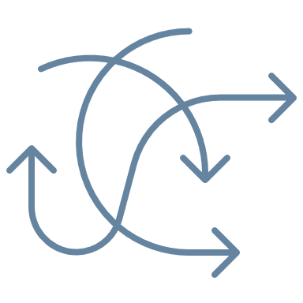

1. Introduction
Economic Growth and Environmental Impact
  According to the Environmental Kuznets Curve (EKC) hypothesis (Grossman, 1991; Arrow et al., 1995), environmental impact increases in early stages of growth, but declines after a certain stage of economic growth.
  Decoupling economic growth from greenhouse gas (GHG) emissions is crucial for climate change mitigation (Yang et al., 2021).
  Key factors behind decoupling (Nansai et al., 2007; Okamoto, 2013);
  Technological factors
  Consumption factors
  Trade factors (e.g., import share)
Per capita GHG
Per capita GDP
Notes:
Let me start with a brief introduction on economic growth and environmental impact.
According to the Environmental Kuznets Curve hypothesis, environmental impact tends to increase during the early stages of economic growth, but declines after reaching a certain level of development.
To mitigate climate change, it is essential to decouple economic growth from greenhouse gas emissions.
Previous studies have identified key factors that drive this decoupling: for example, technological factors, consumption factors, and trade factors.

Slide 3
1. Introduction
Challenges in Decoupling Analysis
  Most existing studies focus on single-country or short-term analyses.
  Few studies have conducted multi-country or long-term time-series analyses of decoupling and compared its driving factors (Wang and Han, 2021).
Challenges:
Limited ability to identify GHG reduction pathways and formulate effective policies for different stages of economic growth.
Insufficient investigation of trade structure changes as a decoupling factor.
This means such analyses cannot consider the rise of emerging economies in global supply chains or the choice of trading partners.
Notes:
I will now describe the challenges in decoupling analysis.
Most existing studies focus on either single countries or short-term periods.
Very few studies have conducted multi-country or long-term time-series analyses and compared the driving factors of decoupling, as noted by Wang and Han in 2021.
There are two main challenges:
First, there is a limited ability to identify GHG reduction pathways and to develop effective policies for different stages of economic growth.
Second, there has been insufficient investigation into how changes in trade structures affect decoupling.
Because of these limitations, current analyses often fail to consider the rise of developing economies in global supply chains or how countries choose their trading partners in decoupling analysis.

Slide 4
1. Introduction
Research Objectives
  To provide guidance for global CO₂ reduction strategies.
  To develop a comprehensive and detailed analytical approach for identifying drivers of decoupling using the World MRIO table.
Key Features of This Study
  Examination of a wide range of factors, including global trade structure.
  Analysis of time trends in decoupling states across countries over a given period.
  Discussion of GHG reduction through degrowth.
  Empirical analysis covering 43 countries over 15 years (2000–2014).
Notes:
Let me outline the research objectives and key features of this study.
Our goal is to provide guidance for global CO₂ reduction strategies.
To do this, we develop a comprehensive and detailed analytical method to identify the drivers of decoupling, using the World Multi-Regional Input-Output table.
This study has several key features.
First, it examines a wide range of decoupling factors, including the global trade structure.
Second, it analyzes the time trends in decoupling states across countries over a specific period.
Third, it discusses greenhouse gas reduction through degrowth.
Finally, it includes an empirical analysis covering 43 countries over 15 years, from 2000 to 2014.

Slide 5





2. Methodology: Definition of decoupling indicator
  Definition of decoupling indicator
  The decoupling of environmental impacts from economic growth is expressed in terms of elasticity values (Tapio, 2005; Wang et al., 2015).
$$D_{t}^{r}=\frac{{(q_{t}^{r}−q_{0}^{r})}/{q_{0}^{r}}}{{(y_{t}^{r}−y_{0}^{r})}/{y_{0}^{r}}}=\frac{\%∆q_{t}^{r}}{\%∆y_{t}^{r}}$$
$D_{t}^{r}$ : Decoupling indicator of country $r$ year 0 to year $t$
$q_{t}^{r}$ : Per capita carbon footprint of country $r$ in year $t$
$y_{t}^{r}$ : Per capita final demand (i.e., GDE) of country $r$ in year $t$
  Estimation using EE-IO
  Applying the EE-IO model to the World MRIO table,
  $$q_{t}^{r}={e_{t}{(I−A_{t})}^{−1}f_{t}^{r}}/{{pop}_{t}^{r}}$$
$$y_{t}^{r}={if_{t}^{r}}/{{pop}_{t}^{r}}$$
    $e_{t}$ : CO₂ emission coefficients row vector in year $t$
    $I$ : Identity matrix
    $A_{t}$ : Input coefficient matrix for $N$ countries and $M$ : sectors in year $t$
    $f_{t}^{r}$ : Final demand column for country $r$ in year $t$
    ${pop}_{t}^{r}$ : Population of country $r$ in year $t$
    $i$ : Row vector with all elements equal to 1
$$(2)$$
$$(3)$$
$$(1)$$
Notes:
Let’s move to the definition of the decoupling indicator.
This indicator shows how environmental impact, measured by per capita carbon footprint, changes relative to economic growth, measured by per capita final demand or GDE.
This is expressed as elasticity, following Tapio 2005 and Wang et al. 2015.
The formula calculates the ratio of the percentage change in carbon footprint to the percentage change in economic growth over the period from the base year to year t.
We then estimate these values using the Environmentally Extended Input-Output (EE-IO) model applied to the World Multi-Regional Input-Output (MRIO) table.
The per capita carbon footprint is calculated by multiplying the emission coefficients vector by the Leontief inverse matrix and the final demand vector, then dividing by the population.
Similarly, per capita final demand is calculated by summing the final demand vector and dividing by the population.
---
Here are the definitions of the components used in the formula:
et​ is the CO₂ emission coefficients vector at year t,
I is the identity matrix,
At​ is the input coefficients matrix representing production technology for all countries and sectors,
ftr​ is the final demand vector for country r,
Pop^tr​ is the population of country r,
and i is a vector of ones used to sum the elements.

Slide 6
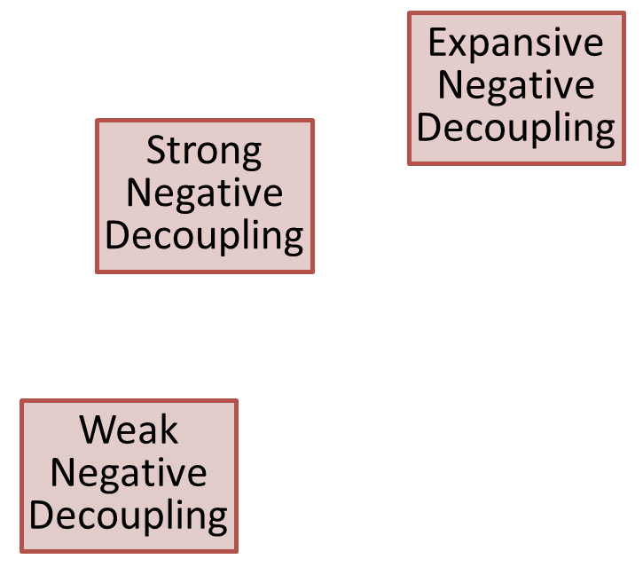


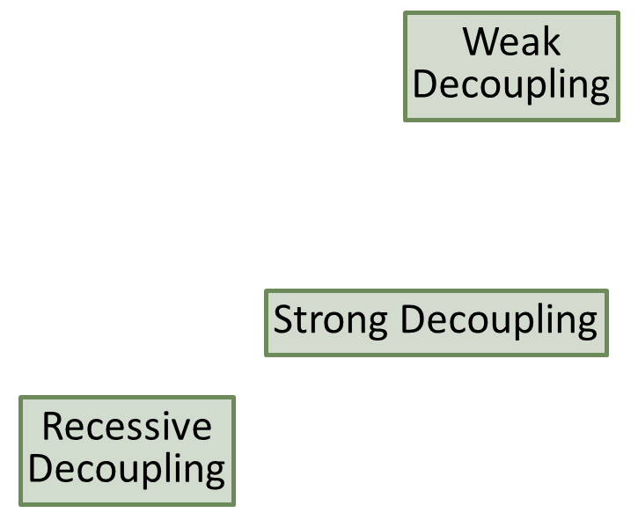

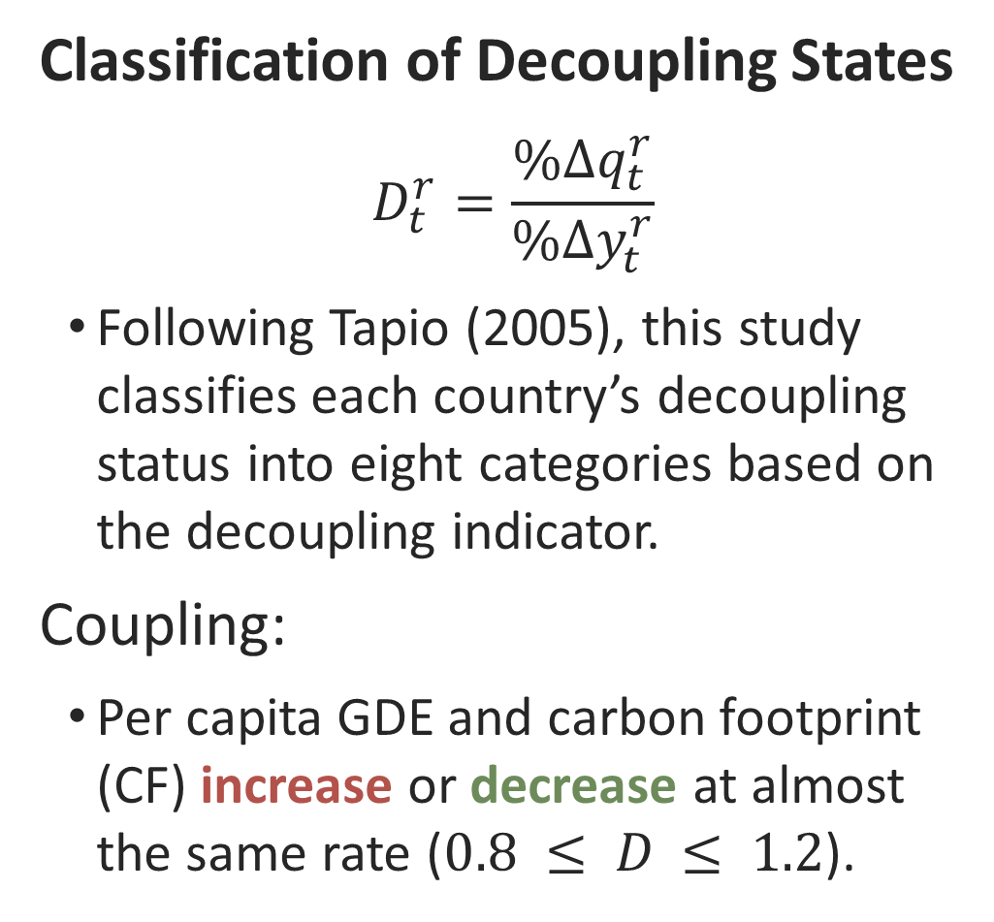




2. Methodology: Definition of decoupling indicator
$$D=1.2$$
Classification of Decoupling States
$$D_{t}^{r}=\frac{\%∆q_{t}^{r}}{\%∆y_{t}^{r}}$$
Following Tapio (2005), this study classifies each country’s decoupling status into eight categories based on the decoupling indicator.
Coupling:
Per capita GDE and carbon footprint (CF) increase or decrease at almost the same rate ($0.8 ≤ D ≤ 1.2$).
$$\%∆q$$
Expansive
Negative
Decoupling
$$D=0.8$$
Strong
Negative
Decoupling
$$(1)$$
Expansive Coupling
Weak
Decoupling
Weak
Negative
Decoupling
$$\%∆y$$
Strong Decoupling
Recessive Coupling
Recessive
Decoupling
Notes:
We’ll look at how we classify decoupling states.
Using the decoupling indicator defined on previous slide, we categorize each country's decoupling states into eight types.
First, "Coupling" refers to the state where per capita final demand, or GDE, and per capita carbon footprint increase or decrease at nearly the same rate. This corresponds to a decoupling indicator value between 0.8 and 1.2.

Slide 7

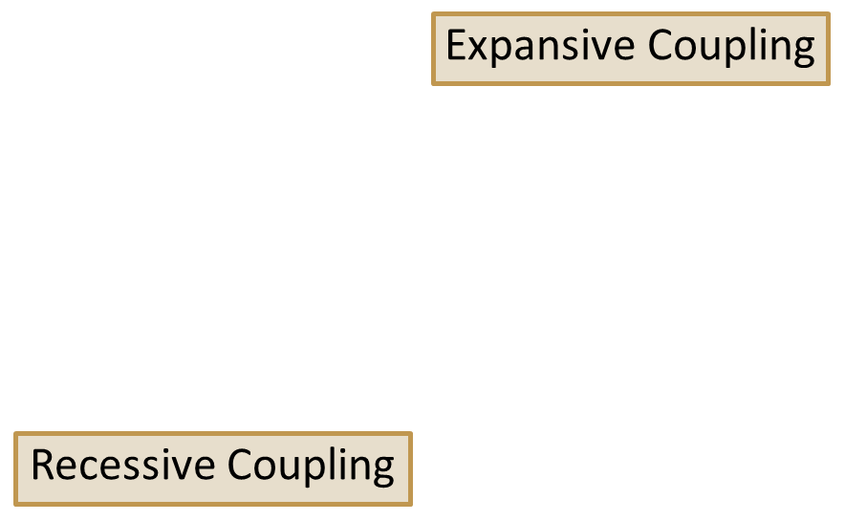

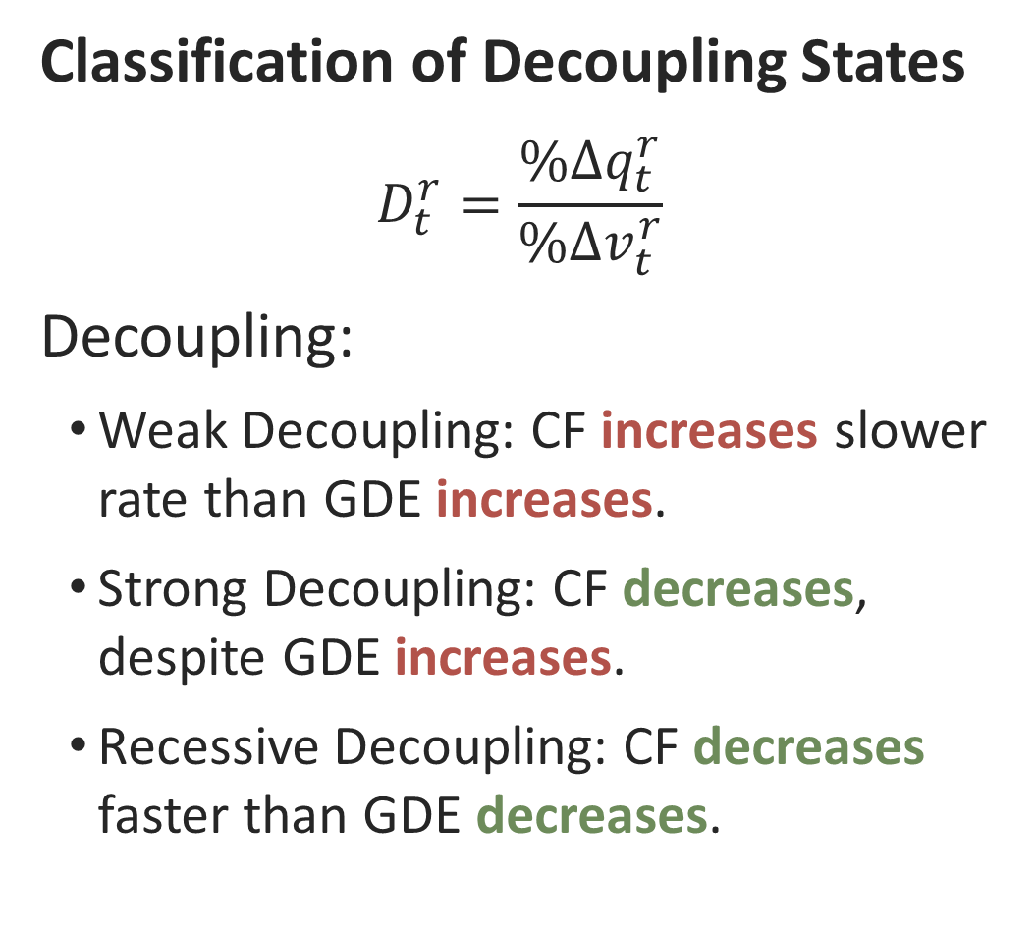

2. Methodology: Definition of decoupling indicator
$$D=1.2$$
Classification of Decoupling States
$$D_{t}^{r}=\frac{\%∆q_{t}^{r}}{\%∆v_{t}^{r}}$$
Decoupling:
Weak Decoupling: CF increases slower rate than GDE increases.
Strong Decoupling: CF decreases, despite GDE increases.
Recessive Decoupling: CF decreases faster than GDE decreases.
$$\%∆q$$
Expansive
Negative
Decoupling
$$D=0.8$$
Strong
Negative
Decoupling
$$(1)$$
Weak
Decoupling
Weak
Negative
Decoupling
$$\%∆y$$
Strong Decoupling
Recessive
Decoupling
Notes:
Decoupling has three types.
Weak Decoupling means CF increases, but slower than GDE.
Strong Decoupling means CF decreases, despite GDE increases.
Recessive Decoupling means CF decreases faster than GDE decreases.

Slide 8
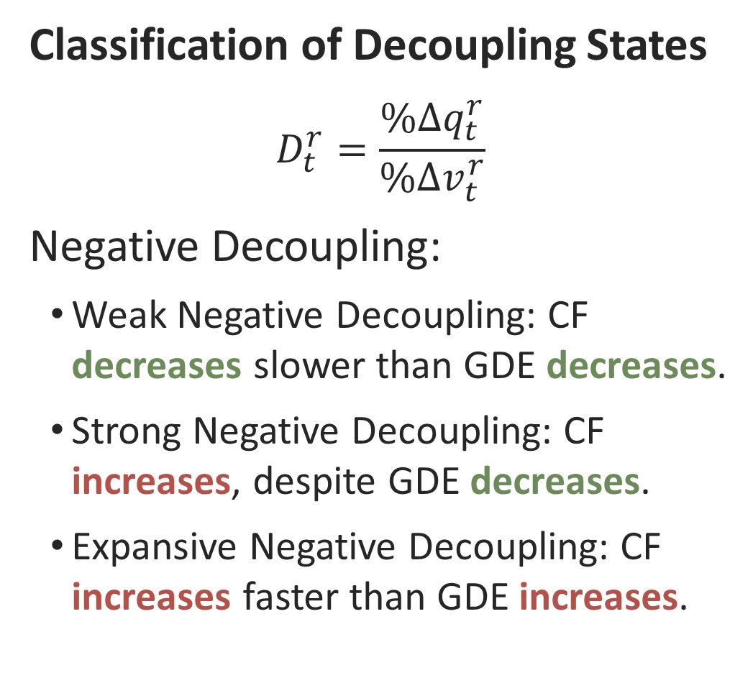
2. Methodology: Definition of decoupling indicator
$$D=1.2$$
Classification of Decoupling States
$$D_{t}^{r}=\frac{\%∆q_{t}^{r}}{\%∆v_{t}^{r}}$$
Negative Decoupling:
Weak Negative Decoupling: CF decreases slower than GDE decreases.
Strong Negative Decoupling: CF increases, despite GDE decreases.
Expansive Negative Decoupling: CF increases faster than GDE increases.
$$\%∆q$$
Expansive
Negative
Decoupling
$$D=0.8$$
Strong
Negative
Decoupling
$$(1)$$
Weak
Decoupling
Weak
Negative
Decoupling
$$\%∆y$$
Strong Decoupling
Recessive
Decoupling
Notes:
I will cover negative decoupling.
Weak negative decoupling is when the CF decreases, but more slowly than GDE.
Strong negative decoupling happens when the CF increases, despite a decrease in GDE.
Finally, expansive negative decoupling means CF increases faster than GDE.

Slide 9

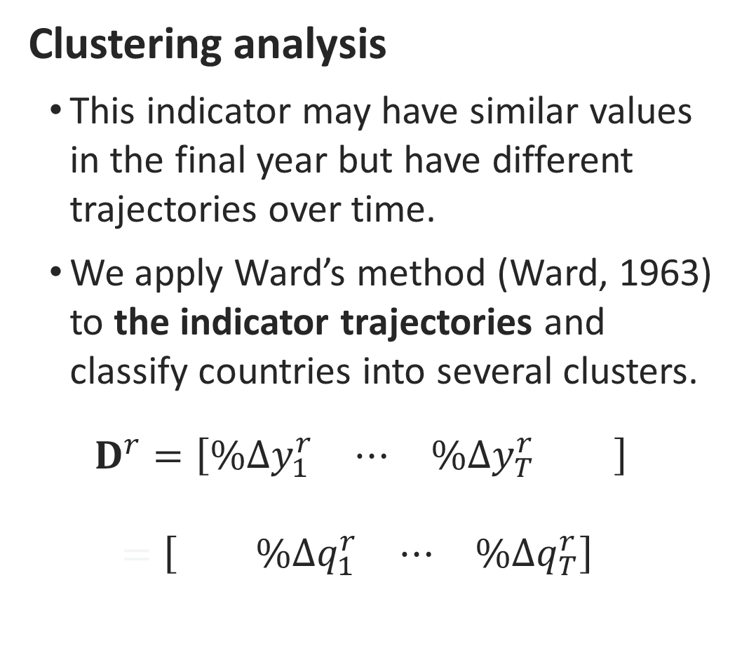
2. Methodology: Trends in the decoupling indicator
$$D=1.2$$
Clustering analysis
  This indicator may have similar values in the final year but have different trajectories over time.
  We apply Ward’s method (Ward, 1963) to the indicator trajectories and classify countries into several clusters.
  $$D^{r}=\left[\begin{matrix}\begin{matrix}\%∆y_{1}^{r} & ⋯ & \%∆y_{T}^{r}\end{matrix} & \end{matrix}\right] \\ =\left[\begin{matrix} & \begin{matrix}\%∆q_{1}^{r} & ⋯ & \%∆q_{T}^{r}\end{matrix}\end{matrix}\right]$$
$$\%∆q$$
$$D=0.8$$
$$\%∆y$$
$$(4)$$
Notes:
Let’s examine the trends in the decoupling indicator.
Although some countries may have similar indicator values in the final year, their trajectories over time can be quite different.
To analyze this, we use Ward’s clustering method to classify countries into several groups based on their indicator trajectories.

Slide 10
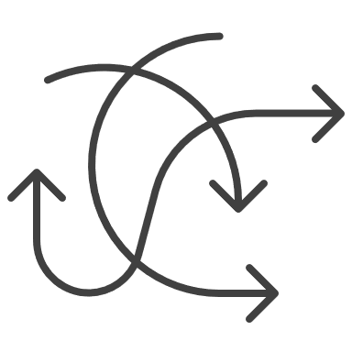









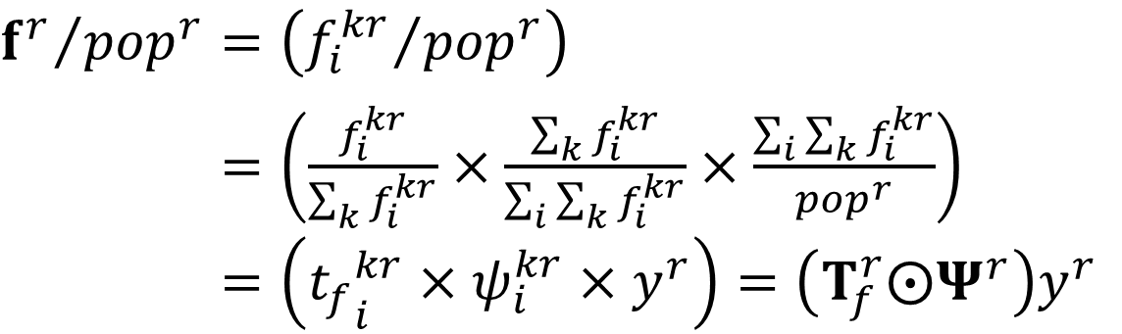

2. Methodology: Structural decomposition analysis
  Structural decomposition analysis of per capita carbon footprint
  We decompose the two matrices used to estimate the carbon footprint.
$A=\left(a_{ij}^{kl}\right)=\left(\frac{a_{ij}^{kl}}{\sum_{k}{a_{ij}^{kl}}}×\sum_{k}{a_{ij}^{kl}}\right)$
$$A=\left({t_{m}}_{ij}^{kl}×b_{ij}^{kl}\right)=T_{m}⨀B$$
$${f^{r}}/{{pop}^{r}}=\left({f_{i}^{kr}}/{{pop}^{r}}\right)$$
${f^{r}}/{{pop}^{r}}=\left(\frac{f_{i}^{kr}}{\sum_{k}{f_{i}^{kr}}}×\frac{\sum_{k}{f_{i}^{kr}}}{\sum_{i}{\sum_{k}{f_{i}^{kr}}}}×\frac{\sum_{i}{\sum_{k}{f_{i}^{kr}}}}{{pop}^{r}}\right)$
$${f^{r}}/{{pop}^{r}}=\left({t_{f}}_{i}^{kr}×ψ_{i}^{kr}×y^{r}\right)=\left(T_{f}^{r}⨀Ψ^{r}\right)y^{r}$$
$$(6)$$
$$(5)$$
Share of supplying
countries for
intermediate
goods
Production
technology
Share of supplying countries for final goods
Sectoral
composition
Per capita
GDE
Notes:
I will introduce the structural decomposition analysis for per capita carbon footprint.
We start by decomposing the two matrices used in the estimation.
First, the input coefficient matrix is divided into two parts: the share of supplying countries for intermediate goods, and pure production technology.
Second, the per capita final demand vector is divided into three parts: the share of supplying countries for final goods, the sectoral composition, and per capita GDE.
This decomposition helps us identify the contributions of various factors to carbon footprint changes.
---
Using the decomposition framework developed by Oosterhaven and Hoen (1998) helps identify production technology, trade structures of intermediate and final goods, and final demand.

Slide 11






2. Methodology: Structural decomposition analysis
  Structural decomposition analysis of per capita carbon footprint
  We decompose the change in country $r$’s carbon footprint from the base year to year $t$ into 6 contributing factors.
  $$∆q_{t}^{r}=q_{t}^{r}−q_{0}^{r}=∆q_{e}+∆q_{B}+∆q_{Tm}+∆q_{Tf}+∆q_{Ψ}+∆q_{y}$$
$$(7)$$
Technology
Trade structure
Final demand
Emission
factor
Production
technology
Share of supplying countries:
Sectoral
composition
Per capita
GDE
Intermediate
goods
Final
goods
CO₂
Notes:
Here, we break down the structural decomposition analysis of per capita carbon footprint.
We decompose the change in carbon footprint of country r, from the base year to year t, into six factors.
These factors are grouped into three categories: technological factors, which include the emission factor and production technology; trade factors, which cover the trade structure of intermediate and final goods; and consumption factors, including sectoral composition of final demand and per capita GDE.
This approach helps us understand the detailed causes of carbon footprint changes.

Slide 12
3. Data
World Input-Output Database (Dietzenbacher et al., 2013; Timmer et al., 2015)
  This covers 43 countries and 56 sectors, from 2000 to 2014.
  We used tables estimated at constant prices in 2014 (Tokito et al., 2024).
  We also used Environmental Accounts, fully consistent with WIOD (Corsatea et al., 2019).
World Development Indicators (World Bank, 2024)
  Total population in 42 countries for the period 2000-2014.
Macro Database (National Statistics, R.O.C (Taiwan), 2024)
  Total population of Taiwan (not included in the above database).
Notes:
For the data, we used the World Input-Output Database.
This database covers 43 countries and 56 sectors from 2000 to 2014.
We used tables in 2014 constant prices.
We also used environmental accounts that are fully consistent with the WIOD.

Slide 13
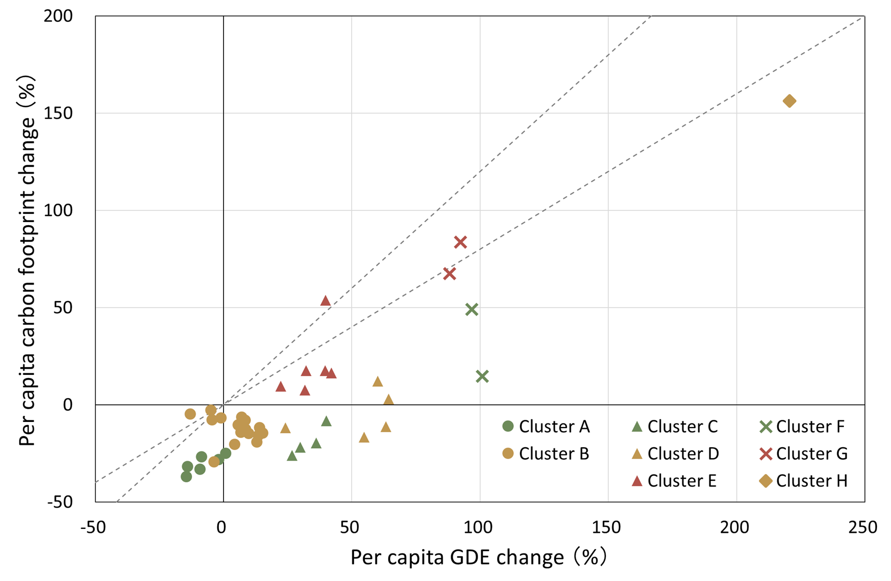
4. Results: Transition patterns of decoupling indicators
  To identify patterns in the relationship between economic growth and CO₂ emissions, we applied clustering to the time series of decoupling indicators.
  From 2000 to 2014, 43 countries were classified into 8 clusters.
  By referring to the hierarchical structure of the clusters, we identified a cluster consisting of countries with similar economic (GDE) growth rates but different rates of change in carbon footprints (CF).
+20 to +40% growth
Coupling or Weak Decoupling
Strong Decoupling
Notes:
This slide marks the start of the results section.
We present the results on transition patterns of decoupling indicators.
We applied clustering analysis to the time series of decoupling indicators, aiming to identify patterns in the relationship between economic growth and CO₂ emissions.
Between 2000 and 2014, we classified 43 countries into 8 clusters.
The left figure shows the rate of change in per capita GDE on the horizontal axis, and the rate of change in per capita carbon footprint on the vertical axis.
By examining the cluster structure, we identified a group of countries that share similar economic growth rates but have different carbon footprint change rates.
In the following slides, I will compare the SDA results for countries with similar economic growth rates but different decoupling outcomes.
First, in the moderate growth stage, with +20 to +40% growth, I will compare the cluster that achieved strong decoupling and the cluster that did not.

Slide 14
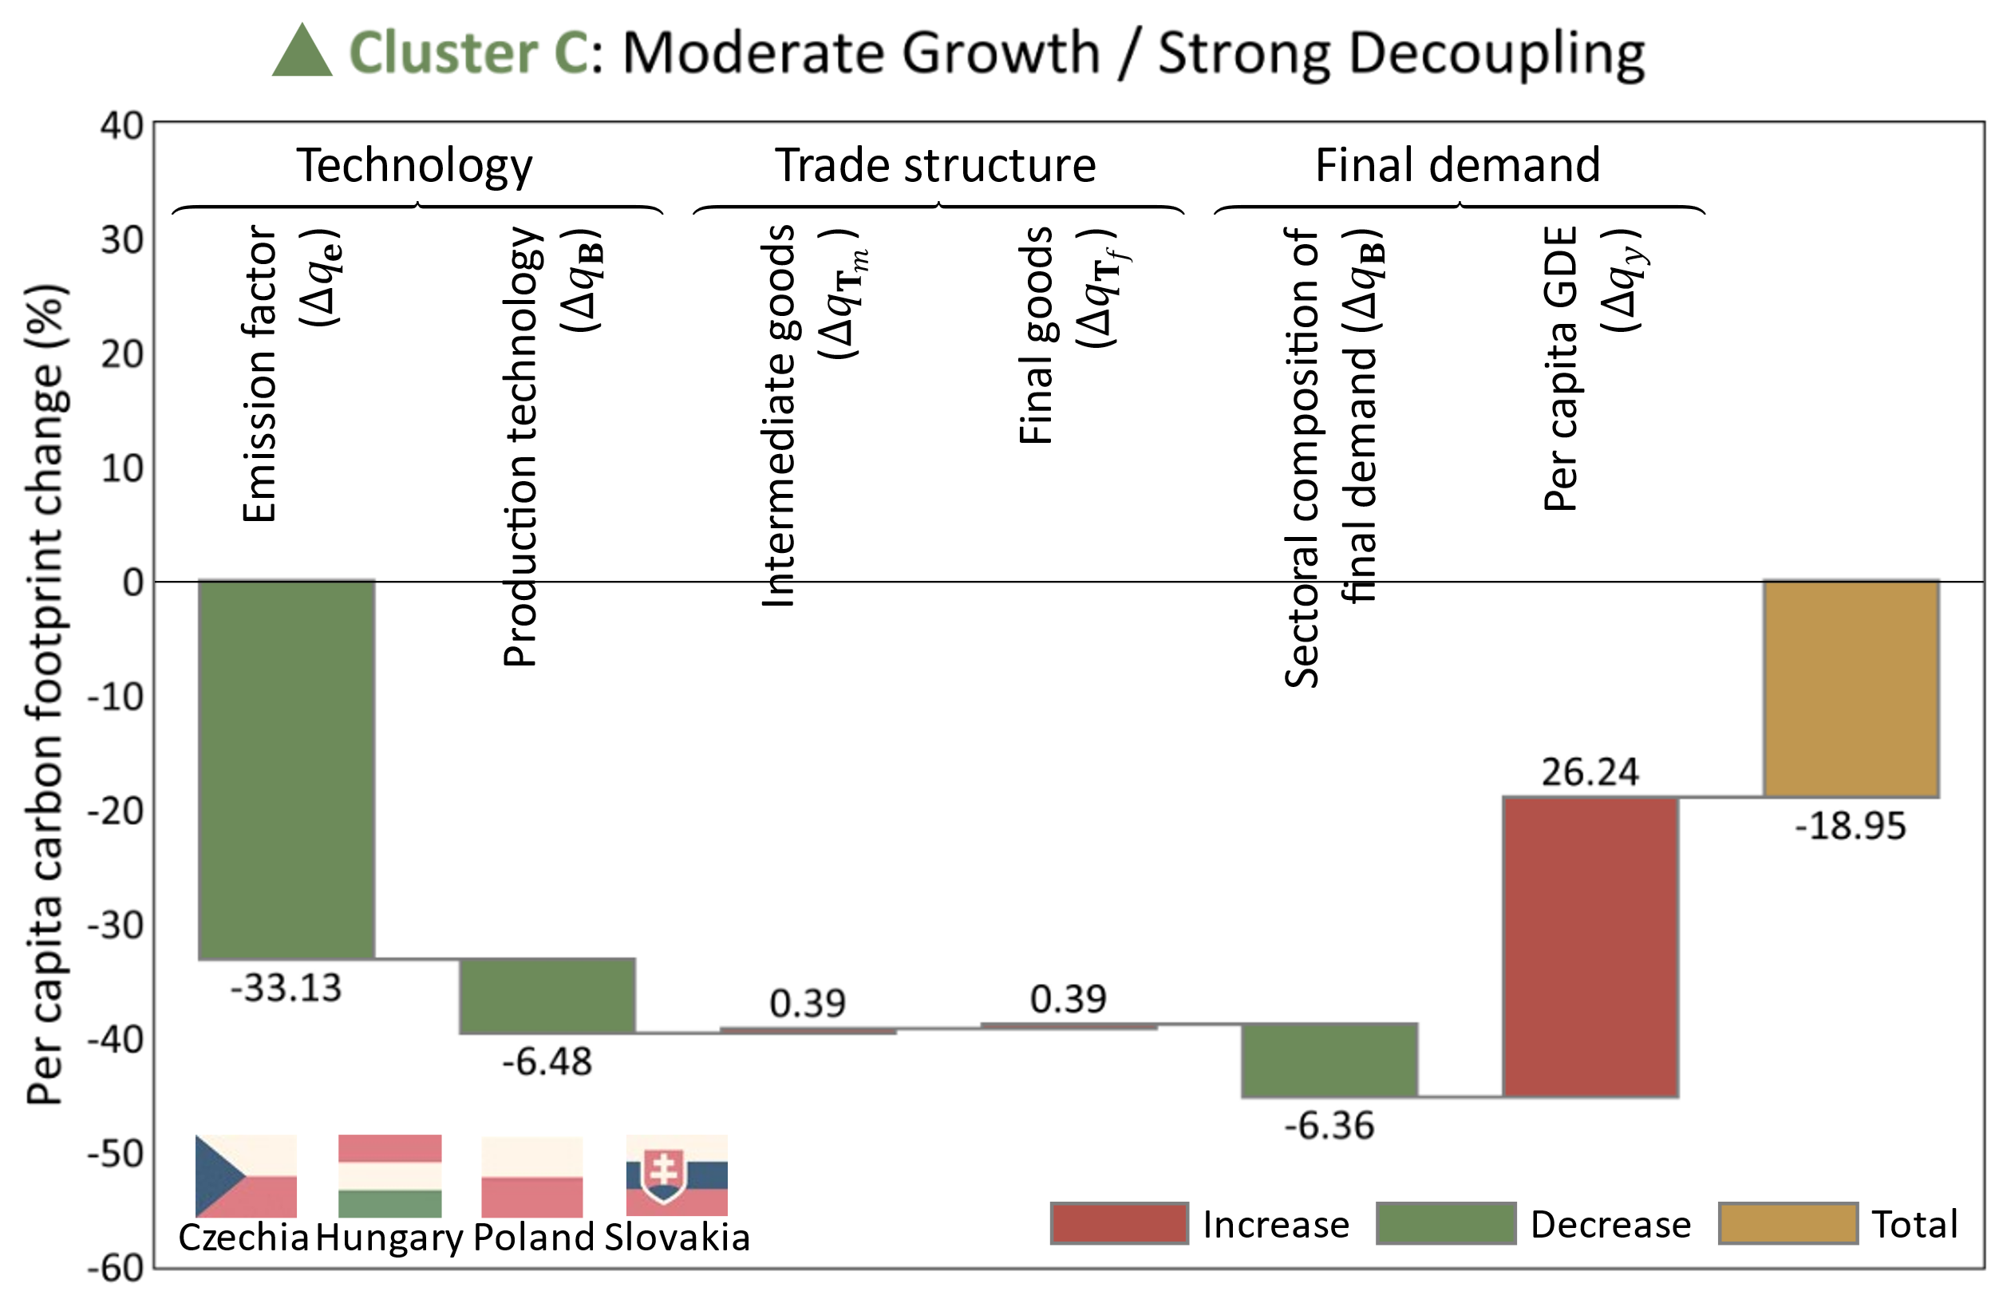
4. Results: Decomposition of carbon footprint changes
  To identify the factors behind the differences in carbon footprint change rates, despite similar GDE growth rates, we applied SDA to the CF change rates.
  Countries with strong decoupling (GDE growth: +20 to +40%, CF growth: -19%)
  Main drivers of carbon footprint reduction:
  Lower emission factor
  Improved production technology
  Shift in the sectoral composition of final demand
Notes:
Let’s focus on countries with strong decoupling, where carbon footprint decreased 19%, despite GDE growth of 20 to 40 percent.
The yellow box in the figure shows the change rate of per capita carbon footprint over the period.
The six boxes on the left show the contributions of different factors to that change.
Red indicates increases, and green indicates decreases.
The main drivers behind their carbon footprint reduction are:
first, reduced emission factors,
second, improved production technology,
and third, shifts in the sectoral composition of final demand.

Slide 15
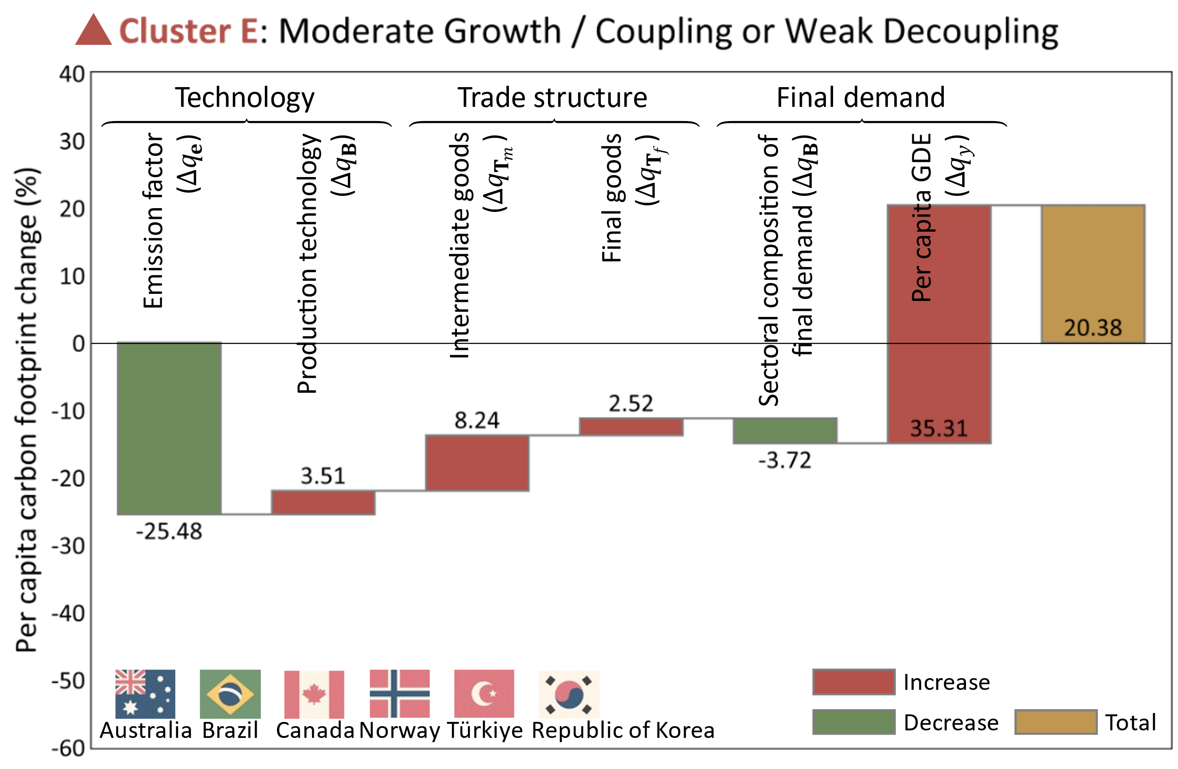

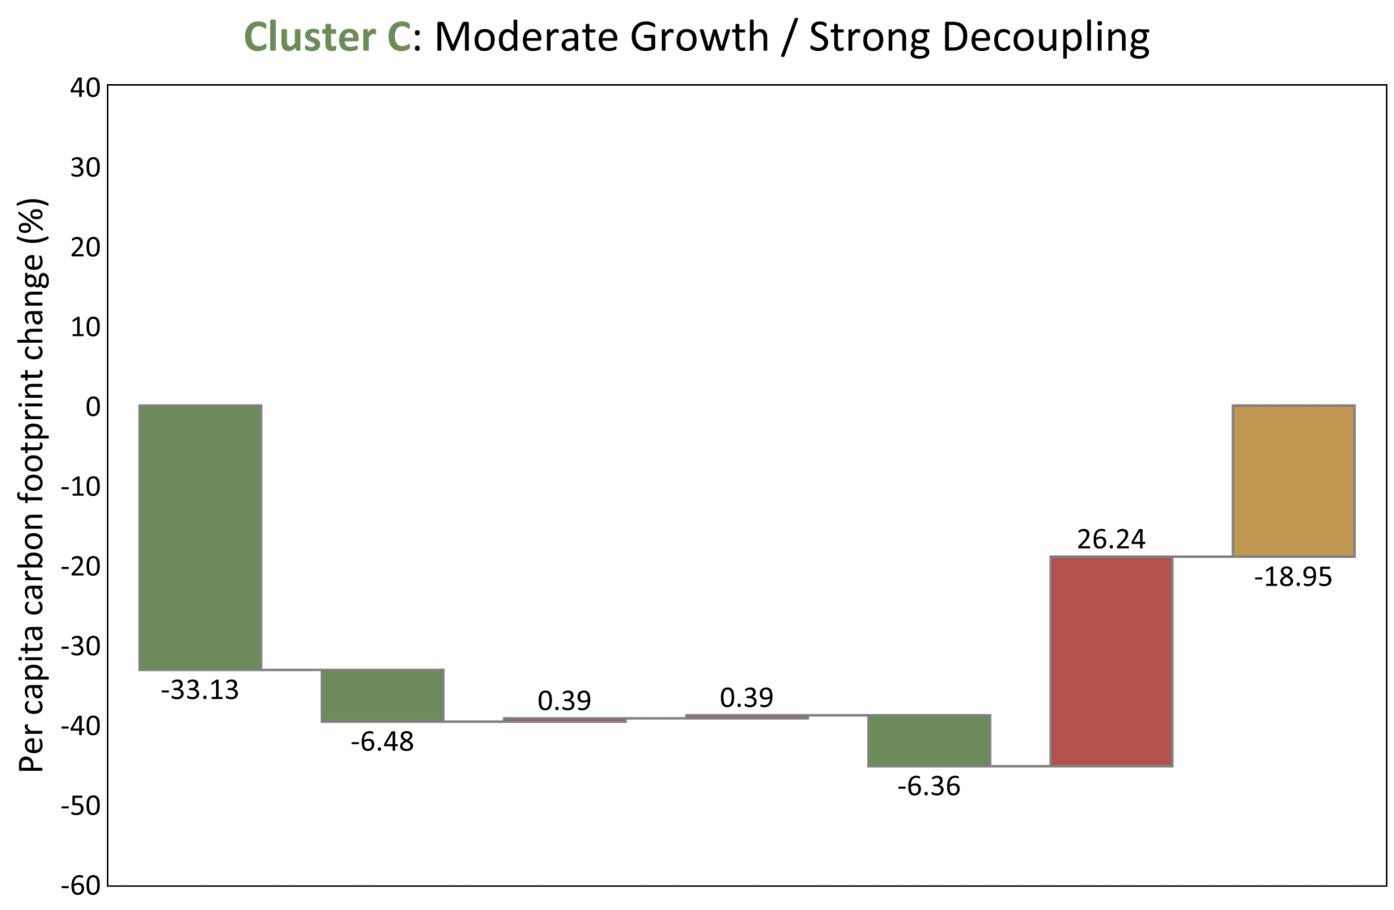
4. Results: Decomposition of carbon footprint changes
  To identify the factors behind the differences in carbon footprint change rates, despite similar GDE growth rates, we applied SDA to the CF change rates.
  Countries without decoupling (GDE growth: +20 to +40%, CF growth: +20%)
  Smaller reduction effects from: emission factor and sectoral composition of final demand.
  Larger increase effects from: production technology and trade structure.
Notes:
By contrast, countries with similar GDE growth but increased carbon footprint by 20%, showed a different pattern.
Compared to the decoupled group, they had smaller reduction effects from emission intensity and the structure of final demand.
At the same time, increase effects from production technology and trade structure were larger.
In other words, their carbon footprint increased more due to technological and trade-related changes,
and they were less successful in reducing emissions through cleaner production or structural shifts in demand.

Slide 16
4. Results: Transition patterns of decoupling indicators
  To identify patterns in the relationship between economic growth and CO₂ emissions, we applied clustering to the time series of decoupling indicators.
  From 2000 to 2014, 43 countries were classified into 8 clusters.
  By referring to the hierarchical structure of the clusters, we identified a cluster consisting of countries with similar economic (GDE) growth rates but different rates of change in carbon footprints (CF).
+90 to +100% growth
Coupling
Weak Decoupling
Notes:
Moving to the high growth stage, with +90 to +100% growth, I will compare the cluster that achieved weak decoupling with the one that did not.

Slide 17
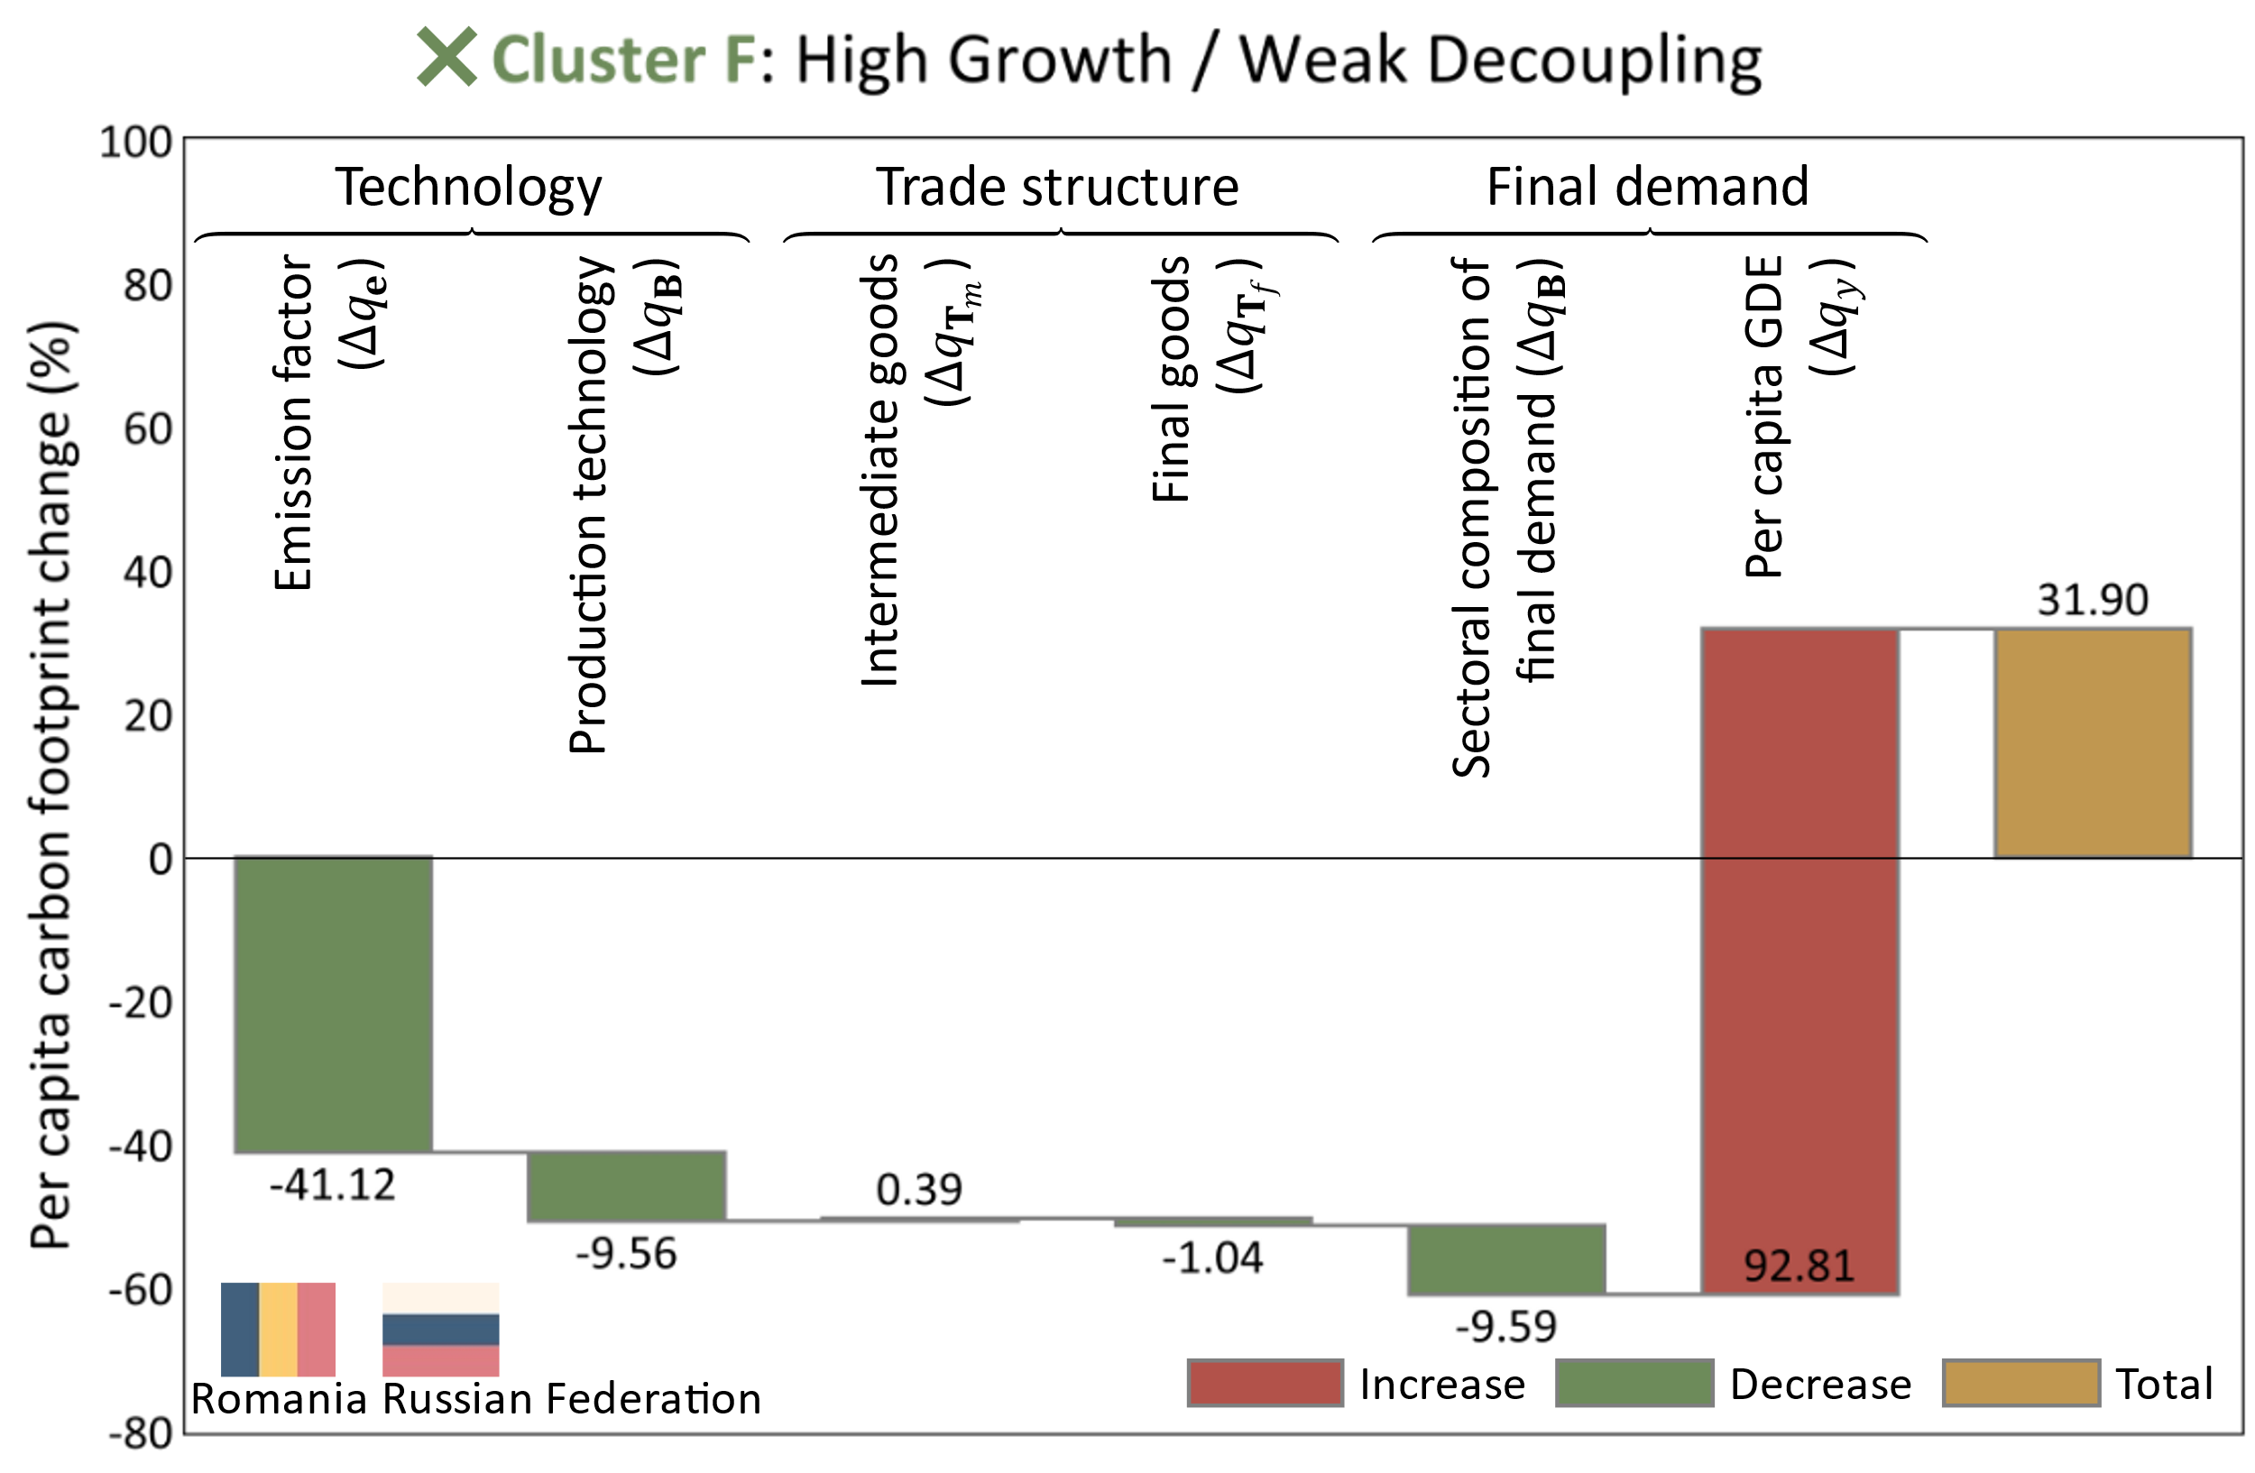
4. Results: Decomposition of carbon footprint changes
  To identify the factors behind the differences in carbon footprint change rates, despite similar GDE growth rates, we applied SDA to the CF change rates.
  Countries with weak decoupling (GDE growth: +90 to +100%, CF growth: +32%)
  Main drivers offsetting the increase in per capita GDE:
  Technological factors (emission factor and production technology)
  Changes in the sectoral composition of final demand
Notes:
Let’s take a closer look at countries in the high growth stage.
In countries with weak decoupling, where carbon footprint increased 32%, despite GDE growth of 90 to 100 percent.
the main drivers offsetting the increase in per capita GDE are:
First, technological factors, including the emission factor and production technology, contributed to reducing the carbon footprint.
Second, changes in the sectoral composition of final demand also played an important role in offsetting this growth.

Slide 18
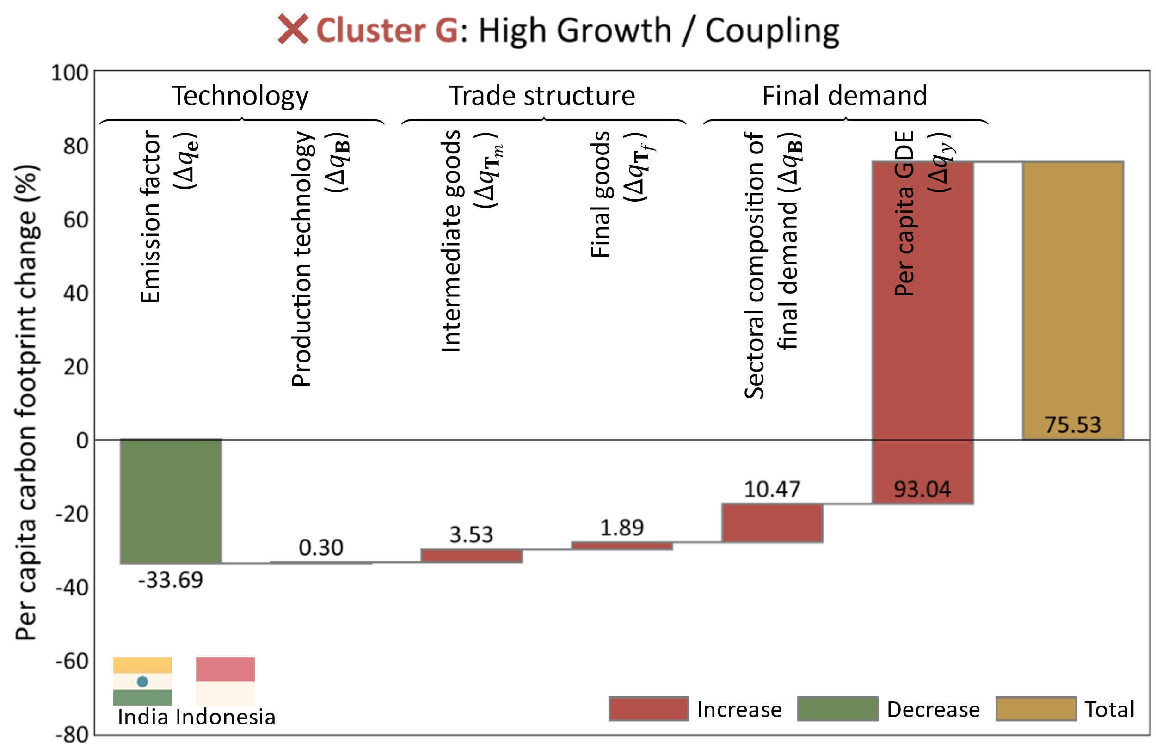
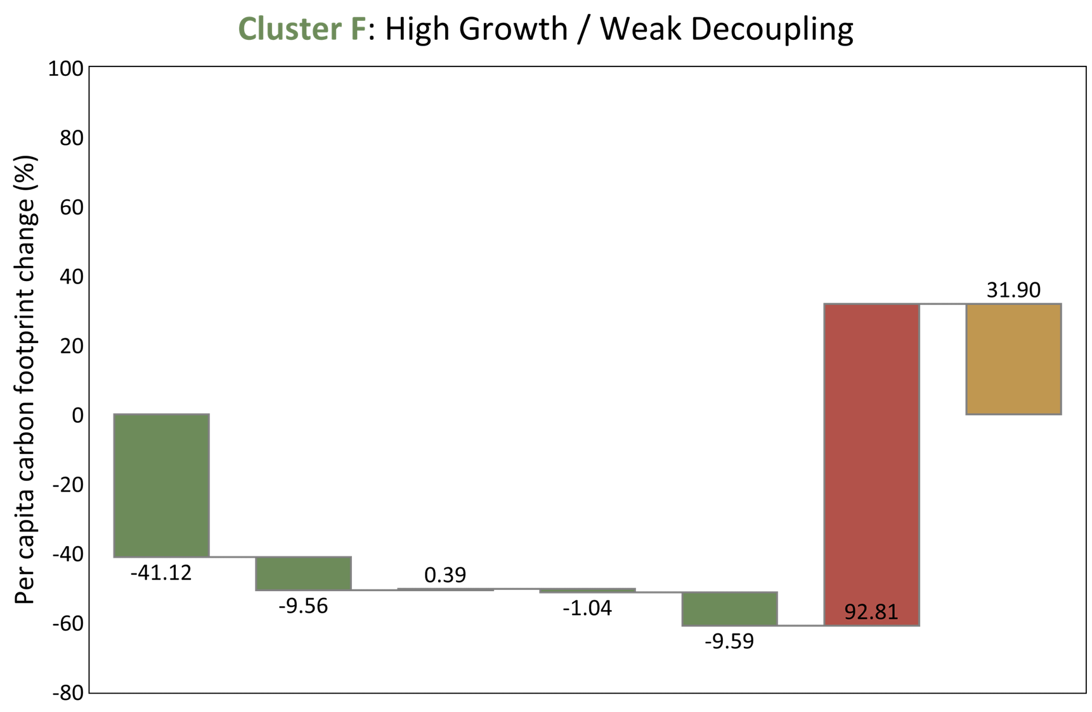
4. Results: Decomposition of carbon footprint changes
  To identify the factors behind the differences in carbon footprint change rates, despite similar GDE growth rates, we applied SDA to the CF change rates.
  Countries with coupling (GDE growth: +90% to +100%, CF growth: +76%)
  no reduction effect from improved production technology
  the sectoral composition of final demand changed in a way that increased emissions.
Notes:
By contrast, countries with similar GDE growth but increased carbon footprint by 76%, showed a different pattern.
Compared to the decoupled group,
these countries showed no emission reduction from improved production technology.
In addition, the sectoral composition of their final demand shifted in a direction that increased emissions.

Slide 19
4. Results: Transition patterns of decoupling indicators
  To identify patterns in the relationship between economic growth and CO₂ emissions, we applied clustering to the time series of decoupling indicators.
  From 2000 to 2014, 43 countries were classified into 8 clusters.
  By referring to the hierarchical structure of the clusters, we identified a cluster consisting of countries with similar economic (GDE) growth rates but different rates of change in carbon footprints (CF).
-2% to -10% growth
Recessive Decoupling
Notes:
Lastly, I will present the results on drivers of decoupling in the degrowth stage.

Slide 20
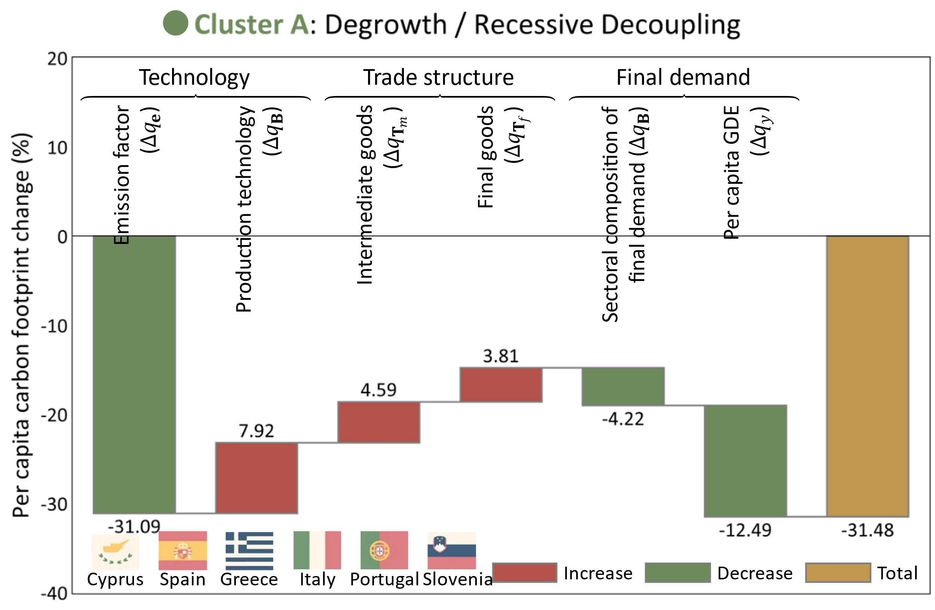
4. Results: Decomposition of carbon footprint changes
  To identify the factors behind the differences in carbon footprint change rates, despite similar GDE growth rates, we applied SDA to the CF change rates.
  Countries that achieved decoupling with degrowth (GDE growth: -2% to -10%)
  Emission reductions were driven by shrinking final demand and lifestyle changes.
  However, production technology and trade structure contributed to emission increases.
Notes:
We now consider countries that achieved decoupling during a period of degrowth, with GDE growth of minus 2 to minus 10 percent.
In these countries, emission reductions were mainly driven by shrinking final demand and lifestyle changes.
However, production technology and trade structure contributed to increasing emissions.

Slide 21
5. Conclusion and Policy implications
To achieve strong decoupling:
For countries with low to moderate economic growth:
Improve production technology and transform trade structure.
Identify emission-intensive supply chains and reorganize them with cleaner technologies and trade partners (Maeno et al., 2022).
For countries with high economic growth:
Improve production technology and shift consumption behavior.
To achieve emission reductions through degrowth:
It is essential to address dependence on global supply chains and declining technological capacity.
Notes:
Let me summarize my presentation.
To achieve strong decoupling, different strategies are needed depending on the level of economic growth.
For countries with low to moderate economic growth:
they should focus on improving production technology and transforming their trade structures.
It's also important to identify emission-intensive supply chains and reorganize them using cleaner technologies and new trade partners.
For countries with high economic growth:
they should work on improving production technology and transforming consumption behavior.
To achieve emission reductions through degrowth:
it's essential to address dependence on global supply chains and the decline in technological capacity.

Slide 22
5. Conclusion and Policy implications
  This study uses the World MRIO Table to analyze how countries’ carbon footprints have changed with economic growth, focusing on pathways of change.
  We also apply Structural Decomposition Analysis (SDA) to break down the change in carbon footprint into six contributing factors.
  Using multi-country, long-term time series data, we identified several distinct decoupling pathways.
  Furthermore, this study enables comparison of the factors contributing to decoupling among countries at different stages of economic growth.
  The empirical results clearly show that the key factors and their relative contributions vary depending on the stage of economic growth.
Notes:
This study used the World Multi-Regional Input-Output Table to analyze how countries’ carbon footprints have changed alongside economic growth, with a focus on the pathways of change.
We also applied Structural Decomposition Analysis, or SDA, to break down changes in carbon footprint into six contributing factors.
By using multi-country, long-term time series data, we were able to identify several distinct decoupling pathways.
Furthermore, this study makes it possible to compare the factors that contribute to decoupling among countries at different stages of economic growth.
Our empirical results clearly show that the key factors and their relative importance vary depending on the stage of economic growth.

Slide 23
5. Conclusion and Policy implications
  We compared the drivers of carbon footprint changes between countries with similar economic growth rates but significant differences in carbon footprint change rates.
  These results indicate the mitigation potential of each factor for achieving decoupling while maintaining economic growth.
  We found that changes in the trade structures of intermediate goods and final goods—newly identified in this study—may play an important role in whether decoupling is achieved.
  This suggests that the SDA method proposed here, which can accurately capture mitigation effects from changes in the global trade structure, is valuable for decoupling analysis.
Notes:
We also compared the drivers of carbon footprint changes between countries with similar economic growth rates but significant differences in carbon footprint change rates.
These results highlight the mitigation potential of each factor for achieving decoupling while maintaining economic growth.
We found that changes in the trade structures of intermediate goods and final goods—something newly identified in this study—may play an important role in determining whether decoupling is achieved.
This suggests that the SDA method proposed here, which can more accurately capture the mitigation effects of changes in the global trade structure, is a valuable tool for decoupling analysis.

Slide 24
Thank you for your kind attention.
Notes:
That concludes my presentation. Thank you for your attention.

Slide 25



Appendix:
  The per capita carbon footprint of country r :
$$q^{r}=e{\left(I−T_{m}⨀B\right)}^{−1}\left(T_{f}^{r}⨀Ψ^{r}\right)y^{r}q^{r}=e{\left(I−A\right)}^{−1}\frac{f^{r}}{{pop}^{r}}$$
  $q^{r}$ : Per capita carbon footprint of country $r$
  $e$ : Direct CO₂ emission coefficient row vector
  $I$ : Identity matrix
  $A$ : Input coefficient matrix
  $f^{r}$ : Final demand vector of country $r$
  ${pop}^{r}$ : Population of country $r$
  $T_{m}$ : Trade coefficient matrix for intermediate goods
  $B$ : Technology coefficient matrix
  $T_{f}^{r}$ : Trade coefficient vector for final goods of country $r$
  $Ψ^{r}$ : Final demand (sectoral) composition or preference coefficient matrix in country $r$
  $y^{r}$ : Per capita total final demand （i.e., GDE） in country $r$
  $⨀$ : Hadamard product (element-wise multiplication)
$$\left(2\right)$$
Notes:
The input coefficient matrix and the per capita final demand vector for country r, used in estimating the per capita carbon footprint, are each decomposed as follows.

Slide 26
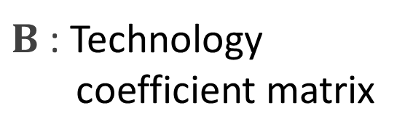
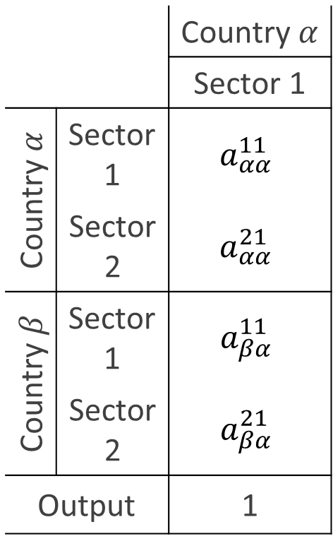
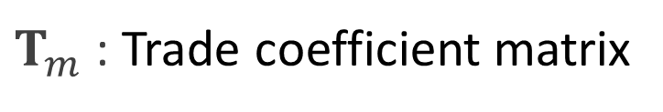

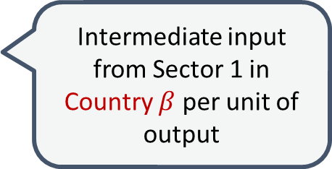
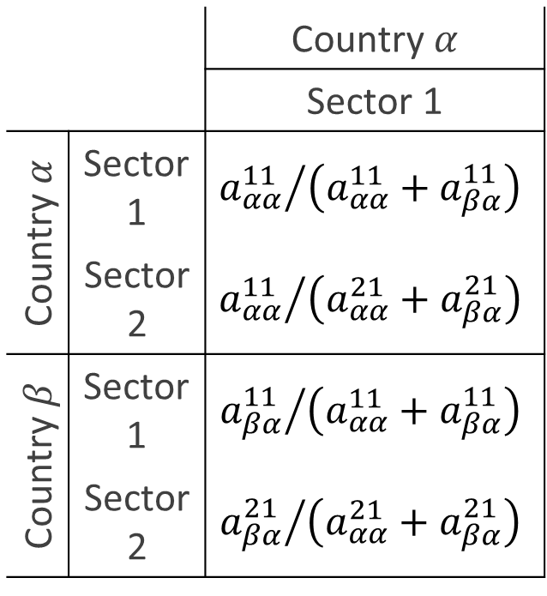

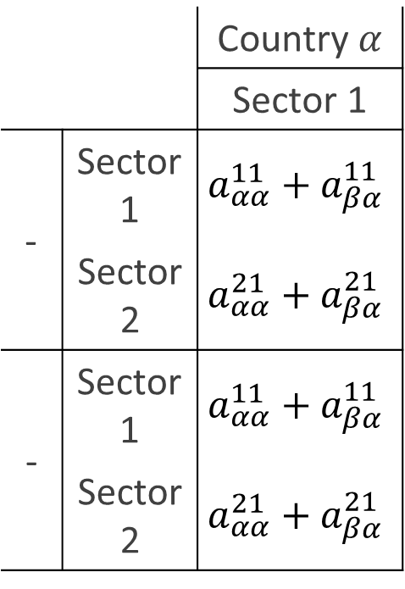

Appendix: Decomposition of the Input Coefficient Matrix
Decomposition of $A$into $T_{m}⨀B$
  $A$ : Input coefficient matrix
$B$ : Technology coefficient matrix
$T_{m}$ : Trade coefficient matrix
 |  | Country $α$
 |  | Sector 1
Country $α$ | Sector 1 | $$a_{αα}^{11}$$
 | Sector 2 | $$a_{αα}^{21}$$
Country $β$ | Sector 1 | $$a_{βα}^{11}$$
 | Sector 2 | $$a_{βα}^{21}$$
Output |  | 1
 |  | Country $α$
 |  | Sector 1
Country $α$ | Sector 1 | $${a_{αα}^{11}}/{\left(a_{αα}^{11}+a_{βα}^{11}\right)}$$
 | Sector 2 | $${a_{αα}^{11}}/{\left(a_{αα}^{21}+a_{βα}^{21}\right)}$$
Country $β$ | Sector 1 | $${a_{βα}^{11}}/{\left(a_{αα}^{11}+a_{βα}^{11}\right)}$$
 | Sector 2 | $${a_{βα}^{21}}/{\left(a_{αα}^{21}+a_{βα}^{21}\right)}$$
 |  | Country $α$
 |  | Sector 1
- | Sector 1 | $$a_{αα}^{11}+a_{βα}^{11}$$
 | Sector 2 | $$a_{αα}^{21}+a_{βα}^{21}$$
- | Sector 1 | $$a_{αα}^{11}+a_{βα}^{11}$$
 | Sector 2 | $$a_{αα}^{21}+a_{βα}^{21}$$
Intermediate input from Domestic Sector 1 per unit of output
Share of domestic inputs from Sector 1
$$=$$
$$⨀$$
Intermediate input from Sector 1 in Country $β$ per unit of output
Intermediate input from Sector 1 including both domestic and imported per unit of output
→ Pure production technology of Country 𝛼
Share of intermediate inputs from Sector 1 supplied by Country b

Slide 27
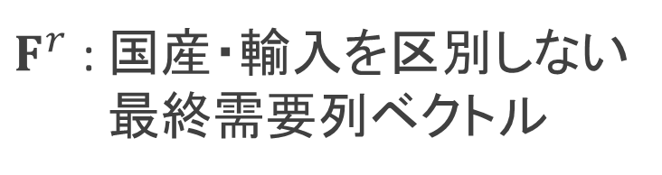

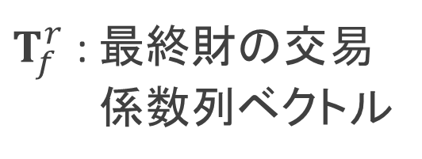

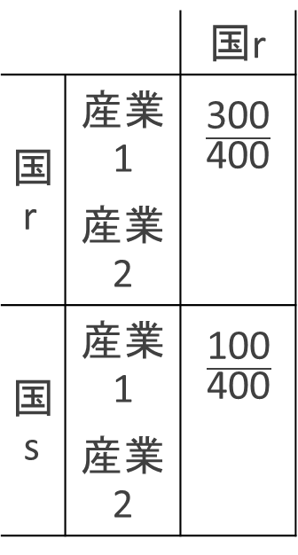
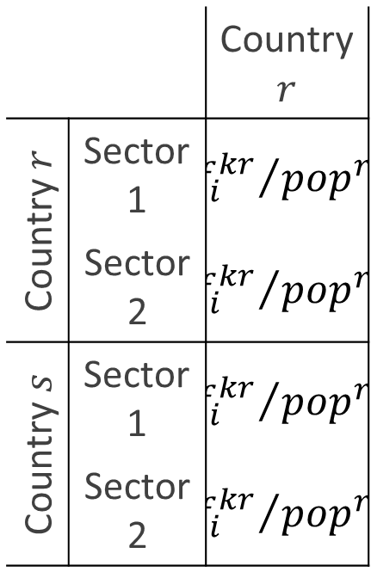



Appendix: Decomposition of the Final Demand Vector
  Decomposition of ${f^{r}}/{{pop}^{r}}$ into$\left(T_{f}^{r}⨀Ψ^{r}\right)y^{r}$
  ${f^{r}}/{{pop}^{r}}$: Per capita final demand vector of country $r$
$$=$$
$T_{f}^{r}$ : 最終財の交易
係数列ベクトル
$$⨀$$
$F^{r}$ : 国産・輸入を区別しない
最終需要列ベクトル
 |  | Country $r$
Country $r$ | Sector 1 | $${f_{i}^{kr}}/{{pop}^{r}}$$
 | Sector 2 | $${f_{i}^{kr}}/{{pop}^{r}}$$
Country $s$ | Sector 1 | $${f_{i}^{kr}}/{{pop}^{r}}$$
 | Sector 2 | $${f_{i}^{kr}}/{{pop}^{r}}$$
家計部門の
「国産・輸入を問わない」 「産業1」への最終需要額
 |  | 国r
国r | 産業1 | $$\frac{\text{3}\text{00}}{\text{400}}$$
 | 産業2
国s | 産業1 | $$\frac{\text{100}}{\text{400}}$$
 | 産業2
家計部門の
「国内」の「産業1」への最終需要額
 |  | 国r
- | 産業1 | 400
 | 産業2
産業1への最終需要のうち「国内」の割合
$$\frac{\text{2}\text{00}}{\text{3}\text{00}}$$
家計部門の
「国s」の「産業1」への最終需要額
産業1への最終需要のうち「国s」の割合
300
$$\frac{\text{1}\text{00}}{\text{3}\text{00}}$$
家計部門の最終需要の産業構成
最終財に占める各国の割合
＝国rの最終財の交易構造

Slide 28
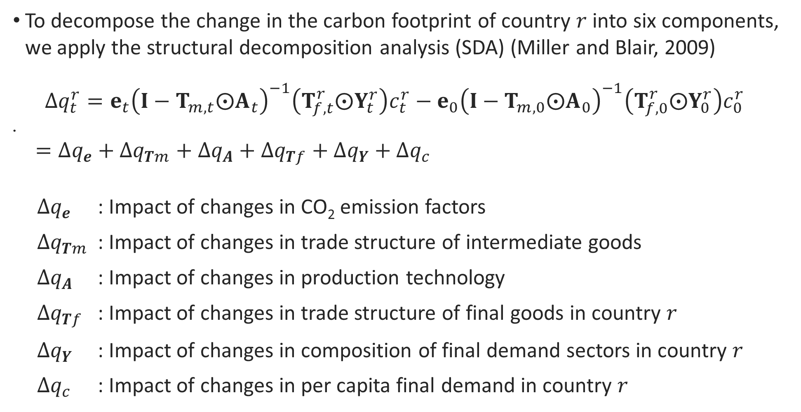

2.4 Methodology – Structural Decomposition Analysis
  To decompose the change in the carbon footprint of country $r$ into six components, we apply the structural decomposition analysis (SDA) (Miller and Blair, 2009)
  $$∆q_{t}^{r}=e_{t}{\left(I−T_{m,t}⨀A_{t}\right)}^{−1}\left(T_{f,t}^{r}⨀Y_{t}^{r}\right)c_{t}^{r}−e_{0}{\left(I−T_{m,0}⨀A_{0}\right)}^{−1}\left(T_{f,0}^{r}⨀Y_{0}^{r}\right)c_{0}^{r}$$
  $=∆q_{e}+∆q_{Tm}+∆q_{A}+∆q_{Tf}+∆q_{Y}+∆q_{c}$
  $∆q_{e}$ : Impact of changes in CO₂ emission factors
  $∆q_{Tm}$ : Impact of changes in trade structure of intermediate goods
  $∆q_{A}$ : Impact of changes in production technology
  $∆q_{Tf}$ : Impact of changes in trade structure of final goods in country 𝑟
  $∆q_{Y}$ : Impact of changes in composition of final demand sectors in country 𝑟
  $∆q_{c}$ : Impact of changes in per capita final demand in country 𝑟
$$(7)$$
Notes:
Finally, To decompose the change in the carbon footprint of country $r$ into six components, we apply the structural decomposition analysis.
The components are the following

Slide 29
45度線、なんで0.8, 1.2

Slide 30





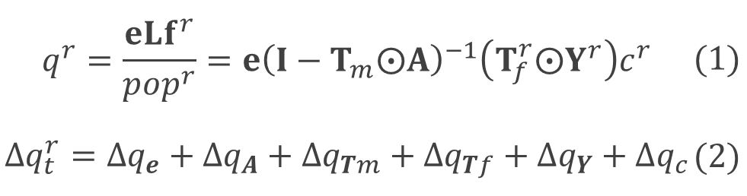


2. 手法
(1) デカップリング指標を定義
一人あたりGDEが1%変化したとき、一人あたりカーボンフットプリントが何%変化したかを表す弾性値。
8つの状態に分類される。
(2) 世界各国のデカップリング指標の経年変化にクラスタリング分析を適用
(3) 構造分解分析（SDA）を用いてカーボンフットプリントの変化要因を特定
$$\%∆CFP$$
$$q^{r}=\frac{eLf^{r}}{{pop}^{r}}=e{\left(I−T_{m}⨀A\right)}^{−1}\left(T_{f}^{r}⨀Y^{r}\right)c^{r}$$ | $$(1)$$
$$∆q_{t}^{r}=∆q_{e}+∆q_{A}+∆q_{Tm}+∆q_{Tf}+∆q_{Y}+∆q_{c}$$ | $$(2)$$
$$\%∆GDE$$
排出係数 | 生産技術 | 中間財の交易構造 | 最終財の交易構造 | 最終需要部門構成 | 1人あたりGDE
CO₂
$$\%∆CFP$$
$$\%∆CFP$$
同程度の経済成長率で、
・ デカップリングを達成したクラスター
・ そうでないクラスター、の変化要因を比較。
$$\%∆GDE$$
$$\%∆GDE$$

