Slide 1
The Restructuring of Global Supply Chains and Inter-Country Value Transfers
31st International Input-Output Association Conference,
6th - 11th July 2025, Malé, the capital city of the Maldives

Slide 2
“Trump Says Global Trade Is Unfair. Does He Have a Point?”
Swanson, Ana. New York Times [Digital Edition], 2 Apr. 2025

Slide 3
1. Introduction
Challenging Trade Orthodoxy Global divergence persists despite neoclassical claims of trade-driven convergence.
Marxian Framework Distinguishes value produced (labor time) from value captured (exchange), revealing hidden transfers.
Global Supply Chains as Value Transfer Channels Input-output data shows how structural dependencies redistribute surplus labor across borders.
Trade as Structural Exploitation Inequality is not a failure of upgrading, but a systemic outcome of global trade relations.

Slide 4
2. Causes, mechanisms, and channels of unequal exchange
Causes
Value: socially necessary labor time (value produced)
Price: value realized in an exchange
Value transfer: deviation of price from value (seller obtains transfer: $p−λ$)
Seller
Price: $p$
Buyer
Value of commodity: $λ$

Slide 5
Mechanisms that lead to price/value deviation
Heterogeneity in the organic composition of capital (Bauer 2000)
Wage disparities (Emmanuel 1972)
Monopoly power (Baran 1957)
Exchange rate misalignment (Ricci 2021)
Market fluctuations
Channels
Productive sector trade
Unproductive sector trade (Qiao et al 2025; Rotta 2025)

Slide 6
3. Measuring unequal exchange
Value of commodity
$$λ=λA+l$$
$$λ=l{\left(I−A\right)}^{−1}$$
Price of commodity
$$p$$
International value transfer via export from country i to j:
$$t_{ij}=\left(p−λ\right)E_{ij}$$

Slide 7
4. Measuring the restructuring of global supply chains
Direct backward linkages: $A$
Total backward linkages: $B={\left(I−A\right)}^{−1}$
Root mean squared errors (RMSE):
$$\sqrt{\frac{1}{n^{2}}\sum_{i,j}{{\left(A_{ij}^{\left(t+1\right)}−A_{ij}^{\left(t\right)}\right)}^{2}}}$$

Slide 8
5. The restructuring of global supply chains
Table 1: Change in the Backward Linkages in the Global Supply Chains
Period of change | Matrix $A$ |  |  | Matrix $B$
 | RMSE (1) | Mean (2) | RMSE /mean (3) | RMSE (4) | Mean (5) | RMSE /mean (6)
2000: 2001 | 0.0015 | 0.0064 | 0.24 | 0.0042 | 0.026 | 0.16
2005: 2006 | 0.0013 | 0.0064 | 0.21 | 0.0036 | 0.026 | 0.14
2006: 2007 | 0.0015 | 0.0065 | 0.23 | 0.0039 | 0.026 | 0.15
2007: 2008 | 0.0016 | 0.0065 | 0.25 | 0.0044 | 0.026 | 0.17
2008: 2009 | 0.0020 | 0.0066 | 0.30 | 0.0051 | 0.027 | 0.19
2009: 2010 | 0.0042 | 0.0064 | 0.66 | 0.0164 | 0.026 | 0.63
2010: 2011 | 0.0020 | 0.0065 | 0.30 | 0.0055 | 0.026 | 0.21
2016: 2017 | 0.0013 | 0.0064 | 0.20 | 0.0053 | 0.026 | 0.20
2017: 2018 | 0.0009 | 0.0064 | 0.15 | 0.0032 | 0.026 | 0.12
2018: 2019 | 0.0017 | 0.0065 | 0.27 | 0.0037 | 0.026 | 0.14
2019: 2020 | 0.0015 | 0.0065 | 0.23 | 0.0038 | 0.026 | 0.14

Slide 9
Figure 1: Composition of Gross Output of China and the United States, 1995-2020

Slide 10
Table 2: Ranking of China’s direct backward linkage with supplying economies
Rank | 1995 | 2000 | 2005 | 2010 | 2017 | 2018 | 2019 | 2020
1 | Japan (21.7) | Japan (17.7) | Japan (14.6) | Rest of World (13.1) | Rest of World (12.2) | Rest of World (14.4) | Rest of World (15.5) | Rest of World (14.3)
2 | Taiwan (13.7) | Taiwan (14.1) | Taiwan (13.4) | Japan (10.8) | South Korea (11.5) | South Korea (10.8) | South Korea (9.0) | South Korea (8.8)
3 | United States (11.0) | South Korea (11.4) | South Korea (12.0) | South Korea (10.2) | United States (9.1) | United States (7.8) | Japan (7.4) | Japan (8.1)
4 | South Korea (10.3) | United States (9.5) | Rest of World (8.9) | Taiwan (10.0) | Taiwan (8.3) | Japan (7.6) | Australia (7.1) | Taiwan (7.5)
5 | Germany (5.1) | Rest of World (7.2) | United States (7.6) | United States (7.5) | Japan (8.1) | Taiwan (7.0) | Taiwan (6.7) | Australia (7.0)

Slide 11
Table 3: Ranking of China’s total backward linkage with supplying economies
Rank | 1995 | 2000 | 2005 | 2010 | 2017 | 2018 | 2019 | 2020
1 | Japan (20.9) | Japan (16.9) | Japan (14.0) | Rest of World (13.1) | Rest of World (13.2) | Rest of World (15.3) | Rest of World (16.7) | Rest of World (15.6)
2 | Taiwan (12.0) | Taiwan (12.0) | South Korea (11.5) | Japan (10.5) | South Korea (11.2) | South Korea (10.5) | South Korea (8.9) | South Korea (8.8)
3 | United States (11.6) | South Korea (10.9) | Taiwan (10.7) | South Korea (9.9) | United States (9.4) | United States (8.4) | United States (7.1) | Japan (7.5)
4 | South Korea (10.1) | United States (10.6) | Rest of World (9.2) | Taiwan (8.3) | Japan (7.7) | Japan (7.2) | Japan (7.0) | United States (7.3)
5 | Germany (5.0) | Rest of World (7.5) | United States (8.5) | United States (7.9) | Taiwan (6.9) | Australia (5.9) | Australia (6.6) | Australia (6.7)

Slide 12
Table 4: Ranking of United States’ direct backward linkage with supplying economies
Rank | 1995 | 2000 | 2005 | 2010 | 2017 | 2018 | 2019 | 2020
1 | Canada (18.3) | Canada (19.1) | Canada (18.3) | Canada (16.1) | Canada (15.0) | Canada (14.8) | Canada (15.1) | China (14.9)
2 | Japan (13.5) | Japan (10.1) | Rest of World (12.1) | Rest of World (12.8) | China (14.3) | China (14.6) | China (12.9) | Canada (14.5)
3 | Rest of World (7.0) | Mexico (9.5) | Mexico (8.6) | China (9.4) | Mexico (10.4) | Mexico (10.8) | Mexico (11.4) | Mexico (10.8)
4 | Mexico (6.8) | Rest of World (8.1) | China (7.9) | Mexico (9.4) | Rest of World (6.4) | Rest of World (6.9) | Rest of World (5.1) | United Kingdom (5.0)
5 | Germany (5.5) | United Kingdom (5.3) | Japan (6.2) | Japan (5.0) | Japan (5.0) | Japan (4.8) | Japan (4.8) | Germany (4.5)

Slide 13
Table 5: Ranking of United States’ total backward linkage with supplying economies
Rank | 1995 | 2000 | 2005 | 2010 | 2017 | 2018 | 2019 | 2020
1 | Canada (15.4) | Canada (16.2) | Canada (15.3) | Canada (13.1) | China (19.2) | China (19.2) | China (17.6) | China (20.2)
2 | Japan (13.7) | Japan (10.1) | Rest of World (11.7) | China (12.8) | Canada (12.0) | Canada (11.8) | Canada (12.1) | Canada (11.7)
3 | Rest of World (7.4) | Rest of World (8.5) | China (10.6) | Rest of World (12.6) | Mexico (7.7) | Rest of World (7.9) | Mexico (8.3) | Mexico (7.8)
4 | Mexico (5.8) | Mexico (7.8) | Mexico (6.9) | Mexico (7.2) | Rest of World (7.3) | Mexico (7.9) | Rest of World (6.4) | Rest of World (5.3)
5 | Germany (5.8) | China (5.7) | Japan (6.3) | Japan (5.1) | Germany (5.0) | Germany (4.8) | Germany (4.9) | Germany (4.7)

Slide 14
Figure 2: Backward Linkages (Percentage) of China and the United States

Slide 15
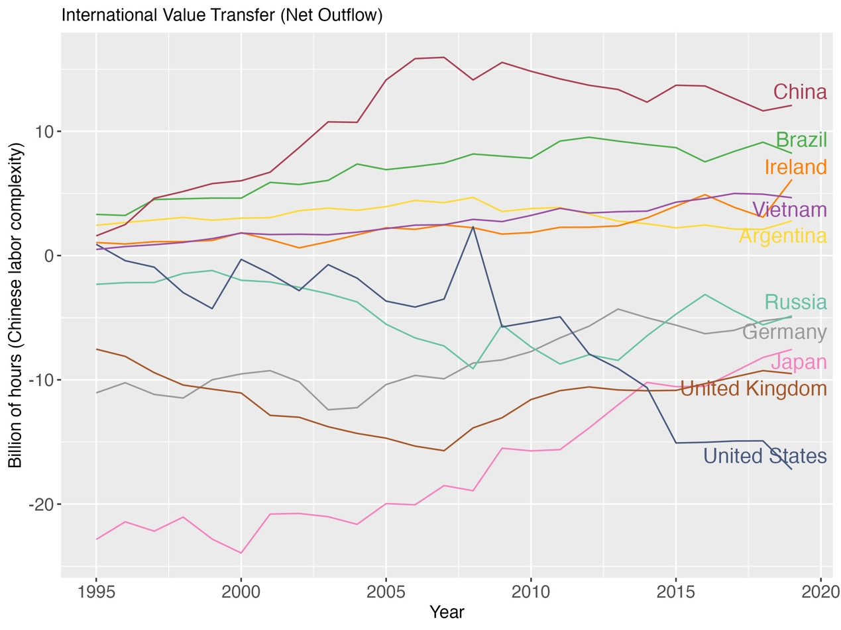
6. The shifting patterns of inter-country value transfer
Figure 3: Top 5 gaining and losing countries in labor values by 2019 ranking

Slide 16
Table 6: Net Value outflows of China and the United States (Billion of hours)
 | Sector | 1995 | 2000 | 2005 | 2010 | 2016 | 2017 | 2018 | 2019
China | Productive | 1.1 | 4.8 | 12.1 | 11.6 | 8.7 | 7.8 | 6.5 | 7.4
 | Unproductive | 0.5 | 1.2 | 2 | 3.2 | 4.9 | 4.9 | 5.1 | 4.7
 | Total | 1.6 | 6 | 14.1 | 14.8 | 13.6 | 12.7 | 11.6 | 12.1
United States | Productive | 3.4 | 1.9 | -3.3 | -1.8 | -9 | -8.9 | -9.5 | -11.4
 | Unproductive | -2.5 | -2.2 | -0.4 | -3.5 | -6 | -6.1 | -5.4 | -5.8
 | Total | 0.9 | -0.3 | -3.7 | -5.3 | -15.0 | -15.0 | -14.9 | -17.2

Slide 17
Table 7: China’s value losses to and gains from trading partners (Billion of hours)
China | Trade partner | 1995 | 2000 | 2005 | 2010 | 2015 | 2016 | 2017 | 2018 | 2019
Net Loss to | United States | -0.1 | 1.5 | 3.4 | 2.8 | 4.4 | 3.4 | 3.1 | 3.9 | 3.9
 | Japan | 1.9 | 3.5 | 5 | 4.3 | 3.3 | 3.2 | 3 | 2.8 | 2.5
 | South Korea | 0.0 | 0.6 | 1.6 | 1.3 | 1.8 | 1.6 | 1.6 | 1.7 | 1.4
 | United Kingdom | 0.1 | 0.4 | 0.9 | 1 | 1.4 | 1.3 | 1.2 | 1.2 | 1.2
 | Germany | 0.3 | 0.4 | 1.0 | 1.4 | 1.3 | 1.3 | 1.3 | 1.2 | 1.1
Net Gain from | Brazil | -0.1 | -0.3 | -1.2 | -1.7 | -3.1 | -2.7 | -3.6 | -4.7 | -3.7
 | Argentina | -0.1 | -0.4 | -0.9 | -1.1 | -0.6 | -0.5 | -0.4 | -0.2 | -0.7
 | New Zealand | 0.0 | -0.1 | -0.1 | -0.3 | -0.4 | -0.4 | -0.5 | -0.6 | -0.6
 | Vietnam | 0.0 | 0.0 | 0.0 | -0.1 | -0.3 | -0.3 | -0.3 | -0.5 | -0.4
 | India | 0.0 | 0.0 | 0.0 | -0.3 | -0.3 | -0.2 | -0.2 | -0.3 | -0.3

Slide 18
Table 8: United States’ value losses to and gains from trading partners (Billion of hours)
United States | Trade partner | 1995 | 2000 | 2005 | 2010 | 2015 | 2016 | 2017 | 2018 | 2019
Net Loss to | United Kingdom | 0.3 | 0.7 | 1.7 | 1.8 | 1.4 | 1.3 | 1.1 | 0.9 | 0.7
 | Switzerland | 0.2 | 0.4 | 0.5 | 0.6 | 0.6 | 0.6 | 0.6 | 0.5 | 0.6
 | Japan | 8.4 | 8.7 | 5.1 | 3 | 1.4 | 1.1 | 0.9 | 0.7 | 0.4
 | Germany | 0.6 | 0.8 | 0.8 | 0.4 | 0.3 | 0.3 | 0.2 | 0.2 | 0.2
 | Russia | 0.2 | 0.3 | 0.6 | 0.6 | 0.3 | 0.1 | 0 | 0.2 | 0.2
Net Gain from | China | 0.1 | -1.5 | -3.4 | -2.8 | -4.4 | -3.4 | -3.1 | -3.9 | -3.9
 | Ireland | -0.2 | -0.5 | -0.9 | -1.2 | -2.1 | -2.7 | -2.3 | -2 | -3.3
 | Mexico | -0.4 | 0.3 | 0.3 | -0.1 | -1.4 | -1.5 | -1.6 | -1.7 | -1.7
 | Vietnam | -0.1 | -0.5 | -0.8 | -1.1 | -1.4 | -1.6 | -1.7 | -1.4 | -1.6
 | India | -0.5 | -0.9 | -1.3 | -1.7 | -1 | -1.2 | -1.3 | -1.2 | -1.1

Slide 19
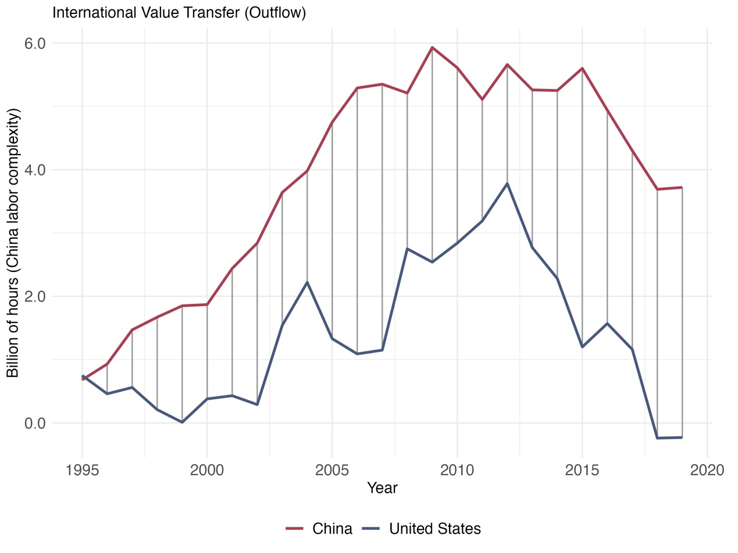
Figure 4: Value flows between China and the United States

Slide 20
Table 9: Value outflows between China and the United States (Billion of hours)
 | 1995 | 2000 | 2005 | 2010 | 2016 | 2017 | 2018 | 2019
China | 0.68 | 1.87 | 4.75 | 5.61 | 4.94 | 4.3 | 3.69 | 3.72
United States | 0.75 | 0.38 | 1.33 | 2.84 | 1.57 | 1.16 | -0.24 | -0.23
Net (China) | -0.07 | 1.49 | 3.42 | 2.77 | 3.37 | 3.14 | 3.93 | 3.95

Slide 21
7. Restructuring of global supply chains and value transfer
Table 10: Twoways fixed effect regression results
 | Dependent variable: Net value loss
 | (1) | (2) | (3) | (4)
Direct backward linkage | 1.701*** |  | 1.883***
 | (0.156) |  | -0.163
Total backward linkage |  | 1.574*** |  | 1.870***
 |  | (0.16) |  | (0.182)
Composition of capital |  |  | -0.0004 | 0.0003
 |  |  | (0.001) | (0.001)
Labor share |  |  | -1.466** | -1.846**
 |  |  | (0.72) | (0.803)
Observations | 39452 | 39452 | 38309 | 38309
R² | 0.102 | 0.053 | 0.113 | 0.063
Adjusted R² | 0.042 | -0.011 | 0.053 | -0.0004
Notes:*p<0.1; **p<0.05; ***p<0.01; Spatial-robust standard errors (Conley-HAC) in parentheses.

Slide 22
8. Concluding remarks
Global supply chains are constantly restructuring, but even major shocks like the U.S.–China trade war caused limited systemic change.
The U.S. and China remain deeply interdependent, with persistent asymmetry: China loses labor value, while the U.S. captures surplus through trade.
Unequal exchange operates through both productive and unproductive-sector trade, reinforcing global economic divergence.
Structural reliance in supply chains leads to value loss, showing that global trade continues to function as a mechanism of exploitation.

Slide 23
Bibliography
Emmanuel, Arghiri. 1972. Unequal Exchange: A Study of the Imperialism of Trade. New York: Monthly Review Press.
Baran, Paul A. 1957. The Political Economy of Growth. New York: Monthly Review Press.
Qiao, Xiaonan, Xin Li, and Junshang Liang. 2025. International Labor Value Transfers Through Unproductive-Sector Trade. Review of Radical Political Economics OnlineFirst https://doi.org/10.1177/04866134251315864
Ricci, Andrea. 2021. Value and Unequal Exchange in International Trade: The Geography of Global Capitalist Exploitation. New York: Routledge.
Rotta, Tomás N. 2025. Value capture and value production in the world economy: A Marxian analysis of global value chains, 2000–2014. EPA: Economy and Space OnlineFirst. DOI：10.1177/0308518X241299315.

Slide 24
Thank You!
Junshang Liang
School of Economics, Nankai University, Tianjin, China
E-mail: liangjunshang@nankai.edu.cn
Wechat：

