Slide 1
International Competitiveness and Carbon Footprint of Products
Haruta Togasakiª, Ai Nagataª, Shigemi Kagawa^{b}
a: Graduate School of Economics, Kyushu University, Japan
b: Faculty of Economics, Kyushu University, Japan
Notes:
Thank you, chairman for introducing me.
So, hello!
I am Haruta Togasaki from Kyushu University, Japan.
I would like to do a presentation about International Competitiveness and Carbon Footprint of Products.

Slide 2

Topics
Introduction
Methodology
Data
Results
Discussion
Conclusion
Notes:
To begin, this is the flow of the presentation.
It starts from Introduction and ends at conclusion.

Slide 3
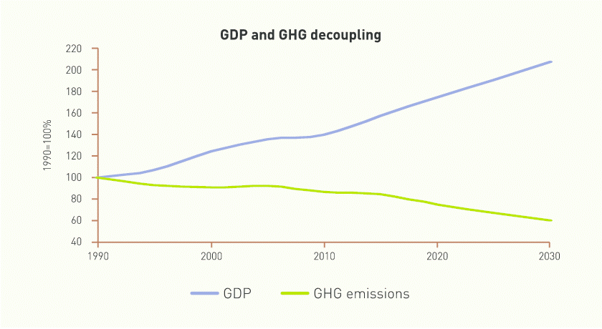
1. Introduction
◎ The EU has achieved a notable decrease in CO₂ emissions within its borders while maintaining economic growth, and it has set further reduction targets.
Given the urgency of the climate crisis, the European Union has set a target of reducing its net GHG emissions by more than 55% relative to 1990 levels by 2030 (European Commission, 2020).
As of 2023, net GHG emissions within the EU had already fallen by 37% compared to 1990, while GDP had increased by 68% (European Commission, 2024).
This indicates a significant decoupling of emissions from economic growth in the EU.
Figure 1. Decoupling of GDP and GHG emissions in the EU between 1990 and 2030.
Note. Adapted from Radusin et al. (2013).
Notes:
Starting with introduction, the EU has achieved a notable decrease in CO₂ emissions within its borders while maintaining economic growth, and it has set further reduction targets.
Given the urgency of the climate crisis, the European Union has set a target of reducing its net GHG emissions by more than 55% relative to 1990 levels by 2030.
As of 2023, net GHG emissions within the EU had already fallen by 37% compared to 1990, while GDP had increased by 68%.
This indicates a significant decoupling of emissions from economic growth in the EU.
(ア₁) To support what I said, figure 1 shows the decoupling of GDP and GHG emissions in the EU from 1990 to 2030.
(ア₂) Both GDP (which is the blue line) and GHG emissions (which is the green line) is started with 100% in 1990.
As you can see in the figure, (ア₃) GDP of EU has been increasing steadily, (ア₄) while the GHG emissions in the EU have been decreasing steadily.

Slide 4




1. Introduction
◎ However, as GVCs expand, the EU’s reported CO₂ emission reductions may be offset by increased CO₂ emissions from producers outside its borders.
The CO₂ emission inventories compiled by EU countries are based on production-based accounting (IPCC, 2007), and do not account for CO₂ emissions embodied in imported goods and services (Jacob & Marschinski, 2013).
Therefore, an increase in CO₂ emissions arising from inter-regional supply chains involving non-EU countries may undermine the effect of EU climate policies that addresses global climate change (Paola et al., 2019; Maria and Tero, 2024; Diego et al., 2024).
Maldives!!!
Notes:
However, as you can see in the figure, (ア₁) as global value chains expand, (ア₂) the EU’s reported CO2 emission reductions may be offset by increased CO2 emissions from producers outside its borders.
The CO2 emission inventories compiled by EU countries are based on production-based accounting and do not account for CO2 emissions embodied in imported goods and services.
Therefore, an increase in CO2 emissions arising from inter-regional supply chains involving non-EU countries may undermine the effect of EU climate policies that addresses global climate change.

Slide 5
1. Introduction
Previous studies on the mitigation of EU CO₂ emissions have not fully distinguished between the emissions induced in intra-EU supply chains and those that arise along inter-regional (EU–non-EU) supply chains.
Paola et al. (2019)
They quantified the EU-28’s consumption-based CO₂ emissions for 2012–2015 using the NCI approach.
However, long term changes of the scale and structure of CO₂ emissions by EU final demand remain unexamined.
Maria and Tero (2024)
They analyzed the impact of the EU ETS on CO₂ emission reductions within EU industrial sectors.
However, the changes of structure of CO₂ emissions induced in different supply-chains by EU final demand remain uncertain.
The objective of this study
How has the structure of CO₂ emissions
induced by final demand of EU countries changed?
Notes:
Previous studies on the mitigation of EU CO2 emissions have not adequately distinguished between the emissions induced in intra-EU supply chains and those that arise along inter-regional (EU and non-EU) supply chains.
For example, Paola et al quantified the EU-28’s consumption-based CO2 emissions for 2012–2015 using the NCI approach.
However, long term changes of the scale and structure of CO2 emissions by EU final demand remain unexamined.
Maria and Tero analyzed the impact of the EU ETS on CO₂ emission reductions within EU industrial sectors. However, the changes of structure of CO₂ emissions induced in different supply-chains by EU final demand remain uncertain.
So, the objective of this study is to clarify, “How has the structure of CO2 emissions induced by final demand of EU countries changed?“

Slide 6



























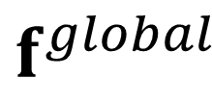















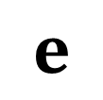













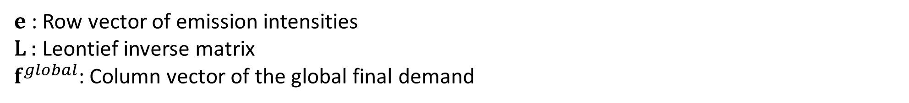

2. Methodology
◎ We estimated the amount of CO₂ emissions induced by global final demand using equation (1), to overview the global CO₂ emissions:
$$(1)$$
$$q^{global}=eLf^{global}$$
(Ex)
3 countries/regions
2 sectors
$$L$$
$$f^{global}$$
$$e$$
$$l_{11}$$
$$l_{12}$$
$$l_{13}$$
$$l_{14}$$
$$l_{15}$$
$$l_{16}$$
$$f_{11}$$
$$l_{21}$$
$$l_{22}$$
$$l_{23}$$
$$l_{24}$$
$$l_{25}$$
$$l_{26}$$
$$f_{21}$$
$$l_{31}$$
$$l_{32}$$
$$l_{33}$$
$$l_{34}$$
$$l_{35}$$
$$l_{36}$$
$$f_{31}$$
$$e_{11}$$
$$e_{12}$$
$$e_{13}$$
$$e_{14}$$
$$e_{15}$$
$$e_{16}$$
$$l_{41}$$
$$l_{42}$$
$$l_{43}$$
$$l_{44}$$
$$l_{45}$$
$$l_{46}$$
$$f_{41}$$
$$l_{51}$$
$$l_{52}$$
$$l_{53}$$
$$l_{54}$$
$$l_{55}$$
$$l_{56}$$
$$f_{51}$$
$e$: Row vector of emission intensities
L : Leontief inverse matrix
$f^{global}$: Column vector of the global final demand
$$l_{61}$$
$$l_{62}$$
$$l_{63}$$
$$l_{64}$$
$$l_{65}$$
$$l_{66}$$
$$f_{61}$$
Notes:
Moving on to the methodology, firstly, we estimated the amount of CO₂ emissions induced by global final demand using equation no.1, to overview the global CO2 emissions.
Equation no.1 is q global equals to the multiplications of e, L, and f global.
e denotes the row vector of emission intensities
L denotes the Leontief inverse matrix
f global denotes the column vector of the global final demand

Slide 7




























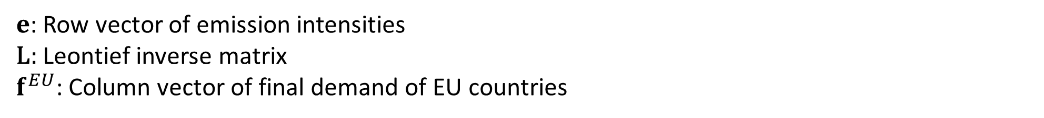






















2. Methodology
◎ We estimated the amount of CO₂ emissions induced by final demand of EU countries using equation (2), to analyze EU’s consumption-based emissions:
$$(2)$$
$$q^{EU}=eLf^{EU}$$
(Ex)
3 countries/regions
2 sectors
$$L$$
$$f^{EU}$$
$$e$$
$$l_{11}$$
$$l_{12}$$
$$l_{13}$$
$$l_{14}$$
$$l_{15}$$
$$l_{16}$$
$$f_{1}^{E}$$
$$l_{21}$$
$$l_{22}$$
$$l_{23}$$
$$l_{24}$$
$$l_{25}$$
$$l_{26}$$
$$f_{2}^{E}$$
$$l_{31}$$
$$l_{32}$$
$$l_{33}$$
$$l_{34}$$
$$l_{35}$$
$$l_{36}$$
$$f_{3}^{E}$$
$$e_{11}$$
$$e_{12}$$
$$e_{13}$$
$$e_{14}$$
$$e_{15}$$
$$e_{16}$$
$$l_{41}$$
$$l_{42}$$
$$l_{43}$$
$$l_{44}$$
$$l_{45}$$
$$l_{46}$$
$$f_{4}^{E}$$
$$l_{51}$$
$$l_{52}$$
$$l_{53}$$
$$l_{54}$$
$$l_{55}$$
$$l_{56}$$
$$f_{5}^{E}$$
$e$: Row vector of emission intensities
L: Leontief inverse matrix
$f^{EU}$: Column vector of final demand of EU countries
$$l_{61}$$
$$l_{62}$$
$$l_{63}$$
$$l_{64}$$
$$l_{65}$$
$$l_{66}$$
$$f_{6}^{E}$$
Notes:
Secondly, we estimated the amount of CO₂ emissions induced by final demand of EU countries using equation no.2, to analyze EU’s consumption-based emissions.
Equation no.2 is q equals to the multiplications of e, L, and f EU.
e and L are same as mentioned in the last slide.
f EU denotes the column vector of final demand of EU countries.

Slide 8

























































































2. Methodology
◎ We disaggregated the amount of CO₂ emissions induced by final demand of EU countries by 2 different supply chains using equation (3):
$$(3)$$
$$q^{EU}=q^{intraEU}+q^{interEU−nonEU}=e\left(L^{intraEU}+L^{interEU−nonEU}\right)f^{EU}$$
(Ex)
$$L^{intraEU}$$
$$L^{interEU−nonEU}$$
3 countries/regions
2 sectors
$$f^{EU}$$
$$e$$
$$l_{11}^{E}$$
$$l_{12}^{E}$$
$$0$$
$$0$$
$$0$$
$$0$$
$$l_{11}^{O}$$
$$l_{12}^{O}$$
$$l_{13}^{O}$$
$$l_{14}^{O}$$
$$l_{15}^{O}$$
$$l_{16}^{O}$$
$$f_{1}^{E}$$
$$l_{21}^{E}$$
$$l_{22}^{E}$$
$$0$$
$$0$$
$$0$$
$$0$$
$$l_{21}^{O}$$
$$l_{22}^{O}$$
$$l_{23}^{O}$$
$$l_{24}^{O}$$
$$l_{25}^{O}$$
$$l_{26}^{O}$$
$$f_{2}^{E}$$
$$0$$
$$0$$
$$1$$
$$0$$
$$0$$
$$0$$
$$l_{31}^{O}$$
$$l_{32}^{O}$$
$$l_{33}^{E}$$
$$l_{34}^{O}$$
$$l_{35}^{O}$$
$$l_{36}^{O}$$
$$f_{3}^{E}$$
$$e_{11}$$
$$e_{12}$$
$$e_{13}$$
$$e_{14}$$
$$e_{15}$$
$$e_{16}$$
$$0$$
$$0$$
$$0$$
$$1$$
$$0$$
$$0$$
$$l_{41}^{O}$$
$$l_{42}^{O}$$
$$l_{43}^{O}$$
$$l_{44}^{O}$$
$$l_{45}^{O}$$
$$l_{46}^{O}$$
$$f_{4}^{E}$$
$$0$$
$$0$$
$$0$$
$$0$$
$$1$$
$$0$$
$$l_{51}^{O}$$
$$l_{52}^{O}$$
$$l_{53}^{O}$$
$$l_{54}^{O}$$
$$l_{55}^{O}$$
$$l_{56}^{O}$$
$$f_{5}^{E}$$
$$0$$
$$0$$
$$0$$
$$0$$
$$0$$
$$1$$
$$l_{61}^{O}$$
$$l_{62}^{O}$$
$$l_{63}^{O}$$
$$l_{64}^{O}$$
$$l_{65}^{O}$$
$$l_{66}^{O}$$
$$f_{6}^{E}$$
$L^{intraEU}$: Leontief inverse that represents the production ripple effects confined to the EU
$L^{interEU−nonEU}$: Leontief inverse submatrix that traces the direct and indirect intermediate inputs in the EU region required as a result of feedback effects from the non-EU region
Notes:
Thirdly, we disaggregated the amount of CO₂ emissions induced by final demand of EU countries by 2 different supply chains using equation no.3.
In equation no.3, we disaggregated q EU into q intraEU and q interEU and nonEU.
These sums are equal to the multiplications of e, (L intraEU plus L interEU and nonEU), and f EU.
L intraEU denotes the Leontief inverse that represents the production ripple effects confined to the EU
L inter EU-nonEU denotes the Leontief inverse submatrix that traces the direct and indirect intermediate inputs in the EU region required as a result of feedback effects from the non-EU region.
In next two slides, I will explain the detail of each L that are disaggregated.

Slide 9








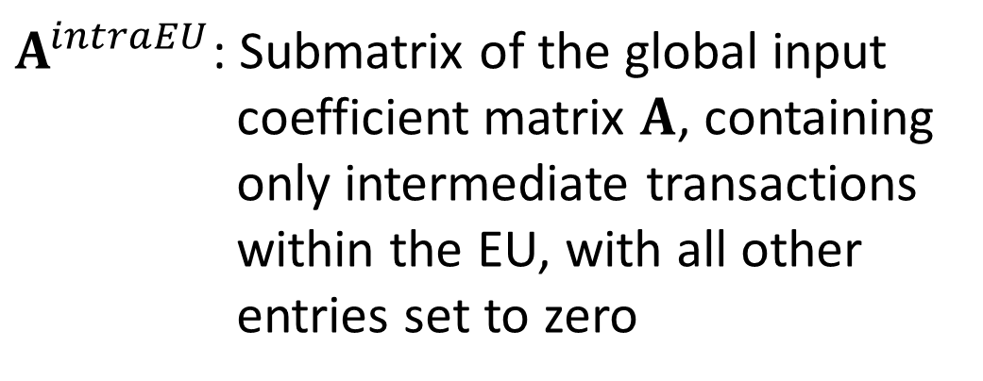




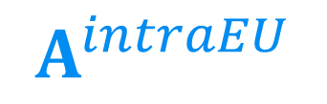


2. Methodology
◎ We estimated Leontief inverse that represents the production ripple effects confined to the EU ($L^{intraEU}$) using equation (4):
$$L^{intraEU}={\left(I−A^{intraEU}\right)}^{−1}$$
$$(4)$$
$$A^{intraEU}$$
$$a_{11}$$
$$a_{12}$$
$$0$$
$$0$$
$$0$$
$$0$$
$A^{intraEU}$: Submatrix of the global input coefficient matrix $A$, containing only intermediate transactions within the EU, with all other entries set to zero
$$a_{21}$$
$$a_{22}$$
$$0$$
$$0$$
$$0$$
$$0$$
$$0$$
$$0$$
$$0$$
$$0$$
$$0$$
$$0$$
$$0$$
$$0$$
$$0$$
$$0$$
$$0$$
$$0$$
$$0$$
$$0$$
$$0$$
$$0$$
$$0$$
$$0$$
$$0$$
$$0$$
$$0$$
$$0$$
$$0$$
$$0$$
Notes:
For L intraEU, we estimated Leontief inverse that represents the production ripple effects confined to the EU using equation no.4.
Equation no.4 is L intraEU equals to (I - A intraEU) to the power of -1.
A intraEU denotes the submatrix of the global input coefficient matrix A, containing only intermediate transactions within the EU, with all other entries set to zero.

Slide 10





















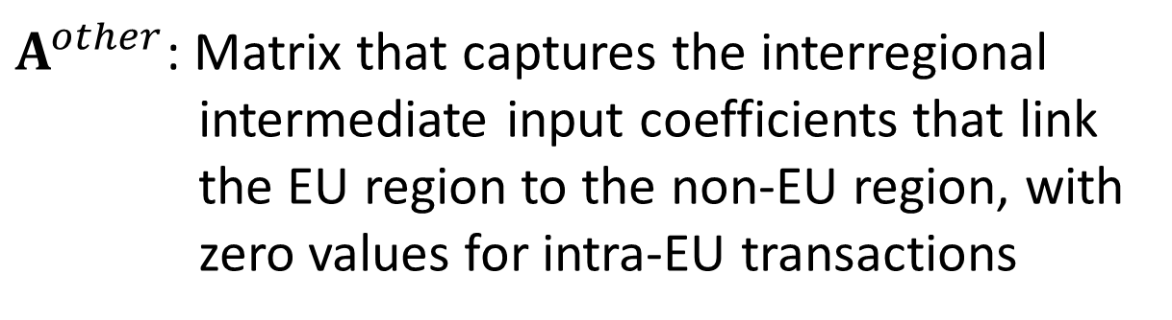










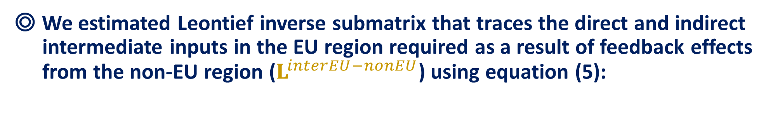







2. Methodology
◎ We estimated Leontief inverse submatrix that traces the direct and indirect intermediate inputs in the EU region required as a result of feedback effects from the non-EU region ($L^{interEU−nonEU}$) using equation (5):
$$L^{interEU−nonEU}={\left(I−A^{intraEU}\right)}^{−1}A^{other}{\left(I−A\right)}^{−1}$$
$$(5)$$
$$A^{other}$$
$A^{other}$: Matrix that captures the interregional intermediate input coefficients that link the EU region to the non-EU region, with zero values for intra-EU transactions
$$0$$
$$0$$
$$a_{13}$$
$$a_{14}$$
$$a_{15}$$
$$a_{16}$$
$$0$$
$$0$$
$$a_{23}$$
$$a_{24}$$
$$a_{25}$$
$$a_{26}$$
$$a_{31}$$
$$a_{32}$$
$$a_{33}$$
$$a_{34}$$
$$a_{35}$$
$$a_{36}$$
$$a_{41}$$
$$a_{42}$$
$$a_{43}$$
$$a_{44}$$
$$a_{45}$$
$$a_{46}$$
$$a_{51}$$
$$a_{52}$$
$$a_{53}$$
$$a_{54}$$
$$a_{55}$$
$$a_{56}$$
$$a_{61}$$
$$a_{62}$$
$$a_{63}$$
$$a_{64}$$
$$a_{65}$$
$$a_{66}$$
Notes:
For L interEU and nonEU, we estimated Leontief inverse submatrix that traces the direct and indirect intermediate inputs in the EU region required as a result of feedback effects from the non-EU region using equation no.5:
Equation no.5 is L interEU and nonEU equals to the multiplications of (I - A intraEU) to the power of -1, A other, and (I-A) to the power of -1.
A other denotes the matrix that captures the interregional intermediate input coefficients that link the EU region to the non-EU region, with zero values for intra-EU transactions.

Slide 11

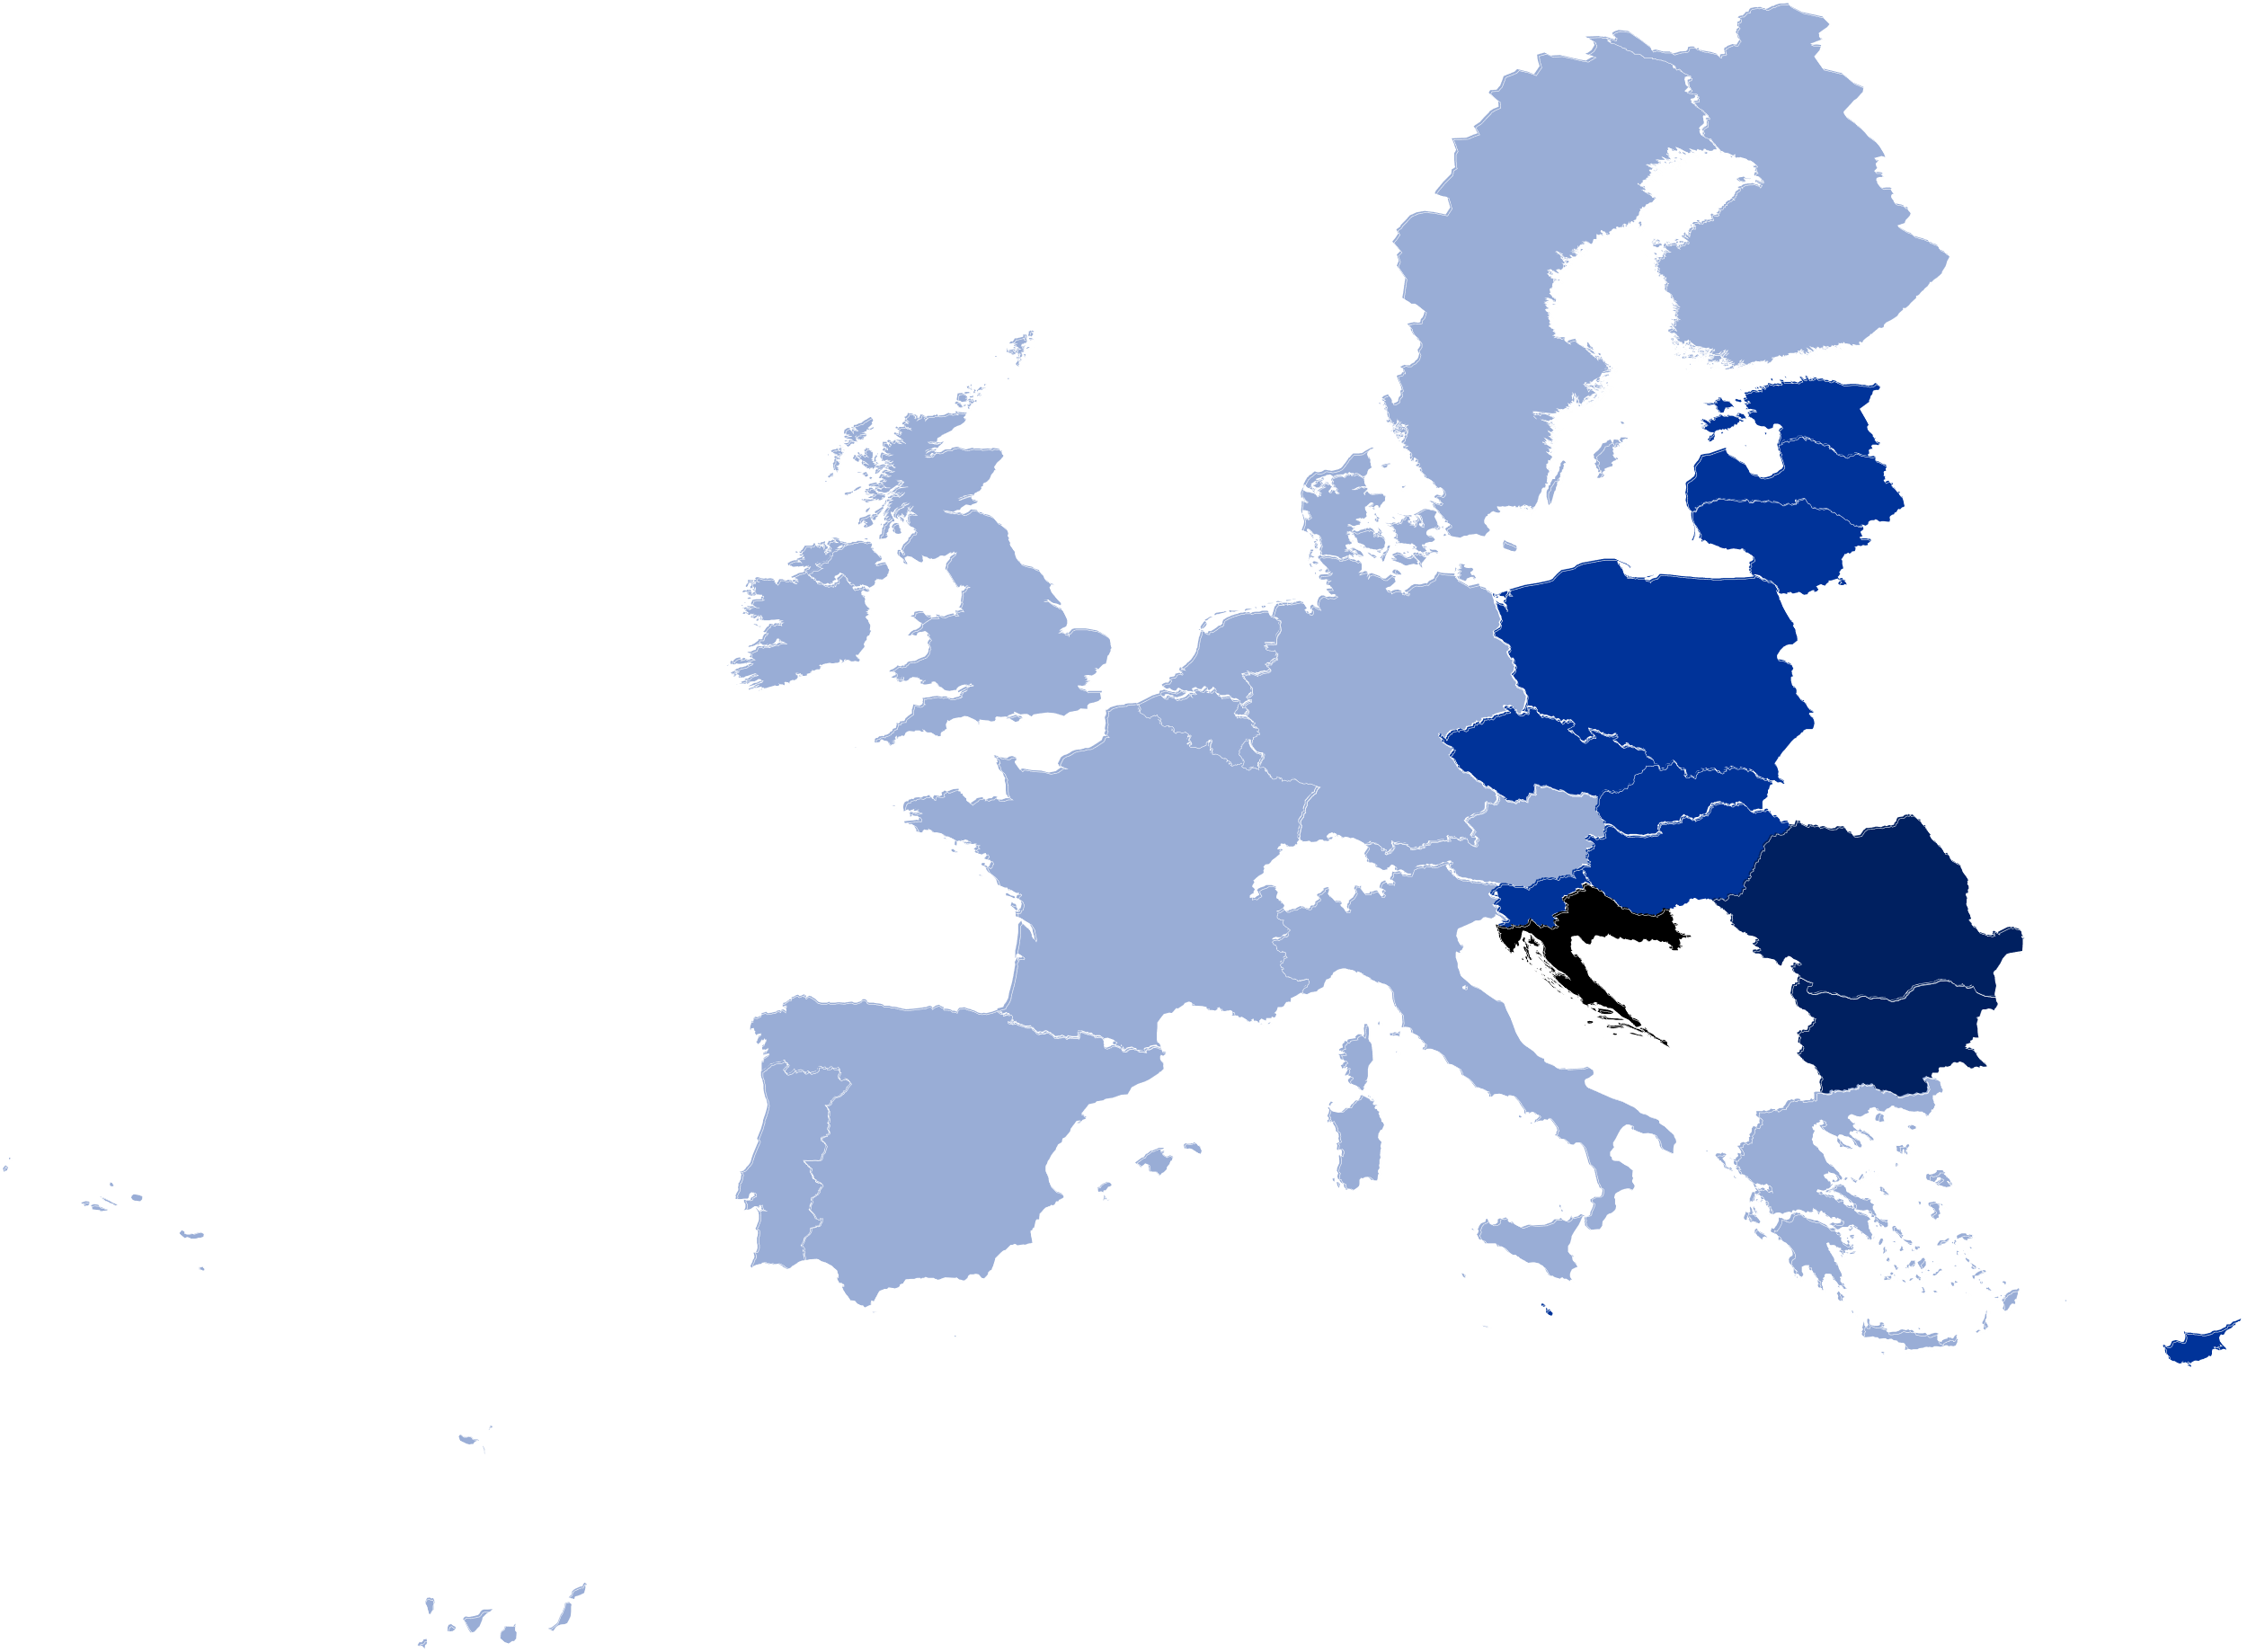

3. Data
◎ World Input-Output Database (Dietzenbacher et al., 2013, Timmer et al., 2015)
We used the world multi-regional input–output (MRIO) table covering 56 industrial sectors across 43 countries/regions for the period from 2000 to 2014. For the MRIO data, we employed the tables deflated to 2014 prices (Tokito et al., 2024).
◎ WIOD environmental accounts (Corsatea et al., 2019)
We used the emission-intensity
supplementary table accompanied to WIOD.
◎ History of EU enlargement (European Union, 2025)
To determine EU membership status for each year,
we referred to data from the European Union,
“History of Enlargement.”
15
+10
+2
+1
2000
2004
2007
2013
Notes:
For the data, These are the data that we used in this study.
Firstly, we used the world MRIO table from world input-output database covering 56 industrial sectors across 43 countries and regions for the period from 2000 to 2014. For the MRIO data, we employed the tables deflated to 2014 prices.
Secondly, we used the emission-intensity supplementary table accompanied to the WIOD.
Lastly, to determine EU membership status for each year, we referred to data from the European Union, “History of Enlargement.”

Slide 12
4. Results
)
35
2
Embodied CO₂ emissions induced by the final demand of EU countries have remained stable relative to total global CO₂ emissions.
The recent rise in global CO₂ emissions is primarily driven by increased emissions induced by the final demand of countries outside the EU.
CO
-
30
25
emissions (Gt
The share in global CO₂ emissions
20
89%
2
15
85%
10
Embodied global CO
5
15%
11%
0
2000
2001
2002
2003
2004
2005
2006
2007
2008
2009
2010
2011
2012
2013
2014
Embodied global CO₂ emissions induced by the final demand of rest of the world
Embodied global CO₂ emissions induced by the final demand of EU countries
Figure 2. Global CO₂ emissions from 2000 to 2014
Notes:
Now, I am moving on to the results.
Figure 2 shows the global CO2 emissions from 2000 to 2014.
Green part represents the embodied global CO2 emissions induced by the final demand of countries outside EU, and pink part represents the embodied global CO2 emissions induced by the final demand of EU countries.
(ア₁) As you can see in the figure, embodied CO2 emissions induced by the final demand of EU countries have remained stable relative to total global CO2 emissions.
(ア₂) So, the recent rise in global CO2 emissions is primarily driven by increased emissions induced by the final demand of countries outside the EU.
(ア₃) Looking at the figure, the share of global CO2 emissions induced by final demand outside the EU (which is the pink part) in global CO2 emissions has increased from 85% to 89%.
(ア₄) From now on, we will only focus on the pink part.

Slide 13
4. Results
12
+30% (2000 to 2007)
-20% (2007 to 2014)
CO₂ emissions induced by the final demand of EU countries increased by 30% between 2000 and 2007 but then decreased by 20% from 2007 to 2014.
These results indicate that CO₂ emissions rose until 2007, then fell, returning to their 2000 level by 2014.
Embodied CO₂ emissions within EU countries associated with intra-regional (EU) supply chains induced by the final demand of the EU
Embodied CO₂ emissions within EU countries associated with inter‑regional (EU–non-EU) supply chains induced by the final demand of the EU
Figure 3. Embodied CO₂ emissions induced by
final demand of EU countries from 2000 to 2014
Notes:
Figure 3 shows the embodied CO2 emissions induced by final demand of EU countries from 2000 to 2014.
So, the whole bar represents the pink part of the graph that I showed in the last slide.
Yellow part represents the Embodied CO₂ emissions within EU countries associated with intra-regional (EU) supply chains induced by the final demand of the EU.
Blue part represents the Embodied CO₂ emissions within EU countries associated with inter‑regional (EU–non-EU) supply chains induced by the final demand of the EU
(ア₁) As you can see in the figure, CO2 emissions induced by the final demand of EU countries increased by 30% between 2000 and 2007 but then decreased by 20% from 2007 to 2014.
(ア₂) These results indicate that CO2 emissions rose until 2007, then fell, returning to their 2000 level by 2014.

Slide 14
4. Results
29%
Over the fifteen-year period, CO₂ emissions originating from intra-EU supply chains declined, whereas those from inter-regional supply chains increased.
These results indicate that though total emissions in 2014 returned to their 2000 level, the underlying structure of supply chain-induced CO₂ emissions underwent a significant transformation.
32%
35%
37%
Embodied CO₂ emissions within EU countries associated with intra-regional (EU) supply chains induced by the final demand of the EU
Embodied CO₂ emissions within EU countries associated with inter‑regional (EU–non-EU) supply chains induced by the final demand of the EU
Figure 4. Share of embodied CO₂ emissions induced in two different supply chains by final demand of EU countries from 2000 to 2014
Notes:
Figure 4 is showing the share of embodied CO₂ emissions induced in each supply chains by final demand of EU countries from 2000 to 2014.
(ア₁) Over the fifteen-year period, CO2 emissions originating from intra-EU supply chains declined, whereas those from inter-regional supply chains increased.
(ア₂) These results indicate that though total emissions in 2014 returned to their 2000 level, the underlying structure of supply chain-induced CO2 emissions underwent a significant transformation.

Slide 15
4. Results
CO₂ emission multiplier (kg-CO₂/USD)
(Ex)
2000
2014
Embodied CO₂ emissions induced in inter-regional (EU–non-EU) supply chains
CO₂ emission multiplier induced by the final demand of EU countries for construction (c27)
Embodied CO₂ emissions induced
by the final demand of EU countries
for construction (c27)
CO₂ emissions induced in
intra-regional (EU) supply chains
c27
Final demand of EU countries (trillion USD)
Final demand of EU countries (trillion USD)
Final demand of EU countries for construction (c27)
Figure 5.1-2. Embodied CO₂ emissions induced by final demand of EU countries by 56 industries in 2000 and 2014
The area of each squares represents the amount of CO₂ emissions induced for each industry.
  Vertical axis represents CO₂ emission multiplier (Embodied CO₂ emissions induced per unit of EU final demand).
  Horizontal axis represents final demand of EU countries.
The area of each squares represents the amount of CO₂ emissions induced for each industry.
  Vertical axis represents CO₂ emission multiplier (Embodied CO₂ emissions induced per unit of EU final demand).
  Horizontal axis represents final demand of EU countries.
Yellow is the amount of embodied CO₂ emissions induced in inter-regional (EU–non-EU) supply chains by the final demand of EU countries.
Blue is the amount of embodied CO₂ emissions induced in intra-EU supply chains by the final demand of EU countries.
Notes:
Figure 5.1 and 5.2 shows the embodied CO₂ emissions induced by final demand of EU countries by 56 industries in 2000 and 2014.
I will explain this figure in this slide.
The area of each squares represents the amount of CO₂ emissions induced for each industry.
Vertical axis represents CO₂ emission multiplier which is the embodied CO₂ emissions induced per unit of EU final demand.
Horizontal axis represents the final demand of EU countries.
(ア₁) Yellow is the amount of embodied CO2 emissions induced in inter-regional (EU–non-EU) supply chains by the final demand of EU countries.
Blue is the amount of embodied CO2 emissions induced in intra-EU supply chains by the final demand of EU countries.
(ア₂) For example, if you look at c27, which is the construction sector, the whole area of the square represents the embodied CO2 emissions induced by the final demand of EU countries for construction sector.
The height represents the CO₂ emission multiplier induced by the final demand of EU countries for construction sector.
The length represents the final demand of EU countries for construction sector.
(ア₃) Yellow area represents the CO2 emissions induced in inter-regional supply chains for construction sector, and Blue area represents the CO2 emissions induced in intra-regional supply chains for construction sector.

Slide 16
4. Results
CO₂ emission multiplier (kg-CO₂/USD)
2000
2014
Manufacture of food products, beverages and tobacco products
Manufacture of food products, beverages and tobacco products
Electricity, gas, steam and air conditioning supply
Electricity, gas, steam and air conditioning supply
-13%
Final demand of EU countries (trillion USD)
+21%
Final demand of EU countries (trillion USD)
Figure 5.1-2. Embodied CO₂ emissions induced by the final demand of EU countries by 56 industries (2000 and 2014)
Firstly, comparing the two figures reveals that the final demand of the EU in 2014 increased by 21% compared to 2000.
Indeed, final demand increased in 35 (out of 56) industries from 2000 to 2014.
Secondly, the average emission multipliers induced by EU final demand in 2014 decreased by 13% compared to 2000.
Indeed, emission multipliers decreased in 38 industries from 2000 to 2014.
Notes:
So firstly, comparing the two figures reveals that the final demand of the EU in 2014 increased (ア₁) by 21% compared to 2000.
Indeed, final demand increased in 35 (out of 56) industries from 2000 to 2014.
(ア₂) Secondly, the average emission multipliers induced by EU final demand in 2014 decreased by 13% compared to 2000.
Indeed, emission multipliers decreased in 38 industries from 2000 to 2014.

Slide 17
4. Results
CO₂ emission multiplier (kg-CO₂/USD)
2000
2014
Manufacture of food products, beverages and tobacco products
Manufacture of food products, beverages and tobacco products
Electricity, gas, steam and air conditioning supply
Electricity, gas, steam and air conditioning supply
Final demand of EU countries (trillion USD)
Final demand of EU countries (trillion USD)
Figure 5.1-2. Embodied CO₂ emissions induced by the final demand of EU countries by 56 industries (2000 and 2014)
Furthermore, among 29 industries that saw their CO₂ increase, 20 experienced growth in both final demand and the inter-regional (EU–non-EU) supply-chain emission multiplier, while the intra-EU supply-chain emission multiplier declined.
Thirdly, comparing the two figures reveals that of the 56 industries, 29 saw their CO₂ emissions increase, and in 25 of those industries final demand rose.
Notes:
Thirdly, comparing the two figures reveals that of the all 56 industries, 29 saw their CO₂ emissions increase, and in 25 of those industries final demand rose.
(ア₁) Furthermore, among 29 industries that saw their CO₂ increase, 20 experienced growth in both final demand and the inter-regional (EU–non-EU) supply-chain emission multiplier, while the intra-EU supply-chain emission multiplier declined.

Slide 18
5. Discussion
◎ The increase in embodied CO₂ emissions induced
by EU final demand in many industries was driven
by two factors:
EU final demand
Emission multiplier of inter-regional supply chains
2000
2014
UP
CO₂
DOWN
UP
Factors | Target | Policy Implications
Emission multiplier of inter-regional supply chains | Industries outside EU | Expanded CBAM (EU Carbon Border Adjustment Mechanism): EU should consider indirect emissions when setting the carbon price on imported goods especially in 20 industry sectors.
 |  | Expanded EU Innovation Fund: EU should extend investments in existing intra-EU emissions-reduction technologies to regions outside the EU.
Notes:
Moving on to the discussion, the increase in embodied CO₂ emissions induced by EU final demand in many industries was driven by two factors, which are the growth of EU final demand and, the growth of emission multiplier of inter-regional supply chains.
To address these factors, I propose 2 policies.
Firstly, I propose Expanded CBAM, which EU should consider indirect emissions when setting the carbon price on imported goods especially in 20 industry sectors.
Secondly, I propose Expanded EU Innovation Fund, which EU should extend investments in existing intra-EU emissions-reduction technologies to regions outside the EU.

Slide 19
6. Conclusions
The objective of this study
How has the structure of CO₂ emissions
induced by final demand of EU countries changed?
We identified that despite a 20% increase in EU final demand, total supply chain emissions remained nearly unchanged, due to reductions in the emission multiplier within intra-EU supply chains.
However, in sectors such as “Manufacture of food products, beverages and tobacco products” sector, the rise was largely driven by higher emission multipliers in inter-regional (EU and non-EU) supply chains.
These 20 sectors accounted for 45% of total emissions in 2014, highlighting the growing importance of extra-EU emissions in the EU’s consumption footprint.
We propose extending the CBAM to include intermediate goods and supporting low-carbon investments in non-EU countries, especially on the 20 sectors identified in this study.
Notes:
So, for the conclusion, the objective of this study is to clarify, “How has the structure of CO2 emissions induced by final demand of EU countries changed?”
(ア₁) We identified that despite a 20% increase in EU final demand, total supply chain emissions remained nearly unchanged, due to reductions in the emission multiplier within intra-EU supply chains.
(ア₂) However, in sectors such as “Manufacture of food products, beverages and tobacco products” sector, the rise was largely driven by higher emission multipliers in inter-regional (EU and non-EU) supply chains.
(ア₃) These 20 sectors accounted for 45% of total emissions in 2014, highlighting the growing importance of extra-EU emissions in the EU’s consumption footprint.
(ア₄) We propose extending the CBAM to include intermediate goods and supporting low-carbon investments in non-EU countries, especially on the 20 sectors identified in this study.

Slide 20
Thank you for your attention.

