Slide 1
Estimating Ownership-Based Bilateral Trade and Its Contribution to World GDP
Quanrun Chen Yuechen Wang Hanlin Li
(University of International Economics and Business)

Slide 2
Introduction
Large trade deficit is often used as a motivation for trade protection policies.
However, in the context of the development of foreign direct investment and the expansion of global value chains, economies around the world have been closely interdependent through the establishment of a commercial presence.
This phenomenon has fundamentally challenged the traditional framework for assessing trade gains in international trade statistics.

Slide 3
Introduction
Economy A’s export to Economy B
Traditional international trade: resident-based trade (transactions between an economy’s resident and its non-resident)
Economy A
Economy B
Resident of Economy A
Resident of Economy B

Slide 4
Introduction
Economy A’s export to Economy B
The challenge of commercial presence on traditional trade statistics
Extensions of exports from Economy A to Economy B
Economy B
Local sectors
These sales are largely controlled by Economy A and reflect the gains of Economy A
Subsidiaries of Economy A
Hidden in Economy B’s domestic trade
Traditional trade statistics could under-estimate the gains of Economy A

Slide 5
Introduction
Economy A’s export to Economy B
Some exports of Economy A are done by foreign-owned firms
Economy A
Economy B
Resident of Economy A
Resident of Economy B
(Foreign-owned)
These exports are controlled by foreign economies
Traditional trade statistics could over-estimate the gains of Economy A

Slide 6
Introduction
Economy A’s export to Economy B
Economy A’s subsidiaries in a third country export to Economy B
Economy C
Economy B
Subsidiaries of Economy A
Resident of Economy B
Traditional trade statistics could under-estimate the gains of Economy A

Slide 7
Introduction
Considering the substitution effect of FDI on traditional trade, the traditional “rule of resident” for identifying bilateral trade no longer accurately reflects the real trade benefits of both parties.
The traditional trade statistics fails to capture who actually controls and benefits from production, especially in an era of globalized capital and FDI.
There is a critical need to redefine trade accounting boundaries to reflect ownership-based control, not just physical resident.
Ownership-based trade is determined by whether there is a change in the 'nationality' of the ownership of a product, rather than by whether the physical movement of product crosses borders.

Slide 8
Why Ownership-Based Trade Matters
Ownership-based trade statistics uncover the hidden structure of global economic power, correcting misperceptions created by the geographic lens of resident-based accounting.
Reflects true economic control
Accounts for who actually owns and benefits from production—not just where it occurs.
Reveals Hidden Trade Imbalances and Corrects Misleading Surplus Narratives
Enhances Policy-Relevant Accounting
Provides a more accurate basis for GDP attribution, GVC mapping, and policy design in taxation, trade, and international negotiations.

Slide 9
The contribution of our work
The “OECD Inter-Country Input-Output table split according to ownership” in the AMNE database distinguishes domestic-owned and foreign-owned firms. We further spilt the foreign-owned firms in these tables according to their parent economies. This provides basic data for estimating ownership-based bilateral trade
Propose a systematic approach to estimating ownership-based bilateral trade by using the “inter-country input-output tables split according to ownership of parent economies”
Evaluate the contribution of ownership-based bilateral trade to world GDP by using inter-country input-output model with hypothetical extraction method and give implications on the potential impact of ownership-based trade protection policies.

Slide 10
Data
Owned by Economy s
Owned by Economy t

Slide 11
Data
Table 2. Gross output by host country, industry and country of ownership
The block diagonal of each matrix indicates the output of domestic-owned firms
Off-diagonal elements correspond to the output of foreign-owned firms (where the parent country is the country in the column of the matrix)

Slide 12
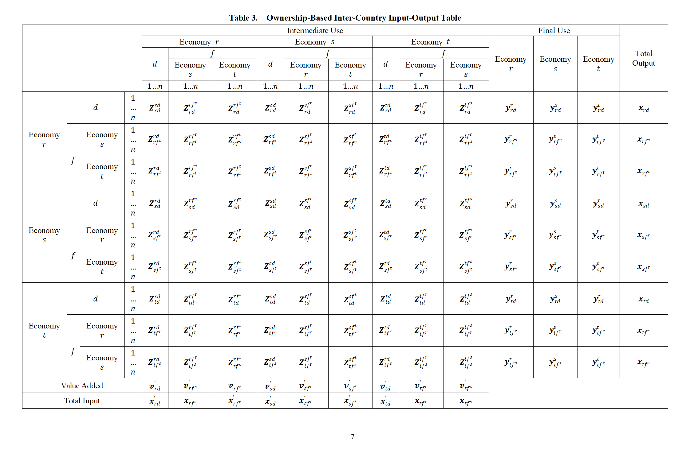
Data

Slide 13
Example: Trade between Economy r and s under the Resident Principle
Resident-based exports from r to s include all cells in row r and column s, regardless of the ownership type of producer in r.

Slide 14
Example: Trade between Economy r and s under the Ownership Principle

Slide 15
Data
Due to limited computing capacity, the top 10 economies in terms of FDI net outflows are split out. In addition, Netherlands and South Korea, who have large amount of direct investment in China, are also split out.
The United States, Japan, China, Hong Kong, China, Germany, Canada, the United Kingdom, Singapore, Sweden, Spain, the Netherlands, South Korea
These 12 economies account for more than 50% of the output of all foreign-owned sectors in the world.

Slide 16
Ownership-Based vs. Residence-Based Trade (2020)

Slide 17
Ownership-Based vs. Residence-Based Trade (2020)
Table 5. The Difference Between Ownership-Based Trade Volume and Residence-Based Trade Volume (%)

Slide 18
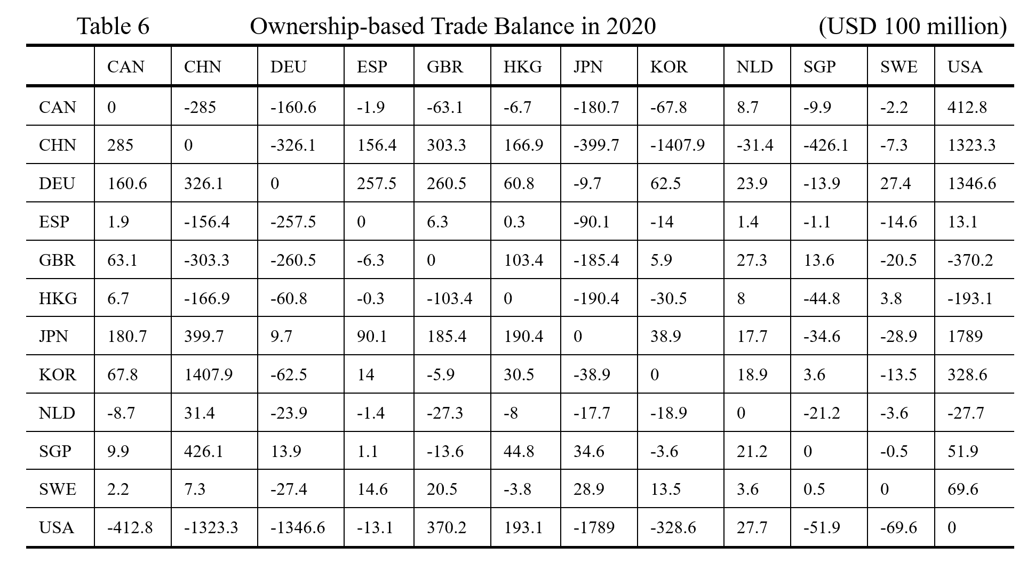
Ownership-Based vs. Residence-Based Trade (2020)

Slide 19
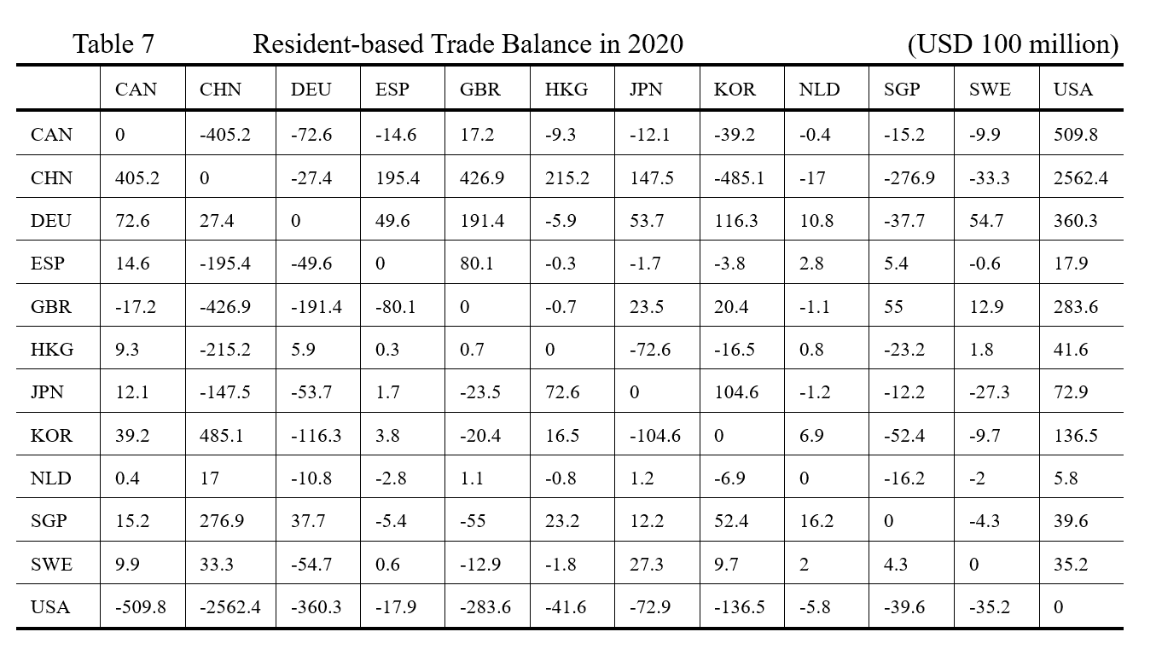
Ownership-Based vs. Residence-Based Trade (2020)

Slide 20
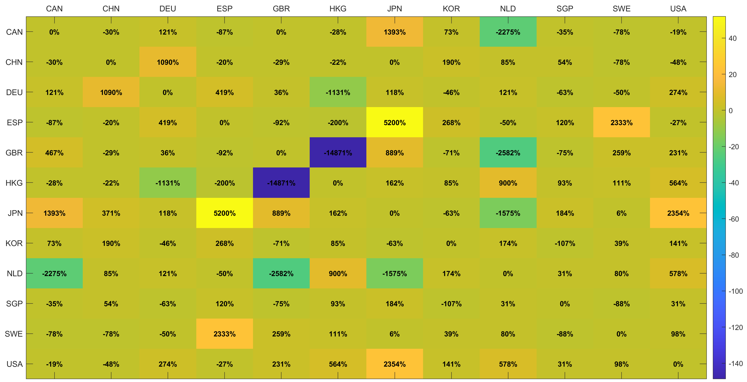
Ownership-Based vs. Residence-Based Trade (2020)
Figure 5. Ownership-Residence Trade Balance Change Ratio

Slide 21
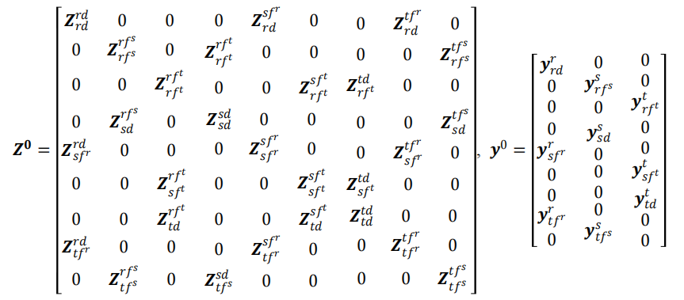



The Contribution of Ownership-based trade to World GDP
The Hypothetical Extraction Method (HEM) is employed
Before extraction, global GDP was:
After extraction, global GDP was:
Where w is the row vector of value-added ratios，L is the Leontief inverse
The contribution of ownership-based trade to world GDP

Slide 22
The Contribution of Ownership-based trade to World GDP
Figure 6. The Contribution Range of GDP in Various Economies

Slide 23
Conclusions
Very preliminary results
To be continued

Slide 24
Thank you!

