Slide 1
Impacts of Scaling up 5G Communication Networks across India: An Integrated macro-econometric sub-national framework
By : Surabhi Joshi, Independent Consultant, India’
Kakali Mukhopadhyay, McGill University, Montreal, Canada
Vishnu S. Prabhu, Independent Consultant, India

Slide 2
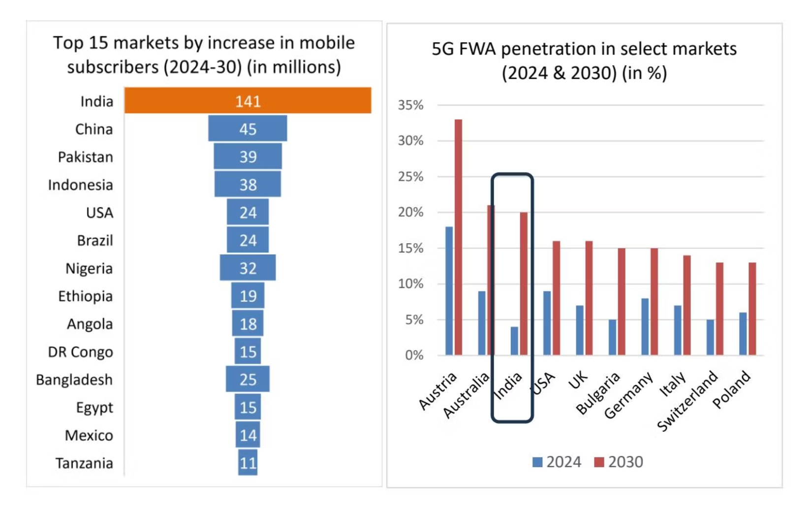
India's Digital Revolution: A 5G Leap
Leading global markets for 5G expansion (2024-30)
India is undergoing a digital revolution marked by the rapid expansion of fifth generation (5G) mobile networks and the evolution of a progressive telecom policy landscape.
India's communication technology sector has experienced rapid growth over the past decade, with 812 million broadband subscribers the second-largest telecom subscriber base (TRAI, 2023) and one of the largest internet user bases globally (ICRIER, 2024).
Since the commercial launch of 5G in October 2022, the country has witnessed one of the fastest 5G deployments globally enabling service in 99.6% districts by early 2025 (TeckNexus, 2025).
As of 2025, over 250 million users are connected to 5G network which is expected to grow to 770 million by 2028 (IBEF, 2025)
Source: (GSMA,2025)
31st International Input Output conference , July 2025, Male, Maldives

Slide 3
Policy Landscape
Digital India Program 2015 : Key catalyzer for 5 G upgradation
Broadband Highways
Include Broadband for all Urban and Rural areas and National Information Infrastructure
Universal Access to Mobile Connectivity
Focus on network penetration and cover unconnected villages.
Public Internet Access Programme
Bharat Net project provides fibre connectivity to villages.
e-Governance
Re-engineering using IT to improve transactions and e-services.
Information for all
Open Data platform and online hosting of information and documents.
IT for Jobs
Focuses on providing training to the youth in the skills required for availing employment opportunities in the IT/ITES sector.
31st International Input Output conference , July 2025, Male, Maldives

Slide 4
31st International Input Output conference , July 2025, Male, Maldives

Slide 5
Environmental Impacts of 5 G Roll out
The 5G expansion is expected to have positive economic impacts but the expansion will also lead to additional energy and GHG burden on the economy.
In the case of 5G infrastructure primary emissions arise from operations of ground based towers and data centers.
Energy infrastructure and use accounts for 20% of total costs for 5G installation with 5G towers as While a typical 4G site might operate around 5 kW, 5G sites can range from 20-40 kW
Private telecom operators in India like Bharti Airtel, Jio, and Vodafone Idea are adopting AI-based network optimization, renewable energy, and energy-efficient cooling systems to meet net-zero targets by 2035–2050 (NASSCOM, 2025; COAI, 2025). Though the national telecom providers (state entities like BSNL and MTNL ) have yet to come up with a decarbonization target
31st International Input Output conference , July 2025, Male, Maldives

Slide 6
Alignment with SDG goals
SDG 7 – Affordable & Clean Energy | Energy-efficient technologies and renewable power adoption
SDG 9 – Industry, Innovation & Infrastructure | Investment in resilient, inclusive, and sustainable digital infrastructure
SDG 12 – Responsible Consumption | E-waste policies and producer responsibility
SDG 13 – Climate Action | Emission reduction goals and net-zero commitments
31st International Input Output conference , July 2025, Male, Maldives

Slide 7
Literature Review Economy-wide impact of broadband services
Broadband services expand faster than cellular networks in Low income countries, due to limited capacity. Fixed Broadband service infrastructure and cellular network development should progress simultaneously (Thompson & Garbacz, 2011; Bagheri & Rodrigues, 2017)
Globally, partial equilibrium models have shown positive impact of broadband connectivity (cellular and fixed) expansion on GDP (Edquist et al., 2018; Castells & Pedros, 2019; Koutroumpis 2019).
Key factors which influence broadband service adoption include economic growth, productivity and education (Kramer & Palan, 2022)
However, key constraints faced by developing countries include, high cost of internet packages, poor ICT infrastructure, capacity constraints (Miraz, Ali, & Excell, 2017).
31st International Input Output conference , July 2025, Male, Maldives

Slide 8
Literature Review ii) The Environmental burden of broadband service expansion
The four key contributors to telecommunications energy footprint include– i) operational energy consumption, ii) embodied energy of network equipment, iii) network traffic growth and iv) expected energy efficiency improvements (Chan et al., 2016).
LCA studies reveals U-shaped curve in GHG emissions, with network infrastructure and electricity consumption contributing the most initially, (Edquist & Bergmark, 2024). User devices during the use phase dominate emissions from networks and data centers (Bergmark & Lunden, 2024).
San Miguel., (2024) adopt an EEMRIO model for Peru revealing total GHG footprint of 289-340 kgCO2/subscription/year along with 7-8 jobs/subscription/year.
In the case of India, Sahu, Schultz & Beig, (2015) quantify the critical pollutants (Nox, PM, CO, HC etc.) from telecom networks while Deevala, Singh, & Kandpal, (2024) assess the variations in the GHG footprint through greening of the baseline electricity mix.
31st International Input Output conference , July 2025, Male, Maldives

Slide 9
Objectives of the study
This paper examines sub national economic and environmental impacts of scaling up 5G communication networks across 9 major Indian states (over 70 % of total subscriber base in India). The analysis focusses on:
Estimating the direct and indirect contributions to GDP and employment through infrastructure and digitally enabling sector at state level
Assessing emissions implications of rolling out of these technologies with respect to state-level decarbonization trajectory
31st International Input Output conference , July 2025, Male, Maldives

Slide 10
Methodological Framework E3-India model
Integrated Dynamic macro econometric simulation model.
Computer based Macro econometric simulation model to asses Economy-Energy-Environment linkages
Organised into 32 regions of India including Indian States and Union Territories; 38 economic sectors, 24 power generation technologies, 24 house-hold income categories and simulated till 2035.
The model consists of collection of stochastic behavioural equations and accounting identities
Based on national accounting framework and designed for projections for business and policy analysis
31st International Input Output conference , July 2025, Male, Maldives

Slide 11
31st International Input Output conference , July 2025, Male, Maldives

Slide 12
The core input-output structure
Industries
Products
Input-Output Table
Household Final Consumption
Government Final Consumption
Fixed Investment
Change in Inventories
Exports
Total Demand
Imports
Domestic Supply
TOP DOWN ECONOMY MODEL
Macro-econometric, post- Keynesian framework
Optimisation is not assumed
No general equilibrium
Demand = Supply but
Demand <=Potential supply
Under right conditions it is possible for regulation to increase output & employment
+
+
+
+
+
=
=
+
Value Added: wages
profits deprecation
+
Taxes and Subsides
=
Gross Output
31st International Input Output conference , July 2025, Male, Maldives

Slide 13
5G communication networks across 9 major Indian states
(over 70 % of total subscriber base in India
31st International Input Output conference , July 2025, Male, Maldives

Slide 14
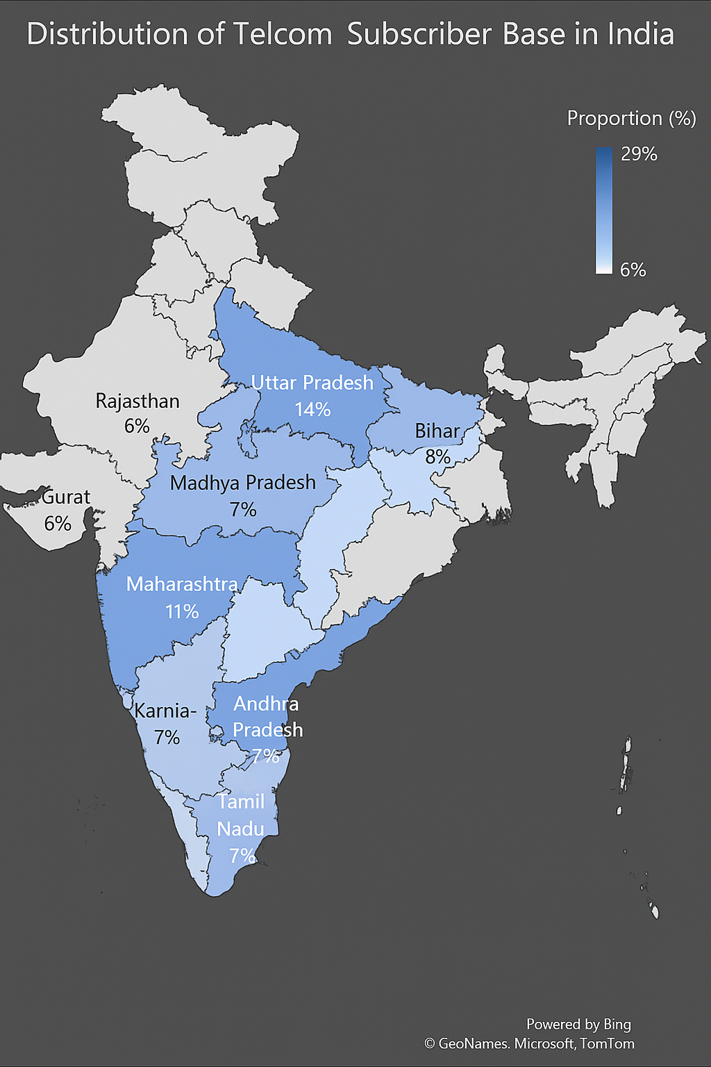
Telecom , Economic and Energy Geography of Indian States
IND
AGRI
AGRI
IND
AGRI
IND
TECH
TECH
TECH

Slide 15
Methodology
The study initially constructs a production block for 5G infrastructure scale up for India The production block included detailed investment inputs for the four elements of scaling up 5G infrastructure
i) Fibre cable deployment
ii) Passive infrastructure including towers
iii) Wi-Fi and inbuilding infrastructure
iv) Scaling up of Data centres
31st International Input Output conference , July 2025, Male, Maldives

Slide 16
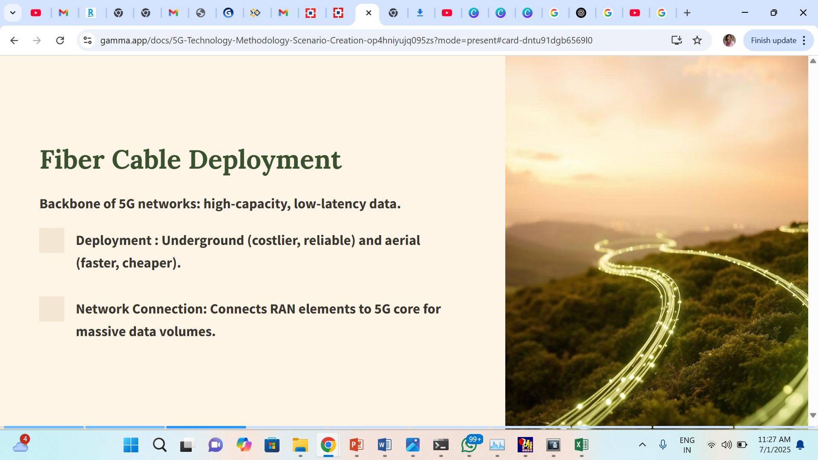
31st International Input Output conference , July 2025, Male, Maldives

Slide 17
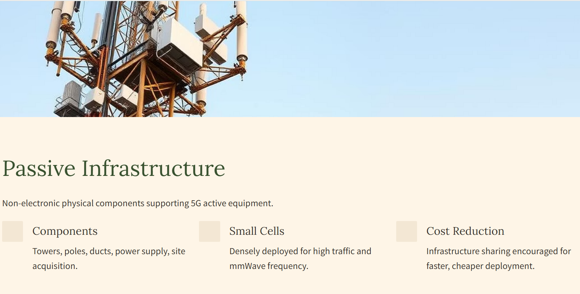
31st International Input Output conference , July 2025, Male, Maldives

Slide 18
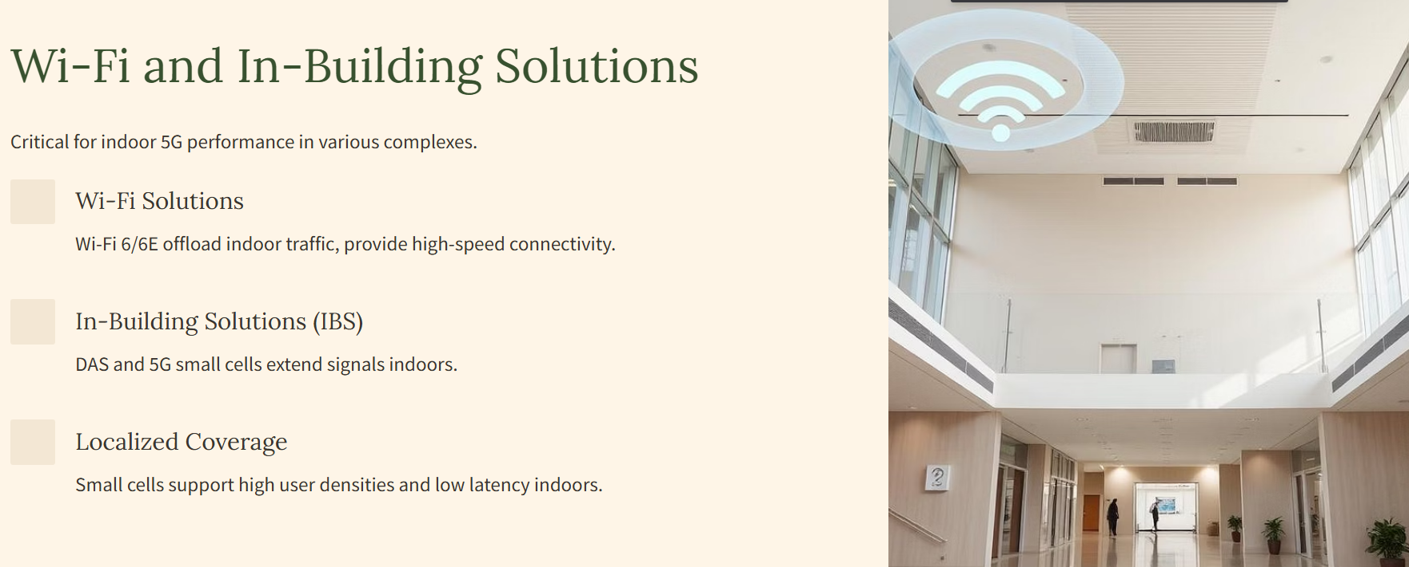
31st International Input Output conference , July 2025, Male, Maldives

Slide 19
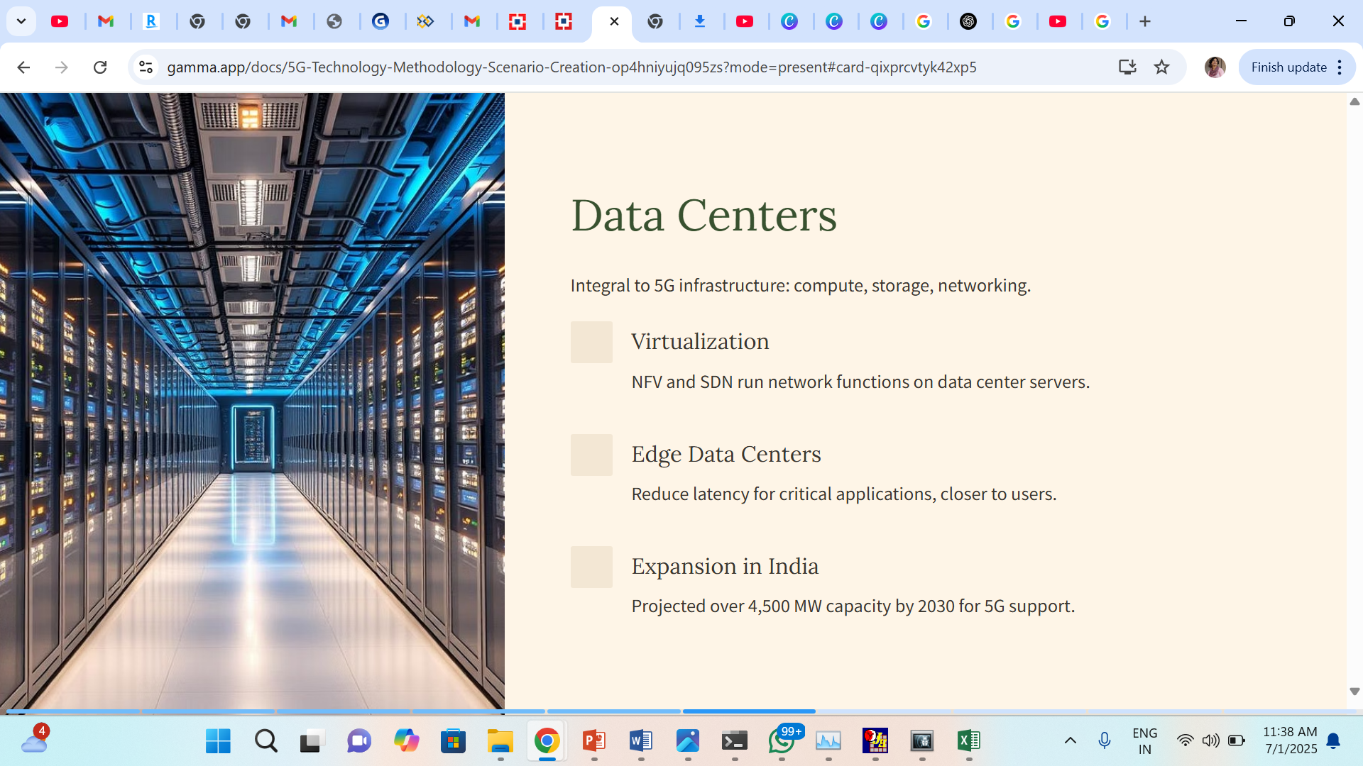
31st International Input Output conference , July 2025, Male, Maldives

Slide 20
5G infrastructure Production Block
 | Proportion (%) | Million INR | Sector
Fiber cable
Fiber Optic Cable Material | 25 | 336750 | Manufacture of electrical equipment
Civil Works | 47.5 | 639825 | construction
Installation Labor | 12.5 | 168375 | construction
Accessories & Equipment | 7.5 | 101025 | Manufacture of electrical equipment
Project Management & Misc. | 7.5 | 101025 | services
Passive Infrastructure
Site Acquisition & Permissions | 17.5 | 75432 | land lease
Tower Structure (Materials + Fabrication) | 32.5 | 140088 | Metal work
Civil Works & Foundation | 26 | 112070.4 | construction
Installation & Labor | 12.5 | 53880 | construction
Power Supply & Backup | 7.5 | 32328 | Electricity supply + electrical equipment
Miscellaneous (Fencing, Lighting, Safety) | 4 | 17241 | construction
31st International Input Output conference , July 2025, Male, Maldives

Slide 21
5G infrastructure Production Block
 | Proportion (%) | Million INR | Sector
WIFI and inbuilding infrastructure
Network Equipment | 45 | 18184 | Electrical equipment
Fiber Backbone and Cabling | 25 | 10102 | Electrical equipment
Installation and Labor | 17.5 | 7071 | construction
Power and Cooling | 7.5 | 3030 | electric supply and electrical equipment
Project Management & Misc. | 7.5 | 3030 | services
Data center
Electrical Systems | 42.5 | 26906 | electronic equipment
Civil Construction | 17.5 | 11079 | construction
Mechanical Systems | 12.5 | 7913 | Electrical equipment
Land Acquisition | 12.5 | 7913 | Services
Networking & Security | 7.5 | 4748 | electronic equipment
Other (Permits, Design) | 7.5 | 4748 | Services
31st International Input Output conference , July 2025, Male, Maldives

Slide 22
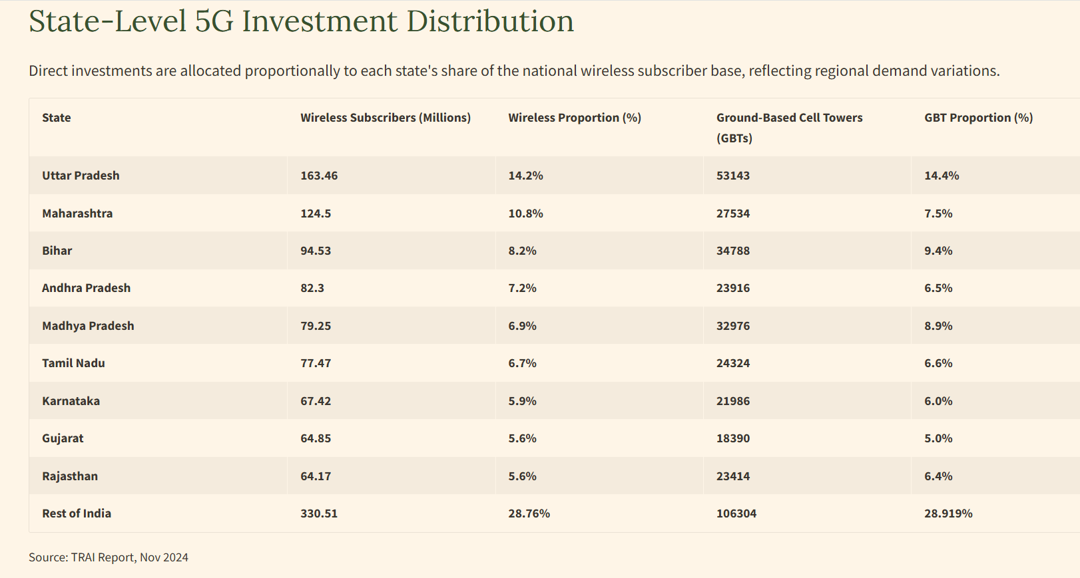
31st International Input Output conference , July 2025, Male, Maldives

Slide 24
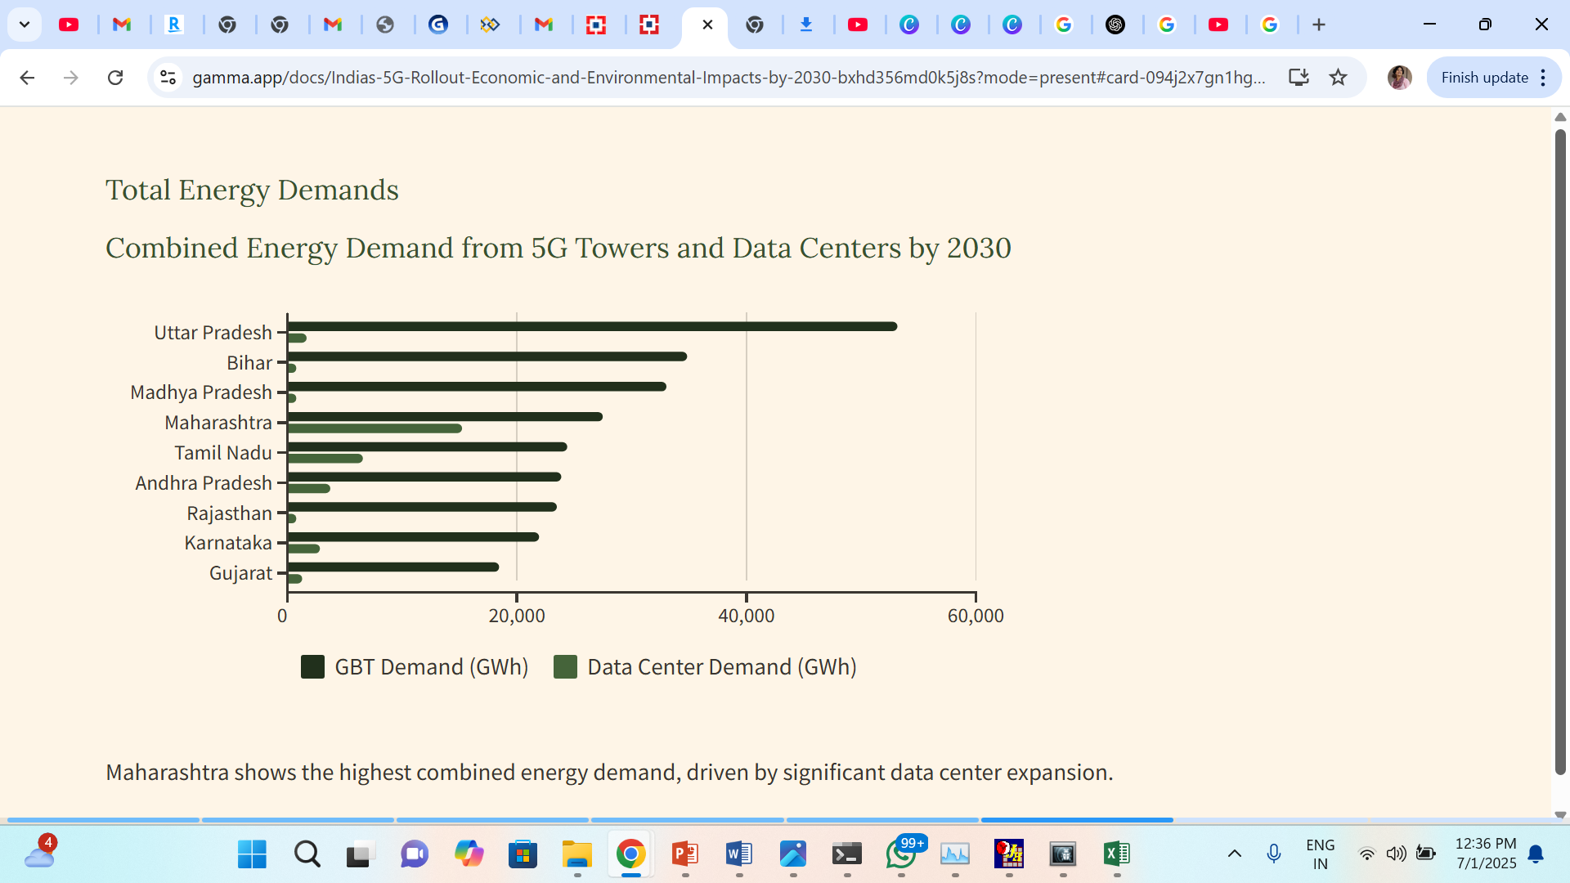
31st International Input Output conference , July 2025, Male, Maldives

Slide 25
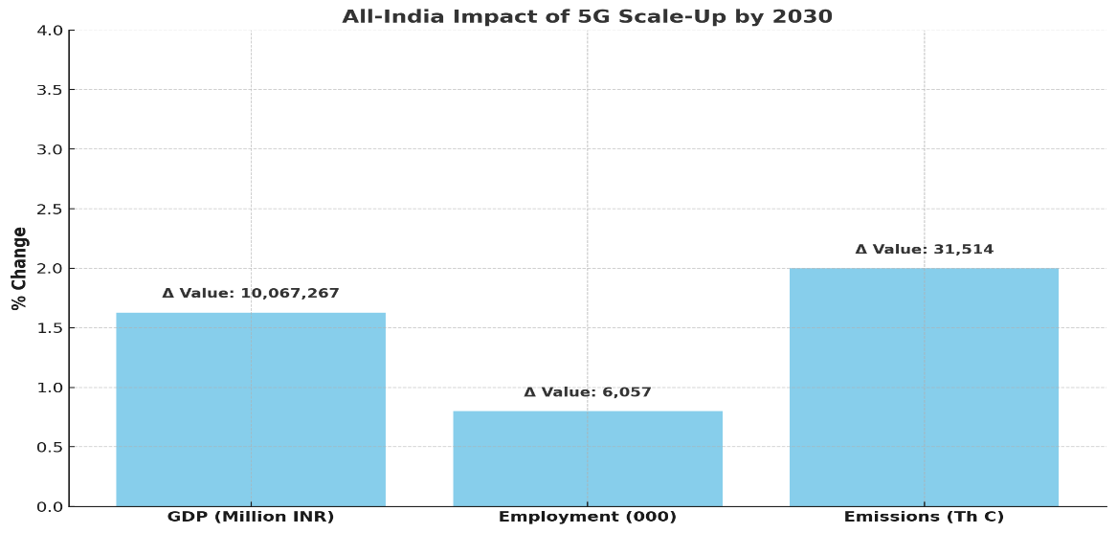
National-Level Impacts of 5G Scale-Up by 2030
1.63%
6.06M
2%
Jobs Created
GDP Increase
Carbon Emissions Increase
Employment projected to rise by 0.8% nationally.
Amounting to INR 10.07 trillion in real value gain.
Equivalent to approximately 31.5 million tonnes of carbon (MtC).
31st International Input Output conference , July 2025, Male, Maldives

Slide 26
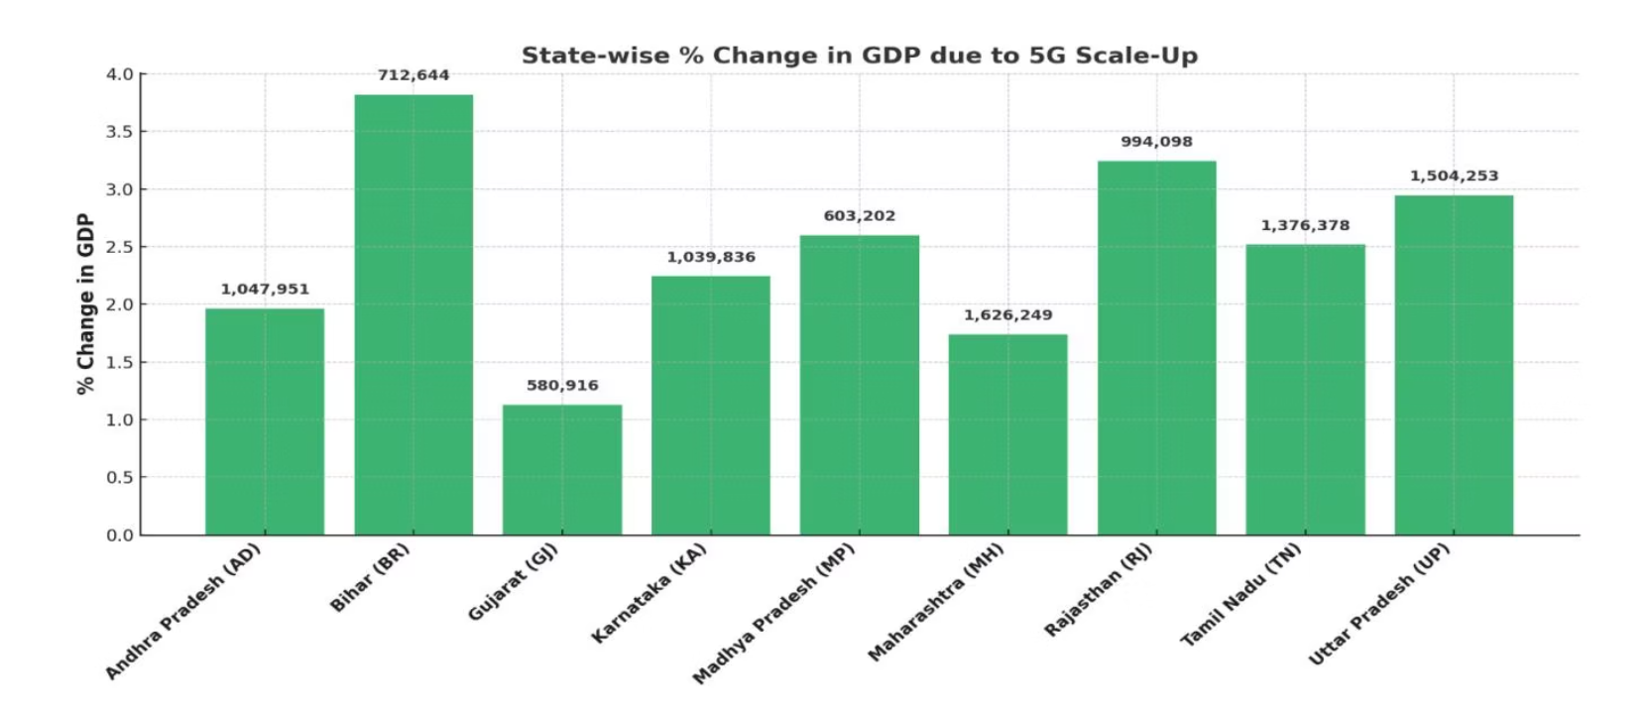
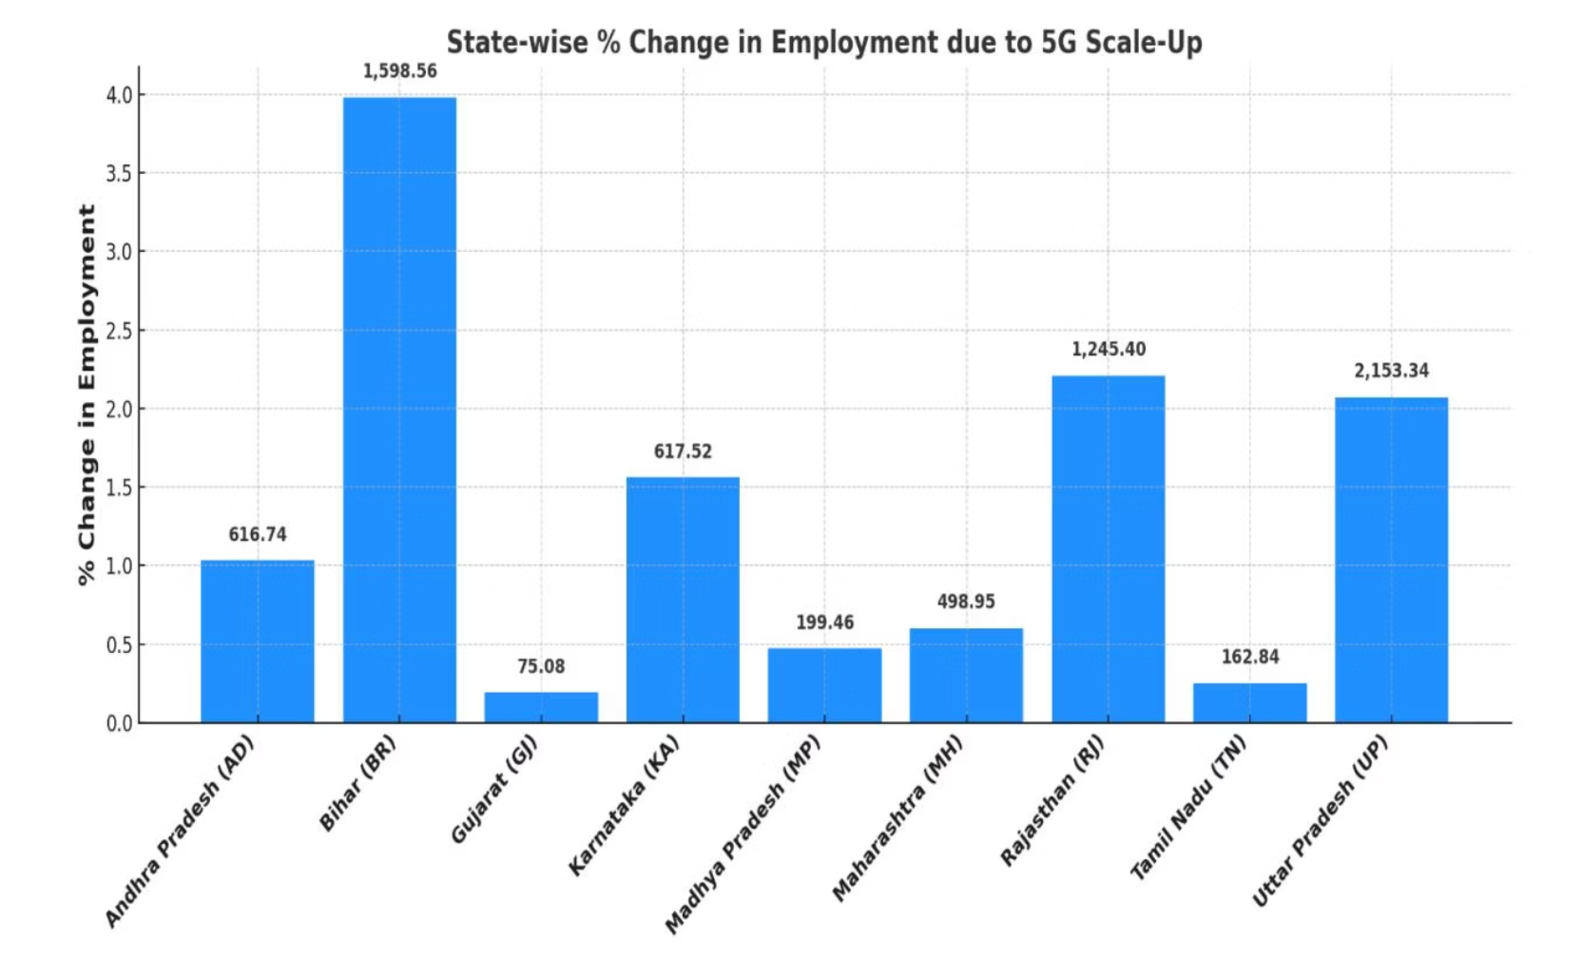
State-Level Impacts: GDP, Employment, and Emissions
Agrarian states (Bihar, UP, MP) show high GDP percentage increases due to lower economic baselines. Industrial (Gujarat, Maharashtra, Rajasthan) and Tech-oriented (AP, Karnataka, TN) states have higher absolute GDP gains.
Bihar, UP, and Rajasthan lead in job creation (over 5 million new jobs) due to labour-intensive economies. Emissions increase significantly in states with fossil-fuel-dominated grids like Bihar (13.4% increase), while states with higher renewable energy integration show cleaner growth.
31st International Input Output conference , July 2025, Male, Maldives

Slide 27
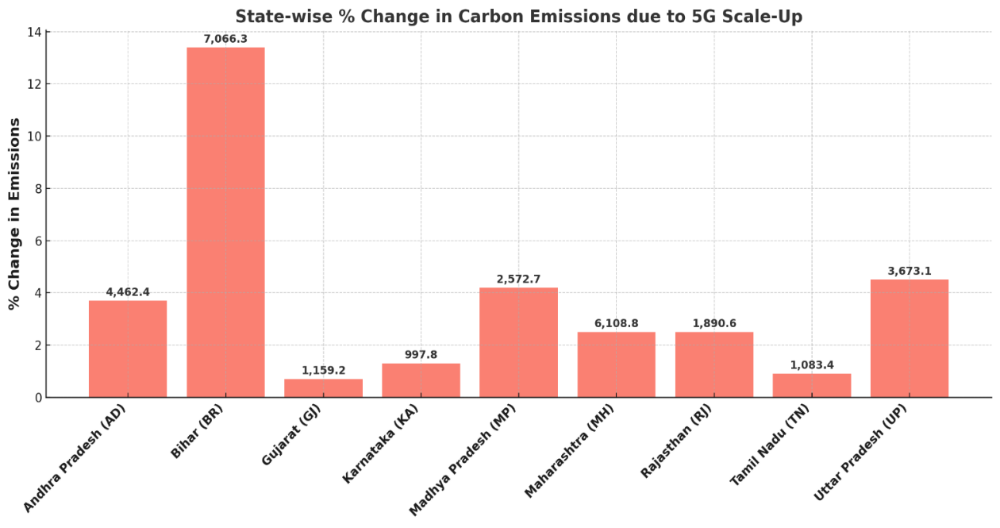
31st International Input Output conference , July 2025, Male, Maldives

Slide 28
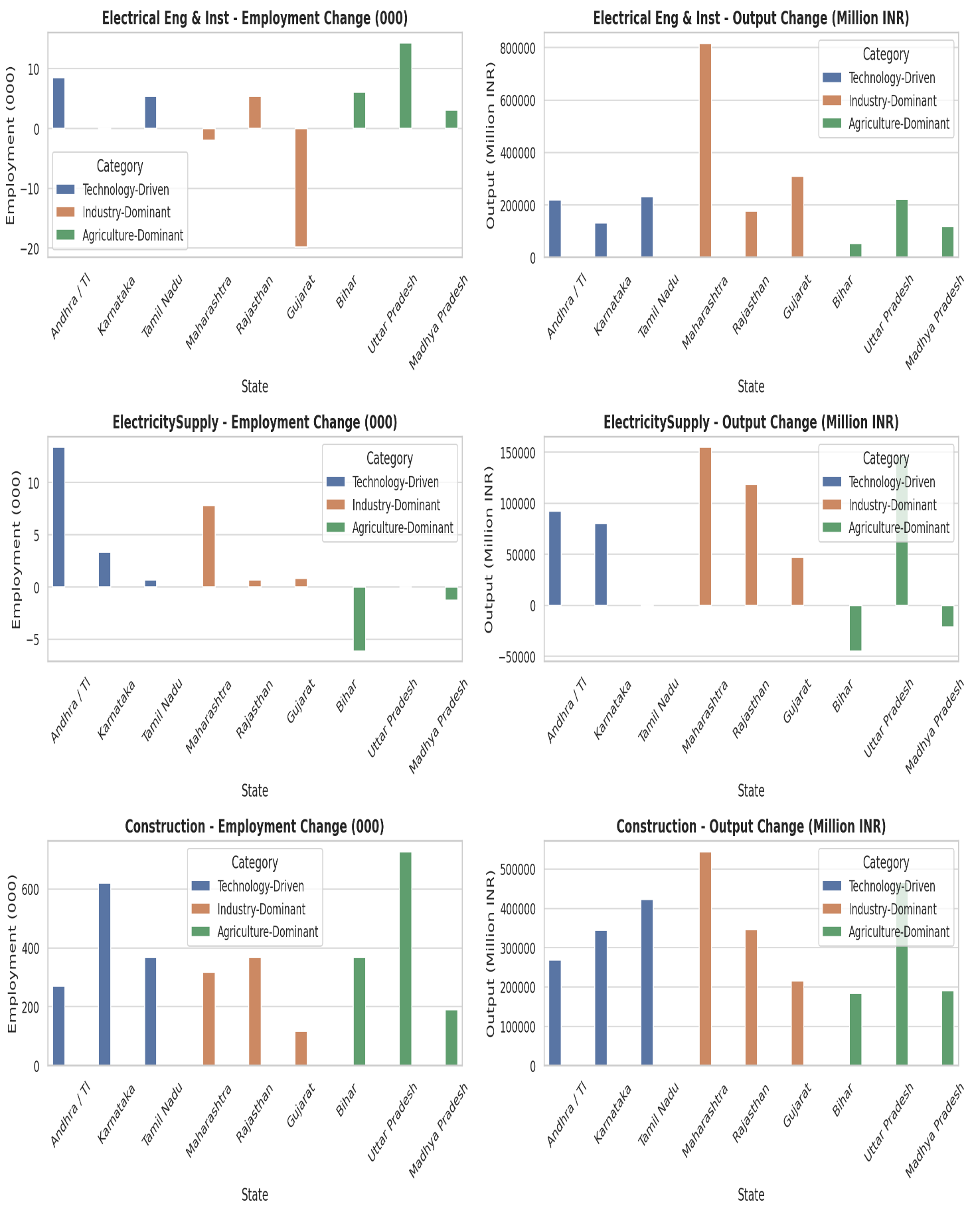
Direct Impacts: Sectoral Output and Employment
Electrical Engineering & Instrumentation
High output, low employment growth (e.g., Maharashtra, Gujarat) driven by capital-intensive automation. Moderate output, notable employment gains in states like Andhra Pradesh & Telangana, Uttar Pradesh, and Tamil Nadu, suggesting a more balanced industrial structure.
Electricity Supply
Positive output and employment in states with grid modernization and RE integration (e.g., Rajasthan, Maharashtra). Declines in Bihar and Madhya Pradesh due to legacy fossil fuel grids and external power procurement.
Construction
Consistent employment engine across all states, especially Uttar Pradesh (~728,000 jobs), Karnataka, Bihar, and Tamil Nadu. Significant output gains underpinning the physical rollout of 5G infrastructure (towers, fiber networks, data centers).
31st International Input Output conference , July 2025, Male, Maldives

Slide 29
SECTOR-SPECIFIC IMPACTS
Indirect Effects High Technology States
Sector/State | Total change in employment (000) | total change In output (Million INR
Basic Metals | 6.55 | 635686.4
Trade and logistics | -1.30 | 619682.2
Electrical Eng & Inst | 15.36 | 583272.8
Oth. Business Serv. | 67.59 | 465459.4
Motor Vehicles | -16.80 | 362093.9
Other Manufacturing | -115.04 | 339901.1
Chemicals | -3.90 | 318774.7
High-Technology States
Basic Metals: High output gain, but employment decline due to automation.
Trade & Logistics: Strong output growth but significant job losses from AI and digital warehousing.
Other Business Services: Balanced growth in output and employment from IT-enabled services.
31st International Input Output conference , July 2025, Male, Maldives

Slide 30
SECTOR-SPECIFIC IMPACTS
Indirect Effects Industrial States
Sector/State | Change in Emp (000) | Change in output (M INR)
Motor Vehicles | -47.92 | 609798.3
Other Manufacturing | 6.55 | 418298.3
Trade and logistics | -1.30 | 417496.7
Electronics | 15.36 | 404581.7
Oth. Business Serv. | 67.59 | 362073.9
Basic Metals | -16.80 | 354685.3
ElectricitySupply | -115.04 | 320510.8
Metal Goods | -3.90 | 278228.3
Industrial States
Motor Vehicles: Highest output gain with marginal employment decline due to automation.
Other Manufacturing: Strong output and net employment gains from smart production environments.
Trade & Logistics: High output increase but massive job loss due to digital logistics.
31st International Input Output conference , July 2025, Male, Maldives

Slide 31
SECTOR-SPECIFIC IMPACTS
Indirect Effects Agrigarian States
Sector/State | Total change in employment (000) | total change In output (Million INR )
Basic Metals | -6.2 | 455577
Trade and logistics | -554.7 | 384333
Motor Vehicles | -5.9 | 353960
Oth. Business Serv. | 38.7 | 324639
Other Manufacturing | 15.5 | 261997
Chemicals | 11.0 | 226411
Metal Goods | 7.7 | 214434
Electronics | 4.3 | 207784
Agriculture etc | -47.9 | 118588
Agrarian States
Basic Metals: Output growth but employment contraction from technology-driven processes.
Trade & Logistics: Substantial output growth, but dramatic job losses due to automation in traditional logistics.
Agriculture: Output increase but employment decline, signaling gains from mechanization.
31st International Input Output conference , July 2025, Male, Maldives

Slide 32
Conclusions
5G Expansion infrastructure expansion in India by 2030 will lead to
Economic Impact by 2030
• GDP Increase: ~1.63% nationally by 2030
• Job Creation: ~6 million new jobs
• Heterogeneous Impacts across sectors and state
Regional Differentiation
Agrarian States (Bihar, UP, MP): High employment in construction & manufacturing, Output gains in underdeveloped industries along with a need for rural workforce transition from agriculture
Industrial States (Gujarat, Maharashtra, Rajasthan): Capital-intensive growth in Auto, Electronics, Automation offsets job creation, Gains from upstream-downstream sectoral linkages
Tech-Heavy States (AP & Telangana, Tamil Nadu, Karnataka): Strong growth in IT & Business Services
with labor restructuring in logistics & automotive. The transition is driven by skill-biased technological change
Environmental Trade-Off
2% increase in CO₂ emissions projected by 2030
Clean energy alignment essential to mitigate emissions
Gujarat & Tamil Nadu show viable RE integration models
31st International Input Output conference , July 2025, Male, Maldives

Slide 33
Key Policy recommendations for a Balanced and green 5G infrastructure Rollout
1. Workforce Reskilling & Sectoral Support for sectors like logistics, manufacturing and construction
Reskill labor in logistics, manufacturing, and construction
2. Decarbonize Digital Infrastructure with a policy push and green mandates for RE-sourced telecom towers and data centers along with strategic investments in smart grids and energy storage systems
3. Strengthening Value Chains which support backward and forward linkages across the economy with respect to 5 G roll out .
4. There is a need for states to roll out policies enabling Regional Development Frameworks on the basis of existing potential for e.g .
Agrarian States: Rural digital infrastructure & services
Industrial States: Smart & green manufacturing
Tech States: Anchor digital exports and service value chains
5. Policy incentives to boost Digital Services Ecosystem that Scale AI, IoT, Cloud, Smart Logistics via:
✔ Startup support,
✔ Public-Private Partnerships,
✔ Interoperable digital platforms
31st International Input Output conference , July 2025, Male, Maldives

Slide 34
Thank You !
31st International Input Output conference , July 2025, Male, Maldives

