Slide 1

Comprehensive Structural Decomposition Analysis of CO₂ Emissions from Vessels: Case Study of Japan
〇Taiga SHIMOTSUURA
Graduate School of Economics, Kyushu University, Japan
Notes:
Hello, everyone. / I’m Taiga SHIMOTSUURA / from Kyushu University, / Japan.
Today, I will make a presentation / entitled “Comprehensive Structural Decomposition Analysis /
of CO2 Emissions from Vessels: / Case Study of Japan.”
(20 sec.)

Slide 2






1. Introduction
01
02
03
40 %
LNG
NH₃
H₂
Bio
About 40% of domestic transport is carried out by sea.
Japan aims to achieve a 17% reduction by 2030
compared to 2013 level.
Zero-emission vessels are key contributors to achieving these goals.
Notes:
To begin with, / I’d like to share / the background of maritime transport in Japan.
First, / about 40% / of domestic transport / is carried out by sea, / indicating the importance /
of shipping sector / to the Japanese economy.
Second, / from an environmental perspective, / Japanese maritime transport aims to achieve a 17% reduction by 2030 / compared to 2013 levels.
However, / with a reduction rate of only about 5% by 2022, / this target is ambitious / given the short timeframe, /
and further CO₂ reduction measures / should be introduced.
Therefore, / zero-emission vessels / using these alternative fuels / are gaining attention / as key contributors / to achieving these goals.
(1 min. 5 sec.)

Slide 3
1. Introduction
01
02
03
40 %
6
LNG
NH₃
H₂
Bio
About 40% of domestic transport is carried out by sea.
Japan aims to achieve a 17% reduction by 2030
compared to 2013 level.
Zero-emission vessels are key contributors to achieving these goals.
Problem to be solved in this study
While much attention is given to the reduction potential of these vessels in operation, lifecycle assessment (LCA) perspective has been overlooked.
Notes:
However, / the problem is that / while much attention is given to the reduction potential / of these vessels in operation, / one important aspect /
the life cycle assessment, / LCA has been overlooked.
This is a problem to be solved in this study because / the LCA perspective comprehensively considers the rapid introduction of these new vessels /
and the early disposal of existing vessels, / before they even reach / the end of their service life.
(35 sec.)

Slide 4
1. Introduction
A product LCA model can assess the environmental impact by considering the entire lifecycle, from raw material extraction to end-of-life.
This model can set scenarios for the average lifespan.
Focusing on the average lifespan, the mechanism of changes in lifecycle impact can be identified.
No studies analyzed comprehensive interrelationships between lifecycle stages.
Notes:
A product LCA model can analyze the environmental impact / by considering the entire lifecycle, / from raw material extraction to end-of-life like this figure.
In addition, / this model can set scenarios for the average lifespan.
Focusing on the average lifespan, / the mechanism of changes in lifecycle impact can be identified /
because the average lifespan determines the flow at the end of life, /
and subsequently, / it affects the demand for new vessels, / processing, / and raw material.
However, / no studies have analyzed comprehensive interrelationships between lifecycle stages.
(50 sec.)

Slide 5

1. Introduction – Literature review
Decomposition analysis has the potential to reveal the interrelationships across lifecycle stages, as it quantitatively measures the impact of predetermined factors.
Two most widely used decomposition analyses (Hoekstra and van der Bergh, 2003)
Index Decomposition Analysis (IDA)
Structural Decomposition Analysis (SDA)
IDA quantifies direct effects based on relatively simple methods and datasets.
The main focus was on operational phase.
      No studies attempted to compare the contributions of operational factors with those of other lifecycle stages.
SDA quantitatively measures direct and indirect impact using IO tables.
Contributions of both supply- and demand-related factors were analyzed.
      No studies attributed the factors’ contributions to lifecycle stages.
Notes:
Decomposition analysis has the potential / to reveal the interrelationships / across lifecycle stages, / as it quantitatively measures / the impact of predetermined factors.
The two most widely used decomposition analyses / are Index decomposition analysis, / IDA, / and Structural decomposition analysis, / SDA.
The IDA quantifies direct effects / based on relatively simple methods / and datasets.
In the context of maritime transport, / existing IDA studies / have mainly focused on the operational phase.
Therefore, / no studies / have attempted to compare / the contributions of operational factors / with those of other lifecycle stages.
In contrast, SDA quantitatively measures direct and indirect impact using IO tables.
In the field of maritime transport, /SDA has been used / to analyze the contributions of both supply- / and demand-related factors.
However, / no studies have attributed / the factors’ contributions / to specific lifecycle stages.
(1 min. 35 sec.)

Slide 6
1. Introduction – Literature review
Decomposition analysis has the potential to reveal the interrelationships across lifecycle stages, as it quantitatively measures the impact of predetermined factors.
Two most widely used decomposition analyses (Hoekstra and van der Bergh, 2003)
Index Decomposition Analysis (IDA)
Structural Decomposition Analysis (SDA)
IDA quantifies direct effects based on relatively simple methods and datasets.
The main focus was on operational phase.
      No studies attempted to compare the contributions of operational factors with those of other lifecycle stages.
SDA quantitatively measures direct and indirect impact using IO tables.
Contributions of both supply- and demand-related factors were analyzed.
      No studies attributed the factors’ contributions to lifecycle stages.
This study develops a comprehensive SDA across different vessel lifecycle stages to clarify both the interrelationships among these stages and how the efforts of key stakeholders at each stage influence changes in CO₂ emissions.
Notes:
To overcome these gaps, / this study develops a comprehensive SDA / across different vessel lifecycle stages /
to clarify both the interrelationships among these stages / and how the efforts / of key stakeholders at each stage / influence the changes in CO2 emissions.
(25 sec.)

Slide 7
1. Introduction – Research objectives
Research objective
This study aims to develop a comprehensive structural decomposition analysis (SDA) to quantitatively compare impact of lifespan changes with other effects.
Analytical framework of this study
Stock-flow model analysis
To estimate the number of vessels newly manufactured and requiring repairs as the average lifespan varies.
Carbon footprint (CF) estimation
Comprehensive SDA
CF includes emissions from all processes excluding end-of-life.
To compare the impact of lifespan changes with that of other factors.
Notes:
So, / the research objective of this study is / to develop a comprehensive structural decomposition analysis / SDA /
to quantitatively compare the impact of lifespan changes with other effects.
The analytical framework of this study is as follows:
First, / stock-flow model analysis was employed / to estimate the number of vessels / newly manufactured and requiring repairs / as the average lifespan varies.
Second, / carbon footprint, / including emissions from all processes, / from manufacturing through maintenance, / but excluding end-of-life was estimated.
Finally, / a comprehensive SDA was conducted / to compare the impact of lifespan changes with that of other factors.
(1 min.)

Slide 8

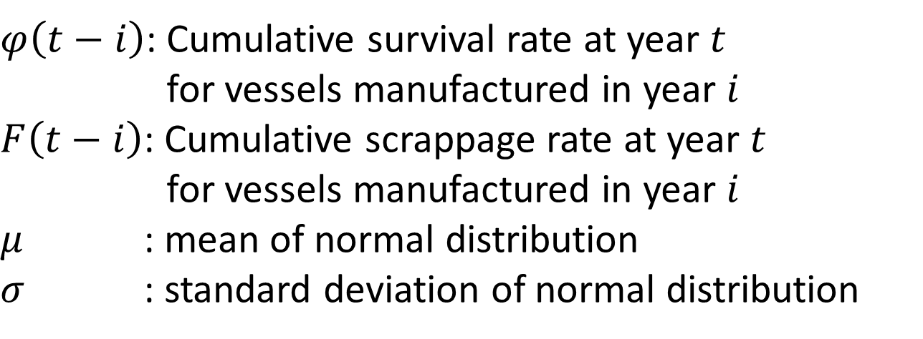
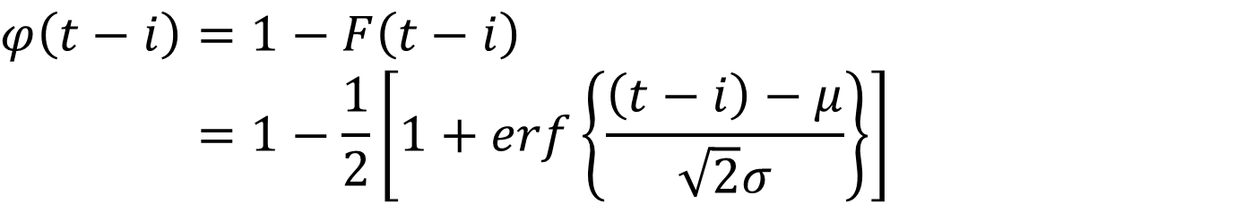
2. Methodology – Stock-flow model analysis
The cumulative survival rate at year $t$ for vessels manufactured in year $i$ follows the normal distribution function (Shimotsuura, 2024).
$$φ\left(t−i\right)=1−F\left(t−i\right) \\ φ\left(t−i\right)=1−\frac{1}{2}\left[1+erf\left\{\frac{\left(t−i\right)−μ}{\sqrt{2}σ}\right\}\right]$$
Cumulative survival rate
$$(1)$$
$φ\left(t−i\right)$: Cumulative survival rate at year $t$
$φ\left(t−i\right)$: for vessels manufactured in year $i$
$F\left(t−i\right)$: Cumulative scrappage rate at year $t$
$φ\left(t−i\right)$: for vessels manufactured in year $i$
$μ$ : mean of normal distribution
$σ$ : standard deviation of normal distribution
Notes:
So, / I’d like to briefly explain the methodology.
First, / I’d like to explain / stock-flow model analysis.
Based on the previous study, / the cumulative survival rate at year $t$ / for vessels manufactured in year $i$ / is assumed / to follow the normal distribution function / in this study.
Equation (1) and the righthand figure represent the cumulative survival rate.
Here, $φ\left(t−i\right)$ represents cumulative survival rate at year 𝑡 for vessels manufactured in year 𝑖, $F\left(t−i\right)$ is cumulative scrappage rate at year 𝑡 for vessels manufactured in year 𝑖.
$μ$ and $σ$ are the mean and standard deviation of normal distribution, respectively.
(1 min. 10 sec.)

Slide 9
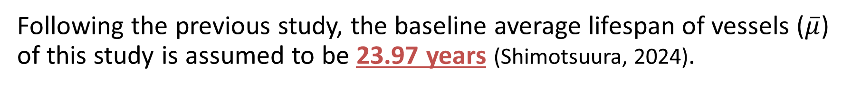
2. Methodology – Stock-flow model analysis
The cumulative survival rate at year $t$ for vessels manufactured in year $i$ follows the normal distribution function (Shimotsuura, 2024).
$$φ\left(t−i\right)=1−F\left(t−i\right) \\ φ\left(t−i\right)=1−\frac{1}{2}\left[1+erf\left\{\frac{\left(t−i\right)−μ}{\sqrt{2}σ}\right\}\right]$$
Cumulative survival rate
$$(1)$$
$φ\left(t−i\right)$: Cumulative survival rate at year $t$
$φ\left(t−i\right)$: for vessels manufactured in year $i$
$F\left(t−i\right)$: Cumulative scrappage rate at year $t$
$φ\left(t−i\right)$: for vessels manufactured in year $i$
$μ$ : mean of normal distribution
$σ$ : standard deviation of normal distribution
Following the previous study, the baseline average lifespan of vessels ($\overline{μ}$) of this study is assumed to be 23.97 years (Shimotsuura, 2024).
Notes:
Following the previous study, the baseline average lifespan of vessels ($\overline{μ}$) of this study is assumed to be approximately 24 years.
(15 sec.)

Slide 10

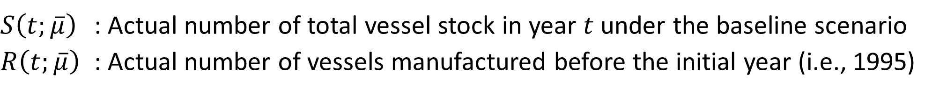
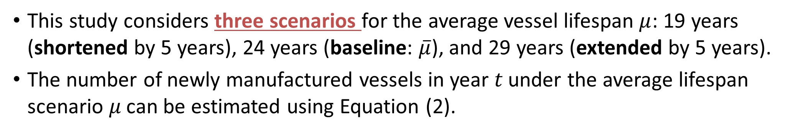
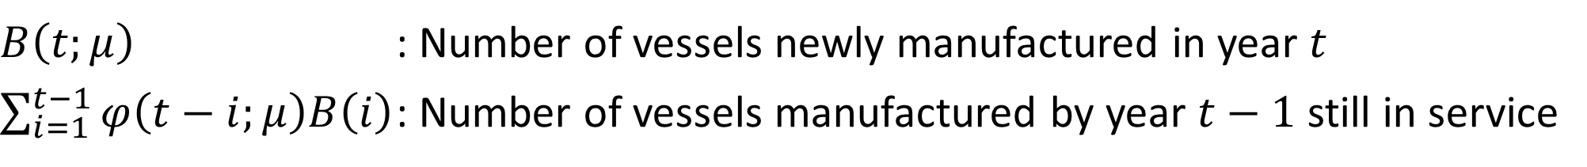
2. Methodology – Stock-flow model analysis
This study considers three scenarios for the average vessel lifespan $μ$: 19 years (shortened by 5 years), 24 years (baseline: $\overline{μ}$), and 29 years (extended by 5 years).
The number of newly manufactured vessels in year 𝑡 under the average lifespan scenario 𝜇 can be estimated using Equation (2).
$$\begin{aligned}B\left(t;μ\right)=S\left(t;\overline{μ}\right)−\sum_{i=1}^{t−1}{φ\left(t−i;μ\right)B\left(i\right)}−R\left(t;\overline{μ}\right)\#\end{aligned}$$
$$\begin{aligned}\left(2\right)\end{aligned}$$
Variables different depending on the average lifespan scenario
$B\left(t;μ\right)$ : Number of vessels newly manufactured in year $t$
$\sum_{i=1}^{t−1}{φ\left(t−i;μ\right)B\left(i\right)}$ : Number of vessels manufactured by year $t−1$ still in service
Fixed variables across the average lifespan scenarios
$S\left(t;\overline{μ}\right)$ : Actual number of total vessel stock in year $t$ under the baseline scenario
$R\left(t;\overline{μ}\right)$ : Actual number of vessels manufactured before the initial year (i.e., 1995)
Notes:
To measure the impact of lifespan changes, / this study considers three scenarios / for the average vessel lifespan 𝜇, /
which are 19 years, / that is shortened lifespan by 5 years, / the baseline average lifespan of 24 years, / $\overline{μ}$, / and 29 years, / that is extended lifespan by 5 years.
The number of newly manufactured vessels in year 𝑡 / under the average lifespan scenario 𝜇 / can be estimated using Equation (2).
Here, / $S\left(t;\overline{μ}\right)$ and $R\left(t;\overline{μ}\right)$ / are fixed variables / across the average lifespan scenarios.
Specifically, / $S\left(t;\overline{μ}\right)$ represents / the actual number of total vessel stock in year $t$ / under the baseline scenario, /
while $R\left(t;\overline{μ}\right)$ is the actual number of vessels / manufactured before the initial year, / which is 1995 in this study.
In contrast, / $B\left(t;μ\right)$ and the remaining component / are scenario-dependent variables.
Specifically, / $B\left(t;μ\right)$ indicates the number of vessels / newly manufactured in year $t$, /
and this part / denotes the number of vessels / manufactured by year $t−1$ / that remain in operation.
(2 min. 05 sec.)

Slide 11
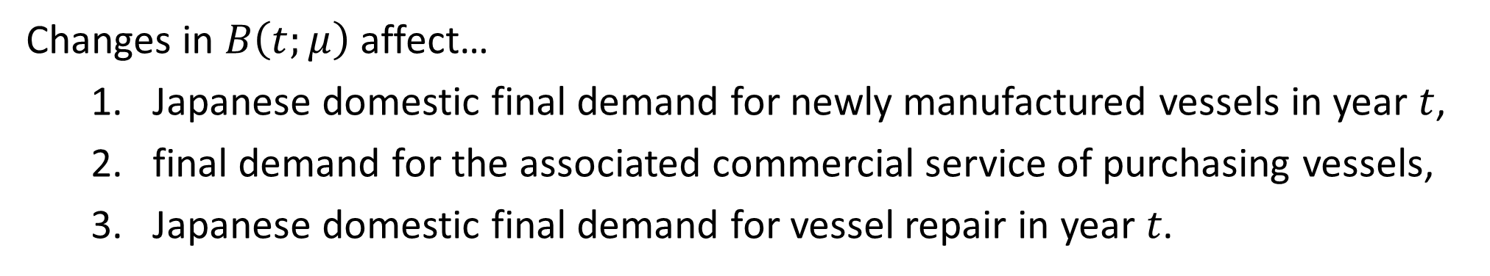
2. Methodology – Stock-flow model analysis
This study considers three scenarios for the average vessel lifespan $μ$: 19 years (shortened by 5 years), 24 years (baseline: $\overline{μ}$), and 29 years (extended by 5 years).
The number of newly manufactured vessels in year 𝑡 under the average lifespan scenario 𝜇 can be estimated using Equation (2).
$$\begin{aligned}B\left(t;μ\right)=S\left(t;\overline{μ}\right)−\sum_{i=1}^{t−1}{φ\left(t−i;μ\right)B\left(i\right)}−R\left(t;\overline{μ}\right)\#\end{aligned}$$
$$\begin{aligned}\left(2\right)\end{aligned}$$
Variables different depending on the average lifespan scenario
$B\left(t;μ\right)$ : Number of vessels newly manufactured in year $t$
Changes in $B\left(t;μ\right)$ affect…
    Japanese domestic final demand for newly manufactured vessels in year $t$,
    final demand for the associated commercial service of purchasing vessels,
    Japanese domestic final demand for vessel repair in year 𝑡.
Notes:
This changes in $B\left(t;μ\right)$ / affect Japanese domestic final demand / for newly manufactured vessels in year $t$, /
final demand for the associated commercial service / of purchasing vessels, /
and Japanese domestic final demand / for vessel repair in year 𝑡.
(30 sec.)

Slide 12


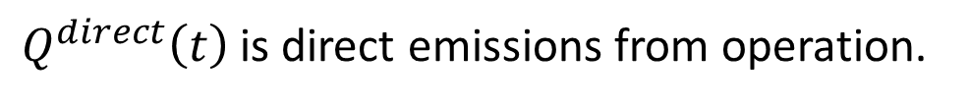
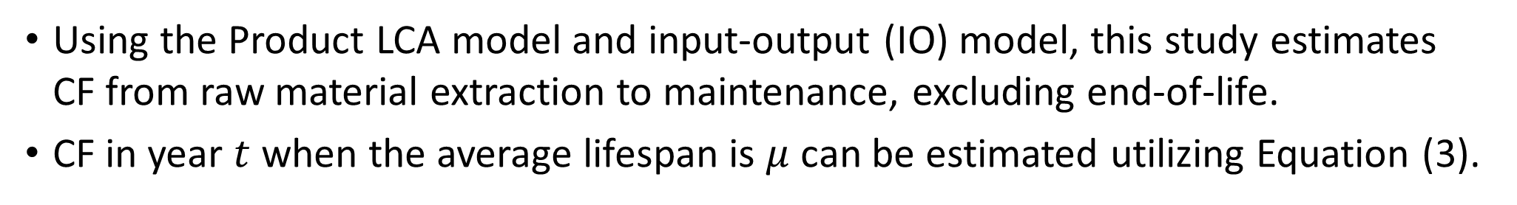
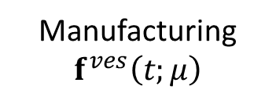


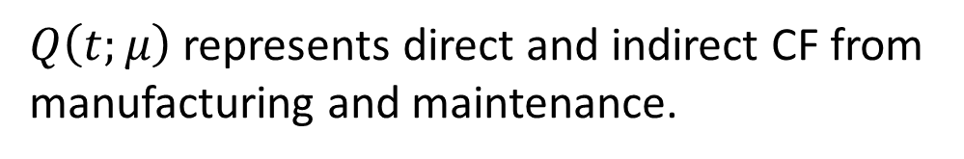
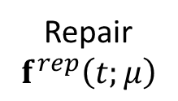
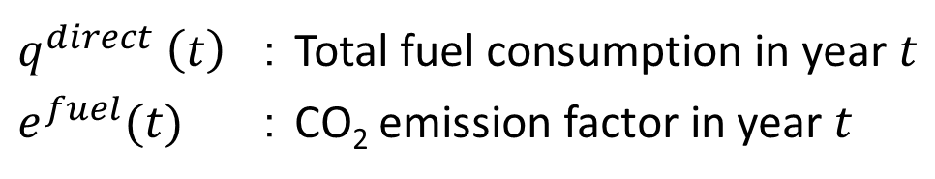
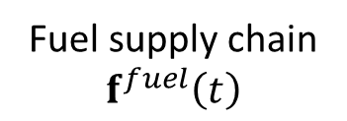
2. Methodology – Carbon footprint (CF) estimation
Using the Product LCA model and input-output (IO) model, this study estimates CF from raw material extraction to maintenance, excluding end-of-life.
CF in year $t$ when the average lifespan is $μ$ can be estimated utilizing Equation (3).
$$CF\left(t;μ\right)=Q\left(t;μ\right)+Q^{direct}(t)$$
$$\begin{aligned}\#\#\#\#\#\#\#\#\#\#\#(3)\end{aligned}$$
$Q\left(t;μ\right)$represents direct and indirect CF from manufacturing and maintenance.
$Q^{direct}\left(t\right)$is direct emissions from operation.
$$\begin{aligned}Q^{direct}\left(t\right)=q^{direct}(t)e^{fuel}(t)\#\end{aligned}$$
$$\begin{aligned}Q\left(t;μ\right)=e\left(t\right)L\left(t\right)f\left(t;μ\right)\#\#\end{aligned}$$
$q^{direct} \left(t\right)$ ：Total fuel consumption in year $t$
$e^{fuel}(t)$ ：CO₂ emission factor in year $t$
+
+
Manufacturing
$$f^{ves}\left(t;μ\right)$$
Fuel supply chain
$$f^{fuel}\left(t\right)$$
Repair
$$f^{rep}\left(t;μ\right)$$
Operation
Notes:
This slide explains / how to estimate / carbon footprint.
Using the Product LCA model and IO model, / this study estimates carbon footprint from raw material extraction to maintenance, /
excluding end-of-life.
Carbon footprint in year $t$ / when the average lifespan is $μ$ / can be estimated using Equation (3).
This part represents / direct and indirect carbon footprint / induced by vessel manufacturing, / fuel supply chain, / and vessel repairing.
And this part indicates direct emissions from operation, / calculated by multiplying total fuel consumption / by the direct CO2 emission factor.
In this model, / varying the average lifespan $μ$ allows for estimating the carbon footprint / under different lifespan scenarios.
(1 min. 10 sec.)

Slide 13
2. Methodology – Structural decomposition analysis (SDA)
This study develops a comprehensive SDA method to quantitatively compare the impact of each factor at different stages of the vessel lifecycle.
The comprehensive SDA method combines SDA-based decomposition and IDA-based decomposition.
Manufacturing: SDA-based
Repair: SDA-based
Operation
Direct emissions: IDA-based
Fuel supply chain: SDA-based
Notes:
This slide explains SDA developed in this study.
This study develops / a comprehensive SDA method / to quantitatively compare the impact of each factor / at different stages of the vessel lifecycle.
The comprehensive SDA method / combines SDA-based decomposition / and IDA-based decomposition.
Basically, / SDA-based decomposition is applied / to vessel manufacturing, / maintenance, / and fuel supply chain / induced by vessel operations, /
while IDA-based decomposition / is applied to direct emissions from vessels.
(50 sec.)

Slide 14







2. Methodology – Structural decomposition analysis (SDA)
Using the Logarithmic mean divisia index (LMDI), CF can be decomposed into the following 12 factors (Ang and Liu, 2007; Wood and Lenzen, 2006).
Notes:
More specifically, using the LMDI, / carbon footprint can be decomposed into the following 12 factors.
First, / carbon footprint can be broken down into the effect of emission intensity, / Leontief inverse, / final demand, / and direct emissions.
Then, the final demand can be further decomposed into demand for new vessels, / fuel type A, / fuel type C, / and vessel repair.
Direct emissions can also be further decomposed into the number of vessels in the fleet stock, / average distance, / average cargo tonnage, /
load factor, / fuel efficiency, / and carbon intensity.
(55 sec.)

Slide 15
2. Methodology – Structural decomposition analysis (SDA)
Using the Logarithmic mean divisia index (LMDI), CF can be decomposed into the following 12 factors (Ang and Liu, 2007; Wood and Lenzen, 2006).
Production
Consumption
Repair
Activity
Notes:
These 12 factors are classified into these four categories based on the Product LCA model: /
Production effect, / Consumption effect, / Maintenance effect, / and Activity effect.
(15 sec.)

Slide 16
3. Data
Japanese IO table
Matsushima et al. (2024) Economic Systems Research 36 (3) pp. 337-352.
is utilized to obtain the linked Japanese IO table for 2005-2011-2015.
Japanese IO tables for 2005, 2011, and 2015 published by Japanese government
are utilized to obtain data for commercial and transport margins for each year.
Activity data on domestic maritime transport
Shipbuilding and machinery statistics survey published by Japanese government
is utilized to obtain the average price of vessel manufacturing and repair.
Domestic shipping activity data published by Japanese government
provides total fuel consumption, transport activity, and fuel prices.
Embodied energy and emission intensity data (3EID)
for Japan using input-output tables is employed to estimate the average
embodied emissions for manufacturing one unit of container ship in 2015.
Notes:
This slide briefly introduces / the data used in this study.
For the Japanese IO table, / the linked IO table / developed by Matsushima et al. (2024) / using GRAS method for the years of 2005, 2011, and 2015 is employed.
Additionally, / Japanese IO tables / published by Japanese government / are used to obtain commercial / and transport margins for each year.
For activity data on domestic maritime transport, / shipbuilding and machinery statistics survey / and domestic shipping activity data / both published by Japanese government are used to obtain the average price of vessel manufacturing and repair, as well as total fuel consumption, transport activity, and fuel prices, respectively.
Embodied energy and emission intensity data, / 3EID / is used to estimate the average embodied emissions / for manufacturing one unit of container ship / in 2015.
(1 min. 20 sec.)

Slide 17
4. Results – Carbon footprint (CF) under various lifespan scenarios
Average lifespan: 19 years
Shortening the lifespan contributed to an increase of 3.5 Mt-CO₂, equivalent to 34% of annual CF in 2022.
Average lifespan: 24 years
Extending the lifespan contributed to CF mitigation by 2.5 Mt-CO₂, equivalent to 24% of annual CF in 2022.
Average lifespan: 29 years
Notes:
From this slide, / I’d like to briefly explain the results of this study.
This figure illustrates the changes in cumulative carbon footprint / under various lifespan scenarios.
The blue line represents the baseline with the average lifespan of 24 years, / while the red and purple dotted lines /
correspond to shortened and extended average lifespans by 5 years, respectively.
From this figure, / we can see that / shortening the lifespan contributed to an increase of 3.5 Mt-CO₂, / equivalent to 34% of annual carbon footprint in 2022.
On the other hand, / extending the lifespan contributed to / carbon footprint mitigation by 2.5 Mt-CO₂, / equivalent to 24% of annual carbon footprint in 2022.
(1 min. 15 sec.)

Slide 18
4. Results – Carbon footprint (CF) under various lifespan scenarios
Average lifespan: 19 years
Shortening the lifespan contributed to an increase of 3.5 Mt-CO₂, equivalent to 34% of annual CF in 2022.
Average lifespan: 24 years
Extending the lifespan, even with a 30-fold increase in additional repair demand, contributed to a 1.7 Mt-CO₂ reduction in CF.
Average lifespan: 29 years
+ 30-fold increase in repair
Notes:
Furthermore, / extending the lifespan, / even with a 30-fold increase in additional repair demand, /
contributed to a 1.7 Mt-CO₂ reduction in carbon footprint, / representing 17% of the annual carbon footprint in 2022.
(20 sec.)

Slide 19
4. Results – Comprehensive SDA from 2005 to 2015
Results for the average lifespan: 24 years (Baseline)
This figure illustrates contributions of each factor to the changes in CF.
Production and activity significantly contributed to the reduction in CF.
Shipyards (production) and shipping companies (activity) played a crucial role in the CF reduction.
The results suggest that typical SDA or IDA can overlook main factors.
Notes:
This slide / shows comprehensive SDA results / from 2005 to 2015 / under the baseline average lifespan scenario.
The figure illustrates / the contributions of each factor to the changes in carbon footprint, / shown in the right-most bar of this chart.
Contributions to decrease and increase in carbon footprint / are shown in blue and orange, respectively.
This figure shows that, / by lifecycle stage, / production and activity contributed significantly to the reduction in carbon footprint.
This highlighted that shipyards, / as the main stakeholder in production stage, / and shipping companies, / as the main stakeholder in the activity stage, /
played a crucial role in the carbon footprint reduction.
Furthermore, / the results suggest that / the typical SDA or IDA, / index decomposition analysis /
can overlook main factors / because they focus on only one part of the lifecycle.
(1 min. 20 sec.)

Slide 20
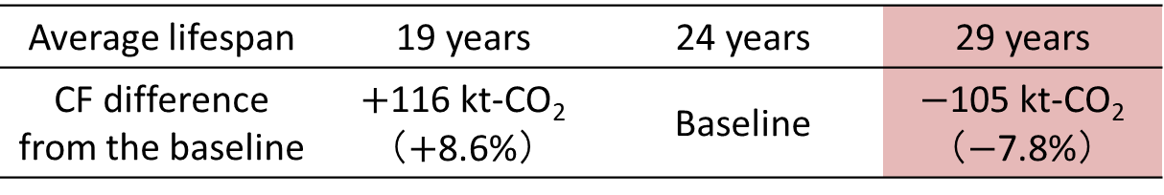
4. Results – Impacts of changes in average lifespan
This figure shows aggregated SDA results under various lifespan scenarios.
Compared to the baseline, CF decreased by about 100 kt-CO₂ (7.8%) with the extended lifespan.
Impacts of lifespan changes are significant ranking at the 3rd largest.
Extending the lifespan can be a viable option to reduce CF of maritime transport.
Average lifespan | 19 years | 24 years | 29 years
CF difference from the baseline | $+$116 kt-CO₂ （$+$8.6%） | Baseline | $−$105 kt-CO₂ （$−$7.8%）
Notes:
Finally, / I’d like to discuss the impact of changes in average lifespan.
This figure shows / the aggregated SDA results under various lifespan scenarios, / with the factors classified into the four life stage categories.
This table represents / the carbon footprint difference, / indicated by the cross mark in this figure, / compared to the baseline scenario.
Both figure and table revealed that, / compared to the baseline, / carbon footprint decreased by about 100 kt-CO2 /
which corresponds to a reduction of 7.8% with the extended lifespan scenario.
Therefore, / the impacts of lifespan changes are significant, / ranking at the third largest.
And Extending the lifespan was found to be a viable option / to reduce the carbon footprint of maritime transport.
(1 min. 10 sec.)

Slide 21
5. Conclusions
This study can be summarized in the following four points:
This study revealed that extending the average lifespan of vessels, despite increased repair demands, contributed to a reduction in carbon footprint (CF).
Comprehensive SDA results revealed that production and activity factors significantly contributed to the reduction in CF, highlighting the crucial roles of shipyards and shipping companies played in this reduction.
The CF decreased by approximately 100 kt-CO₂ with an extended lifespan, primarily due to reduced demand for new vessels; this impact ranked as the third largest among other factors.
Extending the lifespan can be a viable option to reduce CF of maritime transport in Japan.
Notes:
So, / I will summarize this presentation with these four points:
First, this study revealed that / extending the average lifespan of vessels, / despite increased repair demands, /
contributed to a reduction in carbon footprint (CF).
Second, comprehensive SDA results revealed that / production and activity factors significantly contributed to the reduction in CF, /
highlighting the crucial roles of shipyards / and shipping companies played in this reduction.
Third, the CF decreased by approximately 100 kt-CO2 / with an extended lifespan, / primarily due to reduced demand for new vessels; /
this impact ranked / as the third largest among other factors.
Finally, extending the lifespan can be a viable option / to reduce CF of maritime transport in Japan.
(1 min. 10 sec.)

Slide 22
Thank you for your kind attention.
Notes:
That’s all for my presentation.
Thank you for your kind attention.
(10 sec.)

Slide 23
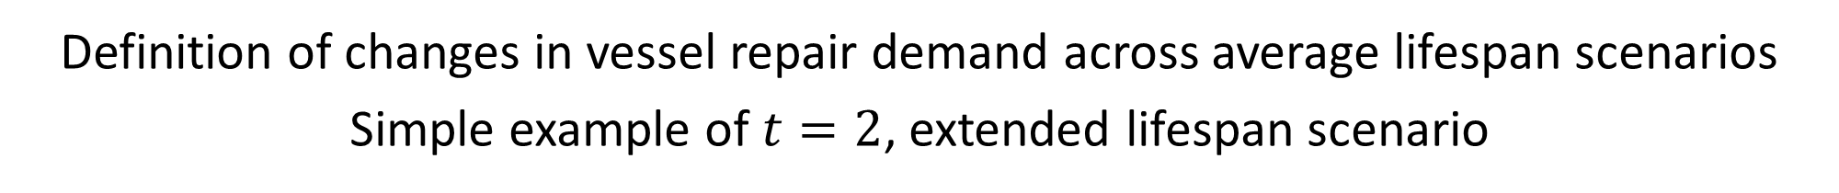
Appendix － Lifespan distribution & estimated parameters
Definition of changes in vessel repair demand across average lifespan scenarios
Simple example of $t=2$, extended lifespan scenario

Slide 24




Appendix － Changes in CF from maritime transport in Japan
$−$0.9 Mt
$−$0.4 Mt
$−$0.1 Mt
$+$1.8 Mt

Slide 25
Appendix － Contributions of changes in $e$ & $L$ of each industry
The impact of extending the average lifespan was approximately 100 kt-CO₂, exceeding the average contributions from changes in emission intensity (e) and industrial structure (L), which were around 76 kt-CO₂ and 62 kt-CO₂, respectively.
Notes:
2011-2015の変化で特徴的なのは、産業構造・重油需要の大幅な減少への寄与です。
産業構造によるカーボンフットプリント減少への寄与は、先行研究でも報告されているように、ショックからの回復により、産業構造の最適化が進んだためだと考えられます。
一方で、重油需要の大幅な減少への寄与は、それぞれの価格の大幅な下落により、より際立っていると考えられます。
(30 sec.)

Slide 26
Appendix － Characteristics of alternative fuels
LNG
H₂
NH₃
Bio
Reduction potential
Technological readiness
Need for new designed ship
Bio-fuels can be used directly in diesel engines or as a mixture with diesel fuels.
Because alternative fuels have different characteristics, which fuels should be used for vessels is still be unclear and the IMO have not declared it yet.
Notes:
These alternative fuels have different characteristics.
The reduction potential for LNG is lower than other fuels, but its technological readiness is higher.
Most importantly, new ships designed for LNG, Hydrogen, and Ammonia are required.
However, there is no need for bio-fuels because they can be used directly in diesel engines or as a mixture with diesel fuels.
This difference can affect the pathways to achieve the reduction target.

Slide 27






Appendix － Why Japan?
Japan is the leading country in coastal freight transport among OECD nations.
Maritime transport accounts for 13.1% of total freight in Japan (by tonnage).
85.5%
1
2
3
13.1%
(25 million ton-km)
1.4%
(55 million ton-km)
0.0%
(163 million ton-km)
Source: OECD (2022)
: 10 million ton-km
Source: MLIT (2021)

Slide 28
Appendix － Changes in fuel efficiency of steel vessels in Japan

Slide 29
Appendix － Changes in vessel stock in Japan

Slide 30
Appendix － Changes in vessel stock in Japan

Slide 31
Appendix － Changes in average price & size of a container ship
3.87 billion JPY in 2008
Price remained constant.
The average price was 3.90 billion JPY, being 3.87 billion JPY in 2008.
Size remained constant.
The average size was 40,000 G/T, compared to 38,000 G/T in 2008.
G/T
Gross Tonnage
D/W
Deadweight Tonnage
Changes in average price & size of a container ship

Slide 32
Appendix － Vessel life stages and key stakeholders in SDA

Slide 33
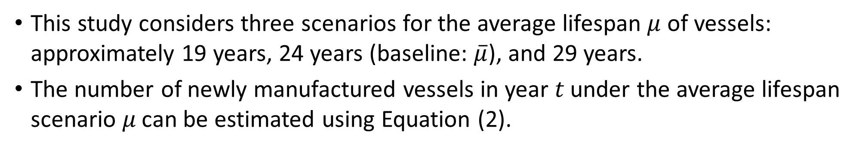
2. Methodology – Stock-flow model analysis
This study considers three scenarios for the average lifespan $μ$ of vessels: approximately 19 years, 24 years (baseline: $\overline{μ}$), and 29 years.
The number of newly manufactured vessels in year 𝑡 under the average lifespan scenario 𝜇 can be estimated using Equation (2).
$$\begin{aligned}B\left(t;μ\right)=S\left(t;\overline{μ}\right)−\sum_{i=1}^{t−1}{φ\left(t−i\right)B\left(i\right)}−R\left(t;\overline{μ}\right)\#\left(2\right)\end{aligned}$$
Fixed variables across the average lifespan scenario
$S\left(t;\overline{μ}\right)$ : Actual number of total vessel stock in year $t$ under the baseline scenario
$R\left(t;\overline{μ}\right)$ : Actual number of vessels manufactured before the initial year (i.e., 1995)
Variables different depending on the average lifespan scenario
$B\left(t;μ\right)$ : Number of vessels newly manufactured in year $t$
$\sum_{i=1}^{t−1}{φ\left(t−i\right)B\left(i\right)}$: Number of vessels manufactured by year $t−1$ under operation
Notes:
So, / I’d like to briefly explain the methodology.
First, / I’d like to explain / how to estimate / carbon footprint.
Using the Product LCA model and IO model, / this study estimates carbon footprint from raw material extraction to maintenance, /
excluding end-of-life.
Carbon footprint in year $t$ / when the average lifespan is $μ$ / can be estimated using Eq. (1).
This part represents / direct and indirect carbon footprint / induced by vessel manufacturing, / fuel refining, / and vessel repairing.
And this part indicates direct emissions from operation, / calculated by multiplying total fuel consumption / by the direct CO2 emission factor.
In this model, / varying the average lifespan $μ$ allows for estimating the carbon footprint / under different lifespan scenarios.
(1 min. 10 sec.)

Slide 34
2. Methodology – Structural decomposition analysis (SDA)
This study develops a comprehensive SDA method to quantitatively compare the impact of each factor at different stages of the vessel lifecycle.
SDA-based decomposition can be applied to…
Manufacturing
and
Maintenance
stages.
Carbon footprint estimated in this study
Notes:
This slide explains SDA developed in this study.
Using the LMDI, / carbon footprint can be decomposed into the following 12 factors.
First, / carbon footprint can be broken down into the effect of emission intensity, / Leontief inverse, / final demand, / and direct emissions.
Then, the final demand can be further decomposed into demand for new vessels, / fuel type A, / fuel type C, / and vessel repair.
Direct emissions can also be further decomposed into the number of vessels in the fleet stock, / average distance, / average cargo tonnage, /
load factor, / fuel efficiency, / and carbon intensity.
(55 sec.)

Slide 35
2. Methodology – Structural decomposition analysis (SDA)
This study develops a comprehensive SDA method to quantitatively compare the impact of each factor at different stages of the vessel lifecycle.
SDA-based decomposition can be applied to…
Manufacturing
and
Maintenance
stages.
Carbon footprint estimated in this study
Direct emissions
Fuel supply chain
SDA-based decomposition
IDA-based decomposition
Notes:
This slide explains SDA developed in this study.
Using the LMDI, / carbon footprint can be decomposed into the following 12 factors.
First, / carbon footprint can be broken down into the effect of emission intensity, / Leontief inverse, / final demand, / and direct emissions.
Then, the final demand can be further decomposed into demand for new vessels, / fuel type A, / fuel type C, / and vessel repair.
Direct emissions can also be further decomposed into the number of vessels in the fleet stock, / average distance, / average cargo tonnage, /
load factor, / fuel efficiency, / and carbon intensity.
(55 sec.)

Slide 36
2. Methodology – Structural decomposition analysis (SDA)
This study develops a comprehensive SDA method to quantitatively compare the impact of each factor at different stages of the vessel lifecycle.
SDA-based decomposition can be applied to…
Vessel manufacturing
Fuel supply chain
Maintenance
Carbon footprint estimated in this study
Direct emissions are analyzed by IDA-based decomposition.
Notes:
This slide explains SDA developed in this study.
Using the LMDI, / carbon footprint can be decomposed into the following 12 factors.
First, / carbon footprint can be broken down into the effect of emission intensity, / Leontief inverse, / final demand, / and direct emissions.
Then, the final demand can be further decomposed into demand for new vessels, / fuel type A, / fuel type C, / and vessel repair.
Direct emissions can also be further decomposed into the number of vessels in the fleet stock, / average distance, / average cargo tonnage, /
load factor, / fuel efficiency, / and carbon intensity.
(55 sec.)

Slide 37








Raw material
Processing
Assembling
Operation
Repair
End-of-life
This model can set variations for the average lifespan.
Focusing on the lifespan, the mechanism of changes in lifecycle impact can be identified.
Vessel lifespan
Shortening
Extending

Slide 38
1. Introduction – Literature review
Decomposition analysis has the potential to reveal the interrelationships across lifecycle stages, as it quantitatively measures the impact of predetermined factors.
Two most widely used decomposition analysis (Hoekstra and van der Bergh, 2003)
Index Decomposition Analysis (IDA)
Structural Decomposition Analysis (SDA)
IDA quantifies direct effects based on simple method and datasets.
The main focus was on operational phase.
      No studies attempted to compare the contributions of operational factors with those of other lifecycle stages.
SDA quantitatively measures direct and indirect impact using IO table.
Contributions of both supply- and demand-related factors were analyzed.
      No studies attributed the factors’ contributions to lifecycle stages.
Comprehensive SDA based on product LCA model (Kagawa et al., 2008; Nakamoto, 2020)
Notes:
A product LCA model can analyze the environmental impact / by considering the entire lifecycle, / from raw material extraction to end-of-life like this figure.
In addition, / this model can set scenarios for the average lifespan.
Focusing on the average lifespan, / the mechanism of changes in lifecycle impact can be identified /
because the average lifespan determines the flow at the end of life, /
and subsequently, / it affects the demand for new vessels, / processing, / and raw material.
However, / no studies have focused on the interrelationships between lifecycle stages.
(50 sec.)

Slide 39
1. Introduction – Literature review
Decomposition analysis has the potential to reveal the interrelationships across lifecycle stages, as it quantitatively measures the impact of predetermined factors.
Two most widely used decomposition analysis (Hoekstra and van der Bergh, 2003)
Index Decomposition Analysis (IDA)
Structural Decomposition Analysis (SDA)
IDA quantifies direct effects based on simple method and datasets.
The main focus was on operational phase.
      No studies attempted to compare the contributions of operational factors with those of other lifecycle stages.
SDA quantitatively measures direct and indirect impact using IO table.
Contributions of both supply- and demand-related factors were analyzed.
      No studies attributed the factors’ contributions to lifecycle stages.
Comprehensive SDA based on product LCA model can examine the economic and environmental impact of changes in average lifespan of automobiles (Kagawa et al., 2008; Nakamoto, 2020)
Notes:
A product LCA model can analyze the environmental impact / by considering the entire lifecycle, / from raw material extraction to end-of-life like this figure.
In addition, / this model can set scenarios for the average lifespan.
Focusing on the average lifespan, / the mechanism of changes in lifecycle impact can be identified /
because the average lifespan determines the flow at the end of life, /
and subsequently, / it affects the demand for new vessels, / processing, / and raw material.
However, / no studies have focused on the interrelationships between lifecycle stages.
(50 sec.)

Slide 40


1. Introduction – Literature review
Decomposition analysis has the potential to reveal the interrelationships across lifecycle stages, as it quantitatively measures the impact of predetermined factors.
$$t$$
$$t+1$$
Notes:
A product LCA model can analyze the environmental impact / by considering the entire lifecycle, / from raw material extraction to end-of-life like this figure.
In addition, / this model can set scenarios for the average lifespan.
Focusing on the average lifespan, / the mechanism of changes in lifecycle impact can be identified /
because the average lifespan determines the flow at the end of life, /
and subsequently, / it affects the demand for new vessels, / processing, / and raw material.
However, / no studies have focused on the interrelationships between lifecycle stages.
(50 sec.)

Slide 41
1. Introduction – Literature review
Decomposition analysis has the potential to reveal the interrelationships across lifecycle stages, as it quantitatively measures the impact of predetermined factors.
Two most widely used decomposition analysis (Hoekstra and van der Bergh, 2003)
Index Decomposition Analysis (IDA)
Structural Decomposition Analysis (SDA)
IDA quantifies direct effects based on simple method and datasets.
      The main focus was on operational phase and no studies attempted to compare its impacts with that of other lifecycle stages.
SDA quantitatively measures direct and indirect impact using IO table.
      Contributions of both supply- and demand-related factors were .
Notes:
A product LCA model can analyze the environmental impact / by considering the entire lifecycle, / from raw material extraction to end-of-life like this figure.
In addition, / this model can set scenarios for the average lifespan.
Focusing on the average lifespan, / the mechanism of changes in lifecycle impact can be identified /
because the average lifespan determines the flow at the end of life, /
and subsequently, / it affects the demand for new vessels, / processing, / and raw material.
However, / no studies have focused on the interrelationships between lifecycle stages.
(50 sec.)

Slide 42
1. Introduction – Literature review
Decomposition analysis can be useful for comparing the interrelationships between lifecycle stages, as it quantifies each stage’s contribution to time-series changes.
Index Decomposition Analysis (IDA)
Structural Decomposition Analysis (SDA)
IDA quantifies direct effects based on simple method and datasets.
Focusing on the average lifespan, the mechanism of changes in lifecycle impact can be identified.
SDA quantitatively measures direct and indirect impact using IO table.
Focusing on the average lifespan, the mechanism of changes in lifecycle impact can be identified.
Notes:
A product LCA model can analyze the environmental impact / by considering the entire lifecycle, / from raw material extraction to end-of-life like this figure.
In addition, / this model can set scenarios for the average lifespan.
Focusing on the average lifespan, / the mechanism of changes in lifecycle impact can be identified /
because the average lifespan determines the flow at the end of life, /
and subsequently, / it affects the demand for new vessels, / processing, / and raw material.
However, / no studies have focused on the interrelationships between lifecycle stages.
(50 sec.)

Slide 43
11
10.5
-5%
-17%
9
CO₂ emissions (Mt- CO₂)
2013
2022
2030

