Slide 1

The Triple Bottom Line Analysis of the Decline in Foreign Tourist Demand in Japan due to the COVID-19 Pandemic:
A Counterfactual Structural Path Decomposition
Yusuke Oga^{a*}, Shigemi Kagawa^{b}
a: Kyushu University, Fukuoka, Japan
b: Faculty of Economics, Kyushu University, Fukuoka, Japan
Notes:
Good [morning/afternoon/evening], everyone. I’m Yusuke Oga from Kyushu University.
Today, I will talk about “The Triple Bottom Line Analysis of the Decline in Foreign Tourist Demand in Japan due to
the COVID-19 Pandemic:
A Counterfactual Structural Path Decomposition .”

Slide 2
Section 1
Introduction

Slide 3






1. Introduction: Importance of Japan’s inbound tourism
Importance of Japan’s inbound tourism market
Inbound tourism in Japan is a important industry for earning foreign currency. Thanks to government efforts, the number of foreign visitors grew quickly until 2019.
Economic and social losses due to COVID-19
As a result of COVID-19 pandemic, Japan’s inbound tourism expenditure in 2020 dropped by 85%, and 300 thousands tourism-related jobs were lost.
Potential environmental impacts of the decline in tourism
CO₂
Tourism-related demand accounts for 11% of Japan’s total CO₂ emissions. The stagnation of inbound tourism may have also contributed to a reduction in CO₂ emissions.
Notes:
Inbound tourism in Japan is a important industry for earning foreign currency. Thanks to strong government efforts to attract foreign tourists, the number of foreign visitors grew quickly until 2019.
However, as a result of lockdown measures during the COVID-19 pandemic, Japan’s inbound tourism expenditure in 2020 dropped by 85%, and approximately 300 thousands tourism-related jobs were lost.
Tourism-related demand accounts for 11% of Japan’s total CO₂ emissions.
Therefore, the stagnation of inbound tourism during the pandemic may have also contributed to a reduction in CO₂ emissions.

Slide 4


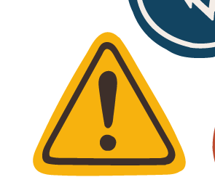


1. Introduction: Vulnerability of Japan’s inbound tourism to disasters
1-2-1
引用明記
The risk of future pandemics
Marani etal, 2021
Global Preparedness Monitoring Board,2024
As of 2025, the COVID-19 pandemic has ended. However, several studies and official reports have warned that “the risk of another similar pandemic still remains.”
Vulnerability to other disasters
Japan’s tourism industry is also highly vulnerable to other disasters, such as earthquakes and tsunamis. Large-scale disasters could have impacts on inbound tourism similar to those caused by COVID-19.
The necessity of preparedness against various disasters
The Japanese government should also prepare disaster-recovery policies.
Notes:
As of 2025, the COVID-19 pandemic has ended, and daily life has mostly returned to normal.
However, several studies and official reports have warned that the risk of another similar pandemic still remains.
Japan’s tourism industry is also highly vulnerable to other types of disasters, such as earthquakes and tsunamis. Large-scale disasters could have impacts on inbound tourism similar to those caused by COVID-19.
Therefore, in addition to strategies for promoting inbound tourism, the Japanese government should also prepare disaster-recovery policies.

Slide 5




1. Introduction: Triple bottom line evaluation
Perspective of triple bottom line evaluation
To design effective recovery policies for tourism in the face of disasters, it is important to evaluate the damage from three perspectives: economic, social, and environmental.
A previous study
Oga and Kagawa (2025) evaluated the impact of the decline in inbound tourism demand due to the COVID-19 in Japan from three viewpoints:
value added, employment opportunities, and CO₂ emissions.
They used a consumption-endogenous input-output analysis to incorporate income-induced effects triggered by changes in Japan’s income structure.
Notes:
To design effective recovery policies,
it is important to quantitatively assess the damage from three perspectives: economic, social, and environmental.
Oga and Kagawa (2025) evaluated the impact of the decline in inbound tourism demand due to the COVID-19 in Japan from these three viewpoints:
value added, employment opportunities, and CO₂ emissions.
They used a consumption-endogenous input-output analysis to incorporate income-induced effects triggered by changes in Japan’s income structure.

Slide 6
















1. Introduction: Research Gap
1-4. Research Gap and the Significance of Using SPD
1-4-1: Gap – Lack of Supply Chain-Level Analysis
Several prior studies have analyzed the impact of the COVID-19 pandemic on the tourism sector using input-output analysis.
However, they do not provide a detailed picture of how the impacts spread through industrial supply chains.
1-4. Research Gap and the Significance of Using SPD
1-4-1: Gap – Lack of Supply Chain-Level Analysis
Several prior studies have analyzed the impact of the COVID-19 pandemic on the tourism sector using input-output analysis.
However, they do not provide a detailed picture of how the impacts spread through industrial supply chains.
To propose more specific recovery policies,
it is important to quantitatively evaluate the transmission of pandemic shocks through supply chain paths
and to identify “supply chain hotspots” that are especially vulnerable.
影響が波及する産業パスを定量評価することで可視化し、ホットスポットを特定することがより具体的な政策提言に有効
How did the impacts spread through industrial supply chains?
Important:
To evaluate the transmission of pandemic shocks through supply chain paths
To identify “supply chain hotspots” that are especially vulnerable
Economy
？？？JPY
・・・
Society
？？？
persons
Environment
？？kt-CO₂
Notes:
Several previous studies have analyzed the impact of the COVID-19 pandemic on the tourism sector using input-output analysis.
However, they do not provide a detailed picture of how the impacts spread through industrial supply chains.
To propose more specific recovery policies, it is important to evaluate the transmission of pandemic shocks through supply chain paths
and to identify “supply chain hotspots” that are especially vulnerable.
1-4-2：サプライチェーンを定量化するSPAとSDAを掛け合わせたSPD
1-4-3：SPDは通常経年変化に用いられるが、これは反実仮想分析においても有用である

Slide 7

1. Introduction: Research objective, novelties, and contribution
Objective of this study
Identifying supply chain “hotspots” caused by the decline in inbound tourism demand, using Structural Path Decomposition (SPD) based on a counterfactual scenario.
Novelties of this study
1.
SPD is applied to evaluate the impacts of the COVID-19 pandemic through a counterfactual analysis framework.
2.
SPD is used in a triple bottom line analysis, which evaluate the economic, social, and environmental impacts of the decline in inbound tourism demand in Japan.
This study contributes to the development of well-balanced disaster-recovery policies for inbound tourism in Japan
Contributions of this study
Identifies the most vulnerable supply chain hotspots in three aspects and by each driving factor
Contributes to the development of well-balanced disaster-recovery policies for inbound tourism in Japan
Notes:
So, this study aims to identify supply chain “hotspots” caused by the decline in inbound tourism demand, using Structural Path Decomposition “SPD” based on a counterfactual scenario.
The key novelties of this study are that:
SPD, which is typically used to analyze temporal structural changes, is applied here to evaluate the impacts of the COVID-19 pandemic through a counterfactual analysis framework.
2.Second, SPD is used in a triple bottom line analysis to evaluate the economic, social, and environmental impacts of the decline in inbound tourism demand.
As a result, this study contributes to the development of well-balanced disaster recovery policies for inbound tourism in Japan.

Slide 8
Section 2
Methodology

Slide 9










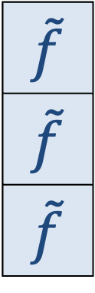



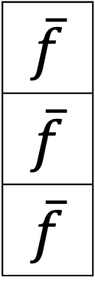

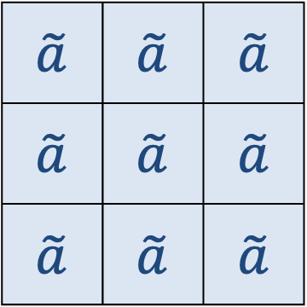












2. Methodology: Flow of calculations
$$\overline{f}$$
$$\overline{f}$$
$$\overline{f}$$
$$\tilde{f}$$
$$\tilde{f}$$
$$\tilde{f}$$
$$e$$ | $$e$$ | $$e$$
$$s$$ | $$s$$ | $$s$$
$$v$$ | $$v$$ | $$v$$
With-COVID Scenario
(BAU Scenario)
Non-COVID Scenario (Counterfactual Scenario)
1.
$$e$$ | $$e$$ | $$e$$
Final demand vector of foreign tourists
Final demand vector of foreign tourists
$$s$$ | $$s$$ | $$s$$
$$\tilde{v}$$ | $$\tilde{v}$$ | $$\tilde{v}$$
$$×$$
$$=$$
$$×$$
$$=$$
VS
2.
Direct-indirect impact in three aspects
Direct-indirect impact in three aspects
$$\tilde{a}$$ | $$\tilde{a}$$ | $$\tilde{a}$$
$$\tilde{a}$$ | $$\tilde{a}$$ | $$\tilde{a}$$
$$\tilde{a}$$ | $$\tilde{a}$$ | $$\tilde{a}$$
$$×$$
$$×$$
$$=$$
$$×$$
$$×$$
$$=$$
3.
Counterfactual structural path decomposition
Decomposition of COVID-19 impacts by supply chain path and driving factors using SPD
Non-COVID
Scenario
With-COVID
Scenario
Impact of
COVID-19
$$∆v$$
$$∆A$$
$$∆h$$
$$∆μ$$
$$∆w$$
$$∆f$$
Notes:
●This is a flow of our calculations,
●The calculation process consists of three major steps.

Slide 10





2. Methodology: Flow of calculations
$$a$$ | $$a$$ | $$a$$
$$a$$ | $$a$$ | $$a$$
$$a$$ | $$a$$ | $$a$$
$$\overline{f}$$
$$\overline{f}$$
$$\overline{f}$$
$$\tilde{f}$$
$$\tilde{f}$$
$$\tilde{f}$$
$$e$$ | $$e$$ | $$e$$
$$s$$ | $$s$$ | $$s$$
$$v$$ | $$v$$ | $$v$$
With-COVID Scenario
(BAU Scenario)
Non-COVID Scenario (Counterfactual Scenario)
1.
$$\overline{a}$$ | $$\overline{a}$$ | $$\overline{a}$$
$$\overline{a}$$ | $$\overline{a}$$ | $$\overline{a}$$
$$\overline{a}$$ | $$\overline{a}$$ | $$\overline{a}$$
$$e$$ | $$e$$ | $$e$$
Final demand vector of foreign tourists
Final demand vector of foreign tourists
$$s$$ | $$s$$ | $$s$$
$$\tilde{v}$$ | $$\tilde{v}$$ | $$\tilde{v}$$
$$×$$
$$=$$
$$×$$
$$=$$
VS
2.
Direct-indirect impact in three aspects
Direct-indirect impact in three aspects
We set up two scenarios:
$$\tilde{a}$$ | $$\tilde{a}$$ | $$\tilde{a}$$
$$\tilde{a}$$ | $$\tilde{a}$$ | $$\tilde{a}$$
$$\tilde{a}$$ | $$\tilde{a}$$ | $$\tilde{a}$$
With-COVID scenario
$$×$$
$$×$$
$$=$$
$$×$$
$$×$$
$$=$$
The actual case reflecting Japanese inbound tourism market in 2020.
3.
Counterfactual structural path decomposition
Non-COVID scenario
The counterfactual case where the COVID-19 pandemic did not occur.
→Final demand vectors were calculated in both scenarios respectively.
Decomposition of COVID-19 impacts by supply chain path and driving factors using SPD
Non-COVID
Scenario
With-COVID
Scenario
Impact of
COVID-19
$$∆v$$
$$∆A$$
Non-COVID
Scenario
With-COVID
Scenario
Impact of
COVID-19
$$∆h$$
$$∆μ$$
$$∆w$$
$$∆f$$
Notes:
First, we set up two scenarios: the with-COVID scenario and the Non-COVID scenario.
The with-COVID scenario is the actual case reflecting Japanese inbound tourism market in 2020.
The Non-COVID scenario is the counterfactual case where the COVID-19 pandemic did not occur.
In both scenarios, we set the respective final demand vectors."

Slide 11
2. Methodology: Flow of calculations
$$a$$ | $$a$$ | $$a$$
$$a$$ | $$a$$ | $$a$$
$$a$$ | $$a$$ | $$a$$
By multiplying the direct and indirect outputs by each coefficient vector, we estimated the value-added effects, employment opportunities, and CO₂ emissions for both scenarios.
With-COVID Scenario
(BAU Scenario)
Non-COVID Scenario (Counterfactual Scenario)
1.
Using “consumption-endogenous” input-output analysis, we calculate the direct-indirect outputs derived by inbound demand in each scenario.
We set up two scenarios:
Final demand vector of foreign tourists
Final demand vector of foreign tourists
Multiplying each coefficient vector by each output, the value-added effects, employment opportunities, and CO₂ emissions in each scenario can be calculated.
With-COVID scenario
$$×$$
$$=$$
$$×$$
$$=$$
The actual case reflecting Japanese inbound tourism market in 2020.
VS
Non-COVID scenario
2.
Direct-indirect impact in three aspects
Direct-indirect impact in three aspects
The counterfactual case where the COVID-19 pandemic did not occur.
→Final demand vectors were calculated in both scenarios respectively.
$$×$$
$$×$$
$$=$$
$$×$$
$$×$$
$$=$$
3.
Counterfactual structural path decomposition
Non-COVID
Scenario
With-COVID
Scenario
Impact of
COVID-19
Non-COVID
Scenario
With-COVID
Scenario
Impact of
COVID-19
$$∆v$$
$$∆A$$
$$∆h$$
$$∆μ$$
$$∆w$$
$$∆f$$
Notes:
Second, using “consumption endogenous” input-output analysis, we calculate the direct-indirect outputs derived by the final demand from inbound tourists in each scenario.
Then, by multiplying three coefficient vectors, by the outputs, we estimated the value-added effects, employment opportunities, and CO2 emissions for both scenarios.
⭐️In our study, we defined the differentials between the two scenarios as the economic losses, social losses, and environmental benefits that COVID-19 brought to Japan's inbound tourism in 2020.

Slide 12

2. Methodology: Flow of calculations
The differences were broken down by 21 inbound tourist nationalities and 6 decomposition factors.
This allowed us to identify
which nationality’s decline in inbound tourism demand, through which factor, had the strongest impact on which supply chain path.
supply chain hotspots that were most affected in terms of economic, social, and environmental impacts.
$$a$$ | $$a$$ | $$a$$
$$a$$ | $$a$$ | $$a$$
$$a$$ | $$a$$ | $$a$$
The differences were broken down by
21 tourist nationalities and
6 decomposition factors.
which nationality’s decline in inbound tourism demand, through which factor, had the strongest impact on which supply chain path.
With-COVID Scenario
(BAU Scenario)
Non-COVID Scenario (Counterfactual Scenario)
We decomposed the differences between the two scenarios into supply chain paths from the 1st to the 3rd order. The differences were broken down by 21 tourist nationalities and 6 factors.
1.
Final demand vector of foreign tourists
Final demand vector of foreign tourists
We could clearly see how the drop in tourism demand from each nationality affected specific supply chain paths, and which factors mainly contributed to these impacts.
$$×$$
$$=$$
$$×$$
$$=$$
VS
2.
Direct-indirect impact in three aspects
Direct-indirect impact in three aspects
Economic, social, environmental supply chain hotspots were identified.
$$×$$
$$×$$
$$=$$
$$×$$
$$×$$
$$=$$
3.
Counterfactual structural path decomposition
Notes:
Thirdly, we decomposed the impact of COVID-19 into supply chain paths from the 1st to the 3rd order.
These differences were further broken down by 21 inbound tourist nationalities and 6 decomposition factors.
We could clearly see how the drop in tourism demand from each nationality affected specific supply chain paths, and which factors were responsible for these impacts.
As a result, economic, social, environmental supply chain hotspots were identified.
-------
we were able to pinpoint supply chain hotspots that were most affected in terms of economic, social, and environmental impacts.

Slide 13




















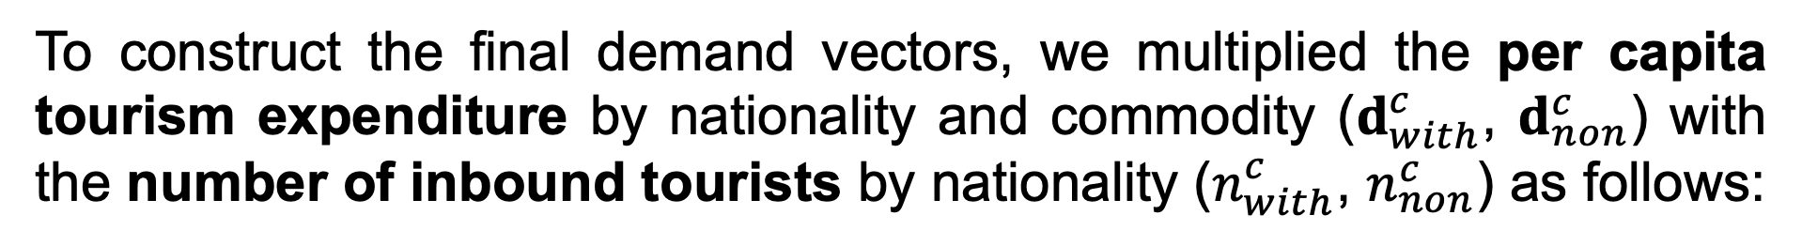
2. Methodology: Calculating final demand vectors in each scenario
To construct the final demand vectors, we multiplied the per capita tourism expenditure by nationality and commodity ($d_{with}^{c}$, $d_{non}^{c}$) with the number of inbound tourists by nationality ($n_{with}^{c}$, $n_{non}^{c}$) as follows:
With-COVID Scenario(BAU)
Non-COVID Scenario (Counterfactual scenario)
$$country: c$$
$$country: c$$
$$f_{1}$$
$$f_{with}^{c}=n_{with}^{c}d_{with}^{c}$$
(3)
$$f_{1}$$
$$f_{non}^{c}=n_{non}^{c}d_{non}^{c}$$
(4)
$$⋮$$
$$⋮$$
$$f_{i}$$
$f_{with}^{c}$:
“observable” final demand column vector
$$f_{i}$$
$f_{non}^{c}$:
“unobservable” final demand column vector
$d_{with}^{c}$:
per capita commodity consumption for foreign visitors in 2020
$d_{non}^{c}$:
per capita commodity consumption for foreign visitors in 2019
$$⋮$$
$$⋮$$
$n_{with}^{c}$:
the number foreign visitors to Japan in 2020
$n_{non}^{c}$:
the estimated number foreign visitors to Japan in 2020
$$f_{94}$$
$$f_{94}$$
Notes:
●Thit is, a detailed explanation of how the final demand vector is calculated.
●To construct the final demand vectors, we first multiplied the nationality-specific average spending per tourist by the nationality-specific number of inbound tourists.
●Equations (3) and (4) are used to calculate the final demand vector in both scenarios. Here, small f represents the final demand vector across 94 sectors, small d stands for the per capita commodity consumption of foreign visitors, and small n indicates the number of foreign visitors to Japan.
●For the with-COVID scenario, we used actual data from 2020. However, for the non-COVID scenario, no actual data exists, so we needed to use alternative data and estimations.
●Regarding per capita expenditure, we assumed that "if the pandemic had not occurred, consumption patterns would not differ significantly from the previous year," and therefore we used 2019 data.
●As for the number of inbound tourists in the Non-COVID scenario, we used simple linear regression based on past trends to estimate the counterfactual values, taking into account the structural changes brought by Japan’s active inbound tourism promotion since 2012.
●Due to time constraints, I’ll skip the detailed explanation here.

Slide 14



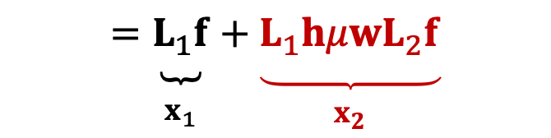

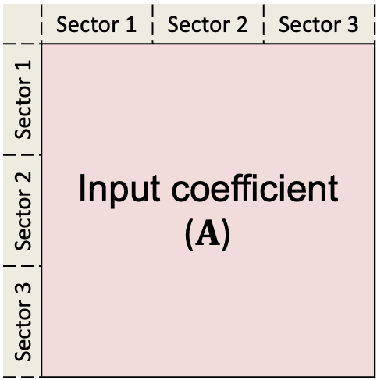

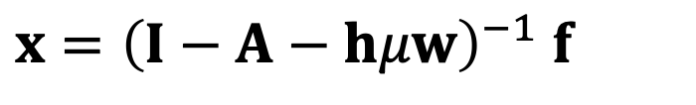
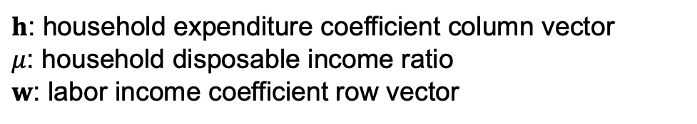
2. Methodology:
Miyazawa and Masegi (1963)
Developed a consumption-endogenized input-output model (Leontief-Miyazawa model) that treats the income → household → consumption cycle as an endlessly propagating economic activity.
$x={\left(I−A−hμw\right)}^{−1} f$
(4)
$h$: household expenditure coefficient column vector
$μ$: household disposable income ratio
$w$: labor income coefficient row vector
 | Sector 1 | Sector 2 | Sector 3
Sector 1 | Input coefficient ($A$)
Sector 2
Sector 3
($h$)
(5)
$=$ ${\left(I−A\right)}^{−1}f+{\left(I−A\right)}^{−1} hw{\left(I−A−hμw\right)}^{−1}f$
$$=\underset{\begin{aligned} \\ x_{1}\end{aligned}}{\underbrace{L_{1}f}}+\underset{\begin{aligned} \\ x_{2}\end{aligned}}{\underbrace{L_{1}hμwL_{2}f}}$$
Income induced effects
Household expenditure coefficient
Labor income coefficient ($w$)
Notes:
In the second step, we estimate the direct and indirect outputs induced by inbound tourism consumption using input-output analysis.
This study employs the consumption-endogenous input-output model developed by Miyazawa and Masegi (1963).
The mathematical formulation is given in Equation (4), where: h represents the household expenditure coefficient column vector, μ the household disposable income ratio , and w the labor income coefficient row vector
Together, these parameters reflect the process by which income generated from final demand flows back into household consumption.
Traditionally, input-output models treat only the intermediate input as endogenous, while household consumption and Lacor income are treated as ⭐️exogenous.

Slide 15

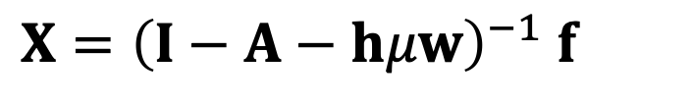

2. Methodology:
Miyazawa and Masegi (1963)
Developed a consumption-endogenized input-output model (Leontief-Miyazawa model) that treats the income → household → consumption cycle as an endlessly propagating economic activity.
$X={\left(I−A−hμw\right)}^{−1} f$
(4)
Endogenizing household consumption and Labor income
$h$: household expenditure coefficient column vector
$μ$: household disposable income ratio
$w$: labor income coefficient row vector
 | Sector 1 | Sector 2 | Sector 3
Sector 1 | Input coefficient ($A$)
Sector 2
Sector 3
($h$)
(5)
$=$ ${\left(I−A\right)}^{−1}f+{\left(I−A\right)}^{−1} hw{\left(I−A−hμw\right)}^{−1}f$
$$=\underset{\begin{aligned} \\ x_{1}\end{aligned}}{\underbrace{L_{1}f}}+\underset{\begin{aligned} \\ x_{2}\end{aligned}}{\underbrace{L_{1}hμwL_{2}f}}$$
Income induced effects
Household expenditure coefficient
Labor income coefficient ($w$)
0
Notes:
⭐️ However, in reality, household consumption depends on income, and income depends on production activity.
So, both the household consumption vector and labor income vector can be endogenized, just like input coefficients.
This approach, called the Leontief-Miyazawa model, considers household consumption and labor income as closely connected activities that continue to affect the economy in a loop.
It helps us clearly see the effects of income changes included in the indirect impacts.
Since the COVID-19 pandemic caused major changes in how people spend money and how much they earn, this model gives us a more realistic way to analyze the situation.

Slide 16
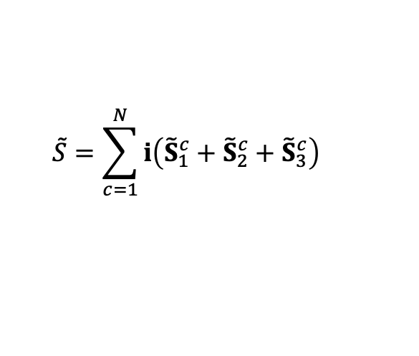


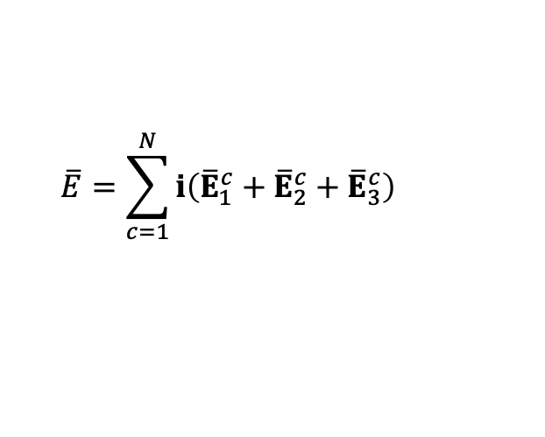




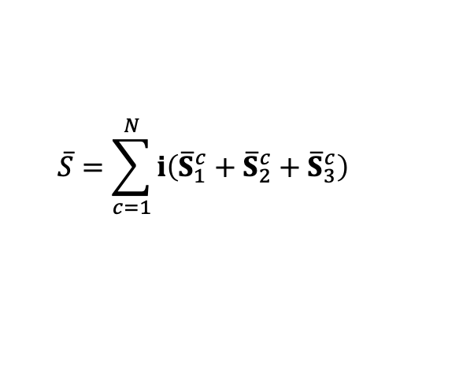




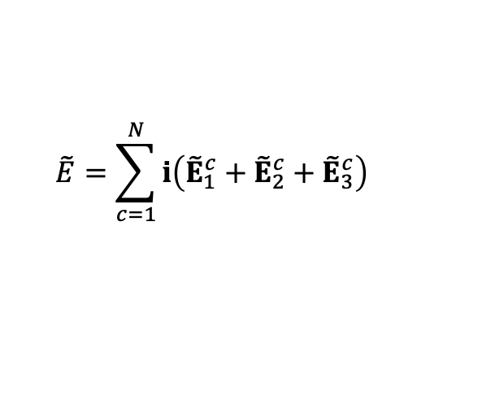

2. Methodology:
$${\overline{x}}_{2020}= \underset{\begin{aligned} \\ {\overline{x}}_{1,2020}\end{aligned}}{\underbrace{{\overline{L}}_{1, 2020}{\overline{f}}_{2020}}}+\underset{\begin{aligned} \\ {\overline{x}}_{2,2020}\end{aligned}}{\underbrace{{\overline{L}}_{1,2020}{\overline{h}}_{2020}{\overline{μ}}_{2020}{\overline{w}}_{2020}{\overline{L}}_{2,2020}{\overline{f}}_{2020}}}$$
$$+$$
$$+$$
The consumption-endogenous input-output analysis is applied to estimate the indirect effects and income-induced effects generated by the direct effect.
With-COVID Scenario
Impact of COVID-19
$$x_{with}={\left(I−A_{with}−h_{with}μ_{with}w_{with}\right)}^{−1}f_{with}$$
(7)
$$ΔV=V_{with}−V_{non}$$
(9)
Direct effect
$$V_{with}=v_{with}x_{with}$$
$$\overline{S}=\sum_{c=1}^{N}{i\left({\overline{S}}_{1}^{c}+{\overline{S}}_{2}^{c}+{\overline{S}}_{3}^{c}\right)}$$
$$\overline{E}=\sum_{c=1}^{N}{i\left({\overline{E}}_{1}^{c}+{\overline{E}}_{2}^{c}+{\overline{E}}_{3}^{c}\right)}$$
$$S_{with}=s_{with}x_{with}$$
$$E_{with}=e_{with}x_{with}$$
Direct effect
$$ΔS=S_{with}−S_{non}$$
(10)
Non-COVID Scenario
$$x_{non}={\left(I−A_{non}−h_{non}μ_{non}w_{non}\right)}^{−1}f_{non}$$
(8)
$$V_{non}=v_{non}x_{non}$$
$$ΔE=E_{with}−E_{non}$$
(11)
$$\tilde{S}=\sum_{c=1}^{N}{i\left({\tilde{S}}_{1}^{c}+{\tilde{S}}_{2}^{c}+{\tilde{S}}_{3}^{c}\right)}$$
$$\tilde{E}=\sum_{c=1}^{N}{i\left({\tilde{E}}_{1}^{c}+{\tilde{E}}_{2}^{c}+{\tilde{E}}_{3}^{c}\right)}$$
$$S_{non}=s_{non}x_{non}$$
$$E_{non}=e_{non}x_{non}$$
Notes:
In both the With-COVID and Non-COVID scenarios, the consumption-endogenous input-output analysis is applied to estimate the indirect effects and income-induced effects generated by the direct effect.
Small x, the total output in each scenario, are calculated as eq.(7) and (8)
●When the value-added coefficient vector, labor coefficient vector and CO₂ emission coefficient vector are defined as ($v$), ($s$),and ($e$) respectively, by multiplying each coefficient vectors to domestic output,
we estimates the economic, social, and environmental effect in each scenario.
●And the differences in both scenarios, ∆𝑉, $∆S$, and $∆E$, calculated in Eqs. (9) to (11), are the impact of COVID-19.

Slide 17
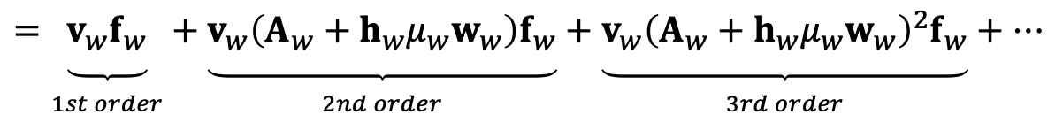
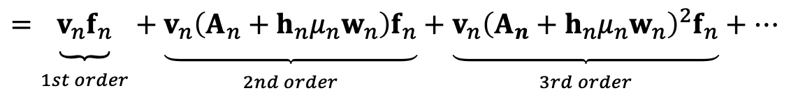
2. Methodology: Structural Path Decomposition
By applying a Taylor expansion to the Leontief-Miyazawa inverse matrix, the input-output analysis results can be decomposed by order of ripple effects.
図を変える
With-COVID Scenario
1st order
2nd order
3rd order
$$V_{w}=v_{w}L_{w}f_{w}=v_{w}{\left(I−A_{w}−h_{w}μ_{w}w_{w}\right)}^{−1}f_{w}$$
シナリオ別に並べる
$$=\underset{\begin{aligned} \\ 1st order\end{aligned}}{\underbrace{v_{w}f_{w}}}+\underset{\begin{aligned} \\ 2nd order\end{aligned}}{\underbrace{v_{w}\left(A_{w}+h_{w}μ_{w}w_{w}\right)f_{w}}}+\underset{\begin{aligned} \\ 3rd order\end{aligned}}{\underbrace{{v_{w}\left(A_{w}+h_{w}μ_{w}w_{w}\right)}^{2}f_{w}}}+⋯$$
(12)
Non-COVID Scenario
With-COVID Scenario
1st order
2nd order
3rd order
$$V_{n}=v_{n}L_{n}f_{n}=v_{n}{\left(I−A_{n}−h_{n}μ_{n}w_{n}\right)}^{−1}f_{n}$$
(13)
Non-COVID Scenario
Notes:
●In SPD, the Leontief inverse is expanded using a Taylor expansion, which allows us to break down input-output results by order of ripple effects—starting from first-order, to second-order, and then third-order effects.
●Equation (12) and (13) show the Taylor expansion applied to the consumption-endogenous Leontief inverse. In this study, we focused on impacts up to the third-order effects

Slide 18

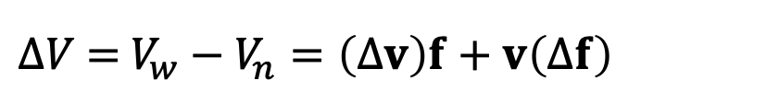







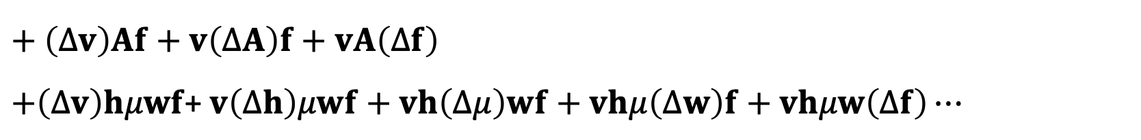
2. Methodology: Structural Path Decomposition
1st order
2nd order
3rd order
By applying a Taylor expansion to the Leontief-Miyazawa inverse matrix, the input-output analysis results can be decomposed by order of ripple effects.
図を変える
$ΔV$ $=$ $V_{w}−V_{n}=\left(Δv\right)f+v\left(Δf\right)$
1st order
$+$ $\left(Δv\right)Af+v\left(ΔA\right)f+vA\left(Δf\right)$
$$+\left(Δv\right)hμwf\text{+} v\left(Δh\right)μwf+vh\left(Δμ\right)wf+vhμ\left(Δw\right)f+vhμw\left(Δf\right)⋯$$
2nd order
シナリオ別に並べる
(14)
(13)
(11)
$∆v$: changes in the value-added coefficient vector
$∆A$: changes in the input coefficient vector
$∆h$: changes in the household expenditure vector
$∆μ$: changes in the disposable income ratio
$∆w$: changes in the labor income coefficient vector
$∆f$: changes in the labor final demand of foreign tourists
With-COVID Scenario
With-COVID Scenario
Non-COVID Scenario
$$∆v$$
$$∆A$$
$$∆h$$
$$∆μ$$
$$VS$$
$$∆w$$
$$∆f$$
1st order
2nd order
3rd order
Non-COVID Scenario
Notes:
Furthermore, we applied Structural Decomposition Analysis (SDA) to each order of ripple effects.
In this study, we used the LMDI method to decompose the changes.
The impacts were broken down into six factors: value-added coefficients, final demand, input coefficients, household consumption propensity, disposable income ratio, and labor income share.
This process enables us to clearly visualize which factors and which industry supply chains contributed most to the observed changes.

Slide 19
Section 3
Results

Slide 20



81 86 75
3. Results: Analytical scope of this study
The 1st to 3rd order supply chain structures identified through the SPD account for approximately 80% of the total impact of the COVID-19.
Aa
Scopes by three impact dimensions
1st order
2nd order
3rd order
Value added loss
1st order
2nd order
3rd order
$$⋯$$
$$⋯$$
2.8
Trillion JPY
81
%
Employment loss
742
Thousand
persons
80%
86
%
CO₂ reduction
8.7
Mt-CO₂
Non-COVID
Scenario
With-COVID
Scenario
Impact of
COVID-19
75
%
Notes:
The 1st to 3rd order supply chain structures identified through the SPD in this study account for approximately 80% of the total impact caused by the decline in inbound tourism under the with-COVID-19 scenario, as compared to the non-COVID scenario, based on input-output analysis.
Looking at the three impact dimensions individually, the SPD captures 81% of the total value-added loss, 86% of the employment loss, and 75% of the CO₂ emission reduction.

Slide 21





































3. Results: SDA results based on LMDI
Figures illustrate the contribution of each factor to the changes in value added, employment, and CO₂ emissions, as identified through SDA.
The negative change in final demand is by far the dominant factor.
Changes in input coefficients ($∆A$) and labor income coefficients ($∆w$) each made a positive contribution of approximately 1-3%.
$$∆A$$
$$∆h$$
$$∆μ$$
$$∆w$$
$$∆f$$
$$∆v$$
$$∆A$$
$$∆h$$
$$∆μ$$
$$∆w$$
$$∆f$$
$$∆A$$
$$∆h$$
$$∆μ$$
$$∆w$$
$$∆f$$
$$10$$
$$−1$$
$$−5$$
$$7$$
$$−117$$
$$43$$
$$2$$
$$−30$$
$$38$$
$$258$$
$$−11$$
$$−59$$
$$80$$
$$∆v:$$
Changes in value added coefficients
$∆A$:
Changes in input coefficients
$∆h$:
Changes in employment loss (thousand people)
Changes in reduction ofCO₂ emissions (kt-CO₂)
Changes in household expenditure
$∆μ$:
Changes in household disposable income ratio
$∆w$:
Changes in labor income coefficients
$∆f$:
Changes in the final demand
$$−753$$
$$−8,945$$
CO₂ reduction
Value added
Employment loss
$$−2,705$$
Figs. 1,2 and 3. SDA results based on LMDI in three dimensions.
Notes:
These Figures 1 to 3 illustrate the contribution of each factor to the changes in value added, employment, and CO₂ emissions, as identified through LMDI-based SDA.
In all three cases, it is evident that the negative change in final demand is by far the dominant factor.
Additionally, changes in input coefficients and labor income coefficients each made a positive contribution of approximately 1–3%.

Slide 22
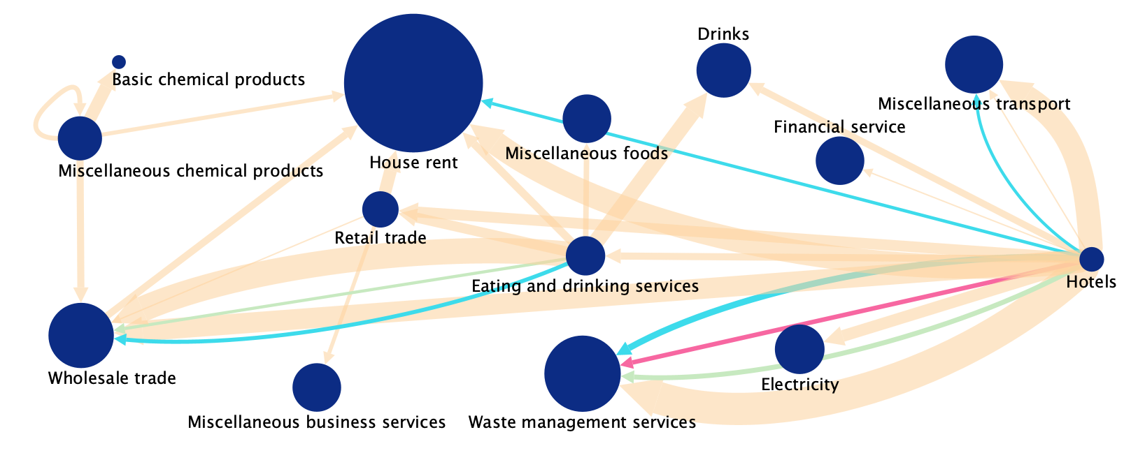

3. Results: The supply chains most affected by value added loss
The size of each bubble represents the value-added coefficient of each industry, the thickness of the arrows indicates the magnitude of the losses, and the color of the arrows represents the nationality of the inbound tourists who contributed to the losses.
The three most severely damaged supply chain paths were:
“hotels → waste management services”
“eating and drinking services → wholesale trade”
“hotels → miscellaneous transport”
These damages were mainly triggered by the decline in tourism demand from Chinese tourists.
The hotel and eating and drinking service sectors acted as key industries, spreading significant losses to downstream sectors such as waste management, transport, wholesale, retail, and beverage production.
The three most severely damaged supply chain paths:
Hotels → waste management services (14.1 billion JPY)
Eating and drinking services → wholesale trade (11.8 billion JPY)
Hotels → miscellaneous transport (11.2billio JPY)
the three most affected paths are
“hotels → waste management services (14.1 billion JPY),”
“eating and drinking services → wholesale trade (11.8 billion JPY),”
“hotels → miscellaneous transport (11.2 billion JPY).”
These results indicate that the decrease in demand from Chinese tourists had a substantial ripple effect on the Japanese economy through SCs.
The impacts originating from the hotels sector spread widely to industries such as waste management, house rent, miscellaneous transport, wholesale trade, and electricity. Similarly, the eating and drinking services sector triggered downstream effects on wholesale trade, drinks, retail trade, house rent, and miscellaneous foods.
In addition, a reduction in the purchase of cosmetics and perfumes due to the decline in Chinese tourists resulted in a value-added loss of 7.3 billion JPY along the path miscellaneous chemical products → basic chemical products, which exceeded the economic loss observed in the hotels → waste management services path linked to the decrease in tourists from Taiwan. Note that several paths converged on the “house rent” sector. However, the decline in tourism demand during the COVID-19 pandemic is unlikely to have directly caused widespread rent defaults, which suggests that this result may not accurately reflect the real-world situation.
The top 30 supply chain paths that experienced the greatest value-added losses.
South Korea
Bubble’s size:
Taiwan
Value-added intensity
The U.S.
China
Arrow’s thickness:
Magnitude of the losses
Arrow’s color:
Nationality of tourists
Fig 4. Network diagram of the top 30 industrial paths with the largest economic impacts from inbound tourism loss, identified through SPD
Notes:
Figure 4 visualizes the top 30 supply chain paths that experienced the greatest value-added losses as a network diagram.
The size of each bubble represents the value-added coefficient of each industry, the thickness of the arrows indicates the magnitude of the losses, and the color of the arrows represents the nationality of the inbound tourists who contributed to the losses.

Slide 23
3. Results: The supply chains most affected by value added loss
South Korea
Taiwan
The U.S.
China

Slide 24




3. Results: The supply chains most affected by value added loss
South Korea
Taiwan
The U.S.
China
The three most severely damaged supply chain paths:
Due to the decline in final demand by inbound tourists from China
China
$$∆f$$
Hotels → Waste management services
-14.1 billion JPY
China
$$∆f$$
Eating and drinking services → Wholesale trade
-11.8 billion JPY
China
$$∆f$$
Hotels → Miscellaneous transport
-11.2 billion JPY
1st order | 2nd order | 産業3 | 要因 | 最終需要 | 付加価値(百万円)
Hotels | Waste management services |  | F | 中国 | -109,434
Eating and drinking services |  |  | F | 中国 | -100,817
Hotels |  |  | F | 中国 | -76,970
Notes:
●The three most severely damaged supply chain paths were:
“hotels → waste management services” “eating and drinking services → wholesale trade”“hotels → miscellaneous transport”
●These damages were mainly triggered by the decline in tourism demand of tourists from China.

Slide 25
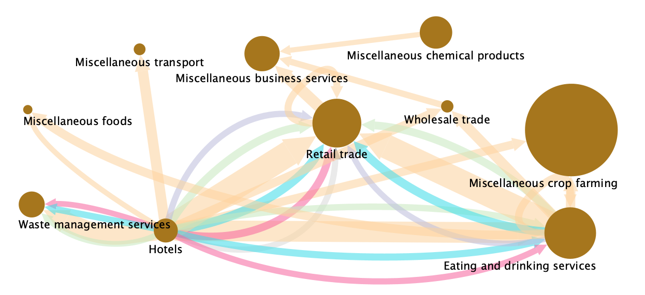
3. Results: The supply chains most affected by employment loss
The top 30 supply chain paths that experienced the greatest employment losses.
China
Bubble’s size:
Hong Kong
Employment intensity
South Korea
Taiwan
Arrow’s thickness:
The U.S.
Magnitude of the losses
Others
Arrow’s color:
Nationality of tourists
Fig 5. Network diagram of the top 30 industrial paths with the largest social impacts from inbound tourism loss, identified through SPD
Notes:
Figure 5 visualizes the top 30 supply chain paths that experienced the greatest employment losses.

Slide 26
3. Results: The supply chains most affected by employment loss
China
Hong Kong
South Korea
Taiwan
The U.S.
Others

Slide 27



3. Results: The supply chains most affected by employment loss
The impacts were particularly pronounced for inbound tourism demand declines from China, Taiwan, South Korea, the U.S., and Hong Kong. Among the affected sectors, hotels and eating and drinking services appeared as the largest bubbles, thereby indicating their substantial role in generating spillover effects on other industries.
In particular, three paths,
“hotels → retail trade,”
“eating and drinking services → retail trade,”
“hotels → eating and drinking services,” were identified as having incurred especially large employment losses.
China
Hong Kong
South Korea
Taiwan
The U.S.
Others
Strong employment interdependencies among face-to-face service industries that were highly exposed to tourism demand shocks.
The three most severely damaged supply chain paths:
China
$$∆f$$
Hotels → Retail trade
-3.7 thousand people
China
$$∆f$$
Eating and drinking services → Retail trade
-3.5 thousand people
China
$$∆f$$
Hotels → Eating and drinking services
-3.0 thousand people
Hotels → Retail trade (-3.7 thousand people)
Eating and drinking services → Retail trade (-3.5 thousand people)
Hotels → Eating and drinking services (-3.0 thousand people)
Notes:
The three most severely damaged supply chain paths were:
“hotels → retail trade”
“eating and drinking services → retail trade”
“hotels → eating and drinking services”
⭐️These linkages highlight the strong employment interdependencies among face-to-face service industries that were highly exposed to tourism demand shocks.

Slide 28
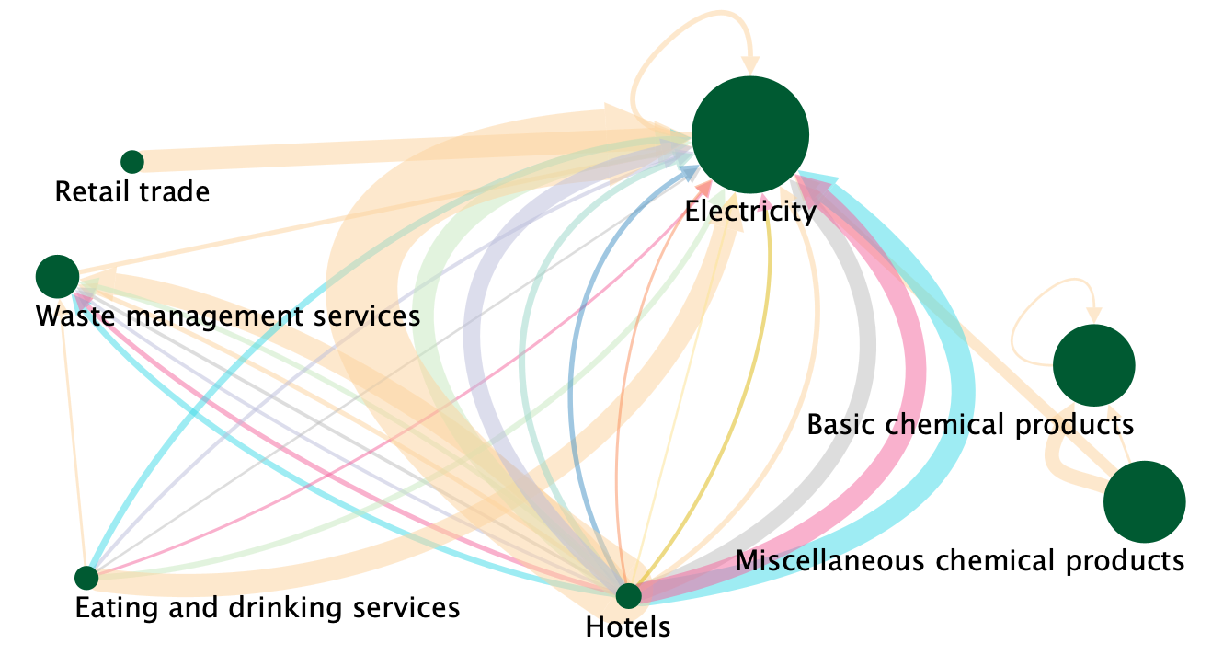
3. Results: The supply chains most affected by CO₂ reduction
The top 30 supply chain paths that experienced the greatest CO₂ reduction.
Australia
South Korea
Bubble’s size:
China
Taiwan
England
Thailand
CO₂ emission intensity
France
The U.S.
Arrow’s thickness:
Hong Kong
Others
Singapore
Amount of the reduction
Arrow’s color:
Nationality of tourists
Fig 6. Network diagram of the top 30 industrial paths with the largest environmental impacts from inbound tourism loss, identified through SPD
Notes:
Figure 6 visualizes the top 30 supply chain paths that experienced the greatest reduction of CO2 emissions..

Slide 29
3. Results: The supply chains most affected by CO₂ reduction
Australia
South Korea
China
Taiwan
England
Thailand
France
The U.S.
Hong Kong
Others
Singapore

Slide 30
3. Results: The supply chains most affected by CO₂ reduction
Australia
South Korea
China
Taiwan
England
Thailand
France
The U.S.
Hong Kong
Others
Singapore
The three most severely affected supply chain paths:
China
$$∆f$$
Hotels → Electricity
-434 kt-CO₂
Taiwan
Hotels → Electricity
-159 kt-CO₂
$$∆f$$
China
$$∆f$$
Eating and drinking services → Electricity
-155 kt-CO₂
Notes:
●The three supply chain paths that contributed most to CO₂ reductions were:
“hotels → electricity” due to the decline in final demand from tourists from China and Taiwan, and “eating and drinking services → electricity” due to the decline in final demand from tourists from China.

Slide 31
3. Results: The supply chains most affected by CO₂ reduction
Australia
South Korea
China
Taiwan
England
Thailand
France
The U.S.
Hong Kong
Others
Singapore
The reduction was largely driven by indirect decreases in electricity demand caused by five specific sectors.
The three most severely affected supply chain paths:
China
$$∆f$$
Hotels → Electricity
-434 kt-CO₂
Taiwan
Hotels → Electricity
-159 kt-CO₂
$$∆f$$
China
$$∆f$$
Eating and drinking services → Electricity
-155 kt-CO₂
Notes:
⭐️The reduction was largely driven by indirect decreases in electricity demand caused by five specific sectors: hotels, eating and drinking services, retail trade, miscellaneous chemical products, and waste management services.

Slide 32
Section 4
Discussion and Conclusions

Slide 33



4. Discussion and Conclusions:
The SPD framework employed in this study is based on an income-endogenous input-output model, which allowed for the incorporation of income-related spillover structures into the analysis. Specifically,
the decomposition included changes in household expenditure coefficients, household disposable income ratios, and labor income coefficients. However, the contribution of these income-related factors was found to be minimal. The substantial decline in final demand by inbound tourists was the overwhelmingly dominant factor driving the observed impacts.
The analysis covered 21 inbound tourist nationalities and 6 decom-position factors.
Overview of This Study
We identified key supply chain impacts of COVID-19 on inbound tourism using SPD and a consumption-endogenous IO model.
The analysis was conducted across economic, social, and environmental aspects disaggregated by the 21 nationalities of inbound tourists and 6 decomposition factors.
Key Findings
Supply chain hotspots were identified
Value added loss
China
$$∆f$$
Hotels → Waste management services
-14.1 billion JPY
Employment loss
China
$$∆f$$
Hotels → Retail trade
-3.7 thousand people
CO₂ reduction
Decline in final demand by inbound tourists from China
China
Hotels → Electricity
-434 kt-CO₂
$$∆f$$
Contribution of the income-related factors was found to be minimal.
Notes:
●This study applied consumption-endogenous input-output analysis and counterfactual SPD to assess the economic, social, and environmental impacts of the COVID-19-induced decline in inbound tourism demand.
●This analysis breaks down the impact on supply chains across the three aspects based on final demand from 21 countries and 10 different driving factors.
●One of the key findings of this study is the identification of supply chain hotspots that were most affected in economic, social, and environmental terms.
●In the economic dimension, the most significant loss was observed in the “hotels → waste management” supply chain.
●In the social dimension, the most affected path was “hotels → retail trade”.
●In the environmental dimension, the “hotels → electricity” path contributed most to CO₂ reduction.
●All of these impacts were primarily driven by the decline in tourism demand from Chinese inbound tourists.
●Additionally, compared to the contribution of the final demand shock, the influence of income- and household consumption-related factors was found to be very limited.

Slide 34






4. Discussion and Conclusions
Policy Implications for Tourism Recovery and Risk Management
・ホットスポットの結果ベース
Policy implications for economic recovery and environmental sustainability:
The government should recognize that the damage to certain industries was the result of a trade-off between economic loss and environmental benefit.
Key Policy Implications for Economic Recovery:
The government should recognize that the damage to certain industries was the result of a trade-off between economic loss and environmental benefit.
For example, the “hotels → waste management services” supply chain path suffered the greatest economic loss, yet also contributed significantly to CO₂ reduction.
While waste management services play an important role in generating value-added from inbound tourism, they are also major CO₂ emitters.
Therefore, financial support for these sectors should be linked to their efforts to cut down CO₂ emissions.
Additionally, since the economic impact was strongly influenced by the high consumption propensity of Chinese tourists, reducing overreliance on the Chinese market could serve as a risk hedge in future crises.
“Hotels → waste management services” suffered the greatest economic loss, yet also contributed to CO₂ reduction.
-14 billion JPY
CO₂
-434 kt-CO₂
Waste management
Hotels
Financial support for these sectors should be linked to their efforts to cut down CO₂ emissions.
Reducing overreliance on the Chinese market could serve as a risk hedge in future crises.
  Diversify tourist source markets to reduce overreliance on China as a risk mitigation strategy.
Economic:
  Provide financial support not only to directly affected sectors (e.g., hotels, restaurants), but also to upstream industries linked through supply chains.
  Diversify tourist source markets to reduce overreliance on China as a risk mitigation strategy.
Social:
  Prioritize support for workers in directly impacted sectors.
  Promote job transitions through training and employment programs to enhance resilience against future disruptions.
Environmental:
  The temporary reduction in CO₂ emissions highlights the need to promote energy efficiency in sectors like hospitality, food services, and chemicals.
  Integrate decarbonization incentives into tourism recovery plans.
Environmental:
Notes:
Based on our findings, we propose three key policy directions.
First, to recover economic losses, the government should recognize that the damage to certain industries was the result of a trade-off between economic loss and environmental benefits.
For instance, the supply chain path from “hotels to waste management services” experienced the largest economic loss, yet also contributed significantly to reductions in CO₂ emissions. Although waste management services play a key role in generating value-added from inbound tourism, they are also major sources of emissions.
Therefore, financial support for such sectors should be tied to their commitment to reducing carbon emissions.

Slide 35






4. Discussion and Conclusions
  Prioritize support for workers in directly impacted sectors.
  Promote job transitions through training and employment programs to enhance resilience against future disruptions.
Policy implications for social recovery:
Face-to-face service industries (e.g., Retail, Hotels) were heavily affected by the pandemic and faced high unemployment risks.
Difficulties of job change
These industries struggled due to indirect impacts from declining final demand.
Damaged sectors
Profitable sectors
Hotels
Retail trade
IT
e-commerce
Restaurant
Government support should focus on:
Facilitating labor transitions to more resilient industries.
Providing job training and employment assistance programs.
Sectors like IT and e-commerce grew, as they adapted well to remote operations.」
However, workers in service industries often face difficulties shifting to these new sectors.
Face-to-face service industries (e.g., retail, hospitality) were heavily affected by the pandemic and faced high unemployment risks.
These industries struggled due to indirect impacts from declining final demand.
Sectors like IT and e-commerce grew, as they adapted well to remote operations.
However, workers in traditional service industries often face difficulties shifting to these new sectors.
Government support should focus on:
Facilitating labor transitions to more resilient industries
Providing job training and employment assistance programs.
Notes:
To support social recovery, it is important to recognize that face-to-face service industries—such as retail and hospitality—were severely impacted by the pandemic, facing high risks of unemployment.
These sectors were affected not only directly, but also indirectly through the decline in final demand, especially in tourism-related services like hotels and restaurants.
On the other hand, industries such as IT and e-commerce experienced growth, as they were well-suited to remote operations.
However, workers in traditional service sectors often face challenges in transitioning to these more resilient industries.
Therefore, government efforts should focus on facilitating such transitions through job training and employment assistance programs.

Slide 36
4. Discussion and Conclusions:
Japan's inbound tourism supply chains—especially those centered on hotels and food services—are highly susceptible to demand-side shocks during disasters.
The finding that final demand had the greatest influence on outcomes suggests that this analytical framework is not only applicable to pandemics, but also broadly adaptable to various disasters that may trigger sudden drops in demand, such as large-scale earthquakes.
Conclusions
As of 2025, inbound tourism in Japan has already surpassed pre-COVID levels. However, inbound tourism remains vulnerable to sudden external shocks.
This analytical framework is not only useful for analyzing pandemics, but also broadly relevant to other types of sudden disasters that lead to crucial decline in tourism demand.
Counterfactual SPA-based analysis is useful for designing balanced recovery strategies across economic, social, and environmental dimensions at the supply chain level.
We recommend incorporating this framework into policy planning, to support a balanced and resilient recovery policies.
Notes:
To conclude, As of 2025, inbound tourism in Japan has already surpassed pre-COVID levels, and the government is aiming for further growth. However, the sector remains vulnerable to sudden external shocks.
Our findings indicate that This analytical framework is not only useful for analyzing pandemics, but also broadly relevant to other types of sudden disasters that lead to crucial decline in tourism demand, such as major earthquakes.
Counterfactual SPA-based analysis is valuable for designing balanced recovery strategies that consider economic, social, and environmental aspects at the supply chain level.
Therefore, we recommend incorporating this framework into policy planning to support more balanced and resilient recovery efforts.

Slide 37
Thank you for your kind attention.

Slide 38
Appendix

Slide 39




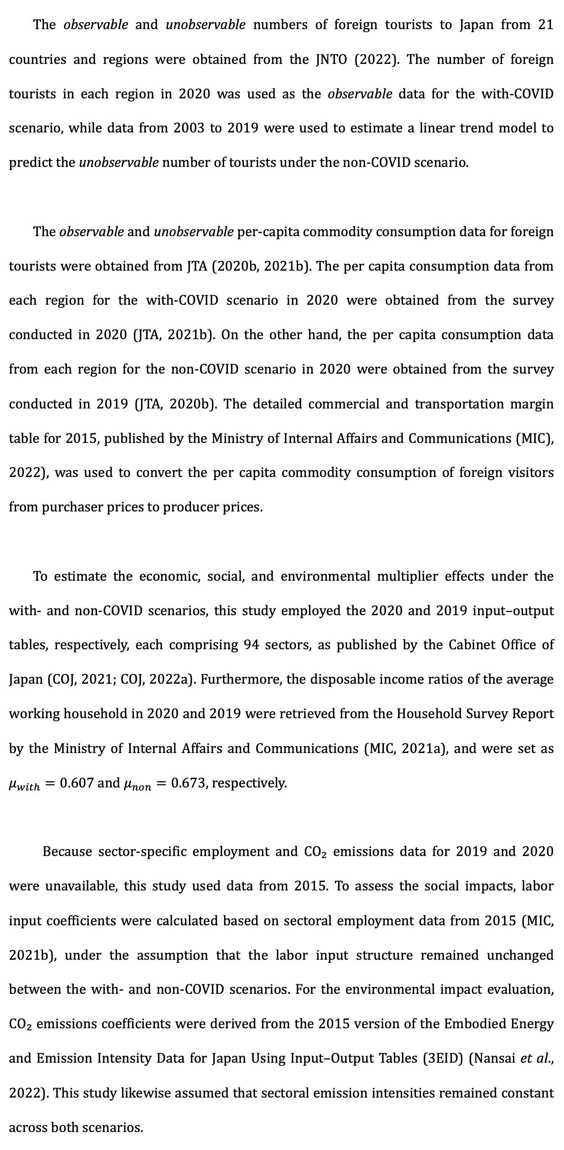














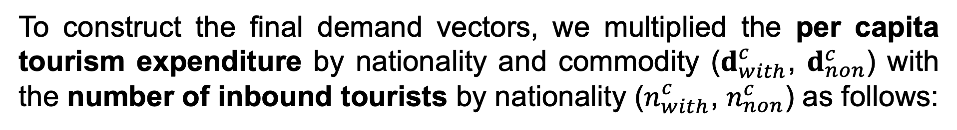



Data
The observable and unobservable numbers of foreign tourists to Japan from 21 countries and regions
were obtained from the JNTO (2022).
The number of foreign tourists in each region in 2020 data from 2003 to 2019 were used to estimate a linear trend model to predict the unobservable number of tourists under the non-COVID scenario.
The observable and unobservable numbers of foreign tourists to Japan from 21 countries and regions were obtained from the JNTO (2022). The number of foreign tourists in each region in 2020 was used as the observable data for the with-COVID scenario, while data from 2003 to 2019 were used to estimate a linear trend model to predict the unobservable number of tourists under the non-COVID scenario.
The observable and unobservable per-capita commodity consumption data for foreign tourists were obtained from JTA (2020b, 2021b). The per capita consumption data from each region for the with-COVID scenario in 2020 were obtained from the survey conducted in 2020 (JTA, 2021b). On the other hand, the per capita consumption data from each region for the non-COVID scenario in 2020 were obtained from the survey conducted in 2019 (JTA, 2020b). The detailed commercial and transportation margin table for 2015, published by the Ministry of Internal Affairs and Communications (MIC), 2022), was used to convert the per capita commodity consumption of foreign visitors from purchaser prices to producer prices.
To estimate the economic, social, and environmental multiplier effects under the with- and non-COVID scenarios, this study employed the 2020 and 2019 input–output tables, respectively, each comprising 94 sectors, as published by the Cabinet Office of Japan (COJ, 2021; COJ, 2022a). Furthermore, the disposable income ratios of the average working household in 2020 and 2019 were retrieved from the Household Survey Report by the Ministry of Internal Affairs and Communications (MIC, 2021a), and were set as $μ_{with}=0.607$ and $μ_{non}=0.673$, respectively.
Because sector-specific employment and CO₂ emissions data for 2019 and 2020 were unavailable, this study used data from 2015. To assess the social impacts, labor input coefficients were calculated based on sectoral employment data from 2015 (MIC, 2021b), under the assumption that the labor input structure remained unchanged between the with- and non-COVID scenarios. For the environmental impact evaluation, CO₂ emissions coefficients were derived from the 2015 version of the Embodied Energy and Emission Intensity Data for Japan Using Input–Output Tables (3EID) (Nansai et al., 2022). This study likewise assumed that sectoral emission intensities remained constant across both scenarios.
To construct the final demand vectors, we multiplied the per capita tourism expenditure by nationality and commodity ($d_{with}^{c}$, $d_{non}^{c}$) with the number of inbound tourists by nationality ($n_{with}^{c}$, $n_{non}^{c}$) as follows:
The observable and unobservable per-capita commodity consumption data for foreign tourists
were obtained from JTA (2020b, 2021b). The per capita consumption data from each region for the with-COVID scenario in 2020 were obtained from the survey conducted in 2020 (JTA, 2021b). On the other hand, the per capita consumption data from each region for the non-COVID scenario in 2020 were obtained from the survey conducted in 2019 (JTA, 2020b). The detailed commercial and transportation margin table for 2015, published by the Ministry of Internal Affairs and Communications (MIC), 2022), was used to convert the per capita commodity consumption of foreign visitors from purchaser prices to producer prices.
$$A_{with}$$
$d_{non}^{c}$
2020
$$n_{with}^{c}$$
The number of foreign tourists in each region
(Japan National Tourism Organization, 2022)
2003-2019
$n_{non}^{c}$
The observable and unobservable per-capita commodity consumption data for foreign tourists
$$d_{with}^{c}$$
$$s_{with}$$
2020
2019
$d_{non}^{c}$
(Japan Tourism Agency, 2022)
$$v_{with}$$
$$s_{non}$$
$$A_{with}$$
$$h_{with}$$
$$w_{with}$$
The 94 sectors input–output tables in Japan
2020
IO
$$μ_{non}$$
(Cabinet Office of Japan, 2021, 2022)
2019
$$v_{non}$$
$$w_{non}$$
$$A_{non}$$
$$h_{non}$$
Yearly Average of Monthly Receipts and Disbursements per Household (Workers' Households of Total Households)
$$μ_{with}$$
$$w_{with}$$
2020
2019
$$μ_{non}$$
(Ministry of Internal Affairs and Communications, 2021a)
CO₂ emissions coefficients
the disposable income ratios of the average working household in 2020 and 2019
Ministry of Internal Affairs and Communications, 2021
the disposable income ratios of the average working household in 2020 and 2019
were retrieved from the Household Survey Report by the Ministry of Internal Affairs and Communications, 2021
To estimate the economic, social, and environmental multiplier effects under the with- and non-COVID scenarios,
this study employed
the 2020 and 2019 input–output tables, respectively, each comprising 94 sectors, as published by the Cabinet Office of Japan (COJ, 2021; COJ, 2022a). Furthermore, the disposable income ratios of the average working household in 2020 and 2019 were retrieved from the Household Survey Report by the Ministry of Internal Affairs and Communications (MIC, 2021a), and were set as 𝜇_𝑤𝑖𝑡ℎ=0.607 and 𝜇_𝑛𝑜𝑛=0.673, respectively.
The number of foreign tourists in each region in 2020
2003 to 2019
were used to estimate a linear trend model to predict the unobservable number of tourists under the non-COVID scenario.
Notes:
The observable and unobservable numbers of foreign tourists to Japan from 21 countries and regions were obtained from the JNTO (2022).

Slide 40






Data
Ministry of Internal Affairs and Communications
Employment Table (Breakdown of Employees by Sector of Production Activity).
2015
$$s_{with}$$
$$s_{non}$$
(Ministry of Internal Affairs and Communications, 2021b).
CO₂ emissions coefficients were derived from
the 2015 version of the Embodied Energy and Emission Intensity Data for Japan Using Input–Output Tables.
2015
$$e_{with}$$
$$e_{non}$$
CO₂
(Nansai et al., 2022).

Slide 41
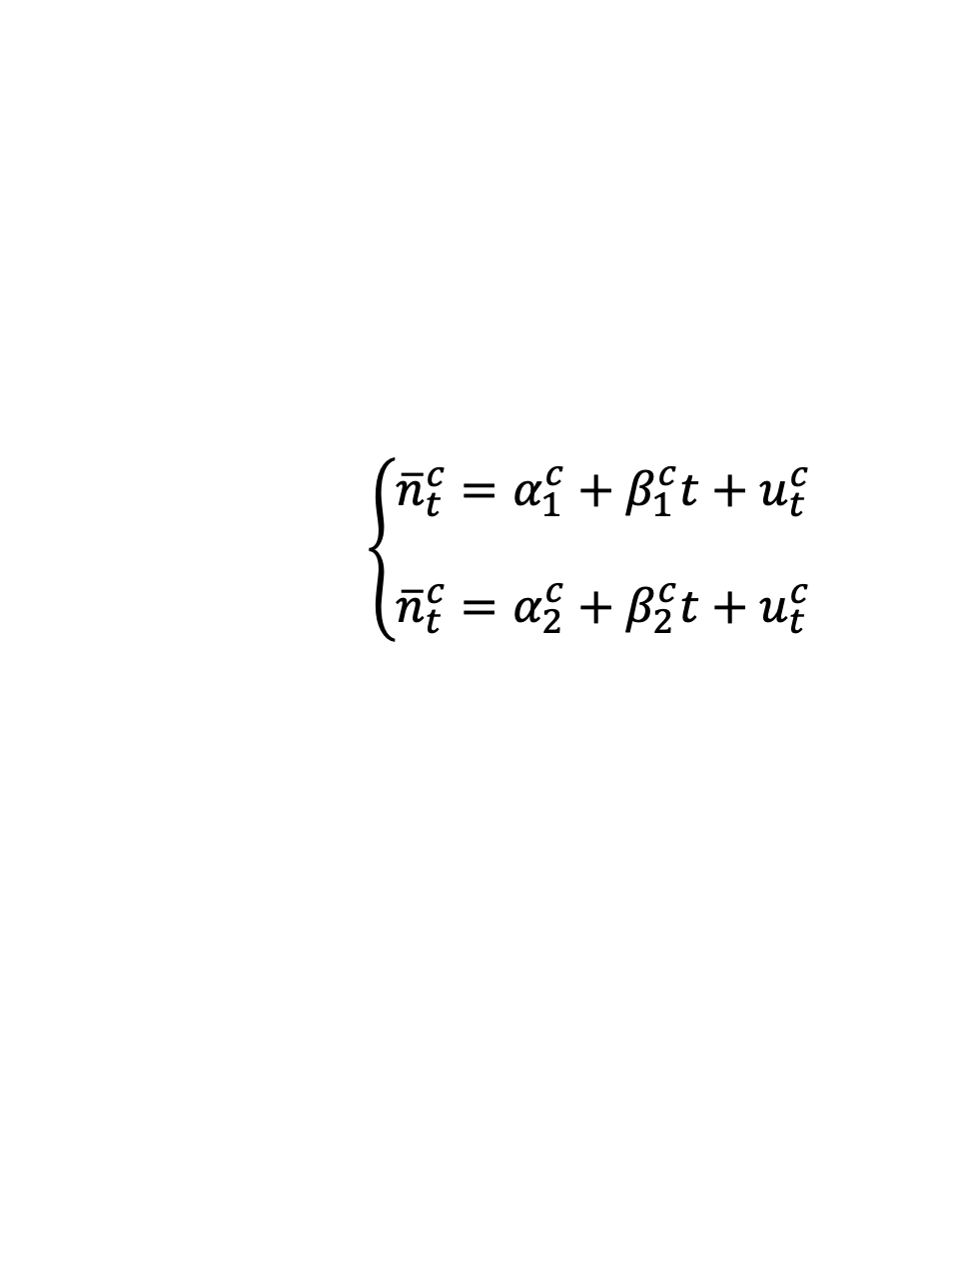






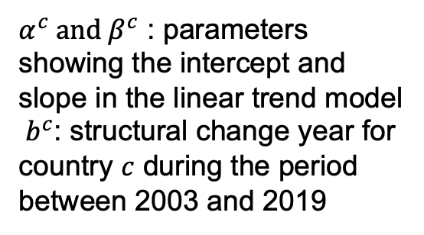



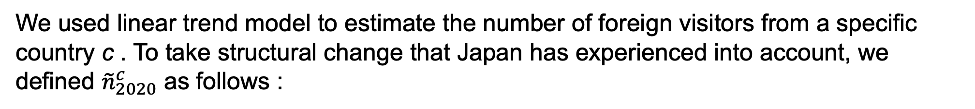
2. Methodology: Setting up two scenarios in 2020
延長推計の図を新しく
𝑒𝑥. Trend in the number of Chinese visitors to Japan
Non-COVID Scenario (Counterfactual scenario)
(3)
$n_{non}^{c}={\tilde{α}}^{c}+{\tilde{β}}^{c}×2020$
${\tilde{n}}_{2020}^{c}$ :
The estimated number of foreign visitors from country or nation c in 2020.
$${\overline{n}}_{t}^{c}=α_{2}^{c}+β_{2}^{c}t+u_{2,t}^{c}$$
(2)
$$\left(t={ b}^{c},{ b}^{c}+1,…, 2019\right)$$
There is no actual data.
$${\overline{n}}_{t}^{c}=α_{1}^{c}+β_{1}^{c}t+u_{1,t}^{c}$$
(1)
$$\left(t=2003, 2004,…,{ b}^{c}−1\right)$$
Structural change year
We used linear trend model to estimate the number of foreign visitors from a specific country c . To take structural change that Japan has experienced into account, we defined ${\tilde{n}}_{2020}^{c}$ as follows :
$α^{c} and β^{c}$ : parameters showing the intercept and slope in the linear trend model
${ b}^{c}$: structural change year for country $c$ during the period between 2003 and 2019
$$\left\{\begin{aligned}&{\overline{n}}_{t}^{c}=α_{1}^{c}+β_{1}^{c}t+u_{t}^{c} \\ & \\ &{\overline{n}}_{t}^{c}=α_{2}^{c}+β_{2}^{c}t+u_{t}^{c} \end{aligned}\right.$$
$$\left(t=2003, 2004,…,{ b}^{c}−1\right)$$
(1)
$$\left(t={ b}^{c},{ b}^{c}+1,…, 2019\right)$$
(2)
$n_{non}^{c}={\tilde{α}}^{c}+{\tilde{β}}^{c}×2020$
(3)
Notes:
Structural changes in the trend of inbound tourists to Japan have occurred due to various tourism promotion policies.
Taking the case of Chinese visitors to Japan as an example,
we observe that the growth trend from 2003 to 2013 differs significantly from that of 2013 to 2019,
with the latter period showing a steeper increase.
This suggests that 2013 represents a structural change year.
Therefore, the trends before and after the structural change can be approximated using separate linear regression models, as shown in Equations (1) and (2).
Assuming that the COVID-19 pandemic did not occur in 2020,
the number of Chinese visitors in that year can be estimated based on Equation (3),
which extrapolates from the post-structural change trend.
To determine the structural change point, we conducted F-tests by assuming each year from 2003 to 2019 as a potential change point
and compared the F-values of the post-change regression models (Equation (2)).

Slide 42






4. Discussion and Conclusions
Policy Implications for environmental sustainability:
The stagnation of five energy-intensive sectors indirectly reduced CO₂ emissions by decreasing electricity demand.
Recovery support should include incentives for lowering the energy intensity of these sectors.
Retail trade
Waste management services
Hotels
Subsidy for suppliers
Discount for
tourists
Eating and drinking services
Miscellaneous chemical products
CO₂
CO₂
CO₂
CO₂
Discount
CO₂
CO₂
Energy-intensive sectors
This approach would help reduce CO₂ emissions associated with inbound tourism even after the pandemic recovery.
Notes:
In addition to restoring economic and social losses, this study also proposes policies aimed at sustaining the environmental benefits, particularly the reduction in CO₂ emissions.
The analysis revealed that the stagnation of five energy-intensive sectors indirectly reduced CO₂ emissions by decreasing electricity demand.
Therefore, recovery support should include incentives for reducing the energy intensity of these sectors.
For example, subsidies for suppliers could be increased for businesses that make efforts to decarbonize—such as improving the energy efficiency of accommodation facilities.
In addition, discounts could be offered to tourists who choose low-impact travel styles.
Such approaches would help reduce CO₂ emissions associated with inbound tourism even after the pandemic recovery.

