Slide 1

Assessing the Macroeconomic Impact
of Next Generation EU
A Country and Industry Analysis of the Recovery and Resilience Facility
Valeria Ferreira, Luis E. Pedauga, José M. Rueda-Cantuche and Daria Ciriaci
European Commission. Joint Research Centre (JRC).
Unit B7 Innovation Policies and Economic Impact.
Analysis and Modelling of Trade and Industrial EU Policies (AMADEUS).
31st International Input-Output Association Conference

Slide 2


Policy objective and main novelties
Assessing the macroeconomic impact of the RRF in each Member State, focusing on its cross boarder impacts with a highly disaggregated sectoral view.
  A new sectoral dataset developed using AI.
  The use of the FIDELIO model.
More information

Slide 3
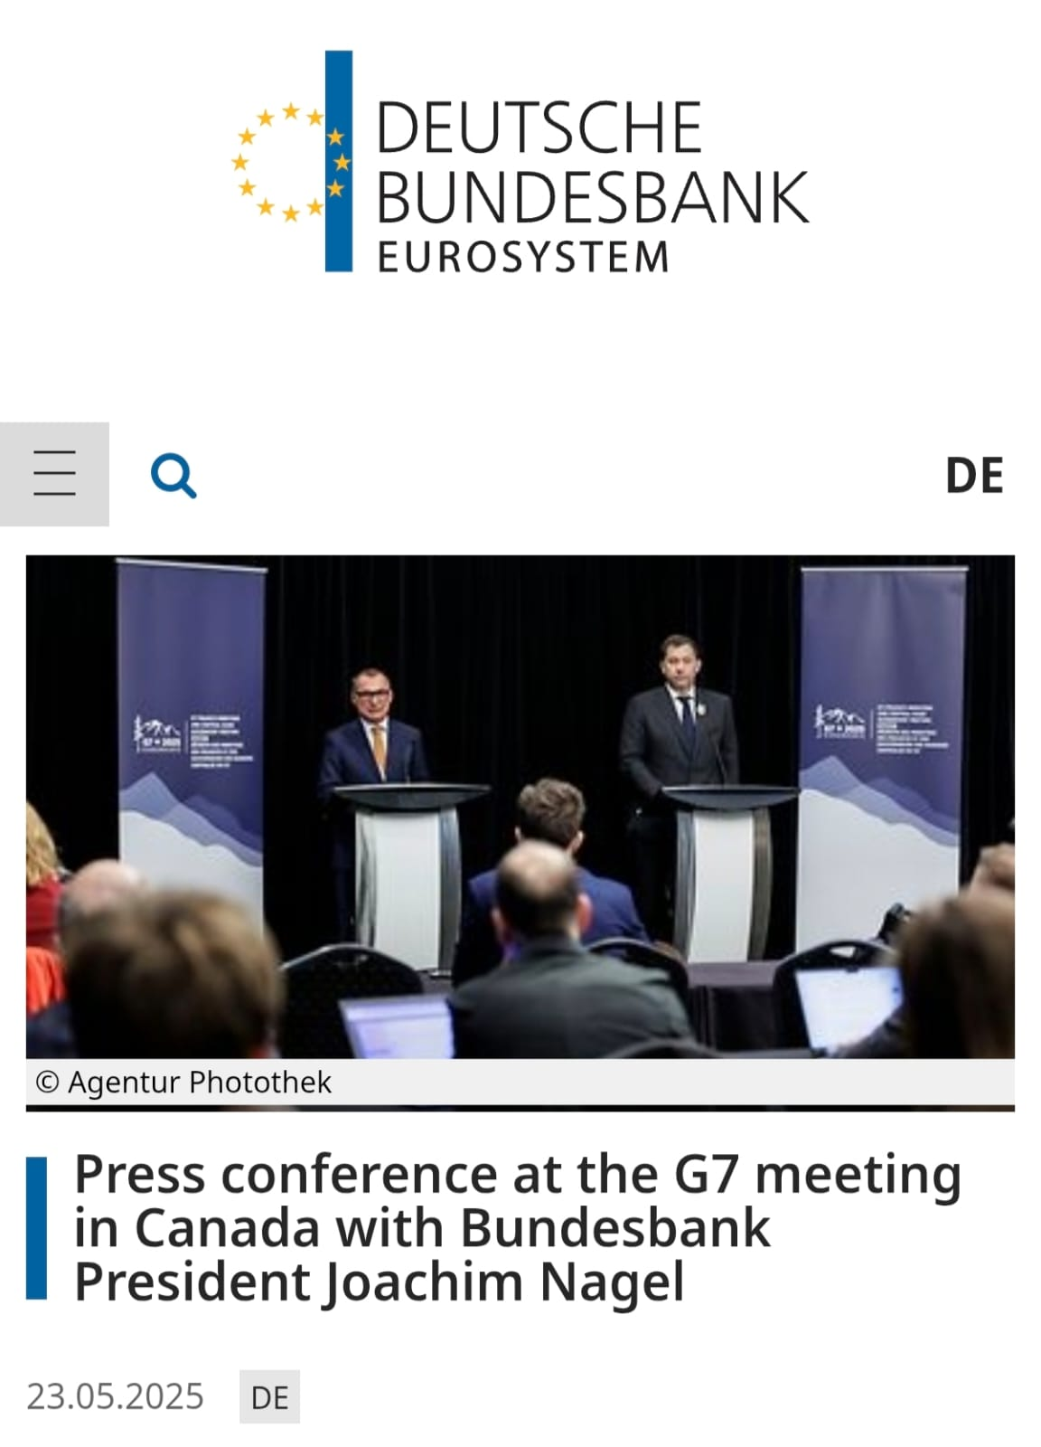
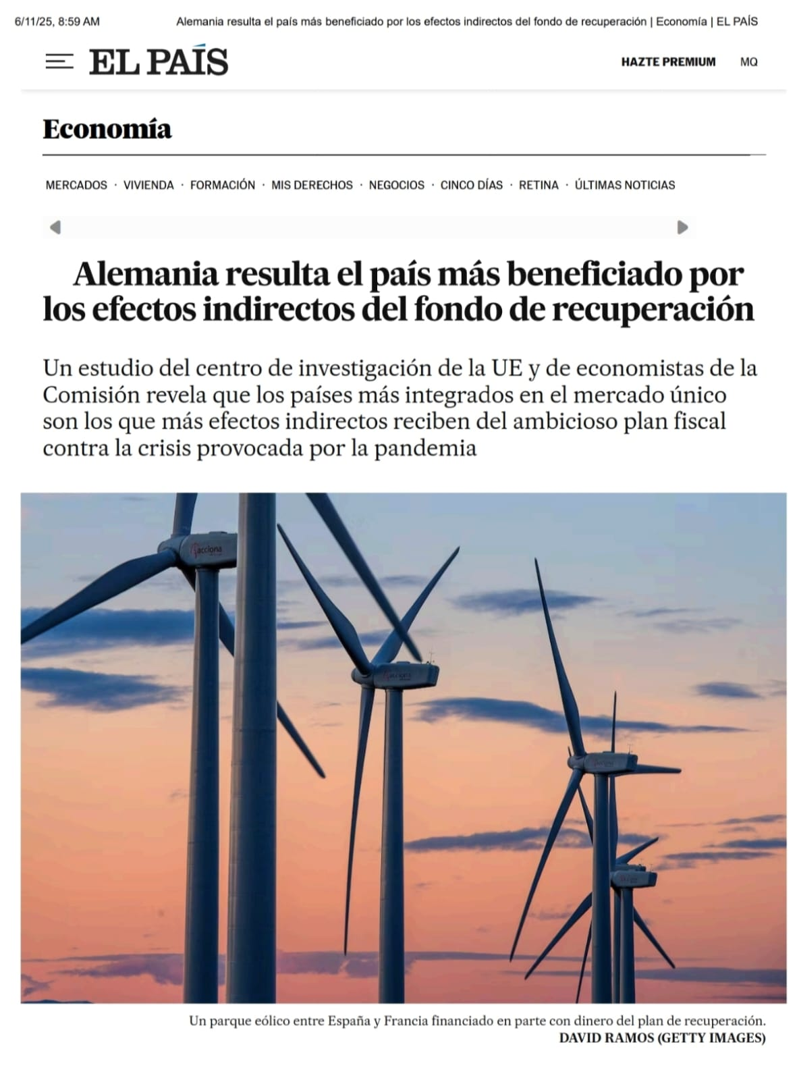

Slide 4
Outline
Understanding the Recovery and Resilience Facility (RRF)
A new sectoral database
Overview of FIDELIO model
Macroeconomic analysis
Conclusions

Slide 5
Understanding the Recovery and Resilience Facility (RRF)

Slide 6
1. Understanding the RRF funds
Recovery and Resilience Facility
Largest component of the
Next Generation EU recovery package.
Established as part of the European Union's response to the COVID-19 pandemic.
Aims to support member states in recovering from the economic and social impact of the crisis.
Promote economic recovery and growth across EU MS.
Support the green transition and digital transformation.
Notes:
The Recovery and Resilience Facility (RRF) is a temporary instrument of NextGenerationEU -the EU’s plan to emerge stronger and more resilient from the current crisis.
Through the Facility, the Commission raises funds by borrowing on the capital markets (issuing bonds on behalf of the EU). These are then available to its Member States, to implement ambitious reforms and investments that:
make their economies and societies more sustainable, resilient and prepared for the green and digital transitions, in line with the EU’s priorities

Slide 7






1. Understanding the RRF funds
Recovery and Resilience Facility
The RRF's strategic framework is built on six key pillars
Digital transition
Smart, sustainable and inclusive growth
Green transition
Health, and economic, social and institutional resilience
Social & territorial cohesion
Policies for the next generation

Slide 8
1. Understanding the RRF funds
Recovery and Resilience Facility
in loans
€291 billion
€655 billion
€364 billion
in grants

Slide 9
1. Understanding the RRF funds
How does the Recovery and Resilience Facility (RRF) utilise strategic investments and reforms to drive economic recovery and long-term resilience across the European Union?
Recovery and Resilience Facility
?

Slide 10

A new sectoral database

Slide 11
2. A new sectoral database
The data was provided by the Directorate General for Economic and Financial Affairs of the European Commission (DG ECFIN).
Classifies investment-related measures on current and planned disbursements of grants and loans, i.e. the commitments of the Member States under their National Recovery and Resilience Plans (RRP).
Using AI tools and manually verified.
Aggregated into 64 sectors to enable macro, sectoral and policy analysis.

Slide 12
Categorisation of RRF investments: overall approach
  RRF investments (+ 'costed' reforms) = EUR 655.5 bn
  The classification follows a 'commodity' approach → measures are categorised based on the sector where they generate demand.
    E.g. An investment in school construction is categorised under the "construction of buildings" sector, reflecting the sectoral destination of the expenditure.
  What happens if a single measure is linked to multiple sectors?
​ Primary NACE Code ​ ​ Most significant expenditure | ​ Secondary NACE code ​ ​ Smaller expenditure​ ​

Slide 13
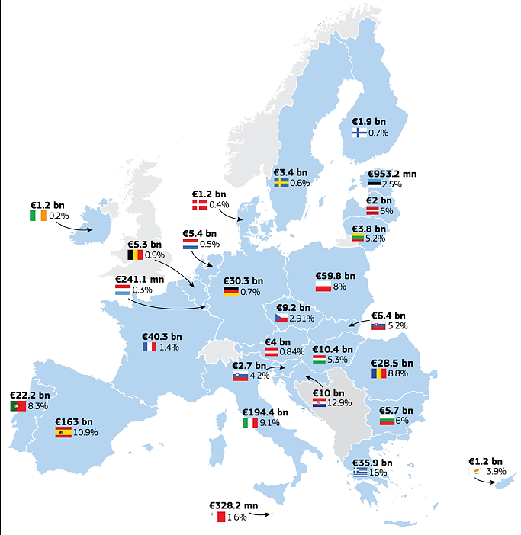
The RRF so far
  EUR 655 billion (4% of EU GDP)

Slide 14
RRF investments: overall distribution by countries
Total RRF funds (655.5 € bn) by EU country
€ bn

Slide 15
RRF investments: overall distribution by NACE sectors
F - Construction
It is estimated that 276 € bn will be allocated to construction (42.1%) followed by computer programming (11.9%), financial services (7.5%) and computer and electronics (5.9%).
€ bn
J62- 63 - Computer programming, consultancy / Information service activities
C26 - Manufacture of computer, electronic and optical products
M72 - Scientific research and development
C28 - Manufacture of machinery and equipment
C27 - Manufacture of electrical equipment
P85 - Education

Slide 16



























RRF Investments: sectoral distribution by country
% of national envelopes
GRANDTOTAL
AT
BE
BG
HR
CY
CZ
DK
EE
FI
FR
DE
EL
HU
IE
IT
LV
LT
LU
MT
NL
PL
PT
RO
SK
SI
ES
SE

Slide 17


Overview of FIDELIO model
More information

Slide 18
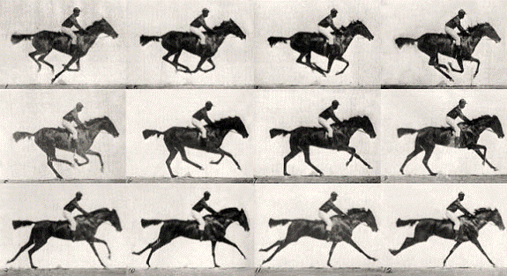


From Figaro to Fidelio
Full International and Global Accounts for Research in input-Output   
Figaro
Fidelio
⧫   Fully Intercountry Dynamic Econometric Long-term Input-Output

Slide 19
3. FIDELIO
Fully Interregional Dynamic Econometric Long-term Input-Output
Type: Multi-sector Dynamic Econometric General Equilibrium economic model
Econometric: calibration of most of the behavioral parameters (dynamic adjustment lags of prices and quantities, and elasticities) is based on econometric estimations, in particular in the consumption block.
Purpose: is designed for policy impact assessment, providing industrial-, country-, and time-specific simulations.
Coverage: is based on official statistics from Eurostat's FIGARO.
Modular approach: more transparent economic impact assessment models.
Fidelio

Slide 20
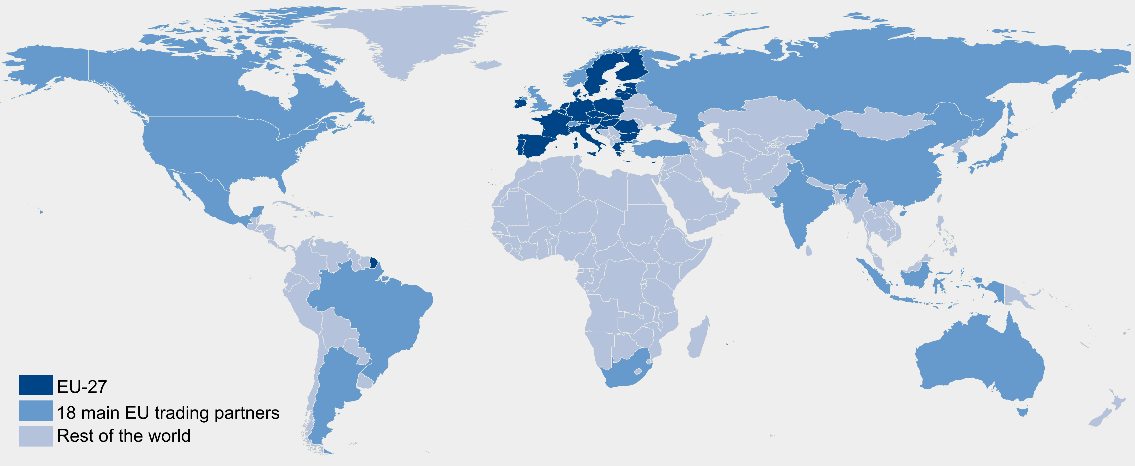

3. FIDELIO: Database
FIGARO: ‘Full International and Global Accounts for Research in input-Output analysis’.
18 main
trading
partners
+ RoW
+
=
Figaro
45 + RoW
The EU inter-country Supply, Use and Input-Output tables (FIGARO tables), are the results of a co-operation between Eurostat and the European Commission’s Joint Research Centre.
Since 2021 it has become EU Official Statistics: fully aligned with countries’ National Accounts official statistics.
  Supply-use by 64 product/industry categories (CPA/NACE Rev.2)
https://ec.europa.eu/eurostat/web/esa-supply-use-input-tables/figaro

Slide 21
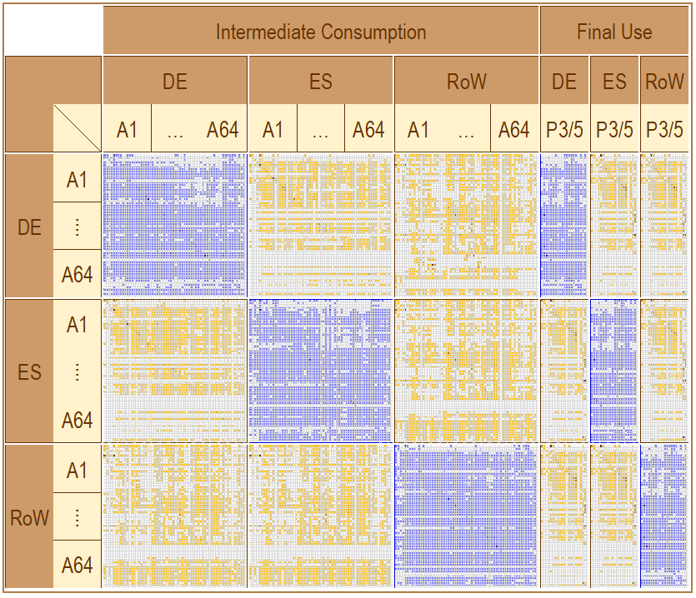
3. FIDELIO: Database
Uses
Figaro
Resources

Slide 22
3. FIDELIO: Database
From DE
to ES
(balanced)
Figaro
From ES
to DE
(balanced)

Slide 23


3. FIDELIO: Database
Mirror
trade
approach
Figaro
Full International and Global Accounts
for Research in input-Output analysis

Slide 24




3. FIDELIO: Description of main blocks
Government Block
Household Block
Government
Demand
Household
Demand
Demand
Total
Step – 1
Armington
elasticity
$$σ_{r,c}^{1}$$
Domestic
Supply
Exported
Supply
Domestic
Goods
Imported
Goods
Domestic
Demand
Imported
Demand
Production Block
Trade Block

Slide 25
3. FIDELIO: underlying economic theory
Dynamic and price settings
Neo-classical long-term properties:
The dynamics of the model is driven by exogenous variables (population growth or labour productivity) and the law of motion for capital.
Capital demand depends on the demand of capital in the previous year and the level of investment in the current period.
Neo-Keynesian properties: short-term behavior progressively adjusted to the long-term optimum (notional) by all economic agents (e.g. unemployment) and capital:
Investment affected by effective demand of capital and long-term optimum.
Adaptive expectations (backward-looking) – autoregressive.

Slide 26

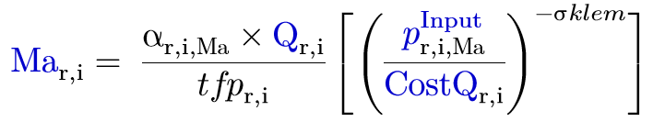

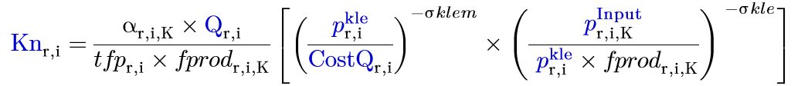
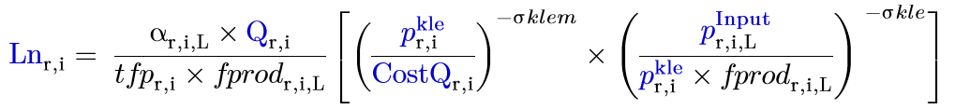
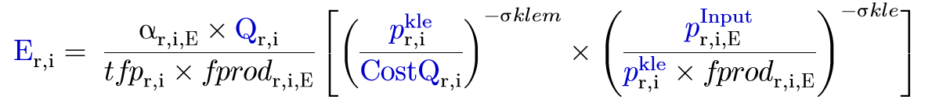


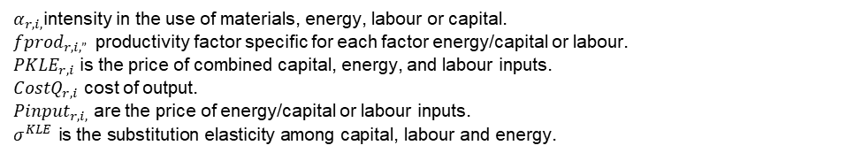
3. FIDELIO: Production block
KLEM
Supply = Demand
$α_{r,i,\text{Ma}}$ = intensity in the use of M
$P{Input}_{r,i, Ma}$ = price of materials
$COSTQ_{r,i}$= cost of output
$σ^{KLEM}$= substitution elasticity between the KLE and M.
KLE
Secondary production: one product can be produced by various industries with different technologies.
Investment
Intermediate demand
Capital
Labour
Energy
$$σ_{r,c}^{kle}$$
CES
function
F
I
G
A
R
O
$α_{r,i,}$intensity in the use of materials, energy, labour or capital.
$fprod_{r,i,” }$ productivity factor specific for each factor energy/capital or labour.
$PKLE_{r,i}$ is the price of combined capital, energy, and labour inputs.
$CostQ_{r,i}$ cost of output.
$Pinput_{r,i,}$ are the price of energy/capital or labour inputs.
$$σ^{KLE} \text{is} \text{the} \text{substitution} \text{elasticity} \text{among} \text{capital}\text{, }\text{labour} \text{and} \text{energy}\text{.}$$
K,L,E,
K,L,E,
Materials
CES
function
$$σ_{r,c}^{klem}$$
Domestic Supply
Nace 1 … Nace n
The notional level corresponds to the LONG-TERM optimal (desired or target) level that the economic agent would choose in the absence of adjustment constraints.
Domestic
Demand
Production Block
Notes:
By default, the substitution elasticity $σ^{KLEM}$ of the first nest is set equal to 0, assuming no substitution between the KLE bundle and materials.
αr,i,L​: It reflects the relative importance of labor in generating output.
tfpr,i​: Total Factor Productivity for industry i in region r. An increase in TFP means less labor (and other inputs) is needed to produce the same amount of output, leading to a decrease in labor demand for a given output.
fprodr,i,L​: This is a factor share parameter for labor within the inner CES nest (KLE composite) for industry i in region r. It represents labor's specific contribution within the Capital-Labor-Energy bundle. Acts as a weighting factor, reflecting labor's initial share in the KLE composite.
pr,ikle​: The price of the Capital-Labor-Energy (KLE) composite input used by industry i in region r. This price reflects the weighted average cost of capital, labor, and energy.
CostQr,i​: The unit cost of producing output Qr,i​ in industry i in region r. This is the overall cost of producing one unit of good i.
σklem​: The elasticity of substitution between the KLE composite and other inputs (like intermediate materials) in the production of good i. This parameter dictates how easily the KLE composite can be swapped with other major input groups.
σkle​: The elasticity of substitution among Capital, Labor, and Energy within the KLE composite for good i. This parameter specifically tells you how easily labor can be substituted with capital or energy (and vice-versa) in the production process.
If the price of labor (pr,i,LInput​) increases relative to the price of the KLE composite (pr,ikle​), firms will demand less labor, especially if the elasticity is high (easy to substitute labor with capital or energy).

Slide 27



3. FIDELIO: Capital Dynamics
While the long-term optimum demand of K is determined by the cost minimization problem, the effective demand of capital depends on previous period, and the level of investment of the current period.
In turn, investment depends on: i) gap between the effective and notional (long-term optimum) capital stock, ii) the price of capital and iii) the bundle KLE, and the substitution elasticity.
Investment
Intermediate demand
Kn
Capital
Labour
Energy
$$σ_{r,c}^{kle}$$
CES
function
F
I
G
A
R
O
Investment demand by industry in t
K,L,E,
K,L,E,
Materials
CES
function
$$σ_{r,c}^{klem}$$
Domestic Supply
Nace 1 … Nace n
Investment by commodity (c) from demand by industry (i) in t
Domestic
Demand
Production Block
Where bridge describes the different goods that industries invest on.
The endogenous dynamic of the model is not only defined by capital accumulation as in many Walrasian models.
Notes:
KLE es la combinación de capital (K), trabajo (L) y energía (E) en la función de producción.
La elasticidad de sustitución mide qué tan fácil es reemplazar un insumo con otro.
Si el capital puede ser fácilmente sustituido por trabajo o energía (alta elasticidad), la inversión en capital será menos sensible a su precio.
"The bundle KLE": This implies that the overall cost and productivity of the composite Capital-Labor-Energy input will influence the incentive to invest in capital. If the KLE bundle becomes more productive or relatively cheaper (perhaps due to falling energy prices making the whole bundle more attractive), firms might expand production and thus demand more capital.
Qr,i​: The total quantity of output produced by industry i in region r. This indicates that investment demand is scaled by the size of the industry's output. As output grows, the need for new capital (and thus investment) typically increases.
(Lag1Kr,i​Lag1Knr,i​​)0.05: This is the crucial term that captures the "gap" between the desired (notional) and actual (effective) capital stock from the previous period.
Lag1Knr,i​: This represents the lagged notional (desired/optimal) capital stock for industry i in region r. This would be the capital stock derived from the long-term cost minimization problem, perhaps from the previous period's solution.
Lag1Kr,i​: This would be the lagged actual (effective) capital stock for industry i in region r. This is the capital stock physically in place at the beginning of the current period (i.e., at the end of the previous period).
The ratio (Lag1Kr,i​Lag1Knr,i​​): If this ratio is greater than 1, it means the desired capital stock is larger than the actual capital stock. This implies a "gap" that firms want to close, thus driving up investment. If the ratio is less than 1, it suggests excess capacity, which would depress investment.
The exponent 0.05: This is an adjustment speed parameter or a partial adjustment coefficient. A value of 0.05 (or α in a general form) indicates that only a small fraction (5%) of the gap between desired and actual capital is closed in the current period. This implies a slow adjustment process. Firms don't immediately jump to their desired capital stock; they move gradually. This parameter is critical for capturing investment dynamics.
(pr,ikle​×fprodr,i,K​pr,iK​​)−σKLE​: This term captures the relative price effect on investment, consistent with the earlier statements.
pr,iK​: This is the price of capital input for industry i in region r, specific for Capital.
pr,ikle​: The price of the KLE (Capital-Labor-Energy) composite for industry i in region r.
fprodr,i,K​: The factor share parameter for capital within the KLE composite for industry i in region r.
σKLE​: This should be the elasticity of substitution among Capital, Labor, and Energy. This term reflects how changes in the relative price of capital compared to the KLE composite (normalized by its share) influence the demand for capital, and thus investment. If capital becomes relatively cheaper compared to the KLE composite, investment demand will increase, as firms substitute towards capital within the KLE bundle.

Slide 28
Macroeconomic analysis

Slide 29
Modelling strategy

Slide 30




4. Simulation strategy
Counterfactual Scenario: deviate from a baseline equilibrium due to a demand-driven investment shock (RRF) of 655.5 € bn (364.5 € bn in grants and 291 € bn in loans), allocated across countries and industries during the period of 2020-2026.
Model takes into account:
Value chains across 64 sectors | No reforms effects, only investments
Bilateral trade between 45 countries | No welfare effects beyond GDP
Differentiates between direct and cross-border (‘spillover’) impacts
Structural effects (i.e. productivity)

Slide 31
4. Simulation strategy
Grants: non-repayable financial contributions given to EU member states.
  RRF grants are assumed to be financed by Member States' contributions to the EU budget, which are, in turn, funded via lump-sum taxes. Under this mechanism, households ultimately bear the cost of the grants through a reduction in their disposable income, consequently offsetting some of the RRF's positive economic effects.
Loans: are repayable amounts that the EU lends to member states, offered at favorable conditions, meaning low interest rates and extended timelines.
  The study has assumed that the loans will be repaid in 30 years, with a seven-year grace period and an interest rate based on the main refinancing operations of the European Central Bank.
Productivity gains: additional value added generated by R&D investments funded through the RRF.
  This effect is derived through econometric estimations that leverage detailed country and industry-specific information on R&D investments and their subsequent impacts on value added (data from the Community Innovation Survey to estimate returns on R&D investments) (Pedauga et al. (2025), Moncada-Paternò-Castello et al. (2020)).
Notes:
Grants reduce the need for additional borrowing, alleviating fiscal pressure, while loans increase national public debt, leading to potential budgetary constraints in the long run.
RRF grants are assumed to be financed through long-term EU debt. This debt is repaid by Member States' contributions to the EU budget, which are, in turn, funded via lump-sum taxes. Repayments are scheduled to begin at the end of the current multiannual financial framework in 2027 and will proceed linearly until 2058. Under this mechanism, households ultimately bear the cost of the grants through a reduction in their disposable income. This negatively impacts household consumption and savings behaviour, consequently offsetting some of the RRF's positive economic effects.
This includes the crucial aspect of productivity gains, which arise from RRF funds dedicated to developing or upgrading new technologies, products, and services. These advancements are vital for fostering long-term economic growth throughout the EU.
Within FIDELIO, productivity gains are specifically attributed to the additional value added generated by R&D investments funded through the RRF. This effect is derived through econometric estimations that leverage detailed country and industry-specific information on R&D investments and their subsequent impacts on value added.
The estimation of these productivity effects is based on the work of Pedauga et al. (2025). Similar to Moncada-Paternò-Castello et al. (2020), their methodology utilises historical data from the Community Innovation Survey to estimate returns on R&D investments. Expected sectoral R&D intensity is derived from the GERD database, and the econometric approach adheres to established methods. The resulting sector-specific elasticities show considerable variation; for instance, high-tech sectors exhibit significantly higher values (0.161) compared to construction sectors (0.0083). When combined with the actual sectoral distribution of RRF investments, the average elasticity stands at 0.028, closely aligning with the low productivity scenario elasticity presented by Pfeiffer et al. (2023).

Slide 32







Government Block
Household Block
Government
Demand
Household
Demand
COICOP
…
Q1-Q5
Transfers
Household
Consumption
Interest
Debt
$$γ_{C}, β_{j}$$
Government
Debt
AIDS
model
Investment
Government Expenses
Savings
Household
Consumption
Household Disposable Income
Government Revenue
Household Income
Taxes
Government
Operating Surplus
Taxes less
subsidies
Social
Security
Income
taxes
Wages
Mixed
income
Property
Income
Gov.
Trans.
Other
Trans.
Social
Security
Demand
Total
Step – 1
$$σ_{r,c}^{1}$$
Armington
elasticity
Investment
Intermediate demand
Exported
Supply
Capital
Labour
Energy
Domestic
Goods
Imported
Goods
$$σ_{r,c}^{kle}$$
CES
function
F
I
G
A
R
O
Trade
Cpa 1 … Cpa n
Shock
Grants
K,L,E,
K,L,E,
Materials
$$σ_{r,c}^{2}$$
Armington
elasticity
CES
function
$$σ_{r,c}^{klem}$$
Step – 2
Domestic Supply
Nace 1 … Nace n
…
F
I
G
A
R
O
Country 1
Country n
Domestic
Demand
Imported
Demand
Production Block
Trade Block
Notes:
As loans and grants may exhibit distinct macroeconomic effects, they have been modelled differently.
Grants, being non-repayable, are modelled as injections into the economy that directly boost consumption and investment. This mechanism reduces fiscal pressure by alleviating the need for additional borrowing, thereby supporting economic growth without overburdening future budgets. Grants lower the fiscal burden on governments, allowing for more proactive spending and easing fiscal constraints, which in turn stimulates economic growth, too.
RRF grants are assumed to be financed through long-term EU debt. This debt is repaid by Member States' contributions to the EU budget, which are, in turn, funded via lump-sum taxes. Repayments are scheduled to begin at the end of the current multiannual financial framework in 2027 and will proceed linearly until 2058. Under this mechanism, households ultimately bear the cost of the grants through a reduction in their disposable income. This negatively impacts household consumption and savings behaviour, consequently offsetting some of the RRF's positive economic effects.

Slide 33
Government Block
Household Block
Government
Demand
Household
Demand
COICOP
…
Q1-Q5
Transfers
Household
Consumption
Interest
Debt
$$γ_{C}, β_{j}$$
Government
Debt
AIDS
model
Investment
Government Expenses
Savings
Household
Consumption
Household Disposable Income
Government Revenue
Household Income
Taxes
Government
Operating Surplus
Taxes less
subsidies
Social
Security
Income
taxes
Wages
Mixed
income
Property
Income
Gov.
Trans.
Other
Trans.
Social
Security
Demand
Total
Step – 1
$$σ_{r,c}^{1}$$
Armington
elasticity
Investment
Intermediate demand
Exported
Supply
Capital
Labour
Energy
Domestic
Goods
Imported
Goods
$$σ_{r,c}^{kle}$$
CES
function
F
I
G
A
R
O
Trade
Cpa 1 … Cpa n
Shock
Loans
K,L,E,
K,L,E,
Materials
$$σ_{r,c}^{2}$$
Armington
elasticity
CES
function
$$σ_{r,c}^{klem}$$
Step – 2
Domestic Supply
Nace 1 … Nace n
…
F
I
G
A
R
O
Country 1
Country n
Domestic
Demand
Imported
Demand
Production Block
Trade Block
Notes:
Loans, while also injecting funds into the economy, are modelled to reflect their impact on public debt. The requirement for repayment increases future fiscal obligations, which can lead to budgetary constraints and potentially limit the long-term economic stimulus effect compared to grants.
These repayments extend over a period of up to 30 years, with a seven-year grace period designed to assist countries in managing their debt as they commence recovery strategies. The interest rate applied to loans is a fixed 3.15% annually, aligned with the European Central Bank's (ECB) main refinancing operations rate.

Slide 34
Main results

Slide 35

5. Overall impact
€891.7 bn
Total impact
In 2030, the RRF total impact would amount to EUR 891.7 bn: a multiplier of 1.36.
This includes:
€546.2 bn
Impacts arise in the country receiving the funds: production and employment in its industries increase directly.
Direct impact
€345.5 bn
Impacts arise from other countries receiving the funds: the increase in demand in one country leads to a higher demand for imported final & intermediate goods in other countries.
Spillover impact

Slide 36
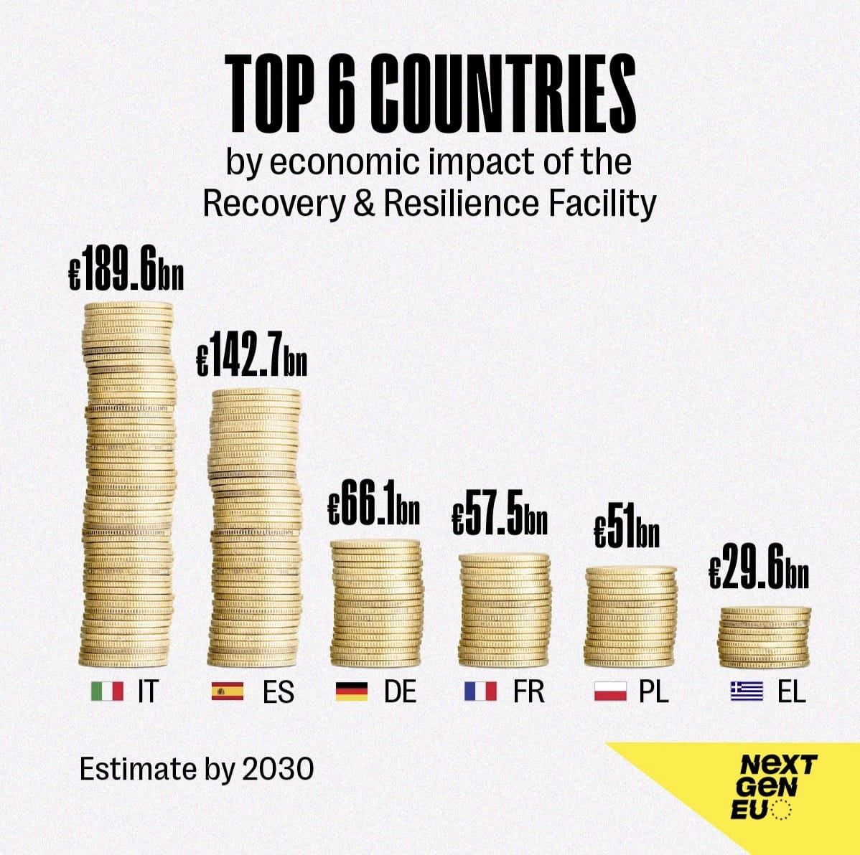
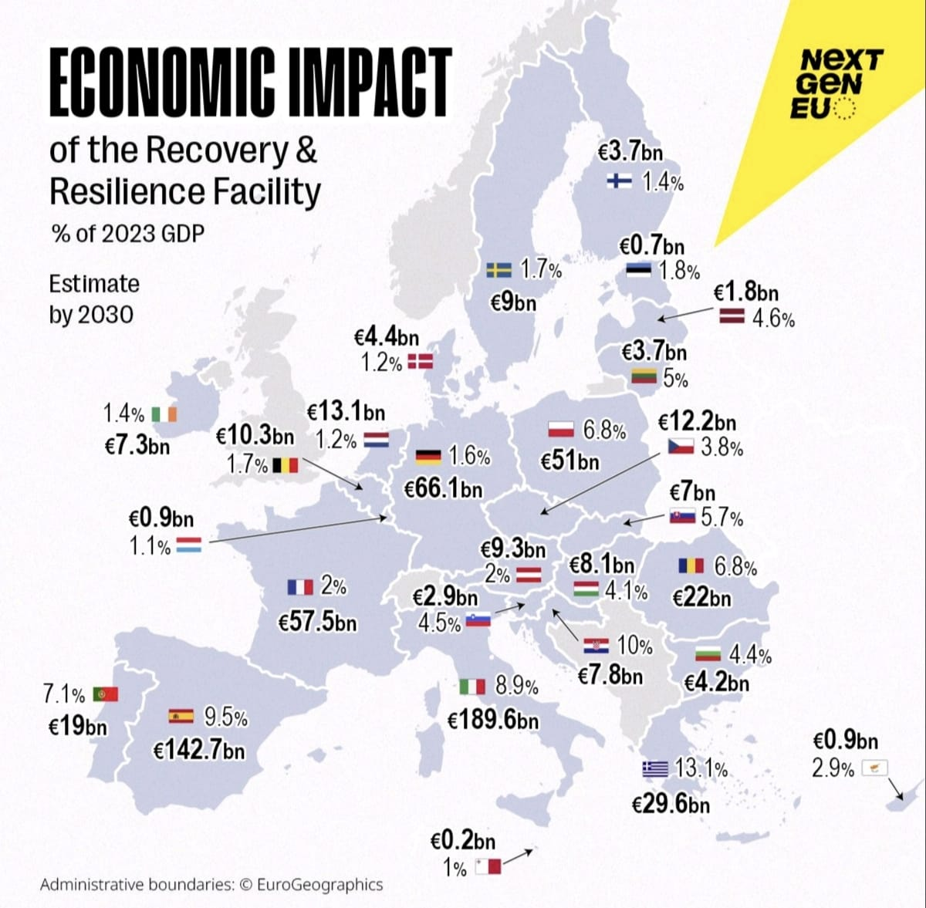
Main Global and EU results
The spillover effects of RRFs are particularly important in Germany, where two out of every three euros of impact come from funds received by other countries, mainly Spain and Italy.
The most impacted sectors are those related to the digital and green transition of the funds, e.g. industrial machinery and equipment, automotive and electronics.
The EU's strong dependence on China and the US in these sectors means that RRFs also have positive spillovers to other non-EU countries, in no case exceeding 1% of GDP.

Slide 37
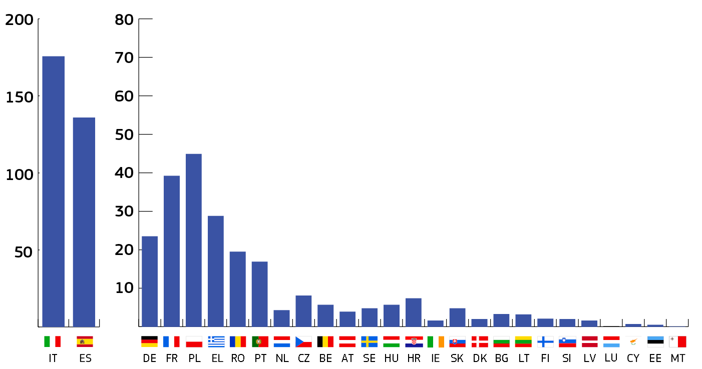
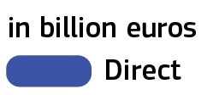
5. RRF direct impact on value added in € bn
Direct impacts materialise as an increase in value added in the industries of the country directly receiving the funds (IT RRP's impact in IT)
        impact on the funded industry,
        effect on other related industries → higher activity generates additional demand for intermediate inputs from domestic supplier industries throughout the national supply chain.
But this is not the end of the story...
Source:

Slide 38
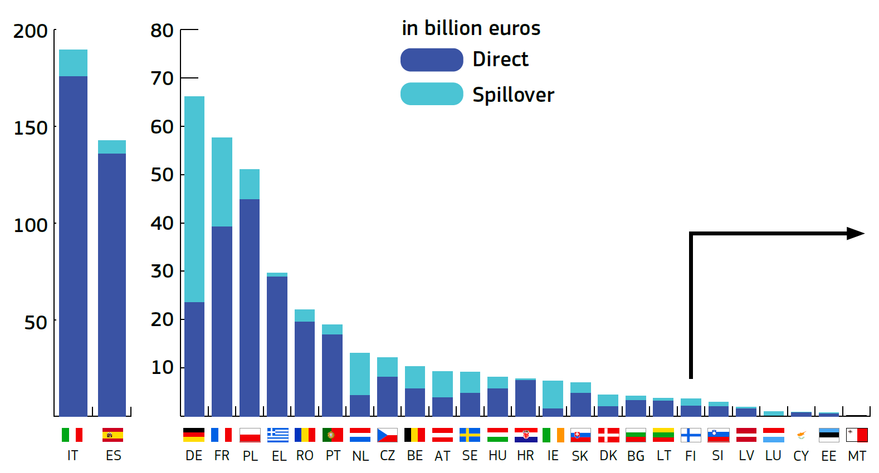
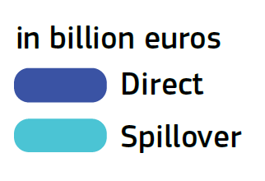
5. RRF direct & spillover impact on value added in € bn
The increase in demand will also lead to a higher demand for imported and intermediate goods (due to the deep economic integration within the EU).
RRF benefits extend beyond national borders.
The German economy is the largest beneficiary of spillovers within the EU (42.6 bn).
In some countries, spillovers account for almost two thirds of the total impact.
Source:

Slide 39
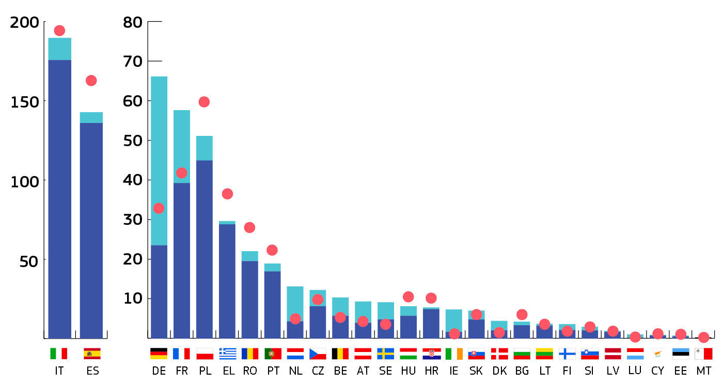
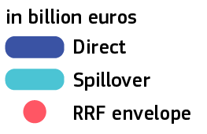
5. RRF direct & spillover impact on value added in € bn, compared to the initial RRP envelopes
RRF impacts in some MS (such as DE, FR, NL, AT) largely exceed the RRF initial envelope. The German economy becomes the 3rd RRF ‘beneficiary’.
Countries with very large RRF envelopes, such as IT and ES as well as PL, EL and RO contribute to the spillovers to other countries. Solidarity is a win-win.
In 2030 some multipliers below 1, in 2040 almost all exceed 1, several above 2. And we are underestimating (no Reforms, no Welfare).
Source:

Slide 40
5. Global spillovers:
% of total spillovers going to non-EU countries
Spillover impacts arise also from the deep economic integration with key non-EU trading partners along global value chains.

Slide 41
The case of Germany

Slide 42
5. Impact in German value added
Total RRFs: 655.5 € bn
Direct impact: 546.28 € bn
Spillover impact: 345.46 € bn
Total impact: 891.74 € bn
It is estimated that 32.3 € bn (0.9% GDP) will be allocated to Germany; 4.9% of the total RRF funds, ranking 6th.
The total potential direct impact in 10 years is 23.5 € bn for Germany, ranking 6th.
Germany has the potential to receive the largest amount of spillover impacts (42.6 € bn) in the EU, ranking 1st.
The total potential impact in 10 years is 66.1 € bn, which is 1.6% of the German GDP, ranking 3rd.

Slide 43
5. Main sectors in Germany benefitting from the RRF

Slide 44
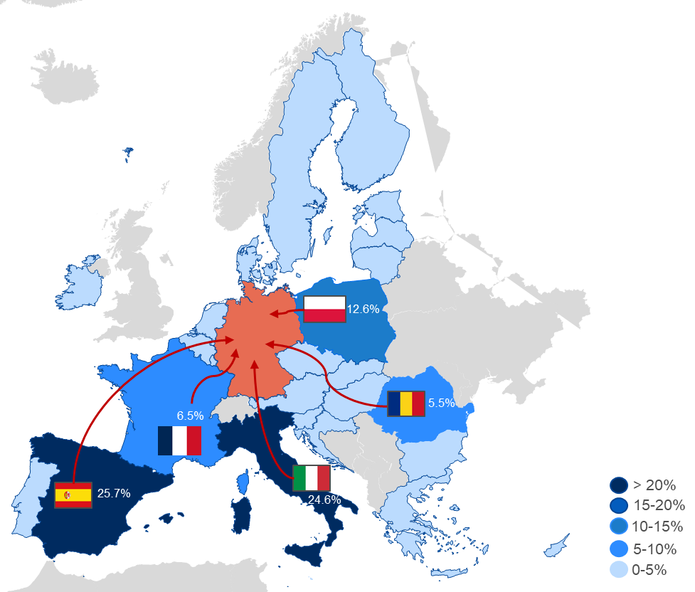
5. Main sources of RRF spillovers to Germany
  Total spillover impact
  for Germany = EUR 42.6 bn
Percentage of the overall RRF spillovers to Germany coming from other EU Member States

Slide 45
Conclusions

Slide 46
6. Key take-aways
Significant impacts confirmed
The RRF has a strong positive impact in every single EU country. In the EU, the medium-term impact of the RRF would be EUR 685.1 bn.
Spillovers are key
All countries benefit from spillover effects. In some cases (e.g. Germany), more than two-thirds of total RRF impacts come from spillovers.
Single Market stronger
Solidarity is a win-win. The RRF kept the Single Market together in the aftermath of the pandemic.
New sectoral evidence
We now have insights at sectoral level and new possibilities for analysis of impacts at macro-economic, sectoral and policy level, also for future analyses.

Slide 47







6. Possible further use
Disbursement updatecountries
In-depth sectoral analyses
In-depth pillar analyses
Economic impact of reforms
Synergies between reforms & investments
Transparency about beneficiaries

Slide 48
Thank you!
More information
Link: Economic Impacts of the Recovery and Resilience Facility: New Insights at Sectoral Level and the Case of Germany - European Commission

