Slide 1
The Unbearable Lightness of Being:
India's Takeover of Industrial Relocation from China
Presented by: Xiaoxu Zhang
Co-authors: Yuze Li, Kunfu Zhu, Kang Lin, Shouyang Wang
Notes:
It’s a great privilege to stand here today to discuss what I've playfully titled 'The Unbearable Lightness of Being: India's Takeover of Industrial Relocation from China.' This title, while borrowing from literary greatness, points to a profound economic question we all face: What Does the Shift of China's Industrial Capacity to India Mean for the World?

Slide 2




OUTLINE
Background
Methodology
Results
Discussion
Notes:
Here is the outline of my presentation.

Slide 3

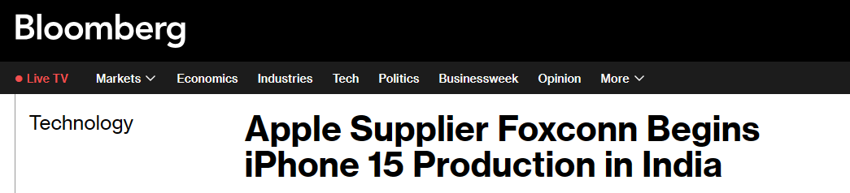
Background
Methodology
Results
Discussion
In recent years, multinational corporations (MNCs) have accelerated the geographic relocation of production capacity from China, as epitomized by Apple's partial shift of iPhone 15 manufacturing to India. This phenomenon reflects a strategic realignment in global industrial distribution, signaling the gradual outward migration of certain Chinese industries.
Global Industrial Reconfiguration: From China to India
Since the 1990s, China emerged as the "world's factory" through its labor endowment advantages and cost competitiveness in globalized production fragmentation. However, beginning in the early 21st century, rising labor costs, coupled with resource and environmental constraints and heightened geopolitical tensions, have driven labor-intensive industries (such as textiles) and labor-intensive production processes (such as assembly and processing) to relocate to other emerging economies (Upward et al., 2013; Cheng et al., 2019).
Notes:
let me take you back to September 2023, when Bloomberg published this headline—
'Apple Supplier Foxconn Begins iPhone 15 Production in India.'
At first glance, this might seem like just another corporate supply chain update.
But through our research lens, this was the starting point of a much bigger story—

Slide 4
Background
Methodology
Results
Discussion
Two Paradigms of Industrial Relocation
Multinational corporations (MNCs) are driving China's industrial relocation through distinct models:
Complementary China-Southeast Asia Mode- Driven mainly by the need to avoid rising labor costs in China and mitigate U.S.-China trade tensions, this production shift still relies on Chinese supply chains for continued operations, creating a complementary relationship between the host economy and domestic supply networks.
Competitive China-India Mode- It primarily depends on the supply chain of the destination region to sustain the development of the relocated industrial chain, creating competition between the host country’s supply chain and that of the original location.
Current research on China’s outward industrial relocation primarily focuses on the former, whereas studies on the latter remain relatively limited.
Notes:
We summarize this industrial relocation as two paradigms.

Slide 5
Background
Methodology
Results
Discussion
Fundamental Restructuring of Global Economic Architecture
Global economic and trade cooperation is undergoing profound changes, marking the advent of the “slow globalization” era (Brakman & Marrewijk, 2022). Persistent imbalances in global goods trade necessitate the reorganization of global industrial chains. Simultaneously, volatile international political and economic conditions, escalating geopolitical tensions, and the resurgence of trade protectionism have accelerated the reconstruction of global value chains.
The division of labor, operational logic, regulatory frameworks, and competitive paradigms within supply and industrial chains are undergoing transformative changes. The global value chain is shifting its emphasis from cost and efficiency toward security and stability, with industrial layouts trending toward “localization”, “regionalization”, and “friend-shoring”.
India: The Future Hub of Industrial Relocation?
India, leveraging its vast market size, low-cost labor force, and alignment with the U.S. “Indo-Pacific Strategy,” has implemented industrial development strategies such as “Make in India” and “Production-Linked Incentive” schemes. These initiatives have positioned India as a prime destination for industrial relocation and the most promising economy for absorbing China’s industrial shift.
Notes:
We are witnessing a fundamental rewiring/ restructuring of global economic architecture.
Based on past facts, China's industrial relocation has primarily been directed towards regions such as Vietnam and Mexico.
However, looking ahead, we believe that India is the economy most likely to take over China's industrial relocation.

Slide 6
Background
Methodology
Results
Discussion
Research Gap
Existing literature on industrial relocation primarily focuses on its driving factors, mechanisms, and economic impacts （Wen, 2004; Ellison et al., 2010; Alfaro et al., 2019; Flaaen et al., 2020 ), while largely neglecting environmental issues.
As a critical component of global economic activity, trade has played a significant role in driving global carbon emissions and environmental changes (Davis & Caldeira, 2010; Davis et al., 2011; Peters et al., 2011; Xu & Dietzenbacher, 2014; Jiang et al., 2015; Oita, A. et al., 2016; Zhang et al., 2020; Tian et al., 2021; Duan et al., 2024), profoundly shaping the global landscape.
Key Questions
In the future adjustment and restructuring of global value chains, which sectors in India possess inherent advantages that enable them to attract international investment and undertake China’s industrial relocation? To what extent can these advantageous sectors in India absorb the scale of industrial relocation from China? What does the shift of iPhone production capacity to India signify for the world? More broadly, what are the implications of India’s absorption of China’s industrial relocation for the world?

Slide 7
Background
Methodology
Results
Discussion
To address these questions, it is essential to conduct systematic and appropriate quantitative research on India’s absorption of China’s industrial relocation. The measurement of industrial relocation forms the foundation of related empirical studies, and current mainstream methods can be categorized into three approaches.
Firm-Level Tracking
The first approach adopts a firm-level perspective, using enterprise survey data to measure industrial relocation (Van Dijk & Pellenbarg, 2000; Roza, 2011; Jensen & Pedersen, 2012) . This method focuses on absolute industrial relocation.
Macroeconomic Indicators
In contrast to the first approach, which relies on statistical information on firm location changes to capture absolute shifts, the second approach uses publicly available macroeconomic data to depict relative changes. This often involves metrics in the form of the Balassa index, such as location quotients (Savona & Schiattarella, 2004) and industrial gradient coefficients (Zhang Shucun & Gu Chuntai, 2018). However, these indicators are susceptible to biases introduced by economic development factors, leading to “pseudo-industrial relocation” phenomena and failing to accurately represent the scale of industrial relocation.
Input-Output Models
Given the limitations of the first two approaches in capturing the global scale of industrial relocation, some scholars (Liu Hongguang et al., 2011; Gao et al., 2022; Yin Jie et al., 2024) have used interregional input-output tables to measure the value of industrial relocation. However, this method cannot precisely assess the structural distribution of industries within a specific economy that absorbs industrial relocation from other regions.
Notably, these studies are all based on ex-post measurement.

Slide 8
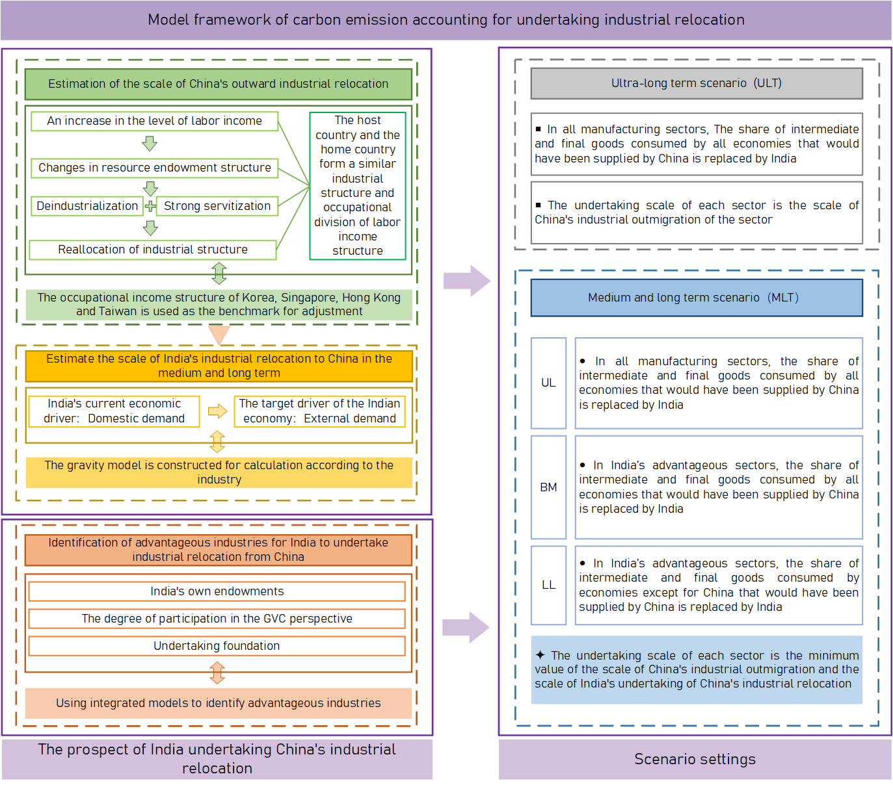
Methodology
Background
Results
Discussion
Considering the lack of ex-ante measurement methods for the environmental impacts of industrial relocation, we have constructed a carbon accounting framework to evaluate India’s absorption of China’s industrial relocation. The framework includes the following key components:
Measurement of Relocation Scale
Scale of China’s Outward Relocation
Scale of India’s Absorption
Identification of Relocated Sectors
Scenario Settings
Ultra-Long Term (ULT)
Medium and Long Term (MLT-UL,BM,LL）
Notes:
Here, we will first explain the scenario settings.
We have categorized the scenarios into ULT MLT-the reason for this naming is that our defined time horizons extend beyond conventional standards for "long-term" and "medium-term.

Slide 9
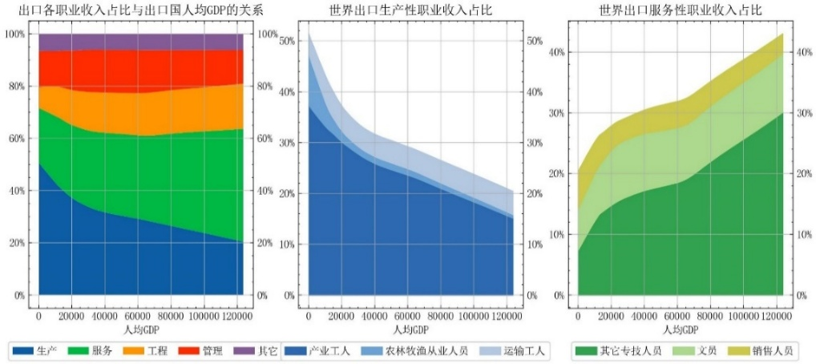
Methodology
Background
Results
Discussion
Measurement of China’s Outward Industrial Relocation Scale
As labor income levels rise, the resource endowment structures of economies undergo significant transformations. Manufacturing exports from a country experience both “deindustrialization” and “intensified servitization”, leading host countries to gradually develop industrial divisions of labor similar to those of the home country. This shift is accompanied by a convergence in occupational income structures.
Using the occupational income structures of South Korea, Singapore, Hong Kong, and Taiwan as benchmarks, adjustments are made to China’s occupational income structure to determine the proportion of industries requiring relocation. This serves as the basis for calculating the industrial relocation ratio for China’s outward industrial relocation by sector.
Measurement of India’s Industrial Relocation Absorption Scale
Since assuming office, Indian Prime Minister Modi has pledged to transform India into a global manufacturing and export powerhouse, consolidating the nation’s position as the fastest-growing major economy. India has implemented measures to unlock its untapped export potential by focusing on export-oriented economic development to meet international market demands. To quantify India’s capacity to absorb China’s industrial relocation, we categorize sample economies into two groups based on whether a given sector’s export orientation exceeds that of India. A gravity model is employed to estimate India’s trade potential for each sector.
Measuring India’s Capacity to Absorb China’s Industrial Relocation
Take smaller of both:
min{China’s outward industrial relocation ratio for the sector, (India’s export potential−India’s actual exports)/China’s export volume in the sector}min{China’s outward industrial relocation ratio for the sector,(India’s export potential−India’s actual exports)/China’s export volume in the sector}.
Notes:
Next, we will introduce the measurement methodology
Take the smaller of both

Slide 10
Background
Methodology
Results
Discussion
Identification of Relocated sectors
Core Factors in Sector Selection:
Endowment Advantages: Natural resources, labor skills, and capital
GVC Integration: Higher participation = Better relocation readiness
System Support: Infrastructure, policies, and market access
Our Methodology:
Combined three proven approaches:
Location Quotient (LQ) → Local production strengths
GVC Participation Model (Wang et al., 2017) → Global competitiveness
Relocation Value Framework (Gao et al., 2022) → Sector potential
Comprehensive Framework for Identifying the Advantageous Sectors in Region R for Industry Relocation from Region S
Identify the set of sectors in Region R with local production advantages
Identify the set of sectors in Region R that have advantages over Region S in GVC
Sectors has an absolute advantage, denoted as M1.
Catch-up advantage sectors , denoted as M2.
Sectors has an absolute advantage over Region S, denoted as N1.
Sectors with certain advantages over S, denoted as N2.
Exclude industries that lack the foundation for industrial relocation of each type, resulting in their respective subsets.
Subset of M1, denoted as M1*
Subset of M2, denoted as M2*
Subset of N1, denoted as N1*
Subset of N2, denoted as N2*
Optimal advantage sector： M1*∩N1*
Suboptimal advantage sector：（M1*∩N2*）∪（M2*∩N1*）
Medium advantage sector： M2*∩N2*
Notes:
In the interest of time, I’ll keep this brief.

Slide 11
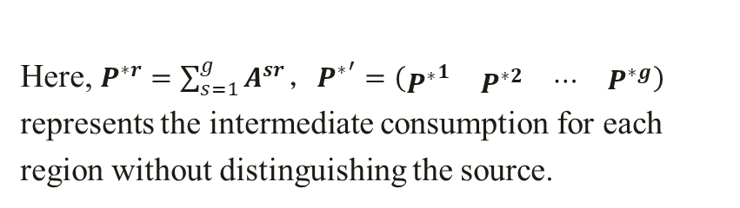
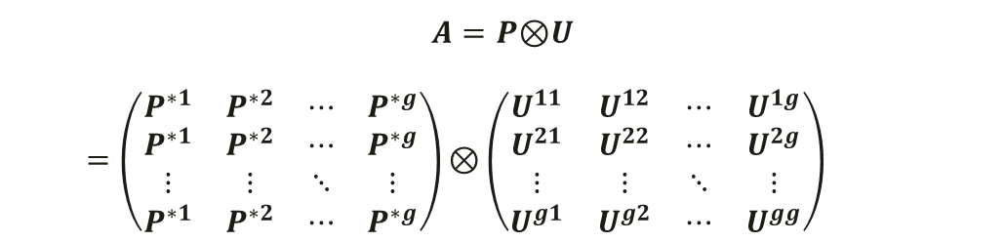
Methodology
Background
Results
Discussion
Changes in Industrial Layout
India’s absorption of China’s outward industrial relocation will be accompanied by changes in the global industrial layout. From the production perspective, firms will decide which regions to import intermediate goods from; from the consumption perspective, consumers will choose which regions to import final goods from to meet their needs. The former leads to changes in the source structure of intermediate inputs, while the latter results in changes in the source structure of final goods.
For changes in the source structure of final goods, the logic of the HEM model is adopted, shifting the final demand of other economies from mainland China to India.
For intermediate goods, due to technological differences across countries, the consumption of Chinese intermediate goods by other economies cannot be directly transferred to India. Instead, We decompose the direct input coefficient matrix A into the Hadamard product of the production technology matrix P and the source structure matrix U, with the changes occurring in the U matrix.
$$A=P\text{⊗}U$$
$=\left(\begin{matrix}P^{∗1} & P^{∗2} & ⋯ & P^{∗g} \\ P^{∗1} & P^{∗2} & ⋯ & P^{∗g} \\ ⋮ & ⋮ & ⋱ & ⋮ \\ P^{∗1} & P^{∗2} & ⋯ & P^{∗g}\end{matrix}\right)\text{⊗}\left(\begin{matrix}U^{11} & U^{12} & ⋯ & U^{1g} \\ U^{21} & U^{22} & ⋯ & U^{2g} \\ ⋮ & ⋮ & ⋱ & ⋮ \\ U^{g1} & U^{g2} & ⋯ & U^{gg}\end{matrix}\right)$
Here, $P^{∗r}=\sum_{s=1}^{g}{A^{sr}}$，${P^{∗}}^{′}=\left(\begin{matrix}\begin{matrix}{P^{∗}}^{1} & P^{∗2}\end{matrix} & \begin{matrix}⋯ & P^{∗g}\end{matrix}\end{matrix}\right)$ represents the intermediate consumption for each region without distinguishing the source.
Changes in Value Added and Carbon Emissions
$${DVA}^{s}={{V^{S∗}}^{′}\left(I−A^{∗}\right)}^{−1}Y^{∗}μ−{{V^{S∗}}^{′}\left(I−A\right)}^{−1}Yμ$$
${DEA}^{s}={{{CE}^{S∗}}^{′}\left(I−A^{∗}\right)}^{−1}Y^{∗}μ−{{{CE}^{S∗}}^{′}\left(I−A\right)}^{−1}Yμ$
Notes:
This will bring change in industrial layout.

Slide 12
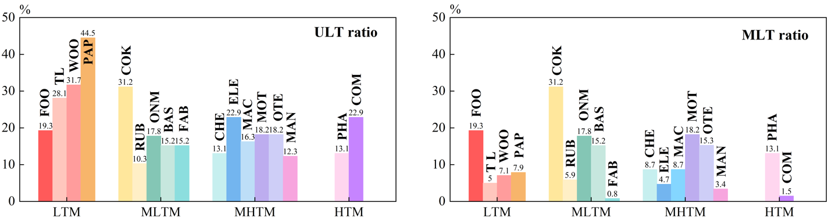
Results
Background
Methodology
Discussion
Scale of Industry Relocation and Competitive Sectors
Table 1：India's advantageous sectors for undertaking industrial relocation from China.
Types of advantageous | Advantage sectors
Optimal advantage | Food products, beverages and tobacco
 | Basic metals
Suboptimal advantage | Paper products and printing
 | Other non-metallic mineral products
 | Other transport equipment
Medium advantage | Computer, electronic and optical equipment
 | Wood and products of wood and cork
Fig. 3：Proportion of transfers for ULT and MLT scenarios. According to the OECD technology density classification, the manufacturing industry is divided into four categories, namely low-technology manufacturing (LTM), medium-low technology manufacturing (MLTM), medium-high technology manufacturing (MHTM) and high-tech manufacturing (HTM)

Slide 13
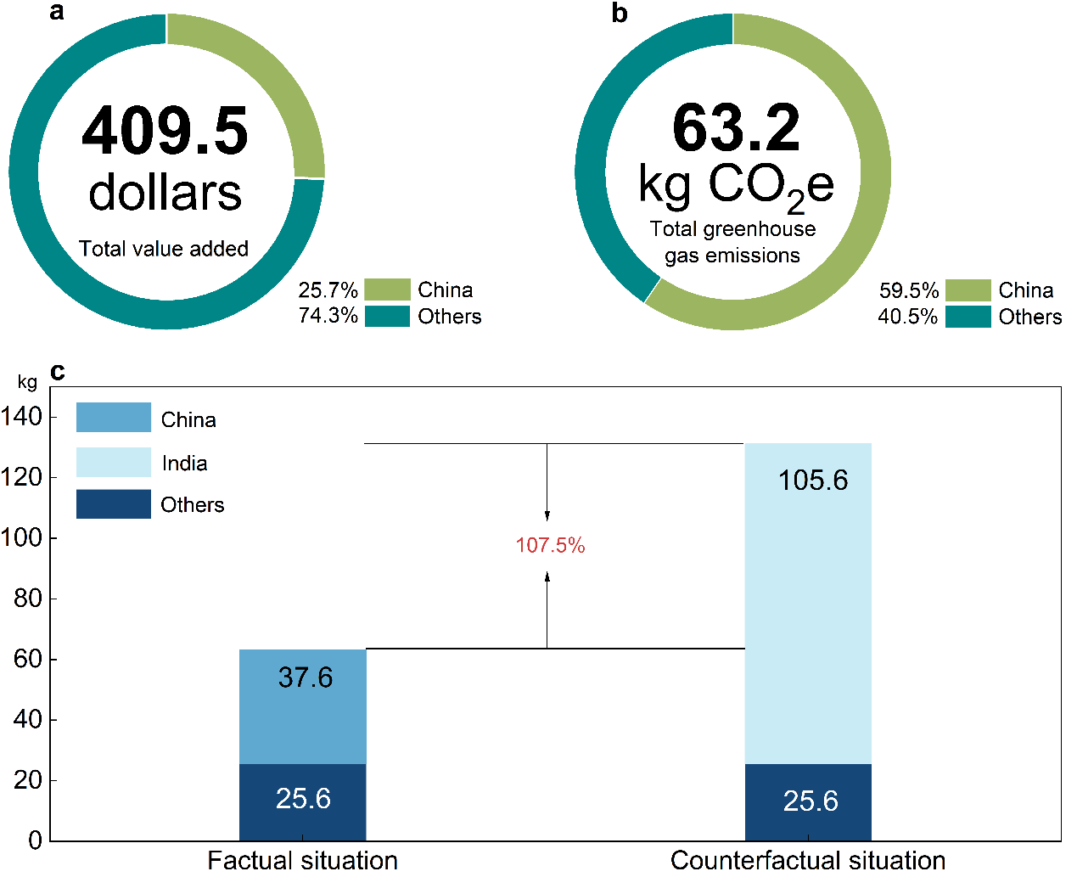
Results
Background
Methodology
Discussion
Carbon Footprint to Double
Individual Case: One iPhone
(a) The production segment undertaken in China generates $104 in value-added, accounting for 25.4% of the total production cost of $409.5 (Xing, 2019).
(b) According to Apple’s iPhone X Environmental Report, the total carbon footprint of an iPhone X is 79 kilograms, of which 80% (63.2 kilograms) is attributed to the production phase. Based on OECD data, the carbon intensity of China’s production chain for iPhone X in 2018 was 0.36 kilograms per dollar, resulting in a carbon footprint of 37.18 kilograms, or 59% of the total production emissions. For non-China segments, the carbon intensity was 0.085 kilograms per dollar, while India’s carbon intensity was 1.02 kilograms per dollar (assuming no decarbonization of electricity).
（c）If Apple relocates the China-based segment of its iPhone production chain to India, the total production carbon footprint could potentially double. For example, in the case of iPhone X, the total production carbon emissions would rise by 68.0 kilograms, resulting in a 107.5% increase in the overall carbon footprint.
Global Scale: Full relocation = +14.8 million tons CO₂ .
Current China-Based Production
Economic Impact:
  Generates $104 value-added per iPhone (25% of total cost)
Environmental Impact:
  37.2 kg CO₂ per unit (59% of production emissions)
  Carbon intensity: 0.36 kg CO₂/$ (vs. 0.085 kg/$ elsewhere)
If Moved to India
Carbon Surge:
  Intensity jumps to 1.02 kg CO₂/$ (3× China’s rate)
  +68 kg CO₂ per iPhone (107% increase)
Notes:
Let's return to where we began—the iPhone.
The results reveal a striking paradox:
While Apple gains production diversification, the planet pays an unexpected price "

Slide 14
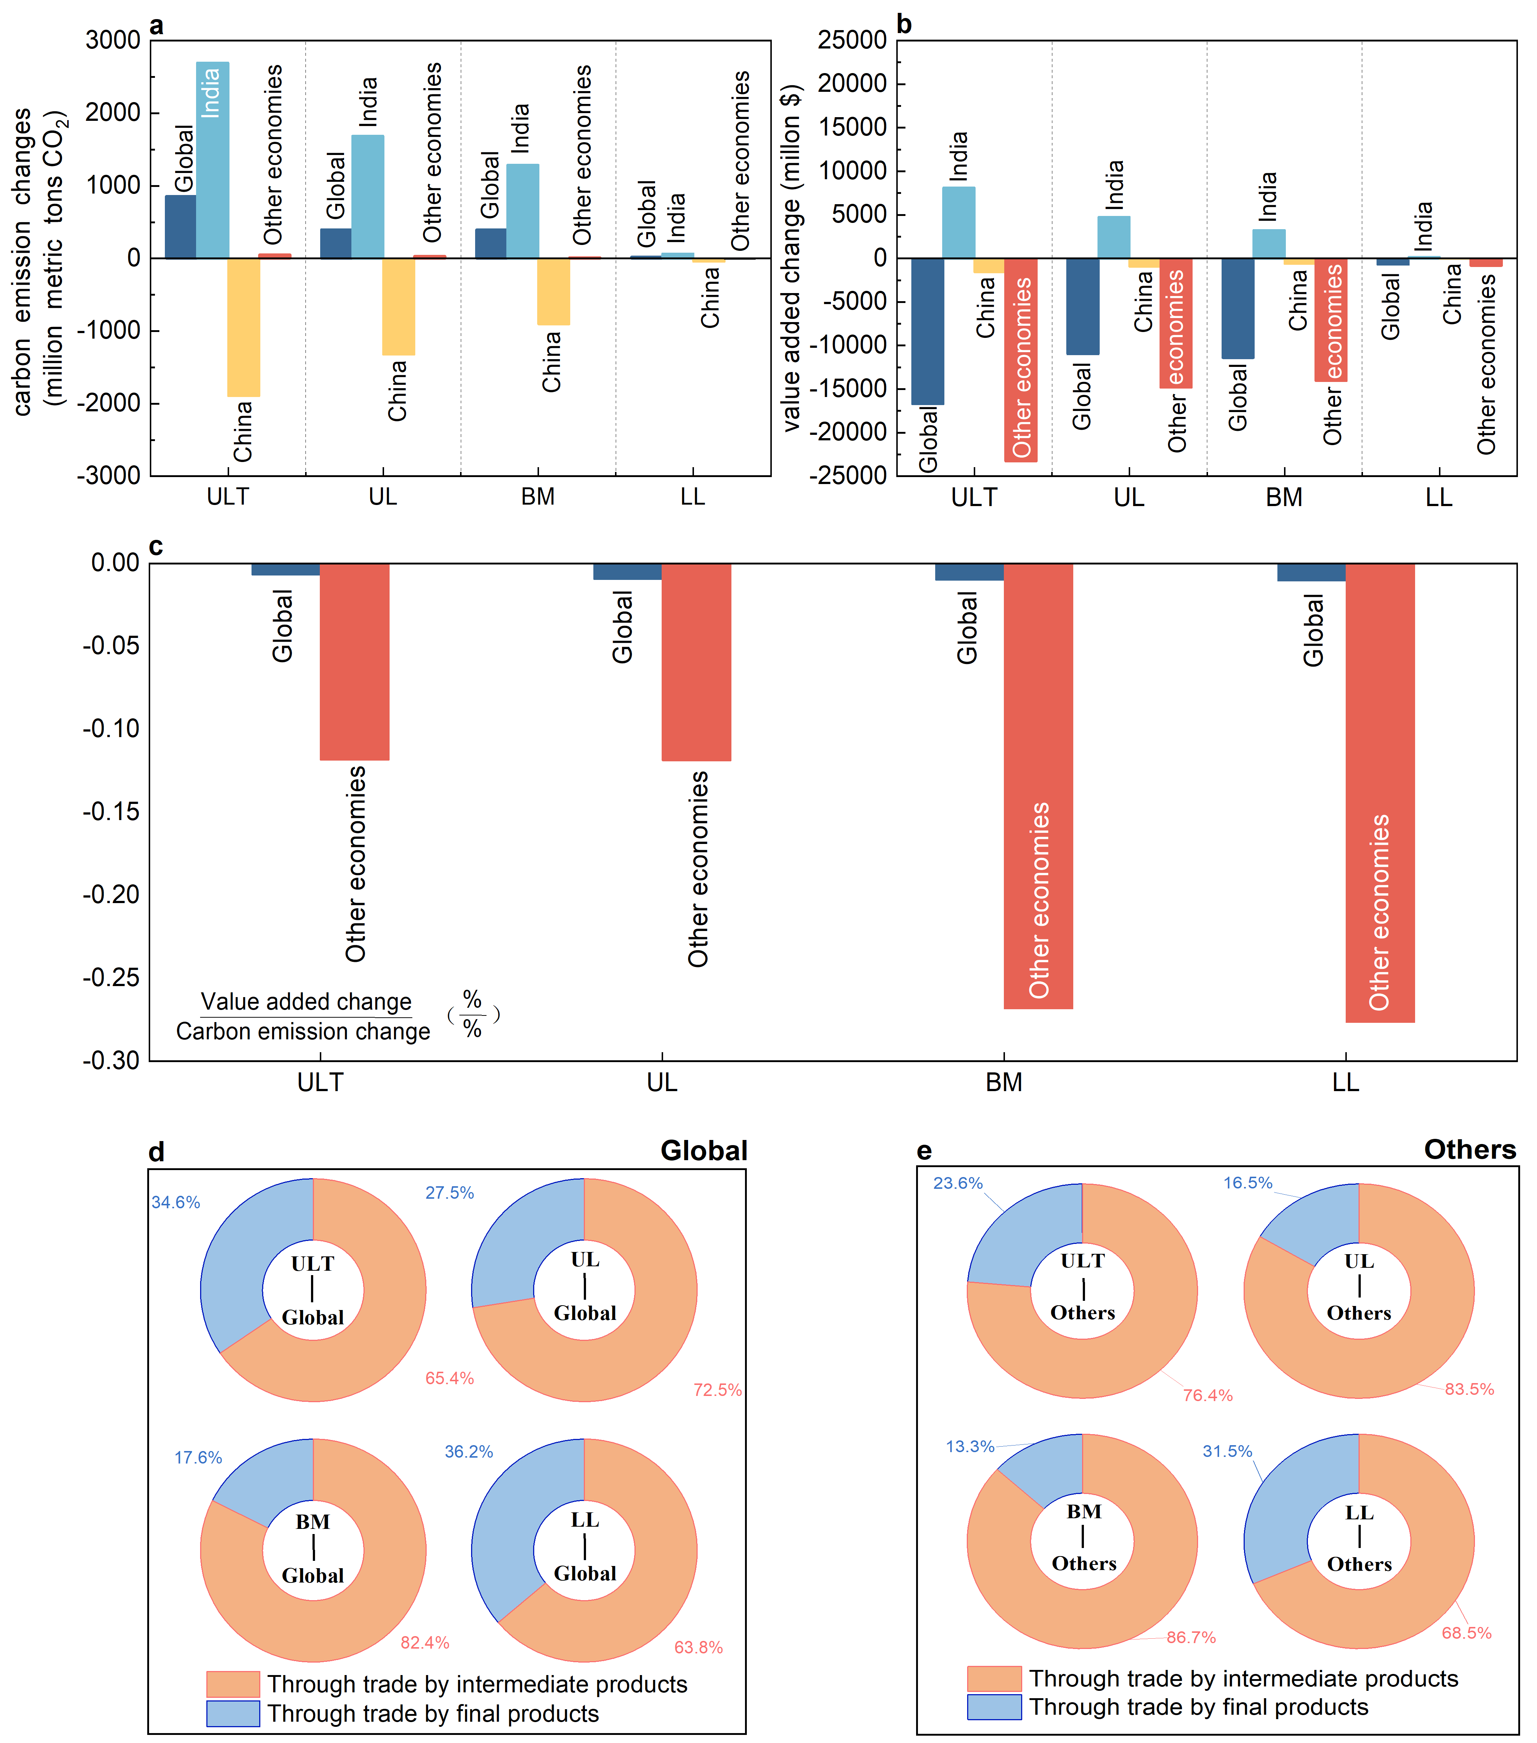
Results
Background
Methodology
Discussion
Increased Carbon Emissions, Slower Economic Growth
(a) Environmental Perspective: This relocation will have negative implications for the global environment.
(ULT- ↑855.5million Mt CO2,MLT -↑ 23.8 to 399.6 million Mt CO2, BM-396.5million Mt CO2).
(b) Economic Perspective: The industrial relocation not only raises global carbon emissions but also reduces global GDP.
(Global: ULT -↓16,712.1 million USD,MLT - ↓ 706.2 to 11,412.9 million USD, BM-10,982.2 million USD;
Other Regions: ULT -↓23,273.4 million USD,MLT - ↓ 835.7 to 14,807.0 million USD, BM-14,046.2 million )
(c) Combined Effects: The ratio of changes in value added to changes in carbon emissions is negative, indicating dual negative impacts of this industrial relocation on both the economy and the environment. Furthermore, this ratio is significantly higher in other regions compared to the global level, suggesting that the negative impacts are more pronounced in other regions.
(d) and (e) indicate that the substitution of intermediate goods by India is the main source of the increase in carbon emissions.
Fig. 4 The emission and economic effect of industrial relocation.
Notes:
But is the iPhone just a unique case, or a systemic trend?
To answer, we quantified the environmental impact that all major sectors simultaneously relocate production from China to India.
The results reveal an alarming amplification effect.
This forces us to confront a critical trade-off: Do the economic benefits outweigh these environmental costs.
The results stunned even our research team. This industrial relocation delivers a double blow to global prosperity:

Slide 15
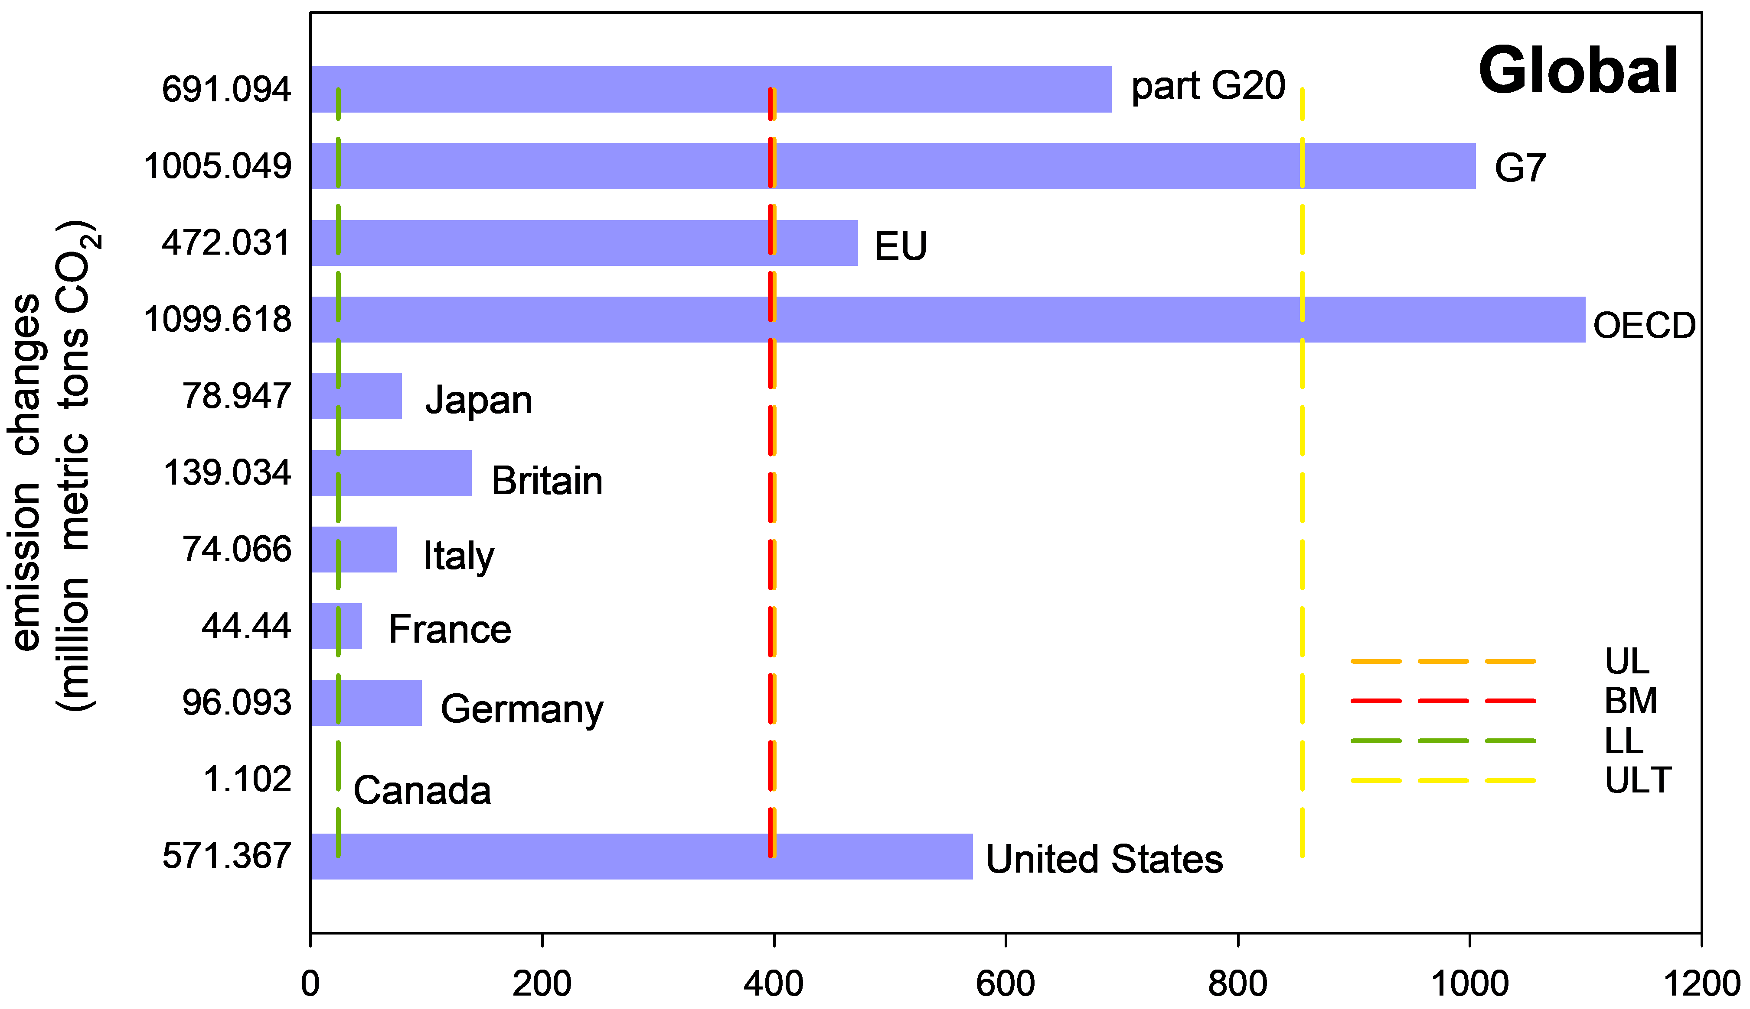
Methodology
Results
Background
Discussion
This Shift Undermines Years of Global Carbon Reduction Efforts
Fig. 5 The impact on carbon emissions in different economies.
Fig. 6 CO2 emission burdens for G7 economies.
From an ultra-long-term (ULT) perspective, the global carbon emissions increase resulting from India’s absorption of China’s industrial relocation (855.5 million Mt CO2) surpasses the total carbon reduction achieved by each G7 country following the Copenhagen Climate Conference (2009–2021). This figure amounts to 85.1% of the combined G7 reductions, exceeding the reductions achieved by the EU (472.0 million Mt CO2) and the G20 (excluding China and India, 691.1 million Mt CO2). It also represents 77.8% of the total reductions by all OECD economies. Similar conclusions hold in the medium-to-long term (MLT).
Notes:
Let's contextualize what 856 million metric tons of CO₂ truly means.
Negates 85% of all carbon reductions achieved by the G7 since the 2009 Copenhagen Accord
Equals the annual emissions of Germany + UK combined

Slide 16
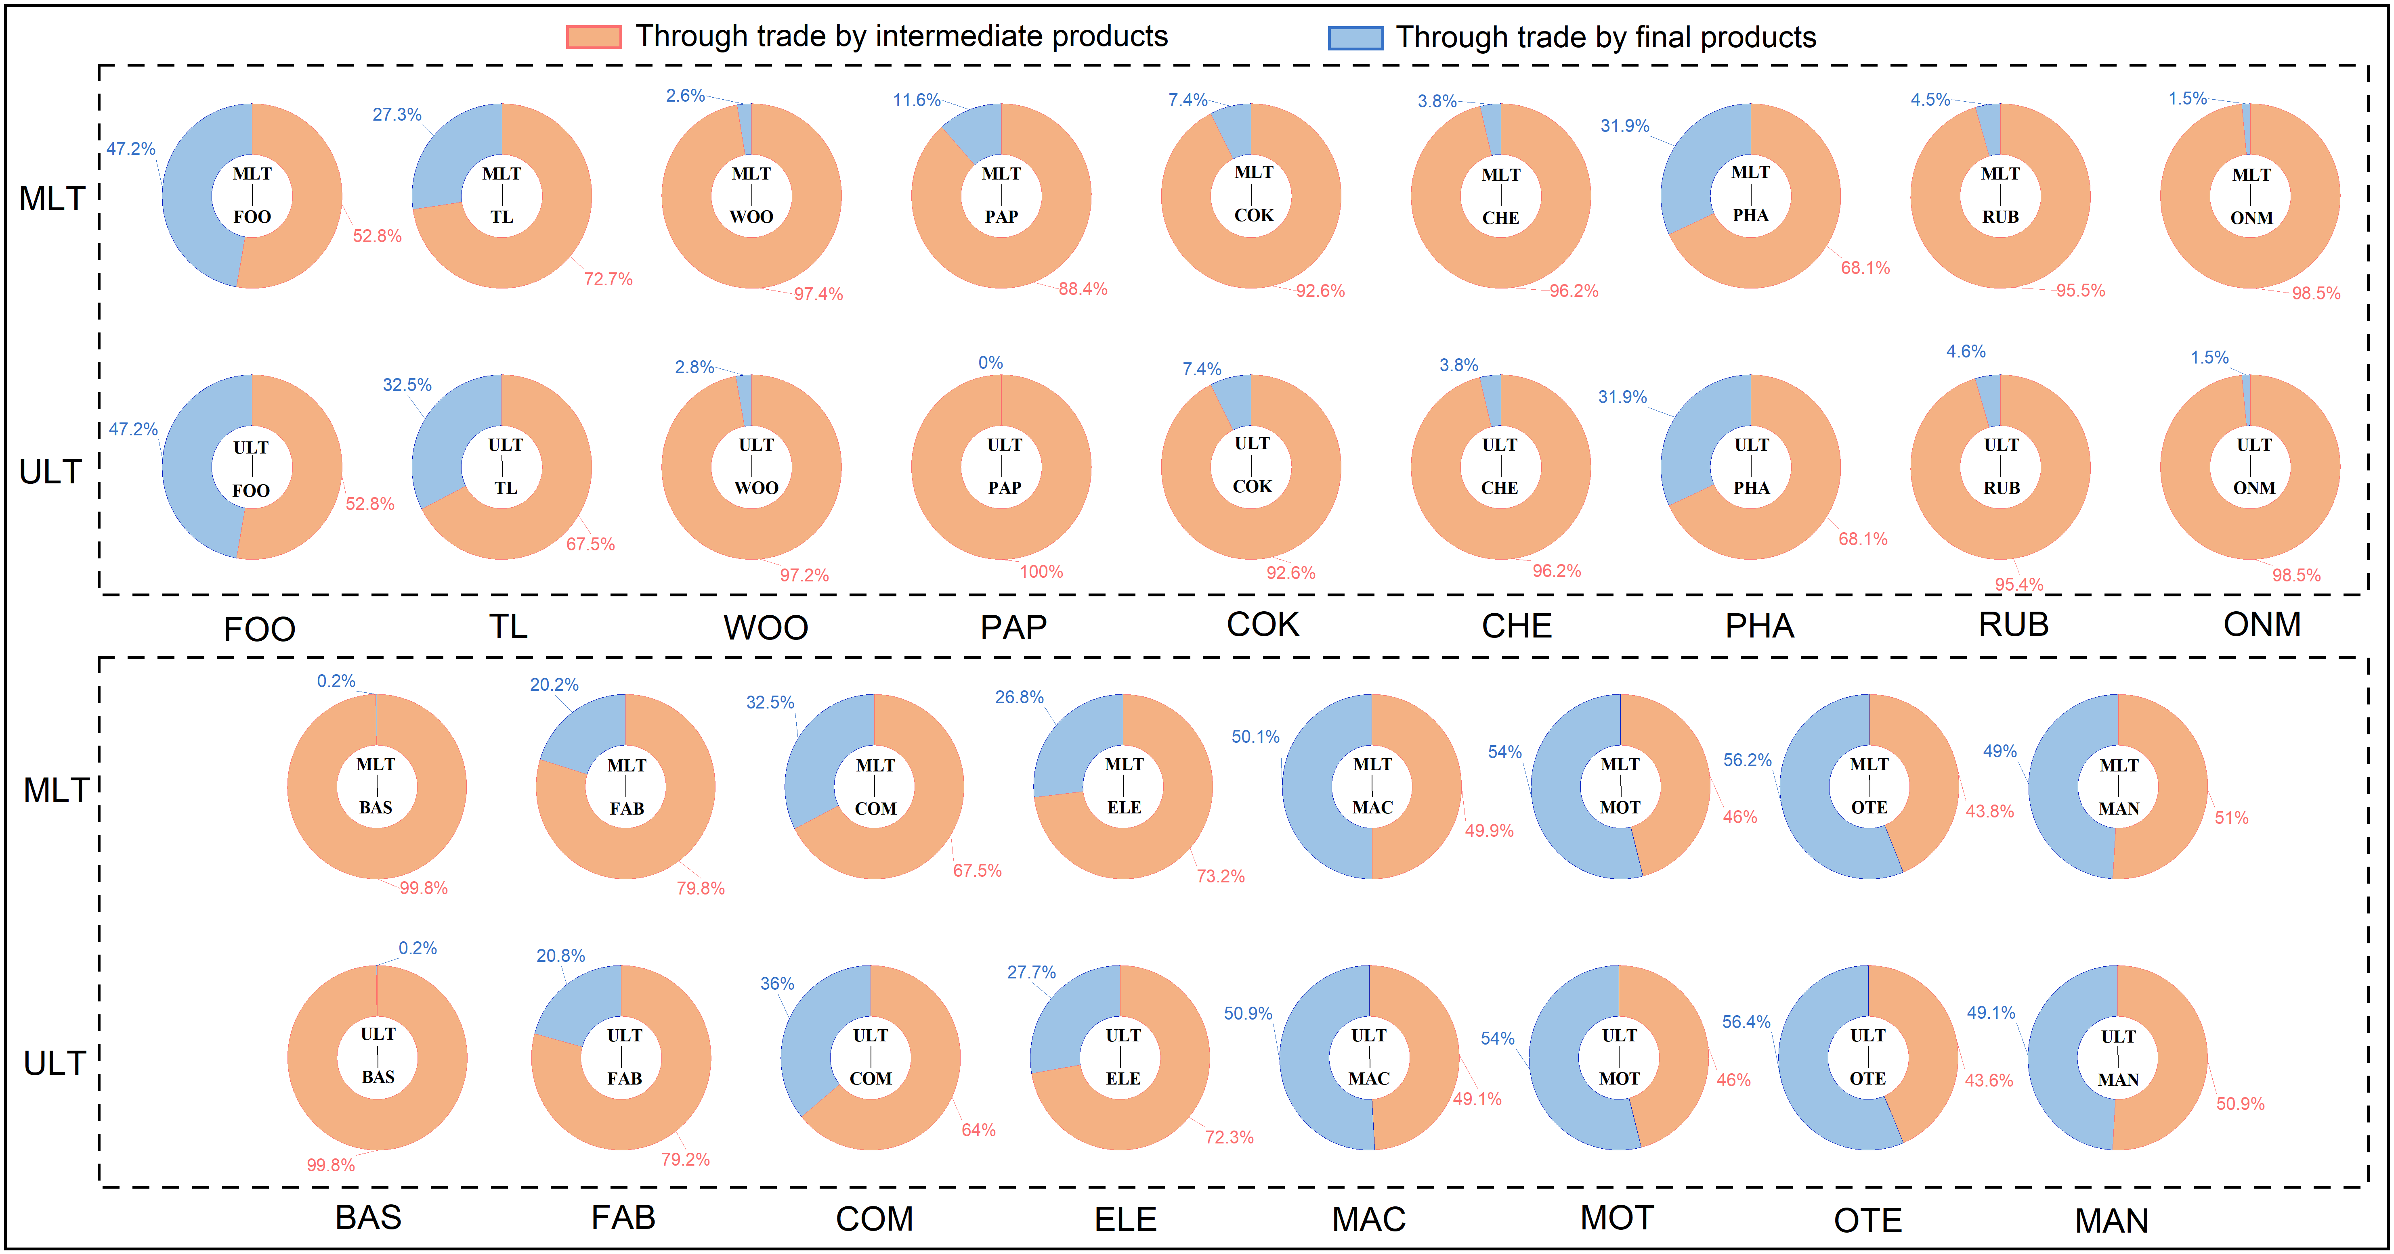
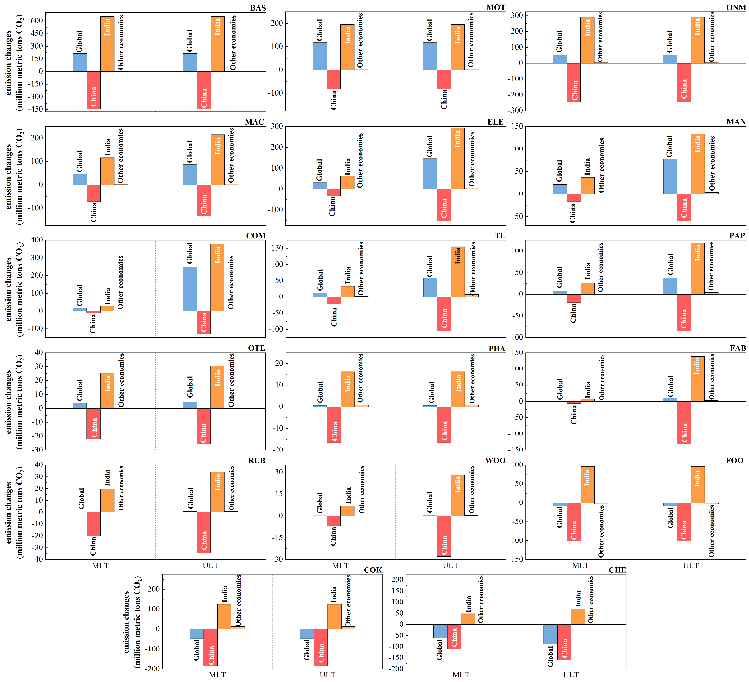
Results
Background
Methodology
Discussion
Sector results
Fig. 8 Source structure of carbon emission effects in different sectors.
Among 17 manufacturing sectors, 14 sectors (excluding food, petroleum, and chemical industries) have negative impacts on global carbon emissions due to the relocation. Key contributors include computers, basic metals, electrical equipment, and automobiles in the ULT scenario, and basic metals and automobiles in the MLT scenario. Ensuring that the intermediate products of computers, basic metals, and electrical equipment and the final products of the automobile industry—originally imported from China—are not replaced by Indian production could reduce 57.4% (523.7 million Mt CO2) of the carbon burden under such circumstances.
Fig. 7 The carbon emission effect of industrial relocation in different sectors.
Notes:
Now let's examine which sectors drive these impacts.

Slide 17
Discussion
Background
Methodology
Results
存在不足
The Stark Reality
This relocation exacerbates global climate issues and hampers global economic growth. The resulting increase in carbon emissions may negate years of global efforts to reduce emissions.
Recommendations
🔴 Sectoral Firewall: Relocation of capacities in computers, basic metals, electrical equipment, and automobiles from China to India should be avoided to mitigate the climate crisis and promote sustainable economic development.
💡Technological Leapfrogging: Accelerate EU/US-funded clean tech transfers to India/Southeast Asia to reduce relocation-related emissions.
Critical Limitations
⚠️This study assumes constant production efficiency, potentially underestimating impacts due to:
• Energy Mix Shifts: India may increase coal/oil use to meet rapid industrial demand, as renewables require longer deployment cycles.
• Construction Emissions: New factories, roads, and power plants for relocated industries will generate substantial embedded CO₂.
• Sectoral Constraints: Concerns regarding India’s food security could reduce the extent of industrial relocation within the food sector relative to current estimates.
• Pollutant Scope: Excludes SO₂/NOx from India’s coal fleet (no scrubbers in 75% of plants), worsening air quality impacts.
Notes:
To conclude, this industrial shift isn’t just about cheaper iPhones—it’s a climate and economic trade-off.
Our models show: India’s gain could be the planet’s pain, unless we rethink how and what we relocate.
Thank you for listening—and now, I’ll try my best to answer your questions.

Slide 18
Thank you！
Q&A

