Slide 1
How to develop AfCIOT into a usable policy tool?
Using TiVA analysis to understand the “success” of countries, and recommend pathways for Africa within the context of today’s world

Slide 2
Questions
We are developing AfCIOT (African Continental Input Output Table) how do we make it into a usable tool, i.e. how can we develop targets for African countries, to monitor progress towards?
Using OECD’s TiVA indicators how can we identify trends and case studies to support the roll-out and use of AfCIOT for African policy-making?

Slide 3
Definitions
Term | Definition
Income Group Upgrade | A transition to a higher World Bank income classification (e.g., LM → UM). Income (GDP per capita, income status and all development indicators taken from the World Bank).
Upgrade Window | The 10-year period before a country transitions to a higher income group
Non-Upgrading Countries | Countries that stayed in the same income group during the observation period
TiVA Indicators | DVA share, FVA share, Forward Linkages, Backward Linkages, VA in foreign final demand, VA by industry from OECD database.

Slide 4
The TiVA indicators most relevant for tracking development
Domestic Value Added in Exports (DVA) – measures how much value is created domestically for each unit of export.
Foreign Value Added Share (FVA) – indicates the degree of dependency on foreign inputs; a high FVA at early stages is typical but should decline as domestic capacity grows.
Backward Linkages – use of foreign inputs in domestic production.
Forward Linkages – domestic inputs used in foreign exports (upstream positioning).
Value Added Embodied in Final Demand Abroad – shows integration into foreign final consumption, not just intermediate production.
Value Added by Sector and Partner Country – identifies strategic sectors and trade partners driving upgrading.
Re-imported Domestic Value Added – indicates circular value chains and regional integration.

Slide 5
Descriptive Trends
Plot average trends of TiVA indicators by:
Upgraders vs Non-Upgraders
Income group at baseline (L, LM, UM)
Sector-specific analysis

Slide 6
Hypotheses for Successful* Development via TiVA Trends
Hypothesis | Indicator Trend | Results
H1: Value-added upgrading | ↑ DVA share in gross exports over time | ✅ Strong support
H2: Import substitution & technological upgrading | ↓ FVA share as domestic intermediate production capabilities increase | ✅Support
H3: Regional integration | ↑ share of exports with domestic VA absorbed in regional partners’ final demand | Partial support
H4: Functional upgrading in GVCs | ↑ forward linkages, showing higher-tech inputs used abroad | ✅ Strong support
H5: Diversification | ↑ number and sophistication of sectors contributing to exports, consistent with ECI (economic complexity index) shifts | ❌ No support
*“Successful” development for the purposes of this study is achieving an income status upgrade according to WB.

Slide 7
Hypothesis 1: Value-added upgrading
Countries that upgrade income groups show a significant increase in Domestic Value Added (DVA) share in exports over the 10 years prior
Element | Reason
i.years_before_upgrade | Focuses on event-time dynamics (upgrade timing), not fixed year trends
i.country_numeric | Controls for unobserved country-specific factors (e.g., governance, geography)
i.industry_code | Accounts for systematic industry differences in VA share
Excludes i.year | Avoids perfect multicollinearity with years_before_upgrade, keeps interpretability

Slide 8
Pre-Upgrade Event-Study
Variable | Coeff. | p-value | Interpretation
Pre-Upgrade Timeline (Peak at 5 yrs):
- 5 years before upgrade | +1.73 | <0.001 | Max DVA increase
- 10 years before upgrade | +1.45 | <0.001 | Sustained buildup
Income Groups (vs. High Income):
- Low Income (L) | -4.60 | <0.001 | Significant DVA gap
- Lower-Middle (LM) | -3.19 | <0.001
- Upper-Middle (UM) | -0.81 | 0.026
GDP per capita | -0.00017 | <0.001 | Wealthier ≠ higher DVA
Pre-upgrade dynamics:
Significant DVA gains begin 5-10 years before income upgrade
Peak effect at 5 years pre-upgrade (+1.73pp)
Income gradient:
Low-income countries start with 4.6pp lower DVA than high-income
Gap narrows as countries approach upgrade
Sectoral patterns:
Service sectors drive DVA growth (Real Estate +8.1pp, Education +8.1pp)
Resource-based industries lag (Petroleum -28.6pp, Mining -7.5pp)

Slide 9
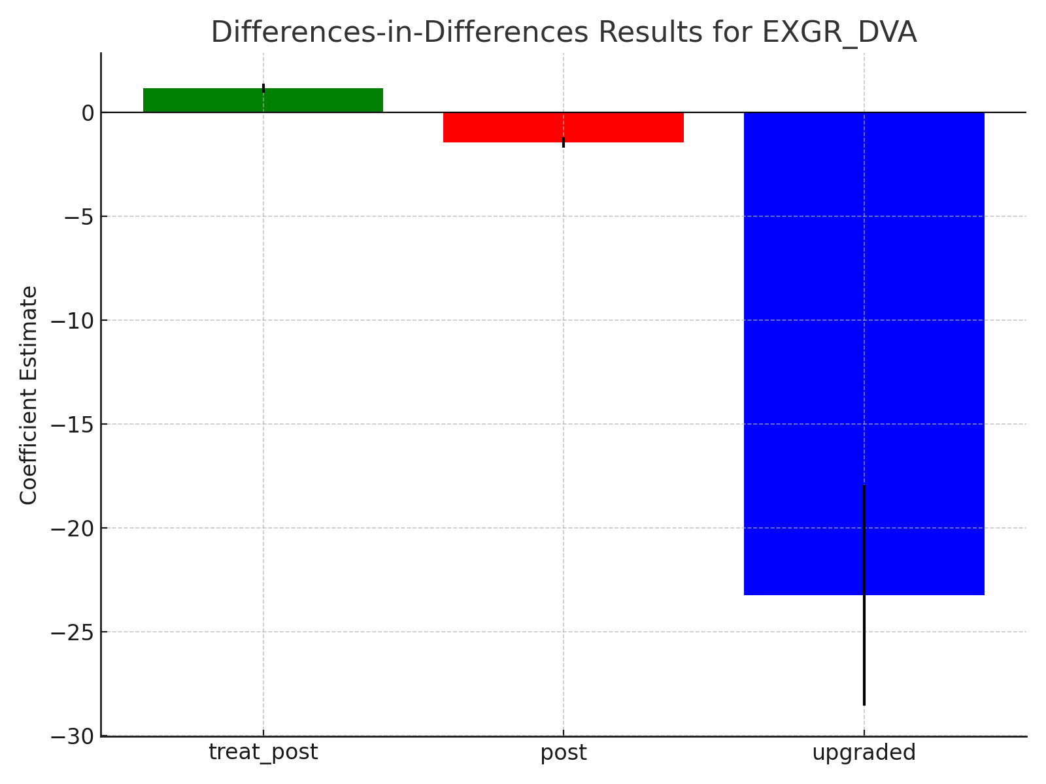
DiD Treatment Effects
DiD Treatment Effects
treat_post: ██████████ 1.15*** (95% CI: 0.93-1.36)
post: ███▌ -1.46*** (95% CI: -1.72--1.21)
upgraded: ███████████████████████▌ -23.24***

Slide 10
Robustness Checks
Collinearity
GNI and GVA are inherently correlated (both measure economic output).
Risk: Inflation of standard errors
Reverse causality
Risk: Endogeneity bias
Measurement overlap
GNI includes net foreign income, GVA is production-based.
TiVA indicators directly contribute to GNI.
Robustness checks employed:
Instrumental Variable
Lagged indicators
Non-GNI upgrade thresholds
Placebo upgrades

Slide 11
Recommendation: African economies should prioritize service sector development and manufacturing diversification 5-10 years before expected income transitions, using agriculture as a DVA-stable foundation.

Slide 12
Targets for African countries
Raise DVA in manufacturing exports to >40% over a decade.
Increase forward linkages in selected sectors (e.g., processed foods, textiles, auto parts).
Expand number of sectors contributing >5% to total VA exports, targeting both agricultural processing and light industry.
Reduce FVA reliance in key sectors by increasing local content policies and input substitution strategies.
Boost value added absorbed by African partners’ final demand, enhancing regional value chains.

Slide 13
Sectorial Prioritization and Employment-Centric Industrialization
These policies requires sectoral specialization and prioritization.
Manufacturing and agro-processing emerge as critical industries with strong linkage effects (Ferraz et al., 2021)​, necessitating targeted industrial policies to deepen local supply chains and reduce reliance on imported intermediate goods.
The prioritization should take into account other factors, such as employment and climate.
While natural resource exports remain dominant, their limited employment effects and exposure to commodity price shocks underscore the importance of labour-intensive manufacturing and services (Frankel, 2012)​.

Slide 14
Regional Collaboration and Trade Resilience amid Geopolitical Uncertainty
Disruptions to global trade, particularly under a second Trump administration, along with China’s expanding presence in Africa, highlight the need for diversified trade partnerships and regional value chain integration.
They also highlight the need for regional trade agreements (e.g., AfCFTA) to build intra-African supply chains, mitigating exposure to external trade disruptions (Carbonell & Nassè, 2020)​.

Slide 15
Specialization vs. Diversification
Achieving the right balance between specialization (leveraging comparative advantage) and diversification (reducing economic fragility) is essential (Boschma, 2016)​. TiVA analysis provides insights into optimizing economic complexity and industrial activities while managing risk exposure (Ferraz et al., 2021).

Slide 16
Conclusion
The path to successful upgrading in African economies through TiVA frameworks involves:
Transitioning from high FVA/low DVA to high DVA with complex sectoral exports.
Leveraging regional demand through forward linkages.
Aligning domestic capability building with changes in the production matrix (A).
Using policy tools that encourage intersectoral linkages, skills, and innovation.

Slide 17
Extensions
Now to look at employment
Link TiVA trends with economic complexity index (ECI) and export product sophistication
Link with domestic policies of countries
Examine imports-to-exports transformation efficiency (using value-added per import)

Slide 18
Appendix

Slide 19
Domestic Policies to Drive TiVA Improvements
Industrial Policy:
Strategic subsidies or tax incentives to encourage domestic input use.
Promote domestic supplier development programs.
Investment in sectoral clustering to improve economies of scale.
Human Capital and Skills:
Focused TVET aligned with the upgrading sectors (e.g., electronics assembly, packaging).
Match occupational structures to complexity needs
Infrastructure and Trade Facilitation:
Invest in logistics, ports, energy — essential for integration and movement along GVCs.
Reduce NTBs that prevent regional trade (key for forward/backward linkages).
Investment and Technology Transfer:
Create incentives for joint ventures and technology spillovers.
Encourage local content requirements with realistic phase-in.
Green Transition:
Embed sustainable production into new sectors for long-term upgrading

Slide 20
Linkage dynamics in raw-material rich African countries
Phase | Forward Linkages | Backward Linkages | Structural Characteristic
Early Development | High — driven by raw material exports | Low — limited use of imported intermediates | Economy reliant on extractive sectors
Transition Phase | Stable or growing | Increasing — as domestic processing expands | Emergence of agro-processing, refining, light industry
Industrial Upgrading | High — more domestic value retained | High — integrated supply chains and GVCs | Exporting processed and manufactured goods

Slide 21
Hypothesis 2: Import substitution & technological upgrading
Countries upgrading to higher income groups reduce their reliance on foreign inputs in exports, reflecting import substitution and technological capability development.
Years Before Upgrade | Coeff. | p-value | FVA Change vs. Upgrade Year
13 years | -2.730 | <0.001 | +2.73pp higher
10 years | -2.201 | <0.001 | +2.20pp higher
5 years | -1.854 | <0.001 | +1.85pp higher
1 year | -0.536 | <0.001 | +0.54pp higher
Group | Coeff. | p-value | Interpretation
Low Income | +2.74 | <0.001 | Highest FVA reliance
Lower-Middle | +0.97 | <0.001
Upper-Middle | -0.48 | 0.009 | Closer to HI patterns

Slide 22
Hypothesis 2: Import substitution & technological upgrading
Countries upgrading to higher income groups reduce their reliance on foreign inputs in exports, reflecting import substitution and technological capability development.
Industry Group | Avg. FVA Coeff. | Key Findings
Manufacturing | +12.41 | Highest FVA: Petroleum (+24.6), Electronics (+17.9)
Transportation | +5.33 | Air/water transport >12pp FVA
Mining | +0.27 | Mixed foreign input use
Agriculture | +1.04 | Moderate FVA (A03 vs. base A01_02)
Services | -2.73 | Lowest FVA: Real Estate (-8.1), Education (-8.1)

Slide 23
Supported: Countries show significant FVA reductions 1-13 years before income upgrades
-2.73pp FVA reduction from 13 years pre-upgrade to upgrade year
Manufacturing drives FVA decline: Petroleum/electronics show largest absolute reductions
Policy Implications:
Dual-track strategy:
Short-term: Leverage foreign inputs for export growth
Long-term: Target FVA reductions 5-10 years pre-upgrade
Sector prioritization:
Reduce FVA in high-impact sectors (petroleum, electronics)
Build domestic capacity in services (education, real estate)
African context:
Low-income countries start with +2.74pp higher FVA → Target import substitution early

Slide 24
Hypothesis 3: Regional integration
To assess whether countries that transitioned to higher income groups demonstrated stronger integration into regional value chains—specifically, whether their domestic value added (DVA) in foreign final demand increased in share terms.
Years Before Upgrade | Coeff. | p-value | Interpretation
13 years | -5.48 | <0.001 | 5.48pp lower than upgrade year
10 years | -4.03 | <0.001 | 4.03pp lower
5 years | -2.10 | <0.001 | 2.10pp lower
1 year | -0.08 | 0.551 | Not significant
Pattern:
FFD_DVA is significantly lower in distant pre-upgrade years
Converges to upgrade-year level as event approaches
Implies FFD integration accelerates near upgrade point

Slide 25
Hypothesis 3: Regional integration
To assess whether countries that transitioned to higher income groups demonstrated stronger integration into regional value chains—specifically, whether their domestic value added (DVA) in foreign final demand increased in share terms.
Sector | Coeff. | p-value | Role in FFD Integration
Air Transport (H51) | +35.98 | <0.001 | Key cross-border enabler
Water Transport (H50) | +31.33 | <0.001 | Critical for goods exports
Electronics (C26) | +17.57 | <0.001 | High-value global demand
Machinery (C24) | +31.45 | <0.001 | Industrial integration
IT Services (J62_63) | +6.86 | 0.005 | Digital integration

Slide 26
Partially Supported: FFD integration increases significantly near upgrade point (1-5 years prior), but:
No early buildup: Lower integration 5-13 years pre-upgrade
Surge pattern: Rapid FFD acceleration in final years before upgrade
Sectoral Insights:
Transportation critical: Air/water transport dominate FFD integration
Tech-driven: Electronics and IT services show strong global demand links
Industrial machinery: Key for upper-middle income upgraders
Policy Implications:
Phase 1 (5-10 years pre-upgrade): Build export infrastructure (ports, airlines, digital networks)
Phase 2 (1-5 years pre-upgrade): Target FFD-intensive sectors (transport, electronics, machinery)
African opportunity: Leverage current high FFD in low-income status for upgrading
Strategic recommendation: Treat FFD integration as a late-stage upgrading indicator that requires prior investment in export infrastructure and sectoral capabilities.

Slide 27
Hypothesis 4: Functional upgrading in GVCs
Years Before Upgrade | Coeff. | p-value | FVA/DVA Reduction
13 years | -0.0439 | <0.001 | -4.39%
10 years | -0.0380 | <0.001 | -3.80%
5 years | -0.0361 | <0.001 | -3.61%
1 year | -0.0131 | <0.001 | -1.31%
Pattern:
Steady decline in foreign/domestic VA ratio approaching upgrade
Strongest reduction 10-13 years pre-upgrade
Accelerated decline continues until upgrade year
Supports hypothesis: Successful upgraders reduce foreign input reliance

Slide 28
Sectoral Backward Linkage Intensity:
Sector | Coeff. | p-value | Interpretation
Petroleum (C19) | +0.85 | <0.001 | Highest foreign reliance
Electronics (C26) | +0.40 | <0.001 | GVC-dependent manufacturing
Basic Metals (C24) | +0.39 | <0.001 | Import-intensive production
Real Estate (L) | -0.11 | 0.002 | Lowest foreign reliance
Education (P) | -0.11 | 0.002 | Domestic-focused

Slide 29
Expected Changes in the A-Matrix (Input Coefficients)
Development through TiVA channels implies structural changes in the input-output A-matrix:
Increased domestic intermediate consumption in manufacturing (i.e., more domestic inputs sourced across sectors).
Reduction in primary product dependence (e.g., less direct raw material exports, more downstream processing).
Emergence of new linkages between sectors, e.g., ICT services into manufacturing, logistics into agri-processing.
Higher inter-sectoral connectivity, indicating economic complexity.
This transformation mirrors what complexity economics expects — an increasingly dense network of productive linkages

Slide 30
“A” matrix case study
Find similar A matrix to African country (e.g. NGA or CMR) from a “success” case.
Track progress of “success” case’s A matrix over time.

Slide 31
Country Leaders in Reduction
Country | Coeff. | p-value | Pre-Upgrade Change
Vietnam | -0.40 | <0.001 | Strongest decline
Malaysia | -0.54 | <0.001 | Major improvement
Jordan | -0.56 | <0.001 | Rapid restructuring

Slide 32
Strongly Supported: TiVA data confirms significant reduction in backward linkages before income upgrades
-3.6% to -4.4% reduction in FVA/DVA ratio 5-13 years pre-upgrade
Consistent decline across all pre-upgrade years
Sectoral Insights:
Resource sectors (petroleum, mining) maintain high foreign reliance
Manufacturing (electronics, metals) show largest absolute reductions
Domestic services (education, real estate) have lowest foreign inputs.
Key strategy: Sequential reduction of foreign inputs starting 10+ years before expected upgrade, prioritizing manufacturing sectors while maintaining services' domestic focus.

Slide 33
Hypothesis 5: Diversification

