Slide 1
Keeping the global consumption within the planetary boundaries
Dr. Peipei Tian
Institute of Blue and Green Development
Shandong University

Slide 2
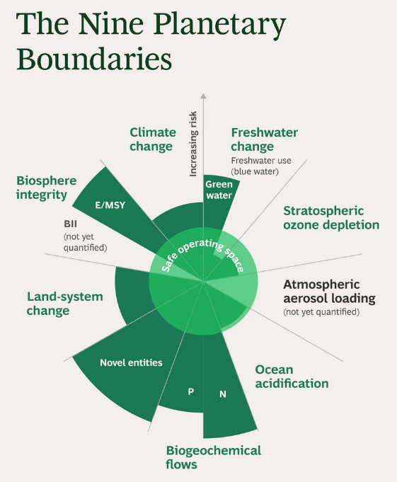
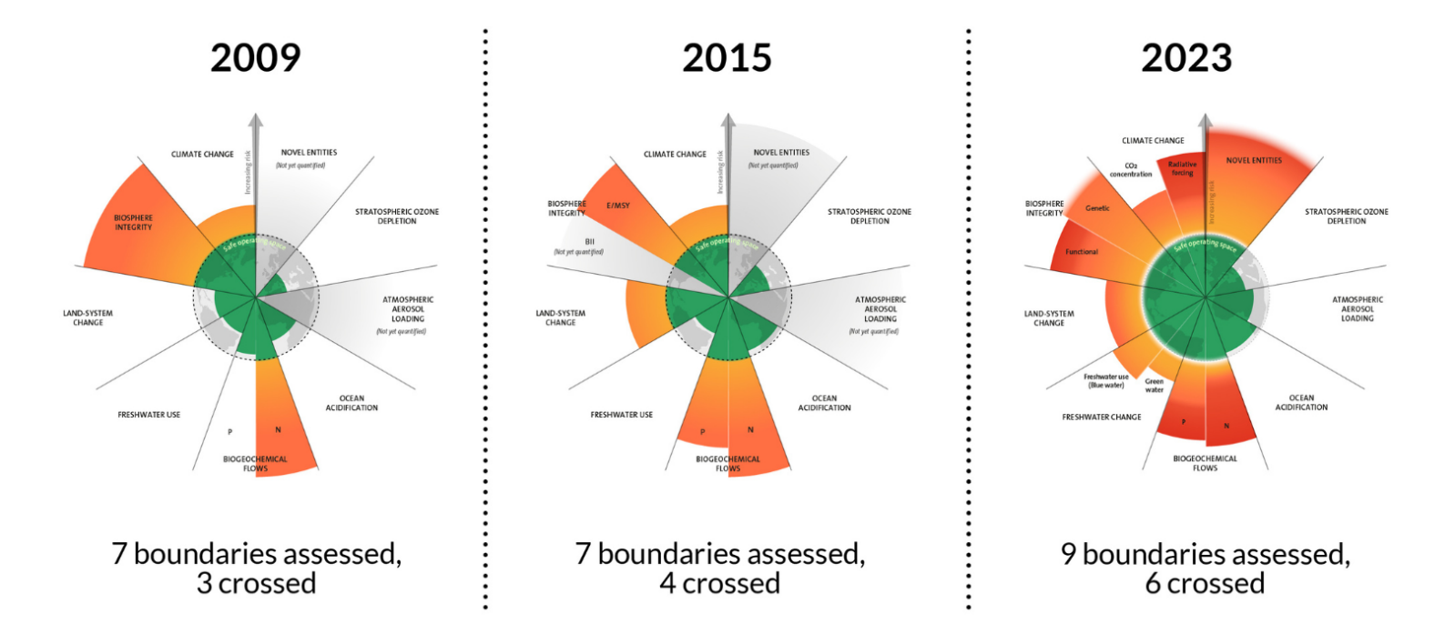
Planetary boundaries under threat
Human activities have pushed the Earth system rapidly away from the stable state of the Holocene.
Multiple planetary boundaries have been transgressed.
Consumption is a major driver: the production–consumption–resource chain is unsustainable.

Slide 3
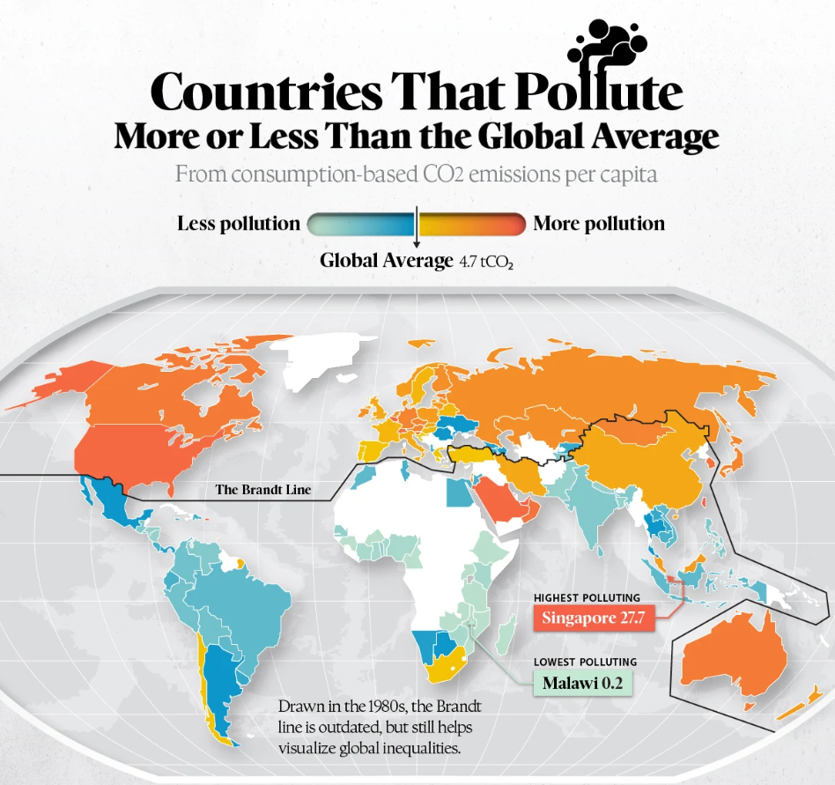
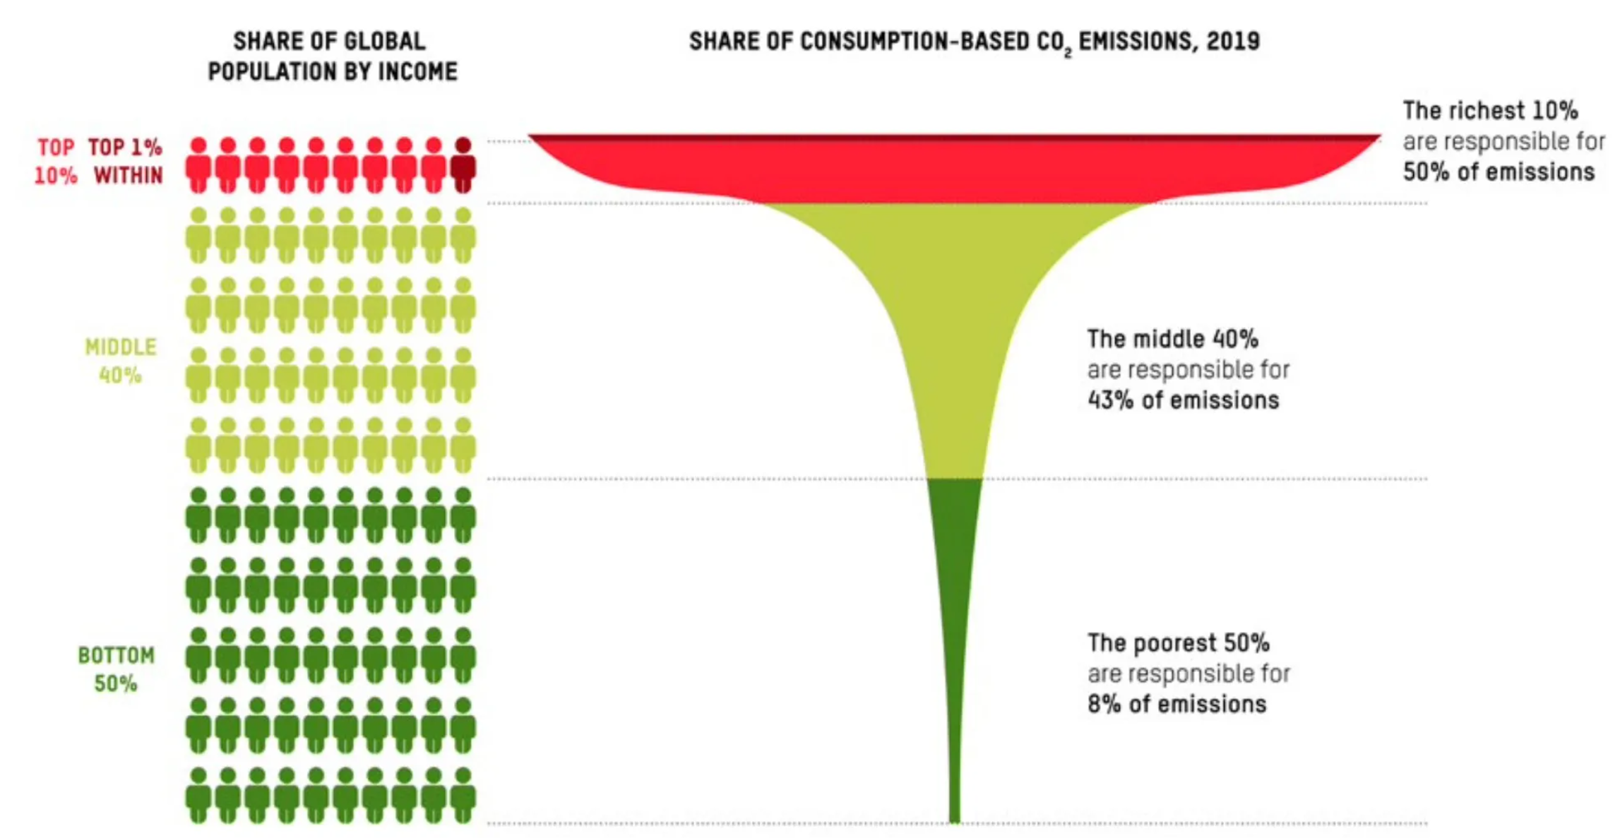
Unequal contributions to environmental pressure
The disparity in environmental impacts across different countries has been widely acknowledged.
The unequal distribution of wealth and income results in unequal consumption and environmental footprints, causing considerable variations in the contribution to planetary boundary transgression among different expenditure groups.

Slide 4
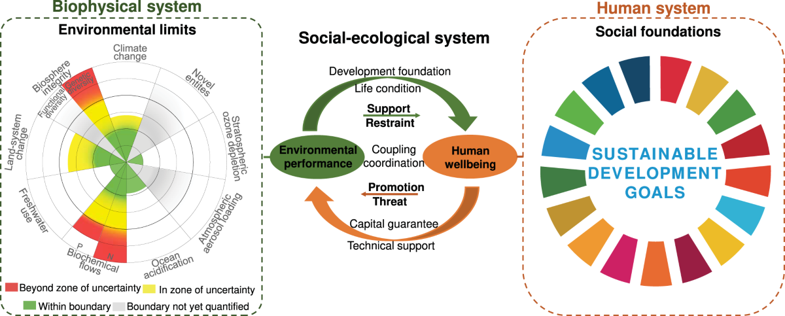
Need for a unified global framework
A globally unified and comparable framework is urgently needed to provide detailed insights into the distribution of key environmental footprints and the responsibility of consumers at different expenditure levels.

Slide 5
Previous research focused
only on the
carbon footprint
Consumer responsibility
Another question is
How can identify and quantify the responsibilities of different consumer groups for exceeding planetary boundaries?
How do use this information to develop targeted emission reduction and sustainable consumption strategies?

Slide 6
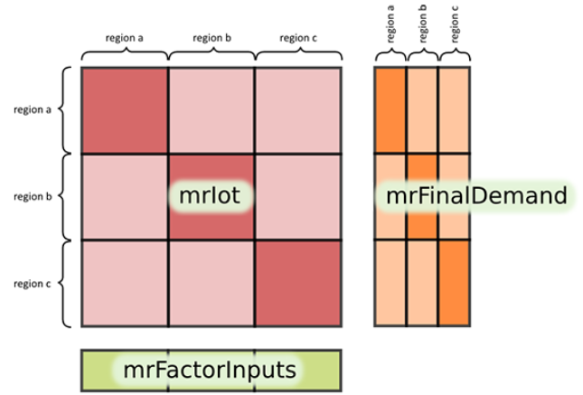
Methods I: EE-MRIO & footprint calculation
Input-output method
Household expenditure
survey
Household footprints of global expenditure decile
The MRIO model and household expenditure survey data is used to calculate the footprints of the six environmental indicators and the shares of each global expenditure decile in the total footprints in 2017.

Slide 7
Methods II: PB comparison & scenario setting
Responsibilities quantifying
Scenarios setting
Scenario 1 (S1)
Consumption reduction of the top 10%
Scenario 2 (S2)
Consumption reduction of the top 20%
Scenario3 (S3)
Efficiency improvement of the top 10%
Scenario 4 (S4)
Efficiency improvement of the top 20%
Scenario 5 (S5)
Consumption reduction and efficiencyimprovement of the top 10%
Scenario 6 (S6)
Consumption reduction and efficiency improvement of the top 20%
Inequality measurements

Slide 8
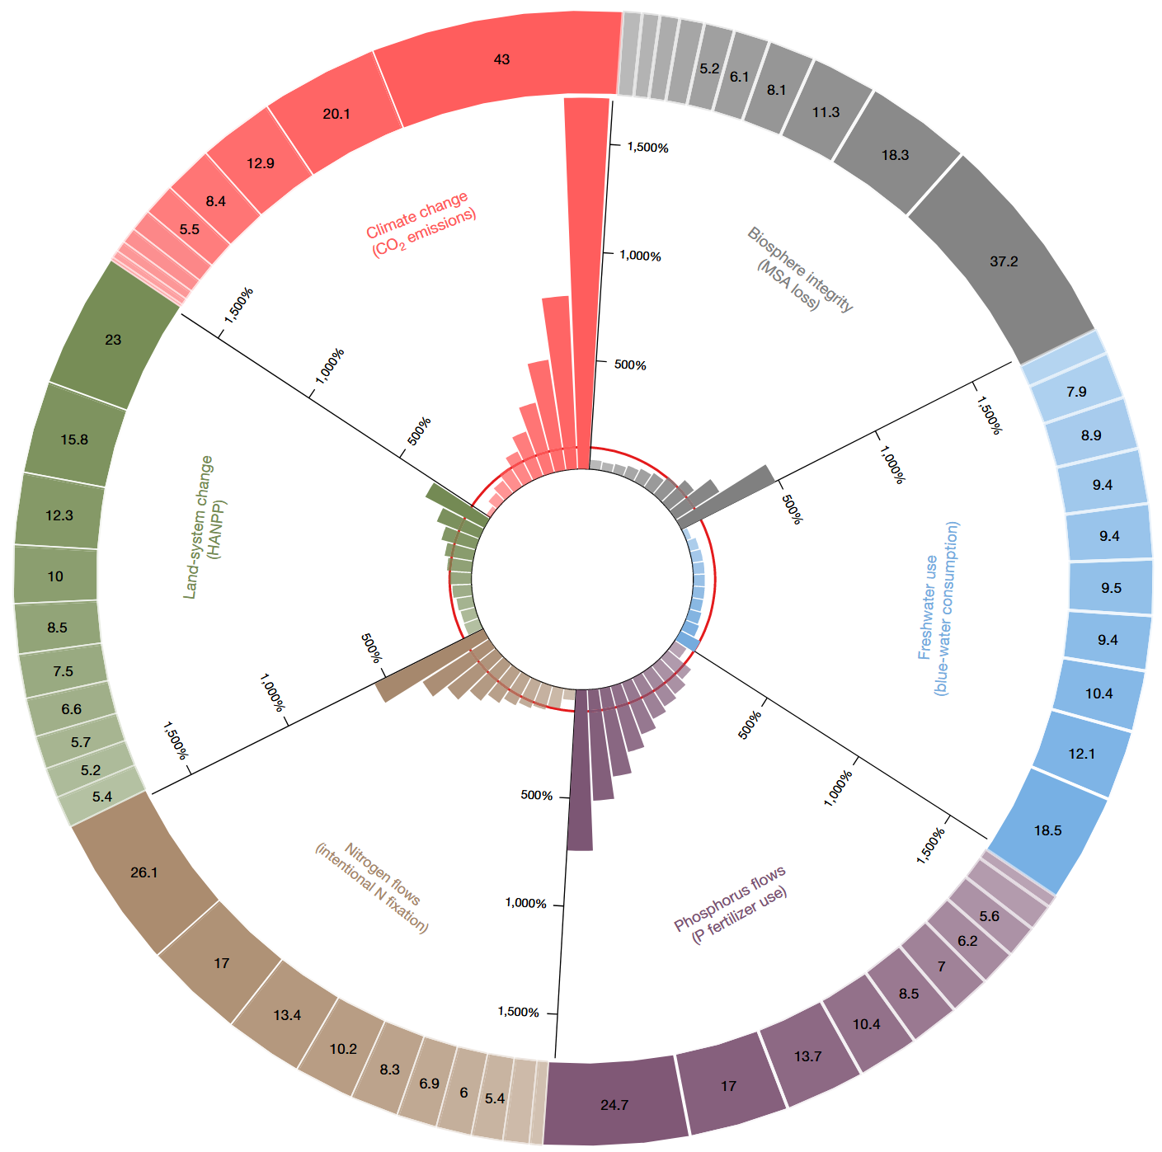
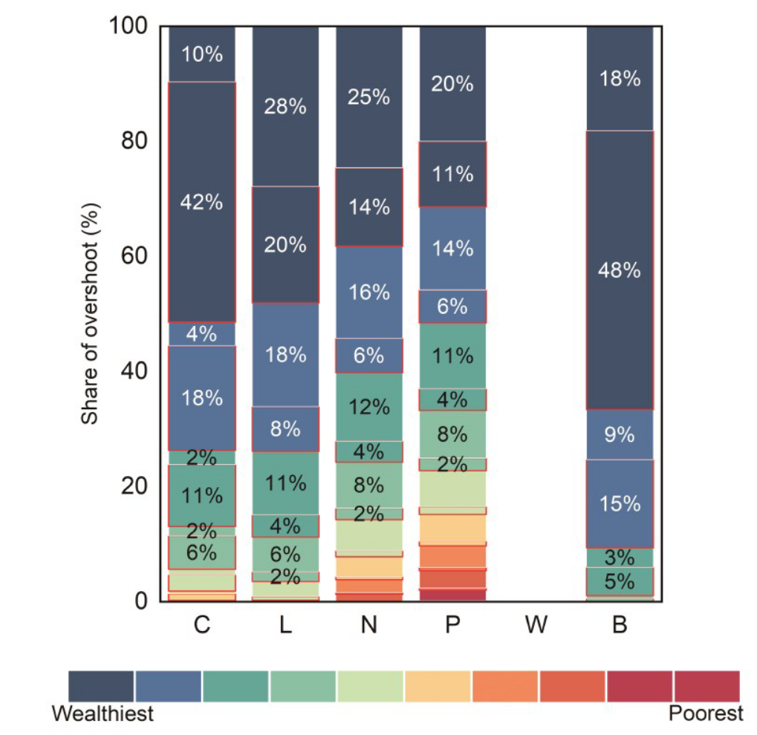
Global footprints of six environmental indicators by expenditure decile
Global environmental footprints show high levels of inequality.
The environmental impacts of the top 10% were 4.2 to 77 times that of the bottom 10%, with the most notable disparities in carbon emissions and MSA loss.

Slide 9
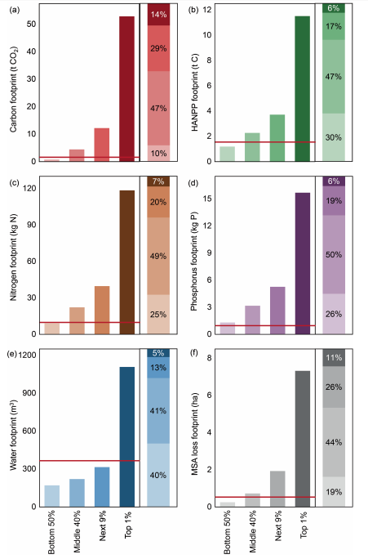
Extreme environmental inequality:
the top 1% vs. the bottom 50%
The per capita environmental footprints of the global top 1% are extremely high, with CO₂ emissions and MSA loss reaching up to 70 times those of the bottom 50%.
Top 10% account for the majority of overshoot
Bottom 50% stay within planetary boundaries across all indicators.

Slide 10
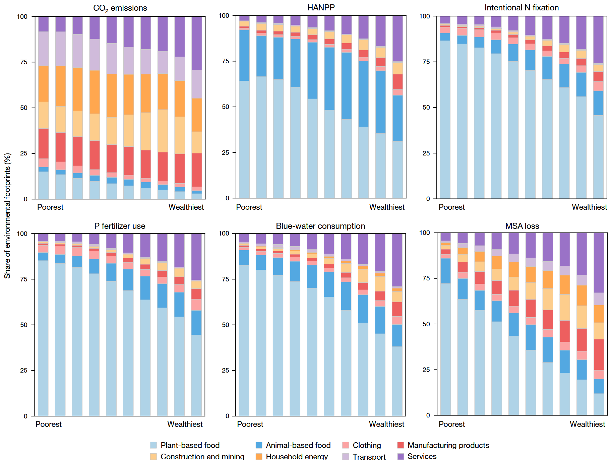
Sectoral composition of footprints
Food consumption, especially animal-based products, is the main driver HANPP, N fixation, P fertilizer use and blue-waster consumption.
Wealthy groups have larger footprints in services, manufacturing, and construction sectors.

Slide 11
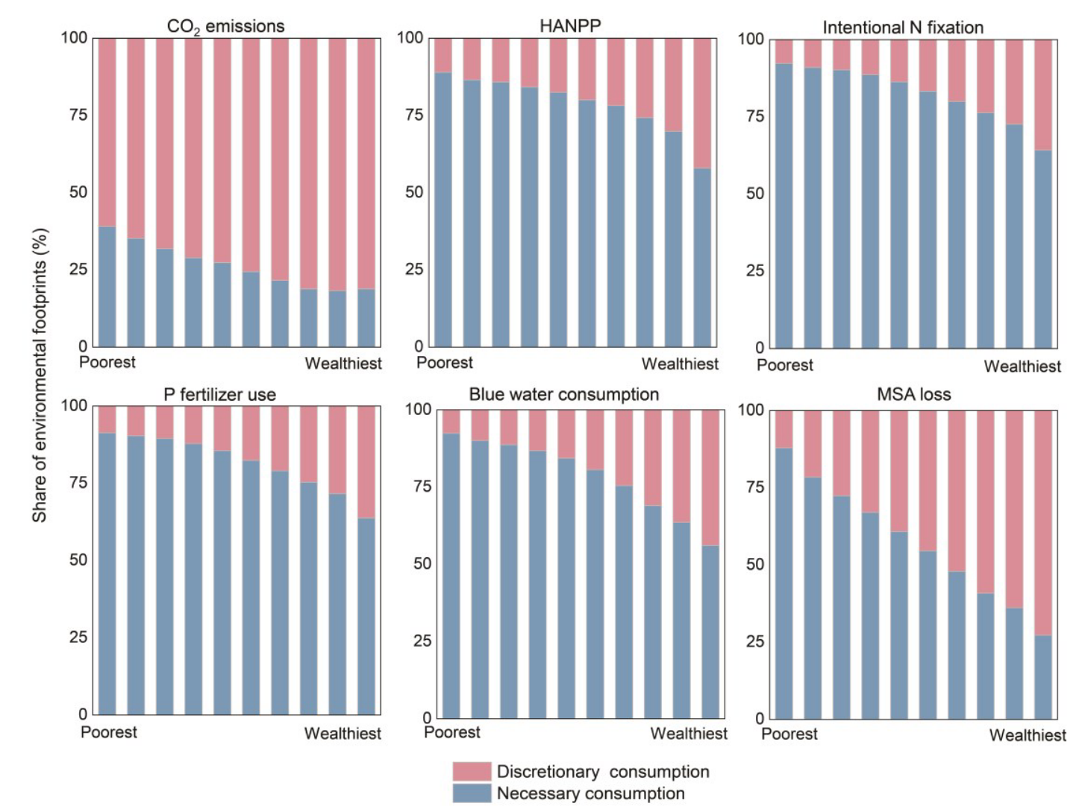
The wealthier groups leading to substantially greater environmental pressure
Discretionary goods are more prevalent among high-expenditure groups and are strongly associated with planetary boundary transgressions.
In contrast, lower-income groups focus more on necessities, and their consumption largely stays within limits.

Slide 12
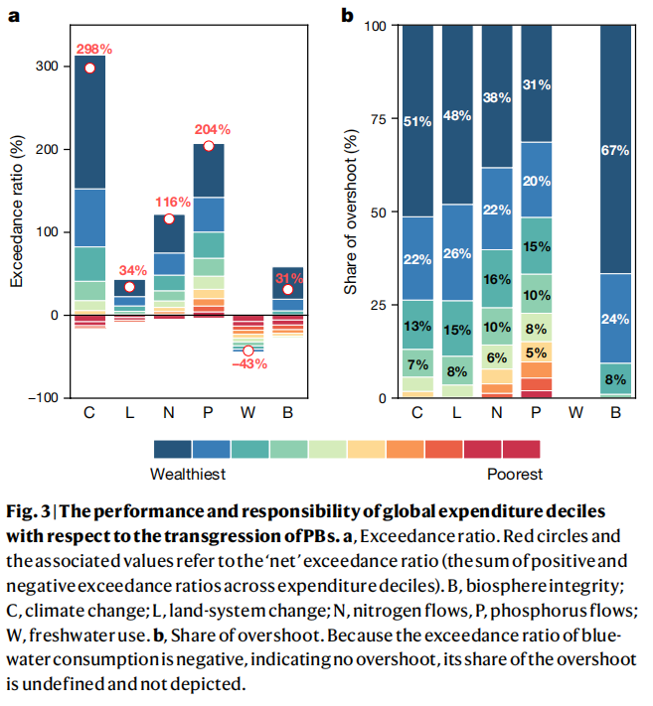
Top consumers are mainly responsible for PB transgression
In 2017, global planetary boundary (PB) transgressions were severe: CO₂ emissions exceeded the PB by 298%, phosphorus fertilizer use by 204%, and nitrogen fixation by 116%.
The global top 10% of consumers were mainly responsible for PB transgression : 51% of climate change transgression and 67% of biosphere integrity overshoot.

Slide 13
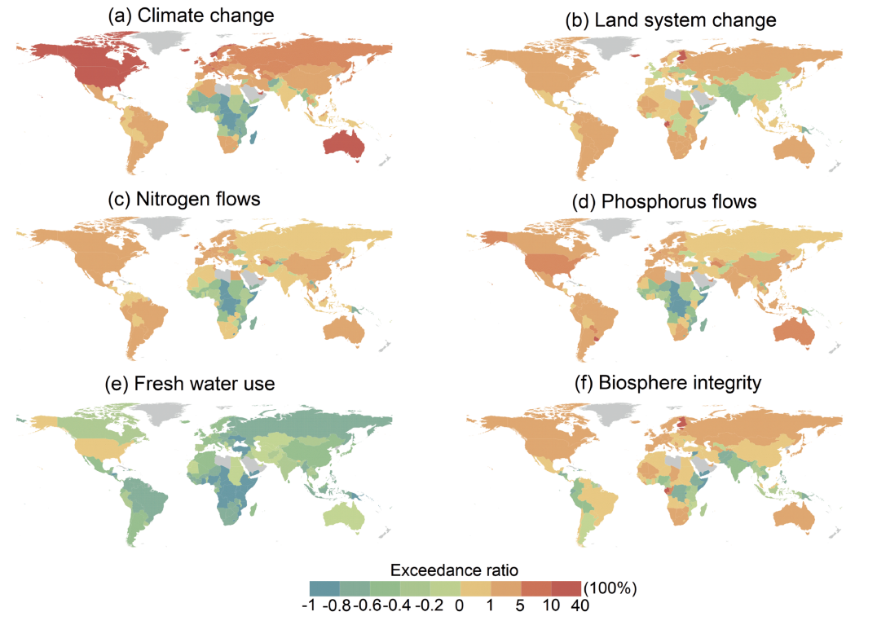
Exceedance ratios by region and decile
High-income deciles in developed regions (especially Europe and the US) contribute disproportionately to PB transgressions, particularly in climate change, N/P flows, and biosphere integrity.

Slide 14
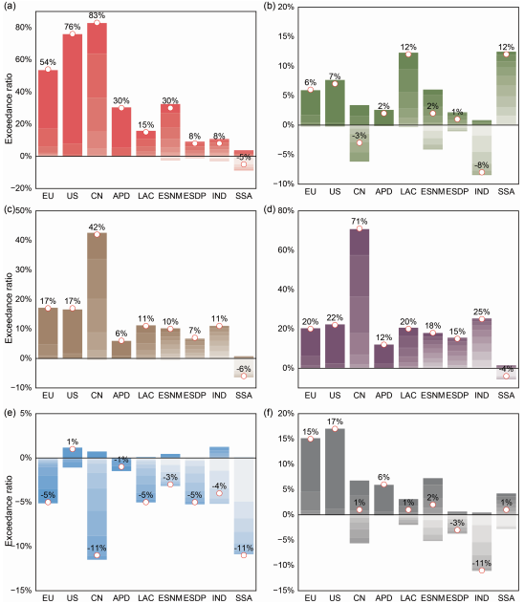
China and India have significant aggregate impacts in PB exceedance
National-level PB performance shows that while per capita footprints differ, large-population countries like China and India still have significant aggregate impacts.
The bottom 50% globally contribute almost nothing.

Slide 15
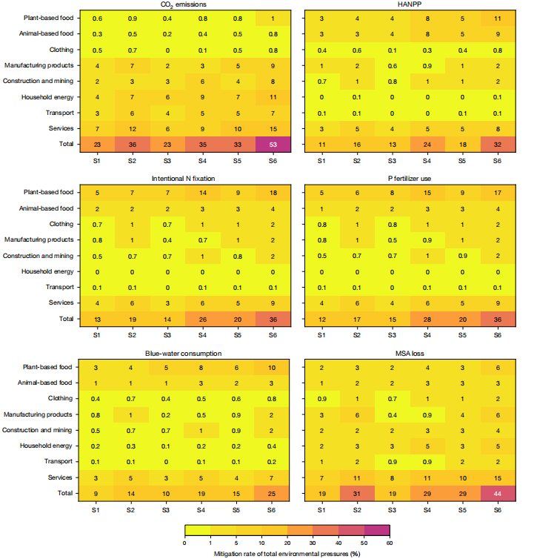
Scenario analysis shows large mitigation potential
S1/S2 (reducing top 10%/20% consumption to 10th/20th percentile):
reduce global environmental pressure by 9–36% and biodiversity pressure drops significantly.
S3/S4 (lowering environmental intensity to the group’s lowest level):
reduce pressures by 10–35%, especially effective for water, land, nitrogen, and phosphorus.
S5/S6 (combining reduction + efficiency improvement):
maximum reduction up to 53%, enabling land-system change and biosphere integrity to return within PBs.

Slide 16
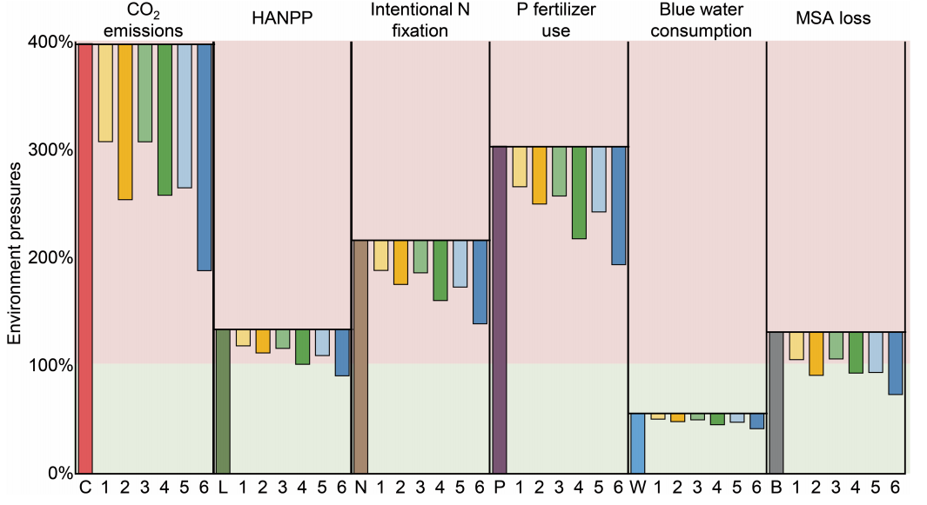
Synergistic actions by top consumers restore planetary boundaries
Single measures (S1–S4) reduce pressure but cannot restore key systems alone.
Scenarios S5 & S6 (top 10%/20% reduce consumption & improve efficiency) achieve the strongest impact.

Slide 17
Policy insights
Focus policies on the top 10–20% of high-impact consumers.
Establish fair consumption floors and ceilings to guide sustainable lifestyles.
Encourage low-impact choices like plant-based diets and efficient services.
Use progressive taxes and pricing to reduce excessive consumption.
Combine top-down regulation with public engagement for feasibility.
Notes:
总的来说，我们发现电力部门的低碳转型能够推进可持续发展目标的实现，转型的程度越高，推动潜力就越大。这在一定程度上解决当前的困局提供了支撑。

Slide 18
Conclusion
Global consumption patterns are highly unequal, with the top 10% responsible for over half of planetary boundary (PB) transgressions.
Food and service sectors are key drivers of environmental pressure.
Targeted consumption reduction and efficiency improvements among the top 20% can reduce global environmental pressure by up to 53%, enabling some PBs to return to safe zones.
Policy efforts must prioritize equity, focusing on sustainable consumption corridors and high-impact groups.
Notes:
总的来说，我们发现电力部门的低碳转型能够推进可持续发展目标的实现，转型的程度越高，推动潜力就越大。这在一定程度上解决当前的困局提供了支撑。

Slide 19
Limitations
EEMRIO models contain structural and data uncertainties from aggregation, imputation, and linear assumptions.
Household surveys may underrepresent the rich and suffer from recall and sampling biases.
Survey data span different years and prices, requiring assumptions that may not reflect real-world changes.
Informal and unpaid consumption is excluded, possibly underestimating low-income group footprints.
Interactions between planetary boundaries are ignored, making overshoot estimates optimistic.

Slide 20
THANKS! TianPP@sdu.edu.cn

