Slide 1
Structural Transformation and Economic Resilience: The Case of Pakistan
Farah Tasneem, Muhammad Aamir Khan
COMSATS University Islamabad
Pakistan.

Slide 2
Introduction
Structural Transformation
Lewis (1954) Dual economy model
Low productivity in primary sector
Labor and capital reallocate from non-capitalist to modern capitalist sectors.
Increased productivity, income, and economic well being.
A panacea for economic development
Economic Diversification
Sustained economic growth
Poverty alleviation

Slide 3
Pakistan’s Structural Transformation – An Overview
GDP by Sector (2024): Agriculture: 19%, Industry: 19%, Services: 62%.
Pakistan’s economy shifted slowly from agriculture to services, with limited manufacturing growth, → Services-led growth.
Deindustrialization: Premature shift to services without a strong industrial base.
Structural dualism: Large informal sector; low-tech exports.
Stagnant Exports: Pakistan’s exports have remained around $25–30 billion for over a decade.
Export Basket Concentration: Reliance on low-value-added textiles and apparel (60%+ of exports).
The textile sector contributes 8.5% to Pakistan’s GDP, makes up 46% of total manufacturing, and employs 40% of the national labor force.
Export-Oriented Structural Transformation
Policy targeting potential sector Textile and Services.

Slide 4
Continued
Service sector contributes 62% to GDP and one-third of employment in Pakistan.
Employment in services rose from 34.25% (1999–2000) to 37.6% (2017–2021).
Pakistan was Ranked 61st in the World in 2020 for Services Exports, with its Services Exports being about $5.4 billion.
With targeted trade and productivity policy, Pakistan’s emerging sectors can accelerate structural transformation, inclusive economic growth and resilience.

Slide 5
REVIEW OF LITERATURE

Slide 6
Key Themes in the Literature
a. Classical & Neoclassical Views
Lewis (1954): Surplus labor moves from agriculture to a modern sector (dual economy model).
Kuznets (1971): Industrialization as a core driver of modern economic growth.
b. Productivity-Based Approaches
McMillan & Rodrik (2011): Growth can come from productivity growth within sectors or reallocation of labor to more productive sectors.
Timmer et al. (2014): Emphasize the role of global value chains and sectoral upgrading.
c. Export & Trade-Led Transformation
Hausmann, Hwang & Rodrik (2007): “Product space” and economic complexity theory – the sophistication of exports affects income.
UNIDO (2020): Industrialization and structural change are linked to trade competitiveness.
d. Premature Deindustrialization
Rodrik (2016): Many developing countries are deindustrializing before becoming rich, limiting their transformation potential.
e. Services-Led Transformation
Ghani & O’Connell (2014): In South Asia, services (like IT and finance) are becoming drivers of structural change, bypassing manufacturing.

Slide 7
Methodological Approaches in the Literature
a. Growth Accounting Decomposition
Decomposes aggregate labor productivity growth into:
  Within-sector productivity change
  Labor reallocation effect
  (McMillan & Rodrik, 2011)
b. Input-Output and Social Accounting Matrix (SAM) Models
Used to trace value-added linkages across sectors.
Example: IFPRI SAM models and GTAP-based CGE models for transformation scenarios.
c. Computable General Equilibrium (CGE) Models
GTAP and MIRAGE models simulate the effects of trade, investment, or policy on structural dynamics.
Sector-specific shocks analyzed for labor shifts and output impacts.
d. Econometric Panel Models
Panel regressions used to estimate impact of sector shares, productivity, and trade composition on GDP per capita and employment.
Examples: Barro regressions, fixed/random effects models.

Slide 8
METHODOLOGY

Slide 9
GTAP Recursive Dynamic (RD) Model
Extension of static GTAP model into multi-period dynamic framework.
Recursive Dynamic: Captures capital accumulation, population growth, and technology changes.
Useful for long-term projections of trade and policy impacts.
Endogenous Investment: Allocation based on returns.
Population & Labor Growth: Exogenously modelled.
The mechanism for moving forward is done through investments that result in expansion of capital used for production, capital Endowment is endogenous and responds to investment changes that lead to capital accumulation.
If there is too much capital in the economy, the expected rates of return to capital fall. The fall in expected returns leads to reduction in future investments due to diminishing marginal returns to capital, as a higher level of capital has a lower returns in relative terms.

Slide 10
Data Modification
GTAP Official Data Release is GTAP V11 – 2017 Base year.
We used GTAP 12 Pre-release – 2019* Base Year.
Updating macroeconomic data for the entire GTAP database for all countries using the GTAPadjust program to update the base year to 2023.
Developing macroeconomic baseline from 2024 to 2050 using the Shared Socioeconomic Pathways (SSPs).
Baseline based on macroeconomic projections on GDP, population and employment captures the business-as-usual movements in the global economy.
Regional and Sectoral Aggregation – 25 Regions and all 65 Sectors.
*Contributor license.

Slide 11
Advalorem Equivalents (AVE’s) of NTMs
Tariffs have steadily declined due to trade agreements and reforms, so non-tariff measures (NTMs) are increasingly shaping global trade, even more in a context of geopolitical competition — industrial policy, protecting strategic industries (national security).
NON-Tariff Measures - All measures that are not tariffs but do affect trade.
“NTMs are policy measures other than ordinary customs that can potentially have an economic effect on international trade in goods, changing quantities traded, or prices or both” (UNCTAD, 2019).
NTMs can significantly increase trade costs, sometimes exceeding the effect of tariffs. Not only increasing compliance costs (technical) but measures at- or behind-the-border which create regulatory divergence making it harder to trade (non-technical).
Notes:
UNCTAD categorized NTMs into 16 types using the International Classification of Non-Tariff Measures (ICNTM).
Quantifying the size of NTMS can involve estimating their ad-valorem equivalents, expressed as the percentage change increase in price or equivalent measure.
The Samuelson iceberg cost method used widely by researchers in GTAP framework to model NTM’s.
The iceberg cost method → the idea here is basically that the NTM raises the cost of the good to the Importer so it's definitely a cost on the Importer side → the increases in cost is shown as a decline in the quantity so the quantity of the good moves from the exporting country to the importing country and that quantity is declining → so basically like an iceberg melting from , as it moves across the world which is why it's called the iceberg cost method

Slide 12
Novy Gravity Redux Methods for NTM’s
A measure of international trade costs which is micro-founded and use a different approach that benchmarks domestic trade data with bilateral trade to compute the AVEs.
Captures systemic trade barriers without requiring direct NTM data (No Dummies for NTM’s are required).
Considers Domestic Trade.
Estimation is done within GTAP Model.
Can’t be used for Goods with Zero Trade.
Does not differentiate between specific NTMs.
Source : Chen and Novy (2012); Anderson and van Wincoop (2004) and Novy (2009). UNESCAP (2024).

Slide 13
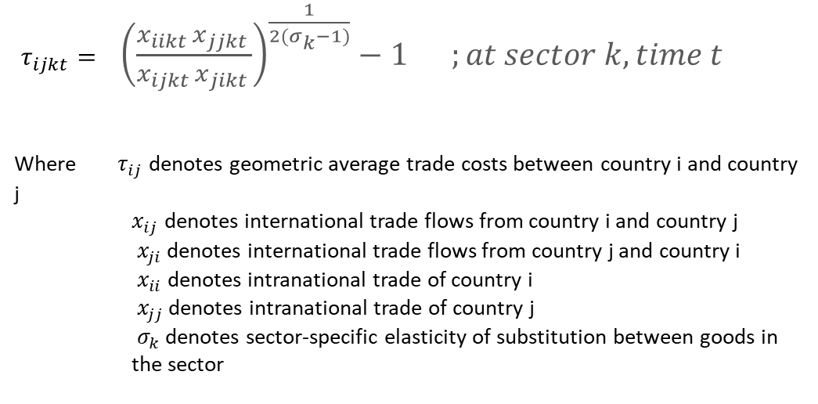
NOVY Gravity REDUX METHOD
$τ_{ijkt}=$ ${\left(\frac{x_{iikt }x_{jjkt }}{x_{ijkt }x_{jikt }}\right)}^{\frac{1}{2(σ_{k}−1)}}−1 ;at sector k, time t$
Where $τ_{ij}$ denotes geometric average trade costs between country i and country j
    $x_{ij}$ denotes international trade flows from country i and country j
    $x_{ji}$ denotes international trade flows from country j and country i
    ${ x}_{ii}$ denotes intranational trade of country i
    $x_{jj}$ denotes intranational trade of country j
    $σ_{k}$ denotes sector-specific elasticity of substitution between goods in the sector
The exponential term depends on the elasticity of substitution between imports (Armington)- for which we use the GTAP estimated elasticities at sector level, assuming a minimum of 8, based on UNESCAP (2024)*.
If a commodity is traded domestically but not traded much bilaterally, with low degree of substitution, we may get a high AVE, for example.
* This value of elasticity of substitution is the same as in Anderson and van Wincoop (2004) and Novy (2009). The past literature, for example, Anderson and van Wincoop (2003) and Jacks, Meissner and Novy (2009), suggests that results are not sensitive to the choice of parameter.

Slide 14
Research Simulations/ Experiments
Trade Liberalization: A 10 % decrease in import tariffs across the board (Pakistan to Rest of World and Vice Versa)
Textile and Clothing Productivity:A 10% increase in Productivity of Textile and Wearing Apparel Sectors of Pakistan.
Services NTMS: Removing 10% of Bilateral actionable NTM’s by Pakistan and it’s all Trading Partners.

Slide 15
RESULTS

Slide 16
Impact on Real GDP (% changes - (Monetary changes))
Year | Sim-I | Sim-II | Sim-III
 | TL | TWAp | Ser-NTM
 | % Change (Monetary Change) Million US $ | % Change (Monetary Change) Million US $ | % Change (Monetary Change) Million US $
2025 | 0.14% ($490.08M) | 1.12% ($3900.10M) | 4.53% ($15852.4M)
2030 | 0.22% ($822.27M) | 1.26% ($4659.52M) | 4.54% ($16793.8M)
2035 | 0.32% ($1520.87M) | 1.43% ($6722.09M) | 4.67% ($21904.2M)
2040 | 0.41% ($2433.30M) | 1.56% ($9133.24M) | 4.72% ($27616.5M)
2045 | 0.51% ($4587.68M) | 1.62% ($14449.39M) | 4.74% ($42431.1M)
2050 | 0.57% ($5330.53M | 1.73% ($16068.53M) | 4.66% ($43444.5M)

Slide 17
Impact on Real Exports
Year | Sim-I | Sim-II | Sim-III
 | TL | TWAp | Ser-NTM
 | % Change (Monetary Change) Million US $ | % Change (Monetary Change) Million US $ | % Change (Monetary Change) Million US $
2025 | 4.16% ($2535.81M) | 0.92% ($552.76M) | -2.35% (-$715.83M)
2030 | 4.45% ($2772.37M) | 1.04% ($634.16M) | -1.68% (-$51.88M)
2035 | 5.04% ($3885.28M) | 1.87% ($1166.70M) | -0.06% (-$21.36M)
2040 | 5.19% ($4974.98M) | 2.47% ($1898.93M) | 1.44% ($687.78M)
2045 | 4.66% ($7347.72M) | 2.97% ($2844.68M) | 3.47% ($2734.92M)
2050 | 4.85% ($7637.17M) | 2.87% ($4531.47M) | 3.46% ($2723.65M)

Slide 18
Impact on Real Imports
Year | Sim-I | Sim-II | Sim-III
 | TL | TWAp | Ser-NTM
 | % Change (Monetary Change) Million US $ | % Change (Monetary Change) Million US $ | % Change (Monetary Change) Million US $
2025 | 3.53% ($4513.09M) | 4.46% ($5452.70M) | 2.09% ($2666.79M)
2030 | 3.51% ($4911.55M) | 4.48% $5727.83M) | 2.10% ($2944.11M)
2035 | 3.31% ($5974.35M) | 4.80% ($6720.95M) | 1.87% ($3377.65M)
2040 | 3.26% ($7004.47M) | 4.78% ($8633.89M) | 1.77% ($3791.31M)
2045 | 3.30% ($7955.39M) | 4.24% ($9103.75M) | 1.57% ($3791.06M)
2050 | 3.32% ($8349.61M) | 4.28% ($10339.96M) | 1.72% ($4332.47M)

Slide 19
Conclusion
This research provides robust evidence of the economic benefits of accelerating structural transformation in Pakistan through targeted trade liberalization and productivity enhancements.
Cumulative gains in terms of Real GDP are positive for all three simulations.
Trade Liberalization and enhancing productivity, particularly in the textiles and apparel sector can significantly boost Trade and overall economic performance in case of Pakistan.
The sectoral expansion in textiles and apparel alone accounts for a substantial share of the gains in manufacturing output, highlighting its pivotal role in driving economic growth.
The removal of NTMs on services unleashes considerable growth potential, as the services sector emerges as the largest contributor to total output and labor productivity growth. However, the relatively higher Real GDP Impact is attributed to the fact that lower NTMs in services enhances consumer welfare by lowering prices, improving service quality, and expanding access, all of which stimulate household consumption — a key driver of GDP growth.

Slide 20
Policy Recommendation
This research recommends following policy recommendations :
Promote export diversification and competitiveness through strategic subsidies and infrastructure.
Government must Support import-competing industries with technological upgrades and productivity improvements.
Expand market access via new trade agreements and diplomatic initiatives.
Establish monitoring systems to track the real-time effectiveness of trade policies.
Balance liberalization with strategic protection of key industries for resilience.

Slide 21
“Essentially, all models are wrong but some are useful”.
The practical question is how wrong do they have to be to not be useful.
George Box

Slide 22

THANKS

