Slide 1

The Effect of Industrial Digitalization on the Gender Wage Gap:
An Analysis based on Input-Output tables and Causal Inference
Wanqing Liao, Nan Zhao, Chunyan Shi
School of Statistics
Beijing Normal University
2025.07.09

Slide 2

01
Introduction
02
Data and Methods
CONTENTS
03
Empirical Results
04
Conclusion

Slide 3
Introduction
01

Slide 4




Introduction
Unequal pay
To achieve equality
63%
131 years needed
What causes this?
Education
Experience
Technology
Social Norm
…

Slide 5


Introduction
V.S
Large Population in China
Large-scale Digital Economy
Global Female Population
Digital
Economy
Chinese
GDP
Industry Digitization
Chinese Women
$$≈18\%$$

Slide 6
Introduction
Key Question
How does industry digitalization affect the gender wage gap?
What we mainly find
Industry digitization significantly reduces the gender wage,
primarily by enhancing women’s comparative advantage in nonmanual skills, increasing job flexibility, and mitigating occupational segregation.
However, persistent labor market discrimination offsets part of the progress.

Slide 7
Introduction
Factors Influencing the Gender Wage Gap
Effects of Industry Digitization on the labor market’s structure
Traditional human capital such as education and working experience (Becker, 1986; Brown & Corcoran, 1997; Blau, 2000).
Noncognitive skills(Balcar & Hedija, 2019; Palczyńska, 2021; Li,2023).
Horizontal and vertical segregation caused by the characteristics of industries and occupations (Macpherson & Hirsch，1995; Jurajda & Harmgart, 2007; Cortés & Pan，2023) .
Increasing the employment proportion of the tertiary industry (Bessen, 2019; Rijnks et al., 2022).
Leading to a "polarization" effect in employment skill structures (David, 2013; Bárány & Siegel, 2018).
Promoting the rise of the gig economy and flexible employment (Macpherson & Hirsch，1995; Jurajda & Harmgart, 2007; Cortés & Pan，2023) .

Slide 8
Introduction
Effects of Industry Digitization on the Gender Wage Gap
Diminishing the importance of physical skills and enhancing women’s comparative advantage (Krieger-Boden & Sorgner, 2018; Chuang, 2021; Lu et al., 2023).
Alleviating women’s work‒family conflict from both the labor supply and demand sides (Churchill & Craig, 2019; Keeble et al., 2020; Arntz & Yahmed, 2022; Farré et al., 2023).
Helping overcome gender-based occupational horizontal and vertical segregation (Goldin, 2014; Keeble et al., 2020; Homroy and Mukherjee，2021; Liu et al., 2024) .
Main
Innovations
Enriching research on the effect of digitization from an industry perspective.
Providing new evidence on how digitization narrows the gender wage gap.

Slide 9
Data and Methods
02

Slide 10
Data: data resources
1. China’s input–output tables
2.Chinese Household Income Project (CHIP)
&
2012
2017
2007
2012
2017
2018
2007
2008
2013
Complied only in years ending in "2" and "7“.
Used to calculate the digitization levels.
Collecting individual and household information through household surveys.
Wage levels, gender, industries etc.

Slide 11
Data: cleaning process
Employed
(except self-employed)
16-60 years old
With all key variables
A total of 27,792 individuals, including 15,576 men and 12,216 women.
11

Slide 12
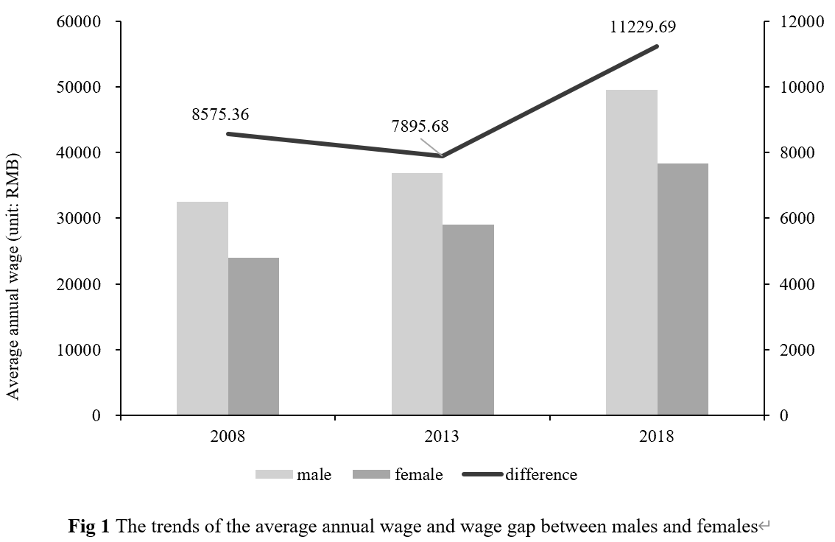
Dependent Variable: Individual's annual wage income
Including various monetary subsidies.
Converted to real wages with 2008 as the base year.
Winsorized at the 1% level.
12

Slide 13


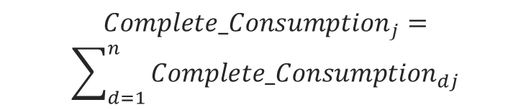

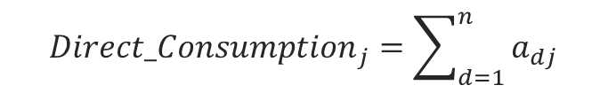
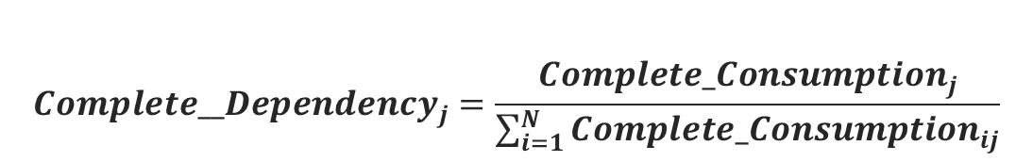

Independent Variable: Industry Digitization Level
Calculation Method
$${Direct_Consumption}_{j}=\sum_{d=1}^{n}{a_{dj}}$$
$${Direct_Dependency}_{j}=\frac{\sum_{d=1}^{n}{a_{dj}}}{\sum_{i=1}^{N}{a_{ij}}}$$
(1)
(2)
$${Complete_Consumption}_{dj}=a_{dj}+\sum_{m=1}^{N}{a_{dm}a_{mj}}$$
$$+\sum_{l=1}^{N}{\sum_{m=1}^{N}{a_{dl}a_{lm}a_{mj}}}+…$$
$${Complete_Consumption}_{j}=$$
$$\sum_{d=1}^{n}{{Complete_Consumption}_{dj}}$$
(3)
(4)
Do not capture relative importance
Can not represent overall reliance
$${Complete__Dependency}_{j}=\frac{{Complete_Consumption}_{j}}{\sum_{i=1}^{N}{{Complete_Consumption}_{ij}}}$$
(5)
13

Slide 14
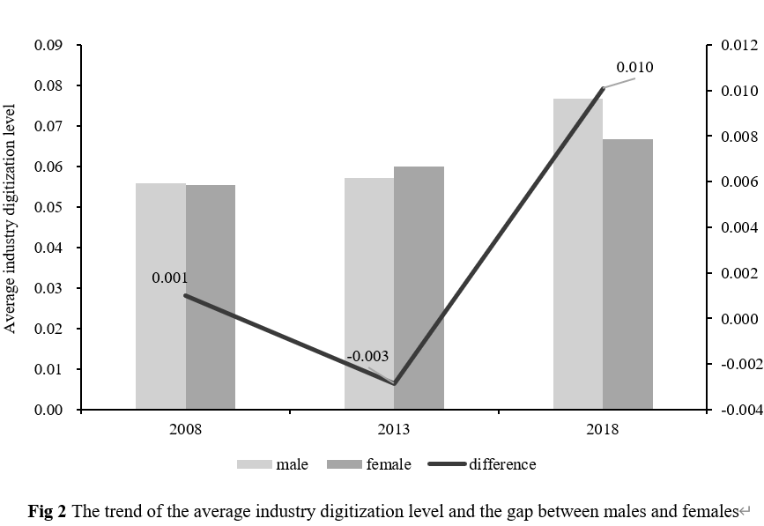
Independent Variable: Industry Digitization Level
The degree of industry digitization has been increasing during the sample period.
Same trend as thechange gender wage gap in Figure 1.
May be positively correlated with wage .
14

Slide 15
Control Variables
Individual level
Household level
Industry level
Province level
Age
Age squared term
Educational level
Work Experience
Health statu
Marriage statu
Number of young children
Number of elder person
Logarithm of industrial fixed asset investment
Logarithm of industrial value added
Logarithm of provincial annual per capital GDP
Provincial marketization index
15

Slide 16
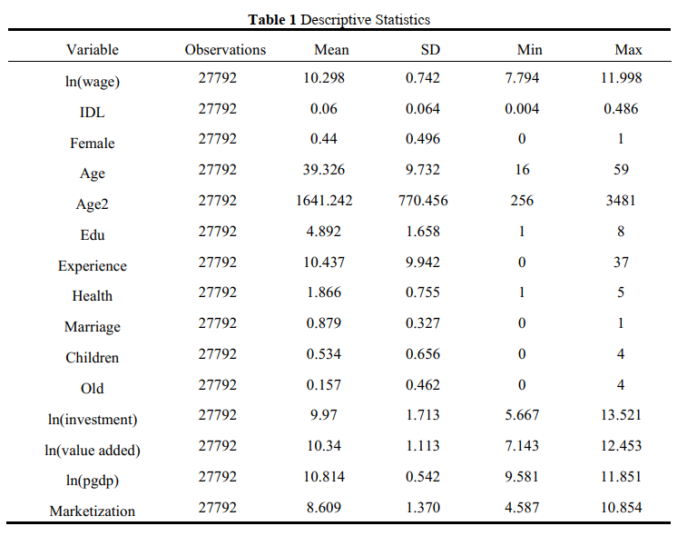
Descriptive Statistics

Slide 17
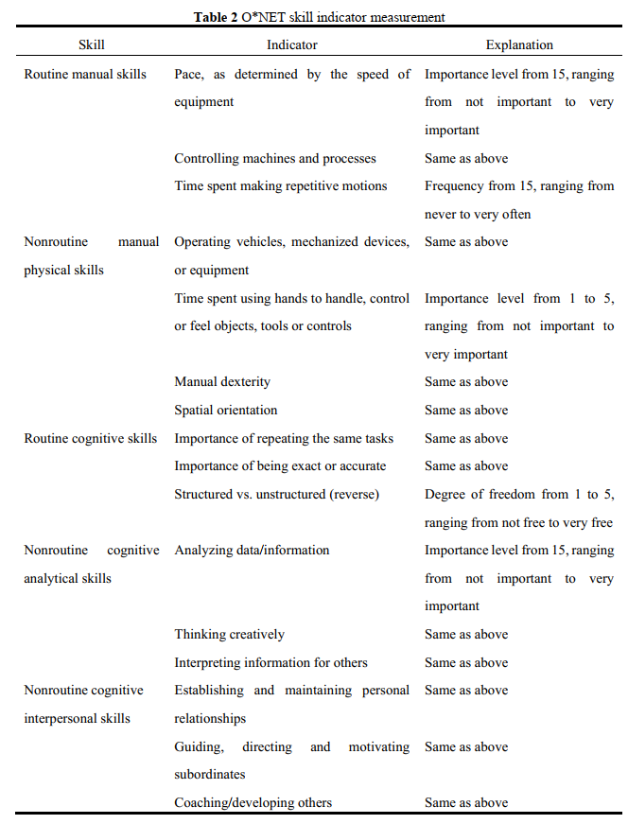
Mechanism Variables
Following the approaches of Acemoglu (2011).
Using data from the U.S. Occupational Information Network (O*NET) .
To explore how digitization affects the pricing of these skills.
17

Slide 18
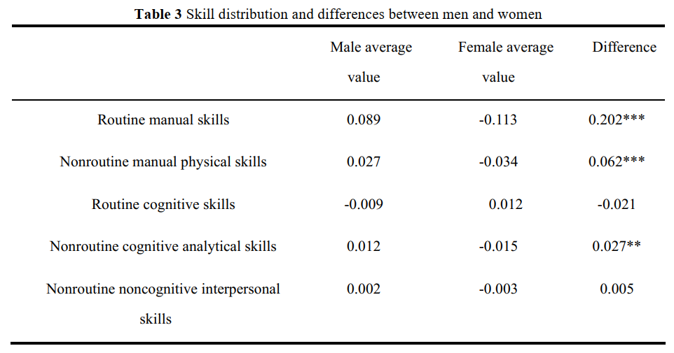
Mechanism Variables
Men significantly outperform women in physical skills and non-routine cognitive skils.
There are no obvious differences in the other two types of skills.
18

Slide 19
Model
Baseline Model
$$\begin{aligned}{lnwage}_{ijpt}=β_{0}+β_{1}{female}_{ijpt}+β_{2}{IDL}_{jp,t−1}+δ{female}_{ijpt}×{IDL}_{jp,t−1}+ \\ γX_{ijpt}+μ_{jp}+λ_{t}+ε_{ijpt}\end{aligned}$$
(6)
$i$: individual $j$: industry $p$: province $t:$year ${female}_{ijpt}$: female=1, male=0 ${IDL}_{jp,t−1}$: industry digitization level
$μ_{jp}$: industry–province interaction fixed effects $λ_{t}$: time fixed effects${ ε}_{ijpt}$: random disturbance term
O-B decomposition
$$E\left({lnY}_{M}\right)−E\left({lnY}_{F}\right)=\left(X_{M}−X_{F}\right)\frac{\left(β_{M}+β_{F}\right)}{2}+\frac{\left(X_{M}+X_{F}\right)}{2}\left(β_{M}−β_{F}\right)$$
(7)
impact of differences in characteristics
impact of differences in coefficients

Slide 20
Empirical Results
03

Slide 21
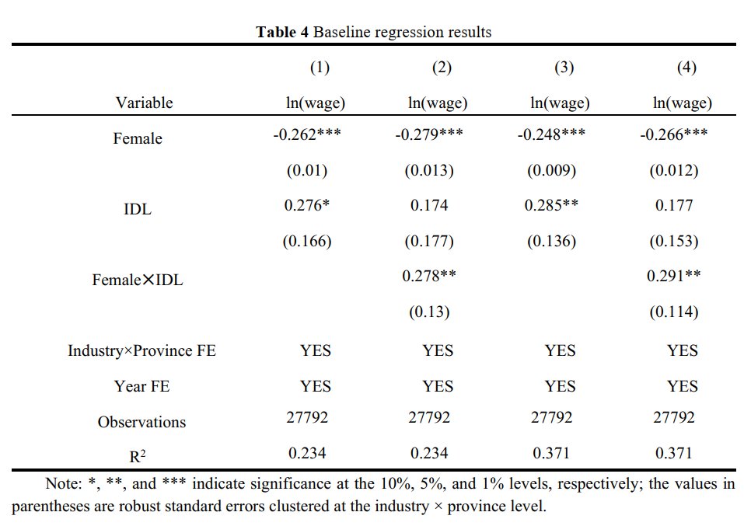
Empirical Results
Women’s wages are lower than those of men’s.
Digitization increases the average wage.
Digitization is more beneficial for females than for males.

Slide 22
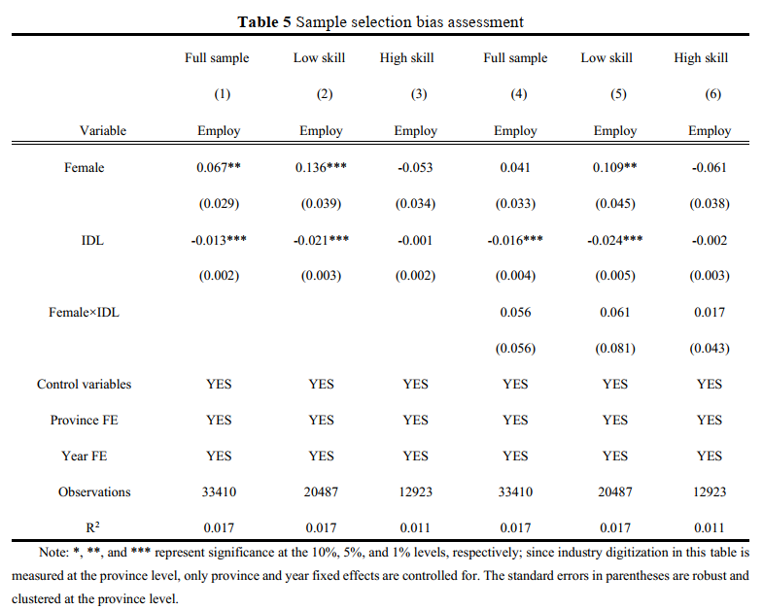
Empirical Results
Low-skilled/income workers are more likely to lose jobs due to digitalization.
&
Women's skills and earnings typically lag behind those of men.
Sample may contain a greater proportion of high-skilled women.
Sample selection bias

Slide 23
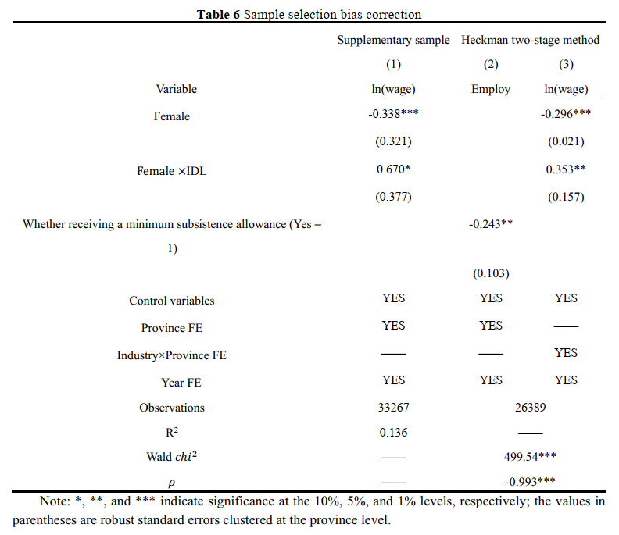
Empirical Results
Assign a wage of 0 to unemployed individuals .
Re-estimate the model using the Heckman two-step method.

Slide 24
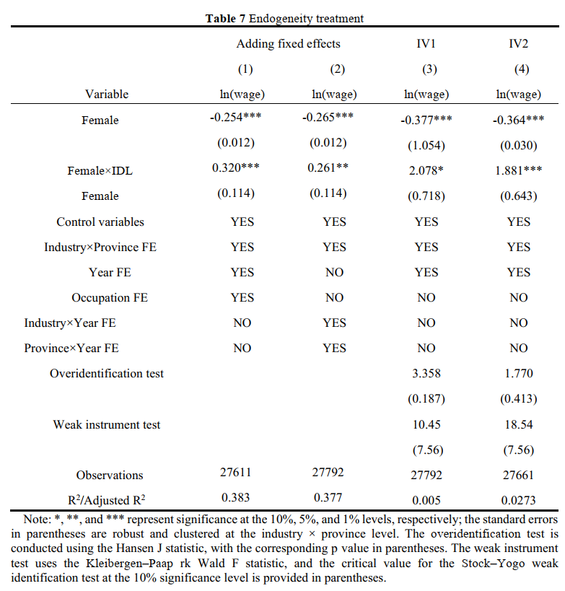
Empirical Results
historical variables
time-varying variables
IV1.1: average number of fixed-line telephones per 100 people in 1984 × digital economy industry value added in 2007, 2012, and 2017
IV1.2: average number of fixed-line telephones per 100 people in 1984 × number of broadband internet connections in 2007, 2012, and 2017
IV1.1
IV1.2
IDL
Female× IV1.1
Female× IV1.1
Female×IDL
The construction of IV2 is similar to that of IV1

Slide 25
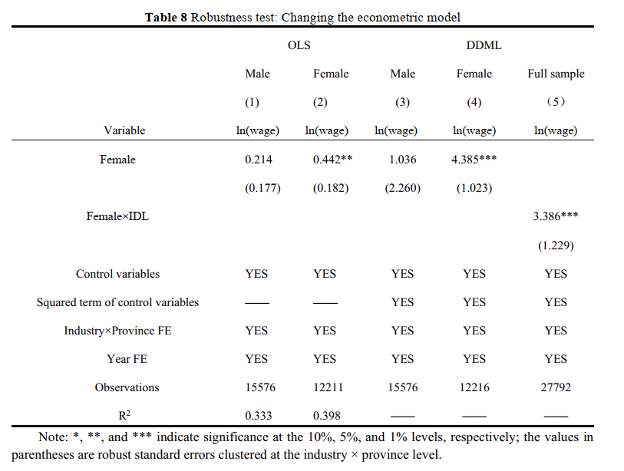
Robustness tests
Changing the econometric model specifications.
Using alternative measures of industry digitization
Changing the cluster level of standard errors.
Replacing the sample of CFPS instead of CHIPS.
Excluding samples from provincial-level municipalities.

Slide 26
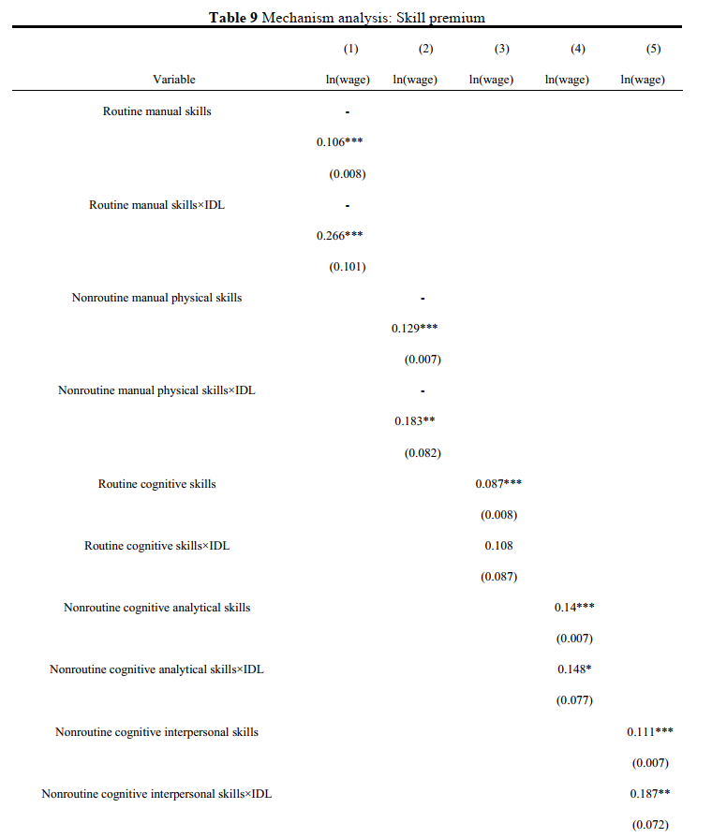
Mechanism analysis
Digitization further devalues physical skills and appreciates non-routine skills.
The depreciation of physical skills, particularly routine manual skills, is an important mechanism for the narrowing of the gender wage gap.

Slide 27
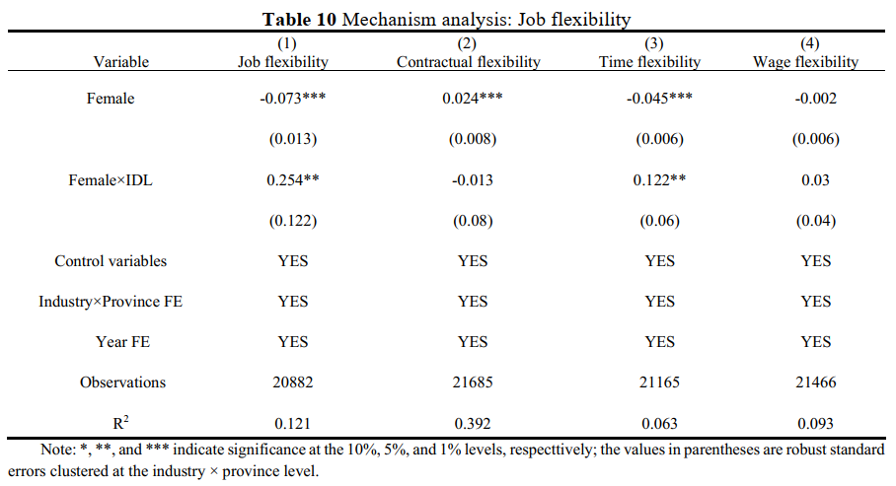
Mechanism analysis
Women experience less work flexibility compared to men.
Digitalization helps improve women's work flexibility, especially in work time flexibility, , thus contributing to alleviating women's work-family conflict.

Slide 28
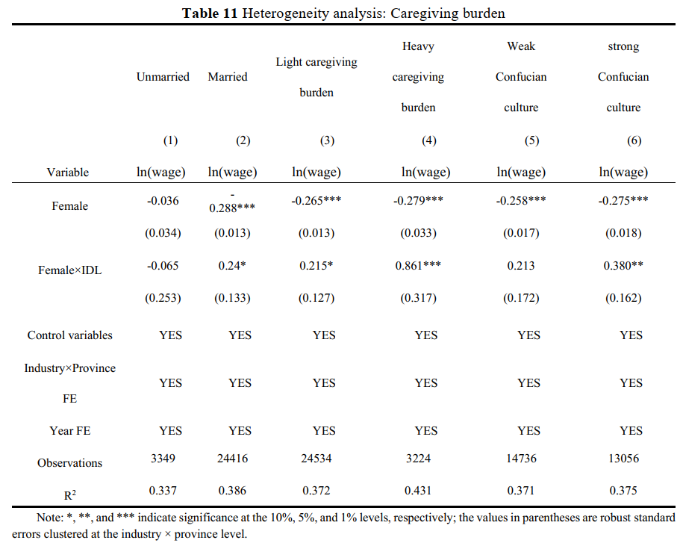
Empirical Results
The effect is stronger in these groups of married, strongly influenced by Confucian culture, and with heavier caregiving burdens.
The alleviation of work-family conflict brought by increased work flexibility is also one of the important mechanisms.

Slide 29
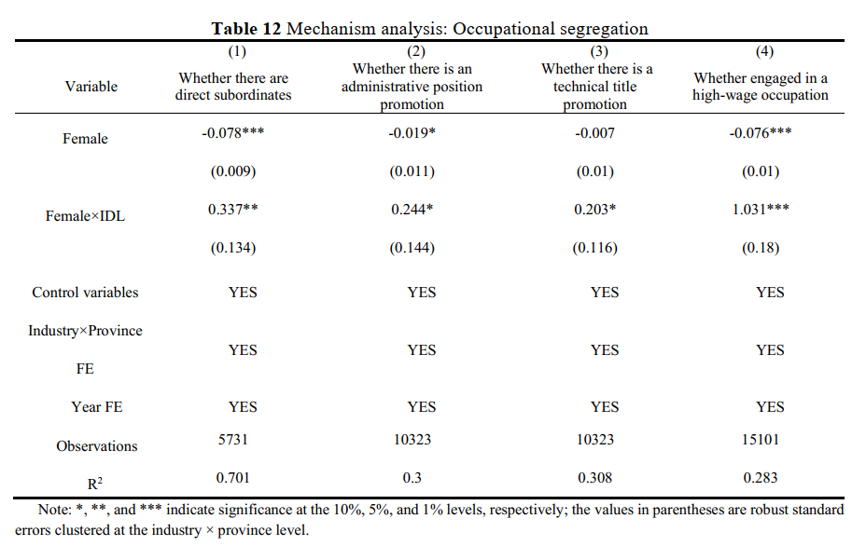
Mechanism analysis
Compared with men, women typically have fewer direct subordinates, fewer promotions, and are less likely to engage in high-wage occupations.
Digitization increases the probability of women holding leadership positions and makes it more likely for women to engage in higher-paying careers.

Slide 30
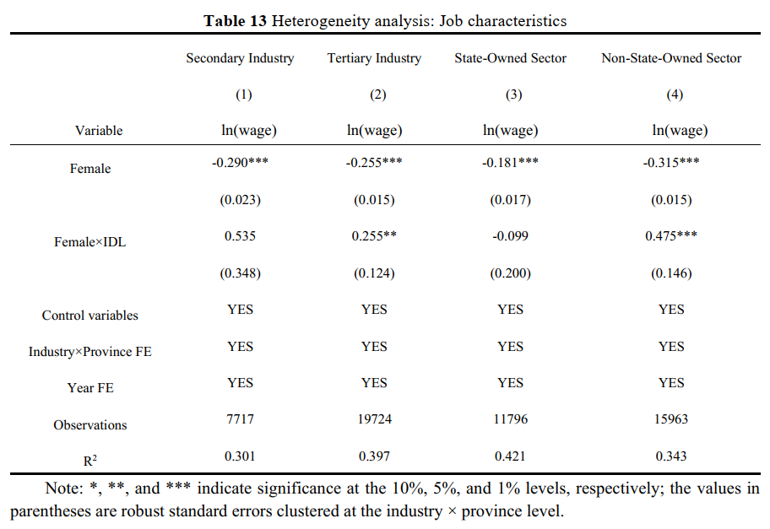
Heterogeneity analysis
The tertiary industry boasts higher digitization, greater work flexibility, and a stronger female presence.
Wage determination mechanisms in non-state-owned sectors are generally more flexible and place more emphasis on job performance than on traditional factors.

Slide 31
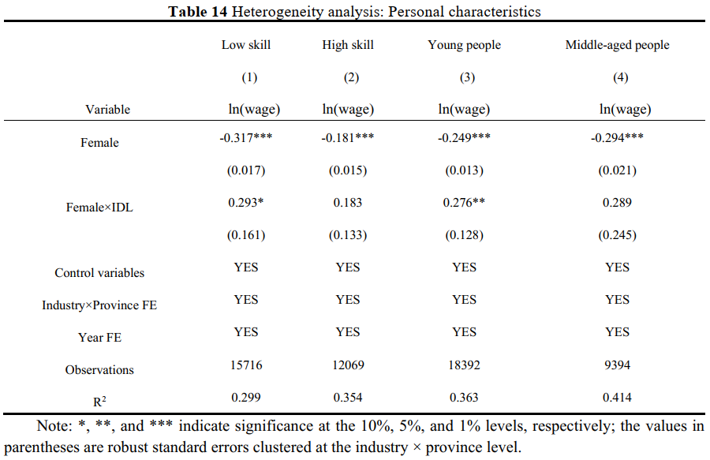
Heterogeneity analysis
Low-skill labor primarily engages in physical labor, and more likely to engage in flexible jobs.
Young women and men have smaller gaps in digital skills and other human capital factors, both of them tend to have more egalitarian gender role attitudes.

Slide 32
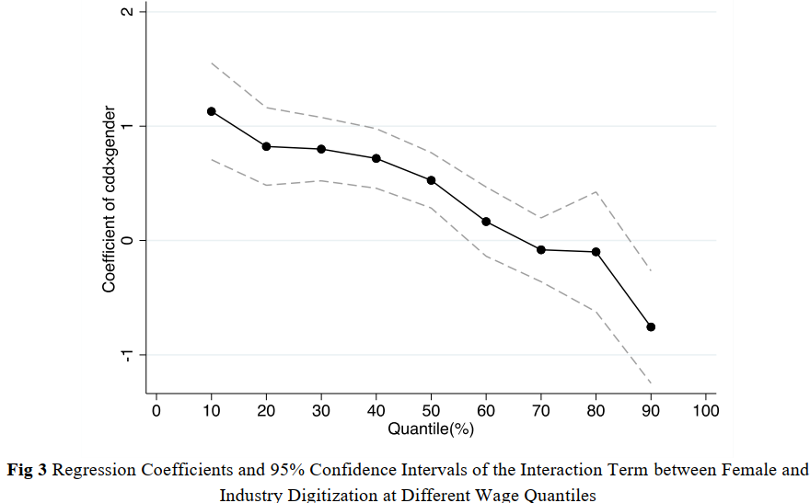
Quantile Regression
The effect of digitization gradually decreases as wages increase.
High-wage occupations typically rely less on physical skill and women’s representation remains low in these occupations.

Slide 33
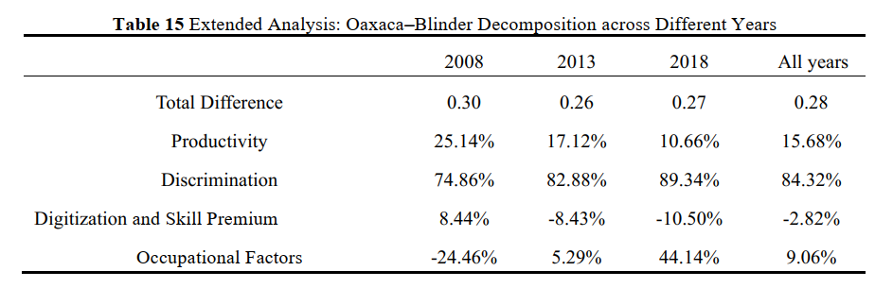
Extend Analysis
Why did the overall gender wage gap not narrow continuously?
Gender discrimination in the labor market gradually intensified, and is the primary cause of the gender wage gap.
Occupational factors have offset the effects of digitization.

Slide 34
Conclusion
04

Slide 35
Conclusion
Industry digitization generally helps narrow the gender wage gap. For every 0.1 unit increase in digital reliance, the gender wage gap is expected to decrease by an average of 2.91%.
The mechanisms are that industry digitization leads to a depreciation of physical skills, an improvement of job flexibility, and helps break down occupational gender segregation.
Gender discrimination in the labor market remains severe and calls for urgent resolution.

Slide 36
Thanks for listening!

