Slide 1
Leveraging Machine Learning in Input-Output Economic Modeling
Kehan HE, Zhifu MI, Dabo GUAN

Slide 2
Introduction
Prediction of economic performance has always been based on historical data
This has been feasible for short future prediction in past studies

Slide 3
Introduction
If looking into more distant future, the prediction uncertainty can be large because the regression model has not seen this in its own history

Slide 4
Introduction
It may theoretically be more tenable to include changes in indicators experienced by other countries in regression simulations

Slide 5
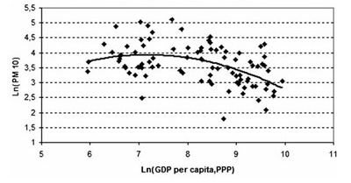
Introduction
The Kuznets curve represents the assumption that economic development is a quadratic function of environmental pressures

Slide 6
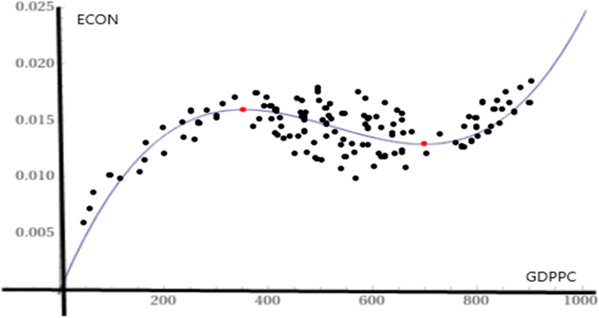
Introduction
Follow-up studies have proved that the relationship between economic development indicators and environmental pressure is far more complex than that of quadratic functions

Slide 7
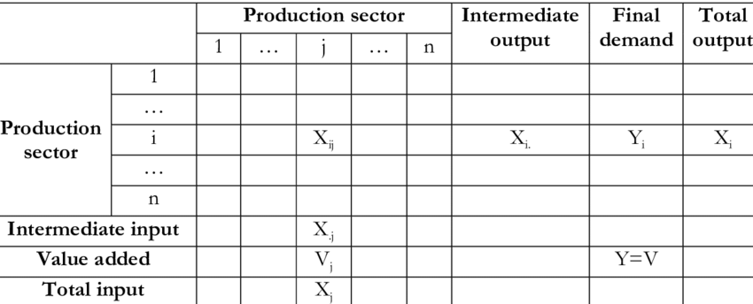
Introduction
The Input-Output (IO) model was first developed by Wassily Leontief in the 1930s to describe interactions and interlinkages between industries
IO tables are compiled by national statistic bureaus periodically to supports economic analysis and policy making.

Slide 8
Research Gap
Limitations of IO Tables
Statistical method prone to time lag, inaccuracy, and error
Conventional national IO tables updated every 5 years on average
Higher time resolution requires extrapolation and interpolation
Challenges in IO Table Compilation
IO table surveying is labor-intensive
Developed countries have established protocols (European Statistics Code of Practice)
Less developed countries may lack resources, leading to missing or inaccurate IO tables

Slide 9
Method
Use of social-economic data $i$to predict the IO relationship of a country at a given time
Sector 1
Sector 2
Sector 3
Sector 4
Sector 5
Sector 6
Sector 1
A11 | A12 |  |  |  |  | …
A21 | …
 |  | …
 |  |  | …
 |  |  |  | …
 |  |  |  |  | …
… |  |  |  |  |  | …
$$A11=f(i1,i2,…,in)$$
Sector 2
$$A12=f(i1,i2,…,in)$$
Sector 3
Sector 4
$$…$$
Sector 5
Sector 6

Slide 10
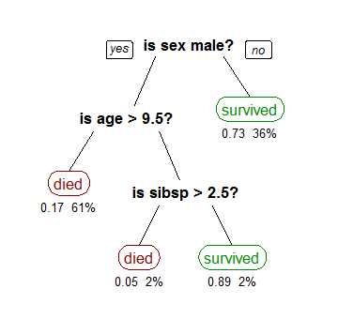
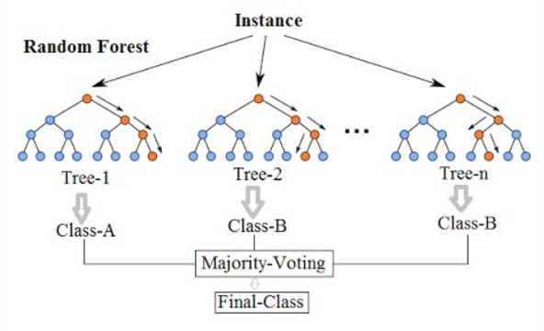
Method – Random Forest
Example: A decision tree that describes the survival rate of passengers on the Titanic
Schematic diagram of the stochastic decision forest
Notes:
Random forest regression is better at handling nonlinear relationships than ordinary regression models, such as linear regression. At the same time, a random forest is made up of many decision trees, which means that it is not sensitive to errors or outliers in a single model. In addition, it is very user-friendly and easy to use for users who don't have much background in machine learning

Slide 11
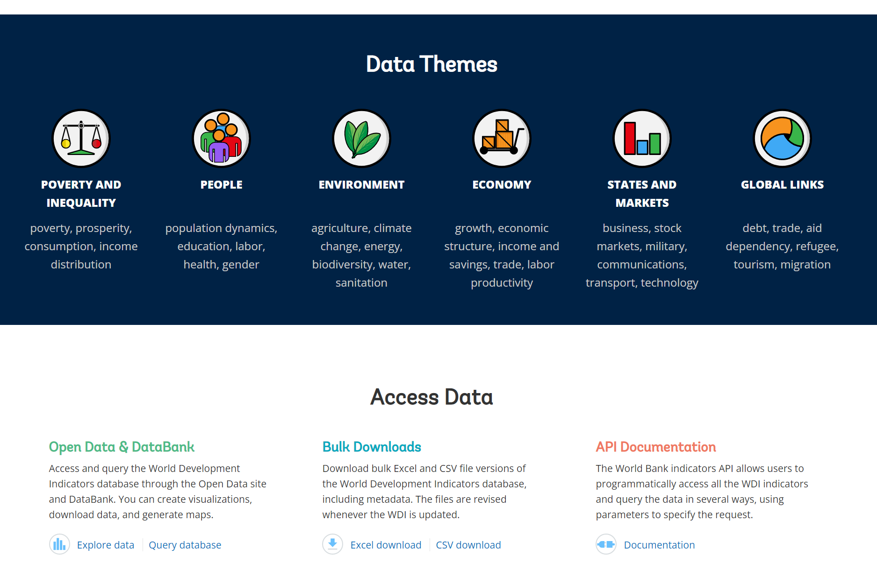
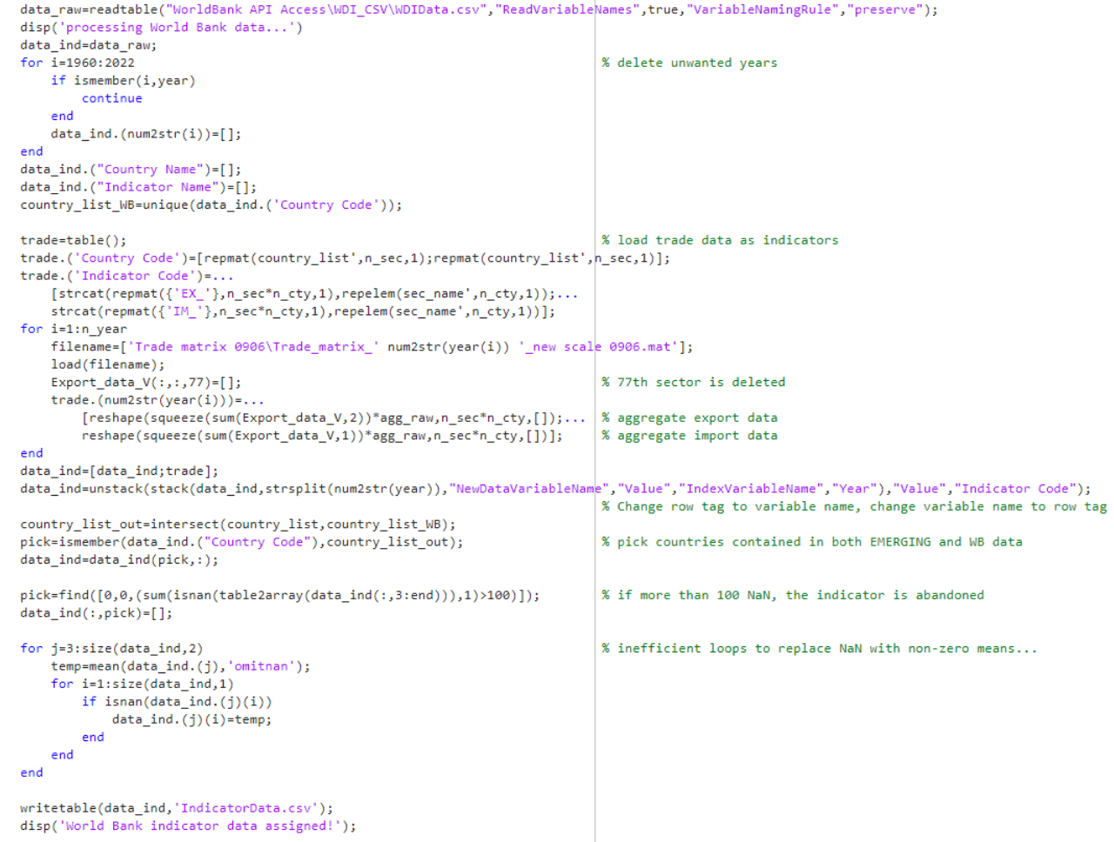
Method - Data
Step 1: Collect and compile annual development indicators for each country from the World Bank database https://datatopics.worldbank.org/world-development-indicators/

Slide 12
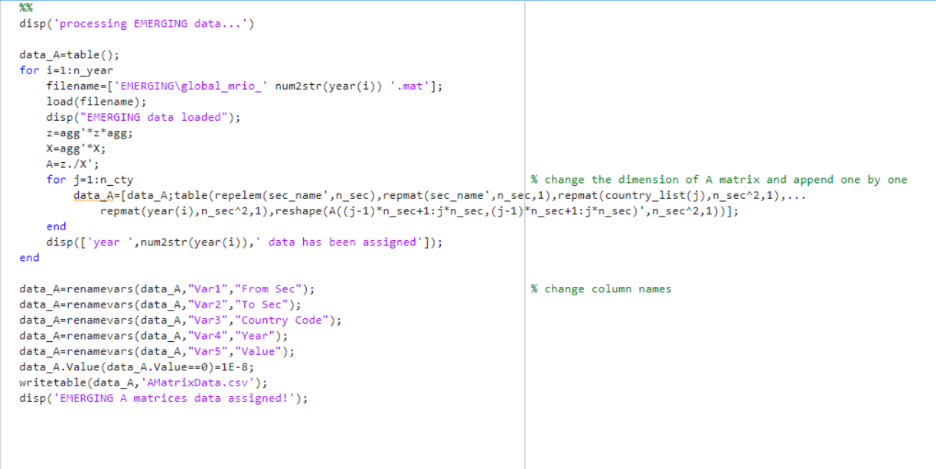
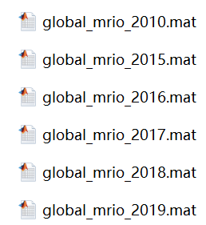
Method - Data
Step 2: Organize the A-matrix of each country in the OECD database Reduced to 16x16 sectorial resolution due to constrain in computational hardware capacity 6 years, 245 countries

Slide 13
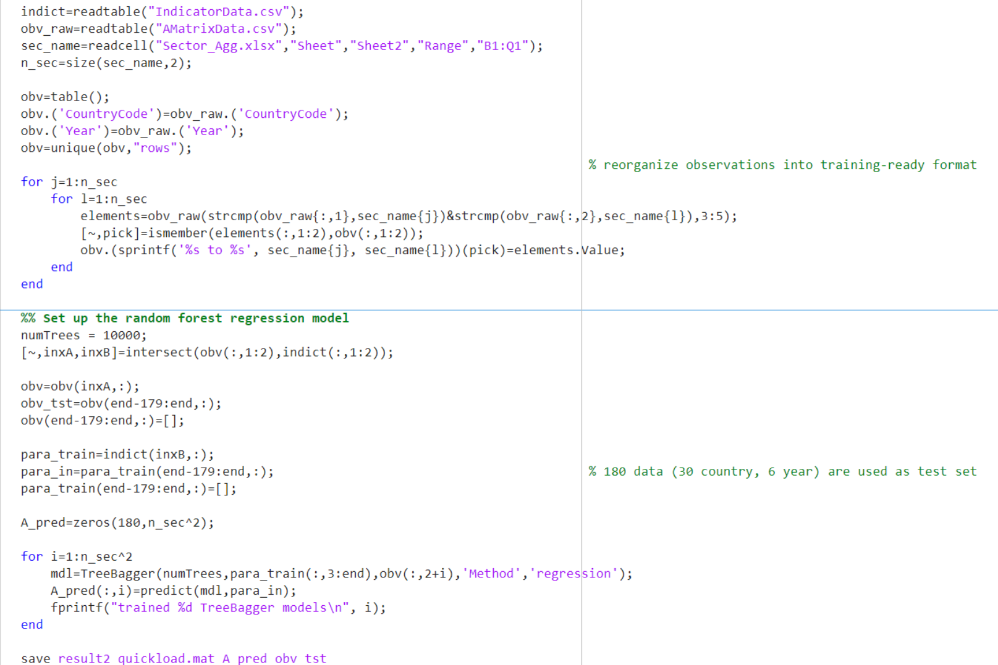
Method - Data
Step 3: Train a regression model by mapping the economic indicator to the A matrix and bring it into the TreeBegger function (188Mb for one model) Discard metrics with more than 100 missing data points Set the parameter to 10,000 decision trees

Slide 14
Result
Data from 30 countries over 6 years out of 245 countries in the dataset were used for validation Set threshold: 70%< (predicted/true) < 130% is considered relatively accurate

Slide 15
Result - Vietnam
Vietnam, training year of 2017
Vietnam, verification year of 2018

Slide 16
Result - Vietnam
Varying “Renewable Energy Ratio” to show the sensitivity of economic structure to the change of this parameter
15% to 21.8%
21.8% to 25%
25% to 30%

Slide 17
Conclusion
Potential and Advancements:
Method shows great potential in economic research
Significant advancement in IO modeling through integration with data science and machine learning
Current Limitations:
Constrained by computational hardware limitations
Limited inclusion of parameters and detailed IO sector breakdown
Future Directions:
Incorporate additional parameters from multiple sources
Utilize better computational devices to enhance model performance

Slide 18
Thank you

