Slide 1
31st International Input-Output Association Conference
IIOA 2025 Male, Maldives
6 – 11 July 2025
MITIGATING REBOUND EFFECTS:
A CGE MODEL FOR ASSESSING HOUSEHOLD ACTIONS
Edgar Towa*, Wouter M.J. Achten*, Jaume Freire-González**
* Institute for Environmental Management and Land-use Planning, Université Libre de Bruxelles (ULB), Av. F.D. Roosevelt 50, 1050 Brussels, Belgium
** Institute for Economic Analysis (CSIC), 08193, Bellaterra, Barcelona

Slide 2
What is rebound effect (RE)?
Adapted from Lange et al. 2021

Slide 3
What is rebound effect (RE)?
Ex-post level of energy consumption (3a & 3b)
3b
Ex-ante level of energy consumption
“Backfire”
1
Actual energy savings
Rebound mechanisms
Cause-effect connections from an energy efficiency improvement to energy consumption
3a
Potential energy savings
A rebound effect is the size of the impact of rebound mechanisms on energy consumption in relation to the energy saving potential of an energy improvement
Potential level of energy consumption
$$RE=\frac{Potential −Actual}{Potential}$$
2
Adapted from Lange et al. 2021

Slide 4
Rebound effect types and mechanisms
... from an energy-economic perspective (non-exhaustive list)
Direct RE: an energy efficiency improvement of an energy service leads to ↓ of cost of the service, which ↑ its demand
Economy-wide
Indirect
Indirect RE: ↓ of the cost of an energy service can produce changes on the demand of other goods which also require energy to be produced.
Direct
Economy wide RE: ↓ of the cost of an energy service ↓ the price of intermediate and final goods adjusting prices and quantities throughout the economy, affecting economic growth and again the demand for energy and other products
Greening et al. 2022; Hertwich 2005

Slide 5
Methods for assessing rebound effect
... from an energy-economic perspective (non-exhaustive list)
Direct RE
Econometrics models
Individuals (micro)
Household demand models
Static
Short and long run
Consumer suveys
Indirect RE
Input-output analysis
Firms
(meso)
Integrated assessment and energy models
Computable general equilibrium models
Economy wide RE
Dynamic
Short and long run
Other macroeconomic models
...
Regions
(macro)
Brockway et al. 2021
Notes:
Several methods have been so far used to assess RE.
Both direct and indirect rebound effects are partial equilibrium, since the methodologies employed to estimate them (e.g., input-output models) hold input and commodity prices fixed throughout the economy and only consider variations in the effective price of the energy service itself. It is mostly a static model.
In contrast, the macroeconomic rebound effects are general equilibrium, since the methodologies employed to estimate them (e.g., computable general equilibrium models) allow input and commodity prices to vary throughout the economy. In practice, these different effects occur simultaneously and their net result - the economy-wide rebound effect – is normally expressed as a percentage of the expected economy-wide energy savings, as estimated from a counterfactual scenario where none of these adjustments occur

Slide 6
The rebound effect challenge in policy design
No consensus on its size and solutions to mitigate it
Consensus as to its existence, but no consensus on its size and real impact on sustainability efforts
Some solutions exist to reduce RE, but the lack of empirical evidence
Policies often underperform due to RE
When the latter are not properly accounted for and integrated in the policy-making process
Lack of evidence about economy-wide RE due to consumption adjustments
The holistic view offered by economy-wide RE
Most comprehensive but hardest to measure - impacts ripple across various economic agents.
Only recently studied due to data/modeling limits but growing momentum.
How CGE models help
Ecological macroeconomic tools capture systemic interactions - ideal for economy-wide rebound.
Why? They link households, firms, trade, policy, and the environment in one framework.
Notes:
While there is consensus on its existence, there is no consensus on its size and real impact on sustainability efforts.
RE in reality is not a good thing because it leads policies to underperform especially when they are not well accounted and integrated in the policy making process
Few studies examine the interplay between broad-based consumption adjustments and macroeconomic rebound effects, leaving policymakers with incomplete guidance on how voluntary conservation measures, often perceived as low-cost solutions, perform in practice
Solutions are studied in the literature, most from a qualitative perspective, leaving room for empirical evidence of the efficacy of those solutions.
-

Slide 7
Key research questions
How do production and consumption shifts compare in reducing emissions considering economy-wide RE?
Which consumption reallocations yield the best climate-economic trade-offs?
How to counteract RE?
Let’s explore the case of carbon taxes.

Slide 8
Methodological approach
SCENARIOS
Changes in consumption patterns
ECONOMY-ENERGY-ENVIRONMENT RECURSIVE DYNAMIC CGE MODEL FOR BELGIUM
OUTPUT
REBOUND EFFECTS (RE)
Government consumption
Investment
Other intermediate inputs
Potential impacts (PI)
1. Changes in consumption patterns
Household consumption
Armington composite
Production structure
Environmental impacts
$$RE=\frac{PI −AI}{PI}$$
Carbon emissions
2. Voluntary energy conservation
2.1. Energy to non-energy commodities
2.2. Energy to saving
2.3. Energy to both other commodities and savings
Imports
Domestic goods
Exports
Actual impacts (AI)
Energy use
Consumption structure
Production
Economic impacts
Maximize positive impact
GDP
Prices
Value added
Energy
Materials
Production
Gas
Labor
Other
Capital
Land
Coal, oil, gas mining
Electricity
Non-energy intermediate inputs
Minimize rebound effect
Coke and refineries
Labor
Notes:
Development of an economy–energy–environment recursive dynamic CGE model for Belgium. With economic and energy use and carbon emissions
Elaboration of consumption adjustments representing household voluntary energy conservation actions, as scenarios
For each scenario, quantification of the size of the economy-wide carbon and energy rebound effects
Identification of policy strategies with potential for suppressing rebound effects and a quantitative design of the optimal values for each policy strategy.
Simulation of policies and comparing results in terms of energy use, carbon emissions and different aggregate and sector-level economic indicators.

Slide 9
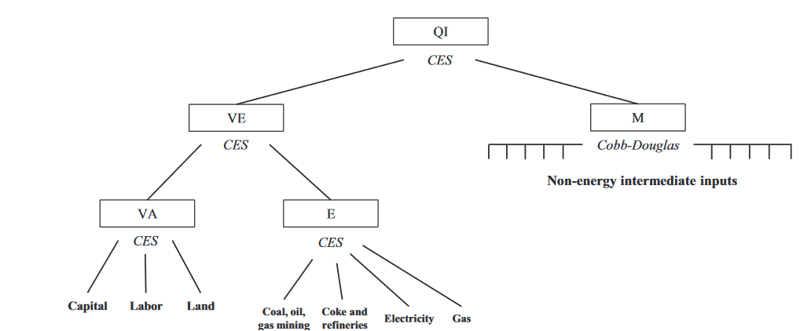
The energy-environmental CGE model
Built on the frameworks of Freire-González & Ho (2019, 2021) for Spain and Catalonia
The Social Accounting Matrix (data from Bureau Fédéral du Plan, Statbel, and the National Bank of Belgium)
Open single-county model calibrated for Belgium - year 2015.
Input-output table with 65 economic sectors (firms).
4 economic agents: firms, government, households, and the foreign sector.
Accounts for sector employment, labor, capital compensation, government expenditures, capital stock, etc.
Details on taxes: value-added tax (VAT), special taxes, subsidies, other taxes on production, tariffs, VAT on imports, and social security contributions.
Economic-Energy-Environment linkages: a nested constant elasticity of substitution (CES) structure governs production functions, combining value-added, energy, and non-energy inputs, and CO2 emissions.

Slide 10
The energy-environmental CGE model
An energy module linked to an environmental one to turn economic flows into energy flows and CO2 emissions.
Consumption of coal, oil, natural gas and electricity is identified from Belgian IO tables from EXIOBASE.
Energy production and use per source is obtained from the Belgian energy balance for 2015 produced by the Bureau Federal du Plan.
CO2 emissions are calculated by multiplying tons of fuels by energy and emissions coefficients using data from the International Energy Agency (IEA) on energy and CO2 emissions for fuel combustion of coal, oil, and natural gas.
Exogenous saving rates → growth is driven by capital accumulation, growth of population and total factor productivity (TFP).
Capital accumulation depends on the depreciated capital stock of previous periods plus the investments of the current period, which is financed by private savings.
We simulate a short-, mid- and long-term period for all the scenarios to observe how the different policy strategies evolve dynamically as well as their long-term effects.
Exogenous variables are population, working-age population, dividend rates, saving rates, current account deficits and government deficits.
Total Factor Productivity (TFP) growth is also exogenous and calibrated to deliver a 2% GDP annual growth rate in the base case.

Slide 11
The energy-environmental CGE model
The Social Accounting Matrix
In million euros | Commodity | Industry | Labor | Capital | Households | Enterprise | Government | Taxes less subsidies on products | Other net taxes on production | Social Security | Tariff | VAT for import | Capital a/c | Exports - Rest of World | TOTAL
Commodity |  | 473,200 |  |  | 182,630 |  | 79,541 |  |  |  |  |  | 121,142 | 229,195 | 1,087,801
Industry | 862,495 |  |  |  |  |  |  |  |  |  |  |  |  |  | 862,495
Labor |  | 212,113 |  |  |  |  |  |  |  |  |  |  |  |  | 212,113
Capital |  | 141,997 |  |  |  |  |  |  |  |  |  |  |  |  | 141,997
Households |  |  | 144,114 |  |  | 79,541 | 118,867 |  |  |  |  |  |  |  | 342,523
Enterprise |  |  |  | 134,640 |  |  |  |  |  |  |  |  |  |  | 134,640
Government |  |  |  | 7,357 | 89,596 | 27,049 |  | 30,952 | 4,233 | 67,999 | 554 | 3,519 | -10,058 |  | 221,201
Taxes less subsidies on products |  | 30,952 |  |  |  |  |  |  |  |  |  |  |  |  | 30,952
Other taxes on production |  | 4,233 |  |  |  |  |  |  |  |  |  |  |  |  | 4,233
Social Security |  |  | 67,999 |  |  |  |  |  |  |  |  |  |  |  | 67,999
Tariff | 554 |  |  |  |  |  |  |  |  |  |  |  |  |  | 554
VAT for import | 3,519 |  |  |  |  |  |  |  |  |  |  |  |  |  | 3,519
Capital a/c |  |  |  |  | 67,295 | 31,052 | 17,526 |  |  |  |  |  |  | -4,789 | 111,084
Imports - Rest of World | 219,139 |  |  |  |  |  | 5,266 |  |  |  |  |  |  |  | 224,406
TOTAL | 1,085,708 | 862,495 | 212,113 | 141,997 | 339,521 | 137,642 | 221,201 | 30,952 | 4,233 | 67,999 | 554 | 3,519 | 111,084 | 224,406 | 3,445,516

Slide 12
Six aggregate consumption groups:
Primary sectors
Construction
Energy sectors
Manufacturing sectors
Services sectors
Transportation sectors.
Scenarios
Scenarios | # of scenarios | Spending transferred year 1 | Spending transferred year 20
Changes in consumption patterns scenarios (CCP) ➔ Progressive increase of a sector’s expenditures and reduction for the other 5 sector groups, proportionally. | 6 | 1.25% | 25%
2. Voluntary energy conservation | 3
2.1. Shift from energy to other commodities (EC) ➔ Energy conservation is progressively redirected to are allocated to the 60 non-energy commodities. | 1
2.2. Shift from energy to savings (ES) ➔ Energy conservation is progressively redirected to are allocated to the savings. | 1
2.3. Shift from energy to other commodities and savings (ECS) ➔ Energy conservation is progressively allocated proportionally between non-energy commodities and savings. | 1
Four energy commodities:
Raw energy products
Coke and oil refining products
Electricity production and distribution services
Manufactured gas and gaseous fuel distribution services.

Slide 13
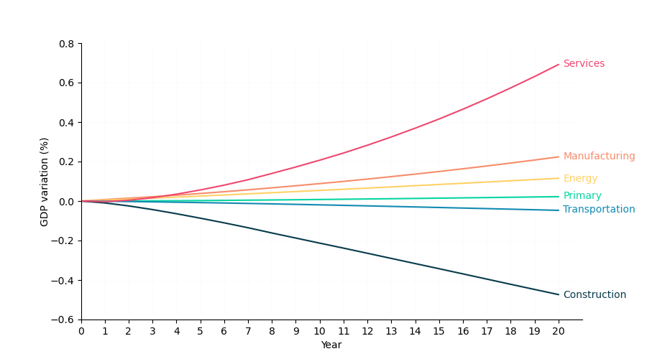
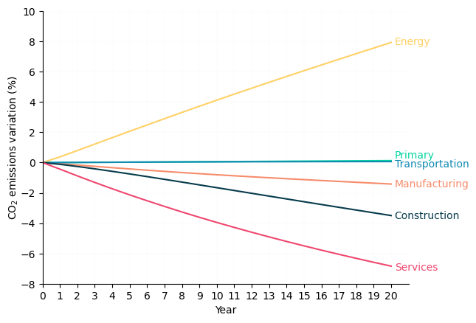
Results
Consumption change patterns (CCP) scenarios
Best for GDP: Services
Best for climate: Services
Worst for GDP: Construction
Worst for climate: Energy
Notes:
Labor-Intensive Nature: Services (e.g., healthcare, education) rely more on labor than capital. In the model:
Labor supply grows slower than capital, making services relatively more expensive over time.
Shifting demand to services increases their output/value-added, raising GDP.
Lower Capital Dependency: Unlike manufacturing, services don’t require heavy machinery/energy, so they’re less affected by capital depreciation or energy price shocks.
Moving consumption patterns towards services sectors is the only consumption group which has positive impacts on both GDP and climate change mitigation in the mid/long term. Moving purchases towards other consumption groups would have limited or negative impacts for these indicators.

Slide 14
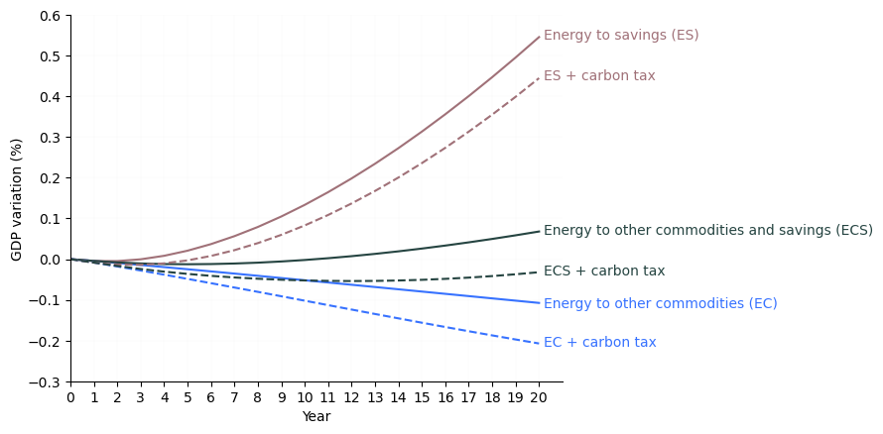
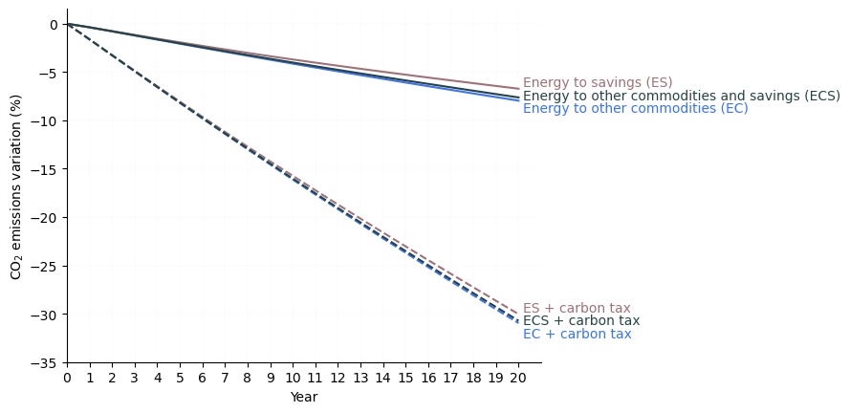
Results
Energy conservation scenarios
Without carbon tax
Best for GDP: Redirecting to Savings (hence investments)
All scenarios lead to almost the same emission reduction magnitude
With carbon tax that offset the rebound effect
Carbon tax reduces the GDP
but still some gains for ES
Fall of GDP for ECS
Carbon tax amplifies the carbon emissions reduction
Notes:
The new tax revenues are used to raise government spending. Under such a taxation design, the only scenario that generates higher 20-year GDP than in the base case is the one that redirects energy expenditures to savings (E-S);

Slide 15
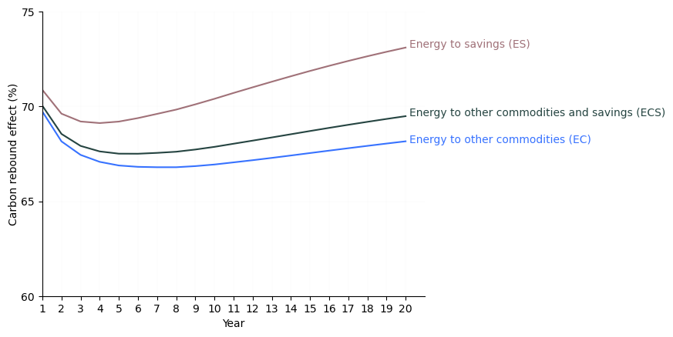
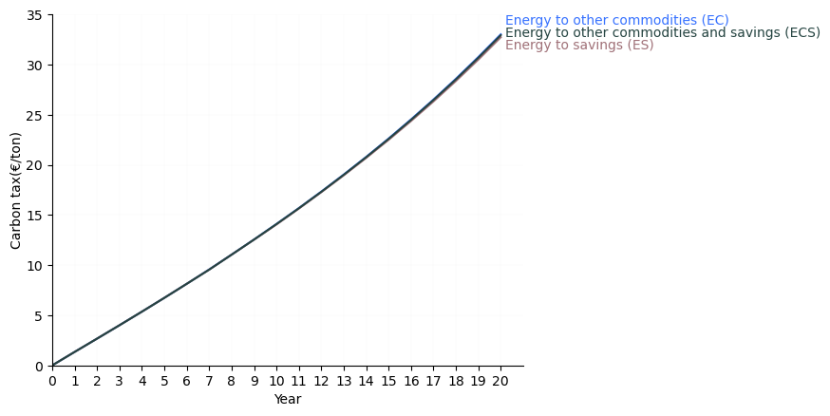
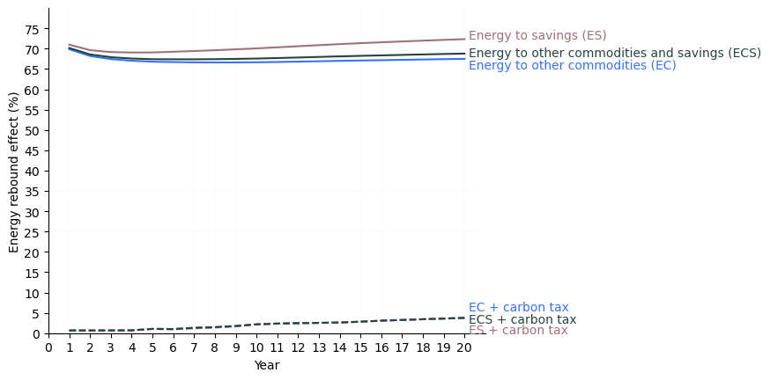
Results
Carbon RE: 67.5% - 70.9% (on average)
Carbon tax of €33/ton by year 20 neutralizes rebound.
With carbon tax energy RE is almost offset
From 67.1% - 70.5% to 2% (on average)

Slide 16
Energy-environment CGE model
Evidences (incl. RE)
Policy design
Conclusion and outlook
Takeaways
Economy-wide rebound effects can undermine policies
Without proper modeling (e.g., energy-environment CGE), even well-intentioned measures may backfire.
Voluntary household measures alone seem to be insufficient
Often perceived as low-cost solutions, but their effectiveness depends heavily on behavioural responses and rebound effects.
Broader consumption shifts matter
Most studies focus on "green consumption" within sectors; our analysis highlights the importance of reallocating spending across major categories (e.g., energy → services).
Systemic policy design is crucial – effective climate mitigation requires integrated policies
Voluntary actions should be combined with for example:
Carbon pricing (to lock in emissions savings).
Respending incentives (to avoid high-carbon leakage).
Maximize positive impact
Minimize rebound effect
Notes:
Voluntary conservation measures aimed at households and promoted by governments are currently used to mitigate climate change, as they are perceived to be inexpensive and effective. However, they may not be as effective as thought by policymakers and public opinion. The effectiveness of voluntary measures in reducing carbon emissions depends largely on how households behave.
Many studies discuss the potential effects of green consumption (shifting consumption within a specific sector, rather than between sectors), but not moving consumption between larger categories as done in this study.
voluntary energy conservation measures are important for many reasons (not just economic), additional measures need to be implemented to be relevant for effective climate change mitigation. The design of comprehensive complex policies that include several measures (i.e., foster voluntary energy conservation, plus respending measures, plus carbon taxes, etc.), is necessary

Slide 17
Conclusion and outlook
Next steps
Design and model policy mix with the best sustainability outcome combining both production (efficiency gains) and consumption patterns (behaviour shifts)
Test revenue recycling schemes
Test the efficacy of other measures to counteract RE
Extend the environmental module to other environmental impacts (not just CO2)
Assess other type of RE such as time-use rebound
Increase the sectoral resolution
…
Notes:
Model scenarios close to the reality. The model has just been developed, and is still being finetuned; here we have performed more of a modelling exercise mainly as a first test of the model

Slide 18
You cannot manage what you cannot measure
Thanks!
Edgar Towa
F.R.S-FNRS Postdoc Researcher
Université Libre de Bruxelles
Avenue F.D. Roosevelt, 50 (CP 130/02),
1050 Brussels (Belgium)
Tel : +32 (0)2 650 66 94
edgar.towa@ulb.be
Peter Drucker

Slide 19
References
Brockway, P. E., Sorrell, S., Semieniuk, G., Heun, M. K. & Court, V. Energy efficiency and economy-wide rebound effects: A review of the evidence and its implications. Renewable and Sustainable Energy Reviews 141, 110781 (2021).
Freire-González, J. & Ho, M. S. Carbon taxes and the double dividend hypothesis in a recursive-dynamic CGE model for Spain. Economic Systems Research 31, 267–284 (2019).
Freire-González, J. & Ho, M. S. Voluntary actions in households and climate change mitigation. Journal of Cleaner Production 321, 128930 (2021).
Greening, L. A., Greene, D. L. & Di, C. Energy efficiency and consumption - the rebound effect - a survey. Energy Policy 13 (2000).
Hertwich, E. G. Consumption and the Rebound Effect: An Industrial Ecology Perspective. Journal of Industrial Ecology 9, 85–98 (2005).
Lange, S., Kern, F., Peuckert, J. & Santarius, T. The Jevons paradox unravelled: A multi-level typology of rebound effects and mechanisms. Energy Research & Social Science 74, 101982 (2021).

