Slide 1
A model-based analysis of the impact of selected agriculture related scenarios on the Gross Ecosystem Product indicator
Bartlomiej Rokicki, Willem-Jan van Zeist, Robert M’Barek, George Philippidis, and Heleen Bartelings
31st International Input-Output Association Conference,
6th - 11th July 2025, Malé

Slide 2
Climate change and ecosystem services
Climate change is commonly associated with the rise in global temperature and heat waves, wildfires, increased droughts or changes in rainfall that results in more frequent storms and floods.
However, it also negatively affects biodiversity and ecosystem services - the provisioning, regulating, supporting, and cultural services that natural systems provide to society supporting human well-being.
The potential of ecosystems to provide these necessary services is declining globally. Between 1997 and 2011, the estimated yearly loss in the economic value of ecosystem services reached $4.3–20.2 trillion (R. Costanza et al., 2014).
As the fastest-warming continent in the world, with the warming speed doubling the global rate since the 1980s, Europe is particularly exposed for all climate change-related hazards.

Slide 3
Ecosystems and agriculture
The agriculture, forestry, and other land use (AFOLU) sector is considered as one of the economic sectors with the strongest impact on climate change. Agrifood systems account for approximately 16.2 billion tonnes of CO2eq worldwide, representing around 30% of total net anthropogenic GHG emissions (FAO, 2024).
Agricultural policies may strongly influence farmers’ behaviour and thus the environmental impacts of the sector (OECD, 2025). Production-coupled support is most likely to generate harmful impacts while less coupled forms of support may in fact result to be environmentally beneficial.
In the European Union (EU), the AFOLU sector is greatly shaped by the Common Agricultural Policy (CAP) that provides financial support for farmers. It accounts for around 1/3 of the EU budget, which translates into more than €300 billion over the 2023-2027 period. Hence, any significant change in CAP may be expected to have substantial environmental impacts.

Slide 4
Aim of the study
This study reports on results of macroeconomic simulations with the newly extended MAGNET model that assume complete removal of CAP after 2025.
Given our environmental focus, we move beyond current indicators of economic development, such as Gross Domestic Product (GDP), that fail to fully capture nature’s contribution to the economy and well-being and do not factor in environmental impacts.
Consequently, we apply the INCA database on monetary value of selected ecosystem services in Europe to implement for the first time in macroeconomic modelling the concept of Gross Ecosystem Product (GEP).
We also introduce the ecosystem stress index (ESI) that allows assessing the evolution of pressure exerted on ecosystems.

Slide 5
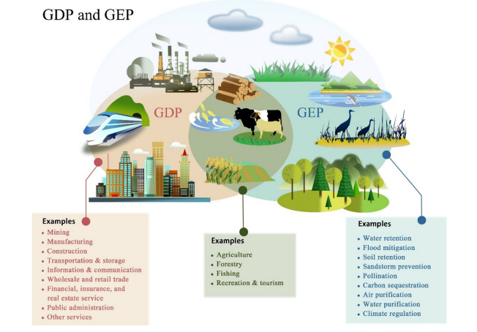
The Gross Ecosystem Product (GEP)
Gross Ecosystem Product (GEP), which summarizes the value that ecosystem services provide to the economy in monetary terms was initially proposed in 2013 (Ouyang et al., 2013).
The concept of ecosystem accounting and GEP is receiving an increasing attention worldwide. The calculus of GEP follows guidance provided by the SEEA EA.
The use of GEP provides a more accurate picture of the impact of policies on the economy and on nature. Hence, already several countries want to implement GEP and integrate the value of ecosystem services into decision-making processes alongside GDP.
GDP and GEP are partly overlapping.

Slide 6
Gross Ecosystem Product formula
The Gross ecosystem value is equal to the total economic value of ecosystem provisioning services (EPV), ecosystem regulating and maintenance services (ERV), and cultural services (ECV) in the given country/region annually:
Following the definition of GEP, all ecosystem services are simply additive. As a result, the monetary value of GEP for different kinds of ecosystem services can be calculated as follows:
$$GEP=\sum_{i}{Y_{i}∗Q_{i}∗P_{i}+\sum_{j}{{Y_{j}∗Q}_{j}∗P_{j}+\sum_{k}{{Y_{k}∗Q}_{k}∗P_{k}}}}$$
where i, j and k are sets of provisioning, regulating and maintenance, and cultural ecosystem services, respectively, Y is the proportion of accounting value attributable to nature, P is the accounting price of ecosystem service i, and Q is the quantity provided of ecosystem service i.
$$GEP=EPV+ERV+ECV$$

Slide 7
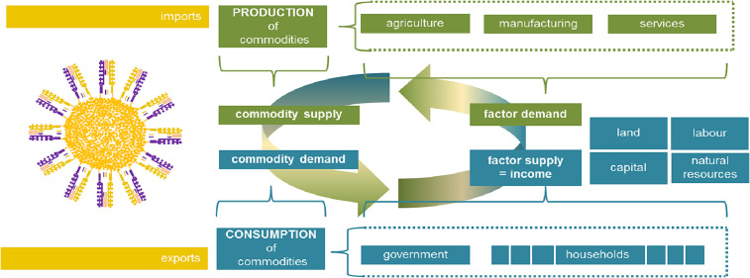
MAGNET model
The Modular Applied GeNeral Equilibrium Tool (MAGNET) is a recursive dynamic, multi-regional, multi-commodity CGE model, covering the entire global economy. The model is jointly developed by Wageningen Economic Research, EC Joint Research Centre and Thünen Institute.
It is built upon the GTAP (Global Trade Analysis Project) database (Hertel, 1997) and has been widely used for the EU policy analysis.
The core of the global MAGNET model is the standard GTAP model (Corong et al., 2017).

Slide 8
MAGNET model (2)
MAGNET currently uses the GTAP 11c database with a coverage of 160 countries and 19 aggregated regions, 65 sectors and 8 production factors including natural resources, oil and gas. In MAGNET, the original GTAP database, was further disaggregated to include additional agricultural and bioeconomy sectors. As a result, the complete MAGNET database contains the total of 122 sectors and 143 commodities. The database includes detailed information on production, gross bilateral trade flows, transport costs and trade protection data for a 2017 benchmark year.
The MAGNET model is modular in nature and extends the GTAP model through the addition of a number of policy-relevant modules. In total, over 20 modules are available for modellers, for instance:
Common Agricultural Policy (CAP) module that allows to include changes to the CAP budget;
Sustainable Development Goals (SDG) module that introduces different indicators to assess multiple dimensions for each one of 12 included SDGs;
Nutrition module that allows to calculate food security indicators defined by FAO;
Emissions module that calculates GHG emissions (both combustion and non-combustion related emissions)

Slide 9
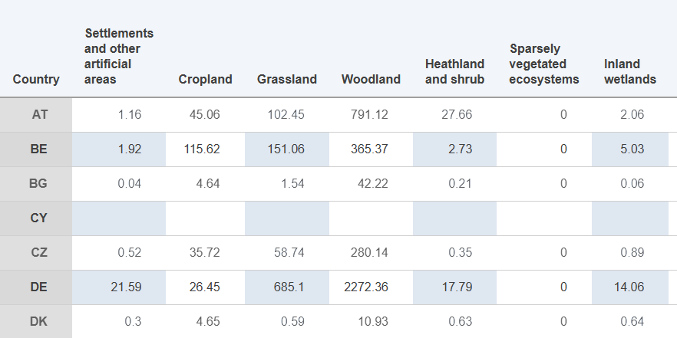
Ecosystem services in INCA database and related problems
INCA offers supply and use tables (SUTs) for nine ecosystem services measured in physical and monetary terms (in euros) for five accounting periods (i.e. 2000, 2006, 2012, 2018, 2021). These services encompass:
Crop provision
Timber provision
Crop pollination
Carbon sequestration
Flood control
Soil retention
Water purification
Nature-based recreation
Habitat and species maintenance
Yet, different waves of INCA rely on different methodologies and provide completely different picture from the supplying land type point of view (e.g., carbon sequestration, crop pollination, flood control).
In order to implement the GEP module in MAGNET we need to understand what drives ESS supply.

Slide 10
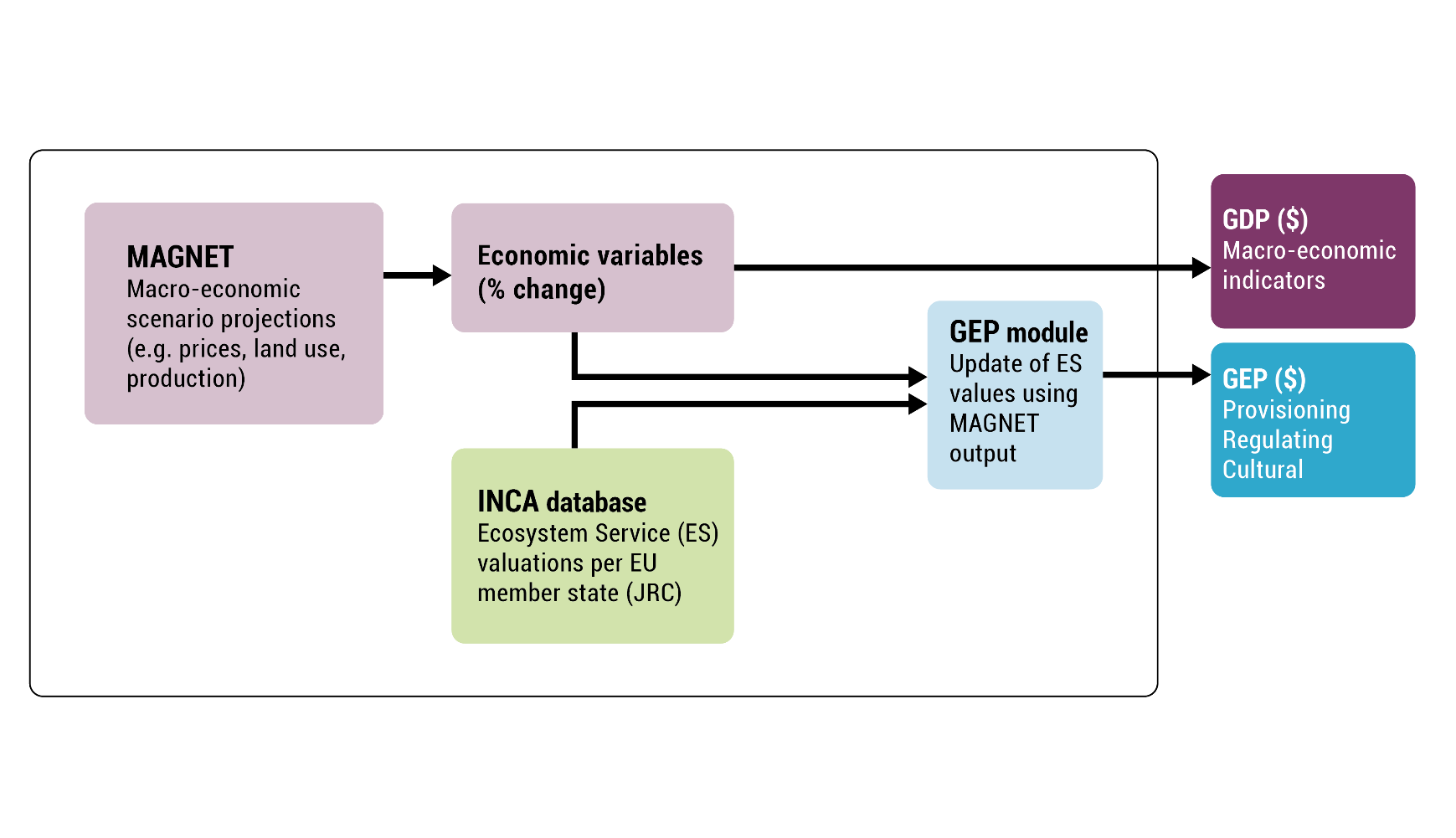
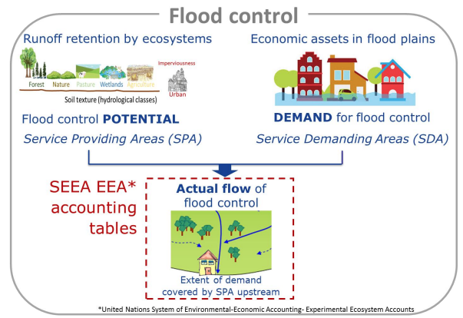
Updating INCA data base with MAGNET
GEP module developed as a post-processing tool linking INCA valuations (taking 2018 data) and updating with appropriate magnet variables.
Update statements from both supply and use side.
Applied to update cropland, grassland, managed forest and ‘other land’ ecosystems.

Slide 11
Baseline projections for the EU
In a baseline projection we see that the EU real GDP grows above 4% per period.
At the same time, however, the value of GEP supply is decreasing at an increasing pace. While, during the 2025-2030 the decrease is around 0.2 p.p. in the 2035-2040 period it reaches almost 1.5 p.p.
The above implies that the GEP/GDP ratio must decrease over time. Indeed, it decreases from 2.5% in 2025 to 2.1% in 2040.
Relatively low GEP/GDP ratio is due to the ecosystem service accounting methodology.
In our simulations we cover 8 different ecosystem services, accounting for monetary value that is strictly related to nature.
Hence, our results cannot be compared to the analyses that account for all nature-related activities that include non-nature inputs (e.g., capital, labour etc.).

Slide 12
GEP evolution and stress index in the baseline
GEP cumulative % change
Stress index
In baseline projections the value of GEP is decreasing for the majority of ecosystem services. The exceptions are crop provisioning, soil retention and wood provisioning.
Stress index measures the difference in the growth of ecosystem services demand and supply. The higher the value the more stress on ecosystems.

Slide 13
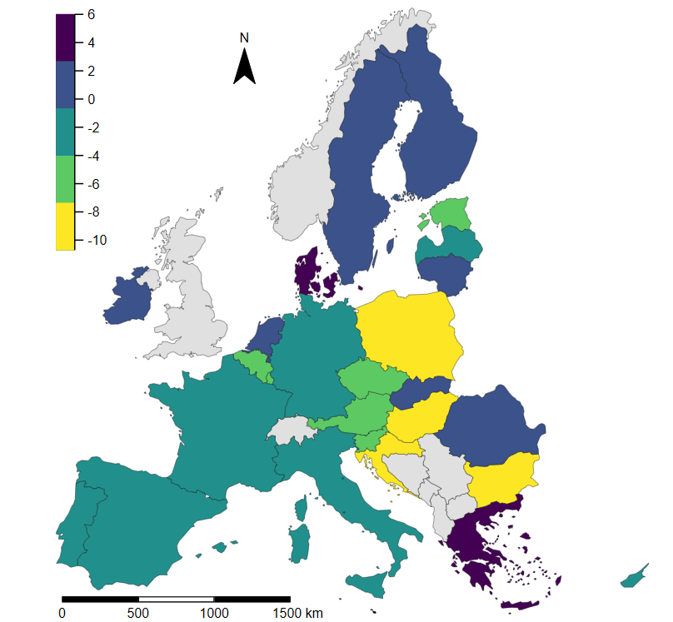
GEP supply in 2040 by individual EU member state
The countries with the highest projected cumulative loss in total GEP value are situated in central and eastern Europe.
Bulgaria, Croatia, Hungary and Poland are the most severely affected with cumulative GEP decrease of more than 7 p.p. in 2040.
At the same time, however, countries like Denmark, Greece or Malta are expected to increase their GEP value by more than 3 p.p. in 2040.

Slide 14
NOCAP scenario
In our ongoing simulations we apply the baseline and the NOCAP scenario previously used in the SCENAR2040 project.
There is a positive but very small impact of CAP removal on overall GDP. The impact on the GEP supply is in turn negative. Although it does not exceed 1 percentage point.
The impact of CAP removal is different for individual ecosystem services.
The monetary value would slightly increase in the case of carbon sequestration, wood provisioning or nature based recreation.
Stronger negative impact is observed on crop pollination, crop provisioning or water purification.

Slide 15
The impact of NOCAP scenario on ecosystems
Would the CAP removal be positive for the environment?
How the simulation results can be interpreted?
The % change in stress index indicates that overall CAP removal would slightly increase the stress on ecosystems.
In particular it can be observed in the case of crop pollination and crop provisioning.
At the same time stress would be relatively lower for soil retention or water purification.
% change in stress index

Slide 16
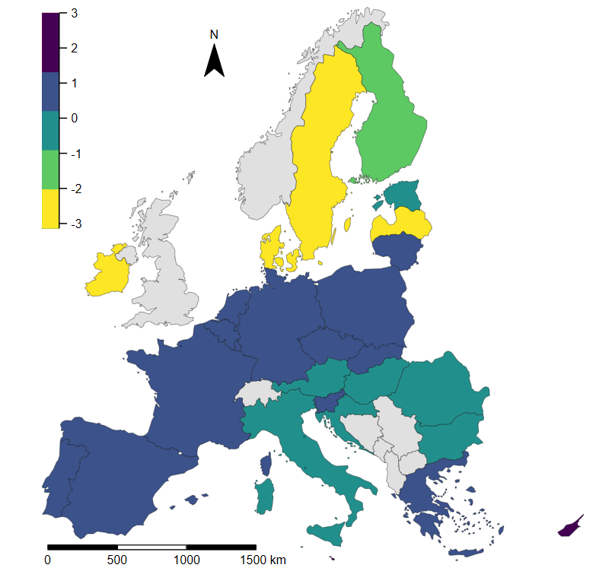
Cumulative difference in ecosystem stress index by individual EU member state
All north European countries (including Ireland) would face a decrease in ESI indicator that should be interpret as a positive outcome.
The remaining member states would either face a small decrease or increase in ESI. The highest increase in ESI is found in Cyprus (1.41 p.p.) and Malta (2.42 p.p.).

Slide 17
Next steps
The implementation of GEP in policy, particularly in forward-looking policy analysis, is still in the early stages.
There is a need to improve the accuracy of GEP accounting, as no ecosystem services valuation technique is perfect, and uncertainty is always a critical issue.
Also, consideration should be given to how GEP results can be applied in policy decision-making (Hao et al., 2022).
There are certain discrepancies and simplifications in how anticipated ecosystem service flows are computed in the present GEP module relative to real-world scenarios.
More refined approaches to updating formulas.
World-wide geographical coverage.

Slide 18
INCA website:
https://ecosystem-accounts.jrc.ec.europa.eu/
MAGNET website:
https://www.magnet-model.eu/
JRC technical report link:
https://op.europa.eu/en/publication-detail/-/publication/187230d1-198b-11ef-a251-01aa75ed71a1/language-en
THANK YOU!

