Slide 1
How Can PFTZs Affect Firms’ GVC Positions through Supply Chains?
Chenchen TIAN, Yimamu ABASI, Yongming HUANG, Suppakorn KHONKHLONG, Xin LI
Wuhan University, China
10 July 2025

Slide 2
1. Introduction
China’s integration into GVCs remains in low value-added segments.
Chinese government prioritizes Pilot free trade zones (PFTZs) as a key investment and national strategy.
Since the establishment of the Shanghai PFTZs in 2013, China has established 21 PFTZs in 56 cities in 7 rounds, spanning from the east to the west of China.
PFTZs now function as critical nexuses anchoring China’s integration into global production network and for high-quality opening-up.

Slide 3
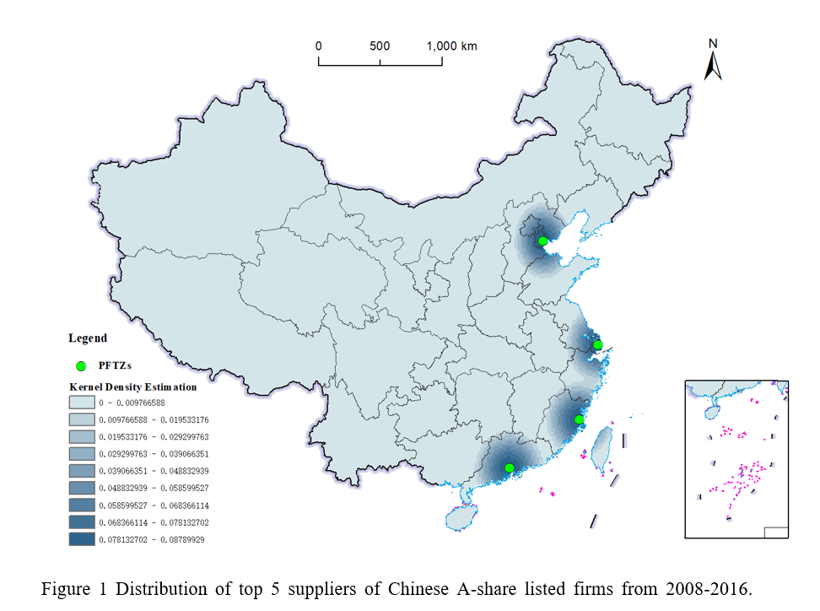
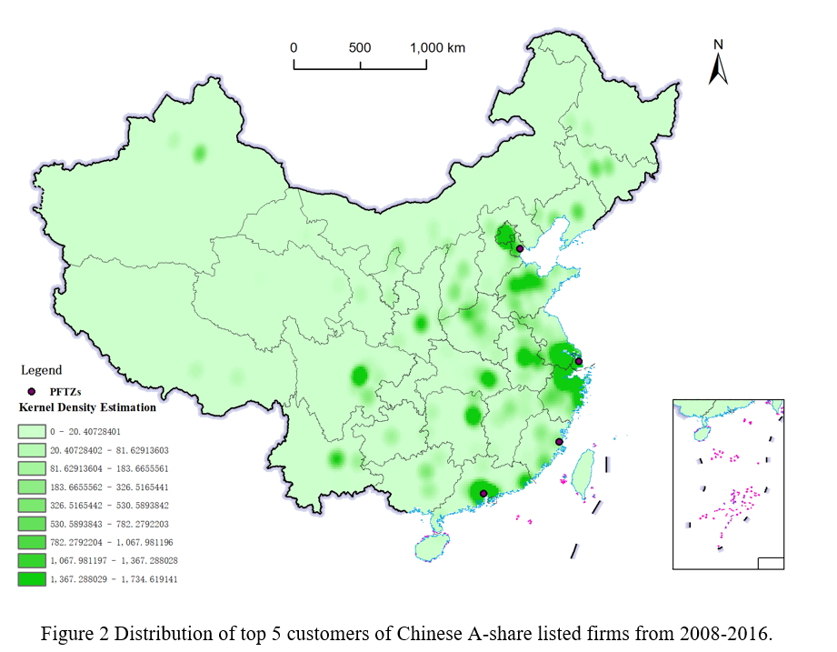
1. Introduction

Slide 4
2. Literature review and Research gaps
Positive Impacts of PFTZs: Institutional Innovation and Growth
PFTZs serve as experimental fields for institutional innovation, significantly accelerating China’s high-quality growth and openness (Yao and Whalley, 2016; Lang, 2025). These positive effects foster agglomeration economy and spatial spillovers, facilitating neighboring industrial upgrading (Guan et al., 2023).
Studies on GVC positions at the firm level
Pipkin and Fuentes (2017) review earlier case studies and conclude that industry shocks and government actions, rather than customers from developed countries, primarily drive firms to upgrade within GVCs.
Building on the method of Chor et al. (2021), Jiang and Cheng (2024) analyze the contribution of local demand to GVC positions of firms, while Hu and Della (2024) identify financial constraints as significant determinants.

Slide 5
2. Literature review and Research gaps
Studies of supply chain spillovers
Firms in global production networks, led by multinational corporations (MNCs), are intricately connected through supplier-customer relationships (Andrenelli et al., 2019). Global supply networks of MNCs interweave internal and external linkages in urban clusters, with free trade zones reinforcing these cluster effects(Rozenblat et al. ,2017).
Goldman (2020) specifically notes that customers with government backgrounds amplify market power of region in which their suppliers located.
Research gaps
While the positive impact and spillovers of PFTZs have been widely discussed, their spillovers within supply chains remain underexplored.
There is still limited empirical evidence on the roles of local policies and firms in global supply chains

Slide 6
2. Literature review and Research gaps
Using the panel dataset of Chinese A-share listed firms during 2008-2016, this study employs a quasi-natural experiment based on whether firms’major customers or suppliers operate in PFTZs, and analyze how PFTZs affect GVC positions of upstream and downstream firms though supply chains.
Three possible innovations
Contributing to the literature on GVC upgrading. This study innovatively analyzes the effects and mechanisms of PFTZs on GVC positions respectively from distinct upstream and downstream perspectives.
Emphasizing and examining the spillover role of PFTZs in supply chains, bridging the gap in previous research on PFTZs.
Systematically quantifying differential spillover effects of PFTZs across large firms and SMEs, offering novel evidence of asymmetrical supplier-buyer bargaining dynamics.

Slide 7
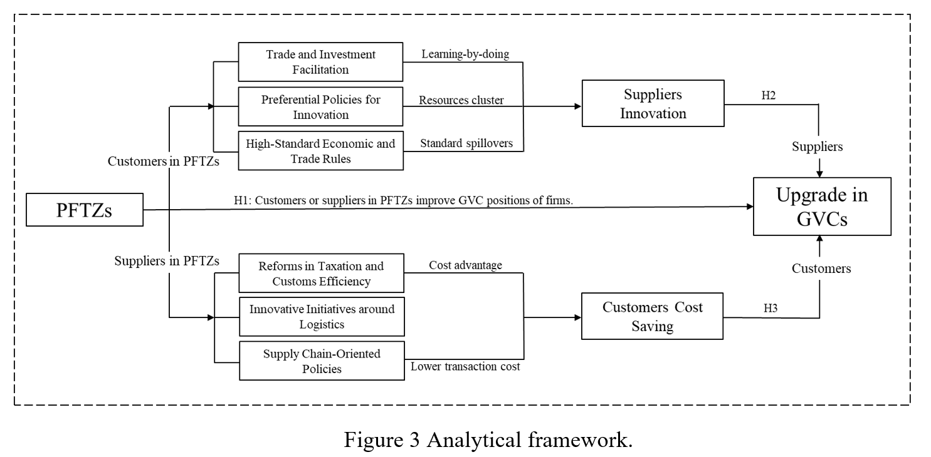
3. Theoretical analysis and Hypotheses

Slide 8
4. Data and Methodology
Data
Dependent variable: firms’GVC positions
$$GVC_pos=\frac{{PLv}_{GVC}}{{\left[{PLy}_{GVC}\right]}^{′}}$$
${PLv}_{GVC}$ : the average production length forward, measured by the ratio of GVC
related domestic value-added to its induced gross output.
${PLy}_{GVC}$ : the average production length backward, calculated as the share of
GVC related foreign value-added to its induced gross output.
data sources:
Input-Output (IO) Tables from Organisation for Economic Cooperation and Development (OECD)

Slide 9
4. Data and Methodology
Data
Dependent variable: firms’ GVC positions
${Pos}_{ft}=\sum_{i=1}^{N}{\frac{M_{ift}}{M_{ft}}{GVC_pos}_{it}}$- $\sum_{i=1}^{N}{\frac{X_{ift}}{X_{ft}}{GVC_pos}_{it}}$
$M_{ift}$ and $X_{ift}$ are the scale of the $f$ firm’s imports and exports of sector $i$ in year $t$.
$M_{ft}$and $X_{ft}$ are the scale of $f$ firm’s total imports and exports in year $t$.
data sources: Chinese Customs Trade Statistics (CCTS)

Slide 10
4. Data and Methodology
Data
Independent variable: ${Pftzs}_{ft}$
indicating whether firms’ customers or suppliers are in PFTZs
Since CCTS provides firm-level data up to 2016, our sample involves the first two batches of PFTZs established in 2013 and 2015, located in Shanghai, Guangdong, Tianjin, and Fujian.
If the top five customers or suppliers are located within the implementation scope of Shanghai PFTZs from 2013, or within the Guangdong, Tianjin, and Fujian PFTZs’ implementation scope from 2015, ${Pftzs}_{ft}$is 1. Otherwise, ${Pftzs}_{ft}$ is 0

Slide 11
4. Data and Methodology
： Control variables
Data
Firm’ s scale and experience.
Firm scale: defined as the logarithm of total assets; Firm age: the logarithm of the firm’ s accounting year minus the year of establishment.
(2) Financial situation.
Margin: gross operating margin; DAR : firm’ s debt to asset ratio.
(3) Corporate governance.
Firms’ board structure: the ratio of independent directors on the board.
(4) City-level variables.
GDP: the logarithm of GDP; Population scale: the year-end population count;
Industrial structure: the share of secondary industry; Fiscal: the logarithm of fiscal expenditure;
Invest: the logarithm of fixed asset investment.
Data sources: China Urban Statistical Yearbook, China Stock Market & Accounting Research Database (CSMAR)

Slide 12
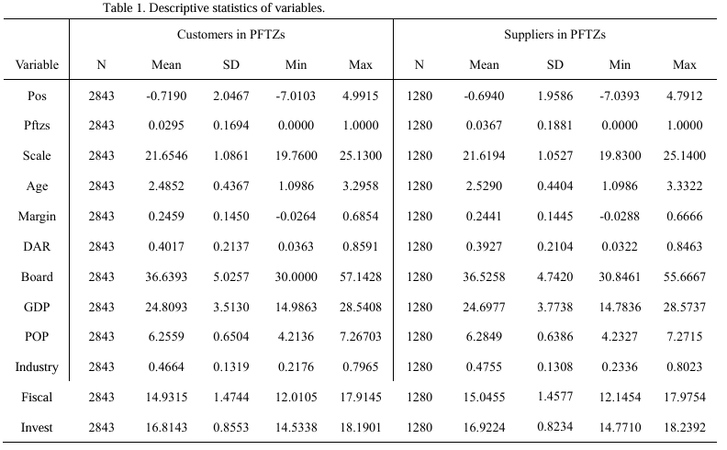
4. Data and Methodology

Slide 13
4. Data and Methodology
Model settings
${Pos}_{ft}$=$α_{0}$+ $α_{1}{Pftzs}_{ft}+α_{2}{Control}_{ft}$+ $λ_{f}$+ $μ_{t}$+ $ε_{ft}$
${Pos}_{ft}$ is the dependent variable indicating the GVC positions of firm $f$ in year $t$.
${Pftzs}_{ft}$ is a dummy variable that indicates whether firm $f$ has customers or suppliers located in PFTZs in year $t$.
${Control}_{ft}$ is a vector of control variables.
$λ_{f}$ and $μ_{t}$ represent firm and year fixed effects.
$ε_{ft}$ is the random error.

Slide 14
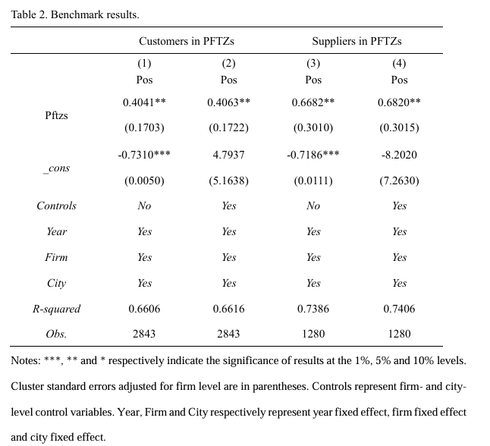
5. Empirical analysis : Benchmark results
firms can benefit from PFTZs through customer supplier relationships.

Slide 15
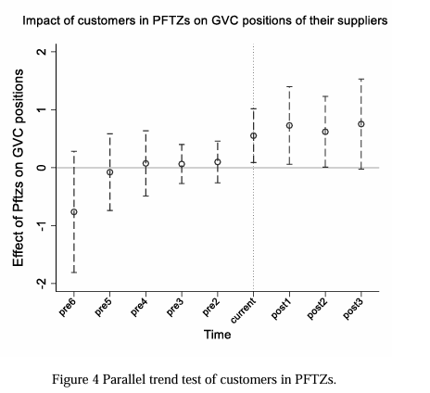
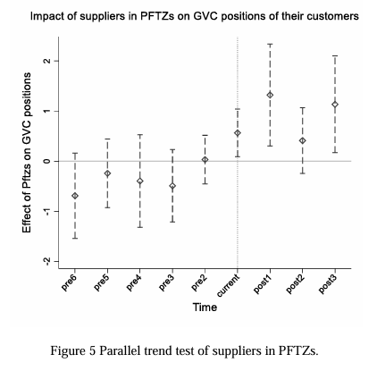
5. Empirical analysis : Robustness test
(1)Parallel trend test
${Pos}_{ft}$=$δ$+ $\sum_{n=−6,n≠−1}^{3}{{β_{n}D}_{ft}^{n}}+γ{Control}_{ft}$+ $λ_{f}$+ $μ_{t}$+ $ε_{ft}$

Slide 16
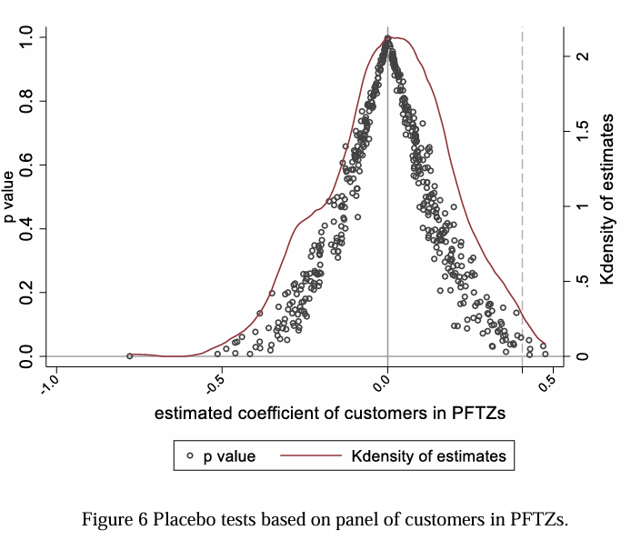
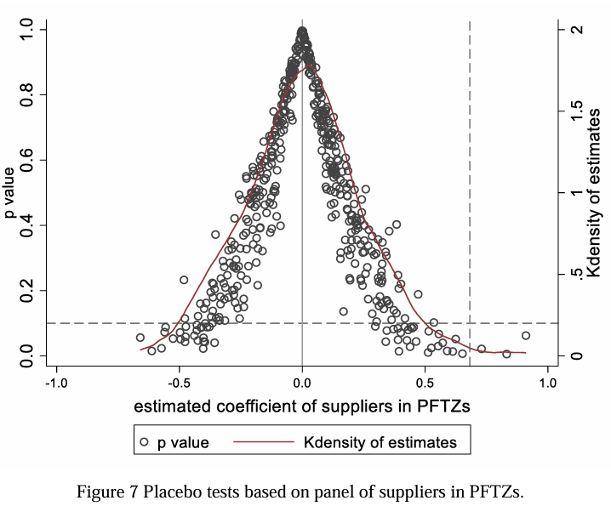
5. Empirical analysis : Robustness test
(2) Placebo tests

Slide 17
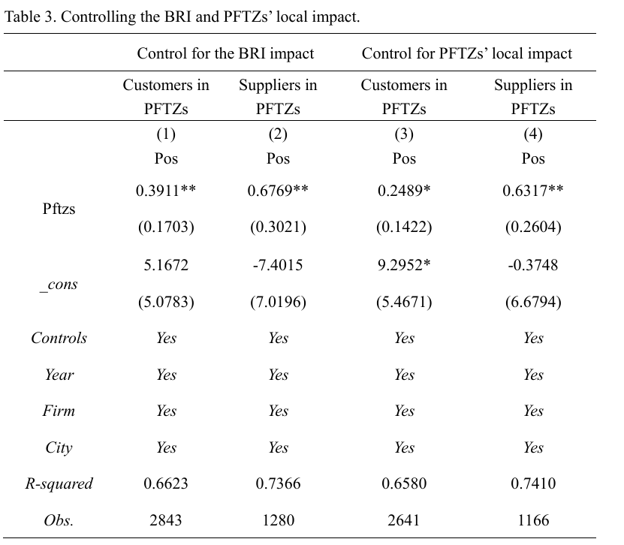
5. Empirical analysis : Robustness test
(3) Control for the impact of the Belt and Road Initiative
(4) Control for the local impact of PFTZs

Slide 18
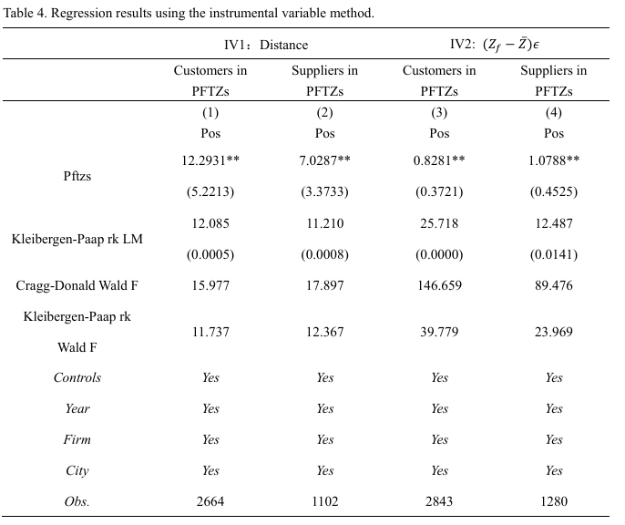
5. Empirical analysis : Robustness test
(5)Endogeneity: two-stage least squares (2SLS) method
Instrumental variable:
${Distance}_{ft}$：the average distance of customers and suppliers from the firm’s location
($Z_{f}$ − $\overline{Z}$)𝜖 : through multiplying the residuals (𝜖) of the regression with the endogenous and exogenous variable by a set of exogenous variables after decentralization ($Z_{f}$ − $\overline{Z}$)

Slide 19
5. Empirical analysis : Robustness test
(6) Heterogeneous Treatment Effects
Firms experience staggered exposure to PFTZs, and their supplier or customer relationships change over time. This heterogeneity may introduce bias in two-way fixed effects estimator (TWFE) due to negative weights under heterogeneous treatment effects (Goodman-Bacon, 2021).
We estimate negative weight proportions as 0.0004 (customers panel) and 0.0022 (suppliers panel), indicating minimal bias. Following de Chaisemartin and D’Haultfœuille (2020), we estimate the average treatment effect of having a customer or supplier in PFTZs using the DIDM estimator. The coefficients of ${Pftzs}_{ft}$ show the average total effects per treatment unit of 0.7687 and 0.5668 based on customers and suppliers panel, significant at the 90% confidence.

Slide 20
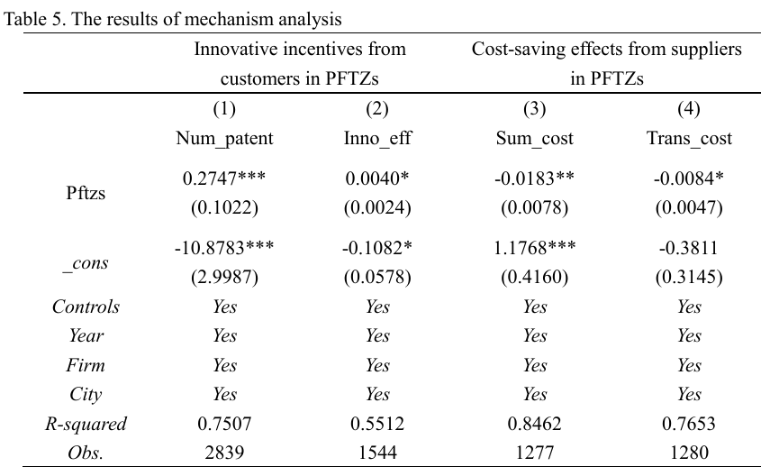
5. Empirical analysis: Mechanism analysis
Innovative incentives from customers in PFTZs
Cost-saving effects from suppliers in PFTZs

Slide 21
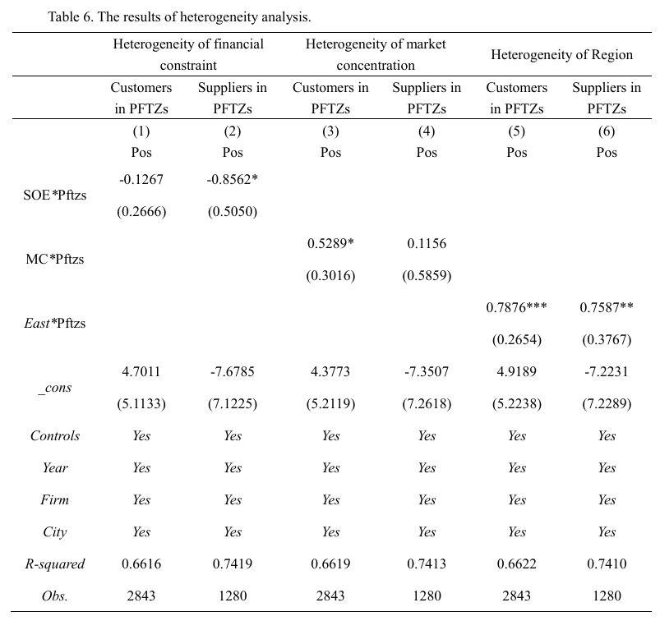
6. Heterogeneity analysis

Slide 22
7. Further analysis
However, the increased competitiveness of small and medium-sized enterprises (SMEs) in global supply chains is still not negligible for regional economic development (Epede and Wang, 2023). Listed firms possess greater market power than capital-constrained SMEs (Jõeveer, 2013; Berger et al., 2019). Our findings thus implicitly assume the premise of low financial constraints and high bargaining power, which may not be applicable to SMEs.
To fully understand the impact of PFTZs, we transform the customer-supplier relationships and examine how listed firms in PFTZs affects GVC positions of SMEs through supply chains.

Slide 23
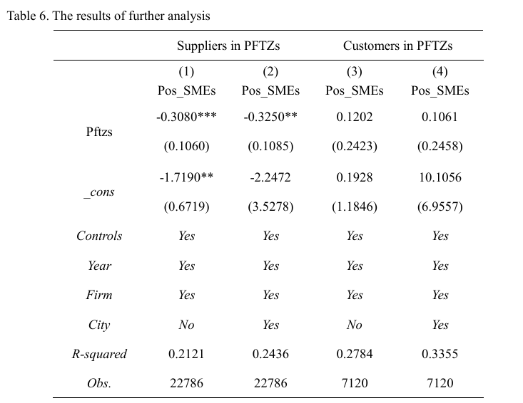
7. Further analysis

Slide 24
8. Conclusions and implications
Conclusions
Customers or suppliers in PFTZs explains the movement of firms to relative upstream in GVCs.
Customers in PFTZs facilitate innovation of their suppliers, while suppliers in PFTZs generate cost-saving effects for their customers, enhancing their GVC positions.
These spillovers exhibit significant heterogeneity across difference in financial constraints, market concentration, and regional characteristics of firms.
Crucially, further analysis finds that PFTZs adversely affect GVC positioning for small and medium-sized downstream firms, while demonstrating statistically insignificant positive effects on small and medium-sized upstream firms.

Slide 25
8. Conclusions and implications
Implications
PFTZs play a vital role in supply chains. It is necessary to deepen specialized reforms to promote supply chain coordination and openness.
Policymakers should strategically encourage the construction of innovation platforms and innovation collaboration between firms in PFTZs and their suppliers.
Strategic upgrading prioritization should target to alleviate financing constraints, cultivate sectoral anchors and increase support for central and western regions.
policymakers should consider asymmetric bargaining dynamics of SMEs while institutionally promoting GVC positions.

Slide 26
Thanks
10 July 2025

