Slide 1
Estimation Results for EVs and
Their impact on the Korean Economy
Bu, Sangdon
Input-Output Statistics Team

Slide 2
1. Introduction
2. Electric Vehicle Market Trends
3. Estimation of the EV Sector
4. Inter-Industry Effects of EVs
5. Conclusion

Slide 3
1. Introduction
The global transition to EVs is accelerating, driven by environmental regulations and government subsidies.
With improvements in battery technology and the expansion of charging infrastructure, EVs are steadily replacing internal combustion engine vehicles.
In Korea, EVs still have a small share, but this shift is key due to expected growth and strong ripple effects on related industries, especially battery manufacturing.
Reflecting this, electric passenger cars were newly classified as a separate sector in the 2020 Korean Input-Output Tables.

Slide 4
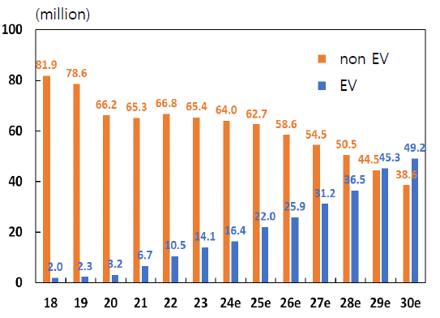
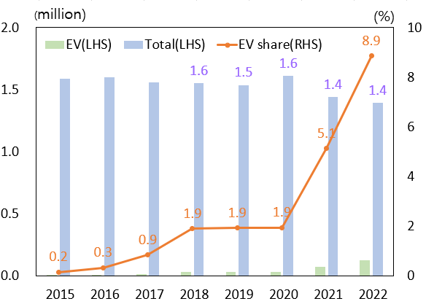
2. Electric Vehicle Market Trends
Electric Vehicles
Global EV sales grew at an average annual rate of 46% (2018-2023) and are projected to exceed non-EV sales after 2030.
Main markets : China (60%), Europe (25%), U.S. (10%)
Korea’s global share is small (1.2%), but domestic EV share is growing rapidly due to government subsidies and improved infrastructure.
Global EV Sales
Korea EV Sales
0.124
Source: SNE Research
Source: KAMA

Slide 5
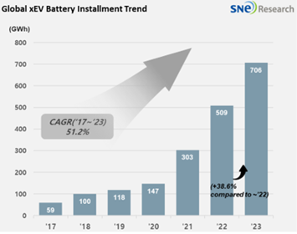
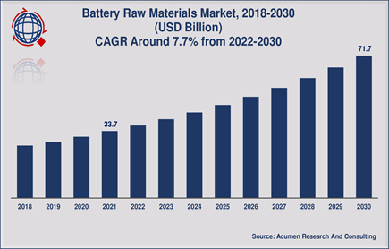
2. Electric Vehicle Market Trends
Batteries and Materials
The battery market, a key EV component, has seen strong growth.
Korea held 24% of the global battery market in 2022, with 8-20% shares in key materials.
However, high import dependence on critical minerals (e.g., lithium, nickel) persists, especially from China.

Slide 6
3. Estimation of the EV Sector
EV Types
Among BEV, PHEV, HEV, and FCEV, only BEVs were included in the I-O sector due to their rising market share and distinct input structure.
PHEVs and HEVs have significantly lower battery capacity and cost than BEVs.
FCEVs differ from the other types of EVs in terms of theirs operating mechanism.
Types of Electric Vehicles

Slide 7
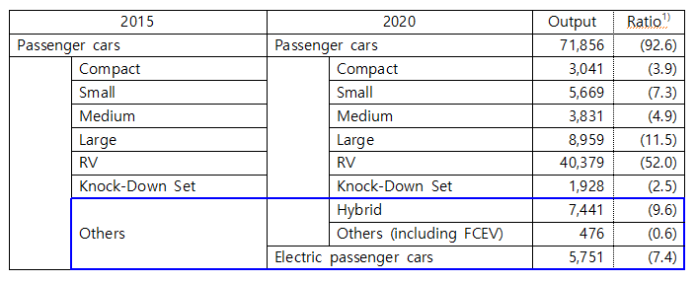
3. Estimation of the EV Sector
Sector Classification
In 2015 I-O tables, EVs were part of “Other passenger cars.”
In 2020, electric passenger cars were newly defined as a separate sector to reflect their growth potential.
Classification of Passenger Cars
(billion KRW, %)
Note: 1) The ratio to the sum of the output of passenger cars and electric passenger cars

Slide 8
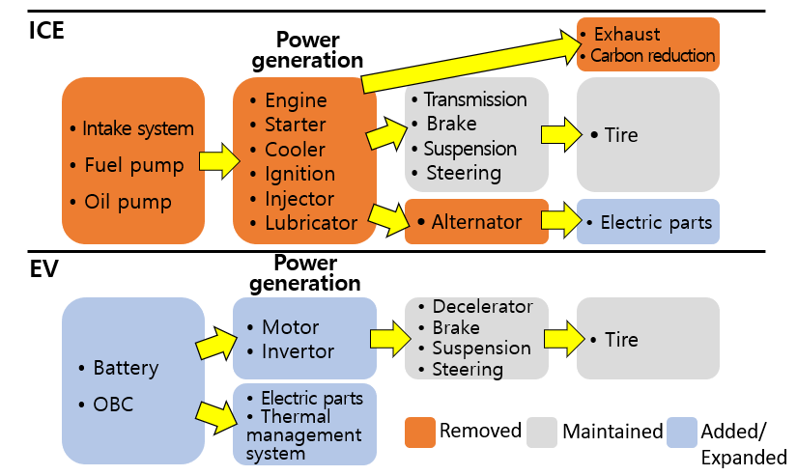
3. Estimation of the EV Sector
Input Structure Differences
EVs run on electricity stored in batteries, replacing engines with motors. This removes many engine components, but adds new ones like inverters. Such fundamental differences support the need for separate sector classification.
Differences in Operating Mechanisms Between EVs and ICEVs

Slide 9
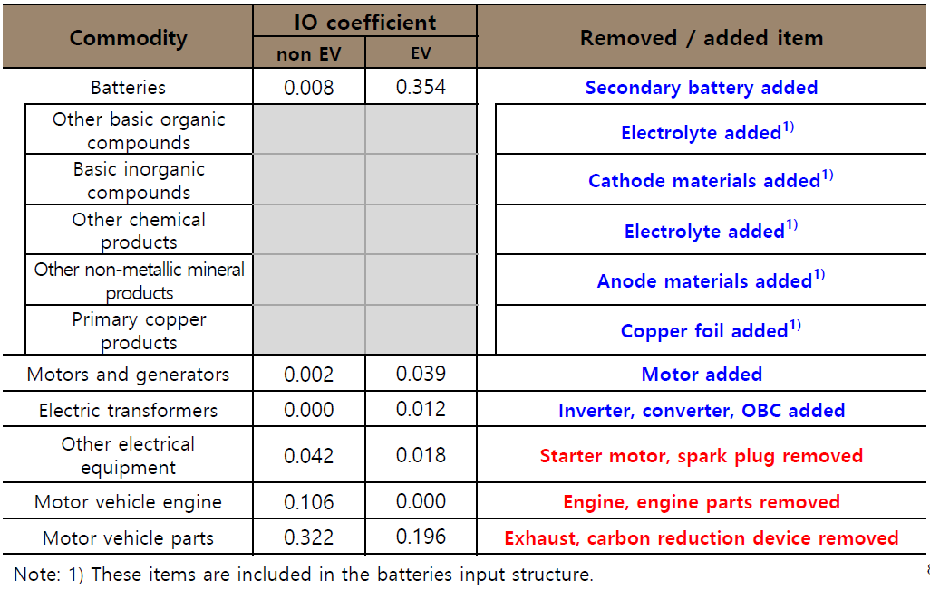
3. Estimation of the EV Sector
Input Structure Differences
EV input structure is based on non-EV structure, adding EV-specific parts (battery, inverter, motor) and removing engine-related parts. Battery accounts for 35.4% of EV production cost, versus 0.8% for non-EVs.
Input Structure of EVs and Non-EVs

Slide 10
4. Inter-Industry Effects of EVs
EVs have a different input structure compared to non-EVs, which leads to different industrial ripple effect.
The production (value-added) inducement coefficients are derived using the Leontief inverse matrix as shown below.
X = (I-A^{d})⁻¹ Y^{d}
V = diag(A^{v})(I-A^{d})⁻¹ Y^{d}
X: domestic output (vector), V: value-added (vector)
Y^{d}: final demand for domestic products (vector)
A^{d}: domestic input coefficients (matrix), A^{v}: value-added ratio (vector)
(I-A^{d})⁻¹: production inducement coefficients (matrix)
diag(A^{v})(I-A^{d})⁻¹ : value-added inducement coefficients (matrix)

Slide 11
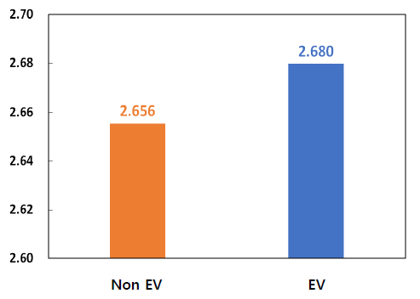
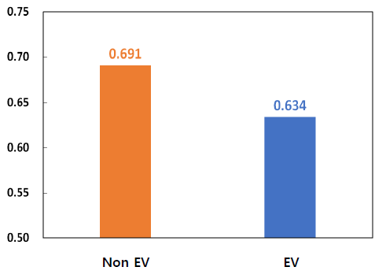
4. Inter-Industry Effects of EVs
EVs have a larger ripple effect across industries, but contribute less to overall economic value added.
Production Inducement Coefficients
Value-Added Inducement Coefficients
2.711
0.725
2.510
0.635

Slide 12
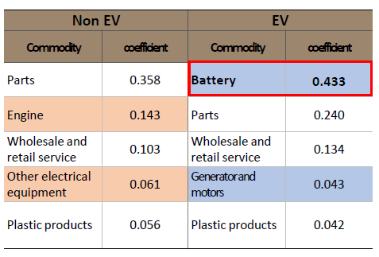
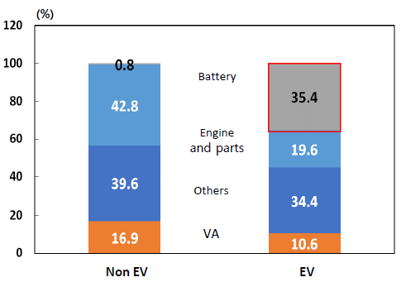
4. Inter-Industry Effects of EVs
The battery sector accounts for the largest share of the production inducement effect.
The battery accounts for 35.4% of EV’s intermediate input, which explains why the production inducement effect is strongest in the battery sector.
Production Inducement Effects
Composition of Input Structure

Slide 13
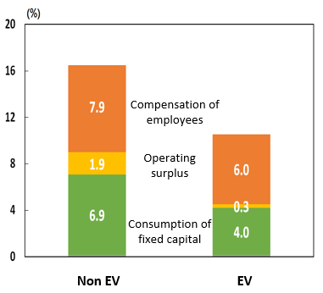
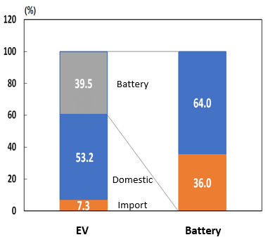
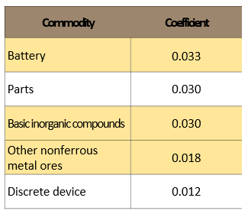
4. Inter-Industry Effects of EVs
Why EVs have lower VA inducement effects → Lower VA ratio
Fewer parts & simpler assembly → Less labor input and lower compensation
High battery costs → Lower operating surplus and profit margins
High import dependence for battery materials → VA leaks abroad
VA Rates by sector
Input Composition
EV’s import Inducement

Slide 14
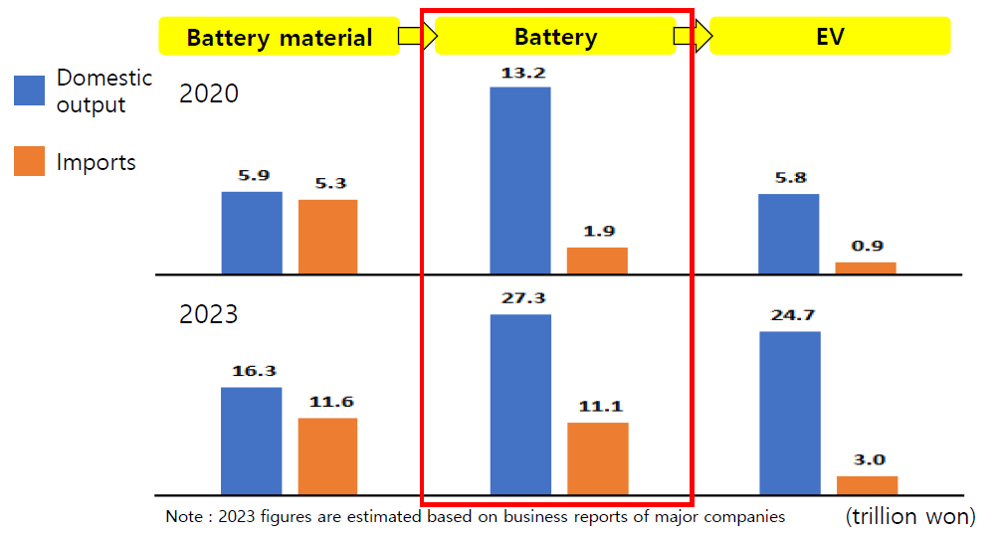
4. Inter-Industry Effects of EVs
VA flows related to the EV supply chain
Battery materials: Localization ↑
Finished batteries: Imports ↑ → VA outflow ↑
Cause: Korean firms produce more batteries overseas and import them for EVs.
Domestic output and imports related to the supply chain of EVs

Slide 15
5. Conclusion
EVs show stronger production inducement but weaker value-added inducement compared to non-EVs.
EV input structures are still evolving due to volatile battery prices and supply chain shifts.
The future VA effect will depend on factors like battery cost stability, domestic production, and localization of materials.
Monitoring value chain changes in the EV sector is key to understanding their impact on domestic value-added.

Slide 16
Q & A

