Slide 1
Re-estimating Total Factor Productivity with Consumption Based Energy Depletion and Carbon Damage: A Time Series Multi–regional Input–output Analysis of China
Yuning Gao¹, Qingchun Wang¹, Miao Yu¹, Bo Meng²
（1.Tsinghua University, China，2.IDE-JETRO, Japan)
2025.07

Slide 2
Agenda
Expanding the nations’ measure of wealth
Direct / indirect decomposition of natural capital loss
GDP accounting

Slide 3
1. Expanding the Measure of Wealth
Current national economic accounts system does not consider the loss of natural capital as it accounts for the value of overexploited resources and energy, into GDP as additional value
As the key measure of the efficiency between output and input factors, traditional calculation of total factor productivity also missed the influence of resource depletion and environmental pollution
Notes:
Therefore, it is necessary to expand the measure of wealth

Slide 4
Adjusted GDP accounting
Based on Social Accounting Matrix including Resource and Environment designed by Atkinson et. al. (1997), the World Bank (1997, 2006, 2011, 2018) constructed the measure of Genuine Saving, later the Adjusted Net Saving
Roumasset, Burnett and Wang (2008) defined Genuine Capital Accumulation (GCA) and Green Net National Product (GNNP) to measure the capital stock and output by just considering the resource depletion
Notes:
Some scholars have already applied similar methods to analyze the green GDP and green TFP for China

Slide 5
Social Accounting Matrix including Resource and Environment items
 | Production | Factors | Institutions | Saving | RoW | Resources | Environment | Totals
Production |  |  | C | I | X |  |  | Total disposition of goods and services
Factors | NDP |  |  |  |  |  |  | Net disposition of goods and services
Institutions |  | NDP |  |  |  | NRP | NEP | Disposition of welfare
Saving | δK |  | Sg |  |  | nR | σ.e | Tot. disposition of saving (investment finance)
Rest of World | M |  |  | (X-M) |  |  |  | Total disposition to rest of world
Resources |  |  |  | n.g |  |  |  | Gross Resource Product
Environment |  |  | PB.B | σ.d |  |  |  | Gross Environmental Product
Totals | Total supply of human-made goods and services | Net supply of human- made goods and services | Supply of welfare (MEW) | Total supply of saving | Total supply to rest of world | Total supply of resources | Total supply of environmental benefits

Slide 6
Redefine national / domestic products
Net National Products (NNP)=GNP - Consumption of Fixed Capital (Nordhaus and Torbin, 1972; Samuelson and Nordhaus, 1992)
Net Domestic Products (NDP) = GDP – Resource and Environment Degrading (UNSTA, 2003)
Genuine NNP(GNNP)=NNP - Natural Resource Depletion - Environmental Damage (Roumasset, Burnett & Wang, 2008; World Bank, 2011)

Slide 7
Basic concepts
Genuine Domestic Saving
Traditional Net Saving = GNP-C-δK
Resource Depletions = Marginal Resource Rental Rate * Net Resource Extraction n(R-g)
(Carbon) Emission Costs = Marginal Social Cost * Net (Carbon) Emission σ(e-d)
G = GNP – C – δK – n(R – g) – σ(e-d) + m (1)
Natural Capital Lost
Notes:
So how to calculate Resource Depletions and carbon emission cost
Marginal Resource Rental Rate equals difference between the producing price (calculated by the international price) and total production costs of natural resources
Marginal Social Cost of carbon dioxide damage is estimated to be US$30 per ton of CO₂ (World Bank, 2018)

Slide 8
Scope of accounting
Resource Depletion includes:
  Energy Depletion (coal, crude oil and natural gas)
  Mineral Depletion (bauxite, copper, iron, lead, nickel, phosphate, tin, zinc, gold, and silver)
  Forest Depletion (round wood)
Pollution Emission Costs includes:
  Carbon Dioxide Emission Costs

Slide 9
Marginal Rental Rate
Marginal Resource Rental Rate equals the gap between international market price and total producing costs (including the depreciation of fixed capital and return of capital, measured by domestic price) of per unit of resource
Marginal Social Cost of carbon dioxide damage is estimated to be $20 per ton of carbon (in 1995 U.S. dollars)
To simplified the accounting, we assumed that the Marginal Resource Rental Rate and Marginal Social Cost of Carbon are the same through sectors.

Slide 10
Marginal Rental Rate (updated)
Marginal Energy Rental Rate equals the present value of stocks of the rent (production volume * [(unit price-unit cost)/unit price]) of main energy sources
Marginal Social Cost of carbon dioxide damage is estimated to be US$30 per ton of CO₂ (the unit damage in 2014 U.S. dollars for CO₂ emitted in 2015)

Slide 11
China’s Natural Capital Lost

Slide 12
China’s adjusted Net Saving Rate
% of GNI
Notes:
China’s loss of natural capital as a percentage of GDP is shockingly high. During the early 1970s, the loss accounted for 3% of GDP. Between the late 1970s and 1980s, the economic loss reached its peak of 16.70% of GDP. It began to drop in the late 1980s, reaching about 10%. However, the expense is actually much more costly than the estimate made at the time. In the 1990s, the percentage lost fell further. By 1995 it had decreased to 8.16%. the loss reached a low of 6.94% in 2000 before rising again to 9.98% in 2008 and finally down to just 3.58% in 2020. The genuine domestic savings rate is greatly discounted because of the loss of natural resources.

Slide 13
2. Direct and indirect Decomposition of Depletions and Damage
Energy Depletion:
CO₂ Damage for all sectors
  CO₂ Emission= Consumption of Fossil Fuel × Carbon Emission Factor × Fraction of Carbon Oxidized
  For Non-metal Mineral Products only: Production of Cement × Processing Emission Factor
Notes:
The difficulty in estimating the CO₂ damage comes from the lack of CO₂ emission data in any of the environmental statistics and materials of China. Because CO₂ emission is highly correlated with energy consumption, the estimation of CO₂ emission based on energy consumption is calculated according to the following formula

Slide 14
Direct Decomposition of Depletions
Mineral Depletion:
  Products includes steel (for iron ore), fertilizer (for phosphate) weighted by international price (World Bank pink sheet)
Net Forest Depletion:
  Decomposed by timber production

Slide 15
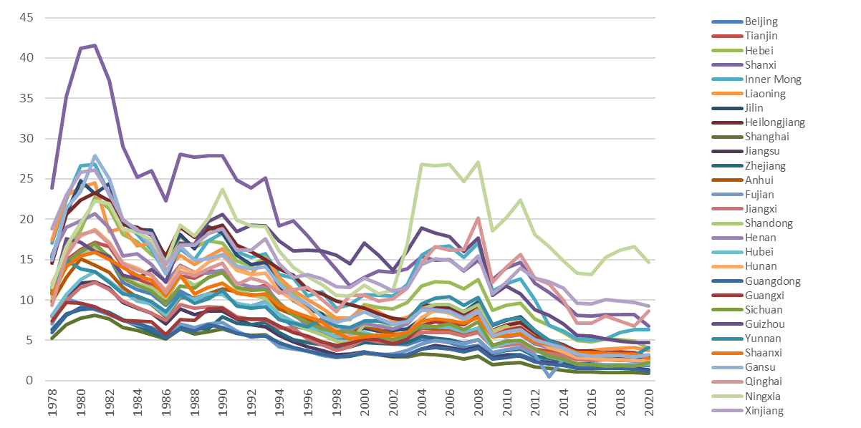
Provincial Depletions and Damage
Notes:
Shanxi province always had the highest value before 1997, whose natural capital loss made up more than 40% of its GDP during the peak time of 1981-1982. After the lowest point in 1999, the trend reversed and rose to about 18%. In contrast, the lowest provinces, Shanghai and Guangdong, show natural capital loss of only 10% of GDP during the peak, falling to about 1% by 2020

Slide 16
Value Chain and interregional transfer
Global and domestic value chain caused interregional transfer of the depletion of non-renewable energy and cost of pollution emission
Koopman, Wang and Wei (2013, 2014) founded the complete theoretical framework tracing the creation and distribution of value added through value chain
Main issue: productivity analysis needs time series multiregional IO table
Solution: Interpolated to time series multiregional IO table by RAS methods
Notes:
During the recent decades,
This research would like to extend the accounting analysis to adjust provincial value added and productivity by applying the multi-regional input-output model considering resource depletion and pollution emission.

Slide 17
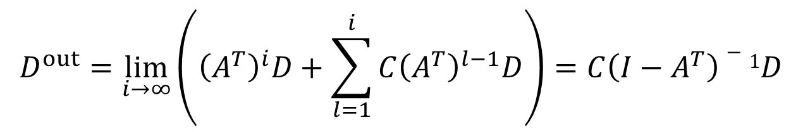
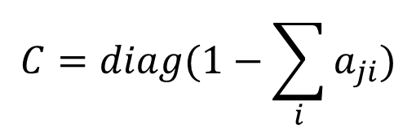
The indirect decomposition of natural capital lost
The decomposition of natural capital lost D happens first between the blocks of intermediate inputs and final use and then through the intermediate input matrix
Hereby C is a diagonal matrix of ratio of final use share
$$D^{out}=\lim_{i→∞}\left({\left(A^{T}\right)}^{i}D+\sum_{l=1}^{i}{C{\left(A^{T}\right)}^{l−1}D}\right)=C\left({I−A}^{T}\right)−1D$$
$$C=diag(1−\sum_{i}{a_{ji}})$$
Notes:
The previous calculation is from the production side. However, the natural capital loss is not only caused by the producer, but also by the consumers. Therefore, we also want to calculate it from the consumption side, which we called indirect decompensation.

Slide 18
Time-series multiregional IO tables
Years Covered in Multiregional Input–Output Tables
Based input–output table | Source | Number of sectors | Number of regions | Year covered
2002 MRIO | Pan et al., 2018 | 37 | 30 | 2000、2001、2002、2003、2004
2007 MRIO | Pan et al., 2018 | 37 | 30 | 2005、2006、2007、2008、2009
2012 MRIO | Pan et al., 2018 | 37 | 30 | 2010、2011、2012、2013、2014
2017 MRIO | Li et al., 2022 | 42 | 31 | 2015、2016、2017、2018、2019、2020
Notes:
National Bureau of Statistics

Slide 19
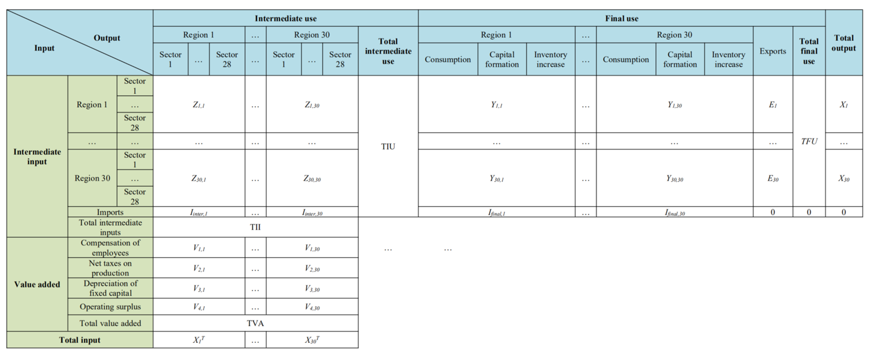
Time-series multiregional IO tables
RAS method to compile the current price time series MRIO tables
Notes:
2000-2020年30省28产业部门时间序列省间投入产出表（除西藏）
历年各省GDP之和等于国家统计局公布的全国GDP（扣除西藏）
历年各省GDP占比等于国家统计局公布的各省GDP占比
历年各省各行业的增加值占比等于各省统计年鉴中各行业增加值占比

Slide 20
Value added and total Output Data
The value added and output data of each region’s 28 sectors from 2000 to 2020 comes from National Bureau of Statistics of China, China Industrial Statistical Yearbook, Statistical Yearbook of Provinces.
2002, 2007, 2012 and 2017 China’s MRIO tables are used to calculate the value-added. 2000-2020 value-added rates are calculated via the linear interpolation and trend extrapolation.
For the total output of tertiary industry sectors, these sectors’ value-added values are divided by the value-added rate in the target year to get these missing total output values.
Adjustment: Using the value added of primary, secondary and tertiary industry of each region (NBS) for total control, combined with the raw value-added proportion structure of each region, and value-added proportion structure of each industry within each region, the adjusted value added could be computed.
Notes:
National Bureau of Statistics

Slide 21
Import, intermediate input and final use data
The China’s import data (excluding Tibet) from 2000 to 2020 comes from NBS.
The base China’s MRIO tables are used to calculate imports for intermediate use rate and imports for final use. Assume the rates of intermediate and final use imports are constant, and the imports account for the same proportion as the share of intermediate use and final use sector respectively. Imports could be divided into imports for each intermediate use and final use sector.
The intermediate input of each regional sector is each reginal sector’s total output minus value added and import.
Final use data from 2000 to 2017 comes from NBS. For 2018 to 2020, we calculate final use data based on 2017 final use structure and GDP growth rate of each region.
Notes:
National Bureau of Statistics

Slide 22
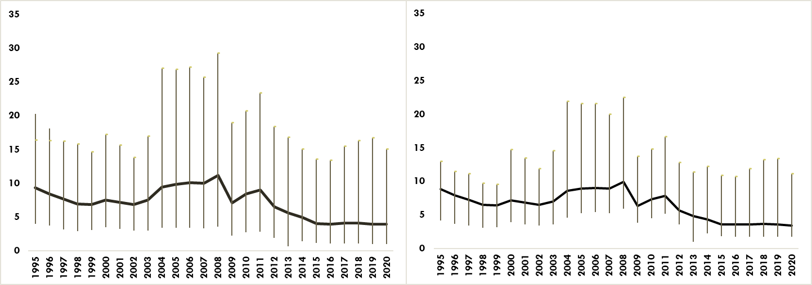
Provincial level natural capital loss
Direct Decomposed
Indirect Decomposed
Notes:
Although most energy depletion was counted in the consumption of industrial sectors, this decomposition shows that around half of the natural capital loss was finally used by other non-industrial sectors such as construction and transportation. Compared with the unadjusted natural capital loss, the ratio of adjusted loss to gross value added was about 1% to 7% lower, showing a more stable proportion to the total value added of all industrial sectors

Slide 23
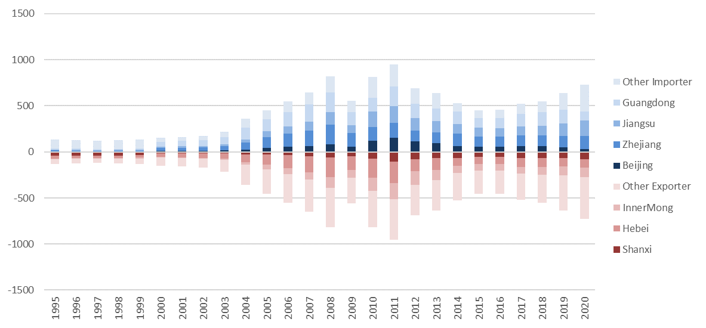
Inter-provincial transfer of natural capital loss
Notes:
When comparing the change of the provincial natural capital depletion under two different measures, we can identify those provinces with higher indirect than direct measures, or “importers” versus “exporters.” Typically, China’s largest coal producer, Shanxi Province, and its largest steel producer, Hebei Province, are the two top exporters while Zhejiang, Jiangsu, and Guangdong, serving as the manufacturing centers of China are importer provinces.
This decomposition is helpful to identify the responsibility of natural capital loss.

Slide 24
3. SNA Related definitions
Genuine Value Added (production approach)
Genuine Capital Formation (expenditure approach)
Genuine Capital Stock (balance sheet accounting)
It’ = It − nt(Rt − gt) − σt(et − dt) + mt
K’_{t} = K’_{t-1}(1 − δ_{t}) + I’

Slide 25
Genuine GDP / GDP
Direct
Indirect
Genuine Capital Formation / Capital Formation
Direct
Indirect
Genuine Capital Stock / Capital Stock
Direct
Indirect
Notes:
Compared with the direct measure of decomposition, the indirect measure leads to a relative higher average provincial GGDP level. Correspondingly, the provincial genuine capital formation and genuine capital stock would also be relatively higher than the direct measure, especially during the 1990s (see Figure 11). This will make the impact of all depletions more balanced between the producers and consumers, which is very important when calculating the “correct” growth rate of genuine capital stock and later the productivity for the resource-intense provinces such as Hebei and Shanxi.

Slide 26
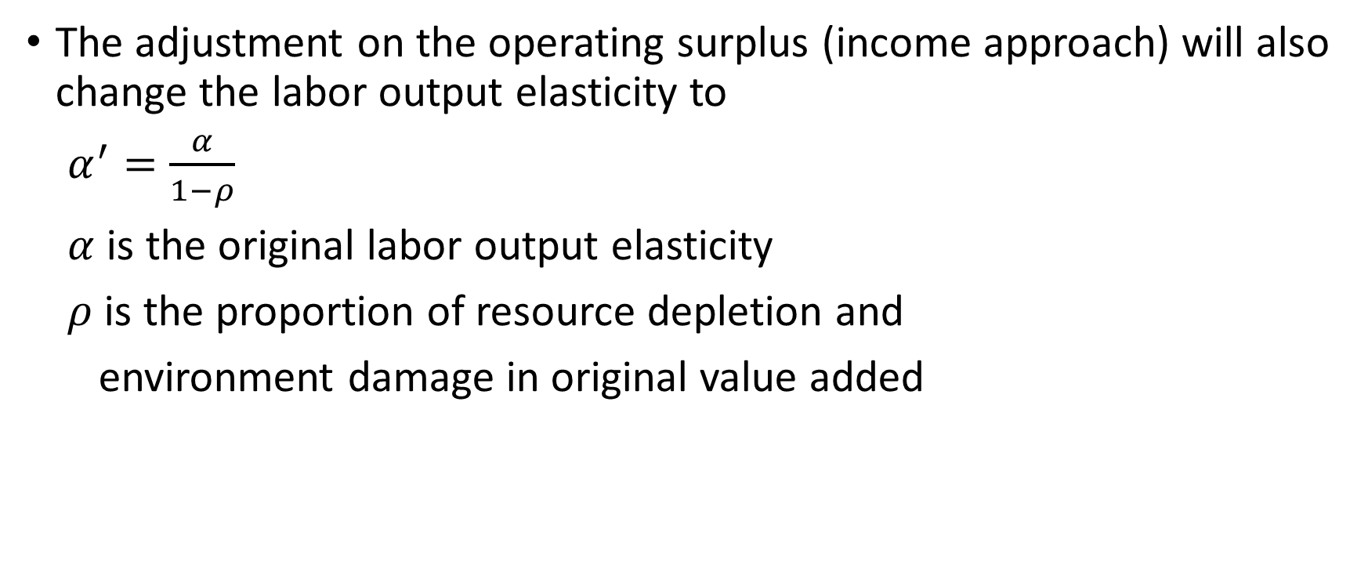
Adjusted labor share
The adjustment on the operating surplus (income approach) will also change the labor output elasticity to
$α^{′}=\frac{α}{1−ρ}$
$α$ is the original labor output elasticity
$ρ$ is the proportion of resource depletion and
environment damage in original value added
Notes:
Assuming constant returns to scale, we can decompose GDP growth into factor contribution and productivity contribution.

Slide 27
Genuine Labor share
Direct
Indirect

Slide 28
4. GDP and Productivity Growth
 |  | Traditional |  | Genuine (Direct) |  | Genuine (Indirect)
1978-1995 | GDP | 10.62 |  | 10.66
 | Capital | 9.08 | }(59.34) | 6.74 | } (61.71)
 | Labor | 2.98 |  | 2.98
 | TFP | 4.32 | (40.66) | 4.08 | (38.29)
1995-2020 | GDP | 9.19 |  | 9.57 |  | 9.60
 | Capital | 13.89 | } (70.47) | 15.33 | } (82.79) | 15.37 | } (72.67)
 | Labor | 0.58 |  | 0.58 |  | 0.58
 | TFP | 2.71 | (29.53) | 1.65 | (17.21) | 2.62 | (27.33)
1995-2008 | GDP | 10.46 |  | 10.72 |  | 10.75
 | Capital | 13.59 | } (68.72) | 15.59 | } (84.39) | 16.04 | } (71.15)
 | Labor | 1.21 |  | 1.21 |  | 1.21
 | TFP | 3.27 | (31.28) | 1.67 | (15.61) | 3.10 | (28.85)
2008-2020 | GDP | 7.82 |  | 8.34 |  | 8.37
 | Capital | 14.22 | } (73.01) | 15.05 | } (80.57) | 14.65 | } (74.81)
 | Labor | -0.10 |  | -0.10 |  | -0.10
 | TFP | 2.11 | (26.99) | 1.62 | (19.43) | 2.11 | (25.19)

Slide 29
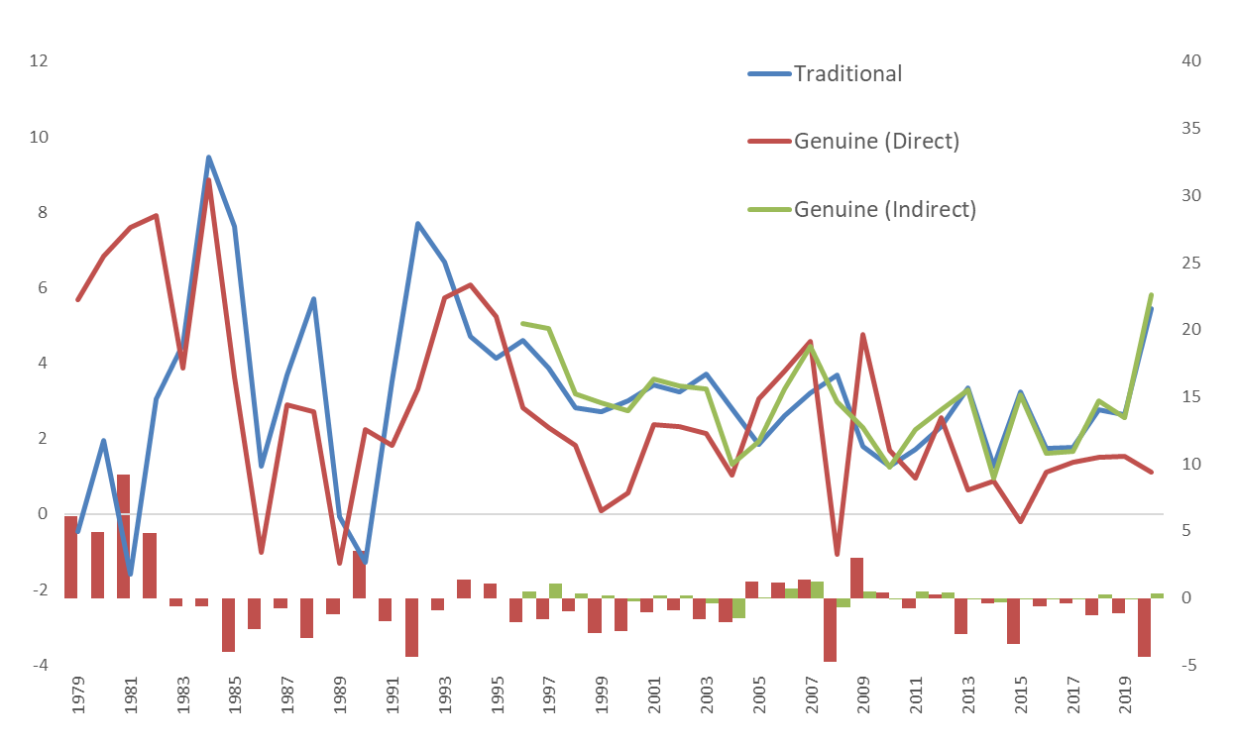
traditional / genuine productivity difference

Slide 30
Determinants of productivity gap
Divisia Productivity Index
Which means the productivity gap has the opposite sign with the first order difference of Natural Capital Loss (θ)

Slide 31
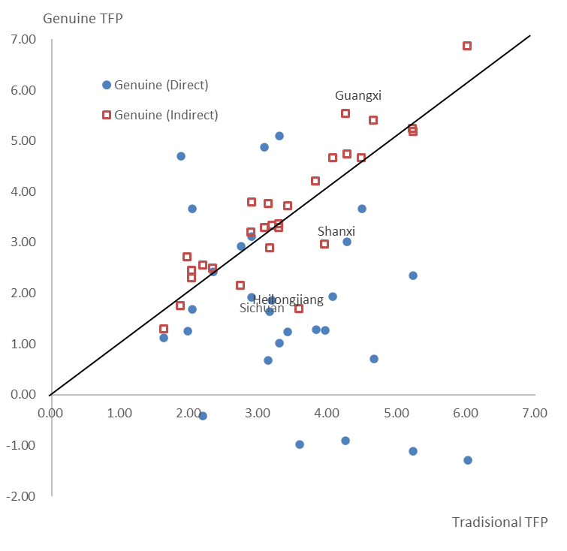
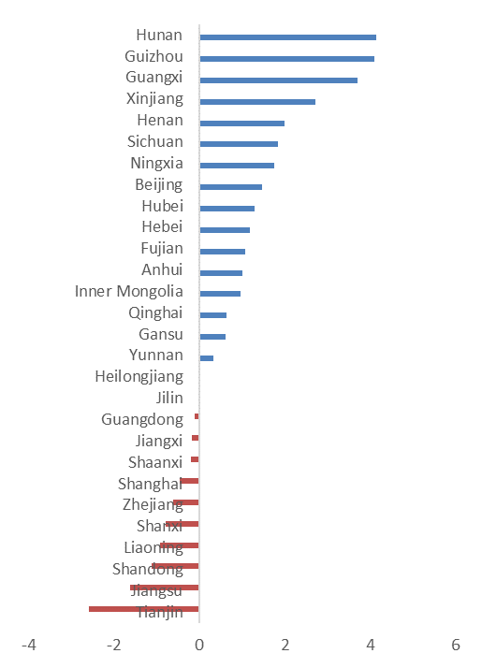
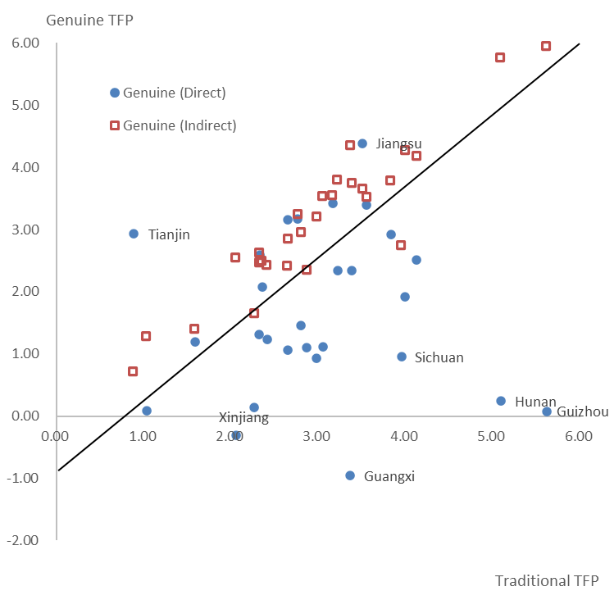
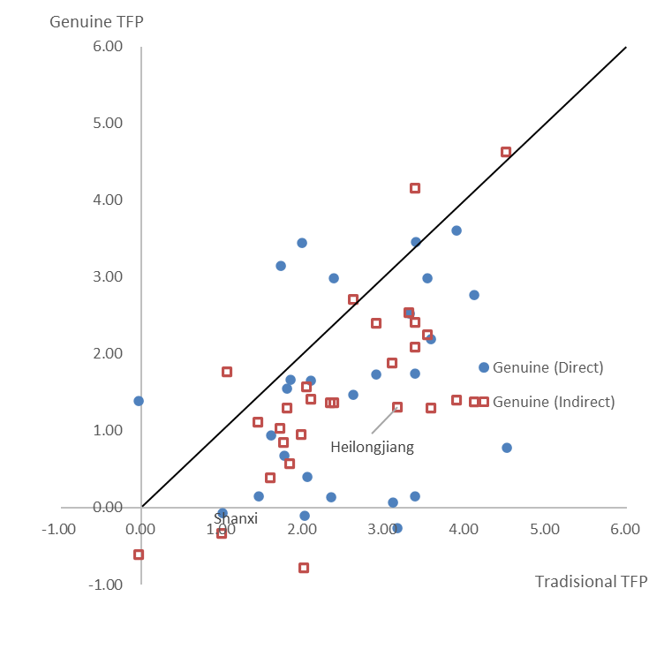
Provincial TFP Growth (1995-2020)
1995-2008
2008-2020
Notes:
the indirect measure of genuine productivity was much closer to the traditional measure not only on the aggregate level but also on the provincial level. The indirect measure of provincial genuine productivity growth was highly correlated with the traditional ones. This means that the indirect measure captures the basic pattern of provincial productivity with proper adjustments for natural capital loss.

Slide 32
Conclusions
The natural resource depletion and carbon damage cost vary between 5 to 30 per cent of China’s provincial and up to 31 per cent (by 2007) of fixed capital stock on average
Transfer of national capital lost between resource supplier and advanced costal provinces is quite obvious and quite consistent
They also lead to a decline slowdown of the productivity growth up to 10 per cent under direct approach in early 1980s while with much less gap under indirect approach recently
The loss of productivity growth through provinces become obvious after 2003 and consistent under two approaches because physical capital stock increased rapidly after that
Notes:
The economic growth of the provinces in the 1980s was a process that utilized high TFP growth to compensate for the loss of natural capital and to enable higher growth. After the 1990s, the comparative natural capital loss decreased and turned to more intensive consumption. However, physical capital stock increased rapidly and China’s provincial economic growth turned to a more extensive mode. This also led to a slowdown in productivity growth under the direct approach by the early 2000s while a consistent pattern using the indirect approach has recently emerged. T

