Slide 1
Divergence in Carbon Emissions Accounting: A Cross-Database Examination of GTAP and OECD ICIO within the Context of the Carbon Border Adjustment Mechanism (CBAM)
Jae Eun Shinª, Eun Young Kim^{b}, Yong-Gun Kim^{b*}
ª Underwood International College, Yonsei University, South Korea
^{b} Graduate School of International Studies, Yonsei University, Seoul, South Korea
31st International Input-Output Association Conference ()
6th - 11th July 2025, Malé, the capital city of the Maldives

Slide 2
Introduction
01
In response to the implementation of the Carbon Border Adjustment Mechanism (CBAM), carbon emissions are increasingly estimated using Multi-Regional Input-Output Tables (MRIOT).
However, discrepancies among sector-level MRIOT databases can lead to significant estimation errors and misinformed policy or strategic decisions.
Previous literature has pointed out that variations between databases can result in substantial differences in carbon emission estimates.
Nonetheless, these studies have largely focused on structural discrepancies in the construction of input-output databases, without addressing sector-specific differences within MRIOTs.
Contributions of this study:
“By comparing sectoral and regional discrepancies across databases, this study underscores the risks of relying on a single MRIOT source and highlights the urgent need to establish more accurate and standardized carbon accounting methodologies.”

Slide 3
Data & Methods : Data
02
Data Sources:
GTAP 11: Provides sectoral emissions intensity estimates based on national input-output tables and global trade data.
OECD ICIO: Integrates national and international input-output flows, with emissions data drawn from the Trade in Embodied CO₂ (TECO2) database.
Rationale for Selection:
(1) Both databases are regularly updated and validated using the most recent data.
(2) Both serve as core foundational sources that allow the construction and manipulation of MRIOT.

Slide 4
Data & Methods : Methods
02
Sectoral and Regional Aggregations for Analysis
Purpose of Aggregation:
Aggregation of sectors and countries was applied in both GTAP and ICIO to:
Reduce computational complexity & Focus on meaningful sectoral/regional contributors to carbon emissions
Prior studies (e.g., Owen et al., 2014; Peters and Solli, 2010) indicate that moderate aggregation yields reasonable and interpretable results
Sector Aggregation:
11 common aggregate sectors created from GTAP and OECD ICIO, reflecting major emission-contributing industries
Example: GTAP’s i_r (iron and steel) + nfm (non-ferrous metals) = OECD ICIO’s C24 (Basic metals)

Slide 5
Data & Methods : Methods
02
Sectoral and Regional Aggregations for Analysis
Aggregate Sectors | Aggregate Regions (Countries)
Agriculture | China
Fossil Fuels | Turkey
Other Extraction | Russia
Chemicals, Plastics, and Rubber | UK
Non-metallic Mineral Products | India
Metals | South Korea
Metal Products | USA
Computers and Other Equipment | Vietnam
Motor and Transport | Japan
Electricity | EU27
Other Industries | Rest of the World
Regional Aggregation:
11 aggregate regions created, reflecting the EU’s major steel trading partners
Based on 2023 UN COMTRADE data
Final region list:
9 countries: Top 10 steel exporters to EU excepts for Ukraine (not present in 2021 OECD ICIO)
EU27: aggregated European Union
Rest of the World

Slide 6
Data & Methods : Methods
02
Carbon Emissions Accounting Approach
Carbon emissions are estimated for Scopes 1, 2, and 3 under the EU CBAM framework
Calculations are based on bilateral trade flows(${vxmd}_{i}^{rs}$) (not specific products or industries)
Implemented using GAMS v36.2.0
$$\begin{aligned}&{vxmd}^{rs} =Z^{rs}1+y^{rs}\#\end{aligned}$$
Trade Flow Matrix
$Z^{rs}$: intermediate inputs from region r to s
$y^{rs}$: Final demand from region r to s

Slide 7
Data & Methods : Methods
02
Carbon Emissions Accounting Approach
$$E_{i}^{scope1}=f_{i}^{r}∙{vxmd}_{i}^{rs}$$
Scope 1: Direct Emissions from Production
$f_{i}^{r}$: carbon intensity of sector i in exporting region r
${vxmd}_{i}^{rs}$: trade flow of product i from region r to s
$$E_{i}^{scope2}=\left(f_{i}^{r}+\frac{\sum_{j}{{eco}_{j, ely}^{r}}}{{vom}_{ely}^{r}}\frac{{vdfm}_{ely,i}^{r}}{{vom}_{i}^{r}}\right)∙{vxmd}_{i}^{rs}$$
Scope 2: Includes Electricity-Related Emissions
${eco}_{j, ely}^{r}$: CO₂ emissions from electricity source j in region r
${vom}_{ely}^{r}$: total output of electricity sector in r
${vdfm}_{ely,i}^{r}$: domestic electricity use by sector I
${vom}_{i}^{r}$: total output of sector i in r

Slide 8
Data & Methods : Methods
02
Carbon Emissions Accounting Approach
$$E_{i}^{scope 3}=f^{r}∙{\left\{{\left(1−A^{rr}\right)}^{−1}\right\}}^{i}∙{vxmd}_{i}^{rs}$$
3: Full Supply Chain Emissions (EEBT method)
$f^{r}$: carbon intensity vector for importing region s
${\left\{{\left(1−A^{rr}\right)}^{−1}\right\}}^{i}$: i-th column of the Leontief inverse matrix for region r
EEBT Method
MRIO method tracks intermediate consumption but is highly complex
EEBT method assigns all emissions to final demand of importing country
Simplifies tracing while still capturing total upstream emissions

Slide 9
Results & Discussions
03
Table 2. Emissions Embodied in Trade to the EU (by region)
 | Scope 1 |  |  | Scope 2 |  |  | Scope 3
 | GTAP | ICIO | (%diff) | GTAP | ICIO | (%diff) | GTAP | ICIO | (%diff)
China | 26.59 | 34.50 | -22.93% | 57.95 | 58.27 | -0.54% | 235.36 | 235.55 | -0.08%
Turkey | 9.22 | 10.51 | -12.23% | 14.80 | 12.23 | 21.00% | 28.82 | 28.29 | 1.87%
Russia | 36.45 | 33.28 | 9.51% | 72.85 | 46.39 | 57.05% | 125.63 | 107.74 | 16.61%
United Kingdom | 15.44 | 17.56 | -12.07% | 21.14 | 19.70 | 7.31% | 33.60 | 34.22 | -1.81%
India | 17.62 | 17.18 | 2.60% | 29.81 | 31.38 | -5.00% | 54.71 | 64.60 | -15.31%
South Korea | 1.83 | 5.51 | -66.71% | 6.44 | 9.49 | -32.20% | 15.05 | 24.18 | -37.76%
USA | 25.41 | 35.06 | -27.52% | 40.13 | 50.24 | -20.12% | 71.02 | 84.57 | -16.02%
Vietnam | 2.74 | 1.50 | 82.67% | 4.23 | 2.72 | 55.39% | 10.35 | 5.80 | 78.50%
Japan | 2.25 | 6.36 | -64.68% | 5.08 | 9.53 | -46.69% | 15.70 | 22.00 | -28.63%
EU | 218.46 | 215.78 | 1.24% | 313.59 | 275.91 | 13.66% | 500.43 | 455.99 | 9.75%
Rest of the World | 136.16 | 174.51 | -21.98% | 195.91 | 231.15 | -15.25% | 310.18 | 409.29 | -24.21%
GRAND TOTAL | 492.17 | 551.74 | -10.80% | 761.92 | 747.00 | 2.00% | 1400.85 | 1472.23 | -4.85%
Note: Carbon emissions measured in units of million tons. Percent differences are calculated for GTAP with ICIO

Slide 10
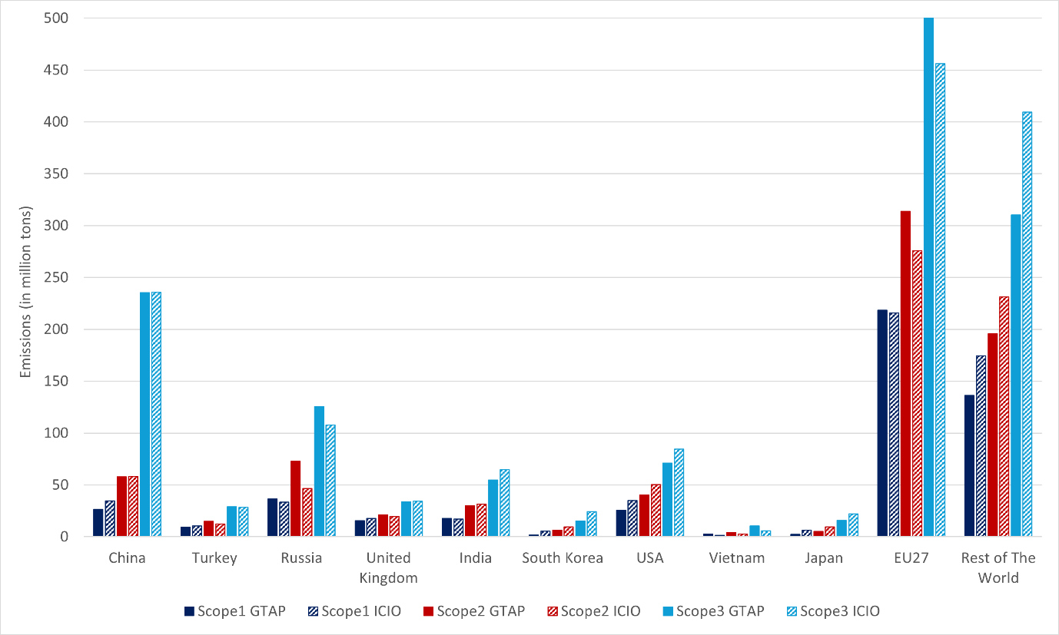
Results & Discussions
03
Figure 1. Emissions Embodied in Trade to the EU (by region)

Slide 11
Results & Discussions
03
Summary
Significant differences in carbon emissions estimates are observed between the two databases, particularly across specific regions and sectors (notably in fossil fuels and metals).
These discrepancies raise concerns about the fairness and regulatory consistency of CBAM, as they may lead to uneven carbon tariff burdens (Andrew & Peters, 2013; Barrett et al., 2013).
Without standardized emissions accounting, CBAM could distort trade competitiveness and impose disproportionate financial burdens (Shuai et al., 2024; Zhao et al., 2023).

Slide 12
Results & Discussions
03
Scope 1 & Scope 3
Scope 1
For most regions, emissions calculated using GTAP11 are lower than those estimated by OECD ICIO.
The largest discrepancies are found for South Korea (-67%) and Japan (-65%).
In contrast, Vietnam shows an 83% higher estimate in GTAP11.
Scope 3
Database differences are relatively smaller across regions under Scope 3.
However, significant gaps persist: South Korea -38%, Japan -29%
Notably, Vietnam is overestimated by 79% in GTAP11—classified as an outlier.

Slide 13
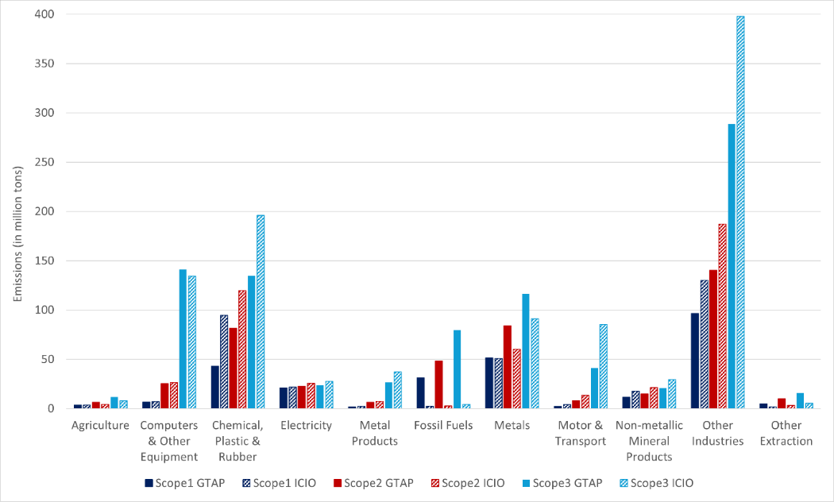
Results & Discussions
03
Figure 2. Emissions Embodied in Trade to the EU (by industry)

Slide 14
Results & Discussions
03
Table 3. Emissions Embodied in Trade to the EU (by industry)
 | Scope 1 |  |  | Scope 2 |  |  | Scope 3
 | GTAP | ICIO | (%diff) | GTAP | ICIO | (%diff) | GTAP | ICIO | (%diff)
Agriculture | 11.99 | 11.19 | 7.14% | 17.30 | 13.30 | 30.02% | 27.13 | 20.44 | 32.75%
Computers & Other Equipment | 10.94 | 12.87 | -14.97% | 38.05 | 36.48 | 4.32% | 187.24 | 166.87 | 12.21%
Chemical, Plastic & Rubber | 69.85 | 125.80 | -44.48% | 134.73 | 160.70 | -16.16% | 213.39 | 259.34 | -17.72%
Electricity | 74.44 | 47.21 | 57.70% | 79.13 | 56.81 | 39.29% | 81.08 | 61.17 | 32.53%
Metal Products | 2.73 | 3.52 | -22.49% | 9.56 | 9.77 | -2.11% | 37.13 | 46.29 | -19.78%
Fossil Fuels | 31.70 | 3.60 | 780.00% | 49.62 | 4.06 | 1121.13% | 81.14 | 5.84 | 1289.74%
Metals | 83.16 | 102.36 | -18.76% | 133.99 | 119.24 | 12.37% | 183.76 | 168.15 | 9.28%
Motor & Transport | 5.14 | 7.17 | -28.28% | 17.23 | 20.32 | -15.23% | 75.37 | 116.42 | -35.26%
Non-metallic Mineral Products | 22.61 | 30.80 | -26.58% | 29.19 | 35.97 | -18.85% | 39.37 | 47.76 | -17.56%
Other Industries | 174.17 | 204.80 | -14.96% | 241.68 | 286.27 | -15.58% | 457.33 | 573.46 | -20.25%
Other Extraction | 5.43 | 2.42 | 124.68% | 11.44 | 4.08 | 180.46% | 17.91 | 6.48 | 176.27%
GRAND TOTAL | 492.17 | 551.74 | -10.80% | 761.92 | 747.00 | 2.00% | 1400.85 | 1472.23 | -4.85%
Note: Carbon emissions measured in units of million tons. Percent differences are calculated for GTAP with OECD ICIO as the reference database (%difference=(GTAP-ICIO)/ICIO).

Slide 15
Results & Discussions
03
Fossil Fuels & Metals
Fossil Fuels (Extreme Discrepancy)
In the fossil fuel sector, GTAP11 overestimates emissions by up to 1290% under Scope 3.
This is likely due to differences in the allocation of final fossil fuel consumption:
GTAP11 assigns most emissions to the production sector itself.
OECD ICIO distributes emissions across downstream sectors that use fossil fuels in their processes.
This discrepancy prompts a key policy question:
“Should emissions be attributed to producers or to industrial users of fossil fuels along the supply chain?”
Metals Sector (Similar to Fossil Fuels)
GTAP11 produces higher estimates for Scope 2 (+12%) and Scope 3 (+9%), but underestimates Scope 1 by 19%.
Key country-level differences: China -40% | Turkey: -67% | Russia: 263%
Findings align with previous studies on emissions accounting inconsistency (Inomata & Owen, 2014; Owen et al., 2014).
Given that steel and aluminum are primary targets under CBAM, improving accuracy in this sector is particularly critical.

Slide 16
Results & Discussions
03
Table 4. Emissions Embodied in Trade to the EU (by region, Metals only)
 | Scope 1 |  |  | Scope 2 |  |  | Scope 3
 | GTAP | ICIO | (%diff) | GTAP | ICIO | (%diff) | GTAP | ICIO | (%diff)
China | 5.13 | 8.66 | -40.77% | 8.27 | 10.56 | -21.70% | 12.98 | 18.16 | -28.52%
Turkey | 0.96 | 2.93 | -67.21% | 2.26 | 3.23 | -30.24% | 3.27 | 5.34 | -38.88%
Russia | 19.54 | 5.38 | 263.55% | 29.14 | 6.09 | 378.14% | 38.91 | 10.24 | 280.00%
United Kingdom | 0.98 | 1.82 | -45.98% | 1.55 | 1.86 | -16.95% | 1.93 | 2.19 | -12.21%
India | 10.30 | 6.43 | 60.14% | 14.79 | 6.94 | 112.96% | 18.44 | 8.71 | 111.76%
South Korea | 0.54 | 1.37 | -60.36% | 1.33 | 1.77 | -25.05% | 1.92 | 2.72 | -29.35%
USA | 1.31 | 2.42 | -45.79% | 2.37 | 3.23 | -26.83% | 3.63 | 4.59 | -20.92%
Vietnam | 0.06 | 0.05 | 21.80% | 0.14 | 0.09 | 53.65% | 0.24 | 0.13 | 90.71%
Japan | 0.21 | 0.85 | -75.12% | 0.32 | 0.94 | -65.68% | 0.70 | 1.83 | -61.94%
EU | 31.82 | 51.51 | -38.23% | 49.87 | 59.28 | -15.87% | 67.30 | 77.08 | -12.70%
Rest of the World | 12.30 | 20.95 | -41.29% | 23.96 | 25.23 | -5.01% | 34.45 | 37.16 | -7.29%
GRAND TOTAL | 83.16 | 102.36 | -18.76% | 133.99 | 119.24 | 12.37% | 183.76 | 168.15 | 9.28%
Note: Carbon emissions measured in units of million tons. Percent differences are calculated for GTAP with ICIO as the reference database (%difference=(GTAP-ICIO)/ICIO).

Slide 17
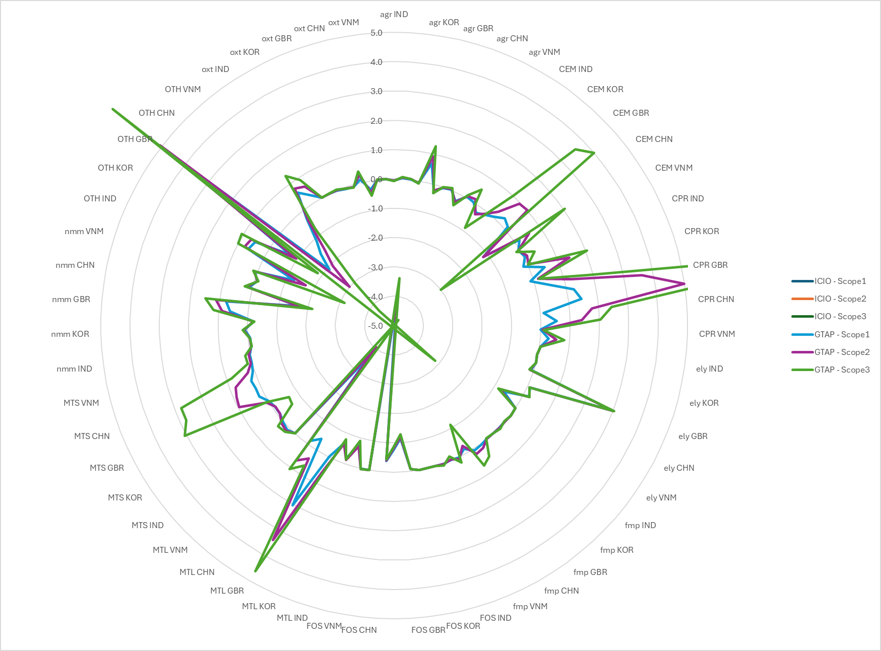
Results & Discussions
03
Figure 3. Discrepancies between GTAP and OECD ICIO for Scope 1/2/3 Emissions (MtCO2)

Slide 18
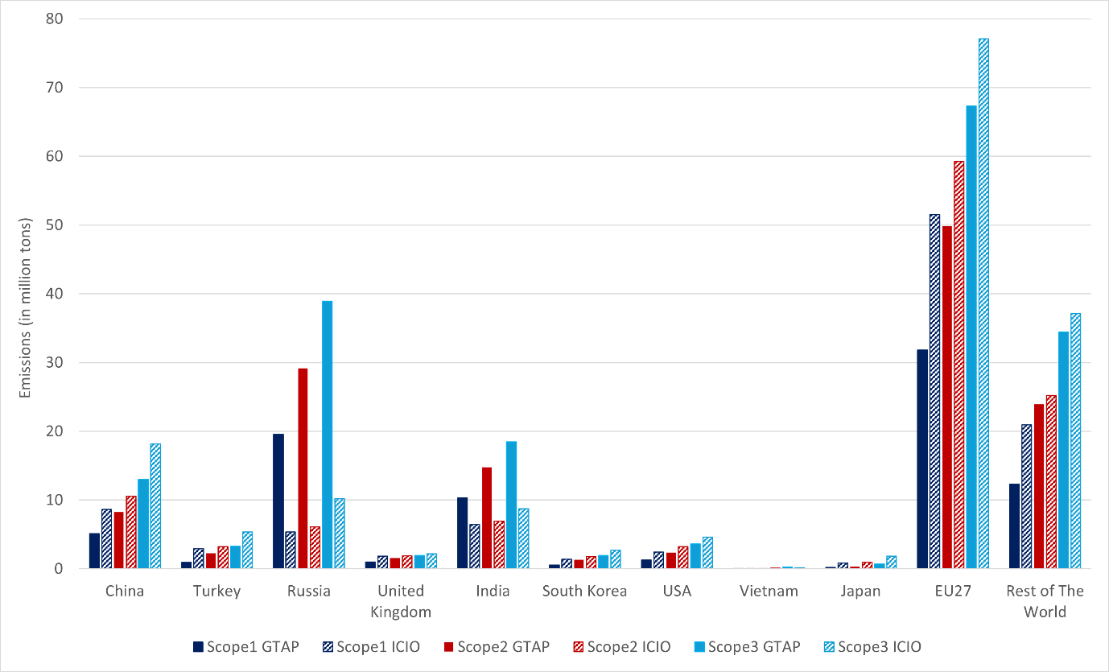
Results & Discussions
03
Figure 4. Emissions Embodied in Trade to the EU (by region, Metals only)

Slide 19
Broader Implications for CBAM Implementation
04
If such inconsistencies remain unresolved, firms may relocate production to countries with lower CBAM liabilities based on database calculations rather than actual emission reductions.
A standardized carbon accounting framework is urgently needed to ensure consistency in CBAM tariff application.
The EU should collaborate with international organizations such as IPCC, UNFCCC, and OECD to develop harmonized emissions reporting protocols.

Slide 20
Conclusion
05
This study empirically verifies that carbon emissions estimates can differ significantly depending on the database used.
The choice of database is especially consequential for emissions-intensive sectors like metals.
Enhancing transparency in emissions accounting methodologies is essential to ensure reliable and fair policy implementation.
Future research should:
Analyze the sources of discrepancies through bilateral trade volume, emissions intensity, and input-output structures.
Apply Structural Decomposition Analysis (SDA) to break down the drivers of emissions differences.
Integrate Computable General Equilibrium (CGE) modeling to assess the broader economic impacts under various accounting frameworks.

Slide 21
Thank you!
Young-Gun Kim (ygkim@yonsei.ac.kr)
This work was supported by Korea Environment Industry & Technology Institute(KEITI) through “Climate Change R&D Project for New Climate Regime”, funded by Korea Ministry of Environment (MOE) [2022003560012]

Slide 22
References
06
Aguiar, A., Chepeliev, M., Corong, E. & van der Mensbrugghe, D. (2022). The GTAP Data Base: Version 11. Journal of Global Economic Analysis, 7(2), 1-37. Retrieved from https://www.jgea.org/ojs/index.php/jgea/article/view/181
Andrew, R. M., & Peters, G. P. (2013). A Multi-Region Input–Output Table Based on the Global Trade Analysis Project Database (GTAP-MRIO). Economic Systems Research, 25(1), 99–121. https://doi.org/10.1080/09535314.2012.761953
Andrew, R., Peters, G. P., & Lennox, J. (2009). Approximation and Regional Aggregation in Multi-Regional Input–Output Analysis for National Carbon Footprint Accounting. Economic Systems Research, 21(3), 311–335. https://doi.org/10.1080/09535310903541751
Arto, I., Rueda-Cantuche, J. M., & Peters, G. P. (2014). Comparing the GTAP-MRIO and WIOD Databases for Carbon Footprint Analysis. Economic Systems Research, 26(3), 327–353. https://doi.org/10.1080/09535314.2014.939949
Barrett, J., Peters, G., Wiedmann, T., Scott, K., Lenzen, M., Roelich, K., & Le Quéré, C. (2013). Consumption-based GHG emission accounting: A UK case study. Climate Policy, 13(4), 451–470. https://doi.org/10.1080/14693062.2013.788858
Giljum, S., Wieland, H., Lutter, S., Eisenmenger, N., Schandl, H., & Owen, A. (2019). The impacts of data deviations between MRIO models on material footprints: A comparison of EXIOBASE, Eora, and ICIO. Journal of Industrial Ecology, 23(4), 946–958. https://doi.org/10.1111/jiec.12833
Inomata, S., & Owen, A. (2014). Comparative Evaluation of MRIO Databases. Economic Systems Research, 26(3), 239–244. https://doi.org/10.1080/09535314.2014.940856
Lenzen, M. (2011). Aggregation Versus Disaggregation in Input–Output Analysis of the Environment. Economic Systems Research, 23(1), 73–89. https://doi.org/10.1080/09535314.2010.548793
Lin, B.-Q., & Zhao, H.-S. (2023). Which sectors should be covered by the EU Carbon Border Adjustment Mechanism? Advances in Climate Change Research, 14(6), 952–962. https://doi.org/10.1016/j.accre.2023.11.012
Moran, D., & Wood, R. (2014). Convergence Between the Eora, WIOD, EXIOBASE, and OpenEU’s Consumption-Based Carbon Accounts. Economic Systems Research. https://www.tandfonline.com/doi/abs/10.1080/09535314.2014.935298

Slide 23
References
06
OECD (2021a). OECD Inter-Country Input-Output Database, http://oe.cd/icio
OECD (2021b). Trade in Embodied CO2(TECO2) Database.
Owen, A. (2017). Techniques for Evaluating the Differences in Multiregional Input-Output Databases: A Comparative Evaluation of CO2 Consumption-Based Accounts. Springer.
Owen, A., Steen-Olsen, K., Barrett, J., Wiedmann, T., & Lenzen, M. (2014). A Structural Decomposition Approach to Comparing MRIO Databases. Economic Systems Research, 26(3), 262–283. https://doi.org/10.1080/09535314.2014.935299
Owen, A., Wood, R., Barrett, J., & Evans, A. (2016). Explaining value chain differences in MRIO databases through structural path decomposition. Economic Systems Research, 28(2), 243–272. https://doi.org/10.1080/09535314.2015.1135309
Perdana, S., & Vielle, M. (2022). Making the EU Carbon Border Adjustment Mechanism acceptable and climate friendly for least developed countries. Energy Policy, 170, 113245. https://doi.org/10.1016/j.enpol.2022.113245
Peters, G. P. (2008). From production-based to consumption-based national emission inventories. Ecological Economics, 65(1), 13–23. https://doi.org/10.1016/j.ecolecon.2007.10.014
Peters, G. P., & Solli, C. (2010). Global carbon footprints: Methods and import/export corrected results from the Nordic countries in global carbon footprint studies. TemaNord 2010:592. Nordic Council of Ministers.
Peters, G. P., Andrew, R., & Lennox, J. (2011). Constructing An Environmentally-Extended Multi-Regional Input–Output Table Using the GTAP Database. Economic Systems Research, 23(2), 131–152. https://doi.org/10.1080/09535314.2011.563234
Peters, G. P., Davis, S. J., & Andrew, R. (2012). A synthesis of carbon in international trade. Biogeosciences, 9(8), 3247–3276. https://doi.org/10.5194/bg-9-3247-2012
Shuai, J., Wang, W., Liu, H., Huang, C., Yi, T., Zhao, Y., & Shuai, C. (2024). The impact of the EU’s Carbon Border Adjustment Mechanism on the global iron and steel trade and emission reduction. Environmental Science and Pollution Research, 31(14), 21524–21544. https://doi.org/10.1007/s11356-024-32528-2

Slide 24
References
06
Steen-Olsen, K., Owen, A., Hertwich, E. G., & Lenzen, M. (2014). Effects of Sector Aggregation on CO2 Multipliers in Multiregional Input–Output Analyses. Economic Systems Research, 26(3), 284–302. https://doi.org/10.1080/09535314.2014.934325
United Nations. (2024). United Nations Commodity Trade Statistics Database [dataset]. https://comtradeplus.un.org/TradeFlow
Wiebe, K. S., & Lenzen, M. (2016). To RAS or not to RAS? What is the difference in outcomes in multi-regional input–output models? Economic Systems Research, 28(3), 383–402. https://doi.org/10.1080/09535314.2016.1192528
Wiedmann, T. (2009). A review of recent multi-region input–output models used for consumption-based emission and resource accounting. Ecological Economics, 69(2), 211–222. https://doi.org/10.1016/j.ecolecon.2009.08.026
Wieland, H., Giljum, S., Bruckner, M., Owen, A., & Wood, R. (2018). Structural production layer decomposition: A new method to measure differences between MRIO databases for footprint assessments. Economic Systems Research, 30(1), 61–84. https://doi.org/10.1080/09535314.2017.1350831
Zhao, L.-T., Chen, Z.-Y., Duan, Y.-X., & Qiu, R.-X. (2023). How will CBAM affect the decarbonisation of steel industry in China? A system dynamics approach. International Journal of Production Research, 1–22. https://doi.org/10.1080/00207543.2023.2285397

