Slide 1
Global footprints of soil phosphorus from 1970-2017
INSTITUTE OF AGRICULTURAL ECONOMICS AND DEVELOPMENT, CAAS
June 2025

Slide 2
CONTENTS
1.
Introduction
2.
Methodology
3.
Results
4.
Discussion and conclusions

Slide 3
Introduction
Soil-P Imbalance
  Phosphorus (P): Essential nutrient in agricultural systems.
  Imbalance: Disparities between P inputs and outputs in agricultural soils.
  Challenges: Environmental quality and food security.
  Surplus
    Regions: Emerging/developed economies (e.g., CN, BR, US, EU).
    Cause: Extensive P fertilizer or manure application.
    Effect: Increased P levels in water ecosystems (runoff and erosion).
  Deficit
    Regions: Less developed/developing economies (e.g., sub-Saharan Africa, Eastern Europe, South America).
    Cause: Limited P fertilizer input; soil P consumed by exports.
    Effects: Lower crop yields, Undernourishment (e.g., sub-Saharan Africa), Projected depletion of soil nutrients (e.g., Argentina).

Slide 4
Introduction
Limitations of Existing Research
  Traditional P flow studies
    Focus: Trade directly related to P in agricultural products (crops, livestock) or production inputs (P rock, P fertilizers).
    Ignores: Upstream supply-chain impacts.
    Issue: Agricultural products used as intermediate inputs in upstream goods (e.g., paper, clothing), then traded as secondary/tertiary goods. Focusing only on agricultural trade ignores these upstream impacts.

Slide 5
Introduction
Research Objectives
  Estimate global soil phosphorus (P) footprints (1970-2017).
  Quantify how trade and consumption drive global P-related environmental and food security risks.
  Achieve this by tracing the trade routes of soil-P surplus and soil-P deficit.
  Research Innovations
  Comprehensive Soil-P Footprint Indicator: Identifies potential P-related environmental and food security risks.
  Long-term Temporal Trends: Presents soil-P footprint trends from 1970 to 2017.
  MRIO & High-Resolution Spatial Data: Couples an MRIO database with high-resolution spatial crop and livestock distribution data to identify P deficit and surplus hotspots resulting from trade.

Slide 6
Introduction
Research Significance
  First Global Study: Connects international trade with soil-P surplus and deficit data.
  Integrated Framework: Integrates P-related environmental and food security risks into one framework.
  Overcomes Policy Fragmentation: Contributes to overcoming policy fragmentation in P management.
  Supports FAO: Supports the Food and Agriculture Organization (FAO) food security strategies.
  Improves WTO RTAs: Improves the environmental and food security provisions of the World Trade Organization (WTO) Regional Trade Agreements (RTA).

Slide 7
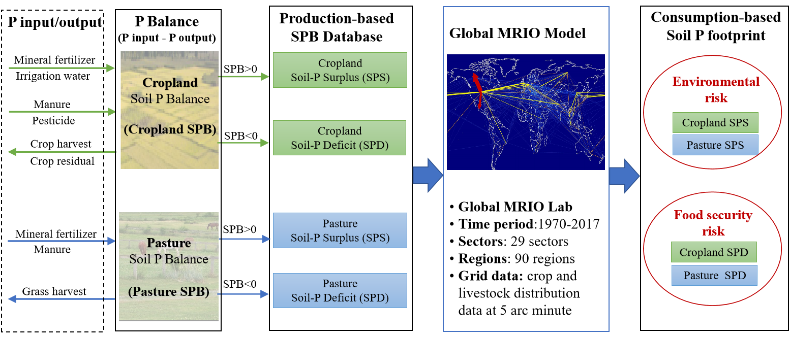
Methodology
Overall Framework
  Construct a global Soil-P Footprint.
  Assess environmental and food security risks by combining production and consumption perspectives.

Slide 8
Methodology
Core Steps
  Establish SPB Database
    Spatial resolution: Grid level (0.5°x0.5° implied from 5 arc minute)
    Time range: 1970-2017
    Coverage: 90 countries and regions
    Data sources: FAO, IFA
  SPB = P Input - P Output (soil-surface balance approach)
    Separate SPB for cropland and pasture
    Calculate Surplus (SPB > 0) and Deficit (SPB < 0)

Slide 9
Methodology
Core Steps
  Integrate with MRIO Database
    Build extended MRIO database (generalized extended MRIO database)
    Link SPB data to MRIO data
    Quantify Consumption-Driven Soil-P Footprint:
    Compute extended input-output matrix
    Trace surplus/deficit flows in global supply chains (embodied soil-P surplus and deficit flows)
  Hotspot Analysis
    Combine MRIO results with high-resolution spatial data (grid-level production distribution data)
    Identify hotspots of trade-induced soil-P surplus/deficit (spatially explicit hotspots exposed to trade)

Slide 10
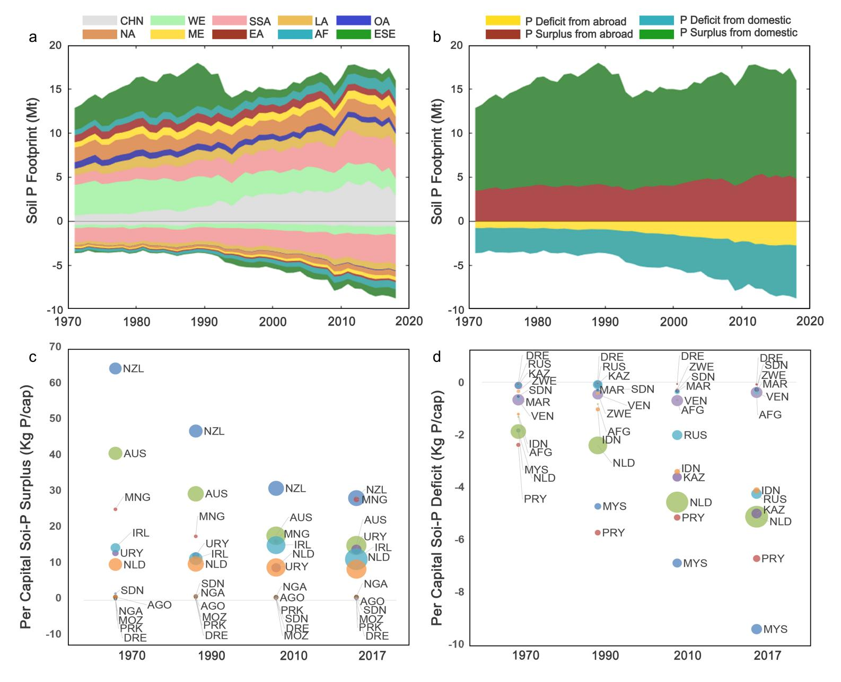
Results
Overall Trends of Soil-P Footprint (1970-2017)
  Global Soil-P Footprint (Surplus + Deficit)
    Increased by 50%: 16.51 Mt -> 24.77 Mt
    Indicates increasing P-related food security and environmental risks.
  Soil-P Deficit (Food Security Risk)
    Increased by 240%: 3.62 Mt P/year (1970) -> 8.79 Mt P/year (2017)
    95% of the increase due to cropland soil-P deficit.
  Soil-P Surplus (Environmental Risk)
    Increased by 24%: 12.89 Mt P/year (1970) -> 16.00 Mt P/year (2017)
    Cropland: 8.19 Mt -> 9.98 Mt
    Pasture: 4.70 Mt -> 6.02 Mt

Slide 11
Results
Overall Trends of Soil-P Footprint (1970-2017)
  Regional Trends in Soil-P Surplus/Deficit (Consumption Perspective)
  Significant Regional Differences
    Soil-P Surplus:
    Asia: Increased by 130% (mainly China and India)
    Europe/North America: Decreased by 37%
  Soil-P Deficit
    Increased significantly in all regions (2-4.8 times).
    South Asia: Highest increase (71%)
    Southeast Asia: 33%
    Eastern/Southeastern Europe: 16%
    Western Europe: 13%
    Africa: 9%

Slide 12
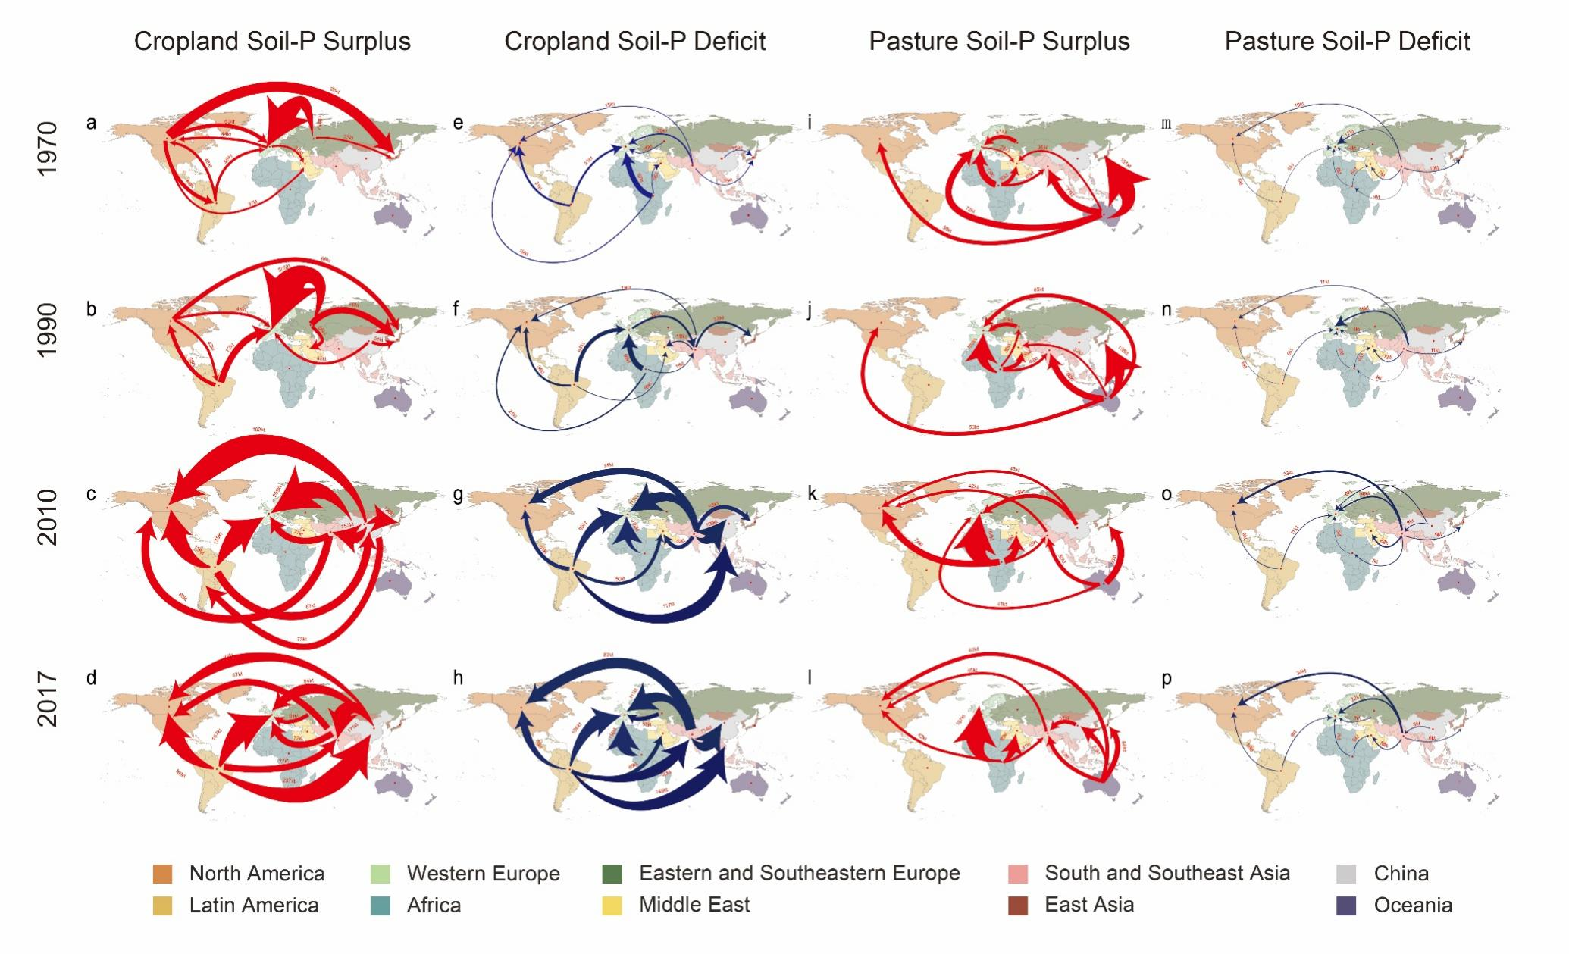
Results
Overall Trends of Soil-P Footprint (1970-2017)
  Top ten flows between regions are analyzed in selected years.
  Arrows indicate the direction of embodied soil-P surplus or deficit flow, which matches the direction of commodity trade.
  Red arrows: Flow of embodied soil-P surplus.
  Blue arrows: Flow of embodied soil-P deficit.

Slide 13
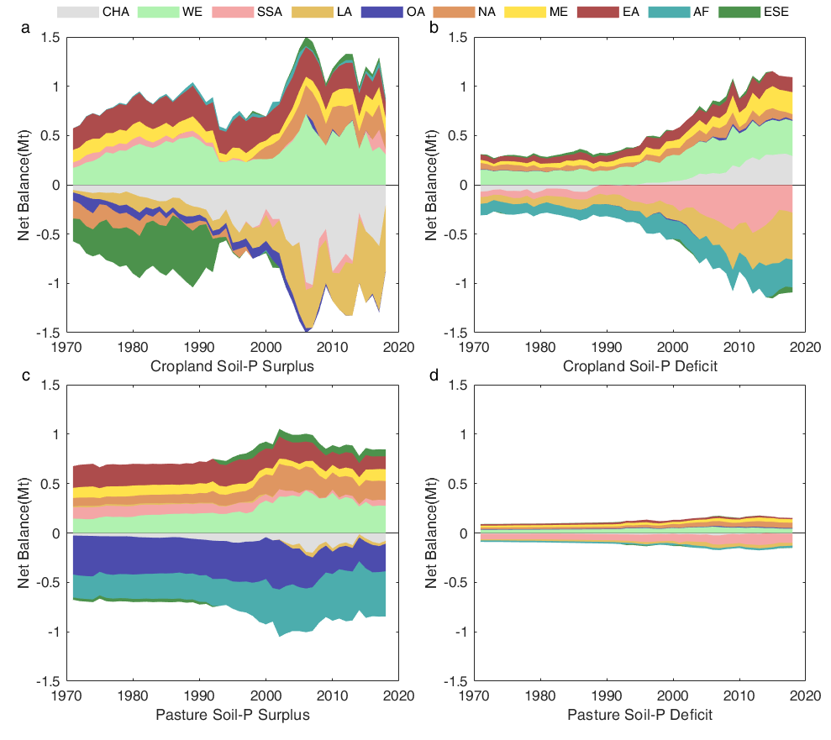
Results
Overall Trends of Soil-P Footprint (1970-2017)
  Trend of Trade Balance (1970-2017) for 10 Regions
  Analyzed for:
    Cropland soil-P surplus (a)
    Cropland soil-P deficit (b)
    Pasture soil-P surplus (c)
    Pasture soil-P deficit (d)
  Key Finding:
    The net trade balance of cropland soil-P deficit surpassed that of cropland soil-P surplus for the first time in 2017.
    Trade's net role on pasture soil-P deficit is not significant.

Slide 14
Results
Overall Trends of Soil-P Footprint (1970-2017)
  Per Capita Soil-P Surplus/Deficit Trends
  Per Capita Surplus
    Gap between countries is declining.
    High GDP countries: Higher per capita surplus, but declining.
    New Zealand: 64.5 kg/person -> 28.5 kg/person
    Australia: 40.9 kg/person -> 15.3 kg/person
  Per Capita Deficit
    Gap between countries is widening.
    Countries with significant growth in per-capita soil-P deficit:
      Malaysia: 1.8 kg/person -> 9.4 kg/person
      Indonesia: 1.2 kg/person -> 4.1 kg/person
      Russia: 0.1 kg/person -> 4.3 kg/person
      Netherlands: 1.9 kg/person -> 5.1 kg/person
  Developed vs. Developing regions: Growing disparities in per capita deficit reflects increasing regional inequality of P in food systems.

Slide 15
Results
Trade’s role in soil-P imbalance over 48 years (1970-2017)
  Global soil-P surplus and deficit generated due to traded goods & services are increasing
  1970: 26% (4.23 Mt) of global imbalance
  2017: 31% (7.59 Mt) of global imbalance
  Soil-P Surplus in trade: 27% (1970) -> 30% (2017)
  Soil-P Deficit in trade: 21% (1970) -> 31% (2017) (Significant increase, indicating trade-related worldwide soil-P deficit)

Slide 16
Results
Trade’s role in soil-P imbalance over 48 years (1970-2017)
  Changes in Trade Routes (1970-2017)
  Global supply chains shifted geographically, changing embodied soil-P trade routes.
  1970: 55% of trade-related soil-P surplus between developed economies.
  2017: 13% of trade-related soil-P surplus between developed economies (87% now between developing economies or developing -> developed).
  Important Trade Route Shifts:
    East Europe -> West Europe (1990): Largest cropland surplus flow disappeared due to Eastern Europe disintegration.
    Latin America -> China (2017): Replaced East Europe-West Europe as largest flow. (237 kt)
    Africa -> West Europe (1970 -> 2017): Largest cropland deficit flow doubled. (67kt -> 134kt)
    Oceania -> East Asia (excluding China) (1970): Top pasture surplus flow. (151kt)
    Africa -> West Europe (2017): Shift in pasture surplus flow. (167kt)

Slide 17
Results
Trade’s role in soil-P imbalance over 48 years (1970-2017)
  Trade Balance (Net Role of Trade)
  Total trade balance of soil-P surplus/deficit increased by 80%.
    1.65 Mt (1970) -> 2.97 Mt (2017)
  Trade balance of cropland soil-P deficit grew fastest. Highlights increasing trade role in displacing food security risks related to soil-P deficit.
  2017:
    Cropland P deficit (1.09 Mt) became the largest indicator
    exceeding cropland P surplus at 0.97 Mt

Slide 18
Results
Trade’s role in soil-P imbalance over 48 years (1970-2017)
  Trade Balance (Net Role of Trade)
  Net Import/Export Regions (1970-2017):
    Net Importers: West Europe, East Asia (excluding China), Middle East, North America
    Net Exporters: Africa, Latin America, Oceania, South and Southeast Asia (Trade accelerates soil-P imbalance)
    Consumption drivers: Western Europe and East Asia (excluding China) contribute significantly to total traded soil-P surplus and deficit.
  Africa: Largest net exporter of soil-P surplus and deficit overall.
    Increased P-related eutrophication risk on African pasture due to sheep, goats, and bovine exports.
    Accelerated P depletion in cropland due to cereal exports.
    Western Europe is a major contributor to soil-P surplus and deficit in Africa.

Slide 19
Results
Trade’s role in soil-P imbalance over 48 years (1970-2017)
  Trade Balance - Country Level
  Top 5 Net Exporters (Soil-P Surplus & Deficit, 1970-2017)
    Brazil, Australia, Sudan, Ethiopia, Argentina
  Top 5 Net Importers (Soil-P Surplus & Deficit, 1970-2017)
    Japan, Germany, United States, Italy, Republic of Korea

Slide 20
Results
Trade’s role in soil-P imbalance over 48 years (1970-2017)
  Trade Balance - Country Level
  United States (US):
    Traditionally a major agricultural exporter, but a large net importer of soil-P surplus and deficit over 48 years.
    US agriculture sector exports 6 Mt of soil-P, but imports 12 Mt through upstream sectors (food processing, manufacturing, public services).
  Brazil: Pulses-related exports embody 40% of cropland soil-P surplus.
  Australia, Sudan, Ethiopia: Increased eutrophication risks on pasture due to sheep, goat, and bovine product exports.
  Argentina: Exports embody 68% of cropland soil-P deficit, 60% from pulses exports.

Slide 21
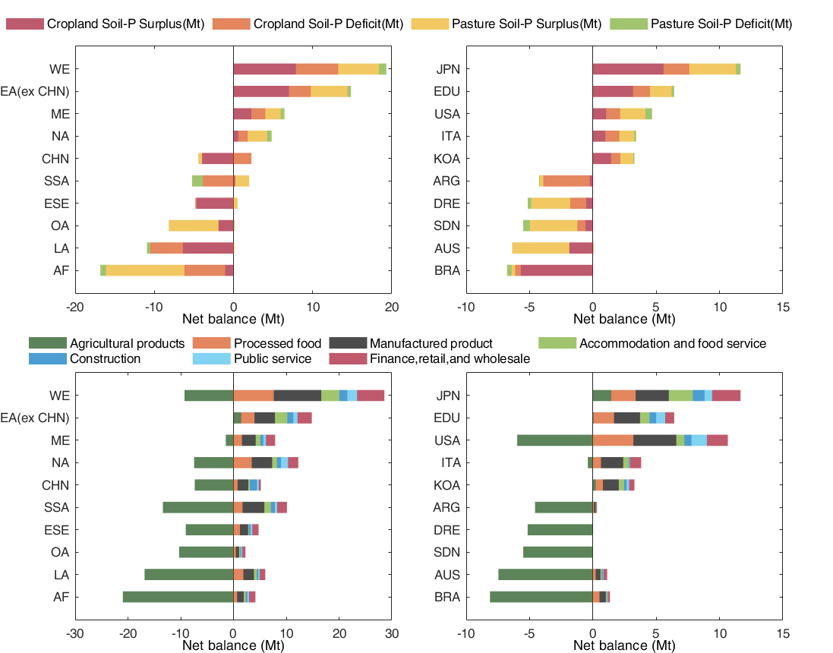
Results
Trade’s role in soil-P imbalance over 48 years (1970-2017)
  Analysis Period: 48 years (1970-2017)
  Focus: Total Trade Balance
  Regions: Ten aggregated regions.
  Top-Ranking Countries: Selected based on trade balance.
  Figure a, c shows regions. Figure b, d shows countries. Figure c,d show sectors.

Slide 22
Results
Spatially explicit soil-P hotspots exposed to trade
  Trade related cropland soil-P deficit hotspots are more numerous than others
    Pre-1990: Eastern Europe
    2010: China and Brazil
    2017: Brazil
  Cropland Soil-P Deficit Hotspots (2017)
    Africa: Ethiopia, Tanzania, Ghana, Cote d’Ivoire
    Latin America: South Brazil, North Argentina
    Asia: Myanmar, Vietnam, Malaysia
    Cropland Soil-P Surplus Hotspots (2017): Southeast Brazil, Ethiopia
    Pasture Soil-P Surplus Hotspots (2017): Australia, South Sudan, Ethiopia

Slide 23
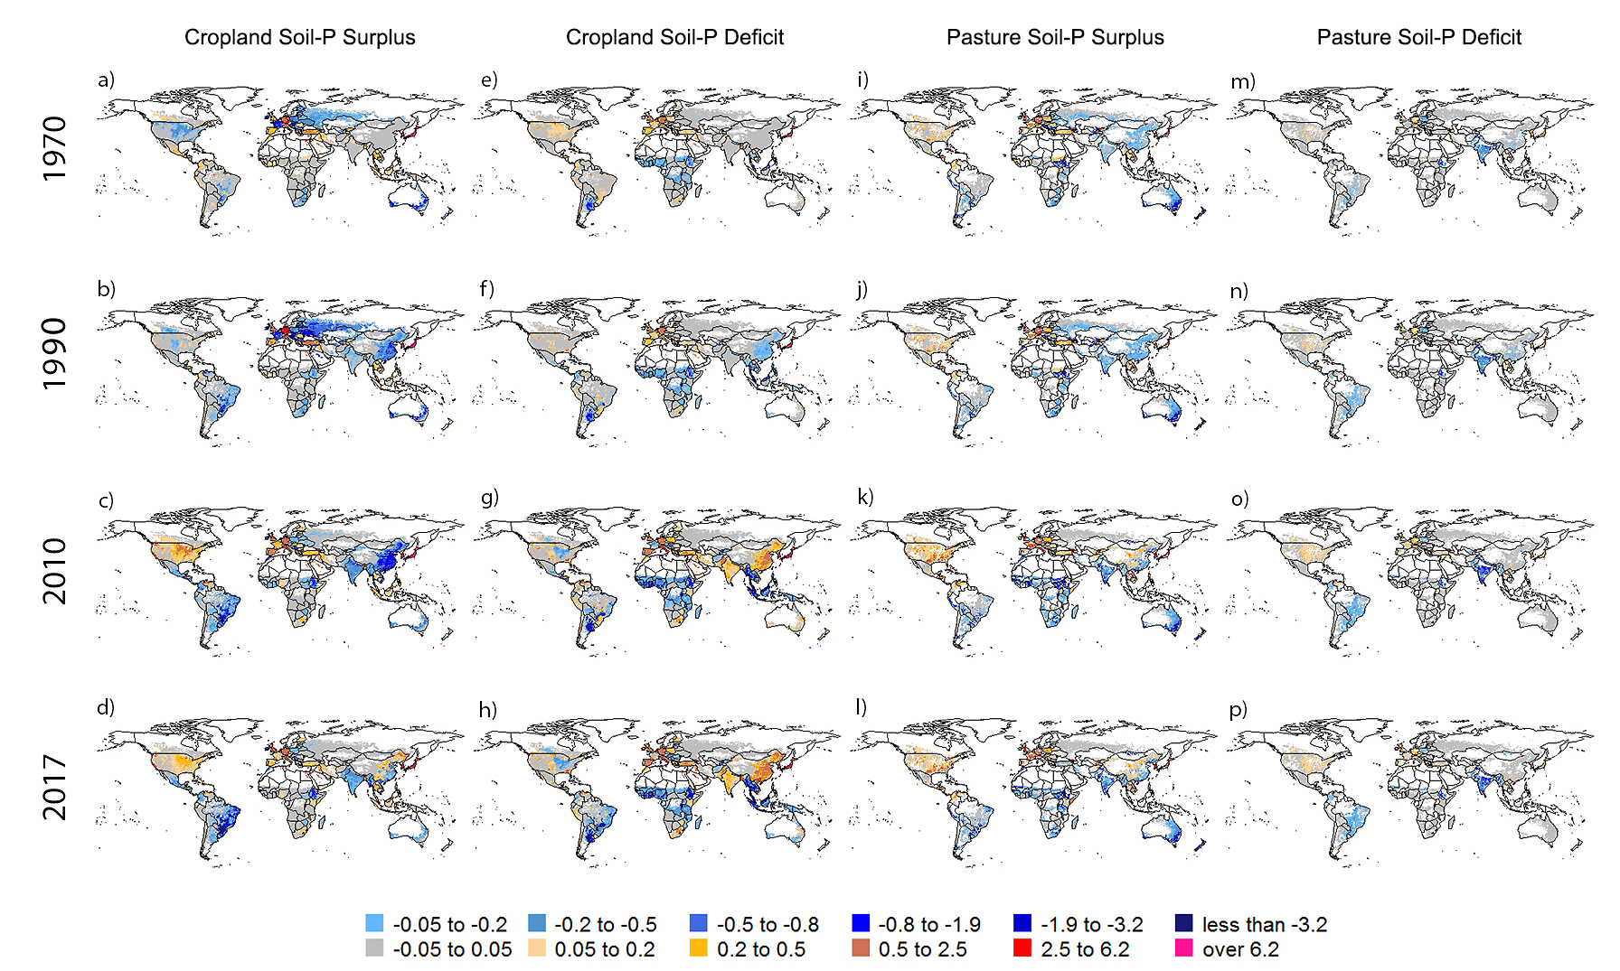
Results
Spatially explicit soil-P hotspots exposed to trade
  Data: Global spatial distribution of trade balance for soil-P surplus and deficit.
  Time Points: 1970, 1990, 2010, and 2017.
  Net Importers: Shades of red.
  Net Exporters: Shades of blue (deeper blue = larger net export volume per unit area).
  Near Equilibrium (-0.05 to 0.05 kg P ha-1 yr-1): Shades of grey.
  Interpretation: Grey areas represent a basic equilibrium between import and export.

Slide 24
Results
US and China Case Studies: Role of Trade
    China
  Soil-P surplus and deficit coexist in large land area countries like the US and China.
    Central Plains: Cropland soil-P deficit indicates a net export (driven by China's demand).
    Western US: Cropland soil-P deficit indicates a net import (Brazil's sugar, Malaysia's nut crops, Indonesia, and Argentina's pulses).
China imports virtual soil-P deficit embodied in Brazil's sugar crops, Argentina's pulse crops, and Malaysia's nut crops.
Southern China: Exports cropland soil-P surplus (vegetables & fruits) to US, Japan, and South Korea.
Northeast China: Imports soil-P surplus (pulse-related products) mainly from Brazil.
Eastern China: Pasture surplus (chicken) exported to the US.
Central China: Pasture surplus (cattle and sheep) imported from Australia.
United States

Slide 25
Discussion and conclusions
Key Findings
  Trade accelerates P-surplus-related environmental impacts in developing regions.
  Trade increasingly facilitates food security risks related to soil-P deficits.
  2017: Net trade balance of cropland soil-P deficit surpassed surplus.
  2017: Trade-related cropland soil-P deficit hotspots outnumbered surplus and pasture surplus hotspots.
  Africa: Faces increasing P-related environmental and food security risks due to high net export volume of both soil-P surplus and deficit.

Slide 26
Discussion and conclusions
Sustainable Management of P
  Requires a holistic approach: from domestic to international, and from production to consumption.
  Must cover both P-related environmental impacts and food security risks across global supply chains.
  Production:
    Identify spatial hotspots of soil-P surplus/deficit driven by international and domestic consumption (various crops and livestock).
    Implement targeted domestic measures.
  Consumption:
    Green procurement.
    Non-tariff barriers to cleaner technologies trade.
    Commitments to develop and adopt environmental regulations.

Slide 27
Discussion and conclusions
Regional Trade Agreements (RTAs) & Environmental Provisions
  97% of RTAs notified to the WTO include environmental provisions.
  Current environmental provisions have limited success in curbing P imbalances associated with trade.
  High-income countries/regions (Canada, EU, UK, US) have more detailed environmental provisions in their RTAs.
  87% of trade-related soil-P surplus impact occurs between developing economies or between developing and developed economies.
  Environmental provisions between developed/developing economies are often unspecified, lacking detail (information sharing, joint research, etc.), omitting definition of any mitigation actions.
  Lack of information leads to lack of action. Existing trade policies fail to curb trade-related P impacts.

Slide 28
Discussion and conclusions
Regional Trade Agreements (RTAs) & Environmental Provisions
Improving Trade Policies:
  Include detailed environmental information in existing RTAs.
  Add complementary environmental cooperation agreements.
  Enhance future trade agreements to avoid P-related food security and environmental impacts.

Slide 29
Discussion and conclusions
P-Related Food Security Issues
  Management of P-related food security lags behind management of P-related environmental risks.
  Comprehensive footprint research on P imbalances is missing from food security discussions.
  Addressing food security is integral to the WTO Agreement on Agriculture.
  Currently, WTO focuses on promoting exports by eliminating trade barriers.
  Eliminating trade barriers improves food availability, but promotes agricultural exports from regions like Africa, triggering nutrient depletion and food security risks.
  Requires factoring food security risks related to nutrient depletion into future agricultural trade provisions with Africa.

Slide 30
Thank you！

