Slide 1
Cross-Regional Transfer and Inequity Effects of Nutrients in Food Loss and Waste
Yang Ziyan
July 8, 2025
Food Loss and Waste July 8, 2025

Slide 2
Global Food Loss and Waste (FLW): A Critical Challenge
Agricultural trade aims to balance global food supply and demand.
However, cross-regional heat transfer in FLW significantly impacts
resource allocation and environmental equity, an underexplored issue.
Astonishing Scale: Over one billion tons of food are wasted globally every day.
This issue is a major challenge for global food security and sustainable development.
It links to multiple SDGs: Ending Hunger (SDG2), Reducing
Inequality (SDG10), Responsible Consumption and Production (SDG12), Climate Action (SDG13), and Protecting Ecosystems (SDG15).
Food Loss and Waste July 8, 2025

Slide 3
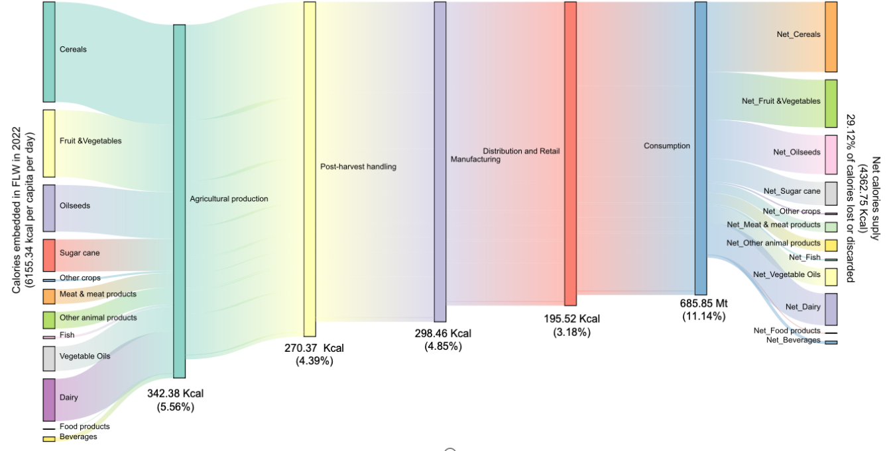
The Stark Reality of Hunger Amidst Waste
Approximately 733 million people face hunger, and over 2.8 billion cannot afford a healthy diet.
Annually, 1.3 billion tons of food are wasted, enough to feed 2 billion people – far exceeding the hungry population.
Key Insight: The global hunger problem stems not from insufficient production, but from inefficiency and unequal distribution in the food system.
Figure S2 Flows of calories (kcal per capita per day) embedded in FLW by food category generated along different stages of global FSC in 2022
Food Loss and Waste July 8, 2025

Slide 4
Unequal Burden: High-Income vs. Low-Income Countries
High-income countries experience the most significant food waste (FW) heat loss, accounting for 35.21% of the global total.
This annual FW heat loss in high-income countries alone could feed
733 million hungry people for 1.45 years.
This highlights ”heat deprivation” in low-income regions within the global supply chain.
Low-income groups face resource scarcity and intensified
environmental pressure from high-income countries’ wasteful behaviors.
Food Loss and Waste July 8, 2025

Slide 5
Comprehensive Assessment Framework
Developed to reveal FLW’s cross-regional heat transfer mechanism and its multi-level impact.
Integrated Approach: Combines Input-Output (IO) analysis, Life Cycle Assessment (LCA) , and mass balance methods.
Data Sources: FAOSTAT Physical Balance Sheet , FAO bilateral trade data, and Exiobase input-output data.
Scope: Global food balance sheet and nutrient loss database covering
49 countries/regions, 95 agricultural products, and five supply chain links (2010-2022).
Quantifies macronutrient (calories, protein, fat, carbohydrates) and micronutrient losses (vitamins A, C, B6, B12; minerals iron, zinc, calcium, magnesium).
Food Loss and Waste July 8, 2025

Slide 6
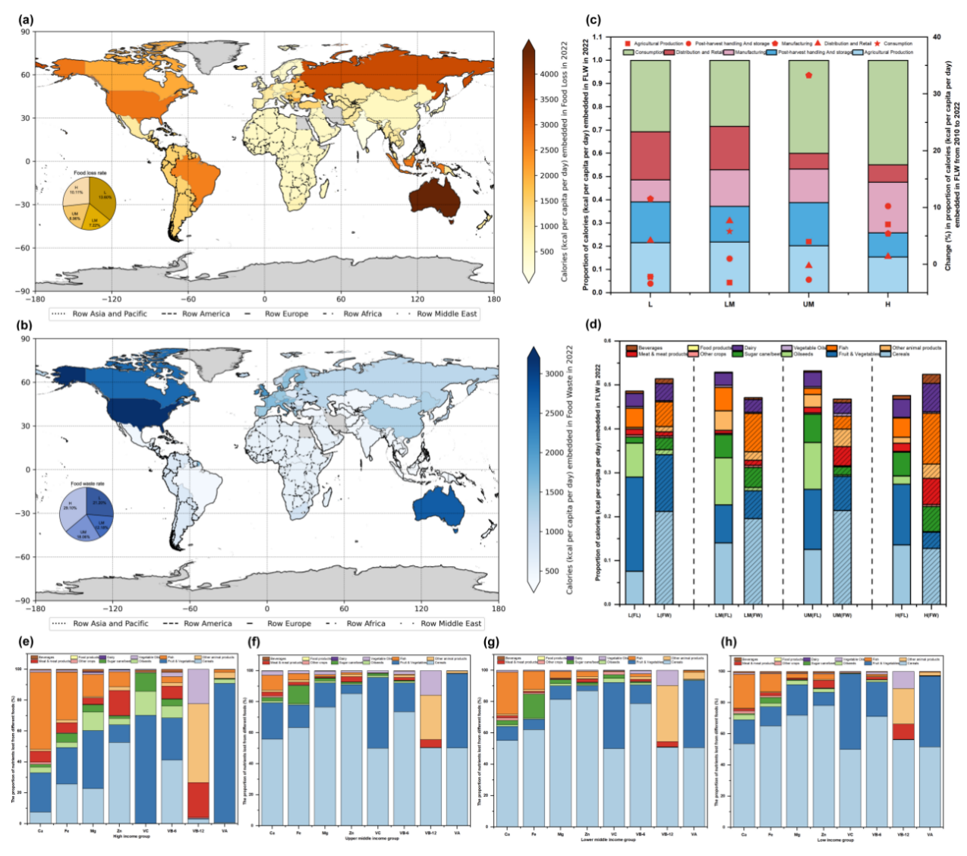
Nutrient Loss: Macronutrients
In 2022, global calorie loss due to FLW was 50355.26 billion kilocalories (1792.59 kcal/capita/day). This is enough to feed 733 million hungry people worldwide.
Spatial Differences:
Low-income countries: Loss mainly in production, post-harvest, storage, and transport.
High-income countries: Loss concentrated in retail and consumption stages.
Figure 1. Global distribution characteristics of nutrients embedded in FLW
Food Loss and Waste July 8, 2025

Slide 7
Nutrient Loss: Micronutrients and Food Categories
Severe loss of key micronutrients: e.g., 11472.95 tons of Vitamin A (34.9% of global adult recommended intake).
High-value nutrients (e.g., meat, dairy) are wasted significantly in high-income countries, leading to nutritional resource mismatch.
FLW Composition Differences:
Low-income: Fruits (43.19%) and grains (15.72%), primarily upstream.
High-income: Dairy (231.76 kcal/capita/day), meat (212.64 kcal/capita/day), beverages (73.71 kcal/capita/day) at
retail/household levels .
Figure 1d and 1e-h show distribution by food category and income
Food Loss and Waste July 8, 2025

Slide 8
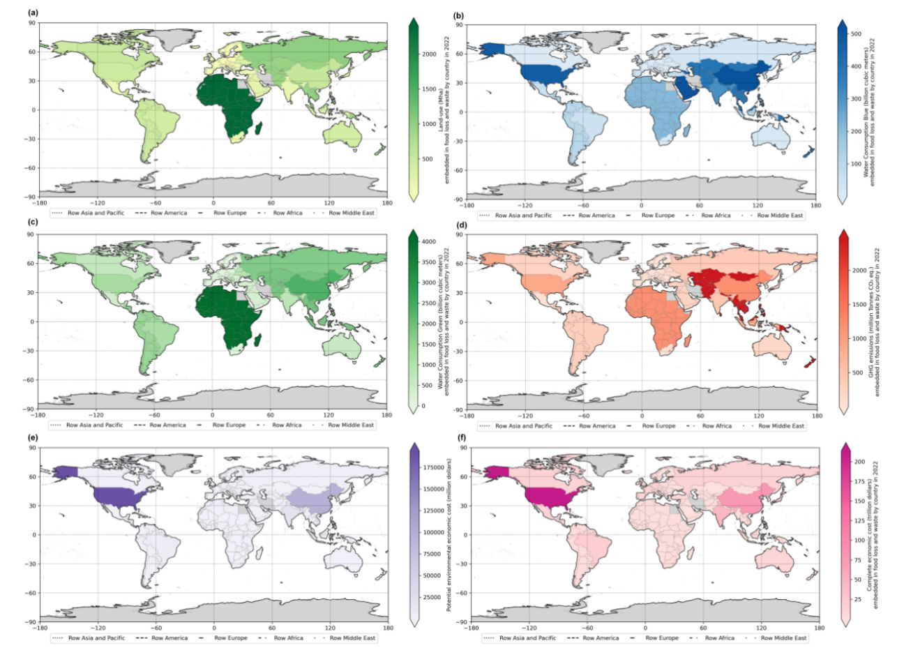
Environmental Footprint of FLW
Global FLW (2022):
26.55 million hectares of agricultural land.
125.037 billion cubic meters of blue water.
281.042 billion cubic meters of green water.
2713.84 million tons of CO2 equivalent GHG emissions.
Figure 2. Land use, water use, greenhouse-gas emissions, greenhouse-gas emissions, potential environmental economic cost and complete economic lost embedded in FLW generated along global food supply chains.
Food Loss and Waste July 8, 2025

Slide 9
Environmental Footprint of FLW
Economic Costs:
Potential environmental economic costs: $354.10 billion USD.
Total economic loss: $19.32 trillion USD.
US ($6.18 trillion) and China ($1.66 trillion) rank highest in economic losses.
Figure 2. Land use, water use, greenhouse-gas emissions, greenhouse-gas emissions, potential environmental economic cost and complete economic lost embedded in FLW generated along global food supply chains.
Food Loss and Waste July 8, 2025

Slide 10
Transboundary Inequity in Environmental Pressure
Environmental pressures show clear spatial heterogeneity.
Producer Countries (Low/Middle-Income): India, Vietnam, Brazil
bear main land/water pressure but gain less from global food trade.
Consumer Countries (High-Income): US (412 million tons CO2 eq.) and Germany (200 million tons CO2 eq.) disproportionately affect environment due to high consumption.
This imbalance exacerbates structural contradictions in global
environmental governance, particularly impacting developing countries.
Food Loss and Waste July 8, 2025

Slide 11
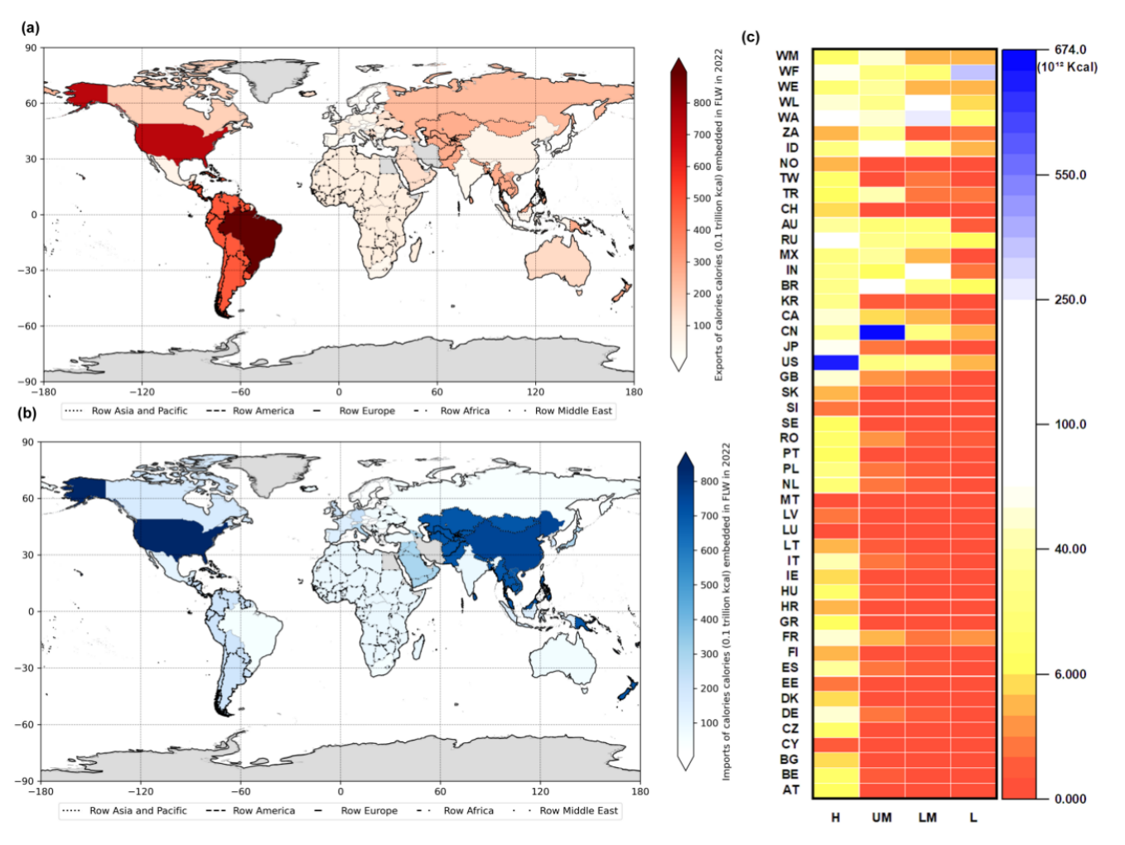
Cross-Border Heat Flow and Dual Imbalance
Global export of heat-embedded FLW is highly concentrated in
countries like Brazil (8.97 trillion kcal) and the US (7.38 trillion kcal).
Major calorie importers are high-income economies: US (8.42 trillion kcal), China (7.55 trillion kcal), Japan (2.81 trillion kcal).
Dual Imbalance: ”Resource dissipation at the production end and excessive waste at the consumption end”.
Figure 3. Calories (kcal per capita per day) embedded in trade-embedded FLW by country
Food Loss and Waste July 8, 2025

Slide 12
Heat Transfer and Systemic Flaws
Current cross-border heat transfer does not optimize global resources; it highlights systemic flaws.
High-income countries (e.g., US: 6,492.98 kcal/capita/day FLW
embedding) import vast amounts of calories, much of which is wasted
.
Low-income countries (e.g., Brazil: 271.13 kcal/capita/day FLW
embedding, 8.97 trillion kcal exports) show severe imbalance between resource output and nutrient acquisition.
This concentrates negative effects (environmental pressure, resource consumption, nutrient loss) on vulnerable producing countries.
Food Loss and Waste July 8, 2025

Slide 13
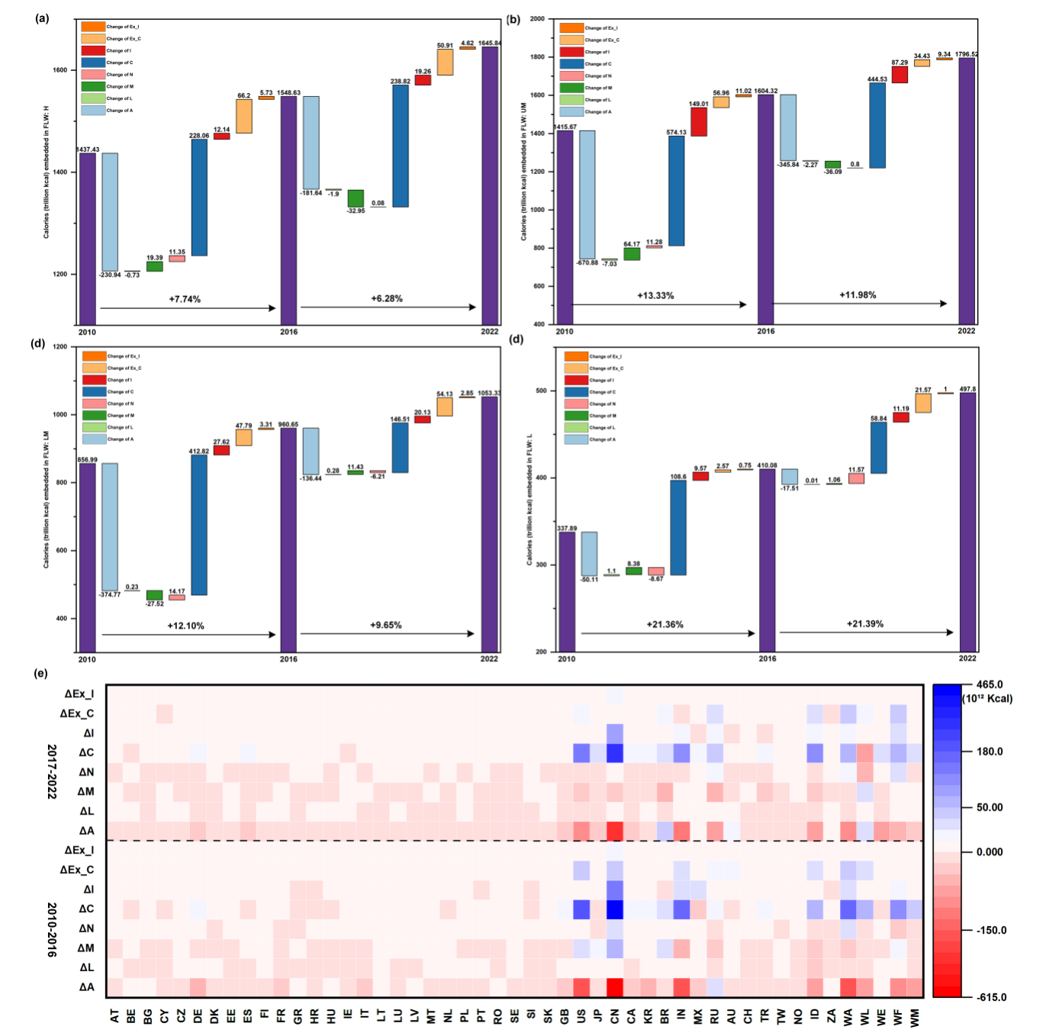
Driving Mechanisms of FLW Expansion
FLW growth varies significantly across income groups (2010-2022).
High-Income: Driven by export-driven consumption (∆Ex C) and domestic consumption (∆C).
Figure 4. Driving factors to the evolution of calories (kcal per capita per day) embedded in FLW
Food Loss and Waste July 8, 2025

Slide 14
Driving Mechanisms of FLW Expansion
Upper-Middle-Income: ∆C is the largest contributor.
Low-Income: Driven by domestic investment (∆I) and export-driven investment (∆Ex I).
Overall, consumption and exports in high-income countries exacerbate terminal waste, while lower-income countries bear systemic losses at the production stage.
Figure 4. Driving factors to the evolution of calories (kcal per capita per day) embedded in FLW
Food Loss and Waste July 8, 2025

Slide 15
Scenario Analysis: FLW Reduction Benefits
Simulated three FLW reduction scenarios (10%, 25%, 50%) based on SDG 12.3.
Nonlinear Correlation: FLW reduction is nonlinearly positively correlated with resource efficiency improvement.
10% reduction: Water consumption (WC GA) decreases by ∼ 1.9%. 25% reduction: WC GA decreases to 18.31%.
50% reduction: WC GA decreases to 45.54%.
Marginal benefit significantly increases when reduction intensity exceeds 25%.
Figure 5. Scenario analysis
Food Loss and Waste July 8, 2025

Slide 16
Policy Recommendations
Phased and Differentiated Policies:
Short-term (2025-2030): Consumer education, supply chain monitoring.
Medium/Long-term (2030-2035): Retail waste taxation, cold chain tech subsidies, international FLW trading market.
Strengthen Cross-Border Cooperation:
FAO to formulate differentiated responsibility framework.
Special funds for capacity building in low-income countries.
Promote technological innovations (smart preservation, waste energy utilization).
Assume Consumer Responsibility (High-Income): FLW reporting, improved food tax, public education, corporate compliance.
Support Low-Income Countries: Cold chain networks, primary processing facilities, trade fair certification.
Implement ”Resource Responsibility Labeling Mechanism”
incorporating heat, carbon, water into trade agreements.
Food Loss and Waste July 8, 2025

Slide 17
Limitations and Future Research
Heat Inequality Framework: Primarily focuses on economic income, but needs to incorporate other social dimensions (gender, ethnicity, urban-rural identity).
Geographical Scope: Based on inter-country trade flow; lacks
coverage of intra-country food flow (urban-rural) and FLW
responsibilities, potentially underestimating ”hidden heat deprivation”.
Special Paths: Did not systematically consider heat transfer in aid food or refugee camp distribution.
Future Work: Integrate variables like population structure, climate pressure, supply chain resilience. Incorporate more inequality
indicators and consistent global datasets for dynamic simulations.
Food Loss and Waste July 8, 2025

Slide 18
Conclusion
Thank you !
Food Loss and Waste July 8, 2025

