Slide 1


Multi-regional Input-output Dataset for the UK from 2017 to 2022
Qianhong Ouyang
School of Statistics and Institute of National Accounts
Beijing Normal University
qianhong.ouyang@mail.bnu.edu.cn
For the 31st. IIOA Maldives, July 2025

Slide 2
CONTENTS
01 / Background
02 / Research Gaps
03 / Overview of This Study
04 / Methodology
05 / Data Records
06 / Data Validation
07 / Discussion

Slide 3
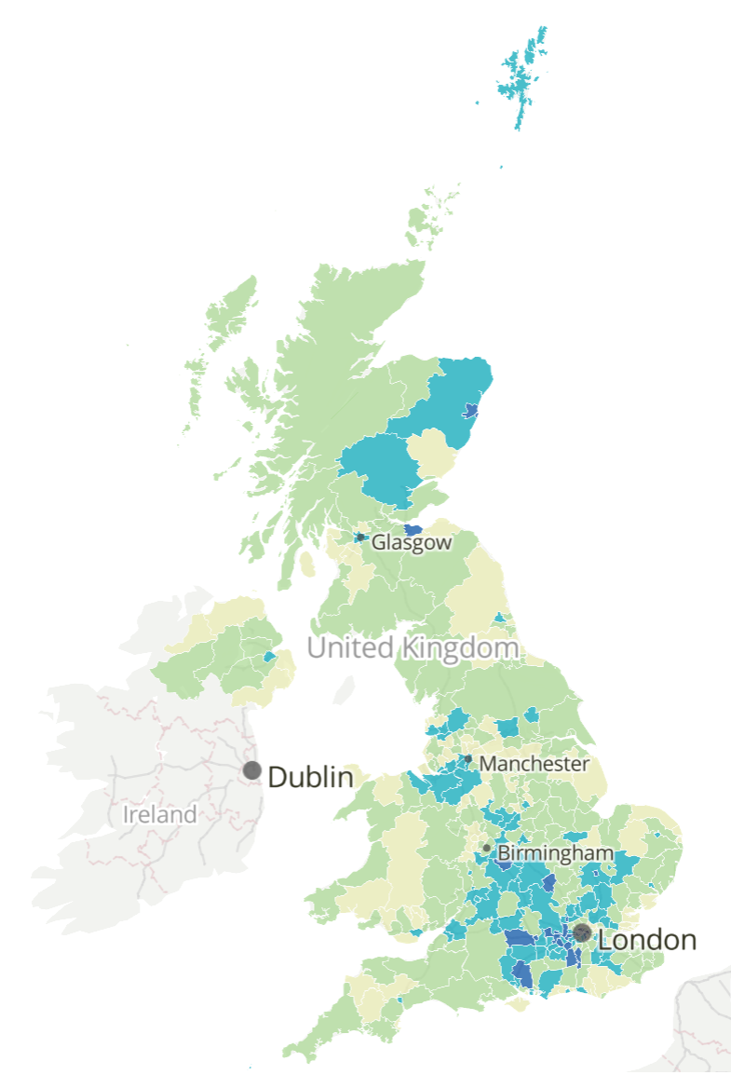
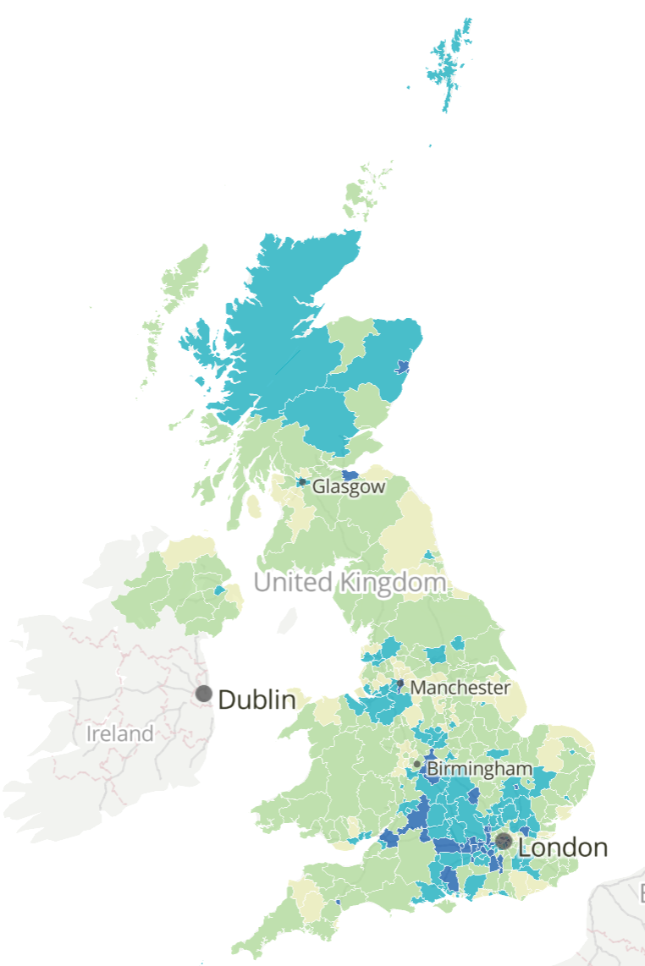
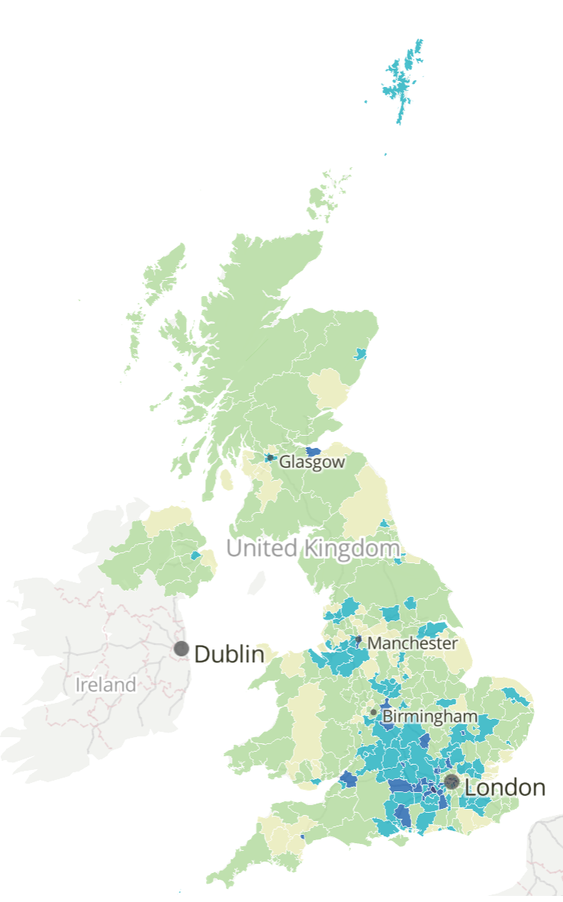
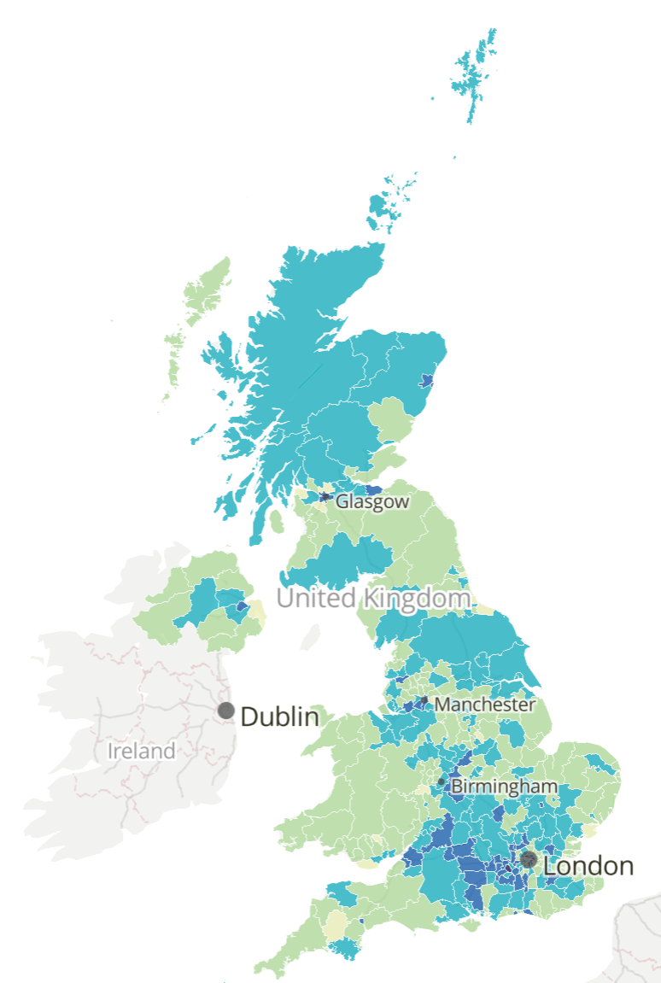
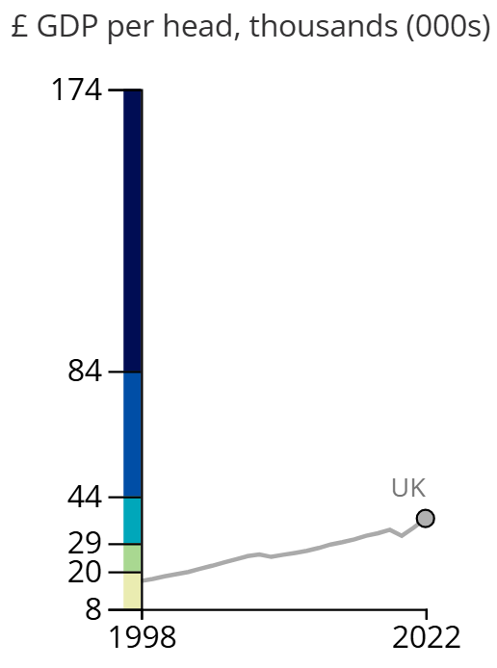
1
Background
2016
2018
Regional disparities in the UK
01
As the sixth-largest economy in the world, the UK incorporates global financial and trade hubs such as London, Birmingham and Glasgow.
However, internal disparities among regions remain significant.
In 2022, London contributes 23% of GDP, Scotland: 7%, North East: <3%
In the face of external shocks, regional resilience also varies.
2020
2022
Motivation of the study
02
Post-Brexit economic shifts.
Heterogeneous effects of supply chain disruptions.
Environmental spillover effects (carbon dioxide, pollution, energy) follow supply chains.
Understand the space-time evolution of the supply chain.
Gross domestic product per head for UK local authorities (ONS)

Slide 4
2
Research Gaps
Most existing MRIO tables are at international-level. Sub-national and city-level MRIO databases are emerging rapidly as they can capture more detailed heterogeneity.
International: GTAP, WIOD, EXIOBASE, Eora, …
MRIO Database
Subnational level based on survey: IMPLAN
Subnational/City-level based on LQ: IELab in AU, CN, JP, …
Subnational/City-level based on CB and Entropy: CEADs
Challenges:
Inadequate sub-national resolution (e.g. lack of sectors)
Substantial data requirements and a significant workload
Usually out of date because source data are not published on a regular basis

Slide 5
2
Research Gaps
To the best of our knowledge, however, very few studies have focused on the inter-regional and inter-industrial structures of the UK.
The most comprehensive UK MRIO database is EU-REGIO, which includes all European Union countries at NUTS 2 region level from 2000 to 2010(M. Thissen et al. 2017).
Later, the authors updated the inter-regional trade data to 2013 from various sources such as BACI, ETIS-Plus, and UN trade in services database(M. Thissen et al. 2019).
Recently, the database is further updated to 2018 through combining aggregated road freight flows data in 2019 with the 2013 trade structure data(Huang and Koutroumpis 2023). However, it only includes 10 sectors.
We lack high-resolution regional dataset for studying economic and policy issues in the UK.

Slide 6

3
Overview of This Study
To overcome the research gaps, we construct UK MRIO tables from 2017 to 2022 using a hybrid approach of both “top-down” and “bottom-up” methodologies, combining officially published data with entropy-based stimulation. The similar method has been successfully applied to subnational level MRIO model development for China(Zheng et al. 2021) and Russia(Li et al. 2024).
Our dataset covers 12 International Territorial Level 1 (ITL-1) regions of the UK with 105 sectors over the period, ensuring consistency and compatibility with the UK’s national industry-by-industry input-output table.
All underlying data are open access through the UK’s Office of Nation Statistics (ONS) official websites, and most of them are updated annually.
The period from 2017 to 2022 reflects the UK’s transition after the announcement of Brexit in 2016, and economic shock caused by actual leaving the EU in 2020, as well as other impacts like the Covid-19 pandemic, the immigration waves and Russo-Ukrainian War. This dataset could offer a solid basis for diverse economic, social and environmental analyses, especially regarding interregional trade, regional disparity, and the environmental impacts of economic activities.

Slide 7
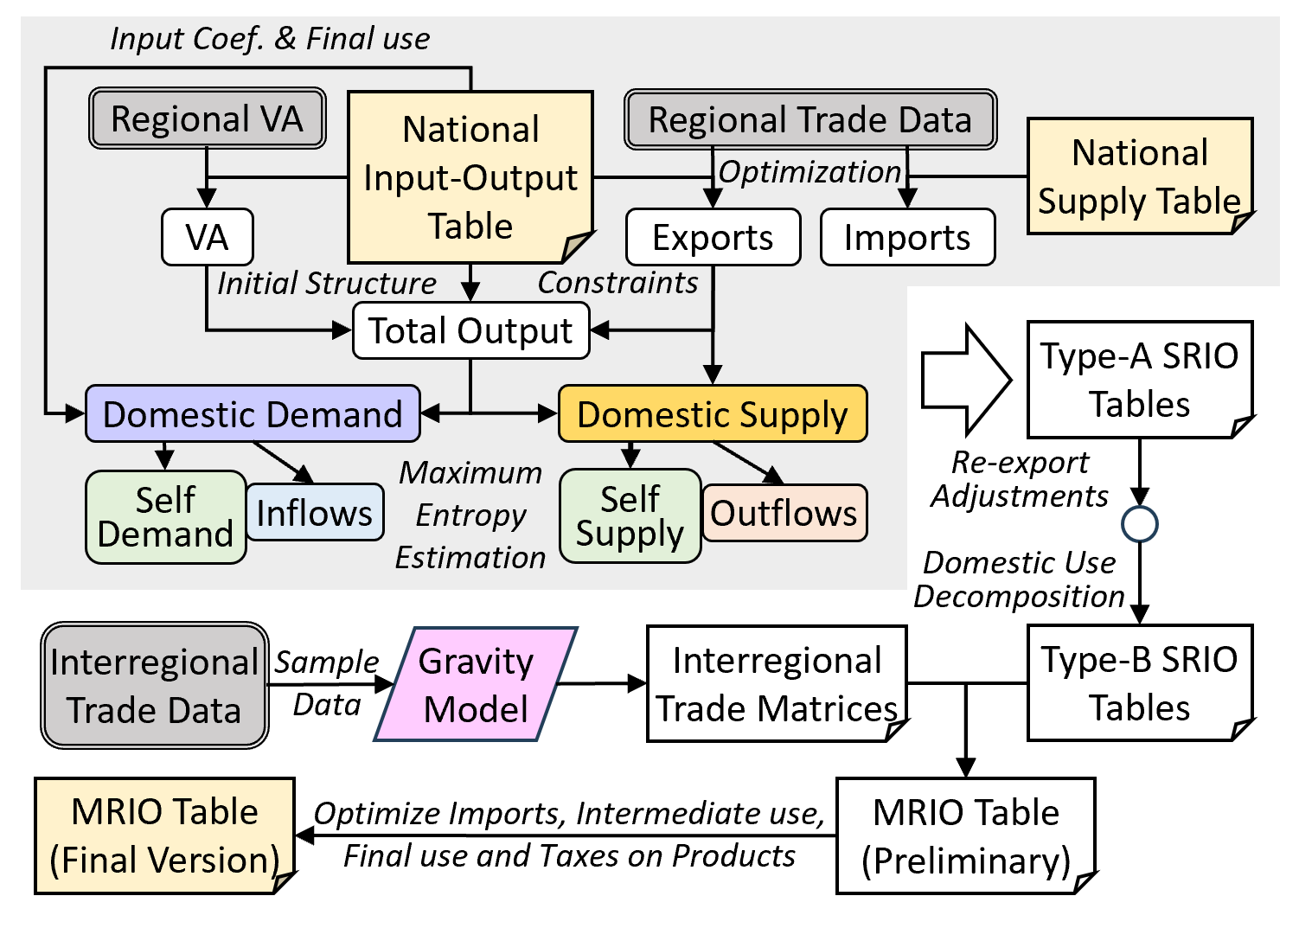
3
Overview of This Study
Overview of our methodology

Slide 8
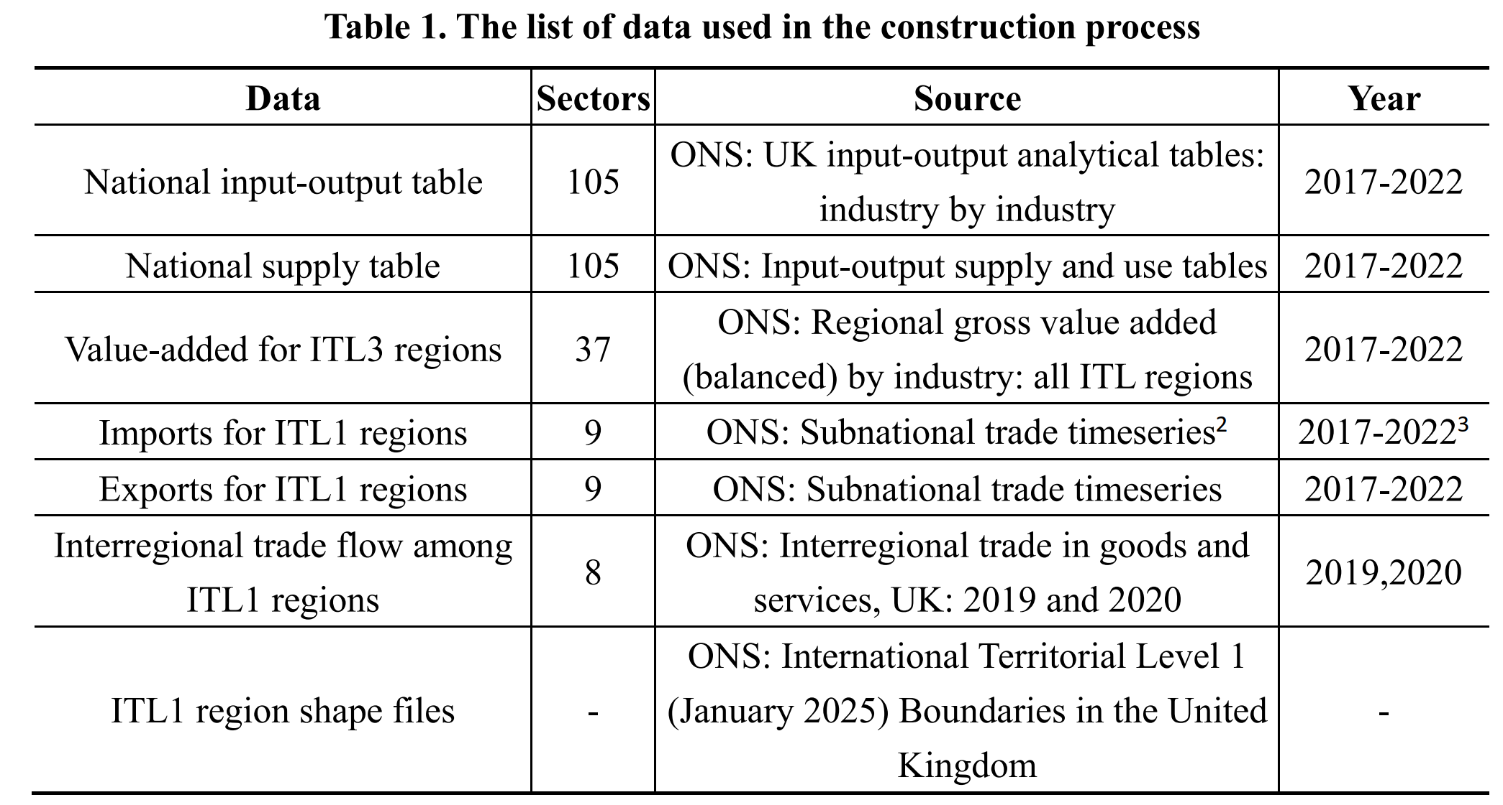
4
Methodology
Data Source
Preprocessing
Total Output Estimation
Supply & Demand
Regional SRIO
Interregional Trade
Finalization of MRIO
All data used in this study are open access and updated annually by the ONS, except for the interregional trade flow data, which are not updated on a regular schedule. We use the trade data in 2019 to compile MRIO for the years 2017 to 2019, and the trade data in 2020 for the years 2020 to 2022.

Slide 9
4
Methodology
Harmonizing the classification of sectors
The target classification of industries contains all 105 sectors from the national IOT.
To harmonize the other data, we construct concordance matrices based on the 2007 version of UK Standard Industrial Classification (114 sectors)
Data Source
Preprocessing
Total Output Estimation
Supply & Demand
Regional SRIO
Interregional Trade
Finalization of MRIO
Adjusting extreme values in the National IOT (NIOT)
If “change in inventories” << 0 or “acquisitions less disposals of valuables” << 0, it is possible that exports > total output, causing the estimates of domestic use < 0.
We deduct those big negative values along with equal values of exports before other steps and proportionally add them back in the end.
Initializing the regional exports and imports
Due to limitation of survey or confidential purpose, regional exports and imports contain missing values.
We use the export data from the NIOT and import data from the national supply table as constraints, to fill the blanks and preserve the regional structure as much as possible.

Slide 10
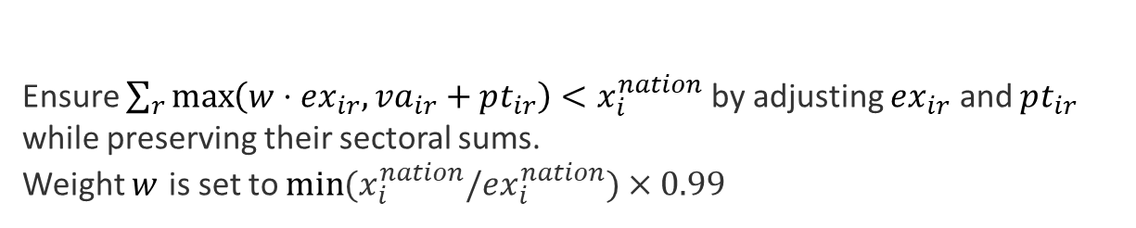

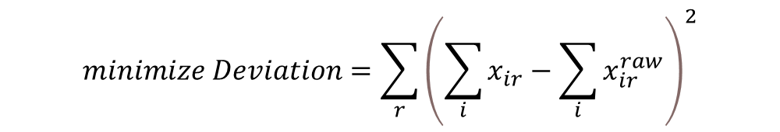
4
Methodology
Initial Estimation
01
Data Source
Preprocessing
Total Output Estimation
Supply & Demand
Regional SRIO
Interregional Trade
Finalization of MRIO
GDP: use regional data and NIOT data as constraints.
Total output: use the structure of GDP to break down the NIOT data.
Taxes less subsidies on products: fixed product tax coefficients assumption.
Boundary Adjustment
02
Ensure $\sum_{r}{\max\left(w⋅ex_{ir}, va_{ir}+pt_{ir}\right)}<x_{i}^{nation}$ by adjusting $ex_{ir}$ and $pt_{ir}$ while preserving their sectoral sums.
Weight $w$ is set to $min⁡(x_{i}^{nation}/ex_{i}^{nation})×0.99$
Optimization
03
$$minimize Deviation=\sum_{r}{{\left(\sum_{i}{x_{ir}}−\sum_{i}{x_{ir}^{raw}}\right)}^{2}}$$
Subject to $\left\{\begin{aligned}&\max\left(w⋅ex_{ir}, va_{ir}+pt_{ir}\right)<x_{ir} \\ &\sum_{r}{x_{ir}}=x_{i}^{nation}\end{aligned}\right.$

Slide 11
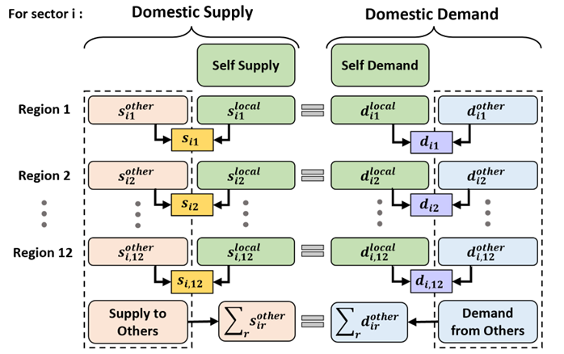
4
Methodology
We estimate the domestic supply and demand for each region to facilitate the estimation of interregional trade. The Domestic supply and demand can be further broken down into supply (demand) for the regional itself and for the others.
For any sector i, regional supply and demand data follow a series of equations.
Data Source
Preprocessing
Total Output Estimation
Supply & Demand
Regional SRIO
Interregional Trade
Finalization of MRIO

Slide 12
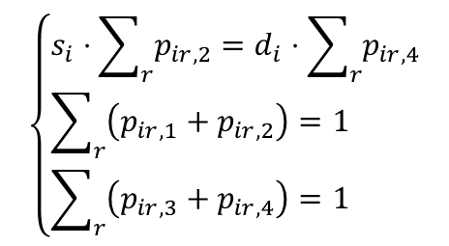
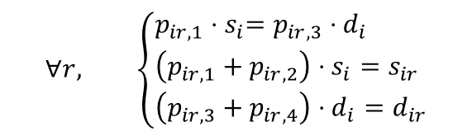
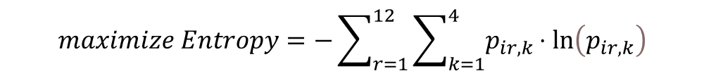


4
Methodology
Initial Estimation
01
$$s_{ir}=x_{ir}−ex_{ir}$$
Data Source
Preprocessing
Total Output Estimation
Supply & Demand
Regional SRIO
Interregional Trade
Finalization of MRIO
Estimates of supply:
Estimates of demand:
$d_{ir}=\frac{d_{ir}^{raw}}{\sum_{r}{d_{ir}^{raw}}}⋅\sum_{r}{s_{ir}}$ where $d_{ir}^{raw}=\sum_{j}{z_{ijr}^{raw}}+tf_{ir}^{raw}$ and
$$\left\{\begin{aligned}z_{ijr}^{raw}=a_{ij}^{nation}x_{jr} \\ tf_{ir}^{raw}=\frac{\sum_{j}{z_{ijr}^{raw}}}{\sum_{j}{z_{ij}^{nation}}}⋅\sum_{k=1}^{6}{f_{ik}^{nation}}\end{aligned}\right.$$
(intermediate use)
(final use)
Supply-and-Demand Balance
02
$$maximize Entropy=−\sum_{r=1}^{12}{\sum_{k=1}^{4}{p_{ir,k}⋅ln\left(p_{ir,k}\right)}}$$
$$\left(∀r,k, p_{ir,k}>0\right)$$
$$\left\{\begin{aligned}&s_{i}⋅\sum_{r}{p_{ir,2}}=d_{i}⋅\sum_{r}{p_{ir,4}} \\ &\sum_{r}{\left(p_{ir,1}+p_{ir,2}\right)}=1 \\ &\sum_{r}{\left(p_{ir,3}+p_{ir,4}\right)}=1\end{aligned}\right.$$
$$∀r, \left\{\begin{aligned}&p_{ir,1}{⋅s}_{i}=p_{ir,3}⋅d_{i} \\ &\left(p_{ir,1}+p_{ir,2}\right)⋅s_{i}=s_{ir} \\ &\left(p_{ir,3}+p_{ir,4}\right)⋅d_{i}=d_{ir}\end{aligned}\right.$$
Subject to
and

Slide 13
4
Methodology
To compile SRIO for each region, we:
Update Z and F with supply(outflow) and demand(inflow) data. Use RAS to balance them.
Estimate the re-export components of inflow and outflow data and removed them.
Split Z and F to transform Type A table to Type B
Z
F
ex
x
Data Source
Preprocessing
Total Output Estimation
Supply & Demand
Regional SRIO
Interregional Trade
Finalization of MRIO
if
iff
Z
F
ex
-im
of
-if
x
im
imf
pt
ptf
pt
ptf
va
Note: of = outflow, if = inflow,
pt = Tax less subsidies on products
off, iff and ptf are their final demand ver.
va
x’
x’

Slide 14
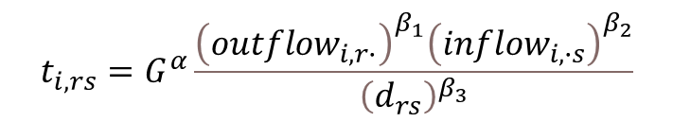
4
Methodology
Although the interregional trade flow data provided by the ONS are already the result data we desired in theory, we cannot use them directly due to:
They are estimated data and contain missing values like the import and export data.
They have only 8 aggregated industries with no financial sector.
The other data (e.g. value-added, total output, …) cannot be coerced to match the results in trade flow data simultaneously.
Data Source
Preprocessing
Total Output Estimation
Supply & Demand
Regional SRIO
Interregional Trade
Finalization of MRIO
Therefore, we take them as sample data in the gravity model, improving the model’s accuracy and reliability. The model assumes that the trade between two regions is the function of supply and demand and the impedance in costs (distance between regions):
$$t_{i,rs}=G^{α}\frac{{\left(outflow_{i,r∙}\right)}^{β_{1}}{\left(inflow_{i,∙s}\right)}^{β_{2}}}{{\left(d_{rs}\right)}^{β_{3}}}$$
$$\ln\left(t_{i,rs}\right)=α+β_{1}ln⁡(outflow_{i,r∙})+β_{2}ln⁡(inflow_{i,∙s})+β_{3}\ln\left(d_{rs}\right)$$
8 sets of coefficients are estimated and matched with 105 sectors. Financial sector uses the overall coefficients for all service sectors.

Slide 15
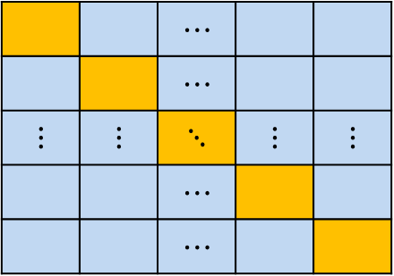
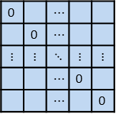

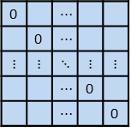

4
Methodology
The final step is to link the SRIO tables with trade matrices to form MRIO. They take up the diagonal matrices and off-diagonal matrices, respectively.
Data Source
Preprocessing
Total Output Estimation
Supply & Demand
Regional SRIO
Interregional Trade
Finalization of MRIO
Trade matrices
Z & F layout of MRIO
Z & F from SRIO
0 |  | $$⋯$$
 | 0 | $$⋯$$
$$⋮$$ | $$⋮$$ | $$⋱$$ | $$⋮$$ | $$⋮$$
 |  | $$⋯$$ | 0
 |  | $$⋯$$ |  | 0
 |  | $$⋯$$
 |  | $$⋯$$
$$⋮$$ | $$⋮$$ | $$⋱$$ | $$⋮$$ | $$⋮$$
 |  | $$⋯$$
 |  | $$⋯$$
$$⋱$$
0 |  | $$⋯$$
 | 0 | $$⋯$$
$$⋮$$ | $$⋮$$ | $$⋱$$ | $$⋮$$ | $$⋮$$
 |  | $$⋯$$ | 0
 |  | $$⋯$$ |  | 0
$$⋱$$
Note that trade flow matrices only contain data from region r to region s (105 * 12 * 12). We calculated the inflow purchase coefficients to further distinguish supplier sectors, yielding 105 * 105 * 12 * 12 pieces of data (matrices on the diagonal blocks are 0).
Finally, we iteratively adjust the imports matrix to match the NIOT. We then use the RAS method to optimize Z and F matrices in MRIO.
The negative values in F are balanced with the NIOT separately.

Slide 16
5
Data Records

Slide 17
6
Data Validation
Input-output balance
Row sums and column sums are identical (difference < 1e-9)
Negative values
Negative values only appear in:
Change of inventories and acquisition less disposal of valuables in final demand and imports
Taxes less subsidies on products.
Gross surplus and mixed income, and taxes less subsidies on production in value-added.
Compare with the NIOT: Part 1
We aggregate the MRIO by region (and by sector for imports) to match with the shape of the NIOT.
Comparison shows that our table are identical with the NIOT in value-added, imports, exports, total output and the column sum of intermediate use.

Slide 18
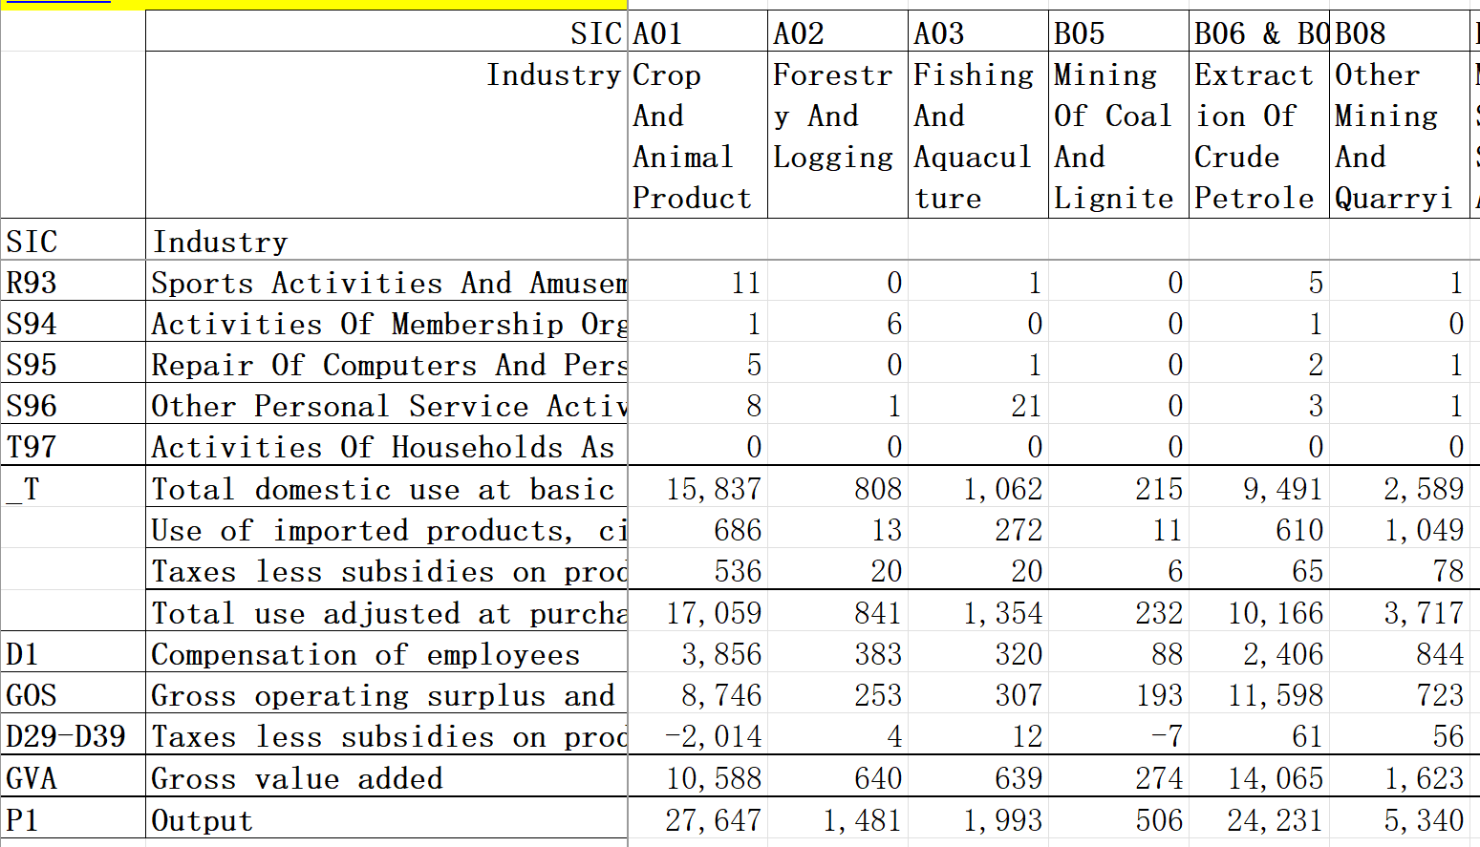
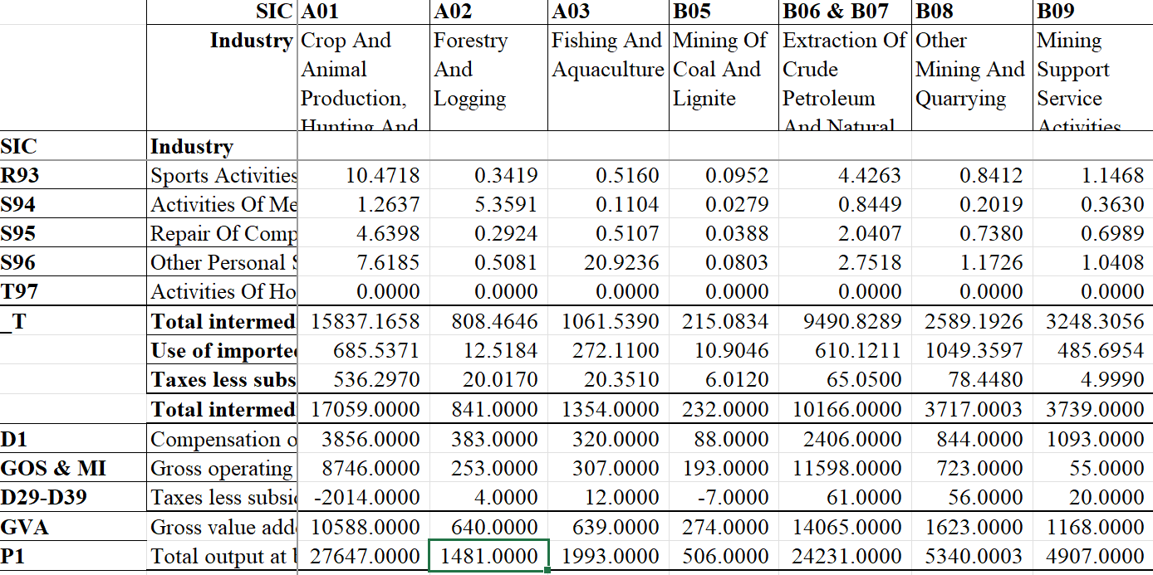
6
Data Validation
Compare with the NIOT: Part 1
NIOT from ONS in 2017
Aggregated MRIO in 2017
This is an illustration of the same slice of the input-output table from ONS and from our dataset.

Slide 19
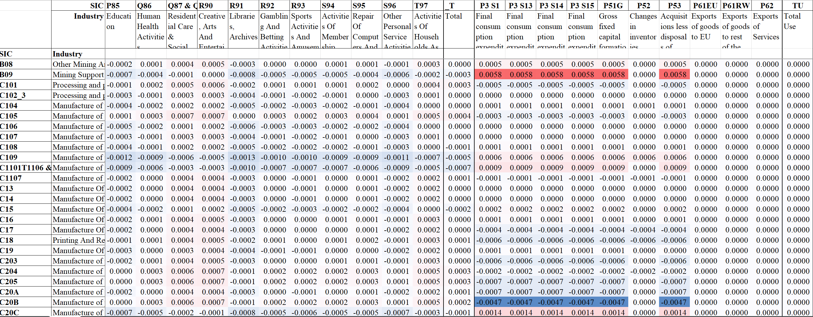
6
Data Validation
Compare with the NIOT: Part 2
We calculated the deviation table = (aggregated MRIO - NIOT) / NIOT
The biggest deviation between our table and the NIOT in 2017

Slide 20
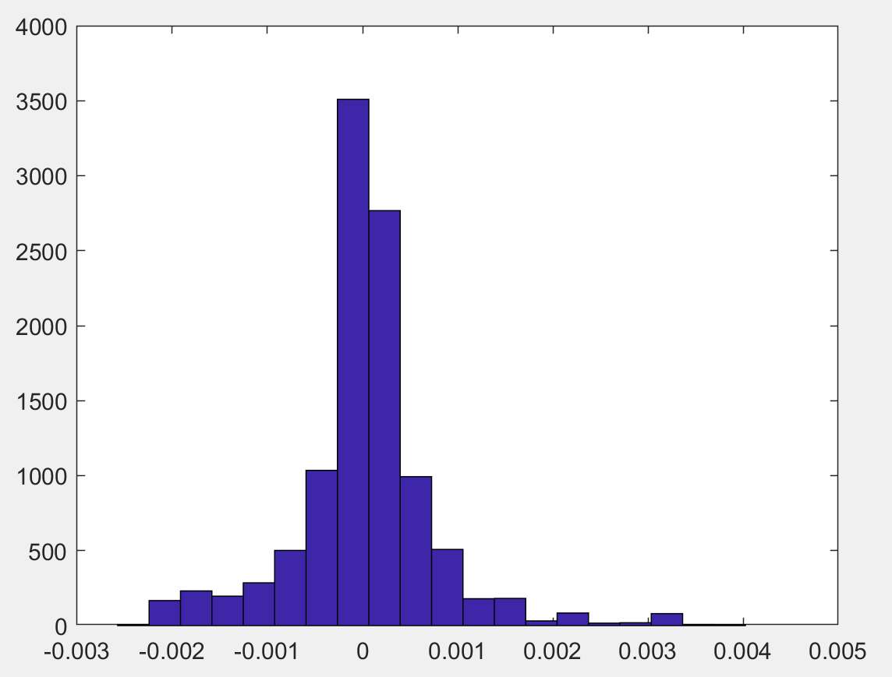
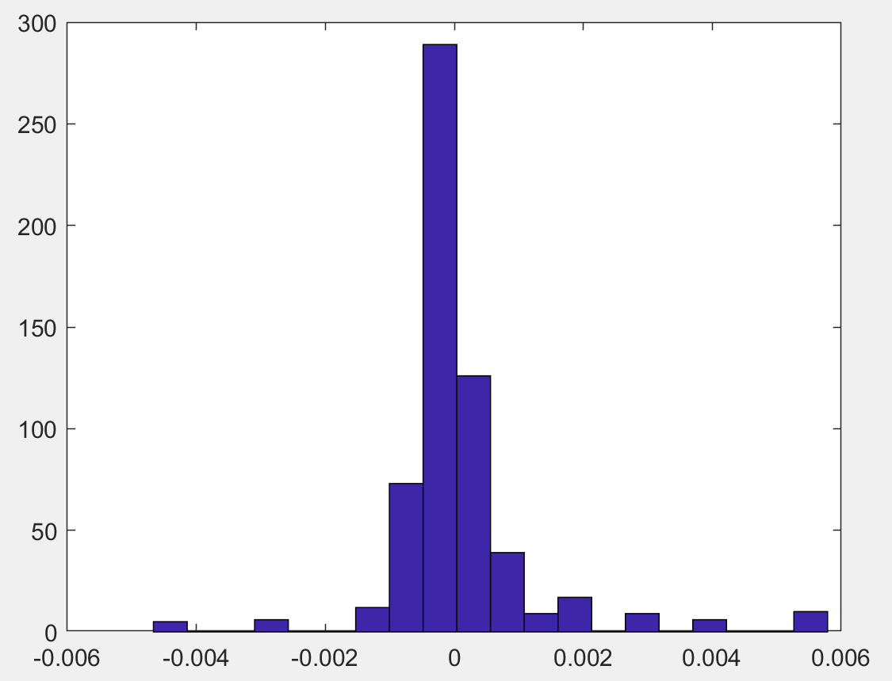
6
Data Validation
Compare with the NIOT: Part 2
Although the column sums of Z and the row sums of Z + F match those in the NIOT, some discrepancies are still observed, as shown in the last figure.
Overall, all the deviances do not exceed 2%, and most of them are less than 0.1% as shown in the histograms below.
Frequency
Deviation of Z from the NIOT in 2017
Deviation of F from the NIOT in 2017

Slide 21
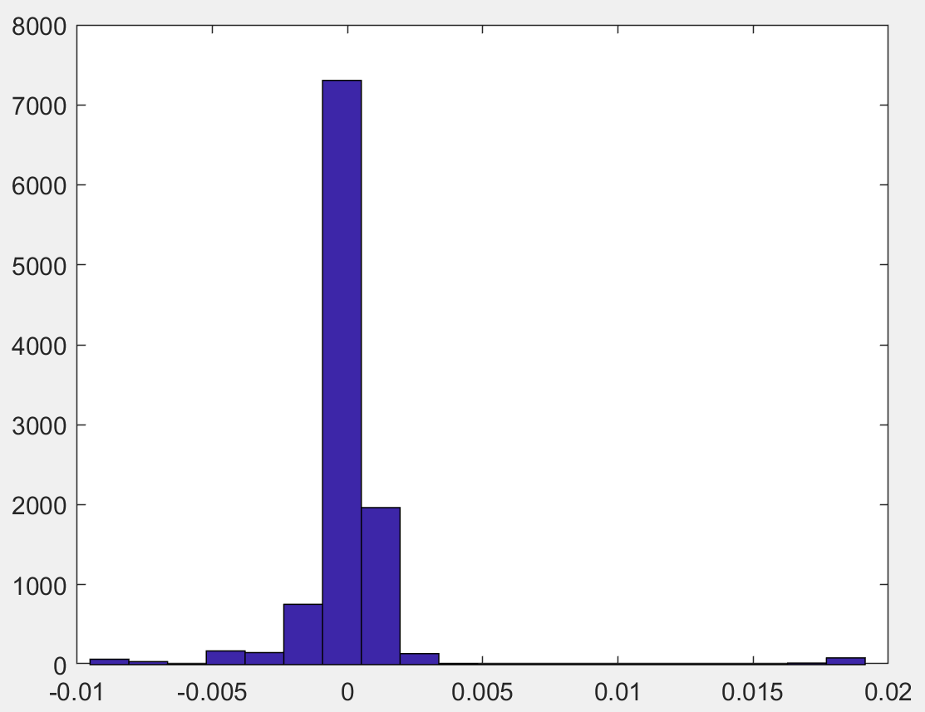
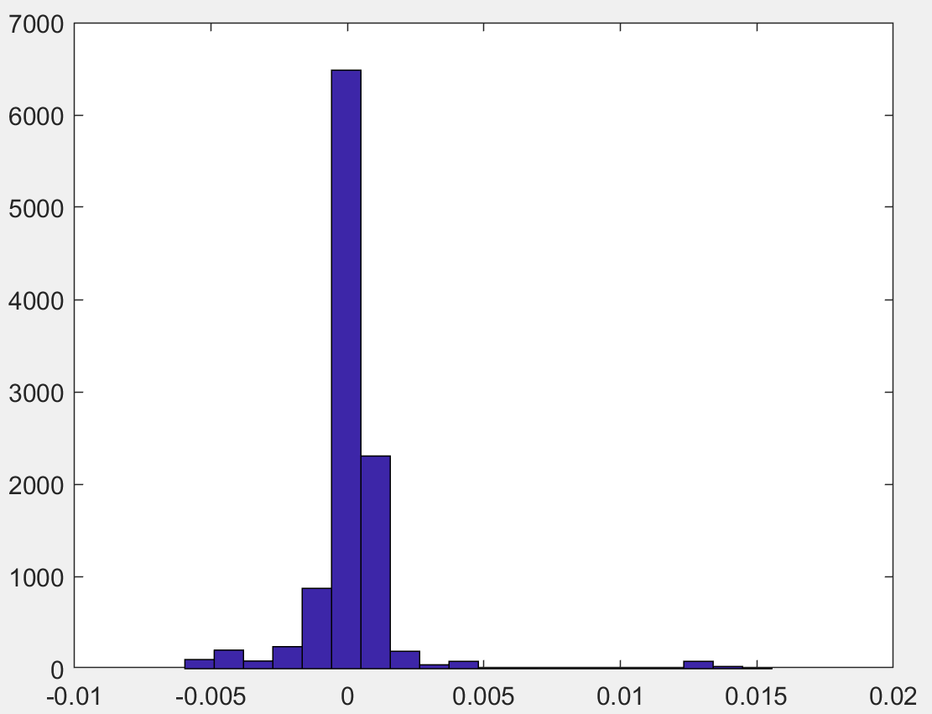
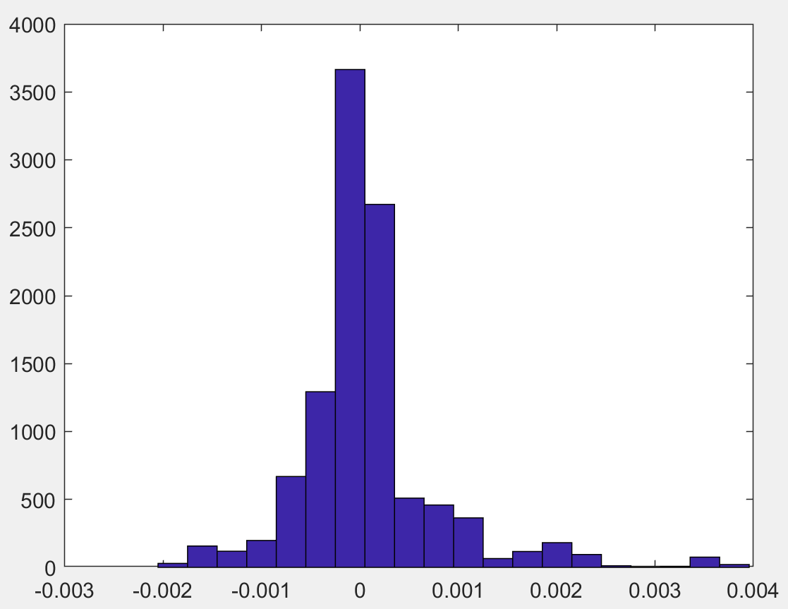
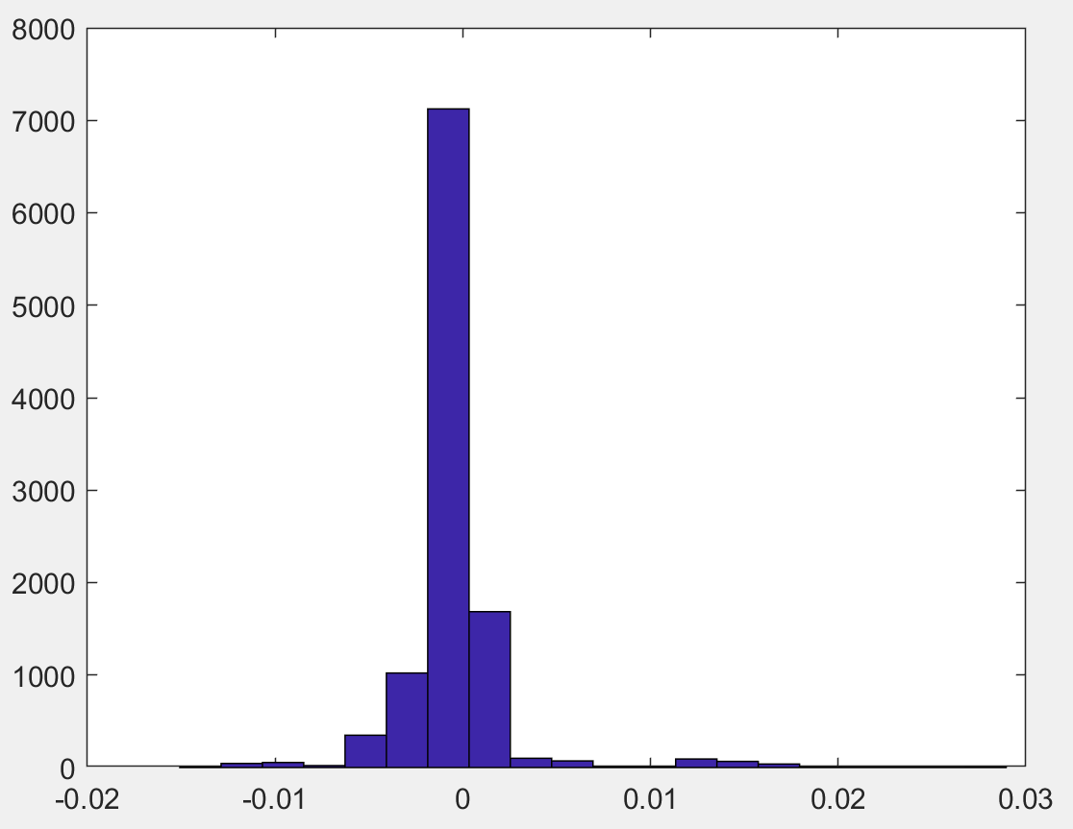
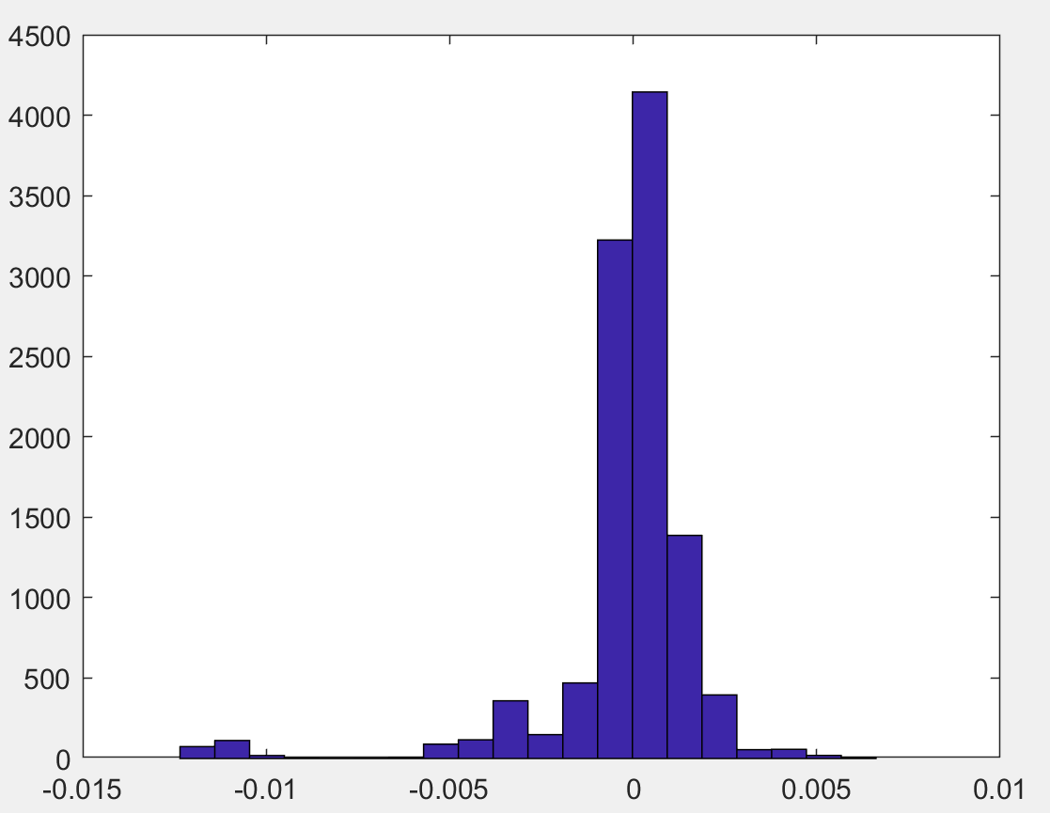
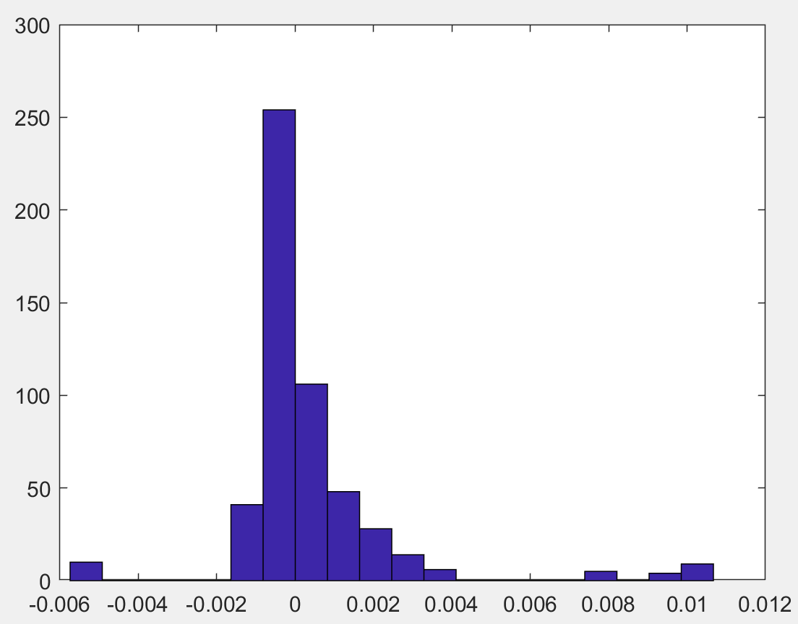
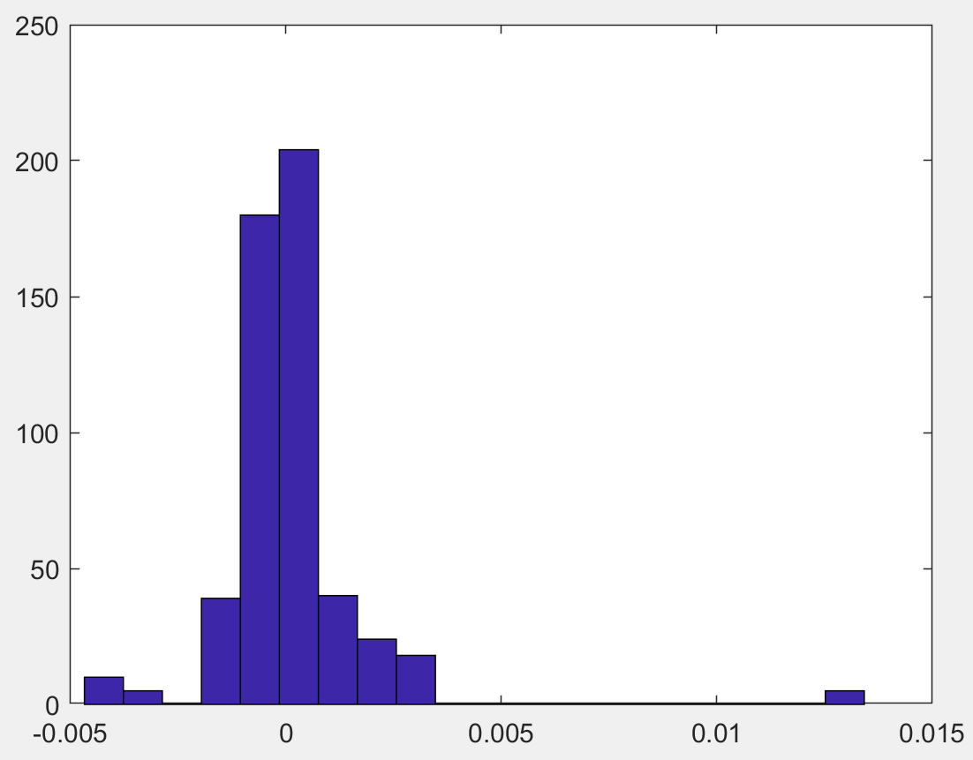
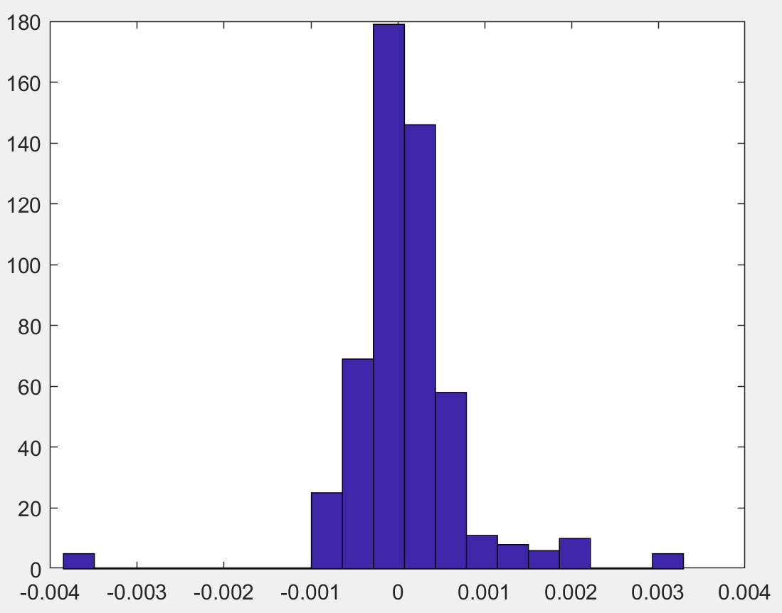
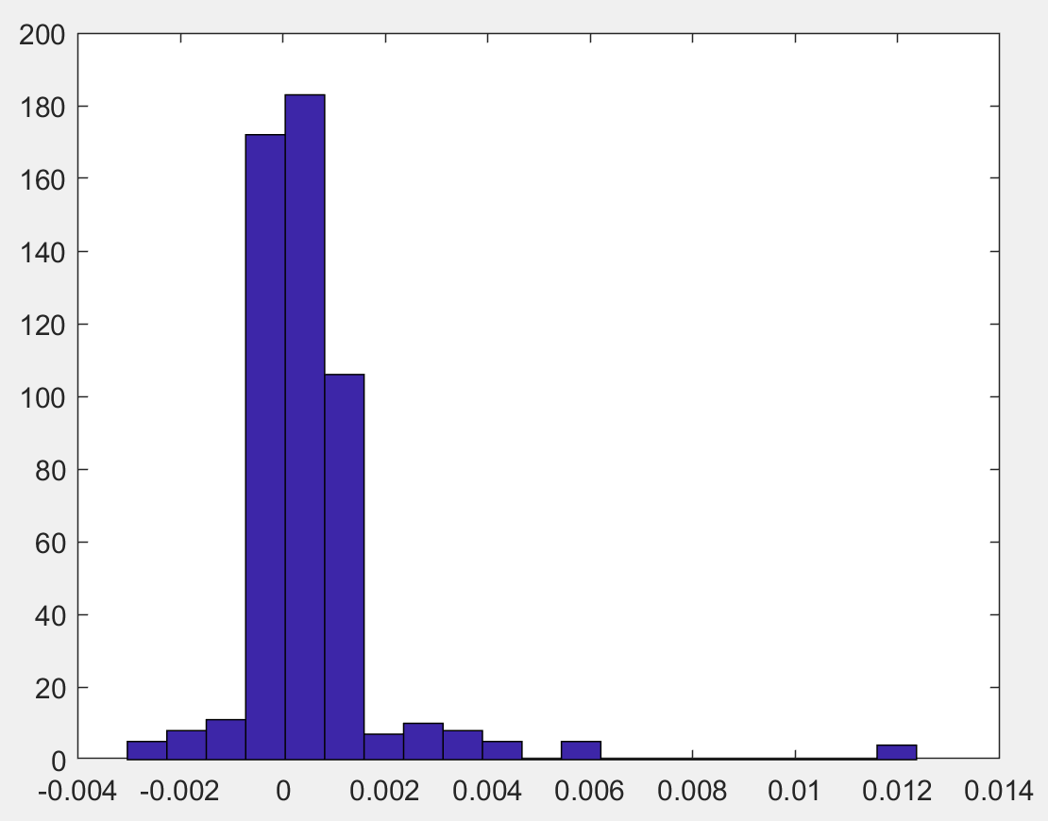
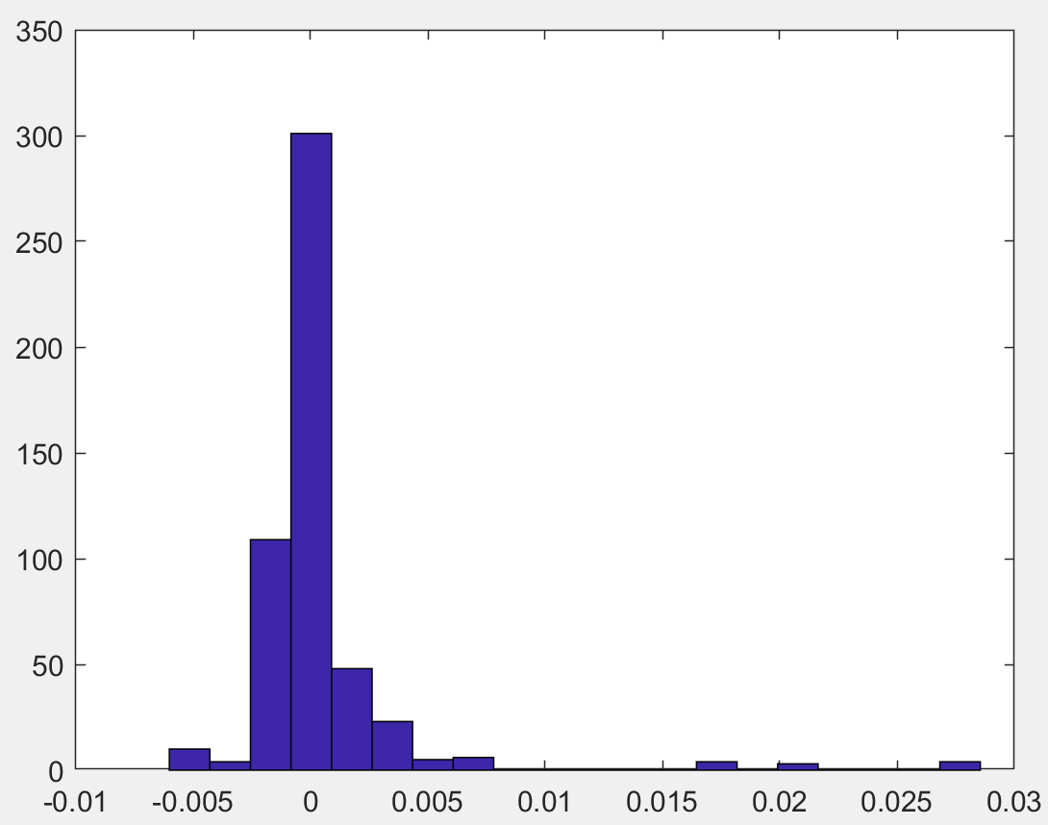
6
Data Validation
Compare with the NIOT: Part 2
Frequency
Deviation of Z, 2018
Deviation of Z, 2019
Deviation of Z, 2020
Deviation of Z, 2021
Deviation of Z, 2022
Frequency
Deviation of F, 2018
Deviation of F, 2019
Deviation of F, 2020
Deviation of F, 2021
Deviation of F, 2022
Apart from a few data points with deviations close to 3%, most figures align well with the national results.

Slide 22
7
Discussion
Features of this dataset
Limitations and research outlook
The most up-to-date MRIO for the UK
Contains 105 sectors and 12 regions, covering 2017-2022
All data used are solely from the UK ONS, publicly available and regularly updated. Used trade flow data in 2019 and 2020.
The aggregated value-added, total output, imports and exports data match the NIOT data exactly. The deviances of intermediate and final use from the NIOT are less than 3%
Need more comparison with other datasets.
More analysis (e.g. multipliers, trade analysis and SDA) to validate the dataset.
ITL-1 regions are not enough for more detailed research.
Based on the available data, the dataset can be extended to the ITL-2 level (46 regions).
Research on Brexit, Covid and spillover effects of wars.

Slide 23

THANKS！

