Slide 1
Research on Regional Digitalization and Its Influencing Factors in China from the Perspective of Firm Heterogeneity
Xuefan GUO, Kunfu ZHU, Jiarong WANG
Presenter： Xuefan Guo
Tsinghua University
July 1, 2025

Slide 2
1 Introduction

Slide 3
1 Introduction
Digital transformation has become an important engine to promote China's economic growth under the new development pattern
In 2023, the scale of digital economy expanded to 53.9 trillion-yuan, accounting for as high as 42.8% of the GDP.
An unbalanced situation has emerged, resulting in the problem of the digital divide
Many enterprises or industries are experiencing severe "fragmentation" or "isolation" during the process of digital transformation;
Make it difficult for the spillover and external effects of the digital economy among economic entities to be manifested
Figure 1. The scale of China's digital economy from 2012 to 2023
Source: China Academy of Information and Communications Technology.
3

Slide 4
1 Introduction
Literature on definition and measurement of digitalization
Many international organizations and researchers have proposed the scope and accounting methods of the digital economy (OECD, 2014; BEA, 2018; CAICT, 2019; Xu and Zhang, 2020; Cai and Niu, 2021; Guo et al., 2023).
Conceptually, tracking the digital input utilized in industrial production to quantify digitalization is a relatively direct approach.
Literature on the digital divide and its impacts
Significant differences in the development of China's digital economy among provinces (Zhang et al., 2017), enterprises (Wang et al., 2022) and groups (He et al., 2020).
The existence of the digital divide has isolated some groups from the achievements of the digital economy, preventing them from fairly enjoying the social dividends brought by digital technologies (Kong et al., 2021; Duan et al., 2024).
For existing research: 1)There is no uniformity either in terms of measurement methods or defined scope；2)When measuring regional digitalization, the economic connections and technological differences among enterprises within the region have been overlooked.
4

Slide 5
What did we do?
1) Construct a digital accounting framework based on an inter-provincial input-output model considering enterprise heterogeneity;
2) Quantify the digitalization level at the regional-industry-firm level in China, and discuss the "regional digital divide" and "enterprise digital divide" generated in the process of China's digitalization development;
3) The structure decomposition method is adopted to conduct an in-depth analysis of the factors affecting the change of China’s regional digitalization level, with a focus on interpreting the role of Hong Kong, Macao and Taiwan-funded enterprises and other foreign-funded enterprises;
4) Explore the impact of regional digitalization level on the division of labor in the domestic value chain and its potential mechanisms.
5

Slide 6
2 Methodology and data

Slide 7
The definition and scope of digitalization
According to the "Statistical Classification of Digital Economy and Its Core Industries (2021)", we redivide and integrate the digital industry into two parts: "ICT manufacturing industry " and "ICT service industry".
Digital Industry | Forming elements | Content | GB/T 4754-2017 | GB/T 4754-2011 | Industry categories
ICT Manufacturing Industry | Digital infrastructure | Computer hardware | C-39 | C-39 | Communication equipment, computers and other electronic devices
ICT Service Industry | Digital infrastructure | Telecommunication equipment and services | I-63 I-64 | I-63 I-64 | Information transmission, software and information technology services
 |  | Computer software | I-65 | I-65
 | Digital media | Internet distribution and publishing | R-8624 R-8625 R-8626 | R-8524 R-8525 R-8529 | Culture, sports and entertainment
 |  | Internet Broadcasting | R-8710 R-8720 R-8730 R-8740 R-8750 R-8760 R-8770 | R-8610 R-8620 R-8630 R-8650 R-8660 R-8670
 | E-commerce | Internet Wholesale B2B | F-5193 | F-5199 | Wholesale and retail trade
 |  | Internet Retail B2C | F-5292 | F-5294
7

Slide 8
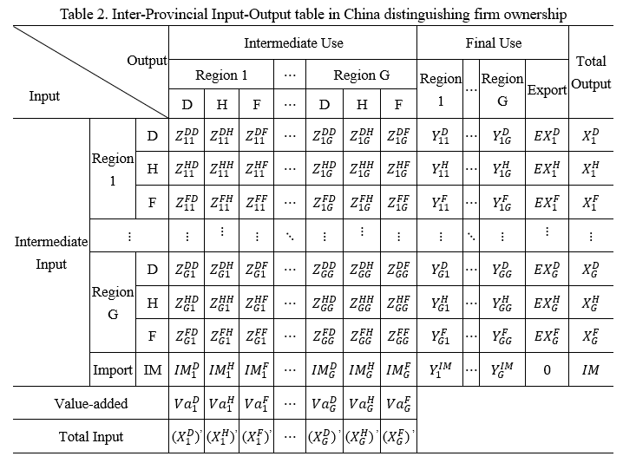
Accounting framework of Digitalization
From the perspective of backward industrial correlation：the final products and services produced by the digital industry + input of the digital industry to the final products or services of non-digital industries (Guo et al., 2023)
$$Dig=Dig_dir+Dig_ind=VL{\hat{Y}}_{d}+\left(VL−V_{\overline{d}}L_{\overline{d}}\right){\hat{Y}}_{\overline{d}}+μML{\hat{Y}}_{d}+μ(ML−M_{\overline{d}}L_{\overline{d}}){\hat{Y}}_{\overline{d}}$$
$$=\underset{Direct digitalization scale}{\underbrace{\left(VL{\hat{Y}}_{d}^{D}+VL{\hat{Y}}_{d}^{H}+VL{\hat{Y}}_{d}^{F}+μML{\hat{Y}}_{d}^{D}+μML{\hat{Y}}_{d}^{H}+μML{\hat{Y}}_{d}^{F}\right)}}+$$
$$\underset{Indirect digitalization scale}{\underbrace{\begin{aligned}\left(VL−V_{\overline{d}}L_{\overline{d}}\right){\hat{Y}}_{\overline{d}}^{D}+\left(VL−V_{\overline{d}}L_{\overline{d}}\right){\hat{Y}}_{\overline{d}}^{H}+\left(VL−V_{\overline{d}}L_{\overline{d}}\right){\hat{Y}}_{\overline{d}}^{F}+ \\ \left(μML−M_{\overline{d}}L_{\overline{d}}\right){\hat{Y}}_{\overline{d}}^{D}+μ\left(ML−M_{\overline{d}}L_{\overline{d}}\right){\hat{Y}}_{\overline{d}}^{H}+μ(ML−M_{\overline{d}}L_{\overline{d}}){\hat{Y}}_{\overline{d}}^{F}\end{aligned}}}$$
$$D_rate={Dig}/{Y^{′}}={Dig_dir}/{Y^{′}}+{Dig_ind}/{Y^{′}}$$
Decomposition of driving factors (the structural decomposition analysis, SDA)
${∆D_rate}^{t1−t0}$=$\underset{\begin{aligned}Direct digitalization \\ effect\end{aligned}}{\underbrace{f\left(∆dir\right)}}+\underset{f\left(∆Ind\right): Indirect digitalization effect}{\underbrace{\underset{\begin{aligned}Domestic intensity \\ effect\end{aligned}}{\underbrace{f\left(∆V\right)}}+\underset{\begin{aligned}Import intensity \\ effect\end{aligned}}{\underbrace{f\left(∆M\right)}}+\underset{\begin{aligned}Structural \\ effect\end{aligned}}{\underbrace{f\left(∆L\right)}}+\underset{\begin{aligned}The proportion effect of \\ the final output of \\ non−digital industries\end{aligned}}{\underbrace{f\left(∆y_{\overline{d}}\right)}} }}$
8

Slide 9
Data source
The Inter-Provincial Input-Output table of China distinguishing enterprise ownership for 2002, 2007, 2012 and 2017 (Chen et al., 2023);
The data of ICT manufacturing industry and ICT software can be directly obtained in the table;
Digital media: (1) Radio, television, film and television sound production: the proportion of its value added to the value added of "Culture, sports and entertainment industry" in 2007, 2012 and 2017, the proportion of operating income of "Radio, Television, Film and Audio-visual Industry" in the 2004 "China Economic Census Yearbook" was used instead in 2002. (2) Digital Publishing: the proportion of the operating income of "Audio-visual product Publishing", "Electronic Publication Publishing" and "Digital Publishing" published in the "Analysis of the News and Publishing Industry"
E-commerce: the proportion of the total e-commerce sales of the whole society in the "wholesale and retail trade commodity sales" (Cai and Niu, 2021).

Slide 10
3 Typical Facts of China's digitalization development

Slide 11
The scale and level of digitalization at the national level
Figure 2. China's overall digitalization level (left) and the digitalization level of different types of enterprises (right)
The overall digitalization level of China shows a growth trend, and its change is mainly driven by the development of digital industry. The integration of information technology and the real economy has also significantly improved;
Differences in the digitalization of different firms: foreign-funded > domestic; HMT-funded has improved rapidly
11

Slide 12
Regional differences and Composition of China's digitalization level
Table 4. Digitalization Level in Different Regions of China from 2002 to 2017
Year | Indicator | Eastern China | Central China | Western China | Northeast China
2002 | Direct digitalization | 10.1% | 2.2% | 2.6% | 3.7%
 | Indirect digitalization | 5.3% | 3.2% | 4.1% | 4.7%
 | Total digitalization | 15.4% | 5.4% | 6.7% | 8.4%
2007 | Direct digitalization | 16.3% | 4.0% | 3.8% | 4.9%
 | Indirect digitalization | 4.6% | 2.9% | 2.7% | 2.9%
 | Total digitalization | 21.8% | 8.3% | 8.3% | 9.2%
2012 | Direct digitalization | 14.1% | 6.3% | 7.3% | 4.5%
 | Indirect digitalization | 5.5% | 4.1% | 3.5% | 3.2%
 | Total digitalization | 21.1% | 12.9% | 13.4% | 11.0%
2017 | Direct digitalization | 16.8% | 8.5% | 10.1% | 5.7%
 | Indirect digitalization | 9.3% | 5.8% | 7.3% | 5.0%
 | Total digitalization | 24.7% | 18.3% | 18.3% | 13.7%
Differences among regions
A prominent phenomenon of the digital divide among regions：The digitalization level of the eastern region > other regions；
The regional digital divide shows a fluctuating development trend：2002-2007↑, 2007-2017↓
12

Slide 13
Table 5. Digitalization Level of Different types of Enterprises within China from 2002 to 2017
Differences within the region
Region | Year | D |  |  | H |  |  | F
 |  | Total | Direct | Indirect | Total | Direct | Indirect | Total | Direct | Indirect
Eastern China | 2002 | 8.4% | 3.1% | 5.3% | 27.0% | 21.9% | 5.0% | 38.8% | 33.4% | 5.4%
 | 2007 | 10.6% | 4.6% | 6.0% | 37.3% | 33.1% | 4.2% | 47.2% | 42.5% | 4.7%
 | 2012 | 12.9% | 5.5% | 7.4% | 37.4% | 31.1% | 6.2% | 43.8% | 38.1% | 5.7%
 | 2017 | 17.8% | 8.6% | 9.3% | 42.3% | 36.4% | 5.9% | 44.9% | 38.7% | 6.2%
Central China | 2002 | 4.7% | 1.5% | 3.2% | 14.2% | 11.8% | 2.5% | 18.6% | 15.4% | 3.2%
 | 2007 | 7.2% | 2.9% | 4.4% | 31.4% | 28.9% | 2.5% | 20.6% | 16.9% | 3.7%
 | 2012 | 10.8% | 4.1% | 6.8% | 62.2% | 58.9% | 3.3% | 18.6% | 13.9% | 4.6%
 | 2017 | 16.0% | 7.8% | 8.2% | 66.2% | 62.3% | 3.8% | 20.9% | 15.4% | 5.5%
Western China | 2002 | 6.2% | 2.1% | 4.1% | 14.3% | 10.2% | 4.1% | 20.2% | 15.2% | 4.9%
 | 2007 | 7.2% | 2.7% | 4.6% | 33.1% | 30.2% | 2.9% | 27.7% | 24.6% | 3.1%
 | 2012 | 9.8% | 3.5% | 6.3% | 72.1% | 70.2% | 1.9% | 39.3% | 35.1% | 4.2%
 | 2017 | 15.7% | 7.3% | 8.4% | 58.2% | 54.2% | 4.0% | 41.4% | 35.5% | 5.9%
Northeast China | 2002 | 6.2% | 1.3% | 4.8% | 21.9% | 18.9% | 3.0% | 23.7% | 19.5% | 4.2%
 | 2007 | 7.4% | 2.9% | 4.5% | 30.0% | 27.5% | 2.5% | 21.1% | 17.8% | 3.3%
 | 2012 | 9.9% | 3.2% | 6.7% | 31.8% | 28.1% | 3.8% | 17.1% | 11.7% | 5.4%
 | 2017 | 13.2% | 5.0% | 8.1% | 28.9% | 24.5% | 4.4% | 15.7% | 8.5% | 7.2%
The unbalanced distribution of foreign capital has become an important reason for the emergence of the regional digital divide.
The eastern region is more favored by foreign capital (foreign-funded enterprises in eastern region > other regions);
The layout of foreign capital is constantly expanding in central and western regions, creating new growth space for local industrial upgrading (HMT-funded enterprises in the central and western regions > eastern region after 2007).
13

Slide 14
Industry Characteristics
Table 6. Industry characteristics of digitalization levels of different enterprises in 2017
Sector Group | Total |  | D |  | H |  | F
 | Direct | Indirect | Direct | Indirect | Direct | Indirect | Direct | Indirect
AGR | - | 3.9% | - | 3.9% | - | 4.3% | - | 5.4%
MIN | - | 7.6% | - | 7.3% | - | -2.0% | - | 10.0%
LTI | - | 6.3% | - | 6.4% | - | 6.3% | - | 5.7%
MTI | - | 6.1% | - | 6.3% | - | 5.3% | - | 5.9%
HTI | 28.0% | 7.9% | 13.0% | 9.6% | 58.6% | 5.0% | 44.2% | 5.9%
EGW | - | 7.4% | - | 7.7% | - | 4.5% | - | 5.3%
CON | - | 8.0% | - | 8.0% | - | 6.8% | - | 8.5%
LSI | 0.9% | 8.2% | 0.9% | 8.3% | 0.7% | 6.0% | 0.5% | 5.8%
PSI | 29.2% | 11.8% | 26.1% | 12.2% | 61.1% | 6.2% | 46.5% | 11.7%
The differences in digitalization levels among enterprises are mainly reflected in high-tech manufacturing industries and productive service industries;
The main reason for the difference is the direct effect of the digital industry;
Digital integration of foreign capital in traditional manufacturing industry is more about providing digital input to domestic firms to promote their production transformation
14

Slide 15
Table 7. Industry Characteristics of digitalization levels of different enterprises in various regions
Region | Sector Group | 2002 |  |  |  | 2017
 |  | Total | D | H | F | Total | D | H | F
Eastern China | AGR | 1.7% | 1.7% | 2.8% | 0.0% | 4.1% | 4.1% | 4.2% | 7.8%
 | MIN | 4.7% | 4.7% | 5.2% | 2.8% | 6.8% | 13.9% | 1.0% | 8.3%
 | LTI | 3.4% | 3.4% | 3.2% | 3.5% | 6.2% | 6.3% | 6.4% | 5.7%
 | MTI | 5.2% | 4.9% | 5.5% | 6.1% | 6.2% | 6.5% | 5.3% | 6.0%
 | HTI | 39.1% | 18.6% | 50.7% | 58.9% | 38.7% | 22.7% | 58.3% | 52.5%
 | EGW | 3.4% | 3.4% | 2.7% | 4.5% | 8.7% | 9.2% | 3.9% | 5.5%
 | CON | 4.7% | 4.7% | 0.0% | 0.0% | 7.5% | 7.5% | 7.3% | 7.5%
 | LSI | 7.2% | 7.4% | 5.5% | 5.9% | 7.8% | 8.0% | 6.1% | 5.8%
 | PSI | 19.9% | 16.0% | 57.7% | 36.9% | 42.2% | 38.9% | 65.8% | 58.3%
Central and Western China | AGR | 1.3% | 1.3% | 0.0% | 2.4% | 3.9% | 3.9% | 4.3% | 6.8%
 | MIN | 1.2% | 1.2% | 68.7% | -0.6% | 7.3% | 7.3% | 10.4% | 10.1%
 | LTI | 2.4% | 2.3% | 2.8% | 3.2% | 6.6% | 6.6% | 6.3% | 6.3%
 | MTI | 2.9% | 2.8% | 3.4% | 3.9% | 6.2% | 6.2% | 6.1% | 5.3%
 | HTI | 14.4% | 13.3% | 24.8% | 22.5% | 32.3% | 24.2% | 84.5% | 40.1%
 | EGW | 4.2% | 4.0% | 3.8% | 7.3% | 6.3% | 6.4% | 5.8% | 5.0%
 | CON | 3.5% | 3.5% | 0.0% | 0.0% | 8.7% | 8.8% | 6.4% | 11.6%
 | LSI | 5.3% | 5.3% | 3.7% | 5.2% | 10.9% | 10.9% | 9.1% | 9.1%
 | PSI | 17.1% | 13.7% | 67.1% | 62.0% | 39.2% | 37.7% | 72.1% | 60.5%
Foreign capital is accelerating the release of the digital potential of manufacturing industry (especially the high-tech manufacturing industry) in the central and western regions；
Foreign investment has also accelerated the digitalization of productive service industries in the central and western regions;
It has also exacerbated the imbalance in digitalization among industries within the region
15

Slide 16
4 Trends and driving factors of China’s regional digitalization level

Slide 17
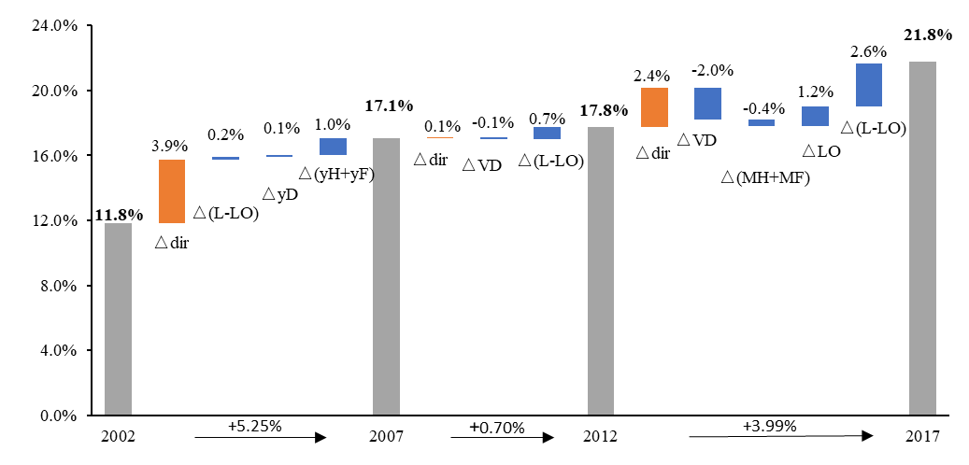
Driving factors of changes in China’s overall digitalization level
The main driving force: Direct digitalization effect; the proportion effect of the final output of non-digital industries in foreign-funded enterprises in 2002-2007；
The joint production between foreign-funded enterprises and domestic firms is gradually playing a positive role.
△VD | domestic intensity effect of domestic firms | △LO | industrial correlation effect among enterprises of the same ownership
△(VH+VF) | domestic intensity effect of foreign-funded enterprises | △(L-LO) | industrial correlation effect among enterprises of different ownership
△MD | import intensity effect of domestic firms | △yD | the proportion effect of the final output of non-digital industries in domestic firms
△(MH+MF) | import intensity effect of foreign-funded enterprises | △(yH+yF) | the proportion effect of the final output of non-digital industries in foreign-funded enterprises
17

Slide 18
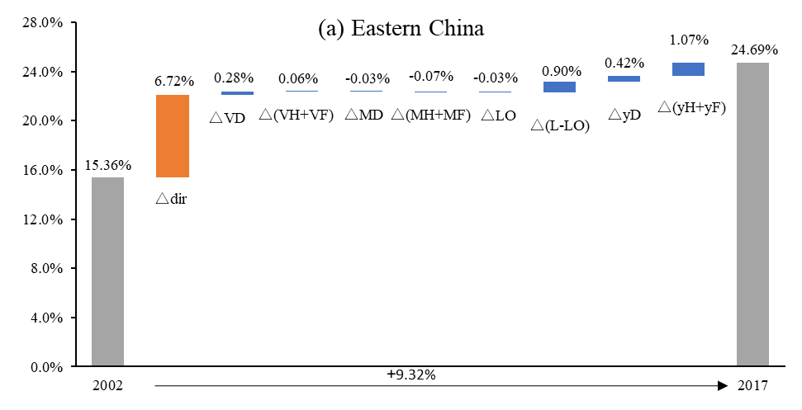
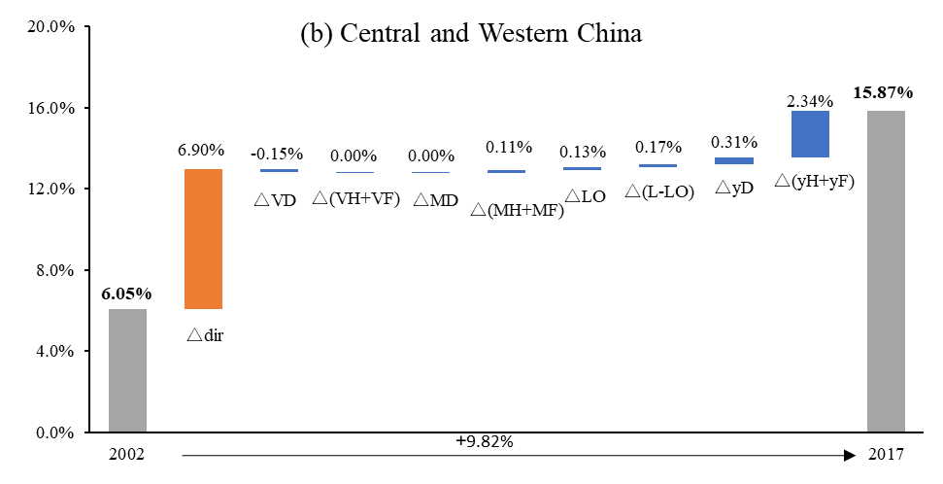
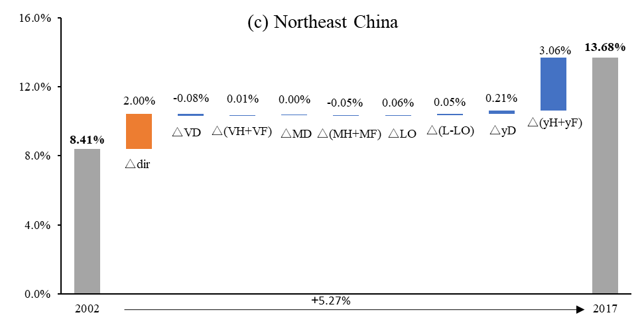
Driving factors of changes in digitalization levels in different regions of China
The main driving force: direct digitalization effect in the eastern region and the central and western regions, indirect digitalization effect in the northeastern region;
The domestic intensity effect of domestic firms and the correlation effect between domestic firms and foreign-funded enterprises have become one of the key reasons for the emergence of the regional digital divide.
18

Slide 19
5 Further discussion: The impact of China’s regional digitalization on the division of labor in the domestic value chain

Slide 20
Regression Model
Digital technology is gradually penetrating and extending into traditional industries, promoting the development of the domestic value chain division of labor pattern towards networking, informatization and collaboration.
$${PNVC}_{i,s,t}=α_{0}+β_{1}{Digisity}_{i,s,t}+γ_{n}{Controls}_{i,s,t}+D_{i}+D_{s}+D_{t}+ε_{i,s,t}$$
i, s, t: region, industry, year;
$Digisity$: the digitalization level by region and industry;
PNVC: the depth of domestic value chain division of labor (Sheng et al., 2020);
Controls: include the consumption level of residents, the level of regional innovation, the degree of opening up, the degree of government intervention, infrastructure and population density;
$D_{i}, D_{t},D_{s}$: region-fixed effects, time-fixed effects, industry-fixed effects;
$ε_{i,s,t}$: random disturbance term
$$V_NVC=\hat{V}LY^{IR}+\hat{V}LA^{IR}BY+\hat{V}LA^{IR}BE=\hat{V}L\left(A^{IR}X+Y^{IR}\right)$$
20

Slide 21
Baseline Regression and Heterogeneity Analysis
 | (1) | (2) | (3) | (4) | (5) | (6) | (7) | (8)
 |  |  | Labor-intensive | Non-labor-intensive | Eastern China | Central and Western China | Direct digitalization | Indirect digitalization
$$Digisity$$ | 0.238*** | 0.244*** | -0.028 | 0.311*** | -0.041 | 0.260***
 | (3.28) | (3.33) | (-0.09) | (4.37) | (-0.02) | (3.06)
$$Dir_digisity$$ |  |  |  |  |  |  | 0.205**
 |  |  |  |  |  |  | (2.42)
$$Ind_digisity$$ |  |  |  |  |  |  |  | 0.337**
 |  |  |  |  |  |  |  | (2.43)
Cons | 0.234*** | -0.100 | 0.241 | -0.340 | -7.845 | -0.403 | -0.090 | -0.071
 | (28.40) | (-0.32) | (0.46) | (-0.89) | (-1.09) | (-0.87) | (-0.29) | (-0.22)
Controls | N | Y | Y | Y | Y | Y | Y | Y
Fixed effect | Y | Y | Y | Y | Y | Y | Y | Y
N | 1800 | 1800 | 720 | 1080 | 660 | 1140 | 1800 | 1800
$$R^{2}$$ | 0.399 | 0.405 | 0.427 | 0.438 | 0.494 | 0.339 | 0.403 | 0.403
The development of regional digitalization will promote the deepening of the division of labor in the domestic value chain.
The improvement of the digitalization level of technology-intensive and capital-intensive manufacturing industries has a significant positive effect, while the result of labor-intensive manufacturing industries is not significant;
The effect of digitalization on domestic value chain division of labor in the central and western regions is significant;
Both direct and indirect digitalization can contribute to the deepening of the division of labor in the domestic value chain, and the effect is more obvious in the latter.
21

Slide 22
Mechanism analysis
 | (1) | (2) | (3) | (4)
 | Economies of scale | Technological innovation | Industrial structure upgrading
 |  |  | $$RCA_O$$ | $$RCA_NVC$$
$$Digisity$$ | 8.886*** | 25.124*** | 2.402** | 1.649**
 | (15.95) | (2.64) | (2.58) | (2.55)
Cons | 7.801*** | -154.760*** | -5.259 | -4.418
 | (3.22) | (-3.75) | (-1.30) | (-1.57)
Controls | Y | Y | Y | Y
Year fixed effect | Y | Y | Y | Y
Regional fixed effect | Y | Y | Y | Y
Industry fixed effect | Y | Y | Y | Y
N | 1800 | 1800 | 1800 | 1800
$$R^{2}$$ | 0.813 | 0.780 | 0.287 | 0.370
Economies of scale effect: The improvement of digitalization level can help rapid expansion of the local market scale, deeply strengthen the connections among upstream and downstream industries in different regions, and thereby generally improve the quality of division of labor in each link of the value chain;
Technological innovation effect: Digitalization level has a strong correlation with technological innovation, which will promote the participation of different regions in the domestic value chain division of labor system;
Industrial structure upgrading effect: The improvement of digitalization level can assist region and industry in accurately identifying their comparative advantage and roles in economic development.
22

Slide 23
6 Conclusions and discussions

Slide 24
6 Conclusions and discussions
This paper explores the "regional digital divide" issue and its influencing factors that have emerged in the process of China's digital development from the perspective of heterogeneous enterprises. Subsequently, the impact of regional digitalization on the division of labor in the domestic value chain was explored.
There is a distinct regional digital divide phenomenon in China, and the digitalization level of the eastern region leads the country;
The unbalanced distribution of foreign capital has become an important reason for the regional digital divide. The digitalization level of MNEs in eastern region is significantly higher than that in other regions. In recent years, foreign capital is accelerating the digital transformation in central and western regions, constantly narrowing the gap with the southeast areas.
Direct digitalization effect is the main driving factor for China's digitalization level and also the main cause of regional digital divide. In addition, the domestic intensity effect of domestic firms and the correlation effect between different firms have become one of the key reasons for the emergence of the regional digital divide.
The improvement of digitalization level can significantly promote the deepening of domestic value chain division of labor through the effects of economies of scale, technological innovation and industrial structure upgrading.
24

Slide 25
6 Conclusions and discussions
We needs to
Formulate strategies for the integrated development of the digital economy and the real economy based on local conditions, and strive to achieve coordinated digital development;
Enhance the application of digital technologies in high-tech manufacturing sectors and their deep integration in productive service industries;
Further strengthen digital technology cooperation with multinational enterprises to lead the digital transformation and development of the domestic industrial chain.
Can be improved
Due to the lack of data support, the digital components included in other industries, such as digital finance, are difficult to be separated from the original industry statistics. Therefore, this part is not included in the current calculation, which may underestimate the degree of digitalization.
25

Slide 26
THANK YOU
Presenter： Xuefan Guo, Tsinghua University
E-mail: xuefan_guo@mail.tsinghua.edu.cn
July 1, 2025

