Slide 1
31st International Input-Output Association Conference
The Regional Inequality of Mexican Productive Articulation: A Spatial Input-Output Perspective
Rodrigo Morales-López
Regional Centre of Multidisciplinary Research
National Autonomous University of Mexico
r.morales@crim.unam.mx
Male, Maldives
July 2025

Slide 2
Background
The low growth and productive disarticulation in Mexico
In the 1980s, Mexico adopted structural adjustment programs that marked the shift from an import substitution model to one based on economic and trade liberalization. This change led to internal productive disarticulation at both the sectoral and regional levels.
The need for a regional-focused productive development policy
The current context of the reconfiguration of global production chains, the low growth of the last three decades, and the regional and sectoral disarticulation of the productive structure underscores the need for a productive development policy with a regional scope.

Slide 3
Objective and contribution
Objective: Estimate and analyze the regional inequality associated with the dynamics of Mexican productive articulation, addressing both backward and forward linkages.
Several studies have explored Mexico’s regional productive articulation using input-output analysis, while others have focused on regional economic inequality from a spatial perspective. However, this study is the first to estimate the regional inequality footprint of Mexico’s productive articulation.
Internationally, this research aligns with broader efforts to understand how productive structures influence inequality (Duan et al., 2022; Duarte et al., 2022).

Slide 4
Figure 1. Regional distribution of Gross National Product by Federal Entity, 2018
(Millions of pesos)
Source: Own elaboration with data from the multi-state input-output matrix of Mexico (INEGI, 2024).
Notes:
The central region accounts for 56.7% of the production, the northern region for 32.9%, and the southern region for 10.3%.
However, regional disparities are not limited to these large regions. For example, within the central region Mexico City accounts for 13%, while Nayarit only represents 0.5%.
Mexico City (13%), Mexico State (9%), Nuevo León (8.7%), Jalisco (7.3%) and Guanajuato (5.1%).

Slide 5
Figure 2. Distribution of Gross National Product by Sectoral Category, 2018
(Percentages)
Source: Own elaboration with data from the multi-state input-output matrix of Mexico (INEGI, 2024).

Slide 6
Methodological Strategy
Sources of information
Multi-State Input-Output Matrix of Mexico 2018 (MSIOM-18)
First phase: Interregional Hypothetical Extraction Method
The Hypothetical Extraction Method is used to estimate the backward and forward linkages (Miller & Lahr, 2001; Dietzenbacher & Lahr, 2013).
The Leontief model was used to estimate backward linkages and the Ghosh model to calculate forward linkages.
The method allows for decomposing the impact on gross production generated by the extractions, according to the federal entities, sectors, and state sectors where the effects are perceived.
Second phase: Inequality Indicators
The spatial Gini Index (Rey & Smith, 2013) is used to estimate spatial inequality in the regional distribution of the impact generated by the intermediate supply and demand of productive sectors.
Notes:
35 sector for 32 federal entities
In this study, we follow the perspective of Gluschenko (2017), who argues that weighting by population size is conceptually inconsistent, as it does not estimate regional inequality but generates indicators of interpersonal inequality.

Slide 7
Figure 3. Backward and Forward Linkages of Federal Entities with the National Productive Structure, 2018
(Percentages)
 | Gini (1) | gwGini (2) | nsGini (3) | gwGinif (4) | nsGinif (5)
Backward linkages | 0.431 | 0.058 | 0.373 | 13.40% | 86.60%
Forward linkages | 0.472 | 0.064 | 0.408 | 13.48% | 86.52%
Source: Own elaboration with data from the 2018 Mexico multi-state input-output matrix (INEGI, 2024). Note: Gini = Spatial Gini index, gwGini = Gini between neighboring entities, nsGini = Gini between non-neighboring entities, gwGinif = Percentage share of gwGini in total Gini, nsGinif = Percent share of nsGini in total Gini.
Notes:
Top 5 with more BL: Mexico City (3.9%), NL (3%), Mexico State (2.6%), Jalisco (2.2%), Coahuila (2%).
Top 5 with more FL: Mexico City (5.1%), NL (3.2%), Mexico State (2.9%), Jalisco (2.4%), Coahuila (1.8%).
In general, the FL are higher than the BL.
The central region and then the northern region present the higher levels of BL and FL.
The southern region is disconnected from the national productive structure.
However, there also exists intraregional inequality.
The higher the value in the Gini column 1, the greater the degree of regional inequality.
Despite the higher absolute values of FL, its impact throughout the productive structure is distributed more unequally than the backward linkages.
The Gini is decomposed in two terms: Gini between Neighbors (gwGini, 2) and Gini between non-neighbors (nsGini, 3)
The inequality between neighbors and non-neighbors is also higher in the case of forward linkages.
The largest share of regional inequality is explained by disparities between non-bordering states. This suggests that a state’s productive articulation is closely linked to the ability of its neighboring states to integrate into the national productive structure.
The last columns shows the participation of the inequality between neighbors (column 4) and between non-neighbors (column 5) in the total inequality degree.
The lower the value in the gwGinif column (4), the greater the relevance of externalities in the dynamics of regional inequality associated with the productive articulation.
In this case, both BL and FL present equally low values of gwGinif (4), so both have an important presence of externalities.

Slide 8
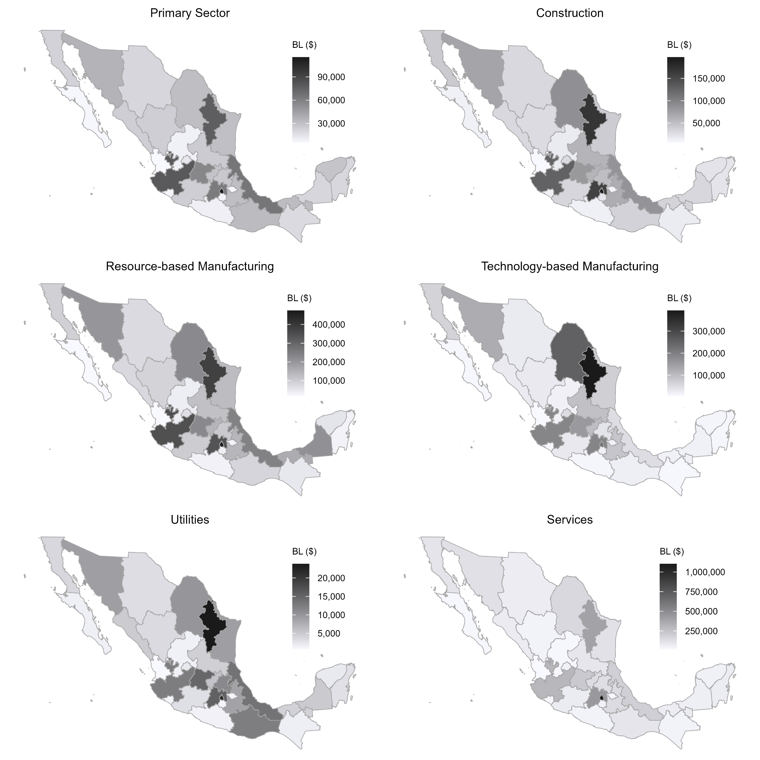
Figure 4. Productive Articulation of Sectoral Intermediate Demand with the Federal Entities, 2018
(Millions of pesos)
Source: Own elaboration with data from the 2018 Mexico multi-state input-output matrix (INEGI, 2024).
Notes:
The impact on production from the extraction of intermediate demand is not evenly distributed among the federal entities. For example, if the primary sector stops purchasing national inputs, the production in Mexico City drops by $115 billion pesos, while the production in Nayarit is only reduced by $5 billion pesos. Therefore, the primary sector's input demand is more articulated with Mexico City than with Nayarit.
The intermediate demand of services is the most integrated with the national productive structure. If this sector stops purchasing national inputs, gross production drops by 11%. It is followed by resource-based manufacturing (10.4%), technology-based manufacturing (5.7%), construction (4.1%), the primary sector (2.38%), and utilities (0.5%).
Mexico City, NL, Mexico State, Jalisco and Coahuila are the entities most connected with the intermediate demand of most sectoral categories.
The impact of the intermediate demand of services is clearly different from the other sectoral categories: it concentrates in Mexico City
The most disconnected are Zacatecas, Morelos, Guerrero, Tlaxcala, Colima, BCS and Nayarit.

Slide 9
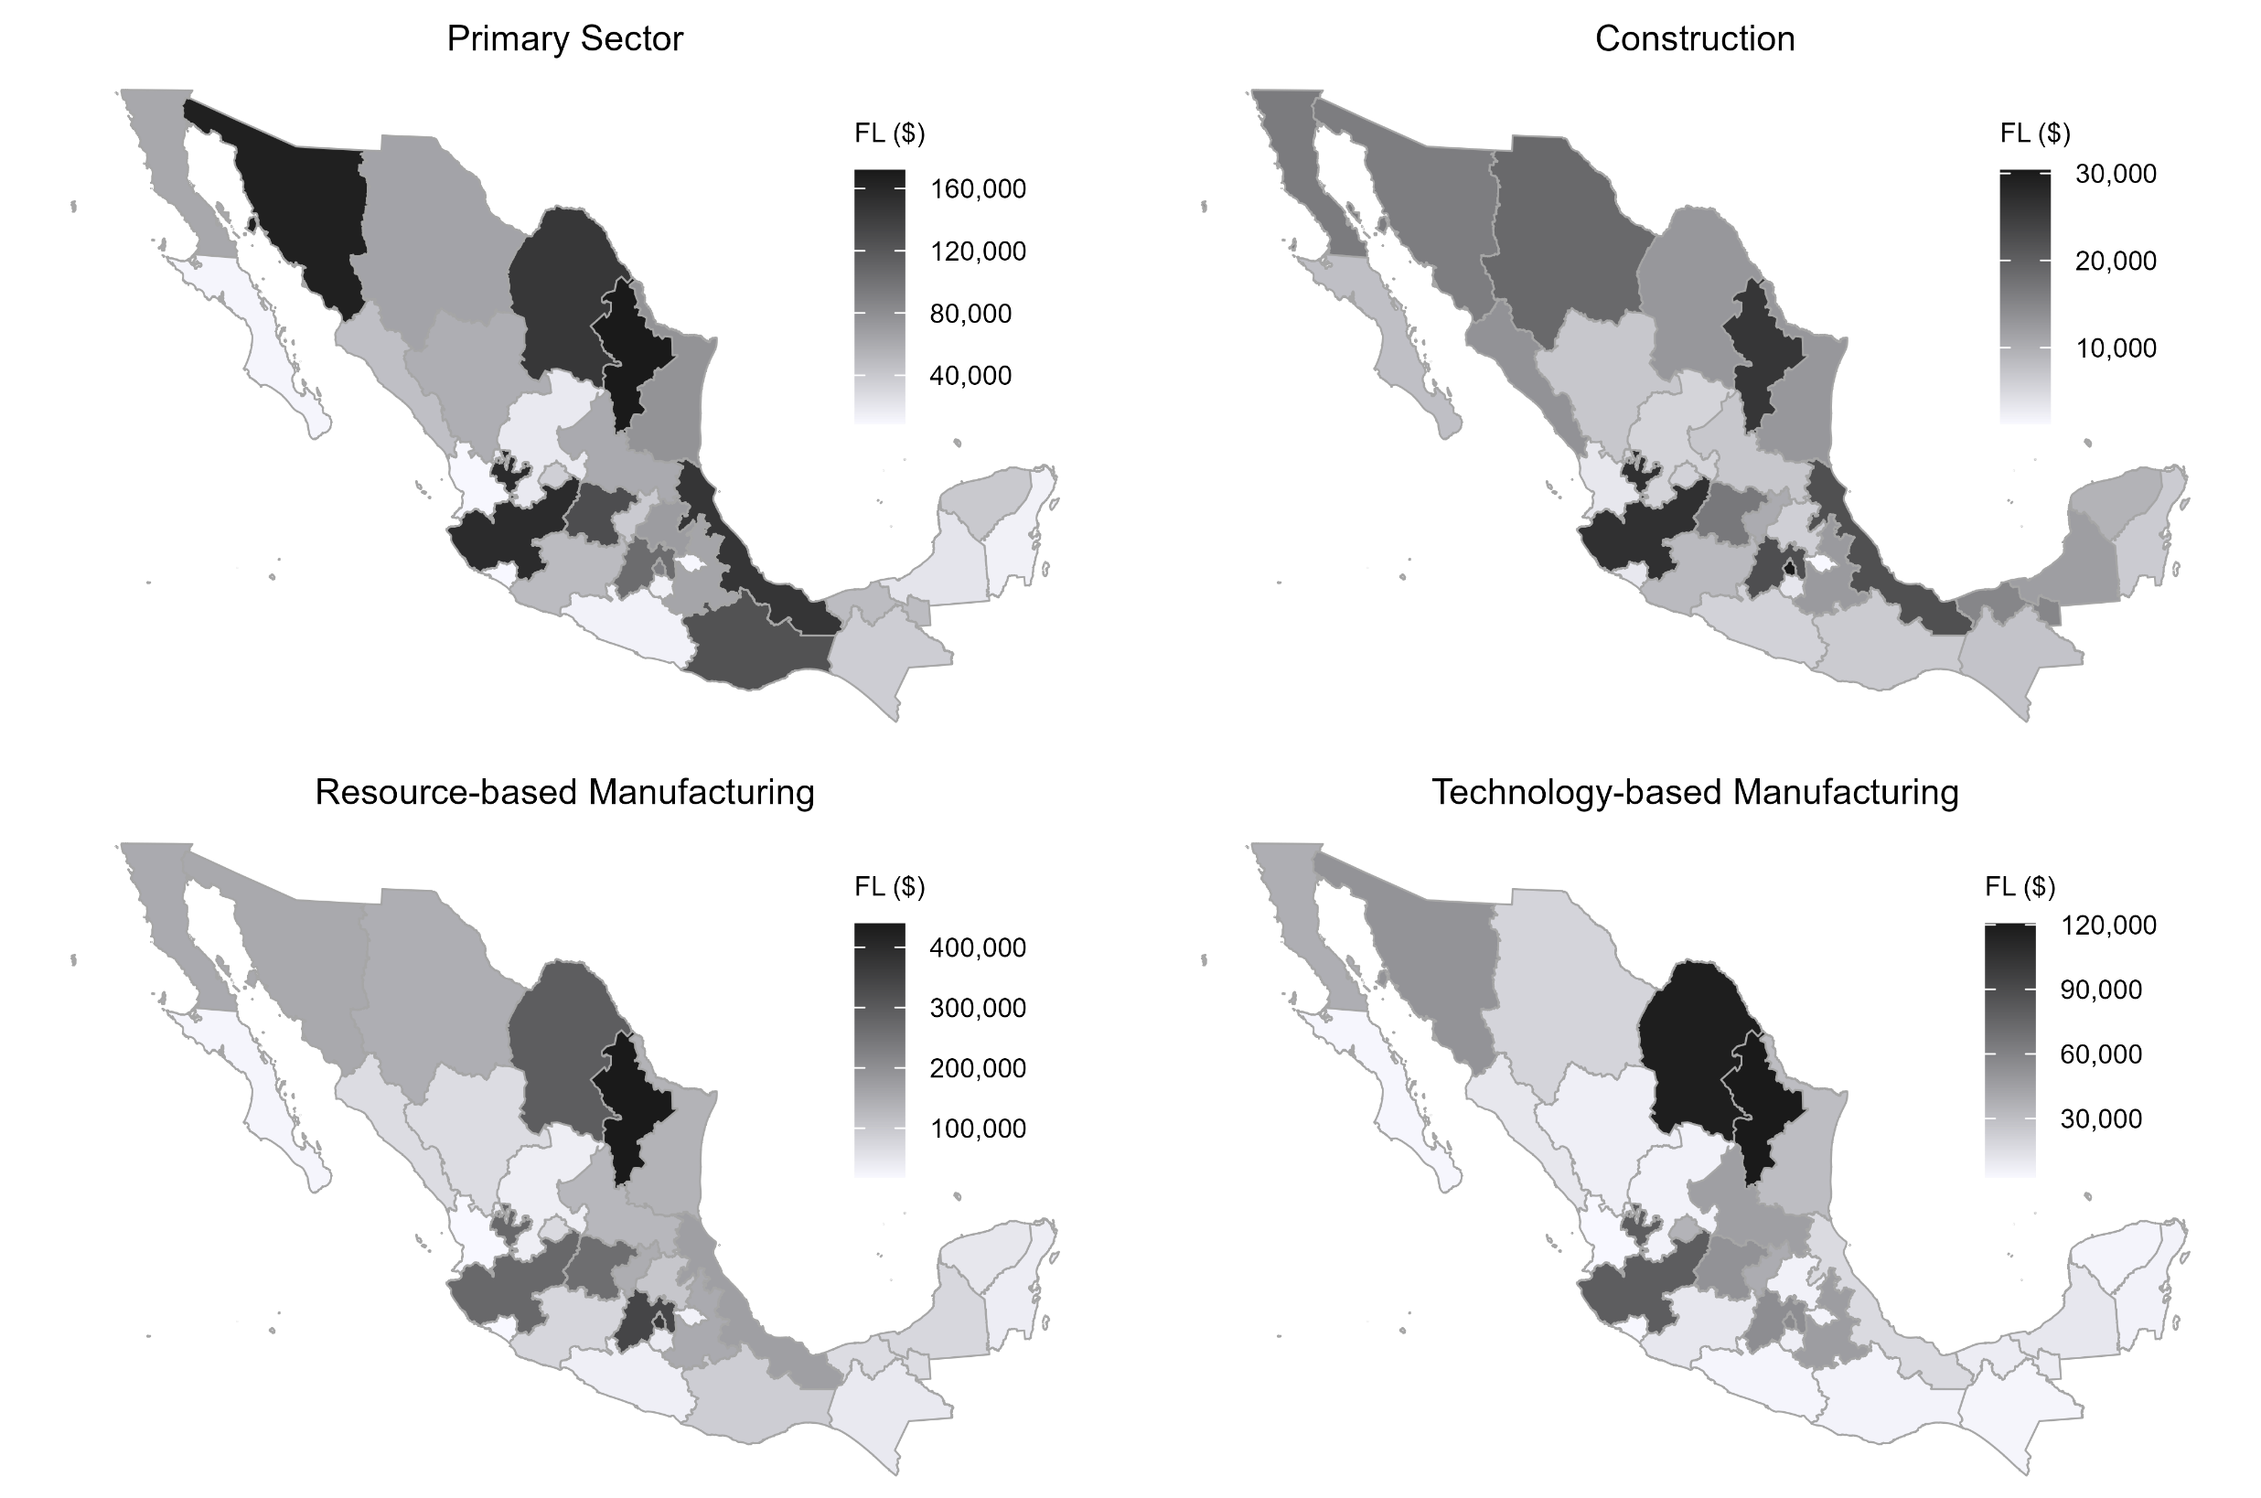
Figure 5. Productive Articulation of Sectoral Intermediate Supply with the Federal Entities, 2018
(Millions of pesos)
Source: Own elaboration with data from the 2018 Mexico multi-state input-output matrix (INEGI, 2024).
Notes:
If the primary sector stops selling domestic inputs, production in Nuevo León decreases by $171 billion pesos, while production in Colima only decreases by $9 billion pesos. Therefore, the primary sector's input supply is more articulated with Nuevo León than with Colima.
The intermediate supply of services is the most integrated with the national productive structure. If this sector stops selling national inputs, gross production drops by 14.5%. It is followed by resource-based manufacturing (9.8%), the primary sector (5%), technology-based manufacturing (2.2%), utilities (1.5%), and construction (0.9%).
As with the intermediate demand, NL, Jalisco, Mexico City, Mexico State and Coahuila are the entities most connected with the intermediate supply of most sectoral categories.
The services also show a similar pattern: the impact of its intermediate supply concentrates in Mexico City
The most disconnected are Morelos, Tlaxcala and Nayarit.
A difference from the regional distribution of the impact of intermediate demand is that Mexico City decreases its presence while Nuevo León increases it.

Slide 10
Table 1. Spatial Gini Index of the Productive Articulation of Sectoral Intermediate Demand and Supply with Federal Entities, 2018
Category | Gini (1) | gwGini (2) | nsGini (3) | gwGinif (4) | nsGinif (5)
INTERMEDIATE DEMAND
Primary sector | 0.396 | 0.058 | 0.338 | 14.60% | 85.40%
Construction | 0.446 | 0.063 | 0.383 | 14.21% | 85.79%
Resource-based manufacturing | 0.448 | 0.065 | 0.383 | 14.47% | 85.53%
Technology-based manufacturing | 0.565 | 0.074 | 0.491 | 13.14% | 86.86%
Utilities | 0.470 | 0.067 | 0.403 | 14.25% | 85.75%
Services | 0.532 | 0.066 | 0.466 | 12.40% | 87.60%
INTERMEDIATE SUPPLY
Primary sector | 0.423 | 0.062 | 0.360 | 14.69% | 85.31%
Construction | 0.345 | 0.051 | 0.293 | 14.91% | 85.09%
Resource-based manufacturing | 0.446 | 0.060 | 0.385 | 13.55% | 86.45%
Technology-based manufacturing | 0.550 | 0.073 | 0.478 | 13.20% | 86.80%
Utilities | 0.395 | 0.054 | 0.341 | 13.74% | 86.26%
Services | 0.469 | 0.061 | 0.408 | 12.94% | 87.06%
Source: Own elaboration with data from the 2018 Mexico multi-state input-output matrix (INEGI, 2024). Note: Gini = Spatial Gini index, gwGini = Gini between neighboring entities, nsGini = Gini between non-neighboring entities, gwGinif = Percentage share of gwGini in total Gini, nsGinif = Percent share of nsGini in total Gini.
Notes:
In both intermediate demand and supply, transactions involving tech-based manufacturing produce the most uneven impact across federal entities.
For intermediate demand, purchases by the primary sector generate the most evenly distributed impact across states. For intermediate supply, the construction sector shows the most balanced distribution of impacts.
The same pattern repeats in the case of inequality between neighbors (2) and non-neighbors entities (3).
Compared to intermediate demand, the degree of regional inequality generated by intermediate supply is lower, indicating that the demand for inputs reinforces regional inequality patterns in the country more than the supply of inputs.
The results of column 4 confirms the existence of spatial spillover processes in the regional productive articulation of intermediate demand and supply across sector categories, specially in the case of services.
An industrial policy that increases the intermediate demand of the primary sector in lagging entities would help reduce regional inequality, as the impact is distributed more equally among the federal entities.

Slide 11
Final Reflections
Mexico's productive articulation generates both interregional and intraregional inequalities, affecting not only the southern region but also states in the central and northern parts of the country.
Economic activity is heavily concentrated in a few federal entities—Mexico City, State of Mexico, Nuevo León, Coahuila, and Jalisco—which host the country's main metropolitan areas: the Valley of Mexico, Guadalajara, and Monterrey-Saltillo.
The production of domestic inputs is more unevenly distributed across states than their use in national production processes.

Slide 12
Final Reflections
The intermediate demand and supply of Technology-based manufacturing generates the most unequal regional impact. In contrast, the primary sector (intermediate demand) and construction (intermediate supply) produce the most balanced regional effects.
The articulation of Mexican productive structure reflects agglomeration dynamics whose benefits are unevenly distributed among federal entities, thus hindering development and social cohesion.
Regional development policy must focus on reducing spatial inequalities linked to productive integration, promoting the use of domestic inputs, and the establishment of new production plants in lagging regions.

Slide 13
Final Reflections
Promoting manufacturing that transforms natural resources and strengthening the primary sector could help reduce the regional inequality footprint of the country’s productive structure.
The design of a regional productive development policy must avoid reproducing existing inequalities and consider other dimensions such as labor, gender, and environmental issues.
The methodological framework developed in this study can be adapted to simulate the impact of selective import substitution scenarios and to compare inequalities associated with exports versus those tied to domestic consumption. Moreover, the approach is replicable in other countries that possess interregional input-output matrices.

