Slide 1
31st International Input-Output Association Conference
The Unequal Income Distribution Generated by Mexican Exports: A Structural-Spatial Analysis
Rodrigo Morales-López
Regional Centre of Multidisciplinary Research
National Autonomous University of Mexico
r.morales@crim.unam.mx
Male, Maldives
July 2025

Slide 2
Background
The failure of the export-led growth model
Integration into the less complex stages of global production chains and the weak linkage between the domestic economy and export activities led to the failure of the model (Fujii-Gambero & Cervantes, 2013).
The growth of regional inequalities
According to Osuna Castelán (1990), regional disparities in Mexico decreased between 1970 and 1980; however, under the new economic model, low growth was accompanied by a deepening of regional divergences (Mendoza-González & Villagra-Piña, 2023; Quintana-Romero & Asuad-Sanén, 2013).

Slide 3
Objective and contribution
In recent years, the study of inequalities in Mexico has boomed, however, the footprint of inequality generated by the productive structure has been scarcely analyzed.
Objective: Estimate and analyze the inequality in the distribution of income generated by Mexican exports from a structural and spatial perspective.
A contrast analysis is carried out between the production of exports and the production for the domestic market.

Slide 4
Figure 1. Regional distribution of Mexican production for exports and domestic final demand, 2018
(Millions of pesos)
Source: Own elaboration with data from the multi-state input-output matrix of Mexico (INEGI, 2024).

Slide 5
Figure 2. Sectoral Structure of Mexican Production for Exports and Domestic Final Demand, 2018
(Percentages)
Source: Own elaboration with data from the multi-state input-output matrix of Mexico (INEGI, 2024).

Slide 6
Methodological Strategy
Sources of information
Multi-state Input-Output Matrix of Mexico 2018 (MSIOM-18) Mexico's 2018 National Input-Product Matrix (NIOM-18) Economic Census of Mexico 2019 (EC-19)
First phase: Construction of satellite vectors
To make the estimates, it was necessary to decompose the value-added of the MSIOM-18 into remunerations and gross operating surplus. In this stage, the ratio between remuneration and gross value-added of the EC-19 was used. For the sectors not represented in the EC-19, as well as those with extreme values, the ratio between remunerations and gross value-added obtained from the NIOM-18 was imputed.

Slide 7
Methodological Strategy
Second phase: Interregional Input-Output Model
The standard Leontief decomposition is used within the framework of an extended interregional input-output model (Timmer et al., 2013), incorporating satellite vectors for wages and gross operating surplus.
This makes it possible to estimate both the wages and the surplus generated—directly and indirectly—by exports and domestic final demand at the state-sector level.
Third phase: Inequality Indicators
The spatial Gini Index (Rey & Smith, 2013) is used to estimate spatial inequality in the regional distribution of wages and the surplus generated directly and indirectly by exports and domestic final demand.
The share of labor compensation linked to exports and domestic final in the gross value-added generated by both types of production is used as an indicator of factorial income distribution.
Notes:
The lower the value of the Gini index among neighbors (gwGini) compared to the Gini index among non-neighbors (nsGini), the greater the relevance of externalities in the dynamics of regional inequality stemming from the distribution of wages associated with sector-state “ik” exports.
In this study, we follow the perspective of Gluschenko (2017), who argues that weighting by population size is conceptually inconsistent, as it does not estimate regional inequality but generates indicators of interpersonal inequality.

Slide 8
Figure 3. Labor Compensation and Gross Operating Surplus generated by Exports and Domestic Final Demand, according to sector category, 2018
(Billions of pesos)
Source: Own elaboration with data from the 2018 Mexico multi-state input-output matrix (INEGI, 2024), the 2018 Mexican national input-output matrix (INEGI, 2023) and the 2019 Economic Census (INEGI, 2019).
Notes:
In general, the Domestic Market is more significan than the external market as a value-added generator.
For every peso of labor compensation linked to exports, domestic final demand generates 4 pesos.
For every peso of surplus linked to exports, domestic market generates 2.6 pesos.
Nonetheless, in the case of primary sector and technlogy-based manufacturfing, exports generate more value-added than the domestic market.
The figure also shows the importance of the tertiary sector in the economy.
In the last 3 decades, Mexico had exhibit a low growth rate. One of the issues is the limited capacity of Mexican manufacturing to contribute to the total labor compensation of the country.

Slide 9
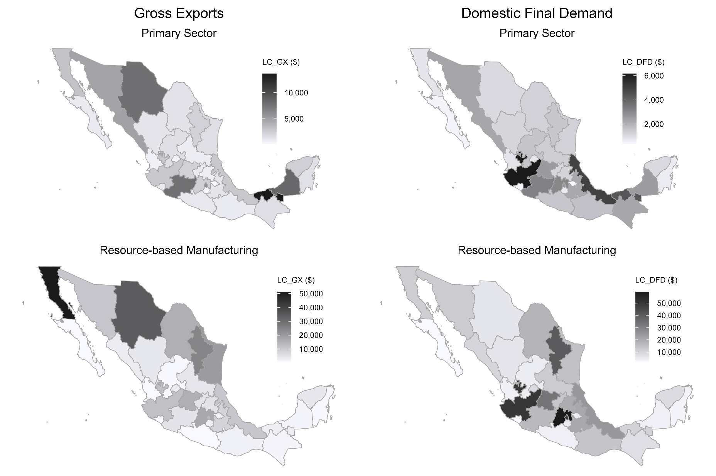
Figure 4. Regional distribution of labor compensation generated by production for exports and domestic final demand, 2018
(Millions of pesos)
Source: Own elaboration with data from the 2018 Mexico multi-state input-output matrix (INEGI, 2024), the 2018 Mexican national input-output matrix (INEGI, 2023) and the 2019 Economic Census (INEGI, 2019).
Notes:
The maps highlight the uneven distribution of labor compensation linked to both exports and domestic market.
Nevertheless, we can observe different patterns of regional distribution according to the sector and destined market (GX and DFD).

Slide 10
Figure 4. Regional distribution of labor compensation generated by production for exports and domestic final demand, 2018
(Millions of pesos)
Source: Authors' elaboration with data from the 2018 Mexico multi-state input-output matrix (INEGI, 2024), the 2018 Mexican national input-output matrix (INEGI, 2023) and the 2019 Economic Census (INEGI, 2019).
Notes:
Although most northern states specialize in tech-based manufacturing, only Nuevo León and Coahuila are among the the states that most capture labor compensation generated by both domestic and external demand.
The role of Mexico City through the provision of services for both the domestic market and exports is central for the functioning of Mexican productive structure.
Generally, the Northern macroregion captures more labor compensation associated with exports, while the Central macroregion captures more compensation generated by production to satisfy domestic final demand.
Except for the oil operations in Campeche and Tabasco, the Southern macroregion, along with the subregion formed by Baja California Sur and Sinaloa, shows disconnection from the productive dynamics, both in terms of exports and domestic final demand.

Slide 11
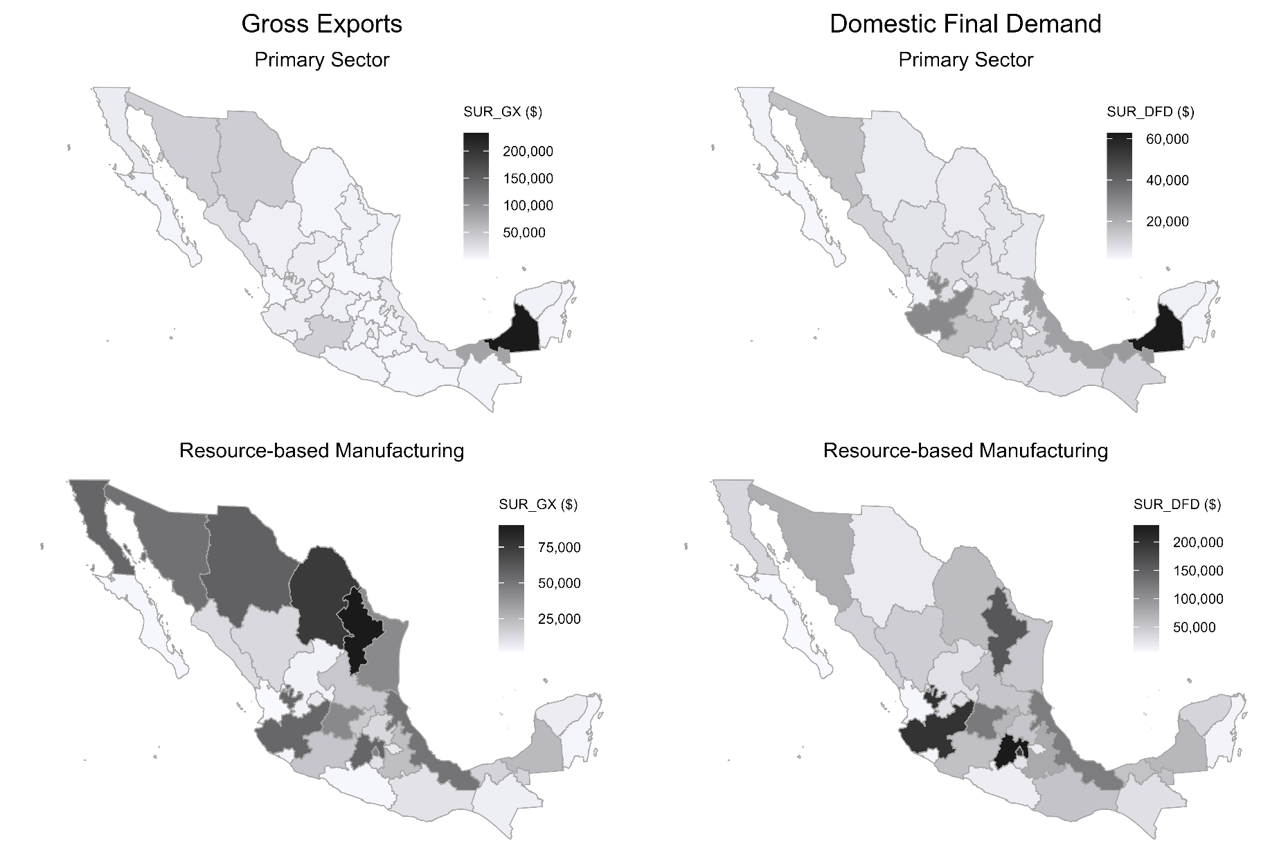
Figure 5. Regional Distribution of Gross Operating Surplus generated by Production for Exports and Domestic Final Demand, 2018
(Millions of pesos)
Source: Own elaboration with data from the 2018 Mexico multi-state input-output matrix (INEGI, 2024), the 2018 Mexican national input-output matrix (INEGI, 2023) and the 2019 Economic Census (INEGI, 2019).

Slide 12
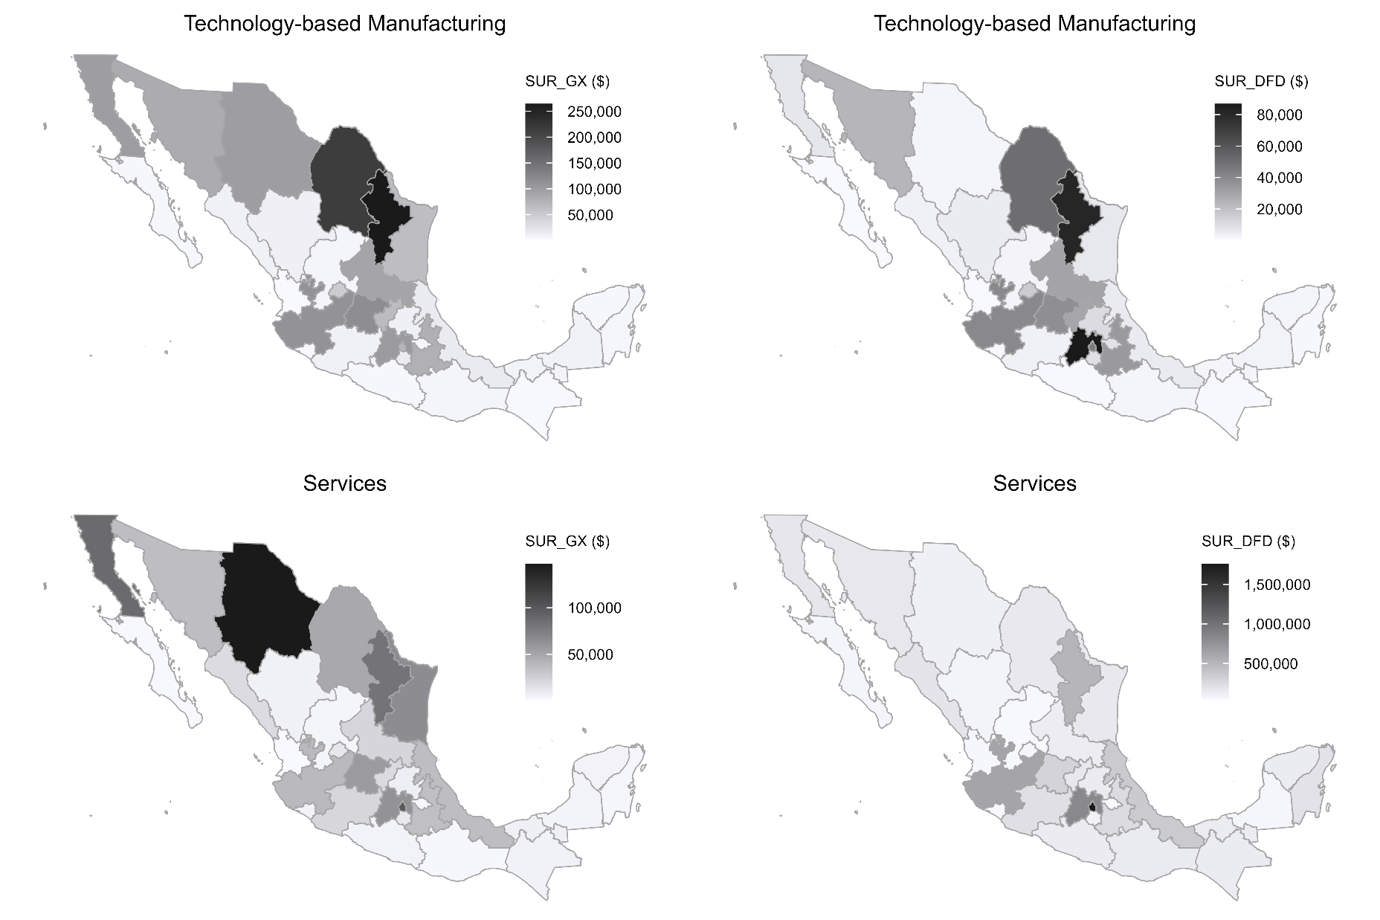
Figure 5. Regional Distribution of Gross Operating Surplus generated by Production for Exports and Domestic Final Demand, 2018
(Millions of pesos)
Source: Own elaboration with data from the 2018 Mexico multi-state input-output matrix (INEGI, 2024), the 2018 Mexican national input-output matrix (INEGI, 2023) and the 2019 Economic Census (INEGI, 2019).
Notes:
As with labor compensation, the surplus is unevenly distributed among the states, with the Central macroregion being the most linked to the domestic market and the Northern macroregion capturing the most surplus associated with exports.
In general, the results for both the labor compensation and gross operating surplus show that the Southwestern, Baja California Pacific Coast and Yucatán Peninsula Regions contribute very little in generating surplus linkled to production for domestic and external markets.
A regional development policy should aim to connect these three subregions with the national productive structure

Slide 13
Table 1. Spatial Gini Index of Labor Compensation and Gross Operating Surplus Generated by Production for Exports and Domestic Final Demand, 2018
Category | Production Type | Gini (1) | gwGini (2) | nsGini (3) | gwGinif (4) | nsGinif (5)
LABOR COMPENSATION
Primary Sector | Gross Exports | 0.509 | 0.058 | 0.451 | 11.40% | 88.60%
 | Domestic Final Demand | 0.368 | 0.052 | 0.316 | 14.24% | 85.76%
Resource-based Manufacturing | Gross Exports | 0.575 | 0.069 | 0.506 | 11.95% | 88.05%
 | Domestic Final Demand | 0.464 | 0.069 | 0.395 | 14.96% | 85.04%
Technology-based Manufacturing | Gross Exports | 0.641 | 0.069 | 0.572 | 10.75% | 89.25%
 | Domestic Final Demand | 0.559 | 0.074 | 0.486 | 13.20% | 86.80%
Services | Gross Exports | 0.587 | 0.07 | 0.517 | 11.87% | 88.13%
 | Domestic Final Demand | 0.46 | 0.058 | 0.402 | 12.65% | 87.35%
GROSS OPERATING SURPLUS
Primary Sector | Gross Exports | 0.694 | 0.069 | 0.625 | 9.98% | 90.02%
 | Domestic Final Demand | 0.473 | 0.059 | 0.414 | 12.47% | 87.53%
Resource-based Manufacturing | Gross Exports | 0.487 | 0.066 | 0.422 | 13.44% | 86.56%
 | Domestic Final Demand | 0.451 | 0.072 | 0.38 | 15.85% | 84.15%
Technology-based Manufacturing | Gross Exports | 0.591 | 0.075 | 0.516 | 12.71% | 87.29%
 | Domestic Final Demand | 0.629 | 0.094 | 0.535 | 14.99% | 85.01%
Services | Gross Exports | 0.573 | 0.071 | 0.502 | 12.45% | 87.55%
 | Domestic Final Demand | 0.502 | 0.067 | 0.435 | 13.34% | 86.66%
Source: Own elaboration with data from the 2018 Mexico multi-state input-output matrix (INEGI, 2024), the 2018 Mexican national input-output matrix (INEGI, 2023) and the 2019 Economic Census (INEGI, 2019). Note: Gini = Spatial Gini index, gwGini = Gini between neighboring entities, nsGini = Gini between non-neighboring entities, gwGinif = Percentage share of gwGini in total Gini, nsGinif = Percent share of nsGini in total Gini.
Notes:
The higher the value in the Gini column 1, the greater the degree of regional inequality.
In almost all sectoral categories, except for tech-based manufacturing in the case of surplus, the labor compensation and gross operating surplus linked to export production are distributed more unequally among federal entities than in the case of domestic final demand.
The Gini is decomposed in two terms: Gini between Neighbors (gwGini, 2) and Gini between non-neighbors (nsGini, 3)
The results show that in all cases, the largest part of the inequality degree is explained by the inequality between entities that don’t share borders. This indicates that a state’s capacity to capture value-added depends on the capacity of a neighboring state.
The last columns shows the participation of the inequality between neighbors (column 4) and between non-neighbors (column 5) in the total inequality degree.
The lower the value in the gwGinif column (4), the greater the relevance of externalities in the dynamics of regional inequality associated with the distribution of value-added generated by the internal and external demand.
The results show that the production destined to external demand have more spatial spillovers in the neighboring entities than the production destined to satisfy the domestic final demand.
In general, the results indicate that a development policy designed to boost exports will have more localized effects than one that promotes production for the domestic market.
Therefore, phenomena such as Nearshoring risk increasing regional inequality if not accompanied by appropriate policies.

Slide 14
Table 2. Share of labor compensation in the value-added generated by production for exports and domestic final demand, according to state, 2018
Federal Entity | Region | Gross Exports |  | Domestic Final Demand
 |  | Direct | Indirect
Aguascalientes | Central-north | 21.87 | 21.92 | 32.74
Baja California | Northwest | 39.09 | 23.60 | 35.10
Baja California Sur | Baja California Peninsula – Pacific Coast | 18.05 | 25.23 | 30.28
Campeche | Southeast | 3.47 | 23.96 | 22.69
Coahuila | Northeast | 17.96 | 20.75 | 30.26
Colima | Central-west | 19.76 | 23.16 | 35.04
Chiapas | Southwest | 19.69 | 21.41 | 36.68
Chihuahua | Northern | 34.26 | 23.45 | 36.63
Mexico City | Centro | 25.87 | 26.81 | 32.14
Durango | Northern | 25.18 | 24.50 | 30.37
Guanajuato | Central-north | 19.34 | 22.23 | 29.16
Guerrero | Southwest | 19.24 | 26.75 | 34.06
Hidalgo | Center | 23.47 | 20.28 | 30.94
Jalisco | Central-west | 19.59 | 21.47 | 26.02
Mexico State | Center | 17.38 | 22.25 | 29.59
Michoacán | Central-west | 17.78 | 23.02 | 32.78
Morelos | Center | 16.34 | 21.40 | 31.66
Nayarit | Central-west | 23.81 | 23.33 | 37.17
Nuevo León | Northeast | 19.27 | 21.50 | 27.13
Oaxaca | Southwest | 19.10 | 13.36 | 31.68
Puebla | Center | 20.24 | 21.57 | 30.94
Querétaro | Central-north | 22.05 | 22.87 | 28.57
Quintana Roo | Yucatán Peninsula | 30.34 | 24.83 | 26.44
San Luis Potosí | Central-north | 12.00 | 21.03 | 28.99
Sinaloa | Baja California Peninsula – Pacific Coast | 18.93 | 22.20 | 31.71
Sonora | Northwest | 19.72 | 20.29 | 29.76
Tabasco | Southeast | 14.01 | 23.42 | 26.91
Tamaulipas | Northeast | 40.07 | 23.09 | 35.23
Tlaxcala | Center | 19.93 | 22.44 | 32.68
Veracruz | Central-east | 17.10 | 18.88 | 29.52
Yucatán | Yucatán Peninsula | 36.64 | 22.76 | 30.52
Zacatecas | Central-north | 21.71 | 26.18 | 35.91
Source: Own elaboration with data from the 2018 Mexico multi-state input-output matrix (INEGI, 2024), the 2018 Mexican national input-output matrix (INEGI, 2023) and the 2019 Economic Census (INEGI, 2019).
Notes:
In comparison with the domestic final demand, the income generated by exports –direct or indirect- is distributed more unequally to the detriment of workers across all states.
In comparison with companies that produce inputs used in the production process of exports, income generated by companies that export directly tends to be distributed more inequally in favor of capital.
The multinationals have a strong presence in the Mexican production process of exports, so a large share of the surplus is expected to return to the contries where headquarters are located.
Policies aimed at promoting production for the domestic market will be distributed more favorably toward workers thank income genrated by policies that support exports.
Las exportaciones generan mayor desigualdad a favor del excedente en comparación con la producción destinada a la demanda interna.
Las exportaciones directas tienden a generar más desigualdad a favor del excedente en comparación con las indirectas.
Promedios CENTRO: 19.89, 22.42, 31.5
Promedios NORTE: 25.8, 22.7, 31.8
Promedios SUR: 20.3, 22.3, 29.8

Slide 15
Final Reflections
The unequal distribution of income across regions and productive factors limits Mexico’s growth potential. While fiscal, labor, and social policies have addressed some aspects of inequality, this study highlights the need for targeted industrial policies to promote equitable productive development.
Production for the domestic market generates more labor compensation and surplus than export-oriented production. This holds across services and resource-based manufacturing, but not for the primary sector and tech-based manufacturing.
Regionally, the north leads in export-related income, while the center benefits more from domestic demand. The south remains weakly integrated into the national productive system.

Slide 16
Final Reflections
Southern subregions face challenges due to their distance from major markets. Strengthening ties with Central America could improve their integration. Meanwhile, Sinaloa and Baja California Sur should strengthen their connections with northern states.
Domestic-demand-driven production exhibits a more balanced regional distribution of labor compensation and surplus, underscoring its potential to mitigate inequality.
Export-driven production shows more localized effects, indicating that export-promotion policies may exacerbate regional disparities if not carefully designed.

Slide 17
Final Reflections
Compared to domestic production, export-generated income is more unequally distributed in favor of capital.
In general, findings suggest that domestic market production has better potential for national economic growth, as it exhibits lower levels of regional inequality associated with its productive processes and a more favorable income distribution toward workers.
In the context of Nearshoring, Mexico must design regional development policies that support growth while reducing structural inequalities.

