Slide 1
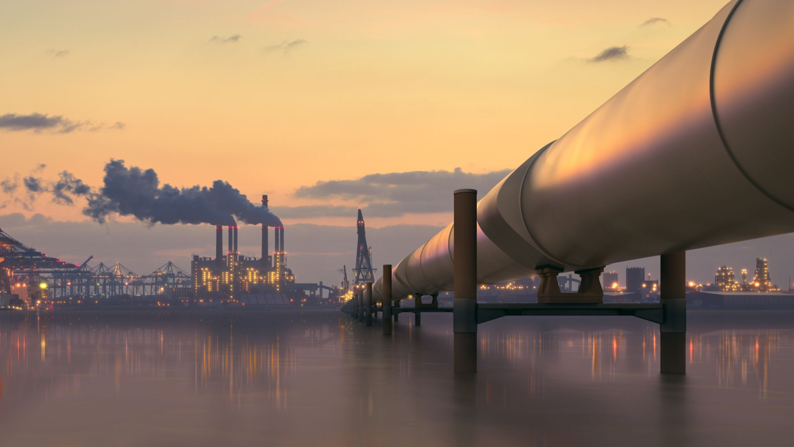
GVCs and Embedded Carbon Emission Dynamics: Implications of CBAM for EU Downstream Sectors
31st IIOA Conference
6th - 11th July 2025, Malé, Maldives
Shifali Goyal
(Indian Institute of Foreign Trade, India)
Areej A. Siddiqui
(University of Dubai, UAE)
Debashis Chakraborty
(Indian Institute of Foreign Trade, India)

Slide 2
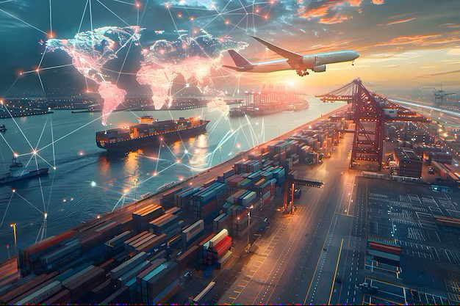

Context
Goods and services traverse international borders multiple times during the course of production
An estimation of emissions embedded in GVCs and their impact on the environment is a complex challenge - requires due consideration
Unilateral measures like CBAM:
  Aimed at mitigating rising emissions and combating carbon leakage
  Implemented by the EU; Announced by UK and Australia
  Claimed as a non-tariff measure, but may emerge as a trade protectionist measure
Given the fragmented nature of production, CBAM may affect not only the targeted products but the entire value chain
EU CBAM may have huge repercussions for international trade and EU manufacturers, especially of downstream sectors

Slide 3
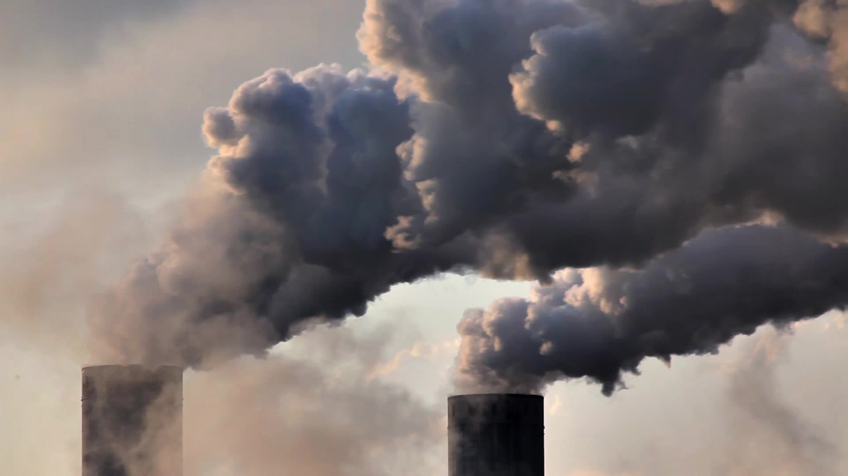
Objectives
An understanding of how much a country/region contributes to the production and consumption of emissions in the global economy.
Estimation of emissions generated domestically and imported to undertake production within the EU.
Decomposition of emissions embodied in GVCs to understand how emissions embedded in India’s and China’s exports to the EU are absorbed

Slide 4

Data and Method
Data
The MRIO tables used in this study are sourced from two databases- World Input-Output Database for the years 2000 and 2014, and Eurostat for the years 2015 and 2022
Countries and sectors covered in the two databases have been aggregated into 7 regions and 25 sectors
Corresponding carbon emissions are sourced from the European Commission, JRC (Corsatea et al., 2000) and Eurostat

Slide 5

Data and Method
Method
The extension of the Leontief model has been used to estimate and decompose emissions embedded in the production of final products
$Country and sector wise emissions= \hat{E}B\hat{Y}$
For a two-good and two-nations economy
$$\hat{E}B\hat{Y}= \left[\begin{matrix}e_{1}^{s}b_{11}^{ss}y_{1}^{s} & e_{1}^{s}b_{12}^{ss}y_{2}^{s} & e_{1}^{s}b_{11}^{sr}y_{1}^{r} & e_{1}^{s}b_{12}^{sr}y_{2}^{r} \\ e_{2}^{s}b_{21}^{ss}y_{1}^{s} & e_{2}^{s}b_{22}^{ss}y_{2}^{s} & e_{2}^{s}b_{21}^{sr}y_{1}^{r} & e_{2}^{s}b_{22}^{sr}y_{2}^{r} \\ e_{1}^{r}b_{11}^{rs}y_{1}^{s} & e_{1}^{r}b_{12}^{rs}y_{2}^{s} & e_{1}^{r}b_{11}^{rr}y_{1}^{r} & e_{1}^{r}b_{12}^{rr}y_{2}^{r} \\ e_{2}^{r}b_{21}^{rs}y_{1}^{s} & e_{2}^{r}b_{22}^{rs}y_{2}^{s} & e_{2}^{r}b_{21}^{rr}y_{1}^{r} & e_{2}^{r}b_{22}^{rr}y_{2}^{r}\end{matrix}\right]$$
Above equation allows us to estimate emissions generated, consumed and embedded in international trade when sector i is produced in country j

Slide 6

Data and Method
Decomposition of emissions embedded in gross exports based on where they are finally absorbed:
$EE{GE}_{F^{sr}}=\underset{(1)}{\underbrace{{\hat{E}}^{s}L^{ss}Y^{sr}}}+\left.\underset{(2)}{\underbrace{{\hat{E}}^{s}L^{ss}\left[{A^{sr}B}^{rs}Y^{sr}+A^{sr}B^{rr}Y^{rr}+A^{sr}\sum_{t≠s,r}^{G}{B^{rt}Y^{tr}}\right]}}\right.+\underset{(3)}{\underbrace{{\hat{E}}^{s}L^{ss}\left[{A^{sr}B}^{rs}Y^{ss}+{A^{sr}B}^{rr}Y^{rs}+A^{sr}\sum_{t≠s,r}^{G}{B^{rt}Y^{ts}}\right]}}+ \underset{(4)}{\underbrace{{\hat{E}}^{s}L^{ss}\left[A^{sr}\sum_{t≠s,r}^{G}{B^{rt}Y^{tt}}+A^{sr} B^{rs}\sum_{t≠s,r}^{G}{Y^{st}}\right]}}$
Term 1: Emissions generated in country s from producing final goods exported to country r, which are finally absorbed in country r.
Term 2: Emissions generated in country s from producing intermediate goods exported to country r, which, after further value addition by country r (and other trading partners), are finally consumed in country r.
Term 3: Emissions generated in country s from producing intermediate goods exported to country r, which, after further value addition by country r (and other trading partners), are reimported by country s.
Term 4: Emissions generated in country s from producing intermediate goods exported to country r, which, after further value addition by country r (and other trading partners), are re-exported to third country t for final consumption.

Slide 7
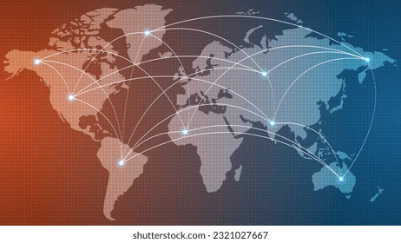
Results and Analysis

Slide 8
Emissions Generated and Consumed while undertaking Final Production
Increase in emissions generated and consumed by developing countries, while emissions from the developed countries decreased over the same period
India, China and Russia generated more emissions than they consumed - net carbon exporters
Developed countries (e.g., EU, USA, SnN) are found to have consumed more emissions than they generated - net carbon importers
The gap between emission generation and consumption has widened over time, indicating increased trade of emissions
Source: Global Carbon Atlas (n.d.)
Notes:
The estimated global carbon footprint (country and sector wise) has been further decomposed to estimate how much emissions were generated domestically and how much were imported in order to undertake production of final goods and services say within EU.

Slide 9
CO₂ Embedded in EU Manufacturing: Domestic vs. Foreign Sources
Table I: Domestic and Foreign CO2 emissions from producing goods and services in the EU for 2000 and 2014 (WIOD)
Sectors | Description | Domestic emissions | Imported emissions | Domestic emissions | Imported emissions
 |  | 2000 |  | 2014
A | Primary Products | 82% | 18% | 78% | 22%
B | Mining and Quarrying | 84% | 16% | 81% | 19%
C10-C12 | Food and Beverage | 80% | 20% | 71% | 29%
C13-C15 | Textile and Leather | 75% | 25% | 56% | 44%
C16 | Wood and Products | 76% | 24% | 71% | 29%
C17- C18 | Paper and Printing | 80% | 20% | 76% | 24%
C19 | Petroleum Products | 58% | 42% | 53% | 47%
C20 | Chemicals | 77% | 23% | 66% | 34%
C21 | Pharmaceuticals | 68% | 32% | 55% | 45%
C22 | Rubber and plastic products | 69% | 31% | 57% | 43%
C23 | Other Non-Metallic minerals | 91% | 9% | 89% | 11%
C24 | Basic Metals | 84% | 16% | 74% | 26%
C25 | Fabricated metal products | 71% | 29% | 59% | 41%
C26 | Computer and Electronics | 58% | 42% | 37% | 63%
C27 | Electrical Equipment | 68% | 32% | 51% | 49%
C28- C33 | Machinery and equipment | 69% | 31% | 53% | 47%
C29 | Motor Vehicles | 69% | 31% | 53% | 47%
C30 | Other Transport Equipment | 63% | 37% | 46% | 54%
C31_C32 | Furniture | 71% | 29% | 57% | 43%
D35 | Electricity | 94% | 6% | 92% | 8%
E36- E39 | Waste Management | 82% | 18% | 77% | 23%
F | Construction | 76% | 24% | 65% | 35%
G45- G47 | Trade of Vehicles | 81% | 19% | 70% | 30%
H49- H53 | Transport and Storage | 89% | 11% | 81% | 19%
S | Services | 79% | 21% | 67% | 33%
CO2 emissions from EU production: decomposed into domestic and imported (foreign) sources
Obtained values from different MRIO tables are not directly comparable, yet reveal important trends
The majority of emissions embedded in intermediates are generated domestically
  Indicating that removing free allowances could be costly and have significant impacts on downstream sectors.
Share of domestic emissions in the EU's total embedded emissions decreased between 2000 and 2014, as well as between 2015 and 2022, while the share of imported emissions increased
Source: Authors’ Computation
Notes:
The estimated global carbon footprint (country and sector wise) has been further decomposed to estimate how much emissions were generated domestically and how much were imported in order to undertake production of final goods and services say within EU.

Slide 10
CO₂ Embedded in EU Manufacturing: Domestic vs. Foreign Sources
Table II: Domestic and Foreign CO2 emissions from producing goods and services in the EU for 2015 and 2022 (WIOD)
Sectors | Description | Domestic emissions | Imported emissions | Domestic emissions | Imported emissions
 |  | 2015 |  | 2022
A | Primary Products | 84% | 16% | 81% | 19%
B | Mining and Quarrying | 88% | 12% | 85% | 15%
C10-C12 | Food and Beverage | 76% | 24% | 71% | 29%
C13-C15 | Textile and Leather | 55% | 45% | 53% | 47%
C16 | Wood and Products | 74% | 26% | 67% | 33%
C17- C18 | Paper and Printing | 79% | 21% | 75% | 25%
C19 | Petroleum Products | 56% | 44% | 59% | 41%
C20 | Chemicals | 74% | 26% | 68% | 32%
C21 | Pharmaceuticals | 58% | 42% | 50% | 50%
C22 | Rubber and plastic products | 60% | 40% | 54% | 46%
C23 | Other Non-Metallic minerals | 91% | 9% | 89% | 11%
C24 | Basic Metals | 77% | 23% | 71% | 29%
C25 | Fabricated metal products | 63% | 37% | 57% | 43%
C26 | Computer and Electronics | 45% | 55% | 42% | 58%
C27 | Electrical Equipment | 53% | 47% | 46% | 54%
C28- C33 | Machinery and equipment | 58% | 42% | 51% | 49%
C29 | Motor Vehicles | 55% | 45% | 49% | 51%
C30 | Other Transport Equipment | 45% | 55% | 39% | 61%
C31_C32 | Furniture | 60% | 40% | 53% | 47%
D35 | Electricity | 95% | 5% | 92% | 8%
E36- E39 | Waste Management | 84% | 16% | 80% | 20%
F | Construction | 72% | 28% | 65% | 35%
G45- G47 | Trade of Vehicles | 77% | 23% | 72% | 28%
H49- H53 | Transport and Storage | 82% | 18% | 81% | 19%
S | Services | 75% | 25% | 68% | 32%
Energy-intensive sectors such as electronics, machinery, equipment, motor vehicles and transport equipment, etc., contribute significantly to emissions outside the EU
The EU is one of the largest producers of automotive goods and the largest producer and exporter of machinery. Any adverse effect of CBAM on these sectors could have wide-reaching economic implications
Source: Authors’ Computation
Notes:
The estimated global carbon footprint (country and sector wise) has been further decomposed to estimate how much emissions were generated domestically and how much were imported in order to undertake production of final goods and services say within EU.

Slide 11
Decomposition of Foreign CO₂e emissions from production in EU- Key Insights
In 2000, the EU’s production generated significant emissions in countries like Russia, the USA, and China.
In 2014, foreign emissions linked to the EU’s production pattern shifted, with a significant increase in emissions from China and India.
While the share of Russia in resulting emissions remained sizable, it has come down considerably.
EU’s emissions from the USA have reduced too, but the extent of reduction has been relatively modest than Russia.
The findings underscore a shift in the EU’s emissions profile, with imported emissions, especially from countries like China and India, comprising a growing share of total embedded emissions.
Similar results have been observed for the years 2015 and 2022.

Slide 12
Decomposition of Foreign CO₂e emissions from production in EU, 2000

Slide 13
Decomposition of Foreign CO₂e emissions from production in EU, 2014

Slide 14
Decomposition of Foreign CO₂e emissions from production in EU, 2015

Slide 15
Decomposition of Foreign CO₂e emissions from production in EU, 2022

Slide 16
Decomposition of emissions embedded in China’s and India’s exports to the EU- Key Insights
For both China and India, the share of Term 1 declined in 2014 compared to 2000 levels, whereas the shares of Terms 2, 3 and 4 increased,
  Emissions embedded in China’s and India’s exports to the EU are getting consumed as intermediates more intensively in 2014 vis-a-vis 2000.
Between 2015 and 2022, the share of Terms 2 and 3 increased across most sectors, but the magnitude of the increase was relatively modest compared to the early 2000s.
China’s exports of emissions to the EU are embedded more in final consumer products than the corresponding figures for India.
For select CBAM sectors—Aluminium, Cement, Fertilisers and Iron and Steel (part of C20, C23 and C24), more than half of the total emissions imported from India and China are absorbed during further processing in EU downstream industries
  Suggesting stricter enforcement of CBAM could have adverse cost implications for domestic producers if it increases their import prices.

Slide 17
Decomposition of emissions embedded in China’s exports to the EU, 2000
Notes:
China and India two major carbon emitters and significant trading partner of EU are expected to get impacted significantly too. Thus, we have also decomposed how emissions embedded in exports of China and India to EU are finally getting absorbed there.
The figure shows that substantial part of emissions generated in China and India while producing goods and services meant to be exported to EU are further used as inputs in their downstream sectors.

Slide 18
Decomposition of emissions embedded in China’s exports to the EU, 2014
Notes:
China and India two major carbon emitters and significant trading partner of EU are expected to get impacted significantly too. Thus, we have also decomposed how emissions embedded in exports of China and India to EU are finally getting absorbed there.
The figure shows that substantial part of emissions generated in China and India while producing goods and services meant to be exported to EU are further used as inputs in their downstream sectors.

Slide 19
Decomposition of emissions embedded in China’s exports to the EU, 2015
Notes:
China and India two major carbon emitters and significant trading partner of EU are expected to get impacted significantly too. Thus, we have also decomposed how emissions embedded in exports of China and India to EU are finally getting absorbed there.
The figure shows that substantial part of emissions generated in China and India while producing goods and services meant to be exported to EU are further used as inputs in their downstream sectors.

Slide 20
Decomposition of emissions embedded in China’s exports to the EU, 2022
Notes:
China and India two major carbon emitters and significant trading partner of EU are expected to get impacted significantly too. Thus, we have also decomposed how emissions embedded in exports of China and India to EU are finally getting absorbed there.
The figure shows that substantial part of emissions generated in China and India while producing goods and services meant to be exported to EU are further used as inputs in their downstream sectors.

Slide 21
Decomposition of emissions embedded in India’s exports to the EU, 2000
Notes:
China and India two major carbon emitters and significant trading partner of EU are expected to get impacted significantly too. Thus, we have also decomposed how emissions embedded in exports of China and India to EU are finally getting absorbed there.
The figure shows that substantial part of emissions generated in China and India while producing goods and services meant to be exported to EU are further used as inputs in their downstream sectors.

Slide 22
Decomposition of emissions embedded in India’s exports to the EU, 2014
Notes:
China and India two major carbon emitters and significant trading partner of EU are expected to get impacted significantly too. Thus, we have also decomposed how emissions embedded in exports of China and India to EU are finally getting absorbed there.
The figure shows that substantial part of emissions generated in China and India while producing goods and services meant to be exported to EU are further used as inputs in their downstream sectors.

Slide 23
Decomposition of emissions embedded in India’s exports to the EU, 2015
Notes:
China and India two major carbon emitters and significant trading partner of EU are expected to get impacted significantly too. Thus, we have also decomposed how emissions embedded in exports of China and India to EU are finally getting absorbed there.
The figure shows that substantial part of emissions generated in China and India while producing goods and services meant to be exported to EU are further used as inputs in their downstream sectors.

Slide 24
Decomposition of emissions embedded in India’s exports to the EU, 2022
Notes:
China and India two major carbon emitters and significant trading partner of EU are expected to get impacted significantly too. Thus, we have also decomposed how emissions embedded in exports of China and India to EU are finally getting absorbed there.
The figure shows that substantial part of emissions generated in China and India while producing goods and services meant to be exported to EU are further used as inputs in their downstream sectors.

Slide 25
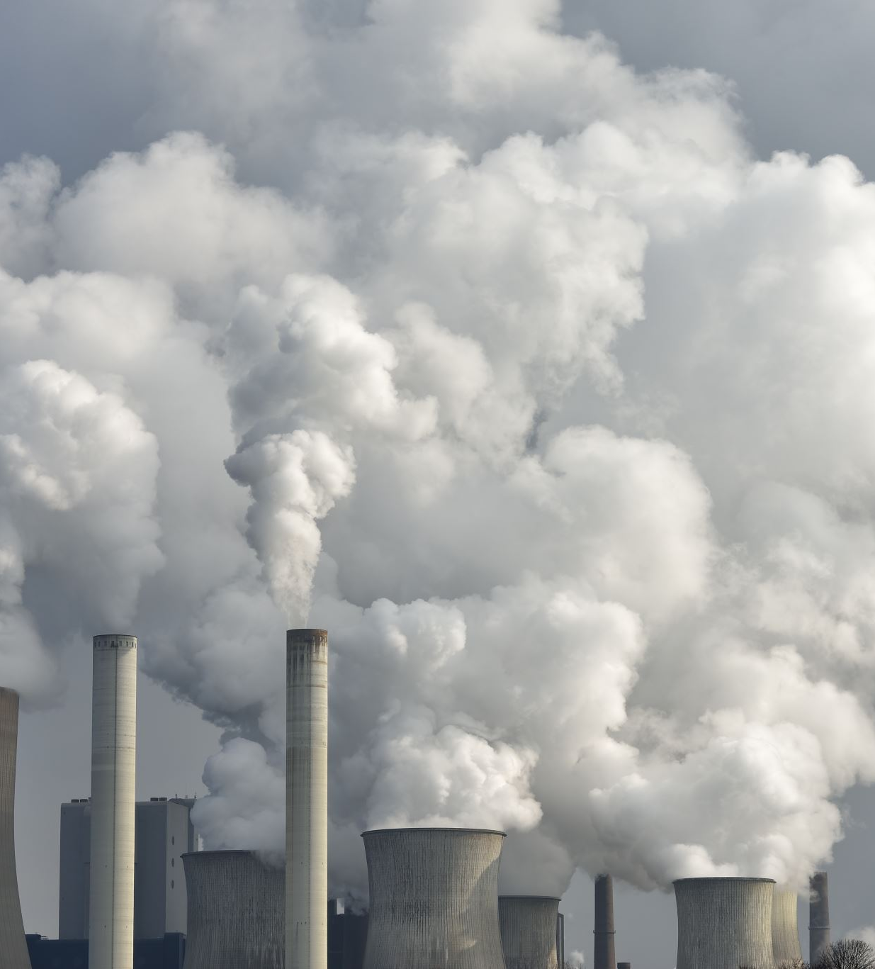
Conclusions
Emissions of developing countries have risen, while developed countries have reduced theirs over the studied period.
The EU increasingly relies on imported emission-intensive inputs, indicating a shift toward the outsourcing of emissions-intensive activities.
A large share of emissions in India’s and China’s exports to the EU are used in downstream production; tariffs on these could significantly raise production costs.
Given deep global trade and GVC interdependence, unilateral trade measures risk hampering free trade and raising costs.
Such measures may also threaten the competitiveness of domestic manufacturers of downstream sectors, exacerbate trade tensions and disrupt global supply chains.

Slide 26
Thank You

