Slide 1


An input-output analysis of the key drivers in CO2 emissions from a regional supply perspective: an application to the Brazilian economy
Fernando Salgueiro Perobelli - UFJF
Geoffrey G D Hewings - UIUC
Eduardo Amaral Haddad - USP
Edson Paulo Domingues - UFMG
Guilherme Perobelli Salgueiro – UFMG
64th Annual Meeting of the Western Regional Science Association.
February, 2025 – Lake Las Vegas, Nevada

Slide 2
Introduction
Brazil emitted 2.3 billion gross tons of greenhouse gases in 2022.
Deforestation, the main responsible for greenhouse gas emissions in Brazil.
  In 2022, the destruction of forests emitted 1.12 billion gross tons of carbon dioxide, corresponding to 48% of Brazilian emissions
  In 2021, deforestation emitted 1.32 billion tons of greenhouse gases, representing 50% of the total of Brazilian emissions.
  The amount of greenhouse gases from agriculture grew.
    In 2022, the sector emitted 617.2 million tons of greenhouse gases, an increase of 3.2% compared to 2021, when 598.3 million tons were emitted.

Slide 3
Introduction
Pressures upon sustainable growth
Production process
Household consumption
International Trade

Slide 4
Introduction
The use of input-output analysis has growing in the field of environmental assessment:
  From the household perspective: Lenzen, et al, (2006), Zhu et al, (2014), Perobelli, et al (2015), Wang et al (2015), Zhang et al. (2017), Zhou and Gu (2020).
  Multi regional analysis: Lenzen, et al, (2004), Liang, et al (2007), Andrew, et al (2009), Wiedmann, et al (2010), Su and a-Ang (2014), Zhang , et al (2014), Su, et al (2020), de Araujo, et al(2020).
  Impacts of international trade and interregional trade: Machado, et al (2001), Wiebe, et al (2012), Wiebe, et al (2012b, Vale, et al (2018), Haddad et al (2024).

Slide 5
Introduction
Objective: analyze, from a production perspective the most important drivers, responsible for CO2 emissions and apply it to Brazilian economy for the year 2019.
Methodology: we use an input-output approach from the supply side to capture the impact of income generation upon CO2 emissions. Also, a Fixed Effect Model.

Slide 6
Introduction
Contribution to the literature:
  Analysis for a developing country.
  Measure the impacts from the supply side.
  Build a typology of sectors and regions emissions in Brazil.
  Implement a systemic analysis.
  Deal explicitly with the Brazilian value chain.

Slide 7
Database
Two datasets.
  Inter-regional input-output matrix for the 27 states of the Federation with 68 productive sectors for a base year in 2019
  The emissions in the Brazilian economy from Greenhouse Gas Emissions and Removals Estimation System dataset (SEEG).
  The Nucleus of Regional and Urban Economics at the University of São Paulo (NEREUS) compatibilized the emissions data with the inter-regional input-output matrix

Slide 8
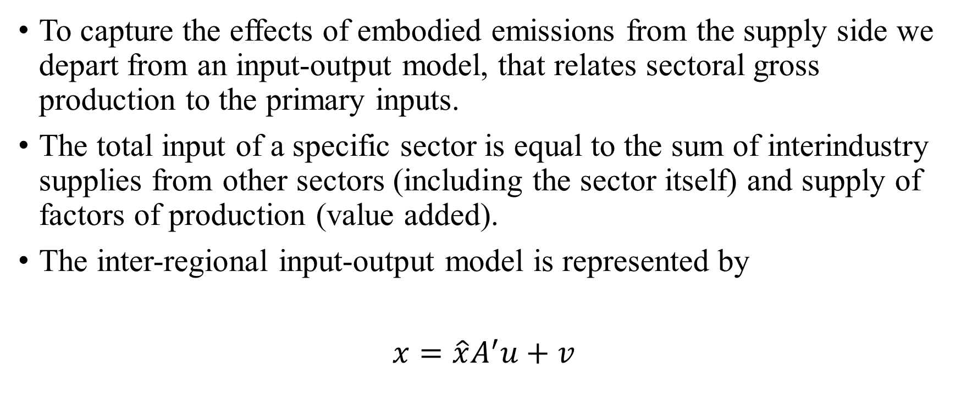
Methodology
To capture the effects of embodied emissions from the supply side we depart from an input-output model, that relates sectoral gross production to the primary inputs.
The total input of a specific sector is equal to the sum of interindustry supplies from other sectors (including the sector itself) and supply of factors of production (value added).
The inter-regional input-output model is represented by
$x=\hat{x}A^{′}u+v$

Slide 9
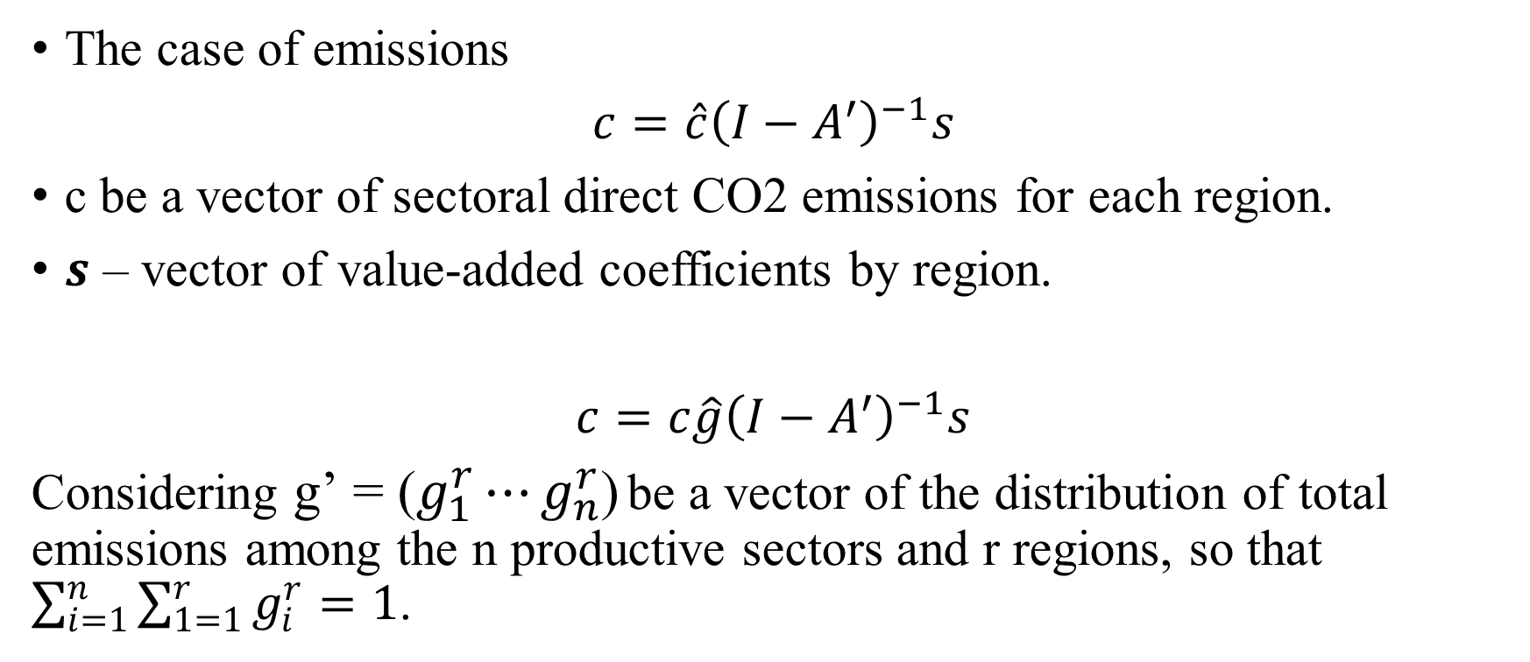
Methodology
The case of emissions
$c={\hat{c}\left(I−A^{′}\right)}^{−1}s$
c be a vector of sectoral direct CO2 emissions for each region.
$s$ – vector of value-added coefficients by region.
$c=c{\hat{g}\left(I−A^{′}\right)}^{−1}s$
Considering g’ = ($g_{1}^{r}⋯g_{n}^{r}$) be a vector of the distribution of total emissions among the n productive sectors and r regions, so that $\sum_{i=1}^{n}{\sum_{1=1}^{r}{g_{i}^{r}}}=1$.

Slide 10
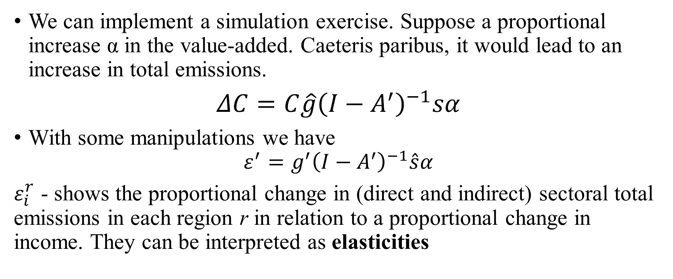
Methodology
We can implement a simulation exercise. Suppose a proportional increase α in the value-added. Caeteris paribus, it would lead to an increase in total emissions.
$ΔC=C{\hat{g}\left(I−A^{′}\right)}^{−1}sα$
With some manipulations we have
$$ε^{′}=g^{′}{\left(I−A^{′}\right)}^{−1}\hat{s}α$$
$ε_{i}^{r}$ - shows the proportional change in (direct and indirect) sectoral total emissions in each region r in relation to a proportional change in income. They can be interpreted as elasticities

Slide 11
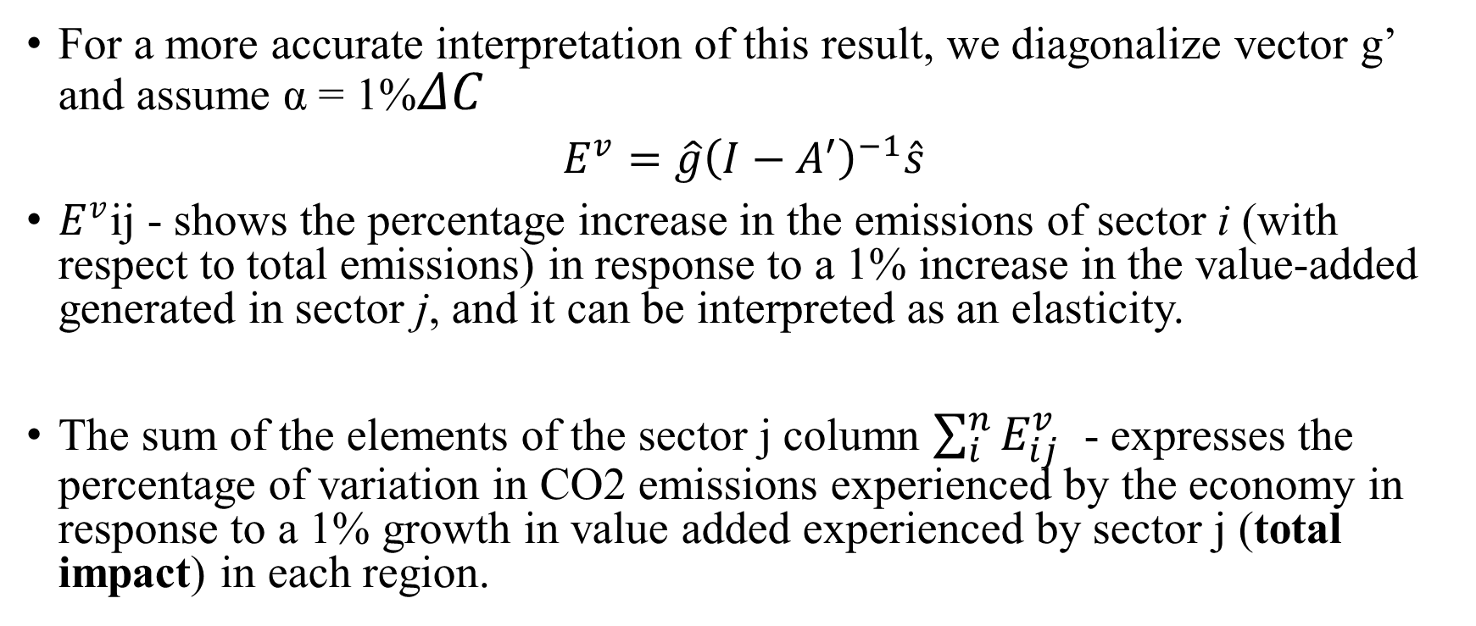
Methodology
For a more accurate interpretation of this result, we diagonalize vector g’ and assume α = 1%$ΔC$
$E^{v}=\hat{g}{\left(I−A^{′}\right)}^{−1}\hat{s}$
$E^{v}$ij - shows the percentage increase in the emissions of sector i (with respect to total emissions) in response to a 1% increase in the value-added generated in sector j, and it can be interpreted as an elasticity.
The sum of the elements of the sector j column $\sum_{i}^{n}{E_{ij}^{v}}$ - expresses the percentage of variation in CO2 emissions experienced by the economy in response to a 1% growth in value added experienced by sector j (total impact) in each region.

Slide 12
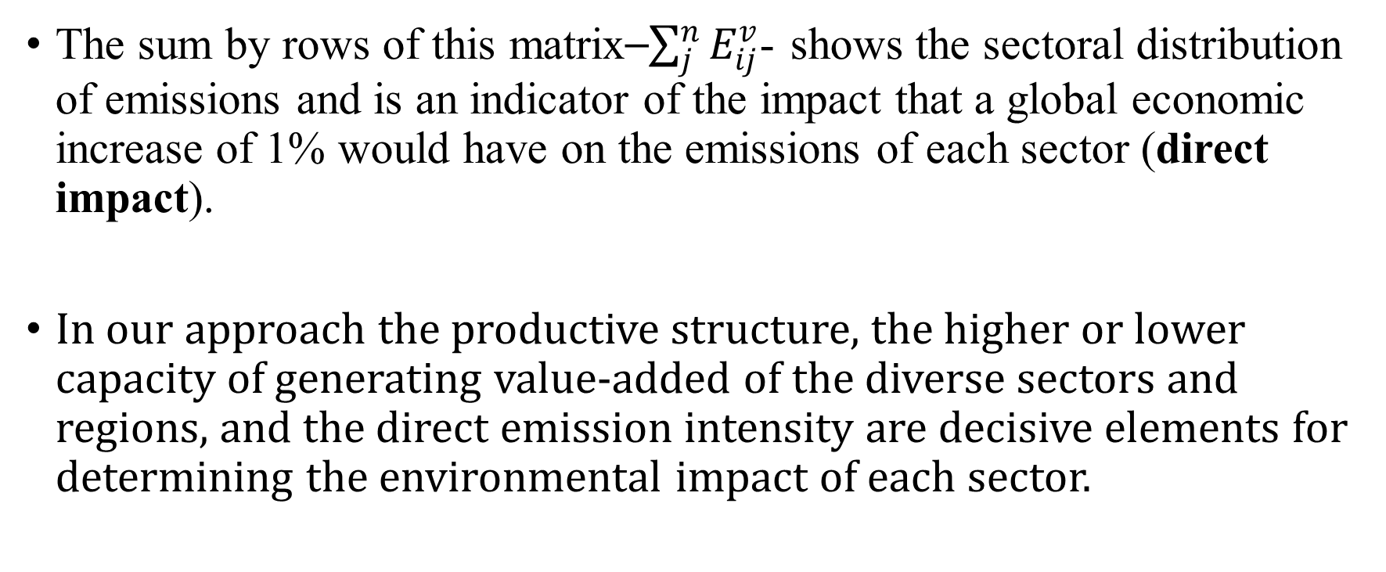
Methodology
The sum by rows of this matrix⎯$\sum_{j}^{n}{E_{ij}^{v}}$- shows the sectoral distribution of emissions and is an indicator of the impact that a global economic increase of 1% would have on the emissions of each sector (direct impact).
In our approach the productive structure, the higher or lower capacity of generating value-added of the diverse sectors and regions, and the direct emission intensity are decisive elements for determining the environmental impact of each sector.

Slide 13
National Results
Table 1 - sectorial typology to show the role played by each sector in terms of its relevance for CO2 emissions.
We classified the direct and total impact in terms of quartiles.
The sectors localized in the third and fourth quartiles in both distributions are those that have the major impact (both direct and total).
The results for these sectors are above the average for the two kinds of impact. From these perspectives, we can classify the sectors as “Key” in terms of CO2 emission.

Slide 14
National Results
An 1% increase in the economy's income implies a variation of 0.8037% in total direct emissions in this set of 12 key sectors.
 |  | Direct Impact
 |  | 4th. Quartile | 3rd. Quartile | 2nd. Quartile | 1st Quartile
Total Impact | 4th Quartile | 1, 2, 3, 5, 10, 19, 21, 26, 27, 38, 42, 43 |  | 55 | 53, 59
 |  | Total = 0,6073
 |  | Direct = 0,8037
 | 3rd Quartile | 17, 41, 44 | 4, 25, 39, 52, 58, 60, 61 | 22, 29, 57 | 24, 37, 46
 | 2nd Quartile |  | 7, 8, 40, 47, 68 | 16, 20, 31, 32, 34, 50, 63 | 18, 48, 51, 67
 |  |  | 9, 11, 13, 62, 66 | 45, 64, 65 | 12,14,15, 23, 30, 35, 36, 49
 | 1st Quartile |  |  |  | Total = 0,0017
 |  |  |  |  | Direct = 0,0001
Table 1. Sectoral classification according to direct and total impact - 2018
A 1% increase in the value-added in these sectors implies a 0.6073% total increase in emissions of the economy.

Slide 15
Impact of the “key” sectors in CO2 emission – 2018 (%)
We observe the elasticity of the emission of the sectors classified as “key” (Table 1) in response to a 1% increase in value-added.

Slide 16
Regional Results
Total and direct impact on CO₂ emissions by Brazilian states: 2019
Regions | Total Impact |  | Direct Impact |  | Most relevant
 | Elasticity | % of total | Elasticity | % of total | impact
Rondônia | 0,0637 | 7,9% | 0,0924 | 9,2% | Direct Impact
Acre | 0,0178 | 2,2% | 0,0288 | 2,9% | Direct Impact
Amazonas | 0,0563 | 7,0% | 0,0784 | 7,8% | Direct Impact
Roraima | 0,0095 | 1,2% | 0,0139 | 1,4% | Direct Impact
Pará | 0,1298 | 16,2% | 0,1937 | 19,4% | Direct Impact
Amapá | 0,0016 | 0,2% | 0,0021 | 0,2% | Direct Impact
Tocantins | 0,0217 | 2,7% | 0,0356 | 3,6% | Direct Impact
Maranhão | 0,0396 | 4,9% | 0,0565 | 5,7% | Direct Impact
Piauí | 0,0113 | 1,4% | 0,0168 | 1,7% | Direct Impact
Ceará | 0,0135 | 1,7% | 0,0164 | 1,6% | Direct Impact
Rio Grande do Norte | 0,0051 | 0,6% | 0,0052 | 0,5% | Direct Impact
Paraíba | 0,0049 | 0,6% | 0,0072 | 0,7% | Direct Impact
Pernambuco | 0,0114 | 1,4% | 0,0102 | 1,0% | Total Impact
Alagoas | 0,0029 | 0,4% | 0,0019 | 0,2% | Total Impact
Sergipe | 0,0032 | 0,4% | 0,0034 | 0,3% | Direct Impact
Bahia | 0,0305 | 3,8% | 0,0366 | 3,7% | Direct Impact
Direct impacts – that measure the percentage increase in the emissions of the economy that occurs in each region in response to an 1% increase in value-added by all regions.
Total impacts – that measure the percentage increase in the emissions generated by the whole productive system in response to an 1% increase in value-added by the corresponding region.

Slide 17
Regional Results
Total and direct impact on CO₂ emissions by Brazilian states: 2019
Regions | Total Impact |  | Direct Impact |  | Most relevant
 | Elasticity | % of total | Elasticity | % of total | impact
Minas Gerais | 0,0498 | 6,2% | 0,0568 | 5,7% | Direct Impact
Espírito Santo | 0,0130 | 1,6% | 0,0149 | 1,5% | Direct Impact
Rio de Janeiro | 0,0442 | 5,5% | 0,0347 | 3,5% | Total Impact
São Paulo | 0,1077 | 13,4% | 0,0623 | 6,2% | Total Impact
Paraná | 0,0245 | 3,0% | 0,0212 | 2,1% | Total Impact
Santa Catarina | 0,0153 | 1,9% | 0,0157 | 1,6% | Direct Impact
Rio Grande do Sul | 0,0296 | 3,7% | 0,0298 | 3,0% | Direct Impact
Mato Grosso do Sul | 0,0149 | 1,9% | 0,0216 | 2,2% | Direct Impact
Mato Grosso | 0,0563 | 7,0% | 0,1159 | 11,6% | Direct Impact
Goiás | 0,0193 | 2,4% | 0,0241 | 2,4% | Direct Impact
Distrito Federal | 0,0063 | 0,8% | 0,0038 | 0,4% | Total Impact
Direct impacts – 5 states concentrate more than 50% of the emissions due to the increase in value-added by all regions.
Total impacts – 5 states concentrate more than 50% of total emissions due to an increase in value-added by the corresponding region.

Slide 18
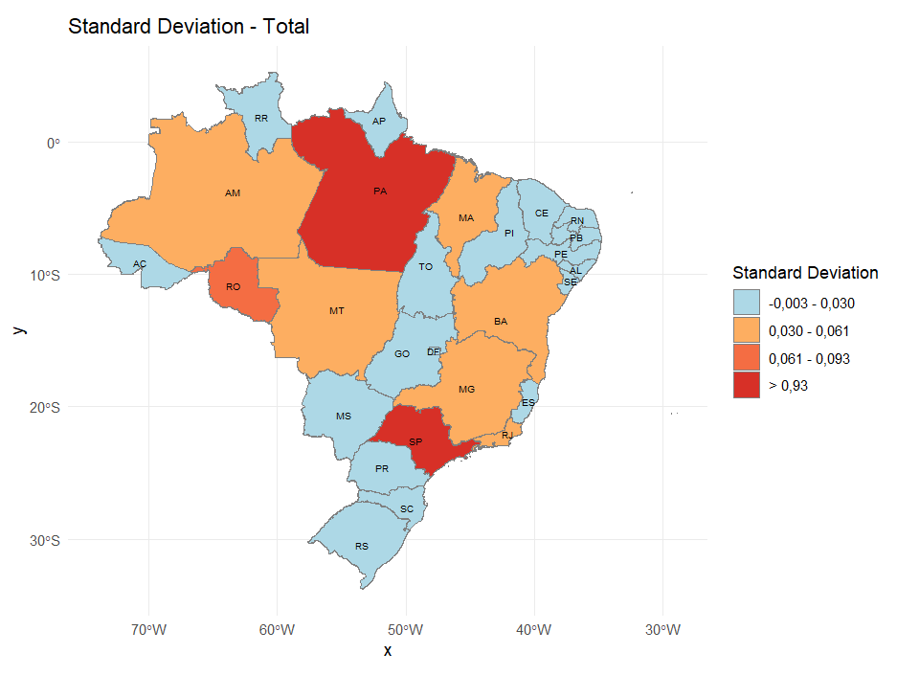
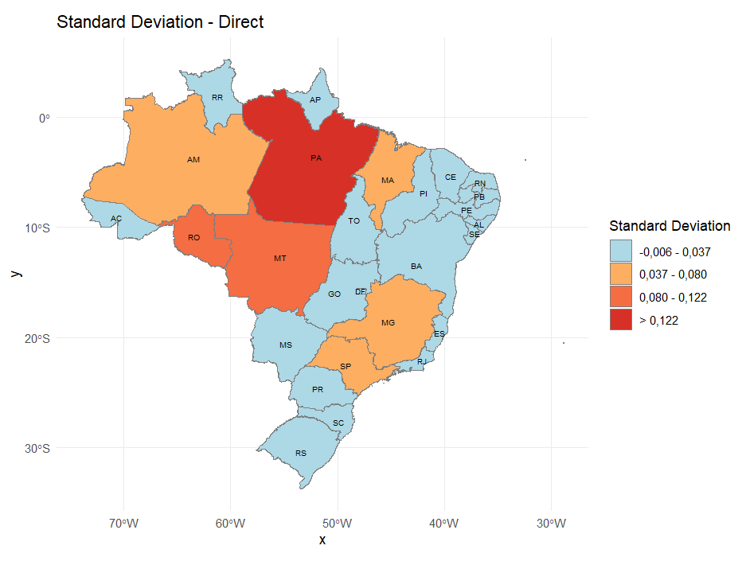
Regional Results – Spatial Analysis
Direct and total impact: standard deviation

Slide 19
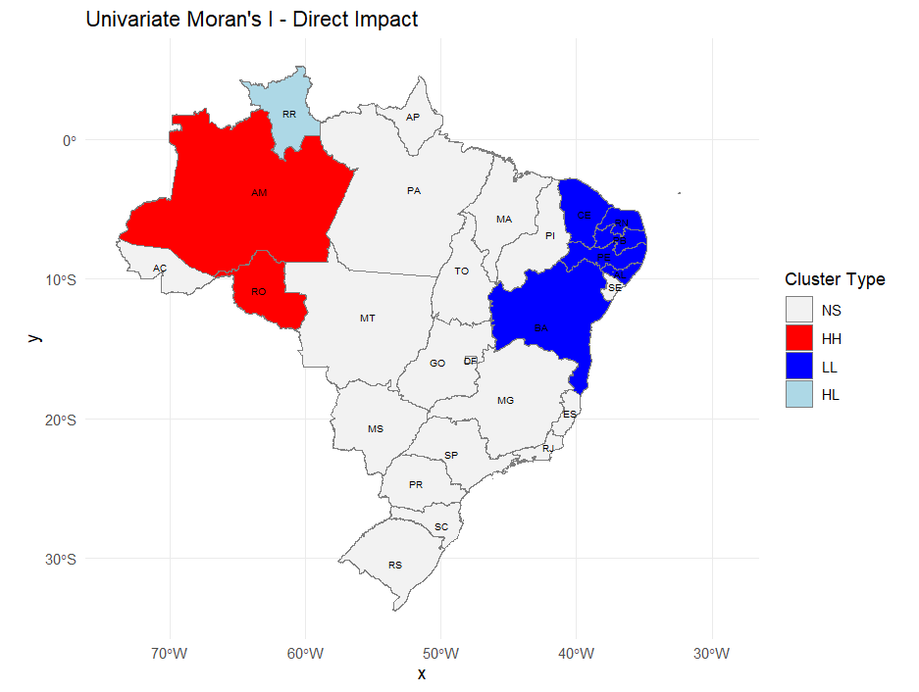
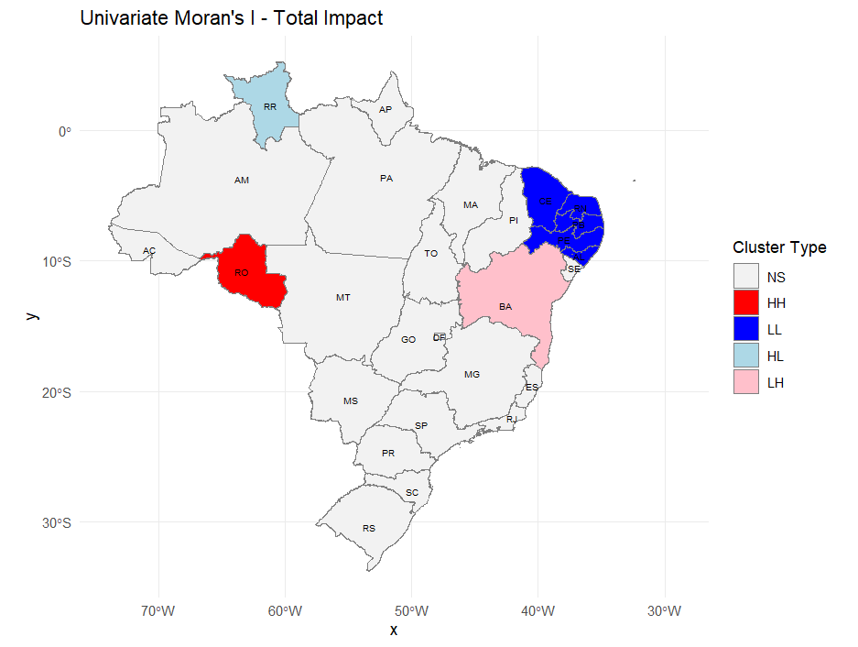
Regional Results – Spatial Analysis
- Local univariate Moran: direct and total impact
Inter-regional pressures
Intra-regional pressures

Slide 20
Regional Results - Typology
An 1% increase in the economy's income implies a variation of 0.6560% in total direct emissions in this set of regions.
 |  | Direct Impact
 |  | 4th. Quartile | 3rd. Quartile | 2nd. Quartile | 1st Quartile
Total Impact | 4th Quartile | RO; AM; PA; MG; SP; MT | RJ | 55 | 53, 59
 |  | Total - 0,5033
 |  | Direct - 0,6560
 | 3rd Quartile | MA | TO; BA; RS; GO | PR
 | 2nd Quartile |  | AC; MS | PI; CE; ES; SC | PE
 |  |  |  | RR | AP; RN; PB; AL; SE; DF
 | 1st Quartile |  |  |  | Total =
 |  |  |  |  | Direct =
Regional classification according to direct and total impact
An 1% increase in the value-added in these regions implies a 0.5033% total increase in emissions of the economy

Slide 21
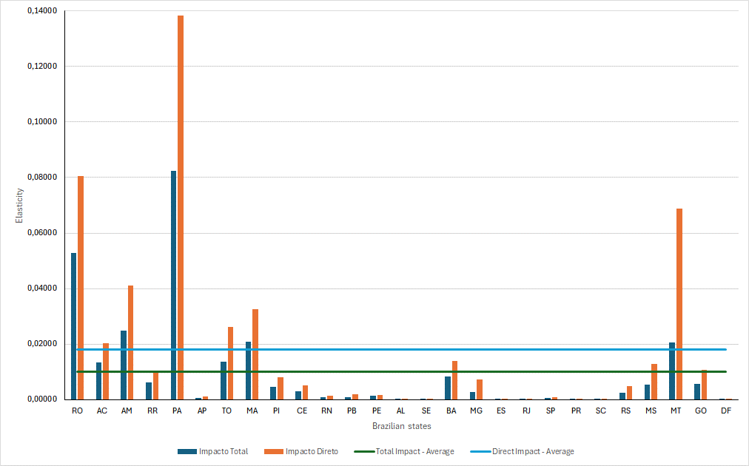
Sectorial Results by region
Livestock including support for livestock: Total and Direct impact by Brazilian states

Slide 22
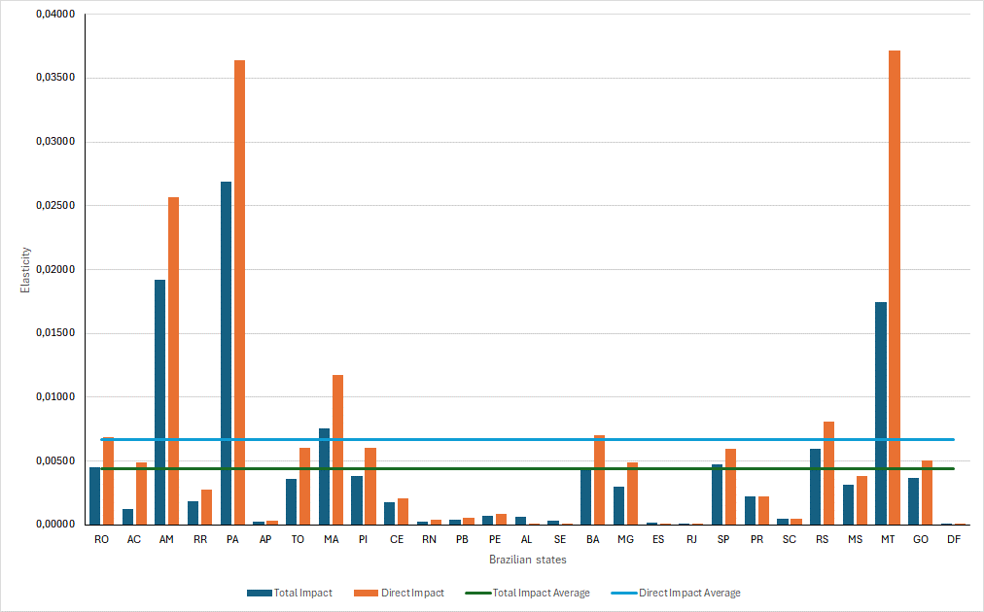
Sectorial Results by region
Agriculture: Total and Direct impact by Brazilian states

Slide 23
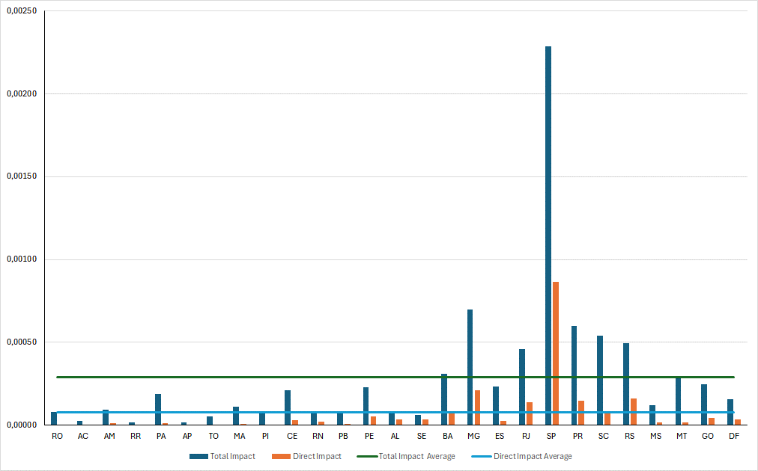
Sectorial Results by region
Whole Sale and Retail Trade: Total and Direct impact by Brazilian states

Slide 24
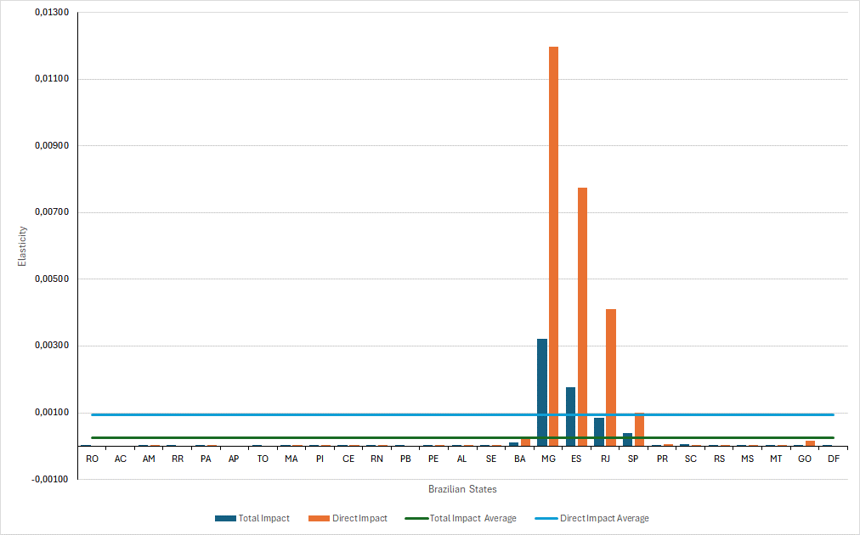
Sectorial Results by region
Production of pig iron/ferroalloys, steel industry and seamless steel tube: Total and Direct impact by Brazilian states

Slide 25
Fixed Effect Model
To complement this analysis and test the significance of the relationship between income from different sectors and emissions, a fixed effects model was built to capture the correlation between sectoral income and emissions.
The sectoral income data were grouped into large productive sectors: exported agriculture, non-exported agriculture, mineral extraction, industry, commerce and services (RAIS, 2024)

Slide 26
Fixed Effect Model
The coefficients show that: for income per capita from the extractive, industry and agriculture of export goods sectors, there is a positive relationship with emissions per capita.
For trade, services and agriculture of non-export goods sectors there is an inverse relationship,

Slide 27
Final Consideration
This paper contributes to the literature measuring the impacts of emissions from the supply side, building a typology of sectors and regions and implementing a systemic analysis.
The sectorial regional analysis highlights the degree of the heterogeneity among the Brazilian states and the different regional drivers for the emissions. For agriculture and livestock, the main driver is local on the other hand the whole sale and the retail trade the main driver is the rest of the economy.
The approach used at this paper is a supply analysis and is important to consider that there is an amount of production of these sectors that are made for other sectors. Thus, the analysis presented here is complementary to the analysis from demand side from the input-output perspective.

Slide 28
Thanks
guilhermeperobelli@outlook.com

