Slide 1
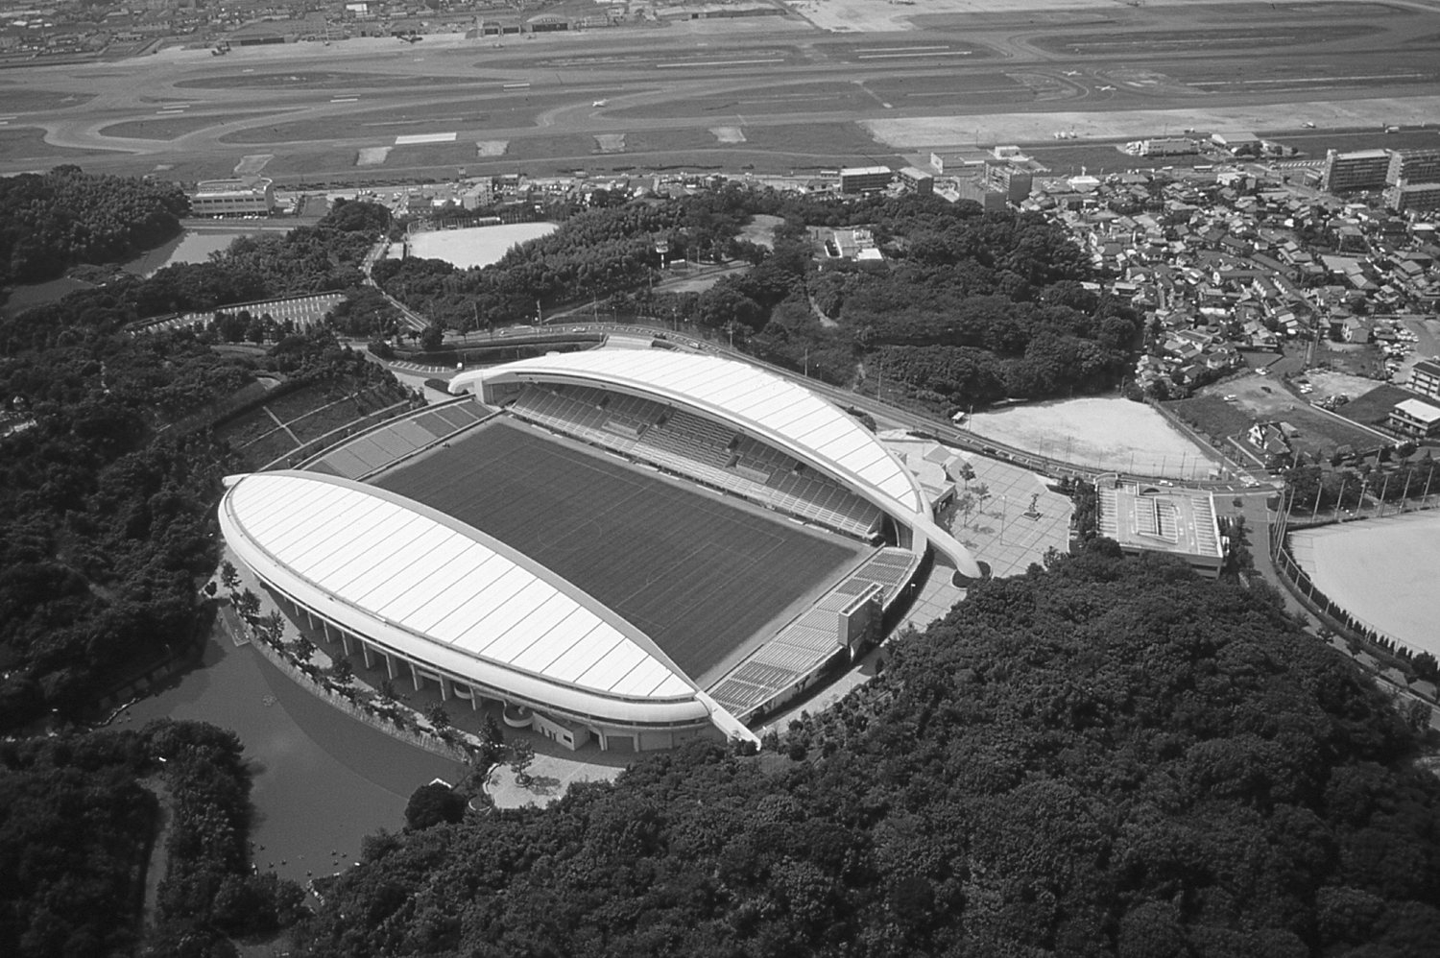
Economic and Environmental Impacts of Sports League Transitions:
A Case Study of the J.League
Ryosuke Yamashitaª, Haruka Todaª, Shigemi Kagawa^{b}
a: Graduate School of Economics, Kyushu University, Fukuoka, Japan
b: Faculty of Economics, Kyushu University, Fukuoka, Japan
Notes:
Hello, I’m Ryosuke Yamashita from Kyushu University
Today, I would like to present my research. My presentation title is Economic and Environmental Impacts of Sports League Transitions:
A Case Study of the J.League

Slide 2
1. A table of contents
Introduction
Methodology
Data
Results
Conclusions
Notes:
The table of contents is as shown.

Slide 3
2. Introduction
Sports events significantly boost local economies by hosting games, yet the travel of players and spectators also imposes environmental burdens
(Luo, 2024; Dolf & Teehan, 2015).
CO₂ emissions associated with players and spectators travel are substantial, accounting for about 70% of the total emissions at the Vancouver 2010 Winter Olympics (VANOC, 2010).
70%
Notes:
First, I will explain about the Introduction section.

Slide 4
2. Introduction
Among all sports, football has around 5 billion fans worldwide (FIFA, 2020), generating enormous economic benefits while also imposing significant environmental impacts(Collins et al., 2007).
Economic benefits
Environmental impacts
Even within the European market alone, the 2023/24 season generated an economic value of €38 billion.
The global football industry emits over 30 million t-CO₂ each year
→Equivalent to Denmark’s
total annual CO₂ emissions.
Notes:
As an economic benefit,
On the other hand, regarding environmental burden

Slide 5
2. Introduction
Previous Research
Aza Conejo et al. (2007)
Sport Management and Marketing
2(5), 459-474
Tóffano Pereira et al. (2019)
Journal of Cleaner Production
227, 167-177
Purpose
Quantified CO₂ emissions from team travel for all 20 English Premier League clubs in 2016/17 by combining travel distances with mode-specific emission factors.
Quantified the economic spillover effects of two soccer clubs in Spain, using input-output analysis.
This study quantitatively evaluates the comprehensive (economic, social, environmental) impacts of J.League and identifies the effects of league trantision.
These studies each assess only a single dimension—such as economic effects or environmental burdens—without offering a holistic evaluation.
Research on sports events has focused heavily on economic aspects, and comprehensive evaluation that includes social and environmental dimensions remains insufficient (Kim & Petrick 2005; Mallen & Chard 2011).
Also, research on league transitions remains scarce.
Notes:
Next, I will introduce about Previous Research.
However, these studies each assess only a single dimension—such as economic effects or environmental burdens—without offering a holistic evaluation. Most sport-event studies focus on economics, with few holistic evaluations that incorporate social and environmental dimensions (Kim & Petrick 2005; Mallen & Chard 2011), and research on league transitions remains scarce
Therefore, this study aims to quantitatively evaluate the comprehensive (economic, social, environmental) impacts of J.League clubs—focusing on Avispa Fukuoka, a J.League club that was promoted from J2 in 2015 to J1 in 2016—and to identify the effects of this league transition.

Slide 6
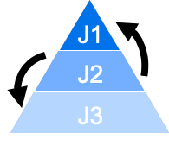
2. Introduction
About J LEAGUE
Overview
The J.LEAGUE—formally the Japan Professional Football League—is Japan’s professional football pyramid with three divisions (J1 to J3); clubs move up or down between divisions each year based on their season performance.
Teams play every other club in their division, home and away.
As of 2024, each division contains 20 clubs, and teams are spread across 41 of Japan’s 47 prefectures.
In this study, we focus on promotion among league changes.
Target club: Avispa Fukuoka -2015(J2), 2016(J1)
Notes:
I will give an overview of the J.League
J1 is the most competitive and popular division.
Target club is Avispa Fukuoka, a football team based in Fukuoka Prefecture; it played in J2 in 2015 and, after promotion, competed in J1 in 2016.

Slide 7
3. Methodology
Estimating tourism consumption by home and away spectators
Estimating social, economic, and environmental impacts of spectator tourism consumption — An input-output analysis
Estimating CO₂ emissions from away spectators’ travel between other prefectures and Fukuoka prefecture
Social impact
? ? ? persons
Economic impact
? ? ? yen
Environmental impact
? ? ? t-CO₂
Fukuoka
Other prefectures
? ? ? t-CO₂
Notes:
Next, I will explain the methodology.
This is the Flow of the method.
First, We estimate tourism consumption by home and away spectators.
In this study, we classify spectators into home spectators and away spectators.
Home spectator is fan in Fukuoka who support Avispa Fukuoka
Away spectator is fan who support clubs in other prefectures.
Second, we estimate social, economic, and environmental impacts of spectator tourism consumption by input-output analysis
Third we estimate CO₂ emissions from away spectators’ travel between other prefectures and Fukuoka prefecture.
Next, I will discuss the details of each step

Slide 8
3. Methodology
1. Estimating tourism consumption by home and away spectators
Home spectators：
${ f}_{t}^{h }=\left(f_{t,i}^{h}\right)=\left(y_{i}^{day}×s_{t}×r\right)$ (1)
$$\begin{aligned}&f_{t}^{a}=\left(f_{t,i}^{a,stay}\right)=\left\{y_{i}^{a,stay}×s_{t}×\left(1−r\right)\right\}\#\end{aligned}$$
Away spectators ：
(2)
${ f}_{t}^{h }$ : Spending by home spectators ($h$) in year $t$ on industry $i$within Fukuoka Prefecture—here, the
Eating and Drinking services and Transportation sectors
$yiday$ : Average tourist outlay per day-trip visitor to Fukuoka Prefecture on industry $i$—here, the
Eating and Drinking services and Transportation sectors
${ s}_{t}$ : Annual total attendance in year $t$
$r$ : Proportion of stadium seats reserved for home spectators
${ f}_{t}^{a}$ : Spending by away spectators ($a$) in year $t$ on industry $i$within Fukuoka Prefecture—here, the
Eating and Drinking service and Transportation, Hotels sectors
$y_{i}^{a,stay}$: Average spending per overnight visitor to Fukuoka Prefecture on industry $i$—here, the the
Eating and Drinking service and Transportation, Hotels sectors
Notes:
First, let’s. talking about Estimating tourism consumption by home and away spectators.
Using equations No.1) and No.2, we constructed tourism-expenditure vectors for both home and away spectators.

Slide 9
3. Methodology
2. Estimating Social, economic, and environmental impacts of spectator tourism consumption
— An Input-Output Analysis
Social impact : $l_{t}={w\left(I−A\right)}^{−1}\left(f_{t}^{h}+f_{t}^{a}\right)=wLf_{t}$ (3)
Economic impact : $y_{t}=vLf_{t}$ (4)
Environmental impact: $q_{t}=eLf_{t}$ (5)
$l_{t} :$ Number of induced jobs created by spectator tourism consumption in year $t$
$w$: Employment coefficient vector derived from the employment table
$I$ : Identity matrix $A$: Input coefficient matrix
$L$ :Leontief inverse matrix
$f_{t}$ : Final-demand vector in year $t$, combining consumption by home and away spectators
$y_{t}$ : Induced gross value added in year $t$
$v$ : Value-added coefficient vector
$q_{t}$ : Direct and indirect CO₂ emissions associated with spectator tourism consumption in year $t$
$e$:Direct CO₂ emission coefficient vector for each sector, based on national-level data
Notes:
Next, for the second step, Estimating social, economic, and environmental impacts of spectator tourism consumption — An input-output analysis
Social impact is estimated by equation No.3
Ecomonic impact is estimated by equation No.4
Environmental impact is estimated by No.5

Slide 10
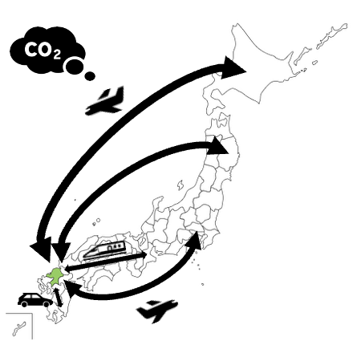
3. Methodology
3. Estimating CO₂ emissions from away spectators’ travel between other prefectures and Fukuoka prefecture
$$C=\sum_{i}^{K}{\sum_{j}^{k}{{g_{j}D}_{j}^{i}N^{i}s_{j}^{i}}}$$
Total CO₂ emissions
(6)
$C$ : CO₂ emissions from away spectators traveling between Fukuoka Prefecture and other prefectures
$gj$ : CO₂ emission factor per passenger-kilometre for transport mode $j$
$D_{j}^{i}$ : Round-trip travel distance for away spectators of prefecture $p$using transport mode $j$
$Ni$ : Number of spectators from prefecture $p$
$s_{j}^{i}$ : Proportion of prefecture $p$’s spectators who choose transport mode $j$
Notes:
Finally, in the last step of the methodology, Estimating CO₂ emissions from away spectators’ travel between other prefectures and Fukuoka prefecture.
we used equation (6) to estimate the CO₂ emissions generated during travel between other prefectures and Fukuoka Prefecture.

Slide 11
4. Data
Embodied energy and emission intensity data for Japan using
input-output tables (3EID)
2015 Fukuoka Prefecture Estimated Tourist Arrivals Survey Report
2015 Fukuoka Prefecture Employment Table
2015 input-output table for Fukuoka Prefecture
J. LEAGUE Data Site
2015 Nationwide Trunk Passenger Net Flow Survey
Inventory of Greenhouse Gas Emissions and Sinks
Travelmath
Notes:
The data used in this study are as shown here.

Slide 12
5. Results
Attendance trends in 2015 and 2016
Total annual attendance was 185,420 people in 2015 and 218,576 people in 2016.
Average attendance per match grew from 8,692 people in 2015 to 12,857 people in 2016.
Promotion reduced home games from 21 to 17, yet average attendance per match rose 1.5 times.
To account for changes in the number of matches, we assess the impact of promotion from two angles:
1. Annual aggregate figures
2. Per-match averages
Trend in average attendance of Avispa Fukuoka during the study period
Notes:
Next, let’s move on to the results. First, we examine the trend in attendance.
The figure on the left shows how Avispa Fukuoka’s average home crowd has changed. The vertical-axis gives the number of spectators, and the horizontal-axis shows the years. Avispa Fukuoka’s Total annual attendance was about one hundred eighty-five thousand people in 2015 and about two hundred twenty thousand people in 2016.
Also, average attendance per match grew from about eight thousand seven hundred people in 2015 to about thirteen thousand people in 2016.
Promotion reduced home games from 21 to 17, yet average attendance per match rose 1.5 times.
To account for changes in the number of matches, we assess the impact of promotion from two angles: 1. Annual aggregate figures 2. Per-match averages

Slide 13
5. Results
Overall view of the social, economic, and environmental impacts of match attendance
Social impact is expressed as the number of jobs created, economic impact as
value added, and environmental impact as CO₂ emissions.
Job created (person) Value added (100 million yen) CO₂ emissions (t-CO₂)
+51person
+250 million yen
+2,700 t-CO₂
Notes:
Next, I present the overall impact of spectator attendance on the social, economic, and environmental dimensions.
These figures show the social, economic, and environmental impacts.
Social impact is expressed as the number of jobs created, economic impact as value added, and environmental impact as CO₂ emissions.
The dark bars show the increase caused by promotion: 51 more jobs, about ¥250 million in extra value, and roughly 2,700 tons of additional CO₂ emissions.
Next, I will discuss the details of the three indicators.

Slide 14
5. Results
Social impacts induced by spectator consumption
The number of jobs created grew from 261 in 2015 to 312 in 2016. In 2016,about 70% of the total was due to away spectator consumption.
Home spectators: 70% on Eating and drinking services sector
Away spectators: 36% on Hotels , 27% on Eating and drinking services
and 26% Road transport sectors.
On a per-person basis, away spectators created ten times more jobs than home spectators.
Social impacts induced of spectator consumption
by category and sector (2015–2016)
Notes:
First, about the social impact.
The figure on the left shows the social impacts induced by spectator consumption and breaks them down into individual components.
Shades of blue indicate service sectors, while shades of brown represent the transport sector.
For home spectators, 70% on Eating and Drinking service sector. For away spectators ,36% on Hotels sector, 27% on Eating drinking services sectror, and 26% onRoad transport sector.
On a per-person basis, away spectators created ten times more jobs than home spectators.

Slide 15
5. Results
Economic impacts induced by spectator consumption
The number of value added grew from 1.57 billion yen in 2015 to 1.82 billion yen in 2016. In 2016,about 70% of the total was due to away spectator consumption.
Home spectators: 35% on Eating and Drinking sector, and 23% on Petroleum refinery products. Away spectators: 26% on Hotels sector, and 22% on Road transport sector.
On a per-person basis, away spectators generated eleven times more value added than home spectators.
Economic impacts induced of spectator consumption
by category and sector (2015–2016)
Notes:
Second, about the economic impact.
The figure on the left shows the economic impacts induced by spectator consumption and breaks them down into individual components.
The number of value added grew from 1.57 billion yen in 2015 to 1.82 billion yen in 2016. In 2016,about 70% of the total was due to away spectator consumption.
For home spectators, 35% on Eating and Drinking sector, and 23% on Petroleum refinery products..
For away spectators , 26% on Hotels sector, and 22% on Road transport sector.
Also, on a per-person basis, away spectators generated eleven times more value added than home spectators.

Slide 16
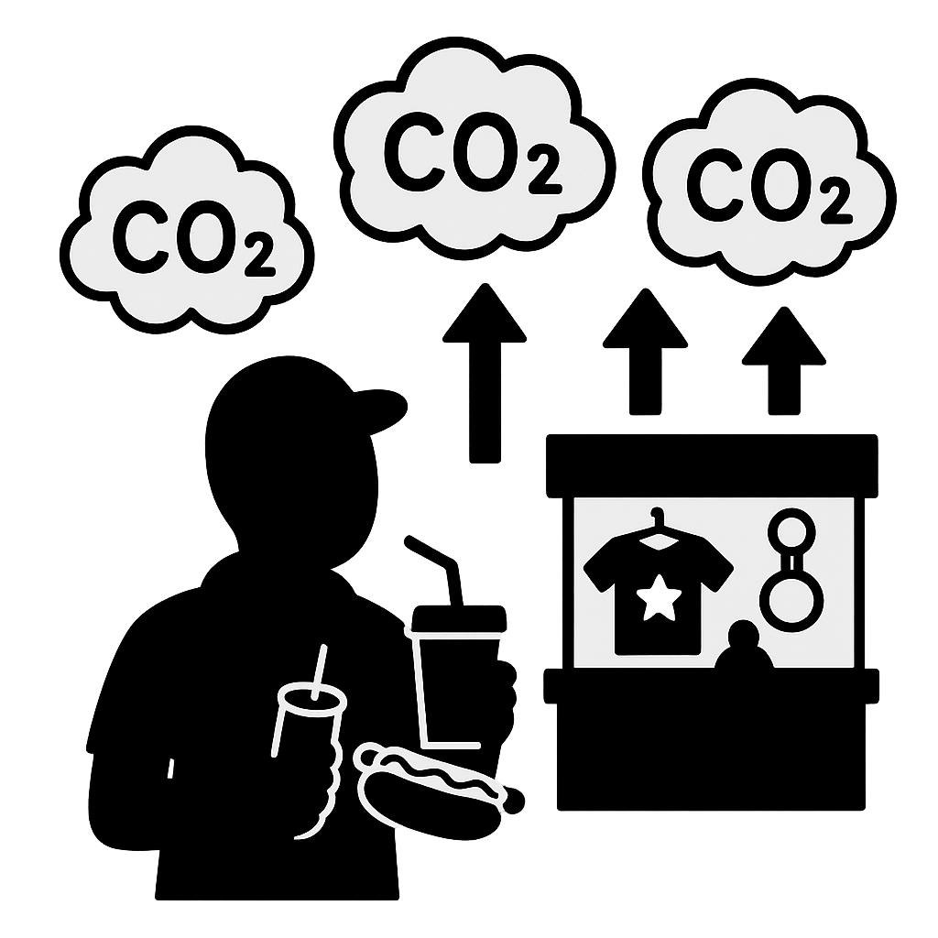
5. Results
In this study, the environmental impact has two parts:
CO₂ from spectator travel to Fukuoka Prefecture and CO₂ from their consumption in Fukuoka Prefecture.
+
Notes:
Finally, about the environmental impact.
In this study, the environmental impact has two parts: CO₂ from spectator travel to Fukuoka Prefecture and CO₂ from their consumption in Fukuoka Prefecture.

Slide 17
5. Results
CO₂ emissions from spectator travel to Fukuoka Prefecture
Promotion
2015
2016
4,809
t-CO₂
6,901
t-CO₂
CO₂ emissions from domestic travel in 2015
CO₂ emissions from domestic travel in 2016
The rise in away spectators following the club’s promotion increased CO₂ emissions from travel to Fukuoka Prefecture by about 2,100 t-CO₂
Notes:
First, about CO₂ emissions from spectator travel to Fukuoka Prefecture.
The environmental impact has two parts: CO₂ from spectators traveling within Japan, and CO₂ from their consumption in Fukuoka Prefecture.
These graphs show the CO₂ emissions generated by travel between Fukuoka Prefecture and other prefectures in 2015 and 2016, respectively, along with their breakdown.
Concentrating on the CO₂ released by travel from other prefectures to Fukuoka, the surge of away spectators after the club’s promotion raised travel-related emissions by roughly 2,100 t-CO₂.

Slide 18
5. Results
5. Results
Environmental impacts induced by spectator consumption
The number of CO₂ emissions rose from 4,398 t-CO₂ in 2015 to 5,029 t-CO₂ in 2016. In 2016,about 70% of the total was due to away spectator consumption.
Home spectators: 43% on Petroleum refinery products sector, and 24% on Electricity sectors. Away spectators: 36% on Electricity sector, and 30% on Road transport sector.
On a per-person basis, away spectators generated ten times more CO₂ emissions than home spectators.
Environmental impacts induced of spectator consumption
by category and sector (2015–2016)
Notes:
The figure on the left shows the environmental impacts induced by spectator consumption and breaks them down into individual components.
The number of CO₂ emissions rose from abou 4,400 t-CO₂ in 2015 to abou 5000 t-CO₂ in 2016. In 2016, about 70% of the total was due to away spectator consumption.
For home spectators, 43% on Petroleum refinery products sector, and 24% on electricity sector.
For away spectator, 36% on Electricity sector, and 30% on Road transport sector.
On a per-person basis, away spectators generated ten times more CO₂ emissions than home spectators.

Slide 19
5. Results
Tripple bottom line evaluation of the league transition
Indexed to 2015 (= 100%)
Social impact increased by 47%
Economic impact increased by 44%
Environmental impact increased by 60%
Social & economic gains Higher spectator spending after promotion → more employment & greater value added
Environmental cost CO₂ emissions also rose, indicating a larger environmental burden
Comparison of per-Match Social, economic and environmental Impacts Induced by spectators consumption
(2015-2016)
Notes:
Next, I will present the actual impact values. The figure is a chart produced by normalizing the 2015 values to 100 %.
The social impact reached 147 %, the economic impact 144 %, and the environmental impact 160 %.
From this results, higher spectator spending after promotion translated into more employment and greater value added, while CO₂ emissions also rose, signalling a larger environmental burden.

Slide 20
6. Conclusions
League promotion brought clear economic and social benefits while even as increasing CO₂ emissions.
It’s highlighting a growth–sustainability trade-off.
In real terms, the 2016 promotion brought a 47% rise in social impact, a 44% rise in economic impact, and a 60% rise in environmental burden—substantial changes across all dimensions.
Away spectators were the dominant contributors to the prefectural impacts, accounting for roughly 70% of each dimension.
Notes:
I will now move on to the conclusions of this study.

Slide 21
6. Conclusions
Policy implication
Policy implication
Home Spectators
Away Spectators
Bundle match tickets with local rail/bus fare to shift trips from private cars
Introduce dynamic parking fees and channel the revenue into on-site renewable power (e.g., solar EV chargers)
Match ticket bundled with public transport + accomodation at renewable-energy / energy-efficient certified hotels
Convert club’s official buses to hydrogen-powered “Moving e” vehicles
H₂
Notes:
Next, about offer policy recommendations derived from the findings of this study.
As policy recommendations aimed at home spectators, we propose two measures. First, bundle match tickets with local rail or bus fares to encourage a modal shift away from private cars. Second, introduce dynamic parking fees and earmark the resulting revenue for on-site renewable-energy facilities—such as solar-powered EV charging stations. Implemented together, these actions could meaningfully reduce private-car use, the main source of the environmental burden generated by home spectators.
For away spectators, we propose two policy measures. First, create an all-in-one package that bundles the match ticket with public-transport fares and accommodation in renewable-energy or energy-efficient certified hotels. Second, replace the club’s official charter buses with hydrogen-powered “Moving e” vehicles. “Moving e” is a hydrogen bus currently being piloted by Fukuoka Prefecture and has already been deployed to shuttle fans to Avispa Fukuoka’s stadium, making the transition both technically proven and operationally realistic.
We believe these measures will enable low-carbon mobility.

Slide 22
Thank you for your attention!

