Slide 1
Towards a Low-Carbon Future for China's Power Supply Chain: Critical Sectors Identification and Scenario Analysis
Lin Tang¹, Jin Yang^{1,*}
¹ School of Economics and Management, China University of Geosciences, Beijing 100083, China
* Corresponding author

Slide 2
Outline
1. Introduction
2. Methods and Data
2.1 Disaggregation of the electricity sector in the IO table
2.2 Embodied carbon emission accounting
2.3 Identification of critical upstream carbon emitting and carbon transmission sectors
2.4 Scenario analysis
2.5 Data
3. Results and Discussions
4. Conclusions

Slide 3
1. Introduction

Slide 4
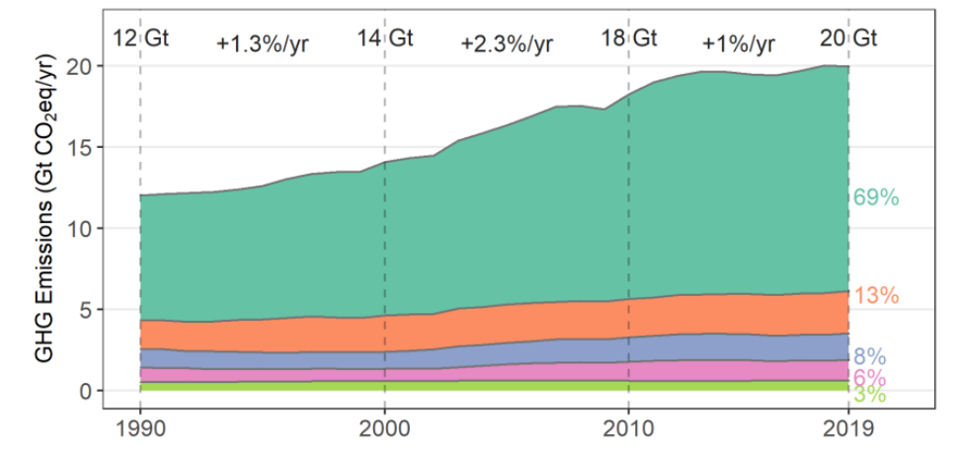
Introduction
Energy systems global GHG emission trends by global energy system emissions
Source: IPCC. AR6 Climate Change 2022: Mitigation of Climate Change
Proportion of power installed capacity of various power generation types in China
Source: China Electric Power Yearbook
The last decades has seen a growing trend toward electricity becoming the central energy.
68% of current electricity generation comes from coal-fired power plants in China, resulting in considerable carbon emissions.
The power sector plays a critical role in achieving China's emission reduction goals, and the transition of the power structure is an essential step toward decarbonizing the sector.

Slide 5
Introduction
China's electricity consumption by province in 2020
Source: China Electric Power Statistical Yearbook
Power generation by power generation type and power supply coal consumption in China's provinces in 2020
Source: China Electricity Council. Compilation of power industry statistics in 2020
Most provinces in China maintain rigid growth in electricity demand. Ensuring power supply is necessary for the economy to function properly.
Provinces that currently undertake a higher share of power generation (e.g., Inner Mongolia, Xinjiang) have relatively higher coal consumption for power supply.

Slide 6
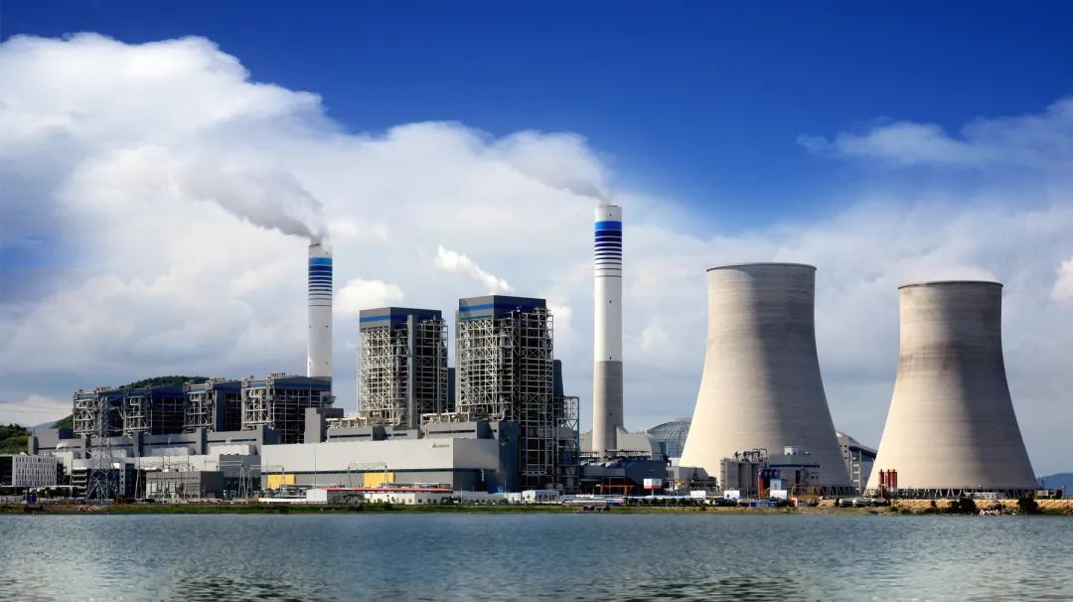
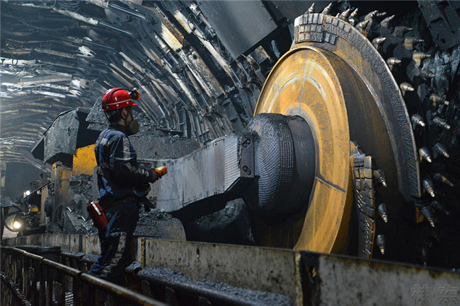
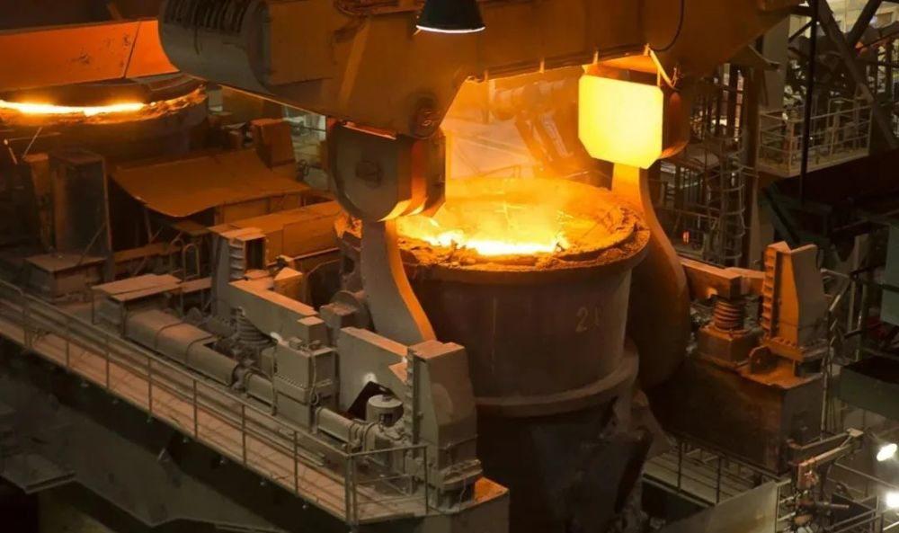
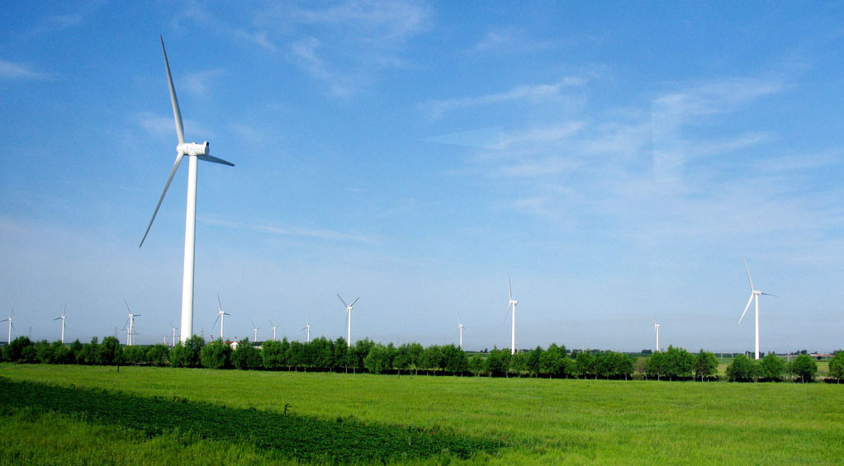
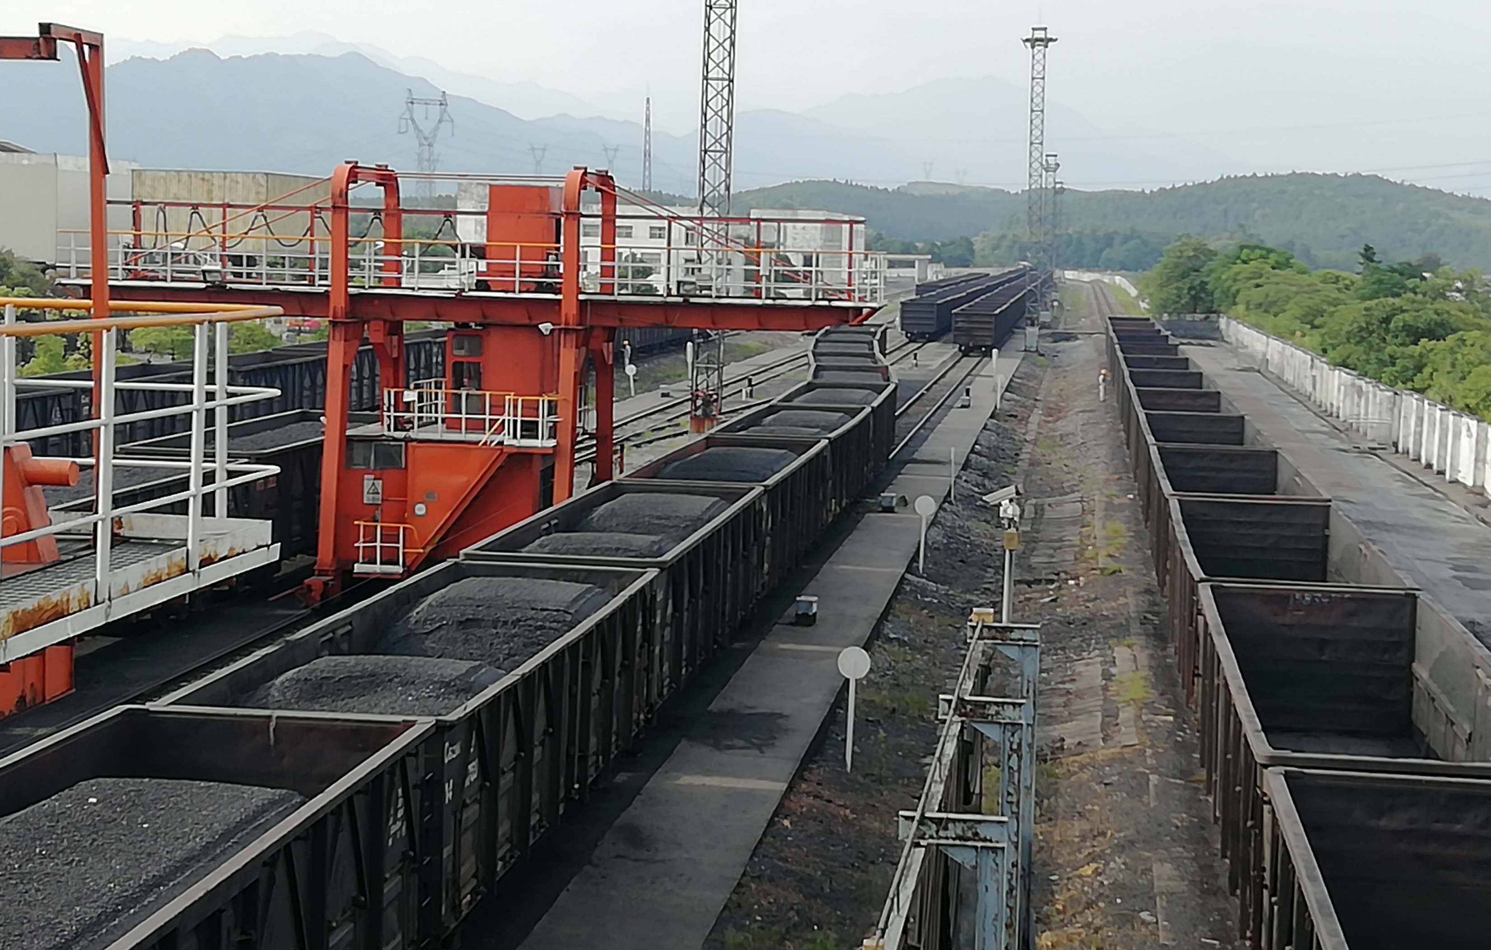
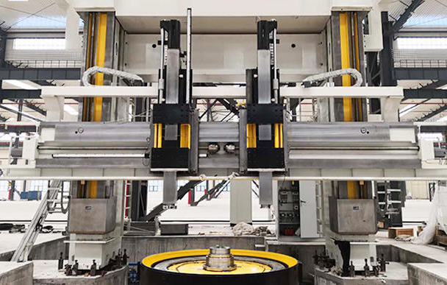
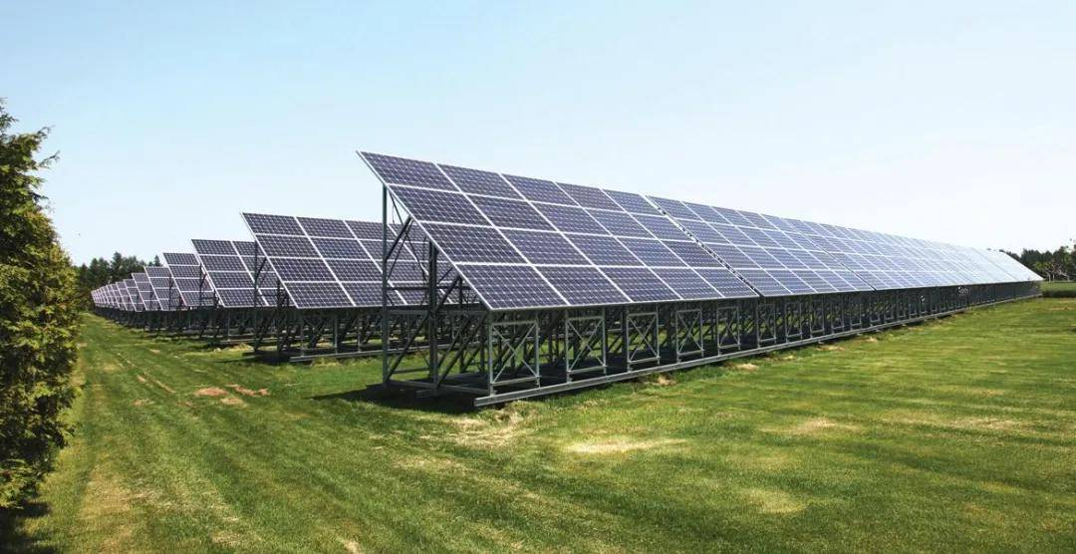
Introduction
Tracking the upstream carbon emissions (indirect emissions) considers the linkages between the power sector and other upstream sectors, which is particularly important in the context of China’s supply-side reform.
Carbon
flow
Carbon
flow
Coal mining
Metal processing
Carbon
flow
Carbon
flow
Coal transportation
Machinery manufacturing
Upstream fuel production
Power generation
Upstream material production

Slide 7
Introduction
Tracking the upstream carbon emissions (indirect emissions) considers the linkages between the power sector and other upstream sectors, which is particularly important in the context of China’s supply-side reform.
Carbon
flow
Carbon
flow
How to achieve supply chain-wide carbon reductions in China’s power system from a provincial perspective?
Coal mining
Metal processing
Carbon
flow
Carbon
flow
Coal transportation
Machinery manufacturing
Upstream fuel production
Power generation
Upstream material production
Notes:
In addition to direct carbon emissions, significant and non-negligible carbon emissions are generated in the supply chain of the power sector. For example, a large number of carbon emissions are generated in the process of coal mining and transportation, and in the process of manufacturing various machinery and equipment. These carbon emissions are generally referred to as embodied carbon emissions. The study of embodied carbon emissions considers the linkages between the power sector and other upstream sectors, which is particularly important in the context of China's supply-side reform.

Slide 8
Introduction
Innovation
Previous studies on the structural transformation of electricity generation have mainly focused on the whole country or a specific region, without taking regional differences into account (Lindner, 2013; Wolfram, 2016).
The coal-fired power sector in the multi-regional input-output table is further disaggregated by combining micro power plant data.
Systematic identification of the critical upstream carbon sectors of different electricity technologies from both consumption perspective and betweenness perspective.
Ignoring the identification of important transmission sectors upstream of the power sector, which has a great potential to alleviate upstream environmental pressures.
Considering the impact of technology and demand changes on carbon emissions in conjunction with scenario analysis during the 14th Five-Year plan period.
Research Gap
Lindner, S., Legault, J., & Guan, D. (2013). Disaggregating the electricity sector of China's input–output table for improved environmental life-cycle assessment. Economic Systems Research, 25(3), 300-320.
Wolfram, P., Wiedmann, T., & Diesendorf, M. (2016). Carbon footprint scenarios for renewable electricity in Australia. Journal of Cleaner Production, 124, 236-245.
Notes:
This study aims to quantify the embodied carbon emissions and value-added intensity of different power sectors by region and assess the contributions of upstream sectors. Finally,

Slide 9
Introduction
Aims
Quantify the embodied carbon intensity of different power sectors by province to reveal inter-provincial differences in the level of power generation technology.
Assess the contributions of upstream sectors to the electricity-related carbon emissions according to their production and transmission.
Scenario analysis of carbon emissions in power system based on the 14th Five-Year Plan of each province.
Questions
What strategies will result in maximum emissions reductions in the power sector?
What is the impact of the upstream sector on electrical supply chain-wide emissions?
Content 1: Data Foundation
Content 2: Embodied Accounting
Compilation of provincial carbon emission inventories for different power generation technologies.
Assessment of the embodied carbon intensity of different electricity technology sectors in 30 provinces.
Content 3: Sectors Identification
Content 4: Policy Impact
Identification of major upstream carbon emitters and transmission nodes in the electricity supply chain.
Scenario analysis based on the provincial 14th Five-Year Plan.
Notes:
This study aims to quantify the embodied carbon emissions and value-added intensity of different power sectors by region and assess the contributions of upstream sectors. Finally,

Slide 10
2. Method and Data

Slide 11
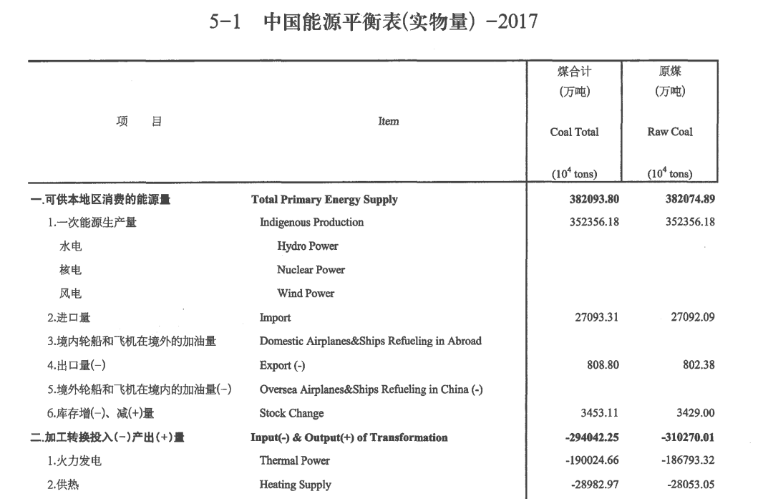
Methods
Disaggregation of the electricity sector in the input-output table
Department classification
Input/output |  | Sector 1 | … | Sector n | Power sector
 |  |  |  |  | T&D | Sub-C | … | Solar
Sector 1
…
Sector n
Power sector | T&D |  |  |  | Internal Disaggregation
 | Sub-C
 | ..
 | Solar
$${CE}_{i}={AD}_{i}×{NCV}_{i}×{CC}_{i}×O_{i}×\frac{44}{12}$$
Provincial Energy Balance Table
Upstream Disaggregation
Downstream Disaggregation
Embodied Carbon Emission Accounting
$F+εZ=εX$ $ε={F(X−Z)}^{−1}$ where F means the row vector of direct carbon emissions for each sector; ε means the row vector of embodied carbon emissions intensity for each sector; Z means the matrix of intermediate inputs and intermediate uses; X means the diagonal matrix of total outputs.
Fuel cost
Fuel-related sectors
Upstream sectors
Intermediate
Inputs
Power sectors
Overnight cost of capital
Capital-related sectors
O&M cost
General sectors
Power sector
Power Generation
Downstream sectors

Slide 12
Methods-Identification of critical upstream sector
Consumption-based method
The consumption-based method refers to determining the carbon reduction responsibility of the upstream sector corresponding to each power subsector by accounting for the indirect carbon emissions resulting from the final consumption of different power technologies. The indirect carbon emissions from the upstream sector t caused by the final consumption of each power subsector k can be measured by the following equation: $$P_{t}=\sum_{s=1}^{n}{e_{t}{L(i,k)}^{s}y_{k}^{s}}$$ where $n$ means the number of regions; $e_{t}$ means the direct carbon emission intensity of upstream sector $n$; $L$ means Leontief inverse matrix; $y_{k}^{s}$ means the final demand of electricity subsector $k$ in region $s$. The critical upstream carbon emitting sectors identified by the consumption-based method can play a role in supply-chain wide carbon reduction by encouraging the development of low-carbon technologies in these sectors.
Betweenness-based method
The betweenness-based method refers to identifying critical intermediate sectors that are located between the two ends of the chain path with high transmissibility. Define $k_{1}$, …, $k_{u}$ as the upstream sectors of sector t, and $h_{1}$, …, $h_{v}$ as the downstream sectors of sector t. We can compute the carbon emissions passed through sector t as follows: $B_{i}\left(k_{1},h_{v}\right)=\sum_{1≤k_{1},…,k_{u}≤n}{{(e}_{k_{1}}a_{k_{1}k_{2}}⋯a_{k_{u}t})\sum_{1≤h_{1},…,h_{v}≤n}{{(a}_{th_{1}}⋯a_{h_{v−1}h_{v}}y_{h_{v}})}}$ $=(eA^{u})_{t}{(A}^{v}y)_{t}=eA^{u}J_{t}A^{v}y$ The betweenness-based carbon emissions of sector t can be measured as follows: $$B_{t}=\sum_{u=1}{\sum_{v=1}{eA^{u}J_{t}A^{v}y}=\sum_{u=1}{(A^{u}J_{t})\sum_{v=1}{{(A}^{v}y)}}}$$ $$=e(\sum_{u=1}{A^{u})J_{t}(\sum_{v=1}{A^{v})y=e(L−I)J_{t}(L−I)y}}$$ Reducing production taxes or providing production subsidies can encourage these sectors to increase production efficiency, which will reduce carbon emissions by using less upstream inputs.

Slide 13
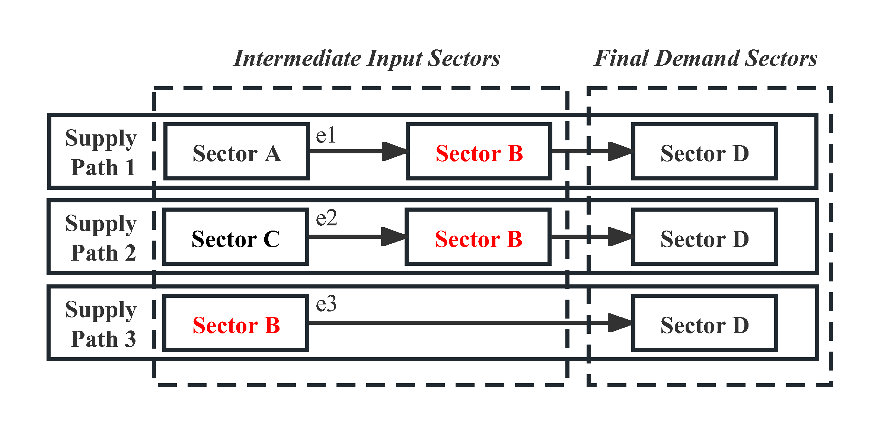
Methods-Identification of critical upstream sector
 | Consumption-based Method | Betweenness-based method
Sector A | e1 | 0
Sector B | e3 | e1+e2
Sector C | e2 | 0

Slide 14
Power Sector Embodied Carbon Emissions
Spatial Distribution
Upstream Sector Intensity
Power Sector Intensity
Generation Mix
Methods-Scenario settings
Name | Description
S1 | Restructure the inter-provincial power supply proportion.
S2 | Restructure the proportion of different power technologies generation in each province.
S3 | Restructure both the proportion of different power technologies generation in each province and the inter-provincial power supply ratios.
S4 | Increase the coal consumption of subcritical units to 300 tce/kWh.
S5 | Replace the subcritical units operating for 15 years and below 300MW with ultra-supercritical units of equal capacity.
S6 | The newly installed power capacity of different technologies will be realigned to provinces with comparative advantages in the regional grid based on S3.
(based on the 14th Five-Year Plan of each province)

Slide 15
Data
Data | Data sources
Multiregional input-output tables (MRIO) of 2017 | China Multi-Regional Input-Output Table 2017, CEADs
Sectoral energy consumption data by province in 2017 | Province Energy Inventory 2017, CEADs
Power generation data of different power generation technologies | Compilation of Power Industry Statistics 2017, Provincial Power Statistical Yearbook, and Statistical Yearbook of cities
Microdata of point source coal-fired power plant | S&P Global Market Intelligence LLC
Generation costs including operation and maintenance cost, fuel cost and capital cost | Annual Development Report of China's Power Industry, and "Projected Costs of Generating Electricity"

Slide 16
3. Results

Slide 17
Results
1. Comparison of Carbon Emission Intensity of Different Electricity Technologies Nationwide
With the improvement of coal-fired unit efficiency and the promotion of renewable energy generation technologies, the overall carbon emissions intensity of the power sector can be effectively reduced.
Subcritical coal-fired power
The highest average carbon intensity for both direct (22.67 tons/10000 CNY) and embodied (27.98 tons/10000 CNY), exceeding those of other thermal power technologies.
Solar power
The lowest average carbon intensity for both direct (22.67 tons/10000 CNY) and embodied (1.25 tons/10000 CNY), exceeding those of other technologies.
Fig.1 Average embodied carbon emission intensity and direct carbon emission intensity of different electricity technologies.

Slide 18
Results
2. Comparison of Carbon Emission Intensity of Different Electricity Technologies in 30 Provinces
Coal-fired power sector
Inner Mongolia is the major power generation province under the east-to-west transmission strategy. However, its coal-fired power generation sectors have higher embodied carbon intensities than those of other provinces, ranging from 48.04 tons/10000 CNY to 61.08 tons/10000 CNY.
Hydropower sector
The embodied carbon emissions intensity is significantly lower in provinces such as Sichuan Province, Hainan Province, and Yunnan Province, which have advantageous geographical conditions for hydropower.
Fig.2 Embodied carbon emission intensity (a) and direct carbon emission intensity (b) of different electricity technologies in 30 Chinese provinces.

Slide 19
Results
2. Comparison of Carbon Emission Intensity of Different Electricity Technologies in 30 Provinces
Wind power sector
Heilongjiang Province, Liaoning Province, Jilin Province, Gansu Province, and some eastern coastal areas have high wind power density and low embodied carbon intensity, despite the current low installed capacity.
Solar power sector
Yunnan Province, Hainan Province, and Sichuan Province both have an embodied carbon intensity of less than 0.5 tons/10000 CNY in solar power sectors, making them well-suited to the production of solar energy.
Fig.2 Embodied carbon emission intensity (a) and direct carbon emission intensity (b) of different electricity technologies in 30 Chinese provinces.

Slide 20
Results
3. Identification of critical upstream sectors of different power technologies - carbon emitting
Sector: energy sectors (S02, S11), energy-intensive sectors (S14, S27), manufacturing sectors (S16, S19), and service sectors (S26, S28).
Province: Shandong province (13.66%).
Fig.3 Critical upstream carbon emitting sectors of different power technologies. Note: (a) Subcritical coal-fired power sector (b) Supercritical coal-fired power sector (c) Ultra-supercritical coal-fired power sector (d) Gas-fired power sector (e) Hydropower sector (f) Nuclear power sector (g) Wind power sector (h) Solar power sector.

Slide 21
Results
3. Identification of critical upstream sectors of different power technologies - carbon emitting
The largest upstream carbon emitter for fossil energy generation is the mining and washing of coal sector (S02), accounting for 72.79% (ultra-supercritical coal-fired power) to 86.63% (nuclear power) of total upstream emissions.
Some non-energy-intensive manufacturing sectors contribute considerable indirect carbon emissions to the wind power, hydropower, and solar power sectors, which do not require fuel supplies.

Slide 22
Results
4. Identification of critical upstream sectors of different power technologies - carbon transmission
Sector: the manufacture of metal products sectors (S15).
Province: Shandong Province, Jiangsu Province, Hebei Province, and Anhui Province.
Fig.4 Critical upstream carbon transmission sectors of different power technologies. Note: (a) Subcritical coal-fired power sector (b) Supercritical coal-fired power sector (c) Ultra-supercritical coal-fired power sector (d) Gas-fired power sector (e) Hydropower sector (f) Nuclear power sector (g) Wind power sector (h) Solar power sector.

Slide 23
Results
4. Identification of critical upstream sectors of different power technologies - carbon transmission
The manufacture of electrical machinery and equipment sectors (S19) is an important transmission sector in the upstream chain of the renewable energy generation sector, and its importance has risen as the efficiency of coal-fired generation units increased.
Fig.4 Critical upstream carbon transmission sectors of different power technologies. Note: (a) Subcritical coal-fired power sector (b) Supercritical coal-fired power sector (c) Ultra-supercritical coal-fired power sector (d) Gas-fired power sector (e) Hydropower sector (f) Nuclear power sector (g) Wind power sector (h) Solar power sector.

Slide 24
Results
5. Carbon emission reductions under the different scenarios
The highest reductions can be achieved by changing the generation mix (S2), where emissions are reduced by 1540.1Mt compared to the baseline. This is due to active development of renewable energy generation in the provinces.
Under the worst-case scenario of only changing the spatial distribution (S1), embodied carbon emissions account for 12500.6Mt in 2025, which also indicates that the power sector continues to shift to the western region during the 14th FYP period.
Under the strict implementation of the 14th FYP in all provinces (S3), the embodied carbon emissions of the power sector are reduced by 1132.2Mt, which is lower than S2 but higher than S1.
Fig.5 Embodied carbon emissions from China's power system under different scenarios in 2025.

Slide 25
Results
5. Carbon emission reductions under the different scenarios
Regarding the coal-fired generation sector, compared with improving the coal efficiency of subcritical coal units (S4), replacing high-capacity subcritical units with ultra-supercritical units (S5) reduces CO2 emissions by 511.03 Mt.
It is particularly effective in Shandong Province, Jiangsu Province, and other provinces with a high number of subcritical units of smaller capacities.
Fig.5 Embodied carbon emissions from China's power system under different scenarios in 2025.

Slide 26
Results
5. Carbon emission reductions under the different scenarios
S6 as an ideal scenario demonstrates that leveraging the advantages of low-carbon technologies for electricity in each province within the regional grid would result in the highest carbon reduction (1855.5Mt).
Especially the power sectors in Central China would achieve the best reduction of 612.4Mt.
Fig.5 Embodied carbon emissions from China's power system under different scenarios in 2025.

Slide 27
Results
5. Carbon emission reductions under the different scenarios
Improving the carbon intensity of upstream sectors will significantly reduce embodied carbon emissions, ranging from 64.51Mt in S1 to 651.45Mt in S6.
Under S6, the reduction in carbon intensity in the upstream sector provides the greatest additional benefits in terms of emission reductions.
Fig.5 Embodied carbon emissions from China's power system under different scenarios in 2025.

Slide 28
4. Conclusions

Slide 29
Conclusions
The current spatial layout of the hydropower and solar power sectors enables a positive impact on carbon reduction, while there is a mismatch between current installation and carbon reduction targets in the coal-fired and wind power sectors. Organizing new power installations in the regional grid based on the comparative advantages of different power technologies in each province will bring higher emission reductions while maintaining grid stability.
Promoting low-carbon technologies and production efficiency in upstream critical sectors will amplify emission reductions across the power supply chain.
Promoting coal power policy of “Replacing Small Generator Units with Large Generator Units” is the most effective strategy to achieve emission reduction targets in coal power.
It is particularly pertinent for Western China, which has greater power generation responsibility, to formulate policies aimed at optimizing technical structures and strengthening supervision over the elimination of old coal-fired power plants.

Slide 30
Thank you!
Presenter: Lin Tang
Email: ssrtang@email.cugb.edu.cn

